Slide 1
Getting started with computational tools:
NSF Year 1 Workshop
We will cover: VS Code, Python environments, GitHub, and coding agents
Session leader: Luis Morales
Session 1 of 3
October 23rd, 2026

Slide 2
Purpose: best practices in research and collaboration
Allows us to manage analyses efficiently and share them with your lab.
Some definitions:
VS Code: Visual Studio Code is a free program that lets us write and run code in one application.
Python: a high-level programming language used to load data, calculate results, and make plots.
Git and GitHub: Git tracks file versions. GitHub hosts Git repositories online for sharing and collaboration.

Slide 3
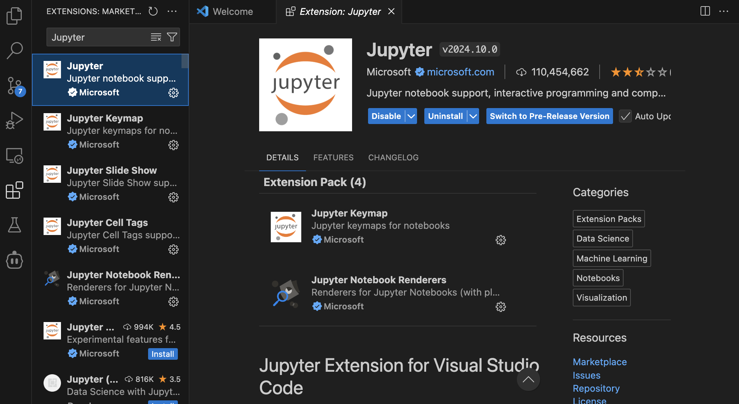
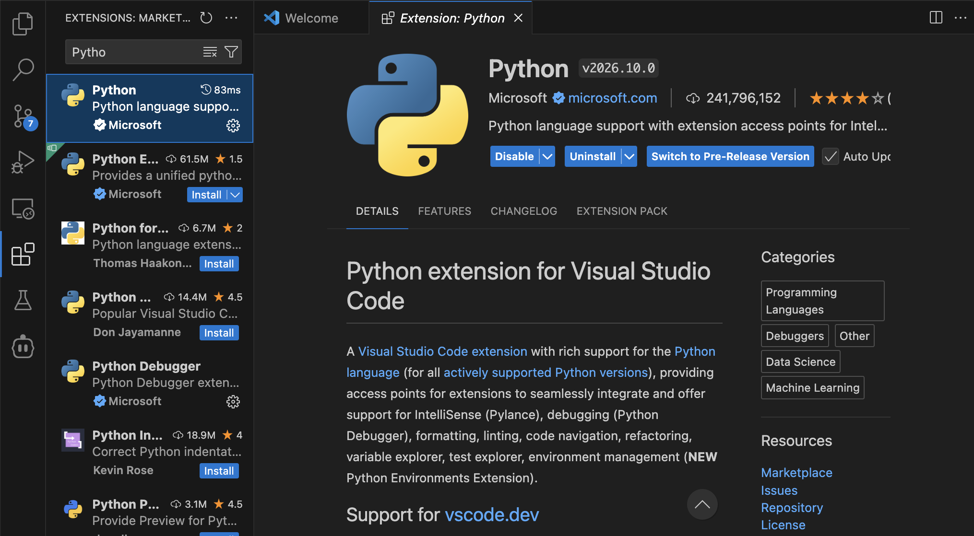
Setup and workshop files
1. Open VS Code and Install Microsoft’s Python/Jupyter extensions.

Slide 4
2a. Installing Git on macOS
VS Code: Terminal > New Terminal
1. Check whether Git is installed (copy and paste highlighted commands):
git --version
2. If a version appears, you’re read y.
If macOS offers to install developer tools, follow the prompts.
3. If Git is unavailable and no prompt appears, run:
xcode-select --install
4. After installation, run git --version again.

Slide 5
2b. Installing Git on Windows
VS Code: Terminal > New Terminal. Use PowerShell.
1. Check whether Git is installed:
git --version
2. If a version appears, you’re ready. Otherwise, run:
winget install --id Git.Git -e --source winget
3. Follow the prompts. Then close and reopen VS Code.
4. Open a new terminal and run git --version again.
If winget is unavailable: git-scm.com/install/windows

Slide 6
Setup and workshop files
3. Create workshop-project on your Desktop.
4. VS Code: File > Open Folder > choose workshop-project.
Check: Explorer should show your new workshop-project folder.

Slide 7
Code and the Python environment
VS Code edits the instructions (the Python code) and a Python interpreter executes them using the selected environment’s packages.
Package/ libraries: existing code you can use, such as pandas for tables.
Environment: an isolated Python setup with a specific version and its own installed packages.
Notebook: a file containing code cells, explanations, and results.
Notebook kernel: the running process that executes notebook cells and keeps variables in memory between cells.

Slide 8
Folders and the terminal
Terminal > New Terminal opens a place to type commands.
pwd #Show the current folder
ls #List its contents
cd name #Enter a folder
cd .. #Move up one level
New to the terminal?
Terminal command reference
Software Carpentry
Unix shell reference

Slide 9
Installing uv
uv manages our project’s environment and dependencies.
macOS / Linux
curl -LsSf https://astral.sh/uv/install.sh | sh
Windows PowerShell
powershell -ExecutionPolicy ByPass -c "irm https://astral.sh/uv/install.ps1 | iex"
Dependencies: Software our project needs. uv records those requirements, resolves package versions, and installs them in the project environment
Reopen the terminal. uv --version should print a version number.

Slide 10
Creating the Python environment
Run each command in the terminal, inside workshop-project.
uv python install 3.14 <----copy and paste this into the terminal!
#obtains Python of a specific version
uv init --python 3.14 --no-package
#creates configuration files without packaging your project for distribution
uv add pandas matplotlib ipykernel
#records dependencies and installs them into a newly created .venv.
After uv add: .venv and uv.lock should appear.

Slide 11
Environment files
You’ll find these in VS Code’s Explorer, at the top level of workshop-project.
Configuration files (specify requirements):
pyproject.toml Project and dependency requirements
.python-version Python version selection
The lockfile (records resolved package versions)
uv.lock Resolved package versions
The installed environment folder:
.venv/ contains the installed environment on this computer

Slide 12
Installing vs importing packages
Install a package in the environment that runs your code.
Terminal: uv add pandas (already done)
#Installs pandas in the project environment.
Within a Python (.py or .ipynb) file:
`import pandas as pd` loads pandas in the running session under the name pd.

Slide 13
Running a Python script
Open main.py, replace its contents, save it, then run it.
In main.py:
print("My project is running")
In the terminal:
uv run python main.py
#uv run executes a command using the Python environment and dependencies associated with your project.
Expected output: My project is running

Slide 14
Creating a notebook
A notebook combines explanatory text, Python code, and results.
1. Open the Command Palette: Cmd+Shift+P / Ctrl+Shift+P.
2. Choose Create: New Jupyter Notebook.
3. Save as analysis.ipynb inside workshop-project.
4. Add a Markdown cell with the title: # Practice analysis.
5. Add a Code cell for the first Python commands.

Slide 15
Notebook kernel
A kernel runs notebook cells and keeps their variables in memory.
ipykernel enables Python to act as a notebook kernel.
1. Open analysis.ipynb.
2. Click Select Kernel at the upper right.
3. Choose Python Environments
4. Select .venv inside this project folder

Slide 16
Checking the selected Python
Check that the notebook uses this project’s Python and can import pandas.
import sys # Access information about the running Python
import pandas as pd # Load pandas under the name pd
print(sys.executable) # Path to Python running this notebook
print(pd.__version__) # Optional: show the pandas version
The Python path should point inside this project’s .venv.

Slide 17
Adding the practice data
The main exercise uses a supplied CSV.
1. In Explorer, create a data folder inside workshop-project.
2. Download practice.csv and move it into data using Finder
or File Explorer.
3. Open data/practice.csv in VS Code to inspect its contents.

Slide 18
Optional: creating a DataFrame
Column names become dictionary keys. Lists supply the column values.
import pandas as pd
data = pd.DataFrame({
"participant": [1, 2, 3, 4, 5, 6],
"condition": [
"congruent", "congruent", "congruent",
"incongruent", "incongruent", "incongruent"],
"rt_ms": [400, 500, 600, 500, 600, 700]
})
data

Slide 19
Optional: saving a CSV
A DataFrame is a table in memory. A CSV is a text file on disk.
from pathlib import Path
Path("data").mkdir(exist_ok=True)
data.to_csv("data/practice.csv", index=False)
index=False leaves out pandas’ automatic row index.
Open the saved CSV to see its header, commas, and rows.

Slide 20
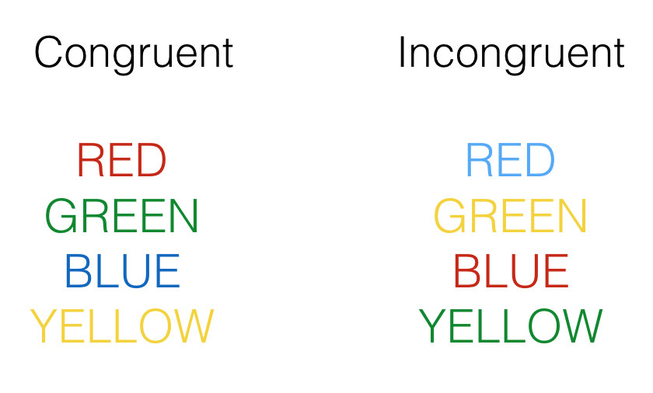
The practice dataset
Stroop task: identify the font color while ignoring the word.
Columns: participant, condition, rt_ms
Each row represents one invented participant’s mean response time.
Congruent: 400, 500, 600 ms. Mean = 500 ms.
Incongruent: 500, 600, 700 ms. Mean = 600 ms.

Slide 21
Loading the data
The path tells pandas which file to read.
data = pd.read_csv("data/practice.csv")
print(data)
Expected: the header and all six rows.

Slide 22
Calculating a mean for each condition
Group the rows, choose reaction time, then calculate the mean.
means = data.groupby("condition")["rt_ms"].mean()
print(means)
Expected: congruent = 500 ms, incongruent = 600 ms.

Slide 23
Making and saving the figure
The last cell makes a plot and writes it to outputs/means.png.
from pathlib import Path
import matplotlib.pyplot as plt
Path("outputs").mkdir(exist_ok=True)
means.plot.bar(ylabel="Mean reaction time (ms)", rot=0)
plt.title("Practice data")
plt.tight_layout()
plt.savefig("outputs/means.png")
plt.show()

Slide 24
Execution order and notebook memory
The kernel remembers variables created by earlier cells.
Restart the kernel: data and means disappear from memory.
Run the cell that calculates the condition means before loading the data: expect NameError.
Run all cells from the beginning: results will return.
Saving edits does not run code or update previous outputs.

Slide 25
Project organization
Keep inputs, analysis, and generated results easy to locate.
data/ Input CSV
analysis.ipynb Explanations and analysis
outputs/ Generated figures
README.md Purpose, setup, and run instructions

Slide 26
Example error messages
Identify the message and the failing line before changing things.
FileNotFoundError: check folder, path, and spelling.
ModuleNotFoundError: check package installation and kernel.
NameError: check earlier cells and variable names.
Notebook location check: print(Path.cwd())

Slide 27
Git and GitHub
Git records versions locally. GitHub hosts a copy online.
Save: write your edits to disk.
Stage: select changes for the next recorded version.
Commit: record that version with a message.
Push: send local commits to GitHub.

Slide 28
What is .gitignore?
Open .gitignore. Keep its contents, add the patterns on the left, and save.
.venv/
Installed Python and packages; recreate on each computer.
outputs/
Generated figures; excluded for this exercise.
__pycache__/
Python’s automatically generated bytecode cache.
.ipynb_checkpoints/
Jupyter’s automatic checkpoint copies.
.env
Local settings that can contain passwords or API keys.
.DS_Store
macOS folder-display settings.
Git leaves matching untracked files out of commits.

Slide 29
Git identity
Before the first commit, set the author for this project.
git config user.name "Your Name"
git config user.email "your-chosen-email@example.com"
Run these in the terminal inside workshop-project.
Replace the example name and email with your own.
Commits record this name and email as their author.
GitHub sign-in lets VS Code upload commits to your account.

Slide 30
The first commit
uv initialized Git. Now record the project’s first version locally.
1. Save your files. Open Source Control in the left sidebar.
2. Click each file to inspect it, then click its + to stage it.
3. Check Staged Changes: include code, CSV, README,
.gitignore, and the environment configuration files.
4. Enter Add practice analysis in the message box.
5. Click Commit. In the terminal, run git status.

Slide 31
Publishing to your GitHub account
VS Code can create the GitHub repository and upload your commits.
1. Open the Command Palette: Cmd+Shift+P / Ctrl+Shift+P.
2. Search for Publish to GitHub and select it.
3. If prompted, sign in in the browser, then return to VS Code.
4. Name the repository workshop-project.
Choose a private repository for this exercise.
5. Finish publishing. If the name is taken, use a new name.

Slide 32
Your project on GitHub
Check the actual repository under your own account.
1. In your browser, sign in at github.com.
2. Profile menu > Your repositories > open workshop-project
(or the name you chose).
3. Check that the page shows your username / repository name.
4. Open analysis.ipynb and data/practice.csv. Read the README.
5. Open the commits list. Find Add practice analysis.

Slide 33
Reviewing a change
A "diff" compares your saved edits with the last committed version.
1. In analysis.ipynb, change the plot title to:
plt.title("Stroop practice: response times")
2. Rerun the plot cell, then save the notebook.
3. Open "Source Control". Under Changes, click analysis.ipynb.
4. Inspect the old and new code in the diff.
Saved outputs or notebook metadata may also differ.

Slide 34
Committing and pushing the update
Commit records the version locally. Push uploads the commit.
1. In Source Control, click + beside analysis.ipynb.
2. Enter Update plot title in the message box. Click Commit.
3. Command Palette > Git: Push.
4. Refresh your repository page on GitHub.
Check the commits list for Update plot title.
5. Open analysis.ipynb and find the new plot title.

Slide 35
Cloning: getting a local copy
Use this for your project on another computer, or a shared project.
Optional practice: make a second copy on this computer.
1. On GitHub: copy the repository URL.
2. Create workshop-copies on the Desktop, outside the original project.
3. VS Code: File > New Window.
Command Palette > Git: Clone > paste the URL.
4. Choose workshop-copies as the destination.
5. Open the cloned project when prompted.

Slide 36
The cloned project’s environment
uv sync creates this clone’s .venv using pyproject.toml and uv.lock.
1. In the cloned project: Terminal > New Terminal.
2. Run uv sync to create its environment. We excluded .venv from Git, so cloning did not copy it.
3. Open analysis.ipynb. Click Select Kernel, then choose this clone’s .venv (realistically, the original .venv would also work because it already has the Python and packages this notebook needs.)
4. Run all cells.

Slide 37
Asking an agent to explain and generate code
An agent can explain or edit project files, depending on its permissions.
“Explain how this notebook loads the data, calculates
the condition means, and saves its figure.
Do not modify files.”
Compare its explanation with the actual notebook.

Slide 38
Reviewing an agent’s edits
Request one change, then check it against results you already know.
“Add the number of observations per condition.
Preserve the existing analysis. Explain your change
before editing. Run the notebook and report what
you checked and what you could not verify.”
Review the diff. Counts: 3 per condition. Means: congruent 500 ms, incongruent 600 ms.

Slide 39
Generating an analysis with an agent
Describe your question and data. The agent can draft the code.
1. Describe the question, data, and output you want.
2. Ask the agent to explain its plan and each analysis step.
3. Read the code, run it, and check the results.
You can follow the logic without memorizing every command.
You remain responsible for whether the analysis is appropriate.
Try a plot or analysis of your choice.

