Slide 1
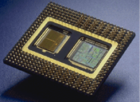
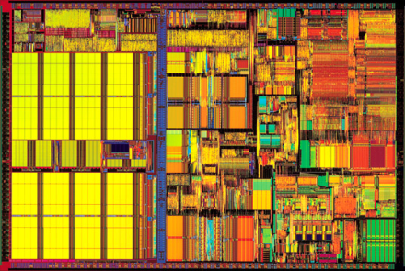

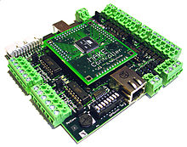
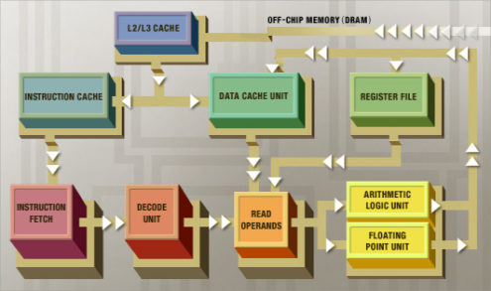
CPE 390: Microprocessor Systems Spring 2018
Lecture 14
Analog to Digital Conversion
Bryan Ackland
Department of Electrical and Computer Engineering
Stevens Institute of Technology
Hoboken, NJ 07030
Adapted from HCS12/9S12 An Introduction to Software and Hardware Interfacing Han-Way Huang, 2010

Slide 2
The Real World of Analog
A microprocessor deals exclusively with digital data
finite precision representations of external real world and internal computational data
A microcontroller in an embedded application takes inputs from real-world sensors
some of these are already digital (e.g. switches, keyboard, mouse)
many are analog (e.g. pressure, temperature, light intensity, microphone, airflow, engine speed, oxygen level)
Analog-to-Digital converter (A/D) transforms analog signal into digital representation usable by microprocessor
temp
Transducer
(sensor)
Signal
Conditioning
A/D
Converter
Micro-
processor
voltage
voltage
digital
value
sound
light
thermometer
microphone
photodiode
both in time
and value
quantized
in time
and value

Slide 3
Analog to Digital Conversion
An A/D converter samples an analog signal at regular intervals and generates a digital code which is its best (closest) approximation to the analog value at that instant
Analog signal: continuous in time and value
Digital signal: quantized in time and value
1001
1101
1110
1101
1001
0101
0101
2.0V
1111
analog
input
voltage
1000
digital
code
levels
1.0V
0000
0
1
2
3
4
5
6
sampling intervals

Slide 4
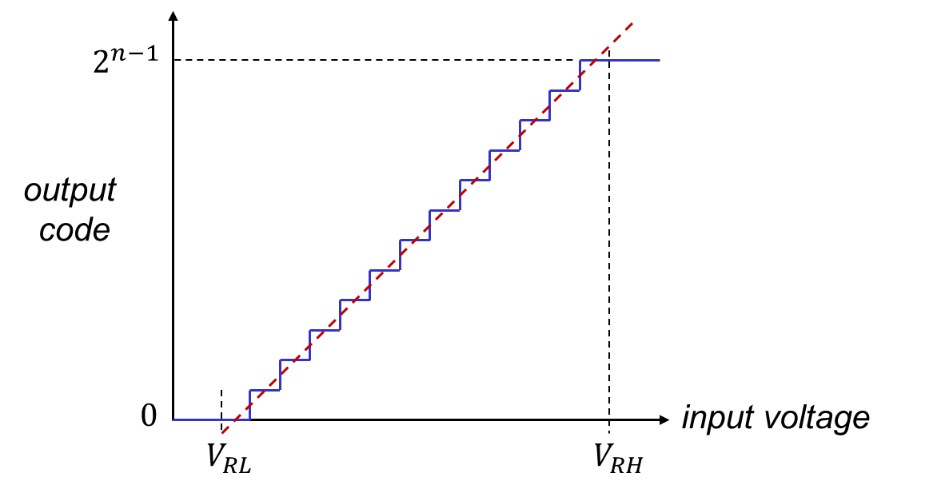
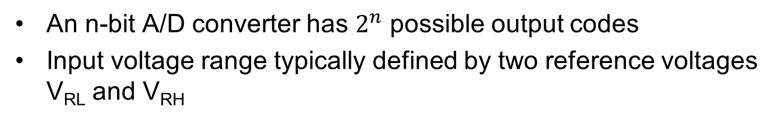






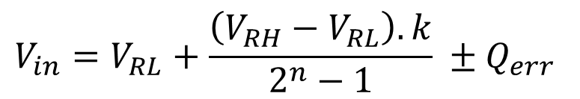
A/D Transfer Function
An n-bit A/D converter has $2^{n}$ possible output codes
Input voltage range typically defined by two reference voltages V_{RL} and V_{RH}
$$2^{n}−1$$
quantization
error (Q_{err} )
output
code
$$k$$
$$0$$
input
voltage
$$V_{RL}$$
$$V_{in}$$
$$V_{RH}$$
$$V_{in}=V_{RL}+\frac{\left(V_{RH}−V_{RL}\right).k}{2^{n}−1} ±Q_{err}$$

Slide 5
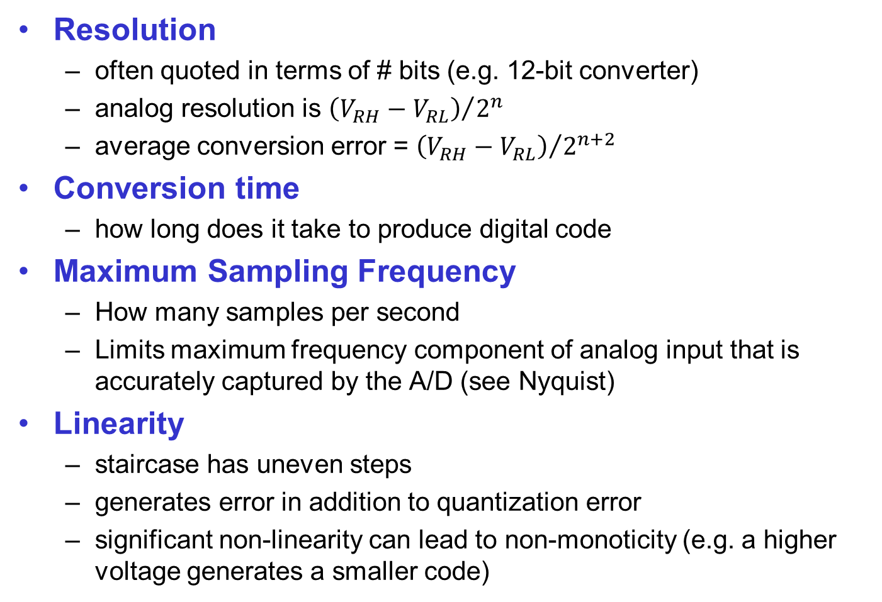
A/D Characteristics
Resolution
often quoted in terms of # bits (e.g. 12-bit converter)
analog resolution is ${\left(V_{RH}−V_{RL}\right)}/{2^{n}}$
average conversion error = ${\left(V_{RH}−V_{RL}\right)}/{2^{n+2}}$
Conversion time
how long does it take to produce digital code
Maximum Sampling Frequency
How many samples per second
Limits maximum frequency component of analog input that is accurately captured by the A/D (see Nyquist)
Linearity
staircase has uneven steps
generates error in addition to quantization error
significant non-linearity can lead to non-monoticity (e.g. a higher voltage generates a smaller code)

Slide 6




Flash (Parallel) A/D Converter
Resistor ladder generates 2^{n} reference voltages
2^{n} comparators simultaneously compare input with each reference
Comparator output k is high if Vin > ref_{k}
Conversion logic generates code indicating greatest value of k for which comparator output is high
Very high speed
Expensive in area & power
Limited to ~ 8-bits
V_{RH}
V_{in}
R/2
$${ref}_{2^{n}−1}$$
–
thermo-meter
to binary
convert
+
R
$${ref}_{2^{n}−2}$$
–
+
R
n-bit
digital
output
$${ref}_{1}$$
–
+
R
$${ref}_{0}$$
–
+
R/2
V_{RL}

Slide 7

Single Slope A/D Converter
Compares input to linear ramp to generate a pulse width proportional to V_{in}
Pulse used to gate clock to high speed digital counter
Simple hardware – popular in low speed applications
High resolution possible
Performance limited by:
V_{in}
+
Ramp
Generator
–
reset
n-bit
counter
high
speed
clock
$$f_{ck}=f_{samp}×2^{n}$$
n-bit
digital output
e.g. for $f_{samp}$ = 1 MHz, a 12-bit converter requires $f_{ck}$ = 4 GHz

Slide 8

Counter Ramp A/D Converter
Variant on single-slope converter
Ramp is generated by counter driving a D/A converter
When D/A output ramp crosses V_{in}, counter value is captured in n-bit latch
Does not require precision analog ramp generation
Precision limited by linearity of D/A
V_{in}
+
n-bit D/A
–
n-bit
counter
$$f_{ck}$$
reset
n-bit
latch
n-bit
digital output

Slide 9


Sigma Delta (Oversampling) A/D Converter
Sigma-delta modulator consists of summer, integrator, clocked comparator and a 1-bit DAC
Modulator runs at many times (e.g. 16x – 1000x) the required sampling frequency to produce very high speed 1-bit waveform
Digital filter coverts this to much slower n-bit digital output
Since 1-bit DAC is perfectly linear, can produce very high resolution (up to 24-bit)
Sampling frequency is limited by need to over-sample
Sigma-Delta Modulator
Digital
Filter
(Decimator)
n-bit
digital
output
V_{in}
Σ
+
–
$$f_{ck}$$
1-bit
DAC

Slide 10
Successive Approximation A/D Converter
Guesses and then corrects digital code in SAR one bit at a time
Initially sets all bits in SAR to ‘0’
Then starting with MSB, for each bit:
set bit to ‘1’ and convert output of SAR to analog value with D/A
compare output of D/A to input voltage
if D/A is larger, set this bit back to ‘0’ and go on to next (lesser sig.) bit
if input is larger, retain ‘1’ for this bit and go on to next bit
Control Logic
n-bit
digital
output
Successive Approximation Register
–
D_{n-1}
D_{n-2}
D₂
D₁
D₀
+
V_{RH}
n-bit D/A Converter
V_{in}
V_{RL}

Slide 11
Successive Approximation Process
111
111
11X
110
101
101
1XX
100
analog
input
011
011
digital
output
(010)
01X
010
001
001
000
SAR gives a good tradeoff between speed and precision
One of most popular A/D techniques in embedded systems
Used in HCS12

Slide 12
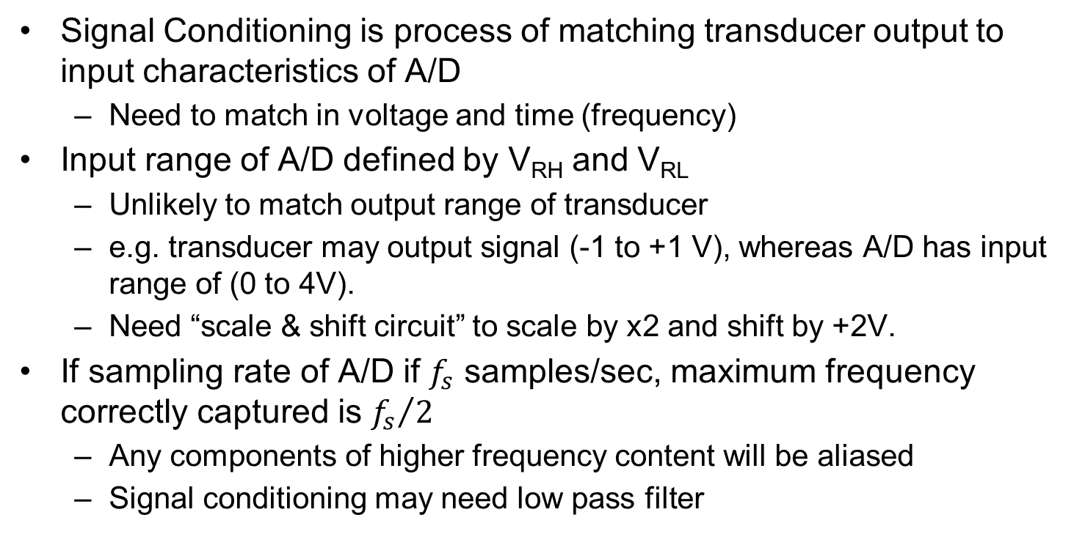
Signal Conditioning
temp
Transducer
(sensor)
Signal
Conditioning
A/D
Converter
Micro-
processor
voltage
voltage
digital
value
sound
light
Signal Conditioning is process of matching transducer output to input characteristics of A/D
Need to match in voltage and time (frequency)
Input range of A/D defined by V_{RH} and V_{RL}
Unlikely to match output range of transducer
e.g. transducer may output signal (-1 to +1 V), whereas A/D has input range of (0 to 4V).
Need “scale & shift circuit” to scale by x2 and shift by +2V.
If sampling rate of A/D if $f_{s}$ samples/sec, maximum frequency correctly captured is ${f_{s}}/2$
Any components of higher frequency content will be aliased
Signal conditioning may need low pass filter

Slide 13
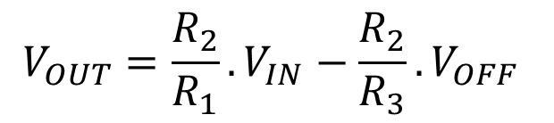

Shift & Scale Circuit
R₀
R₂
+ 12V
R₀
V_{IN}
–
+ 12V
R₁
741
–
V_{OUT}
+
741
R₃
– 12V
+
V_{OFF}
– 12V
$$V_{OUT}=\frac{R_{2}}{R_{1}}.V_{IN}−\frac{R_{2}}{R_{3}}.V_{OFF}$$
From previous example, if R₁ = R₃ = 10kΩ, R₂ = 20kΩ, V_{OFF} = -1V:
$$V_{OUT}=(2×V_{IN})+2$$

Slide 14

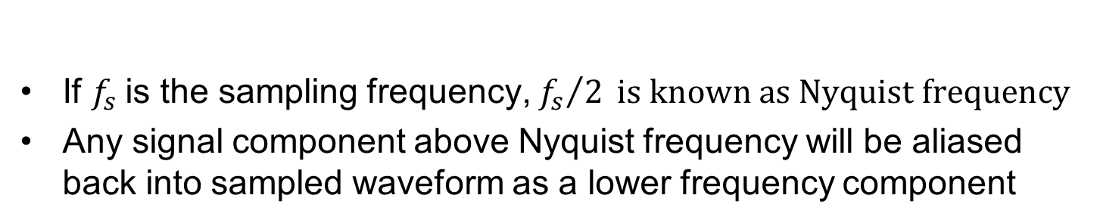
Nyquist Frequency
If $f_{s}$is the sampling frequency, ${f_{s}}/2 is known as Nyquist frequency$
Any signal component above Nyquist frequency will be aliased back into sampled waveform as a lower frequency component

Slide 15

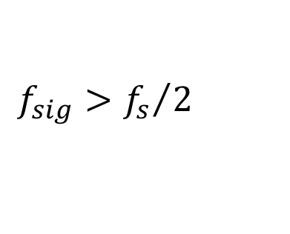
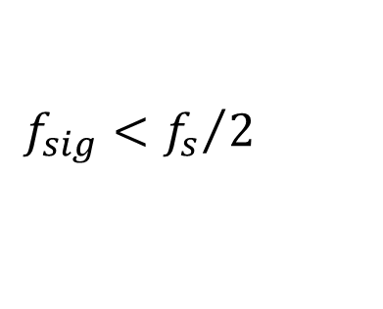
Aliasing
$$f_{sig}<{f_{s}}/2$$
$$f_{sig}>{f_{s}}/2$$
Even if desired signal does not contain components > Nyquist, there may be high frequency noise components which must be removed
Signal conditioning circuits frequently include a sharp low-pass filter to take out any signal components > Nyquist

Slide 16
A/D Conversion on HCS12
HCS12 may have one or two 8-channel 10-bit A/D’s
Each uses successive approximation method
A/D’s runs off an ATD clock that can be set 500kHz ~ 2 MHz
At 2 MHz, ADC can perform an 8-bit conversion in 6μs or a 10-bit conversion in 7 μs.
A/D conversion may be internally triggered (by writing to a control register) or externally triggered (via pins AN7 or AN15)
May be a single conversion or a sequence of conversions
Result(s) can be 8-bit or 10-bit, signed or unsigned:
(–128 to +127) or (–512 to +511) signed
(0 to 255) or (0 to 1023) unsigned
Result(s) stored in 16-bit register(s)
either left or right justified

Slide 17
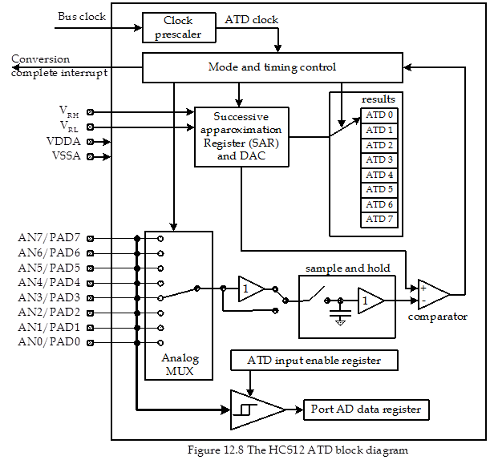
ATD Block Diagram

Slide 18
A/D Pins & Registers
Signal Pins:
AD0 module uses pins AN0 ~ AN7
AD1 module uses pins AN8 ~ AN15
AN7 (AN15) pin can optionally be used to trigger AD0 (AD1) module
V_{RH} and V_{RL} are high and low reference voltage inputs
V_{DDA} and V_{SSA} are power supply and ground pins
Each A/D has following registers:
Six control registers ATDxCTL0 ~ ATDxCTL5
(0 and 1 for factory testing only)
Two status registers ATDxSTAT0 ~ ATDxSTAT1
One input enable register ADTxDIEN
One port data register PTADx
Eight 16-bit result registers ATDxDR0 ~ ATDxDR7
where x= 0 or 1 (we will only describe AD0 registers in following slides)

Slide 19
ATD Control Register 2 (ATD0CTL2)
7
6
5
4
3
2
1
0
ADPU
AFFC
AWAI
ETRIGLE
ETRIGP
ETRIGE
ASCIE
ASCIF
Reset:
0
0
0
0
0
0
0
0
ADPU: ATD power-down bit (‘0’: power-down, ‘1’: normal ATD operation)
AFFC: ATD fast flag clear bit
‘0’: ATD flag is cleared normally (i.e. read status before reading result)
‘1’: Any access to ATD result register will cause associated CCF flag to clear
AWAI: Power-down in wait mode (‘0’: ATD runs in wait, ‘1’: does not run in wait)*
ETRIGLE: External trigger level/edge control (see next slide)
ETRIGP: External trigger polarity (see next slide)
ETRIGE: External trigger mode enable (‘0’: disable trigger on ATD channel 7, ‘1’: enable trigger on ATD channel 7)
ASCIE: ATD sequence complete interrupt enable bit (‘0’: disabled, ‘1’: enabled)
ASCIF: ATD sequence complete interrupt flag
* We will not be using these bits

Slide 20
Notes on ATD0CTL2
ASCIF flag signals that a requested multi-sample sequence conversion sequence has completed (see ATD0CTL3)
If ASCIE is set, this will also cause interrupt
Writing to ATD0CTL2 will abort any current conversion sequence
ETRIGLE | ETRIGP | External Trigger Sensitivity
0 | 0 | Falling edge
0 | 1 | Rising Edge
1 | 0 | Low level
1 | 1 | High level

Slide 21
ATD Control Register 3 (ATD0CTL3)
7
6
5
4
3
2
1
0
0
S8C
S4C
S2C
S1C
FIFO
FRZ1
FRZ0
Reset:
0
0
1
0
0
0
0
0
S8C, S4C, S2C, S1C: Conversion Sequence Length
0000 = 8 conversions
0001 = 1 conversions
0010 = 2 conversions
0011 = 3 conversions
0100 = 4conversions
FIFO: Result register FIFO mode (always set this bit to ‘0’)*
FRZ1, FRZ0: Background debug freeze enable bit (ignore these bits)*
Writing to ATD0CTL3 will abort any current conversion sequence
0101 = 5 conversions
0110 = 6 conversions
0111 = 7 conversions
1xxx = 8 conversions

Slide 22
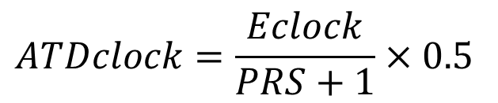
ATD Control Register 4 (ATD0CTL4)
7
6
5
4
3
2
1
0
SRES8
SMP1
SMP0
PRS4
PRS3
PRS2
PRS1
PRS0
Reset:
0
0
0
0
0
1
0
1
SRES8: ATD resolution select bit (‘0’: 10-bit operation, ‘1’: 8-bit operation)
SMP1, SMP0: Select Sample Time bits (see next slide)
PRS4 ~ PRS0: ATD clock pre-scaler bits.
(ATD clock must be between 500kHz and 2 MHz)
Writing to ATD0CTL4 will abort any current conversion sequence
$$ATDclock=\frac{Eclock}{PRS+1}×0.5$$

Slide 23
Sample Time Select
Sample & Hold
Analog
Input
+1
+1
To
Comparator
Sampling process has two stages:
Initially a unity gain sampling amplifier buffers input signal for two cycles to rapidly charge sample capacitor to almost the input potential
Sample buffer is then disconnected and input is connected directly to sample capacitor for 2, 4, 8 or 16 cycles
SMP1 | SMP0 | Length of 2nd Phase of Sample Time
0 | 0 | 2 ATD clock periods
0 | 1 | 4 ATD clock periods
1 | 0 | 8 ATD clock periods
1 | 1 | 16 ATD clock periods

Slide 24
ATD Control Register 5 (ATD0CTL5)
7
6
5
4
3
2
1
0
DJM
DSGN
SCAN
MULT
0
CC
CB
CA
Reset:
0
0
0
0
0
0
0
0
DJM: Result register data justification (‘0’: left justified, ‘1’: right justified^{)#}
DSGN: Result register signed representation (‘0’: unsigned, ‘1’: signed)#
SCAN: Continuous channel scan bit (always set this bit to ‘0’)*
MULT: Enable multichannel conversion bit
‘0’: Sample only one channel (specified by CC/CB/CA)
‘1’: Sample across several channels (start with CC/CB/CA; number of channels specified by sequence length)
CC, CB, CA: Channel select code
Three bit code to select input channel (if MULT=0) or first channel in incrementing sequence (if MULT=1)
# cannot be signed and right justified

Slide 25
Notes on ATD0CTL5
SRES8 | DJM | DSGN | Result Data Format | Bit Mapping
1 | 0 | 0 | 8-bit/left-justified/unsigned | bits 15 ~ 8
1 | 0 | 1 | 8-bit/left-justified/signed | bits 15 ~ 8
1 | 1 | x | 8-bit/right-justified/unsigned | bits 7 ~ 0
0 | 0 | 0 | 10-bit/left-justified/unsigned | bits 15 ~ 6
0 | 0 | 1 | 10-bit/left-justified/signed | bits 15 ~ 6
0 | 1 | x | 10-bit/right-justified/unsigned | bits 9 ~ 0
Writing to ATD0CTL5 will abort any current conversion sequence and start a new conversion sequence

Slide 26
Input Analog Voltage to Output Code
Left justified codes:
Input signal (V) V_{RL} = 0.000 V V_{RH} = 5.120 V | Signed 8-bit codes (MSByte) | Unsigned 8-bit codes (MSByte) | Signed 10-bit codes | Unsigned 10-bit codes
5.115 | 7F | FF | 7FC0 | FFC0
5.100 | 7F | FF | 7F00 | FF00
2.580 | 01 | 81 | 0100 | 8100
2.565 | 00 | 80 | 0040 | 8040
2.560 | 00 | 80 | 0000 | 8000
2.555 | 00 | 80 | FFC0 | 7FC0
2.540 | FF | 7F | FF00 | 7F00
0.020 | 81 | 01 | 8100 | 0100
0.005 | 80 | 00 | 8040 | 0040
0.000 | 80 | 00 | 8000 | 0000

Slide 27
Input Analog Voltage to Output Code
Right justified codes:
Input signal (V) V_{RL} = 0.000 V V_{RH} = 5.120 V | Signed 8-bit codes (LSByte) | Unsigned 8-bit codes (LSByte) | Signed 10-bit codes | Unsigned 10-bit codes
5.115 |  | FF |  | 03FF
5.100 |  | FF |  | 03FC
2.580 |  | 81 |  | 0204
2.565 |  | 80 |  | 0201
2.560 |  | 80 |  | 0200
2.555 |  | 80 |  | 01FF
2.540 |  | 7F |  | 01FC
0.020 |  | 01 |  | 0004
0.005 |  | 00 |  | 0001
0.000 |  | 00 |  | 0000
not
allowed
not
allowed

Slide 28
ATD Status Register 0 (ATD0STAT0)
7
6
5
4
3
2
1
0
SCF
0
ETORF
FIFOR
0
CC2
CC1
CC0
Reset:
0
0
0
0
0
0
0
0
SCF: Sequence complete flag
ETORF: External trigger overrun flag* (indicates trigger occurred while previous conversion still in progress)
FIFOR: FIFO overrun flag* (indicates result register has been written before corresponding conversion complete flag (CCF) has been cleared)
CC2, CC1, CC0: Conversion Counter*
Points to the result register that will receive the result of current conversion
ATD Result Registers ATD0DR0 ~ ATD0DR7
eight 16-bit result registers

Slide 29
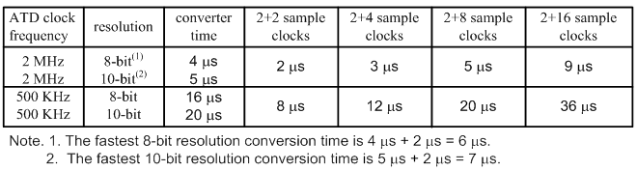
ATD Input Enable Register (ATD0DIEN)
7
6
5
4
3
2
1
0
IEN7
IEN6
IEN5
IEN4
IEN3
IEN2
IEN1
IEN0
Reset:
0
0
0
0
0
0
0
0
IENx: When IENx=1, pin ANx can be used as a general purpose parallel port digital input pin rather than an A/D analog input pin
In this case, digital inputs are read from corresponding bit positions of PTAD0
ATD Conversion Timings:

Slide 30
Multichannel Example
Assume the following setup:
Channel select code (CC ~ CA) of ATD0CTL5 = 6
Conversion sequence length (S8C ~ S1C) of ATD0CTL3 = 5
MULT bit of ATD0CTL5 is set to ‘1’ (i.e. multiple channels)
How would conversion results be stored in data registers?
Analog Channel | Result stored in: (non-FIFO mode)
AN6 | ATD0DR0
AN7 | ATD0DR1
AN0 | ATD0DR2
AN1 | ATD0DR3
AN2 | ATD0DR4

Slide 31
Procedure for Performing A/D Conversion
Set up A/D power supply & reference voltages:
V_{DDA}: connect to 5V (nominal – normally same value as V_{DD})
V_{SSA}: connect to 0V (nominal – normally same value as V_{SS})
V_{RH}: connect to 5V (nominal) V_{RH} ≤ V_{DDA}
V_{RL}: connect to 0V (nominal) V_{RHL} ≥ V_{SSA})
If transducer output is not in range (V_{RL} ~ V_{RH}), use a signal conditioning circuit to shift and scale it to match this range
Configure ATD control register 2 and wait 20μs for ATD circuits to stabilize
Configure ATD control registers 3 and 4.
Select appropriate channel(s) and operation modes by programming ATD control register 5. Writing to ATD0CTL5 starts conversion sequence
Wait until SCF flag of ATD0STAT0 is set, then collect conversion results and store in memory

Slide 32
Example: A/D Initialization
Write a subroutine to initialize the AD0 converter with the following settings:
Software initiated conversions (no external trigger)
Fast ATD flag clear all
No interrupts
No FIFO mode
10-bit operation
2 MHz conversion clock (assume E-clock = 8 MHz)
2 conversion clock periods for second stage sample time
Sequence of n (1 ≤ n ≤ 8) conversions where n is passed in acc A
Need to write following data into ATD registers:
ATD0CTL2: $C0
ATD0CTL3: $00 + (n<<3)
ATD0CTL4: $01
We do not write to ATD0CTL5 at this stage because that would actually start a conversion

Slide 33
A/D Initialization Code
include “hcs12.inc”
openAD0: movb $C0, ATD0CTL2
jsr wait20us ; wait for A/D circuits to stabilize
ldab #8
mult ; left shift sequence # by 3 places
stab ATD0CTL3
movb #$01, ATD0CTL4
rts
wait20us: movb #$90, TSCR2 ; enable TCNT & fast timer clear
movb #0, TSCR1 ; set TCNT pre-scaler to 1
bset TIOS, $01 ; enable OC0
ldd TCNT ; start OC0 operation
addd #160 ; 160 clock cycles = 20 us
std TC0
brclr TFLG1, $01, * ; wait for time-out
rts

Slide 34

Example: Perform 20 A/D Conversions
Write a program to perform A/D conversions on the analog signal connected to pin AN6. Collect 20 10-bit conversion results and store them in consecutive 16-bit memory locations starting at $1000. Data should be unsigned and right justified.
Solution: Initialize A/D to perform sequence of four conversions and then initiate five conversion sequences
HCS12
AN6

Slide 35
20 Conversions Code
include “hcs12.inc”
ORG $4000
lds #$4800
ldx #$1000 ; use X as data pointer
ldaa #4 ; sequence length = 4
jsr openAD0 ; initialize A/D converter
ldy #5 ; loop counter
loop5: movb #$86, ATD0CTL5 ; start ch6 A/D conv. sequence
brclr ATD0STAT0, $80, * ; wait for sequence complete flag
movw ATD0DR0, 2, x+ ; collect and save results
movw ATD0DR1, 2, x+ ; incrementing pointer by 2
movw ATD0DR2, 2, x+
movw ATD0DR3, 2, x+
dbne y, loop5 ; are we done?
swi

Slide 36

Example: Record Potentiometer Output Voltage
Write a program to read the voltage from a potentiometer connected between 0 and +5 volts. The wiper of the potentiometer should be connected to the AN3 pin of AD0. Read the voltage once every 2 seconds and print out (to 2 sig. figs.) on a terminal using the SPI0 RS-232 serial output
Solution: The conversion result 1023 will correspond to +5V. To convert A/D output to volts, divide by 204.6.
Since we don’t have floating point, this can be done by multiplying by 10 and then dividing by 2046
+5V
HCS12
RS-232
AN3
SCI0

Slide 37
Potentiometer Output Code
include “hcs12.inc”
CR: equ $0D ; ascii carriage return
LF: equ $0A ; ascii line feed
ORG $5000
headbuf: dc.b “Voltage = ”, 0
numbuf: dc.b “0.0 V”, CR, LF, 0 ; calculated digits stored here
ORG $4000
lds #$4800
ldaa #1 ; sequence length = 1
jsr openAD0 ; initialize A/D converter
forever: movb #$83, ATD0CTL5 ; start ch3 A/D conv. sequence
brclr ATD0STAT0, $80, * ; wait for sequence complete flag
ldd ATD0DR0 ; get 10 bit data
ldy #10 ; multiply data by 10
emul ; L.S. result in D
ldx #2046 ; divide by 2046
idiv ; quotient in X, rem in D

Slide 38
Potentiometer Output Code (cont.)
exg x, d ; swap X and D
addd #$30 ; convert MSD to ascii
stab numbuf ; store in string buffer
tfr x, d ; remainder back in D
ldy #10 ; multiply remainder by 10
emul
ldx #2046 ; and divide by 2046
idiv ; quotient in X
tfr x, d ; fractional digit in D
addd #$30 ; convert LSD to ascii
stab numbuf+2 ; store in string buffer
ldx #headbuf
jsr putsSCI0 ; output header string
ldx #numbuf
jsr putsSCI0 ; output number string
ldy #20
jsr delayby100ms ; wait for 2 seconds
bra forever

Slide 39
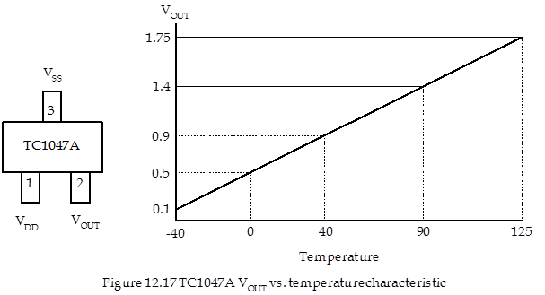
Example: Temperature Sensor TC1047A
Three pin temperature sensor whose output voltage is directly proportional to ambient temperature
Measures temp. in range of -40º C to +125º C
Describe circuit connection and write program to read temperature five times per second and output temperature (signed and rounded to nearest degree C) to external peripheral connected to port T.

Slide 40
Temperature Sensor: Signal Conditioning
Output of temperature sensor is 0.1V ~ 1.75V
To effectively use input range of A/D (0 ~ 5V), need to:
multiply by (5/1.74 = 2.874) which gives a range of 0.29 ~ 5.29V
offset by (–0.29V) which gives a range of 0 ~ 5V
+ 5V
10kΩ
TC1047A
9kΩ
+ 12V
10kΩ
+ 12V
V_{OUT}
–
HCS12
3.1kΩ
741
–
+
741
AN7
150kΩ
+
PT0~7
– 12V
-5V
– 12V

Slide 41
Temperature Sensor: Digital Data Scaling
Following signal conditioning, range of analog input is 0 ~ 5V
Range of digital result is 0 – 1023
Represents temperature range of 165 ºC
Need to divide by 1023/165 = 6.2
i.e. multiply by 10 and divide by 62
this gives a range of 0 ~ 165
Finally subtract 40 to give a range of – 40 to + 125

Slide 42
Temperature Sensor Code
include “hcs12.inc”
ORG $4000
lds #$4800
movb $FF, DDRT ; set up Port T as 8-bit output
ldaa #1 ; sequence length = 1
jsr openAD0 ; initialize A/D converter

Slide 43
Temperature Sensor Code (cont.)
forever: movb #$87, ATD0CTL5 ; start ch7 A/D conv. sequence
brclr ATD0STAT0, $80, * ; wait for sequence complete flag
ldd ATD0DR0 ; get 10 bit data
ldy #10 ; multiply data by 10
emul ; L.S. result in D
addd #31 ; to round divisor
ldx #62 ; divide by 62
idiv ; quotient in X, rem in D
tfr x, d ; rounded quotient in D
subd #40 ; to give signed result
stab PTT
ldy #2 ; wait for 200 ms
jsr delayby100ms
bra forever

