Slide 1
The B-Method of Formal Specification
By: Marshall Leitem

Slide 2
Overview
Def’n & Uses of the B-Method
Explanation of Abstract Machines
Overview of Notations used in B
  Source form & publication form
Example Models (and how they can integrate)
  Piggy Bank
  Coffee Shop
Questions

Slide 3
What is the B-Method?
a collection of mathematically based techniques for the specification, design and implementation of software components.
Systems are modelled as a collection of interdependent Abstract Machines, for which an object-based approach is employed at all stages of development.
B is one of the few formal software development methods that covers the complete software lifecycle, from requirements (specification), through design (refinement) to implementation, code generation, and maintenance.

Slide 4
Why use the B-Method?
Faults in software may lead to
  financial loss, loss of business and reputation
  loss of human life, to damage to life and limb
  harm to the environment
  Litigation
High integrity can be achieved through using rigorous, mathematically-based development methods.
No court of law can argue negligence if best practice has been thoroughly applied.

Slide 5
What has been done with B?
The B method has been used in various mission critical applications, for example
train control systems and smart cards
In some countries the use of formal methods is mandatory for certain critical systems. The most famous and significant use of B is for the control system of the Meteor line, a new driverless train line of the Paris metro opened in October 1998.
http://www.siemens-ts.com/pagesUS/realisations/Paris.htm
http://www.siemens-ts.com/pagesUS/produits/Meteor.htm
The distributed control system handled the critical parts of the central control room, the
wayside equipment along the track and on the platform, the onboard train control. The
Meteor system was developed by Matra Transport, now owned by Siemens. The fol-
lowing pages on the Siemens site mention the B-Method in connection with Safety and
Innovation
http://www.siemens-ts.com/pagesUS/Engagements/Securite.htm
http://www.siemens-ts.com/pagesUS/Engagements/Innovation.htm
The use of B was mandated by the Paris transit authority, RATP.

Slide 6
What is Abstract Machines?
An Abstract Machine is described using the Abstract Machine Notation (AMN). A uniform notation is used at all levels of description, from specification, through design, to implementation.

Slide 7
Abstract Machines
B uses Abstract Machines which are machines that encapsulate:
  State - consisting of a set of variables constrained by an invariant
  Operations - operations may change the state, while maintaining the invariant, and may return a sequence of results.

Slide 8
What is Abstract Machines? (cont)
AMN is a state-based formal specification language in the same school as VDM and Z. An Abstract Machine comprises a state together with operations on that state. In a specification and a design of an Abstract Machine the state is modelled using notions like sets, relations, functions, sequences etc.. The operations are modelled using Pre- and Post-conditions using AMN

Slide 9
Notation
All components of a B development will have a source form, used to specify machines, and a publication form, used in documentation.

Slide 10
Source Form
The notation for the source form will be ascii.
Example:
account : ACCOUNT
This means the variable account is an element of the set ACCOUNT.

Slide 11
Publication Form
The notation for publication is known as the LATEX markup, used in mathematical documents.
Example:
account Є ACCOUNT
This has the same meaning as the ascii example.

Slide 12
Note on Machine Variables in B
Machine variables in B must have at least 2 characters.
Example:
  xx is a valid variable while x is not.

Slide 13
Abstract Machine Notation (AMN)
Used to describe abstract machines
AMN gives B an appearance and a feel of a programming language, although the level of abstraction is not changed.

Slide 14
A Simple Model
As a first simple model we will take a simple coffee club, but we will do it in two steps. First we will model a “piggy bank” into which we can feed money and also take money out.
In our model we will use a variable piggybank whose value is a natural number, representing the contents in cents.

Slide 15
A Simple Model (cont.)
In our model we will also use operations:
  FeedBank(amount) add amount to the piggy bank;
  RobBank(amount) take amount out of the piggy bank;
  Money ← CashLeft an enquiry operation that returns, in money, the total of the contents of the piggy bank.

Slide 16
Let’s step through the specification of a machine that “owns” and manages the piggy bank
MACHINE PiggyBank The name of the machine is PiggyBank
VARIABLES piggybank We need a variable piggybank
INVARIANT piggybank : NAT piggybank is a natural number
INITIALISATION piggybank := 0 We will start with piggybank set to 0
OPERATIONS Now we have the operations
FeedBank(amount)= We need an operation FeedBank with a single argument amount
PRE amount : NAT Amount is a natural number
THEN piggybank := piggybank + amount We set piggybank
piggybank + amount
END; end of preconditioned substitution

Slide 17
RobBank(amount)= now operation RobBank with a single argument amount
PRE amount : NAT amount is a natural number
THEN piggybank := piggybank – amount we set piggybank
END; end of substitution
Money <- - CashLeft= an operation CashLeft that returns a value which is the amount in piggybank
BEGIN money := piggybank END set the return value money to piggybank
END end of machine.

Slide 18
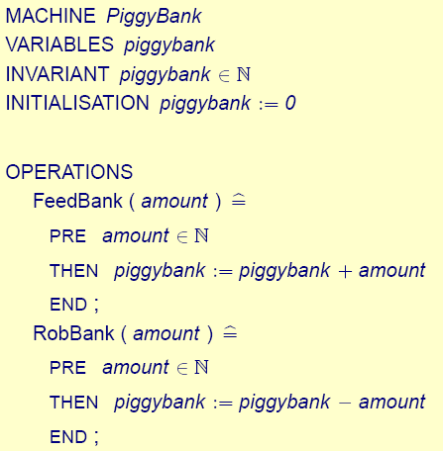
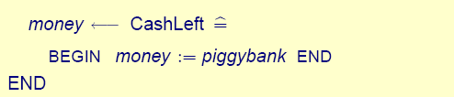
Let’s put that all together and show the machine marked up.

Slide 19
Invariant and Preconditions
The invariant of a machine is an expression of safety or integrity conditions. Satisfying the invariant should ensure the integrity or consistency of the information modelled by the state of a machine.
It is desired that the invariant is as strong as possible, and the precondition is as weak as possible

Slide 20
Modelling a Coffee Club
We will now model a coffee club with the following facilities for members:
  Joining – a person can join the club
  Contributing – members can contribute money to the club. This is used to increase the credit of the member, which is used to pay for cups of coffee.
  Buy – a member can buy a cup of coffee, the price is deducted from the member’s credit.
  Credit – a member can obtain their current credit balance.

Slide 21
A CoffeeClub Machine
The PiggyBank machine is included in this machine. This embeds the state of PiggyBank into this machine, and gives CoffeeClub access to the operations of PiggyBank.
A constant coffee is used for the cost of a cup of coffee.

Slide 22
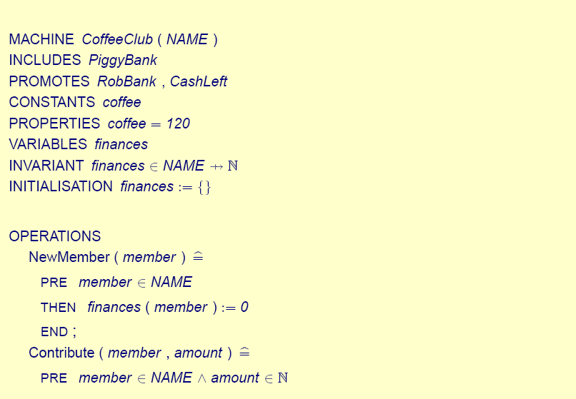

Slide 23
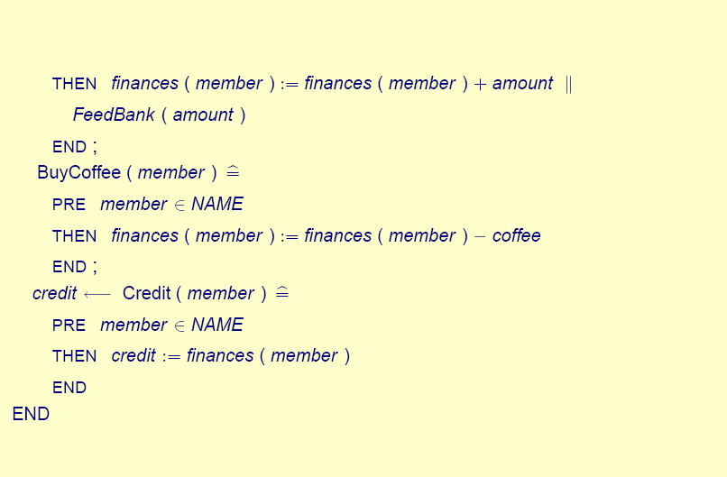

Slide 24
Tools
The B-Tool is a language interpreter and a run-time environment for supporting B. The B-Toolkit is a set of integrated tools which fully supports the B-Method for formal software development, built on top of the B-Tool.

Slide 25
Advantages of Software
Can automatically check for mistakes in your code.
Can generate source code from your specification
The B-Toolkit generates C code.

Slide 26
Questions?

