Slide 1
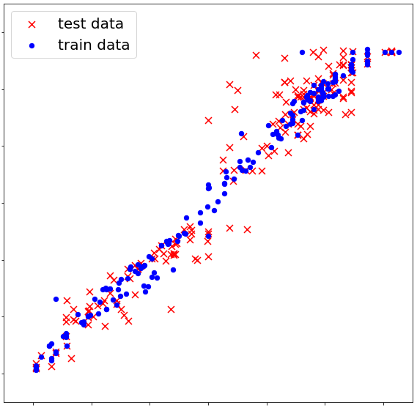
3
2
1
Predicted ∆∆G‡ values
0
-1
-2
-3
-3
-2
-1
0
1
2
3
Actual ∆∆G‡ values

Slide 2
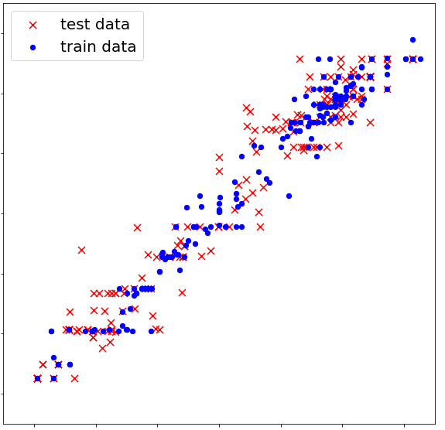
3
2
1
Predicted ∆∆G‡ values
0
-1
-2
-3
-3
-2
-1
0
1
2
3
Actual ∆∆G‡ values

Slide 3
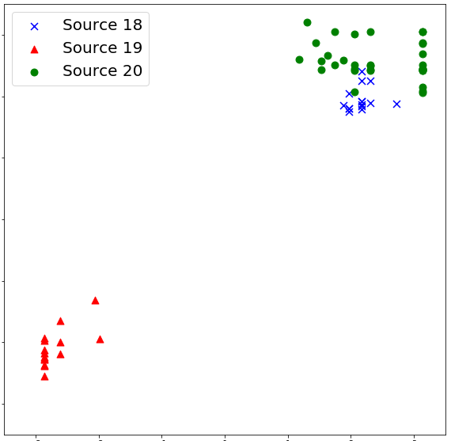
3
Addition of enecarbamates to benzoyl imines
Hydrogenation of fluorinated alkynyl ketimines
2
Addition of thiols to imines (Denmark)
1
Predicted ∆∆G‡ values
0
-1
-2
-3
-3
-2
-1
0
1
2
3
Actual ∆∆G‡ values

Slide 4
Nucleophile GMM
Low Density
High Density
Lasso Model
Imine
GMM
Low Density
High Density
Nucleophile Focused Random Forest
Overall Random Forest

Slide 5
