Slide 1


SHIP ROLL BEHAVIOUR IN LARGE AMPLITUDE BEAM WAVES
Jiaming LIANG & Zhiliang LIN
School of Naval Architecture, Ocean and Civil Engineering
Shanghai Jiao Tong University, China
ASME 34th International Conference on Ocean, Offshore and Arctic Engineering
Prof. Robert F. Beck Honoring Symposium June 2, 2015
St. John’s, NL, Canada
OMAE2015-41802

Slide 2
Overview
Background
Ship Roll motion & Large waves
Mathematical Model
Nonlinear ship rolling system
Fully nonlinear regular wave system
Analysis Methods
Homotopy analysis method
Numerical simulation
Floquet theory
Results and Discussion
Conclusions
OMAE2015-41802

Slide 3
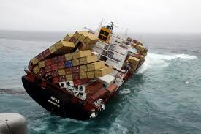
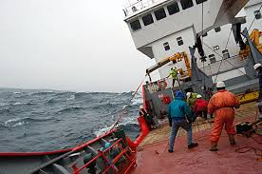
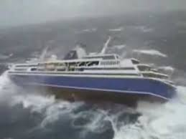
Background
Ship roll motion
Hazardous circumstances
Cargo
Crew
Most significant among ship motions
Capsizing
OMAE2015-41802

Slide 4
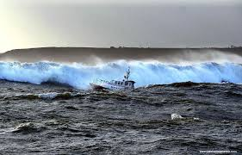
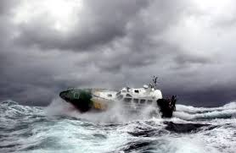
Harsh ocean environments
Highly nonlinear (such as large amplitude waves)
Stability studies
Important to evaluate the stability of ship motions
OMAE2015-41802

Slide 5
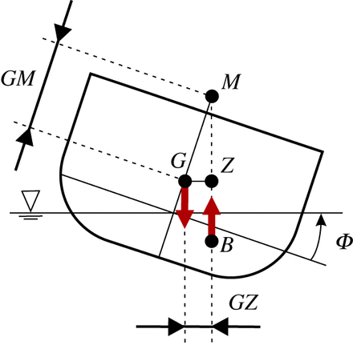
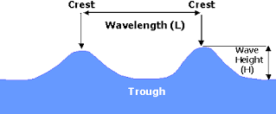
Consider
Ship roll motion + Larger beam wave (regular)
Aim
modify the nonlinear rolling model
solve highly nonlinear system
stability analysis
OMAE2015-41802

Slide 6

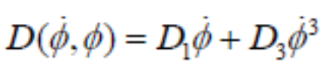

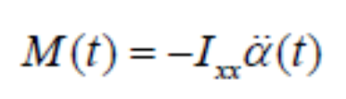
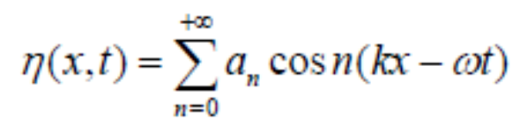

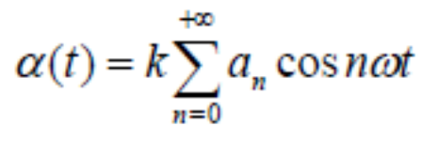

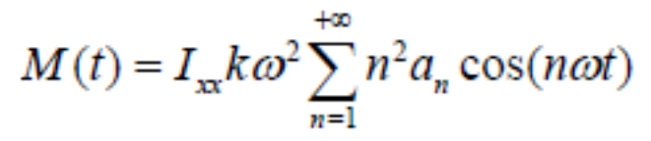

Mathematical Model
Ship roll motions in beam waves
Linear exciting force
Nonlinear exciting force
OMAE2015-41802

Slide 7
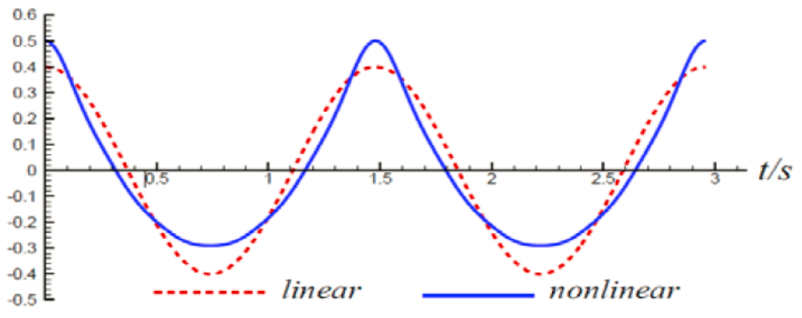

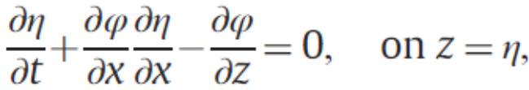
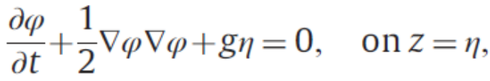
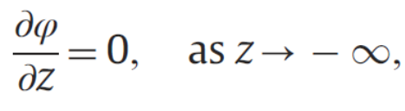
Nonlinear regular wave (wave theory )
Mathematical model for waves
1) fully nonlinear
2) including high
order terms
OMAE2015-41802

Slide 8
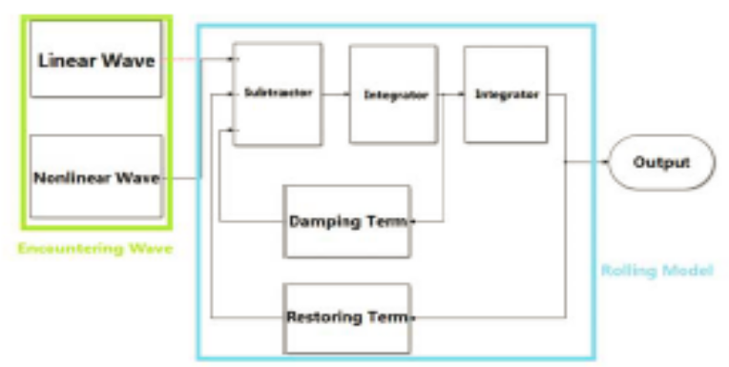
Analysis method
Homotopy analysis method (HAM)
effective for highly nonlinear ODE or PDE systems
for solving wave system and rolling model
Numerical simulation & Fitting
Fourier series fitting
Simulink
Floquet theory
for the stability analysis
OMAE2015-41802

Slide 9
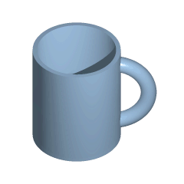

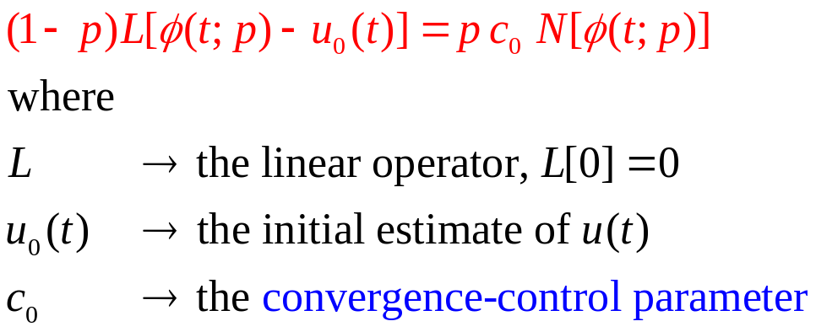

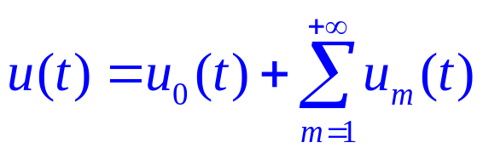
HAM
Advantages:
independent of small/large parameters;
provides a convenient way to guarantee the convergence of solution series;
provides great freedom to choose the equation type of linear sub-problems;
valid for highly nonlinear problems
OMAE2015-41802

Slide 10

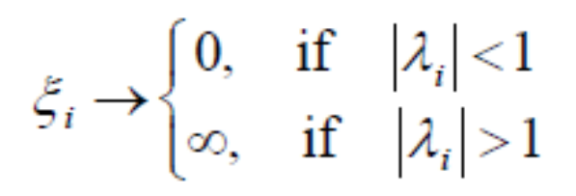

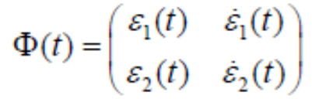


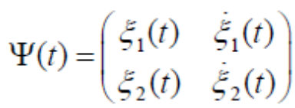


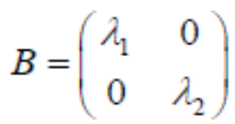



Floquet theory
Stability Criteria
OMAE2015-41802

Slide 11
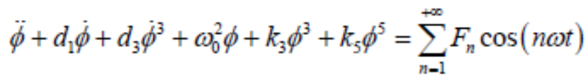
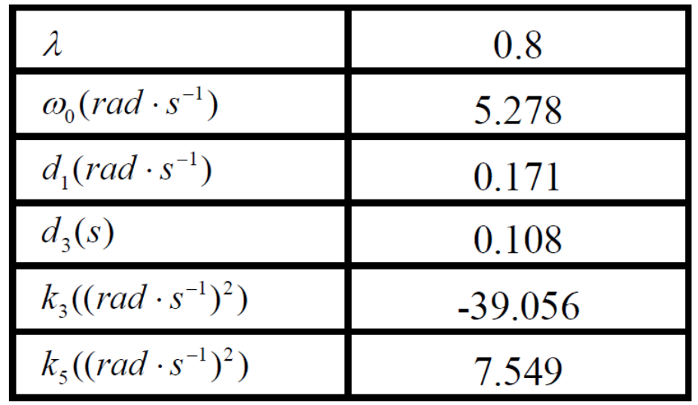
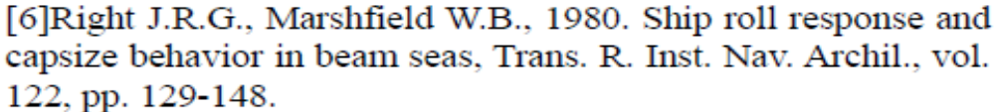
Results & discussion
Nondimensional roll motion equation:
Test vessel (Wright and Marshfield，1980 )
Coefficients
OMAE2015-41802

Slide 12
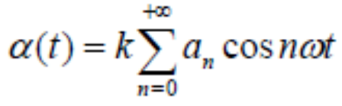
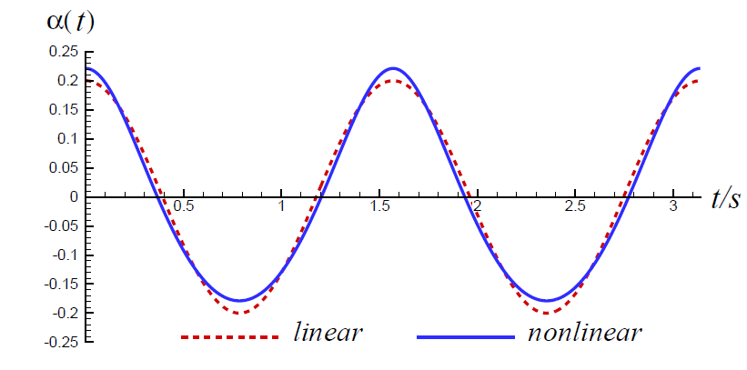
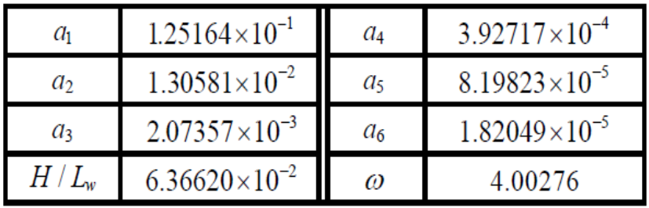
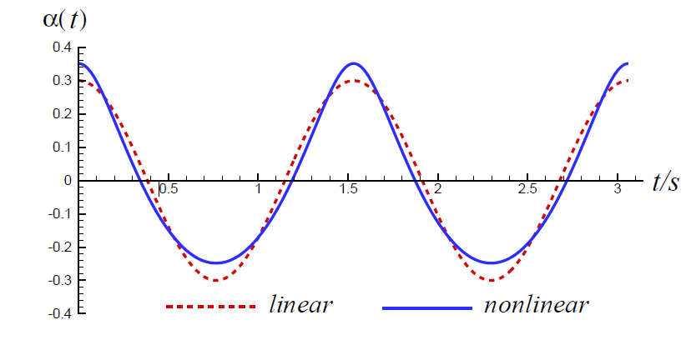
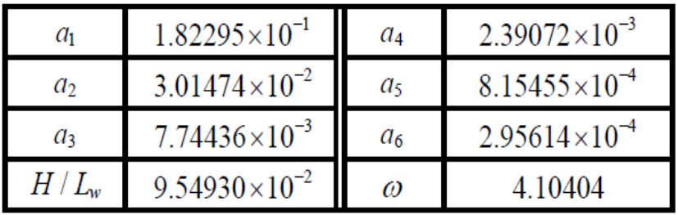
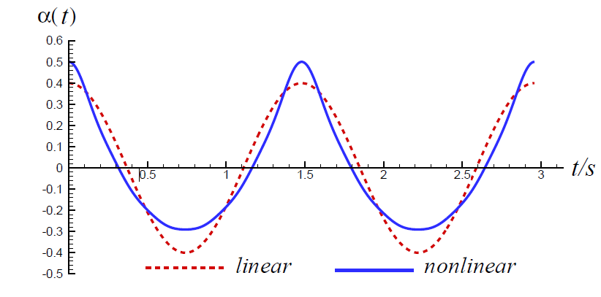
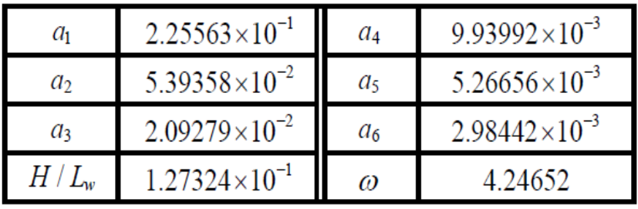
Three kinds of beam waves (Lw = 4 m )
Case 1
Case 2
Case 3
OMAE2015-41802

Slide 13
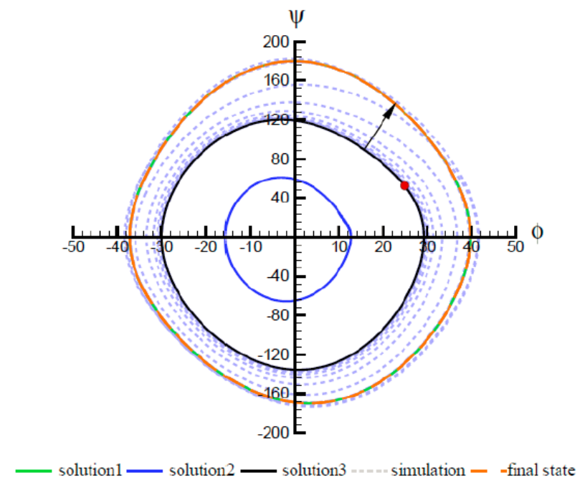
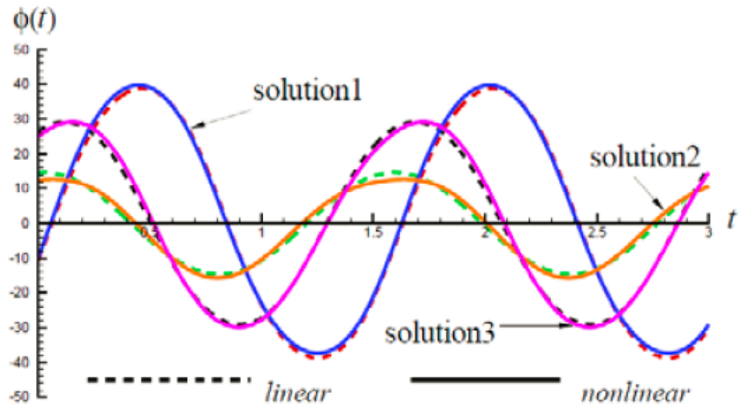
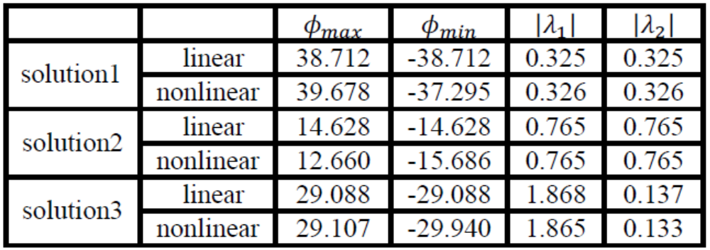
Case 1
OMAE2015-41802

Slide 14
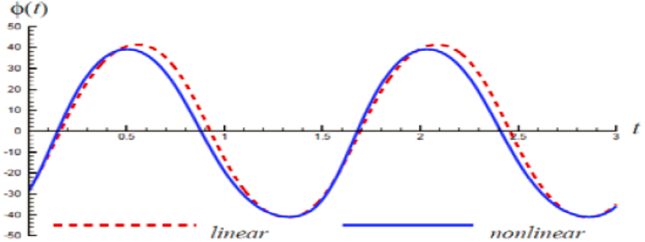
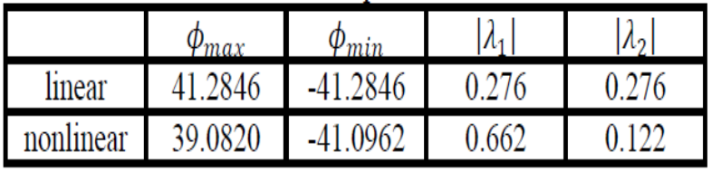
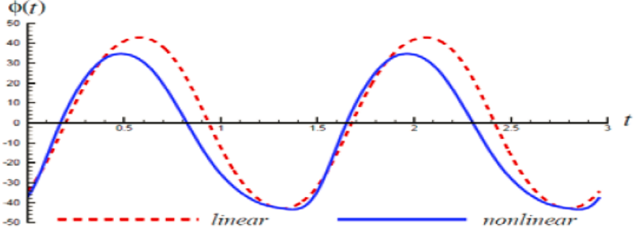
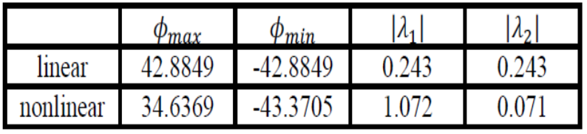
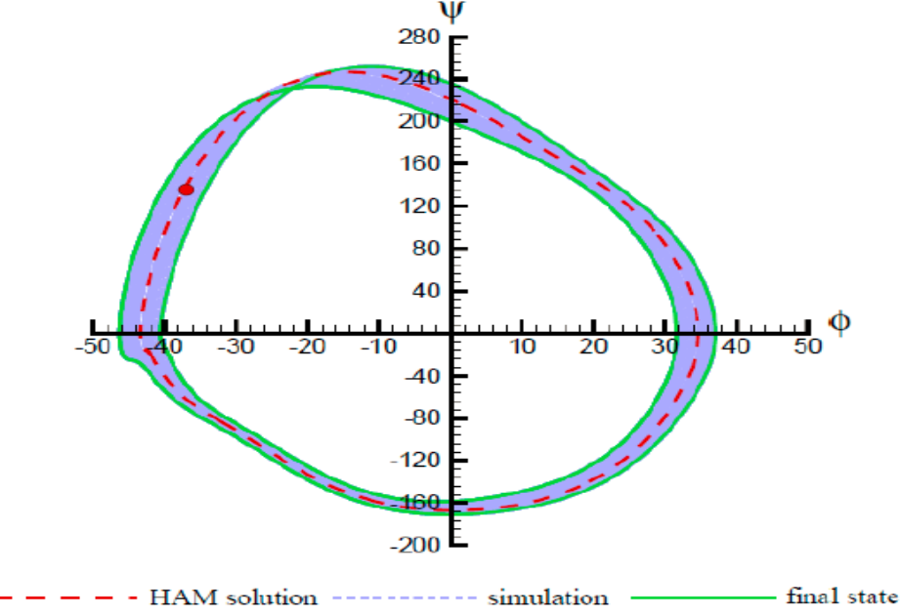
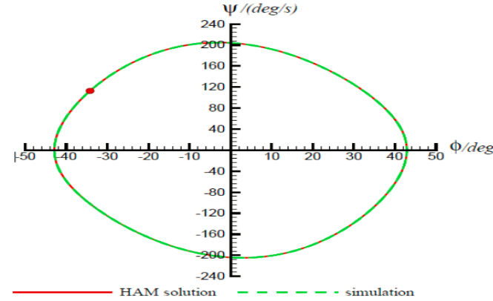
Case 2
Case 3
OMAE2015-41802

Slide 15
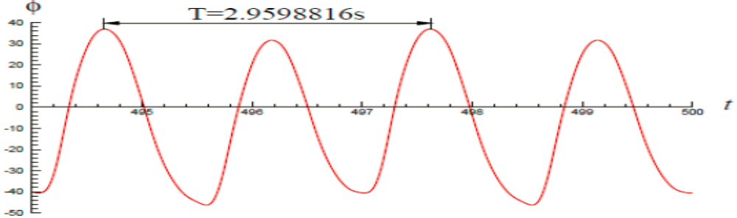


Case 3
Numerical simulation
wave period
Period doubling bifurcation
OMAE2015-41802

Slide 16

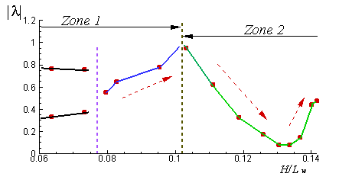
Keep the frequency of incident beam wave unchanged ( =4.0 )
Zone 1: Troll = Tw
Zone 2: Troll = 2Tw
OMAE2015-41802

Slide 17
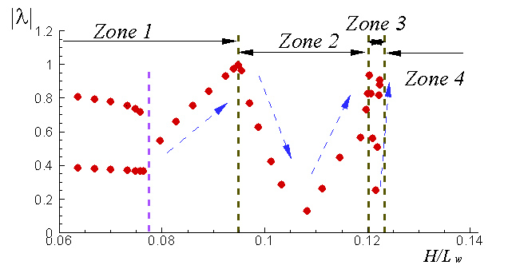
Zone 1: Troll = Tw
Zone 2: Troll = 2Tw
Zone 3: Troll = 4Tw
Zone 4: Chaos
OMAE2015-41802

Slide 18
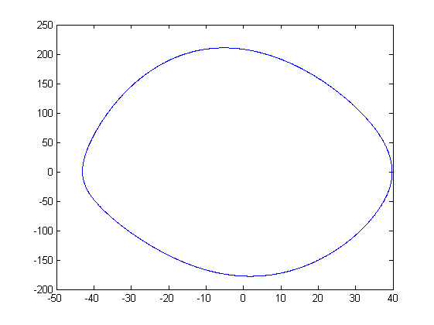
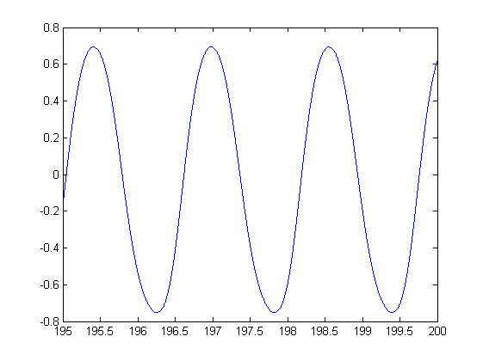
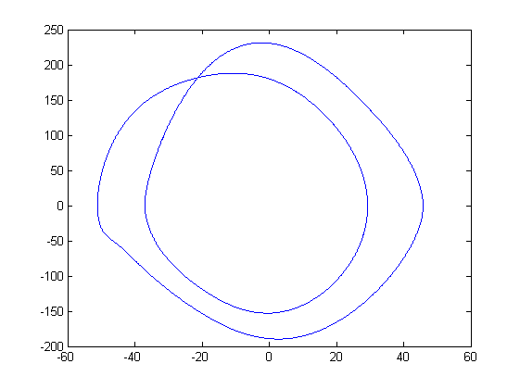
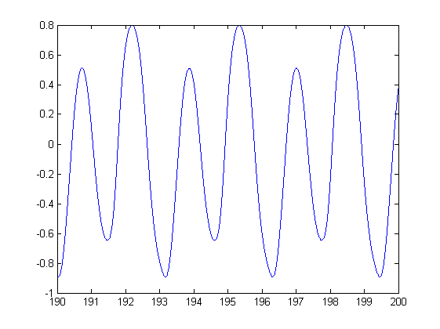
Zone 1: Troll = Tw
Zone 2: Troll = 2Tw
OMAE2015-41802

Slide 19




Zone 3: Troll = 4Tw
Zone 4: Chaos
OMAE2015-41802

Slide 20
Conclusions
When the slope of incident wave is small, there are two stable solutions of roll responses;
As the wave slope increases, the difference of roll motions between linear and nonlinear wave exciting force gets more significant;
When the wave slope is large enough, the roll amplitude doesn’t increase all the time, but the roll motion will experience period doubling, quadrupling bifurcation, chaos, and finally the ship capsizes;
The high order harmonic force terms cannot be neglected when considering ship roll motion in large beam waves.
OMAE2015-41802

Slide 21



