Slide 1
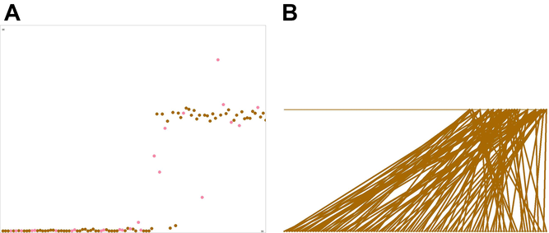
OPTIMAL INVESTMENT IN SOCIAL SIGNALS
Evolution, Volume: 68, Issue: 6, Pages: 1640-1650, First published: 03 February 2014, DOI: (10.1111/evo.12378)
Notes:
Continuous version of the classical social signaling model. Agents choose which other agent they follow; the number of followers per agent is limited to 6. (A) A snapshot of a single run. Red dots represent “infants” that are still learning. (B) The corresponding sociogram. Individuals are located twice, on the lower and upper horizontal axes, depending on their quality. Social links are represented by lines from the lower to the upper axis.
IF THIS IMAGE HAS BEEN PROVIDED BY OR IS OWNED BY A THIRD PARTY, AS INDICATED IN THE CAPTION LINE, THEN FURTHER PERMISSION MAY BE NEEDED BEFORE ANY FURTHER USE. PLEASE CONTACT WILEY'S PERMISSIONS DEPARTMENT ON PERMISSIONS@WILEY.COM OR USE THE RIGHTSLINK SERVICE BY CLICKING ON THE 'REQUEST PERMISSIONS' LINK ACCOMPANYING THIS ARTICLE. WILEY OR AUTHOR OWNED IMAGES MAY BE USED FOR NON-COMMERCIAL PURPOSES, SUBJECT TO PROPER CITATION OF THE ARTICLE, AUTHOR, AND PUBLISHER.

