Slide 1

Entrepreneurial Project
9A1

Slide 2
The Team
Catie Donnelly
Team Leader
Jordan Byers
Project Manager
Chase Bradley
Human Resources, Business Analyst
Johannes Liem
Quality Assurance
James Poje
Design Lead
Tal Cohen
Advisor

Slide 3
Markets
Government
  Stable market, with large resources
Education
  Easy to test with low risk, low reward
Consumer Market
  Easily accessible, low risk, but high failure rate
Corporate Market
  Large resources with high risk, high reward

Slide 4
Initial Ideas
Hardware Store Kiosk
Store Manager Training Program
All-in-one Banking System
Education Assistance
Behavior Simulation
Fantasy Football App.
Traffic Algorithm

Slide 5
Primary Idea
Hardware Store Kiosk
  It is an obvious problem
  Competitive market needs innovation
  We believe the project can be marketable
  We have connections

Slide 6
Problem
Problem: searching for products in a store wastes time and energy
Affects: customers unfamiliar with the layout of the store
Impact: customers who cannot find products easily become frustrated and may not return

Slide 7
Solution
Software on in-store kiosk
Help customers find products without employee assistance
Suggest related items for customer to purchase

Slide 8
Requirements
Accurate—must reflect true inventory
Helpful—map must be easy to understand
Useful—suggested products must be relevant
Lucrative—must increase customer satisfaction, directly increase sales, or both

Slide 9
Research
Survey
  Handed surveys out to random people ages 19-74
  Survey asked questions based on whether the person would use our design, and how they would like to use it
Consulting Experts
  Talked to people inside the corporation and people involved in the industry

Slide 10
Results

Slide 11
Basic Architecture

Slide 12
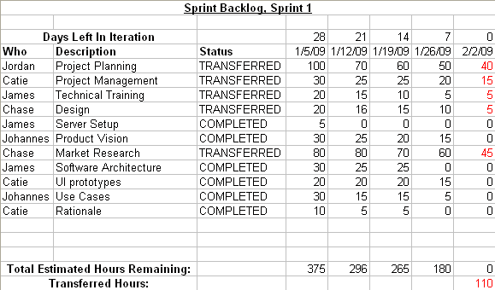
Sprint 1 Backlog

Slide 13
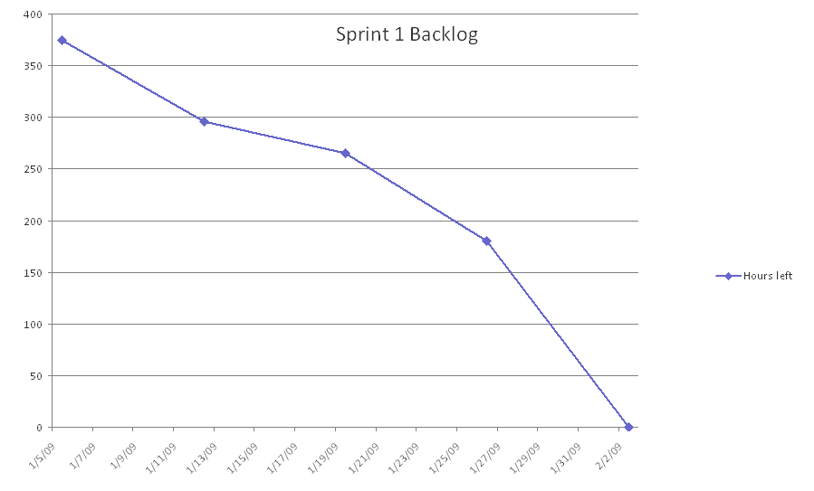
Sprint 1 Burndown

Slide 14
Product Backlog

Slide 15
Product Burndown

Slide 16
Demo

Slide 17
Questions?

