Slide 1

Entrepreneurial Project
Team 9A1
CS 4911
4/22/09

Slide 2
The Team
Catie Donnelly
Team Leader
Jordan Byers
Project Manager
Chase Bradley
Human Resources, Business Analyst
Johannes Liem
Quality Assurance
James Poje
Design Lead
Tal Cohen
Advisor

Slide 3
Solution
Software on in-store kiosk
Help customers find products without employee assistance
Allow customer to search for common home improvement projects

Slide 4
Research
Survey
  Handed surveys out to random people ages 19-74
  Survey asked questions based on whether the person would use our design, and how they would like to use it
Consulting Experts
  Talked to people inside the corporation and people involved in the industry

Slide 5
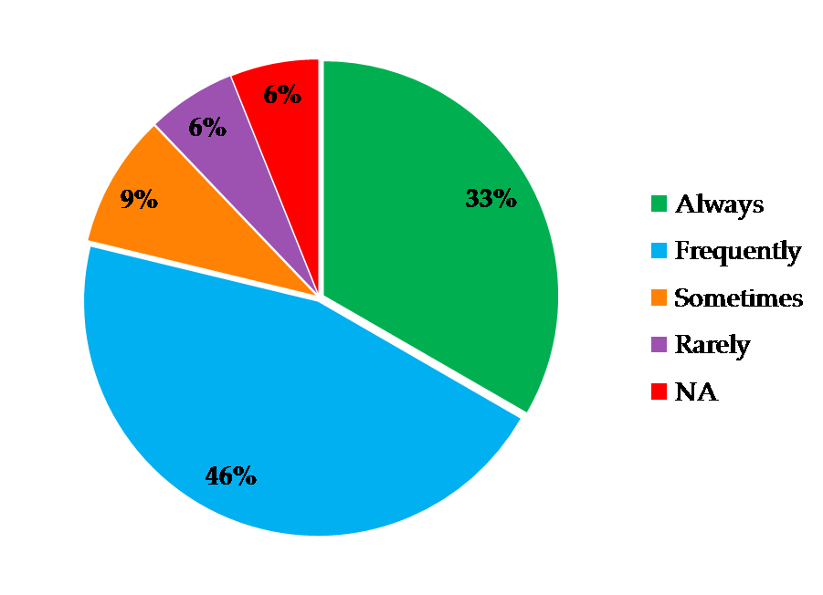
Results
How often would you use this product if it existed?

Slide 6
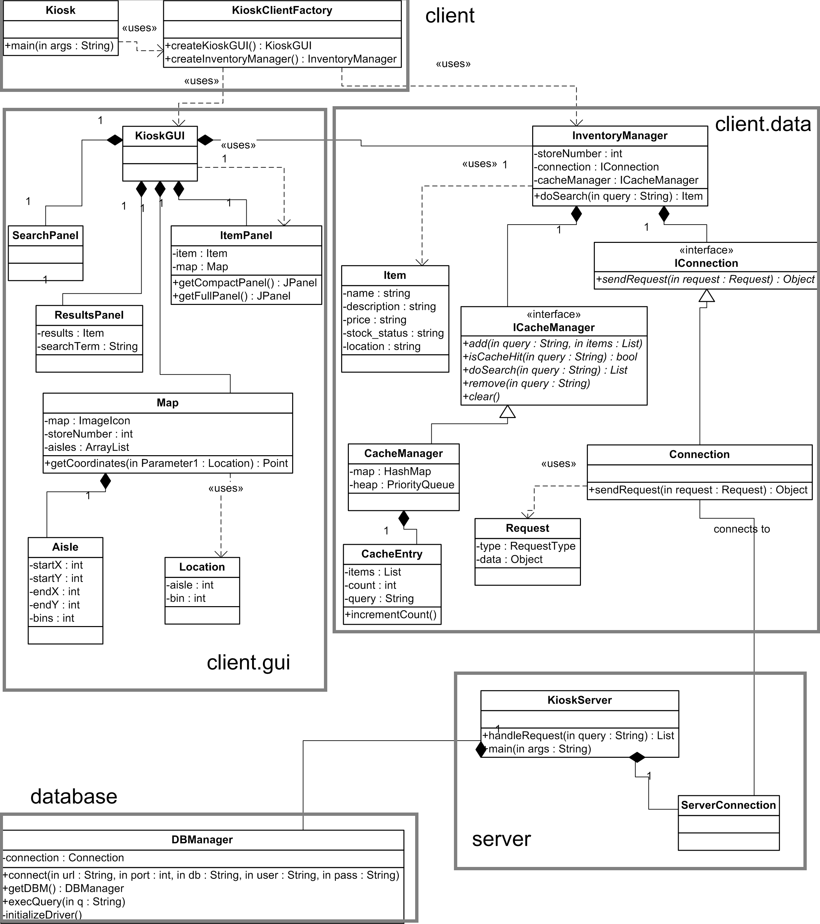
Architecture

Slide 7
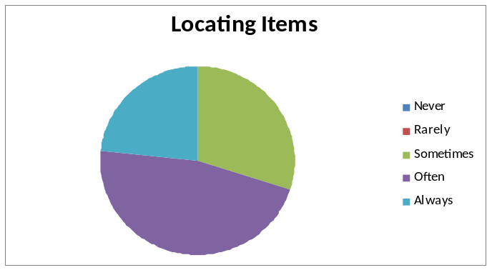
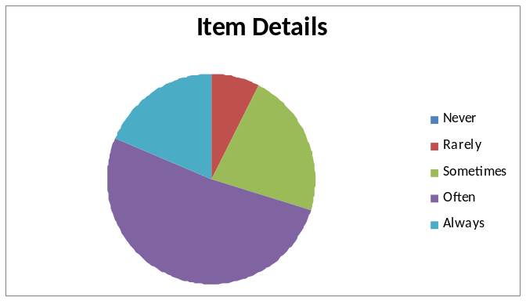
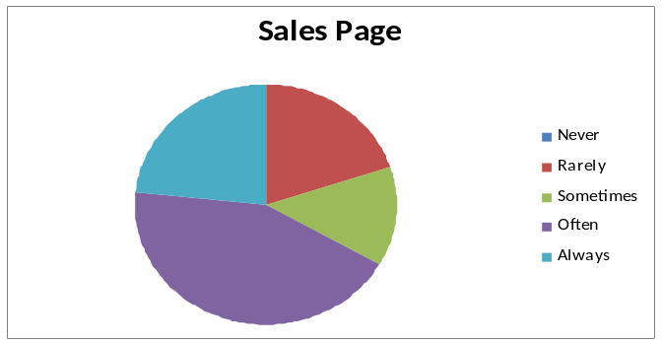
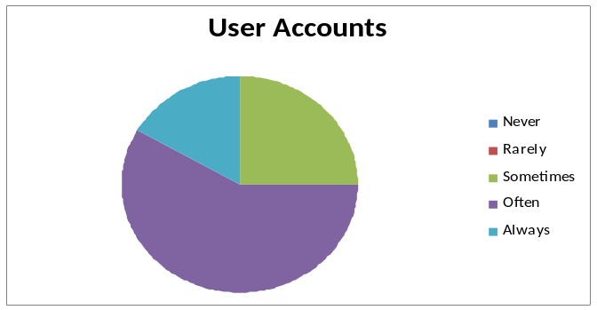
Feature Surveys

Slide 8
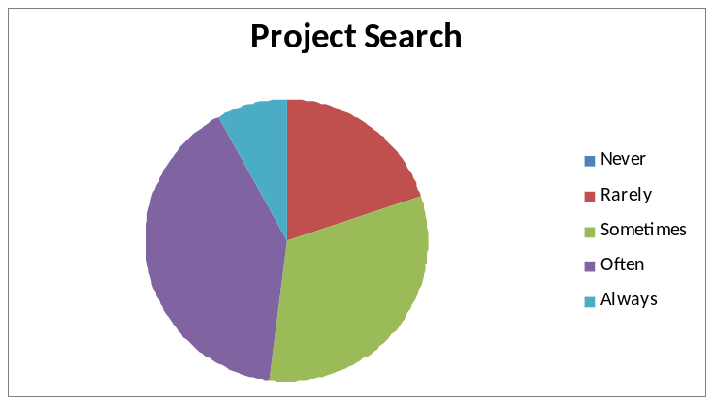
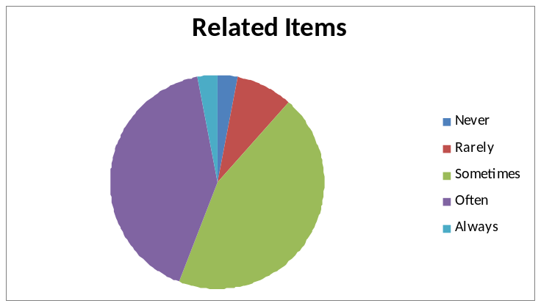
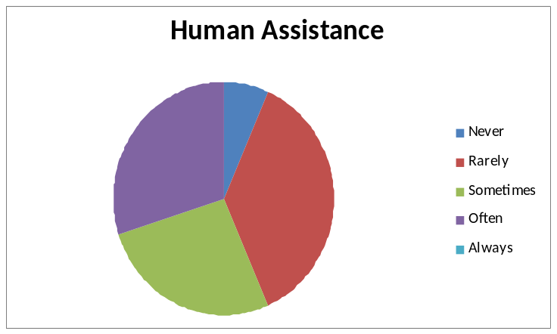
Feature Surveys cont.

Slide 9
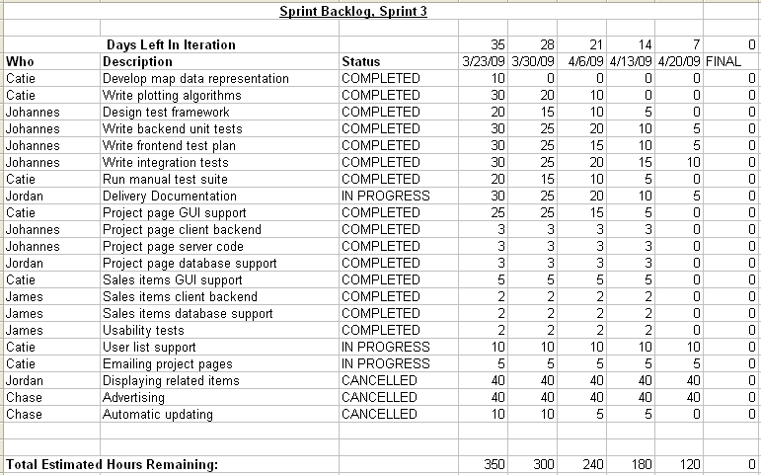
Final Sprint Backlog

Slide 10
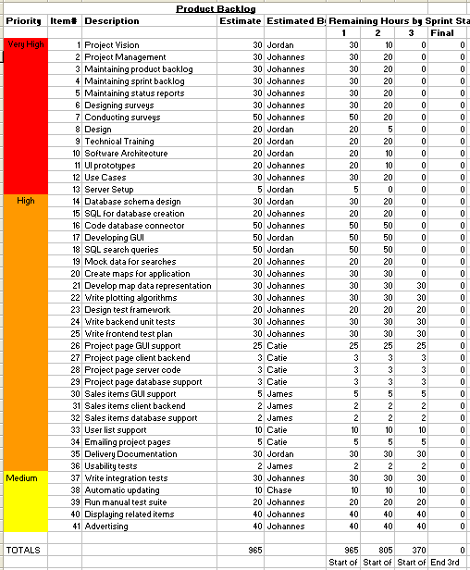

Slide 11
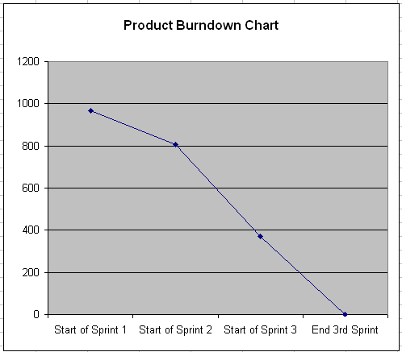
Final Burndown

Slide 12
Quality
GUI usability testing
  Overall, interface was well-received
  Testers thought it was useful and would use in a real environment
  Clarified instruction text on search page
  Some UI improvements like button placement
Code quality
  Unit tests for all methods

Slide 13
Reflections
Efficient use of time
Team worked well together
Well-organized and modular code
Needed more time to complete all planned features
Wanted to get even more data and surveys out

Slide 14
Future Features
Optimize searching
More communication with businesses
Tighter integration with existing websites

Slide 15
Demo

