Slide 1
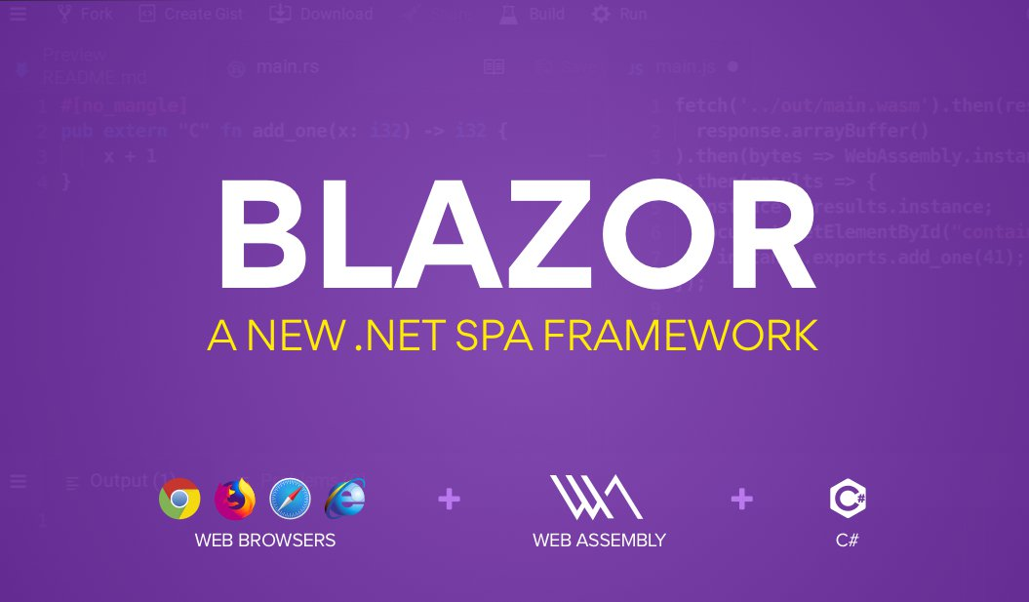

Slide 2
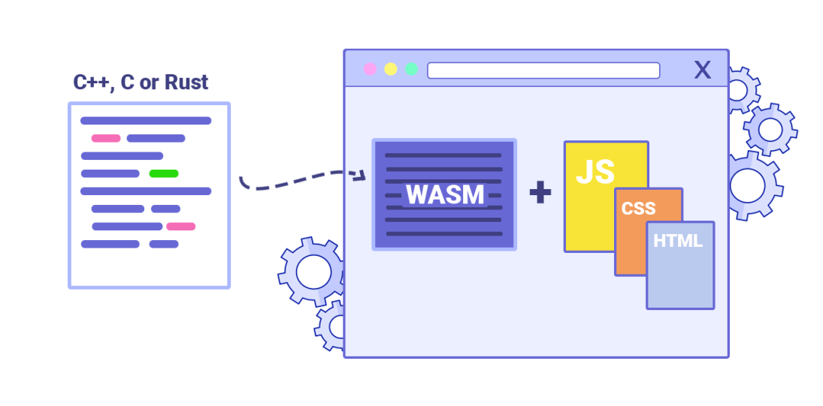
Notes:
https://blog.logrocket.com/webassembly-how-and-why-559b7f96cd71/
You do not write WebAssembly, you compile other higher level languages to it.

Slide 3
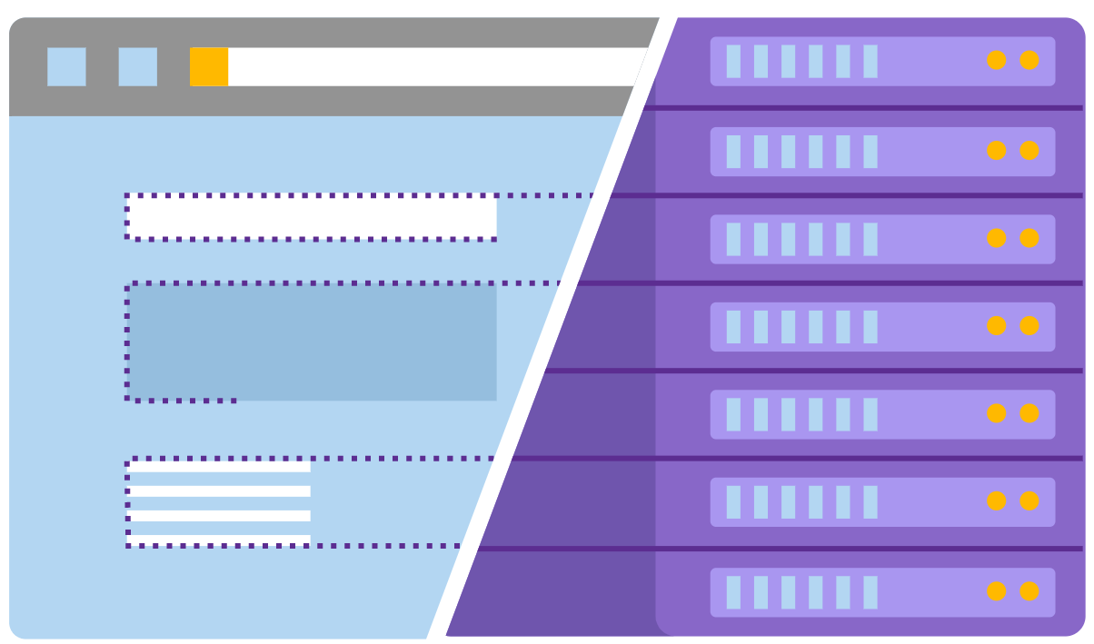
WebAssembly
Server
Notes:
Blazor can run your client-side C# code directly in the browser, using WebAssembly. Because it's real .NET running on WebAssembly, you can re-use code and libraries from server-side parts of your application.
Alternatively, Blazor can run your client logic on the server. Client UI events are sent back to the server using SignalR - a real-time messaging framework. Once execution completes, the required UI changes are sent to the client and merged into the DOM.

Slide 4
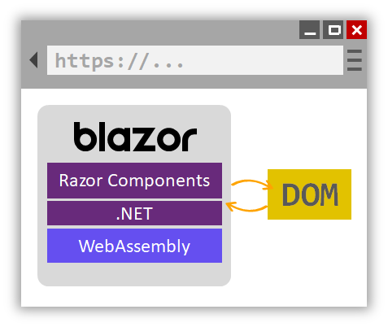
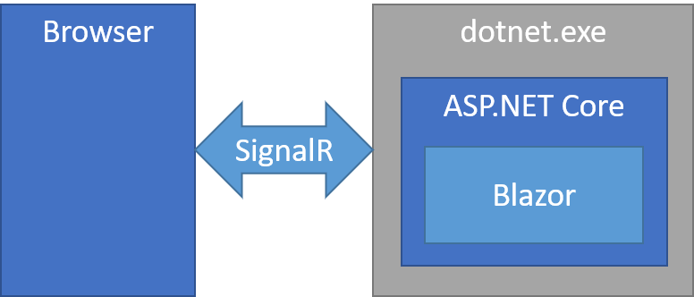
Notes:
https://gunnarpeipman.com/server-side-blazor/
https://docs.microsoft.com/en-us/aspnet/core/blazor/?view=aspnetcore-3.0

Slide 5
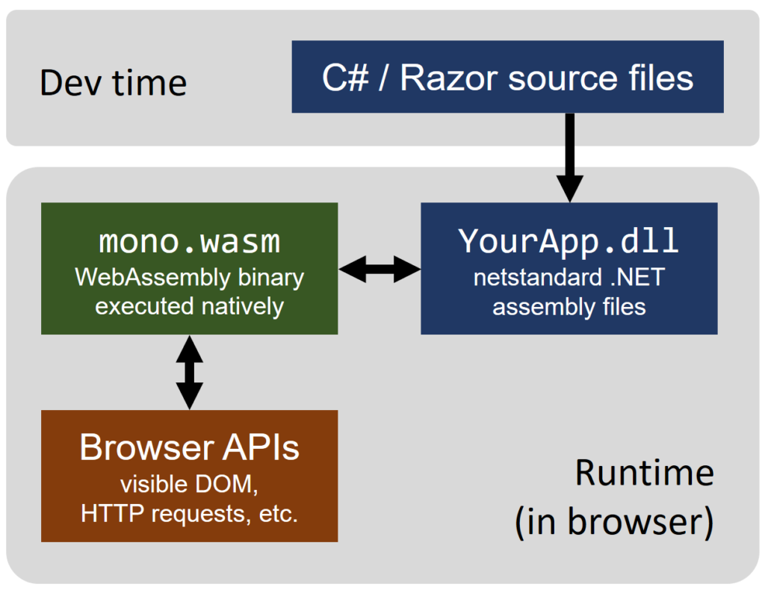
Notes:
https://www.nativoplus.studio/blog/blazor-introduction/

Slide 6


DEMO
https://github.com/jlieuw/blazor

Slide 7
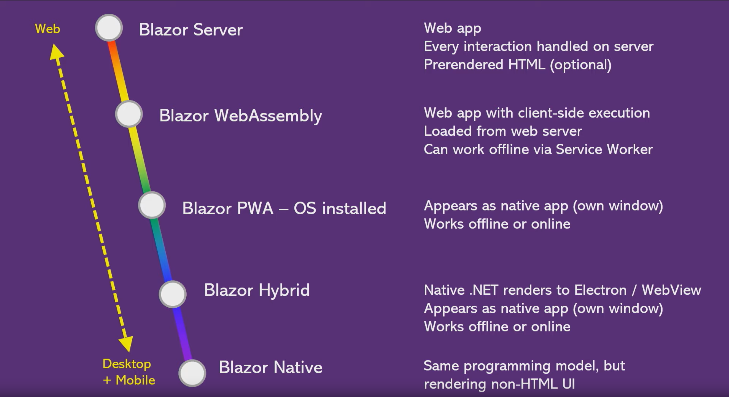

Slide 8

Resources
Officiële Blazor website:
https://dotnet.microsoft.com/apps/aspnet/web-apps/blazor
Documentatie van Microsoft:
https://docs.microsoft.com/en-us/aspnet/core/blazor/?view=aspnetcore-3.0
Web Assembly how and why
https://blog.logrocket.com/webassembly-how-and-why-559b7f96cd71/

