Slide 1
Content breakdown
Tutorial 1
The Rescorla-Wagner (Q-Learning) model
Tutorial 2
Hamiltonian Monte Carlo with cmdstanr
Tutorial 3
Extracting and interpreting parameters, and introducing offset parameters into your model
Tutorial 4
Good practices for computational modelling: Data simulation, parameter recovery and model comparisons

Slide 2
Cognitive Models
A model that describes how an individual performs a task (e.g., problem-solving, decision-making) or engages in a particular cognitive process. They are typically based upon psychological theory, e.g.,:
Prospect theory
Reinforcement Learning
Bayesian inference
Component process of working memory
Expectancy theory
“Traditional” models that simply regress the dependent measure on an assortment of experimental variables (e.g., questionnaire score, age, sex…) tell us very little about what goes on within cognition. These are essentially “black box” models.
We use cognitive models because they allow us to disentangle latent cognitive mechanisms, and hence make inferences about them.

Slide 3
Computational Modelling
What is it?
The use of a computer programme to simulate complex real-world systems and make forward predictions
Why use it?
In the cognitive sciences, mathematical models to describe cognitive processes are often too complex to be captured within a one-liner equation (e.g., linear regression)
Cognitive parameter values also tend to violate distributional assumptions. Some require imposed lower and upper bounds; others follow an exponential distribution… etc.
To reliably estimate cognitive parameter values, we need iterative, computational methods.

Slide 4
COMPUTATIONAL COGNITIVE MODEL
A model that explores and helps us understand various cognitive mechanisms, implemented through a computational process.

Slide 5


The Rescorla-Wagner (Q-Learning) Model
13 May 2024
Light and Divine Winds
Ruben Pang

Slide 6
Reinforcement Learning
Concept inspired by artificial intelligence and Pavlovian conditioning, and continues to be influential in training artificial intelligence nowadays
Agents learn to take a suitable action to maximize reward in a particular situation (state), often through trial and error
https://www.youtube.com/watch?v=L_4BPjLBF4E&t=0s

Slide 7
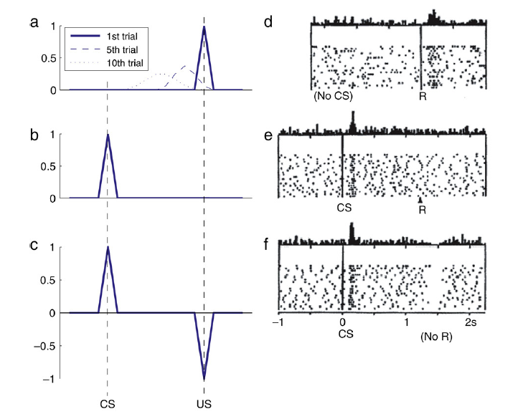
Reinforcement Learning in the Brain
Reward Prediction Error Hypothesis of Dopamine
Dopamine is instrumental for reward learning in the basal ganglia
The firing of dopaminergic neurons reflects a reward prediction error, where burst firing occurs in early stages of learning/training, but not later on when the agent has learned what the optimal decision is.
In Pavlovian conditioning, dopaminergic neurons exhibit a prediction error to the US in early trials, but this PE back-propagates temporally to the CS when the association is formed over several trials
Niv et al., 2005, Schultz et al., 1993
Niv, Y. (2009). Reinforcement learning in the brain. Journal of Mathematical Psychology, 53(3), 139-154. https://doi.org/10.1016/j.jmp.2008.12.005

Slide 8
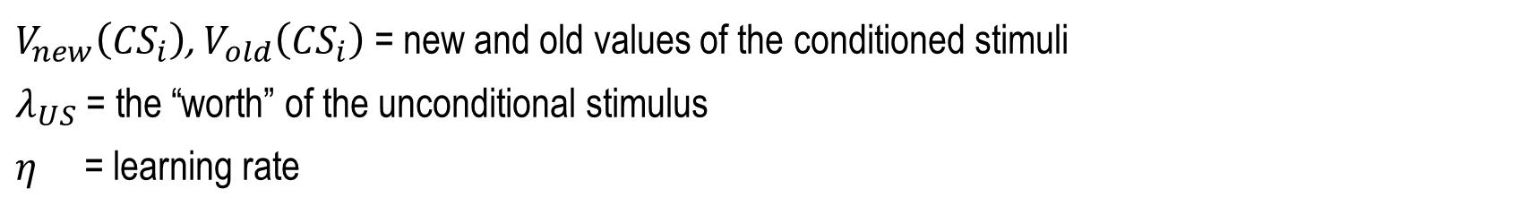

The Rescorla-Wagner model
$$V_{new}\left({CS}_{i}\right)=V_{old}\left({CS}_{i}\right)+ η\left[λ_{US}−\sum_{i}{V_{old}({CS}_{i})}\right]$$
$V_{new}\left({CS}_{i}\right)$, $V_{old}\left({CS}_{i}\right)$ = new and old values of the conditioned stimuli
$λ_{US}$ = the “worth” of the unconditional stimulus
$η$ = learning rate
Two axioms:
Learning only occurs when events are not predicted (violate expectations)
Predictions due to different stimuli are summed to form the total prediction in a trial

Slide 9
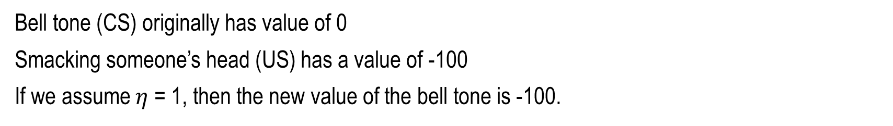
The Rescorla-Wagner model
$$V_{new}\left({CS}_{i}\right)=V_{old}\left({CS}_{i}\right)+ η\left[λ_{US}−\sum_{i}{V_{old}({CS}_{i})}\right]$$
Conditional stimulus = bell tone
Unconditional stimulus = smacking the person’s head
Response = wince in pain
Bell tone (CS) originally has value of 0
Smacking someone’s head (US) has a value of -100
If we assume $η$ = 1, then the new value of the bell tone is -100.

Slide 10
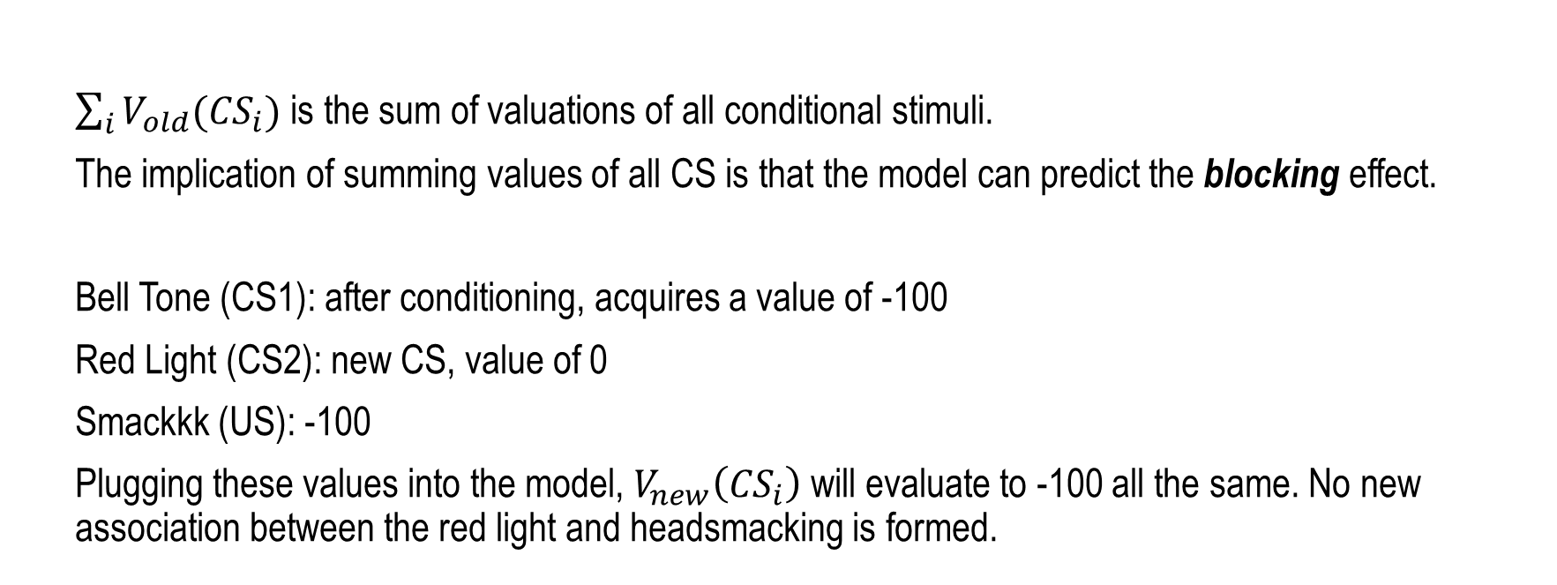
The Rescorla-Wagner model
$$V_{new}\left({CS}_{i}\right)=V_{old}\left({CS}_{i}\right)+ η\left[λ_{US}−\sum_{i}{V_{old}({CS}_{i})}\right]$$
$\sum_{i}{V_{old}({CS}_{i})}$ is the sum of valuations of all conditional stimuli.
The implication of summing values of all CS is that the model can predict the blocking effect.
Bell Tone (CS1): after conditioning, acquires a value of -100
Red Light (CS2): new CS, value of 0
Smackkk (US): -100
Plugging these values into the model, $V_{new}\left({CS}_{i}\right)$ will evaluate to -100 all the same. No new association between the red light and headsmacking is formed.

Slide 11
The Q-Learning model
Q(A)_{t+1} = Q(A)_{t} + η(R−Q(A)_{t})
A learning rule derived from the Rescorla-Wagner framework
where:
𝑄(𝐴)_{𝑡+1} is the expected value of choosing A on the next trial
𝑄(𝐴)_{𝑡} is the expected value of choosing A on the current trial t𝑡
𝑅 is the amount received (i.e., feedback) on current trial t𝑡, which would mean:
The term 𝑅−𝑄(𝐴)_{𝑡} is the reward prediction error i.e., the difference between what was expected and the actual 𝑅 received
𝜂 is the learning rate of the participant, ranging 0 - 1.
This captures the extent to which participants integrates the feedback received on the current trial. If 𝜂 is very close to 1, then the participant is allocating a lot of importance to the feedback on trial 𝑡. In other words, they are more sensitive to, and hence learns quickly from feedback. If it’s close to 0, the participant hardly takes the feedback into consideration when deciding whether to pick A again on the next trial.

Slide 12
The Q-Learning model
Q(A)_{t+1} = Q(A)_{t} + η(R−Q(A)_{t})
We assume that the agent will be more likely to pick the action that results in the state with higher reward.
So, if 𝑄(𝐴)_{𝑡+1}>𝑄(𝐵)_{𝑡+1}, then the probability of the participant choosing A over B on trial 𝑡+1 should be higher, i.e., 𝑝𝑟(𝐴)_{𝑡+1}>𝑝𝑟(𝐵)_{𝑡+1}.

Slide 13


The Q-Learning model
We can calculate pr(A) using the softmax function as follows:
Alternatively, for a binary-choice task, a mathematically-equivalent way of writing the softmax function*:
Where β is the explore/exploit parameter, or degree of behavioural consistency
*This alternative equation may be helpful if you have β x Q values in the first equation that are too large to exponentiate (i.e., computes to infinity).

Slide 14
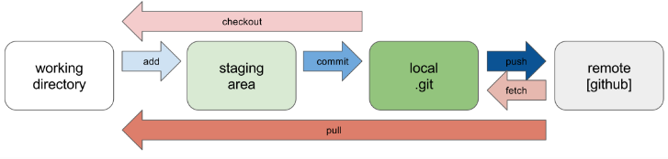
What’s Git?
An open-source revision control system that can be used to:
Host working files for your data projects
Share code with collaborators and iteratively revise scripts
Share code with reviewers/readers, especially for journals with open data access requirements

Slide 15
Git Workflow
Clone: When you want to freshly copy an entire repo onto your computer
Pull: When you want to update your existing copy of the repo to the latest version
Add: When you want to add your changes to your local staging area
Commit: When you want to save and update your changes to your local version
Push: When you want to push your committed changes onto the remote version

Slide 16
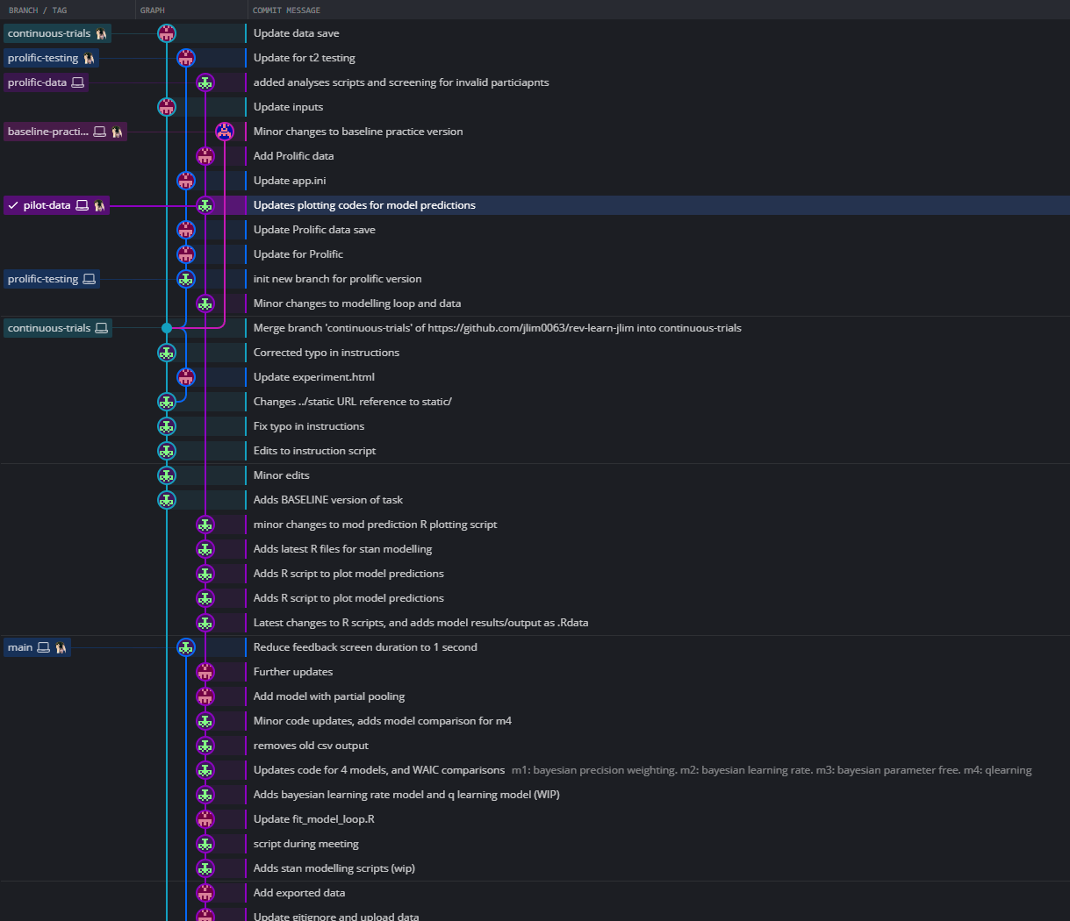
Git Branching
We use branches to add new or alternative features (versions) of the “main” branch.
We branch when working on new or alternative features so as not to disrupt the development of the “main” branch, especially if you already have a functional “main” and don’t want to overwrite it destructively.

Slide 17
What is Git Bash?
Application for Microsoft Windows environments which provides an emulation layer for a Git command line experience
Can serve as an alternative to Command Prompt on Windows, or Terminal on Mac
Install git:
https://github.com/git-guides/install-git

Slide 18
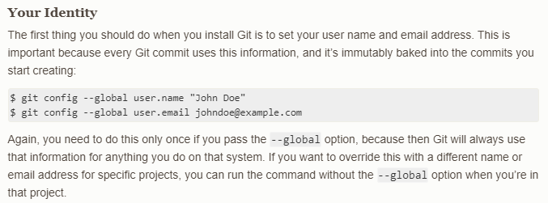
Installing Git and Git Bash on your system
Install git:
https://github.com/git-guides/install-git
To check your Git settings, type into Git Bash:
git config --list

Slide 19
Git Bash commands
Clone: git clone
Pull: git pull
Add: git add .
Commit: git commit –m “message here”
Push: git push origin [branchname]
Create new branch and switch to new branch: git branch -b [branchname]
Switch to another branch: git checkout [branchname]

Slide 20
Link to all commands you can type into Git Bash
https://github.com/joshnh/Git-Commands

