Slide 1
Test Suite Reduction Analysis with Enhanced Tie-Breaking Techniques
Jun-Wei Lin
2008/07/20

Slide 2
Outline
Introduction: Test Suite Reduction Problem
  Problem definition
  Existing solutions
  Effect on fault detection capabilities of reduced test suites
RTB: Reduction with Tie-Breaking
  Concept
  Implementation
    Modified HGS algorithm (M-HGS)
Experiments
  Setup
  HGS / M-HGS / RSR
Conclusion
<number>/20
Notes:
首先說明TSR問題的定義、目前的解法、以及解決之後對測試套件帶來什麼後續的影響
接著說明本論文的做法，包含RTB的概念與實做
最後是實驗及結論

Slide 3
Test Suite Reduction Problem (1/3)
1 int foo(int a, int b, int c) 2 { B1: if (a>0) 3 x=1; 4 else 5 x=-1; 6 B2: if (b>0) 7 y=-2; 8 else 9 y=x+1; 10 B3: if (c>0) B4: if (y<0) 11 return 10; 12 else 13 return(c/y); 14 }
 | B₁^{T} | B₁^{F} | B₂^{T} | B₂^{F} | B₃^{T} | B₃^{F} | B₄^{T} | B₄^{F}
t₁ | × |  |  | × | × |  |  | ×
t₂ |  | × | × |  | × |  | ×
t₃ | × |  | × |  |  | ×
t₄ |  | × | × |  |  | ×
t₅ |  | × |  | × |  | ×
A branch coverage adequate suite T t₁ = {a = 1, b = -1, c = 1} t₂ = {a = -1, b = 1, c = 1} t₃ = {a = 1, b = 1, c = -1} t₄ = {a = -1, b = 1, c = -1} t₅ = {a = -1, b = -1, c = -1}
<number>/20
Notes:
由範例來說明TSR問題是最容易理解的。通常對一段程式碼做測試時，我們會希望測試個案滿足
某種coverage criterion，比如左邊的程式有四個branch，其true跟false都要滿足的話就有八個requirements
依此產生的測試個案及其覆蓋狀況就會像這個樣子
但是我們會發現，要滿足這八個requirements，其實只需要前三個測試個案就可以
所以，測試套件精簡問題就是在滿足與原套件相同的requirements的情況下，將測試套件的size縮減到最小

Slide 4
Test Suite Reduction Problem (2/3)
Sets of
  Test cases T = {t₁, t₂, …, t_{m}}
  Requirements R = {r₁, r₂, …, r_{n}}
Find the minimal subset of T to cover R
Equivalent to the minimum set-covering problem (NP-complete)
Reference: M. J. Harrold, R. Gupta, and M. L. Soffa, “A Methodology for Controlling the Size of a Test Suite,” ACM Transactions on Software Engineering and Methodology, vol. 2, no. 3, pp. 270–285, July 1993
<number>/20
Notes:
如同上頁的例子，TSR問題就是有一組test cases T及其所滿足的requirements R，找出minimal subset of T仍然滿足R
這個問題等同於minimum set-covering problem，它是一個NP-Complete問題
因此目前提出的解法多偏向heuristic

Slide 5
Test Suite Reduction Problem (3/3)
Motivation
  Test cases are continuous generated to validate the latest modification
  Limited by time and resource, rerunning all the test cases may be impossible
  20,000 LOC product, seven weeks to run all the test cases
Reference: G. Rothermel, R. H. Untch, C. Chu, and M. J. Harrold, “Prioritizing Test Cases for Regression Testing,” IEEE Transactions on Software Engineering, vol. 27, no. 10, pp. 929-948, October 2001
<number>/20
Notes:
TSR問題的動機，在於測試個案在軟體修改過程中不斷被產生，受限於時間與資源，我們無法每次修改軟體後
都重跑所有測試個案。有個例子是20000行的產品，重跑其所有的測試個案需要七個禮拜

Slide 6
Existing solutions (1/2)
Traditional greedy
  View: for each test case, the number of requirements it covers
  Randomly break the ties
Reference: T. H. Cormen, C. E. Leiserson, R. L. Rivest, and C. Stein, Introduction to Algorithms, MIT Press, 2001
 | B₁^{T} | B₁^{F} | B₂^{T} | B₂^{F} | B₃^{T} | B₃^{F} | B₄^{T} | B₄^{F}
t₁ | × |  |  | × | × |  |  | ×
t₂ |  | × | × |  | × |  | ×
t₃ | × |  | × |  |  | ×
t₄ |  | × | × |  |  | ×
t₅ |  | × |  | × |  | ×
A tie occurs
<number>/20
Notes:
解決TSR問題經典的解法為greedy。每次都選擇cover最多requirements的test case，直到所有requirements都滿足為止
過程中遇到平手的測試個案就隨機選擇
如以下這個例子，一開始t1跟t2都滿足4個requirements( a tie occurs)，隨機選擇一個後將其滿足的requirements刪除
接著t2與t4一樣隨機選擇一個(假設選t4)；最後發現只剩B4T尚未被滿足(t2)，選擇t2後問題即解決

Slide 7
Existing solutions (2/2)
The HGS algorithm
  View: for each requirement, the number of test cases which cover the requirement
  Recursively check, or randomly break at final
Reference: M. J. Harrold, R. Gupta, and M. L. Soffa, “A Methodology for Controlling the Size of a Test Suite,” ACM Transactions on Software Engineering and Methodology, vol. 2, no. 3, pp. 270–285, July 1993
 | r₁ | r₂ | r₃ | r₄ | r₅ | r₆ | r₇ | r₈
t₁ |  |  | × |  | × | ×
t₂ |  |  | × |  |  |  |  | ×
t₃ | × |  | × | × |  |  | × | ×
t₄ |  |  |  |  | × |  | × | ×
t₅ | × | ×
t₆ |  |  |  | × |  | ×
t₇ |  |  |  |  |  |  | × | ×
A tie occurs
Recursively check
<number>/20
Notes:
另一個well-known的解法是HGS(三位發明者的姓的第一個字母)
它是由每個requirement被多少test cases所滿足的角度來看
以下這個例子，首先r2只被一個test case t5所滿足，代表t5非選不可
於是選擇t5，mark其所滿足的requirements；接著r4, r5, r6分別都只被兩個test cases所滿足
在其中我們欲選擇出現次數最多的test case，發現t1與t6各出現兩次，也就是它們同等重要，
HGS演算法此時會recursively check下一層(requirement被3個test cases所滿足)的test cases中有沒有t1或t6出現
發現t1重複出現，因此就選擇t1，mark t1 所滿足的requirement… (剩下的過程一樣)

Slide 8
Effect on fault detection capabilities of reduced test suites (1/2)
Test suite minimization techniques can provide significant saving in suite size
However, reducing the size of a test suite may significantly decreases the fault-detecting capability of that suite
Reference: G. Rothermel, M. J. Harrold, J. Ostrin, and C. Hong, “An Empirical Study of the Effects of Minimization on the Fault Detection Capabilities of Test Suites,” Proceedings of the 14th International Conference on Software Maintenance, (ICSM´98), pp. 34-43, November 1998
 | |T| | |F| | |T_{min}| | |F_{Min}| | Suite Size Reduction (SSR) % | Fault Detection Effectiveness Loss (FDE Loss) %
tcas | 35.63 | 17.76 | 5.00 | 6.67 | 76.77 | 56.23
<number>/20
Notes:
目前解決TSR問題的方法都能夠大量縮減test suites的sizes
但是造成的影響就是reduced test suite的fault-detecting capability會下降
如以下這個例子, tcas是程式名稱, |T|是該程式所用的test suite的平均size, |F|是該test suite平均能找到的錯誤
Test suites經過精簡之後, 平均size剩下5 (|Tmin|), 能找到的錯誤數也只剩6.67個, 可以看到縮減的比例為 76%,
少找到的錯誤比率也高達56%

Slide 9
Effect on fault detection capabilities of reduced test suites (2/2)
Most of prior works which address this problem affect some extent of suite size reduction
  Reduce with Selective Redundancy (RSR)
  Assign hitting factors to requirements
The redundancy increases the overhead of maintaining and reusing test suites
Reference:
D. Jeffrey and N. Gupta, “Improving Fault Detection Capability by Selectively Retaining Test Cases during Test Suite Reduction,” IEEE Transactions on Software Engineering, vol. 33, no. 2, pp. 108-123, February 2007
J. von Ronne, Test Suite Minimization: An Empirical Investigation, university honors college thesis, Oregon State University, Corvallis, USA, June 1999.
<number>/20
Notes:
因為remove了test cases才造成reduced suites的錯誤偵測能力下降
為了減少這個影響，以往的做法採取增加redundancy的方式，比如RSR
或者可以對每個requirement assign hitting factor (hitting factor是可以指定requirements可以不只被滿足一次)
如此一來可以少remove一些test cases, 達到提高錯誤偵測能力的效果
不過這種做法就違背了TSR的本意

Slide 10
Reduction with Tie-Breaking (1/2)
Previous work:
  Randomly break the ties during minimization
  Recursively check (in HGS algorithm)
  Add redundancies to improve fault detection effectiveness
RTB concept: breaking the ties with the coverage information of additional criterion
  improve the fault-revealing capability of the reduced suites at almost no expense in the sizes
  Accelerate the minimization process
Reference:
M. Hutchins, H. Foster, T. Goradia, and T. Ostrand, “Experiments on the Effectiveness of Dataflow- and Controlflow-Based Test Adequacy Criteria,” Proceedings of the 16th International Conference on Software Engineering, pp. 191–200, May 1994
D. Jeffrey and N. Gupta, “Improving Fault Detection Capability by Selectively Retaining Test Cases during Test Suite Reduction,” IEEE Transactions on Software Engineering, vol. 33, no. 2, pp. 108-123, February 2007
<number>/20
Notes:
本論文的做法針對之前解法的特性做改良：random tie-breaking, recursive check, adding redundancies
在此我們的做法為使用額外的coverage information break the ties
根據之前的文獻, 我們相信這種做法可以選擇有較高機率能找到錯誤的test cases, 進而提高 reduced suites 的偵錯能力
另外我們捨棄了 recursive check, 可以加速 minimization process

Slide 11
Reduction with Tie-Breaking (2/2)
1 int foo(int a, int b, int c) 2 { B1: if (a>0) 3 x=1; 4 else 5 x=-1; 6 B2: if (b>0) 7 y=-2; 8 else 9 y=x+1; 10 B3: if (c>0) B4: if (y<0) 11 return 10; 12 else 13 return(c/y); 14 }
 | B₁^{T} | B₁^{F} | B₂^{T} | B₂^{F} | B₃^{T} | B₃^{F} | B₄^{T} | B₄^{F}
t₁ | × |  |  | × | × |  |  | ×
t₂ |  | × | × |  | × |  | ×
t₃ | × |  | × |  |  | ×
t₄ |  | × | × |  |  | ×
t₅ |  | × |  | × |  | ×
A branch coverage adequate suite T
t1 = {a = 1, b = -1, c = 1}
t2 = {a = -1, b = 1, c = 1}
t3 = {a = 1, b = 1, c = -1}
t4 = {a = -1, b = 1, c = -1}
t5 = {a = -1, b = -1, c = -1}
 | a(1,B₁) | b(1,B₂) | c(1,B₃) | c(1,13) | x(3,9) | x(5,9) | y(7,B₄) | y(7,13) | y(9,B₄) | y(9,13)
t₁ | × | × | × |  | × |  |  |  | ×
t₂ | × | × | × |  |  |  | ×
t₃ | × | × | × | × |  |  |  | ×
t₄ | × | × | × | × |  |  |  | ×
t₅ | × | × | × | × |  | × |  |  |  | ×
Error: divided-by-zero
<number>/20
Notes:
以之前的例子來說明。假如我們已經選擇了t1與t2，此時會發現只有B3F尚未被滿足
而t3, t4, t5是tie的狀況，不同於randomly breaking，我們利用secondary coverage criterion，例如du-pair coverage來做選擇
我們會發現t5 cover更多的du-pair，因此我們會認為t5比其他兩個test cases更重要而選擇它
而t5在這裡會detect divided-by-zero error，因此在這個範例中我們的方法比以往的方法更好

Slide 12
RTB: Implementation
Modified HGS algorithm (M-HGS)
  Instead of recursive examination or randomly breaking, we immediately break the ties using secondary coverage information
<number>/20
Notes:
我們選擇HGS演算法來實做提出的技巧，遇到平手的情況，我們不randomly breaking 或 recursively check，
而是立即利用secondary coverage information來判別

Slide 13
Experiments Setup (1/3)
Data set: Siemens subject programs
Reference:
M. Hutchins, H. Foster, T. Goradia, and T. Ostrand, “Experiments on the Effectiveness of Dataflow- and Controlflow-Based Test Adequacy Criteria,” Proceedings of the 16th International Conference on Software Engineering, pp. 191–200, May 1994.
G. Rothermel, M. J. Harrold, J. Ostrin, and C. Hong, “An Empirical Study of the Effects of Minimization on the Fault Detection Capabilities of Test Suites,” Proceedings of the 14th International Conference on Software Maintenance, pp. 34-43, November 1998.
D. Jeffrey and N. Gupta, “Improving Fault Detection Capability by Selectively Retaining Test Cases during Test Suite Reduction,” IEEE Transactions on Software Engineering, vol. 33, no. 2, pp. 108-123, February 2007
“The Software-artifact Infrastructure Repository,” Available: http://sir.unl.edu/portal/, 15 June, 2008
Name | Lines of Code | Faulty Version Count | Test Pool Size | Description
tcas | 162 | 41 | 1608 | altitude separation
totinfo | 346 | 23 | 1052 | information measure
schedule | 299 | 9 | 2650 | priority scheduler
schedule2 | 287 | 10 | 2710 | priority scheduler
printtokens | 378 | 7 | 4130 | lexical analyzer
printtokens2 | 366 | 10 | 4115 | lexical analyzer
replace | 514 | 32 | 5542 | pattern replacement
<number>/20
Notes:
Data set使用Siemens subject programs，這是探討TSR問題的人常用的data set
包含程式碼, 錯誤版本, test pool等

Slide 14
Experiments Setup (2/3)
Steps (repeat 1000 times):
  Randomly generate a test suite from test pool (the size of the test suite: 0-0.5*LOC)
  Randomly add test cases to the suite until branch adequate (100% coverage)
  Respectively apply the original algorithm and the RTB-augmented algorithm to the test suite
  (HGS / M-HGS / RSR)
    P.S. We use the def-use pair coverage as the secondary criterion
<number>/20
Notes:
實驗步驟如下：首先根據程式碼行數generate一隨機大小的test suite, 接著增加test cases直到該suite branch coverage 100%
接著分別使用三種方法reduce this suite, 包含HGS/M-HGS以及RSR, RSR是前面提過的一種選擇性增加redundancy的方法,
也是由HGS演進而來. 對所有的程式, 重複以上步驟1000次取平均值
Secondary criterion使用 def-use pair coverage

Slide 15
Experiments Setup (3/3)
We measure the following things:
  The percentage of suite size reduction (SSR) (Higher is better),
  The percentage of fault detection effectiveness loss (FDE Loss) (lower is better)
  The Faults-to-test ratio (Higher is better)
  The consumed time of minimization programs and the percentage of tie occurrences (PTO) when applying the HGS
<number>/20
Notes:
我們測量以下指標：1. SSR, 越高越好; 2. FDE Loss, 越低越好
3. Faults-to-test ratio指的是平均每一個test case可以找到幾個錯誤, 值越高代表test suite的偵錯品質(quality)越好
4. 為了得知我們的做法是否可以加速reduction process，我們除了測量程式執行時間之外，也記錄了PTO, 亦即tie發生的比率 while applying HGS

Slide 16
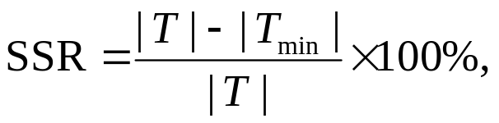
Experiment: M-HGS (1/4)
Programs | |T| | |T_{min}| |  |  | SSR (%)
 |  | HGS | M-HGS | RSR | HGS | M-HGS | RSR
tcas | 38.83 | 5.00 | 5.12 | 6.77 | 77.12 | 76.87 | 71.96
totinfo | 82.97 | 5.03 | 5.15 | 5.04 | 86.67 | 86.46 | 86.66
schedule | 71.48 | 3.09 | 3.16 | 5.11 | 90.05 | 89.94 | 85.04
schedule2 | 68.55 | 4.71 | 4.78 | 4.95 | 86.71 | 86.61 | 86.24
printtokens | 91.29 | 6.38 | 6.54 | 7.04 | 87.50 | 87.32 | 86.45
printtokens2 | 87.88 | 5.70 | 5.96 | 8.45 | 86.77 | 86.45 | 82.93
replace | 124.89 | 10.65 | 11.27 | 21.67 | 84.05 | 83.57 | 71.95
<number>/20
Notes:
實驗結果在SSR部分首先可以看HGS與改良過後HGS的比較，可發現兩者的SSR幾乎相同，這代表我們的技巧並不會
降低演算法的精簡能力；而RSR並非如此，可以看到其SSR可以與HGS相差10%以上

Slide 17
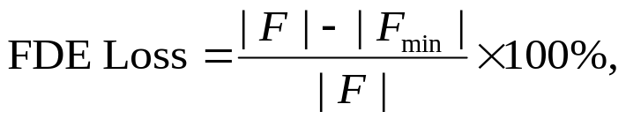
Experiment: M-HGS (2/4)
Programs | |F| | |F_{min}| |  |  | FDE Loss (%)
 |  | HGS | M-HGS | RSR | HGS | M-HGS | RSR
tcas | 17.80 | 6.51 | 6.81 | 8.31 | 56.65 | 55.10 | 47.39
totinfo | 18.82 | 11.35 | 14.19 | 11.35 | 38.02 | 23.59 | 38.00
schedule | 5.55 | 1.96 | 2.22 | 2.58 | 61.33 | 56.97 | 49.62
schedule2 | 4.67 | 2.07 | 2.37 | 2.10 | 50.28 | 44.62 | 49.58
printtokens | 4.57 | 2.81 | 3.06 | 2.85 | 35.37 | 30.20 | 34.50
printtokens2 | 8.89 | 7.36 | 7.57 | 7.68 | 16.68 | 14.27 | 13.20
replace | 19.07 | 7.66 | 8.61 | 12.40 | 56.80 | 52.18 | 32.62
<number>/20
Notes:
FDE Loss方面，M-HGS的表現全部都較原本的HGS好，就算與RSR相比，也在幾隻程式裡表現為最佳
而RSR的低FDE Loss是犧牲了SSR換來的

Slide 18
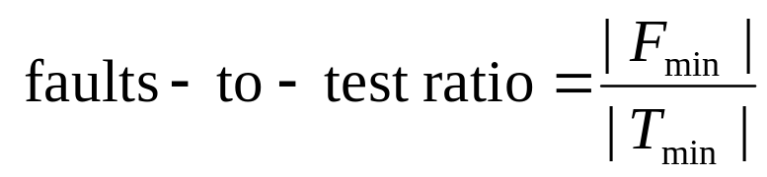
Experiment: M-HGS (3/4)
Programs | Faults-to-test ratio
 | HGS | M-HGS | RSR
tcas | 1.30 | 1.33 | 1.23
totinfo | 2.26 | 2.77 | 2.25
schedule | 0.65 | 0.71 | 0.52
schedule2 | 0.45 | 0.51 | 0.44
printtokens | 0.46 | 0.49 | 0.43
printtokens2 | 1.36 | 1.34 | 0.95
replace | 0.72 | 0.77 | 0.58
<number>/20
Notes:
Faults-to-test ratio方面，可以看到M-HGS表現幾乎為最佳，這代表著經M-HGS選擇的test cases有最佳品質

Slide 19
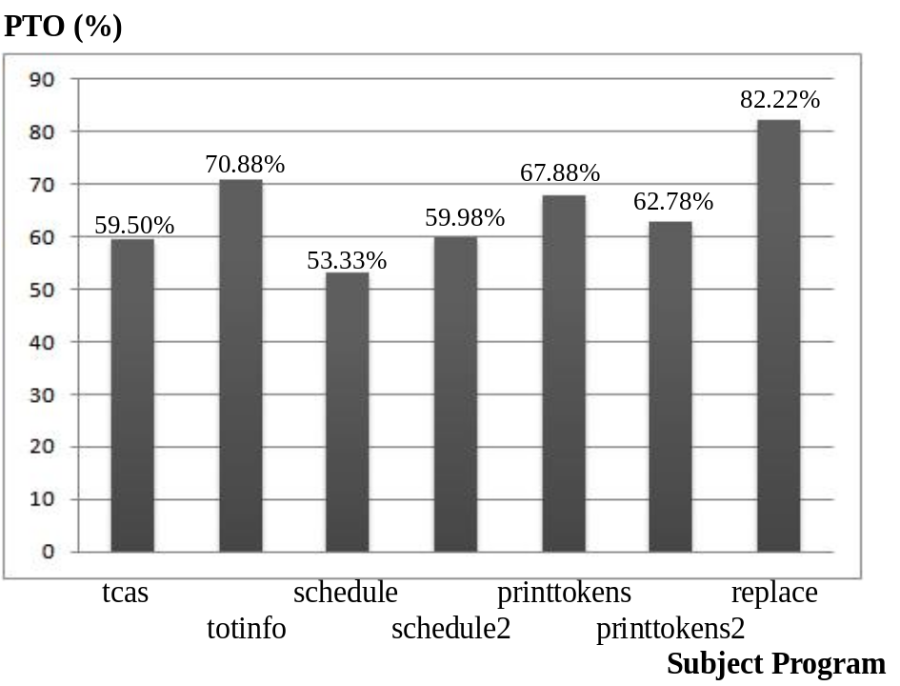
Experiment: M-HGS (4/4)
Acceleration of minimization process
Variations on execution time
compared with HGS
Programs | M-HGS | RSR
tcas | −85.17 % | +1.53 %
totinfo | −94.74 % | +0.25 %
schedule | −94.52 % | +1.62 %
schedule2 | −96.00 % | +0.66 %
printtokens | −85.46 % | +1.12 %
printtokens2 | −84.01 % | +0.55 %
replace | −92.41 % | +0.50 %
The percentage of tie occurrence
for each subject program
<number>/20
Notes:
加速方面，首先看左邊表格，其顯示了M-HGS演算法的執行時間比HGS少了90%左右，也就是執行速度快了十倍
而RSR並沒有這種好處；加速的原因是因為在HGS演算法執行過程中，tie 發生的機率高達50%以上，而我們不像HGS
使用recursive function calls，而是立即判定，因此可大幅加速minimization process

Slide 20
Conclusion
A novel and versatile approach for test suite reduction
  Improving the fault detection effectiveness of reduced suites with negligible increase in the sizes
  Greatly accelerating the process of minimization
  Provide open choices for
    Coverage criteria
    Any reduction techniques which apply random selections
<number>/20
Notes:
結論：本論文對於TSR提出了一嶄新且多樣性的方法，實驗結果證明本方法可以幾乎不增加test suites sizes的情況下
提高FDE，同時大幅加速精簡過程。另外本方法對於secondary coverage criteria也提供很多選擇，比如結合black-box testing requirements或是operational profiles中的operations；另外reduction process中有apply random selections的方法都可以用所提出的方法改良

