Slide 1
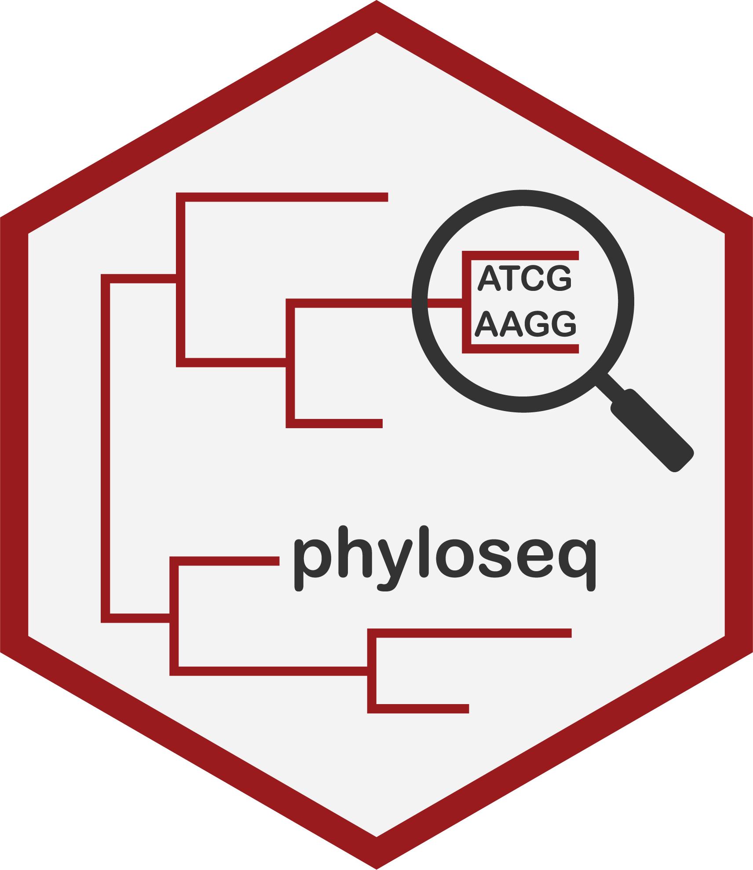

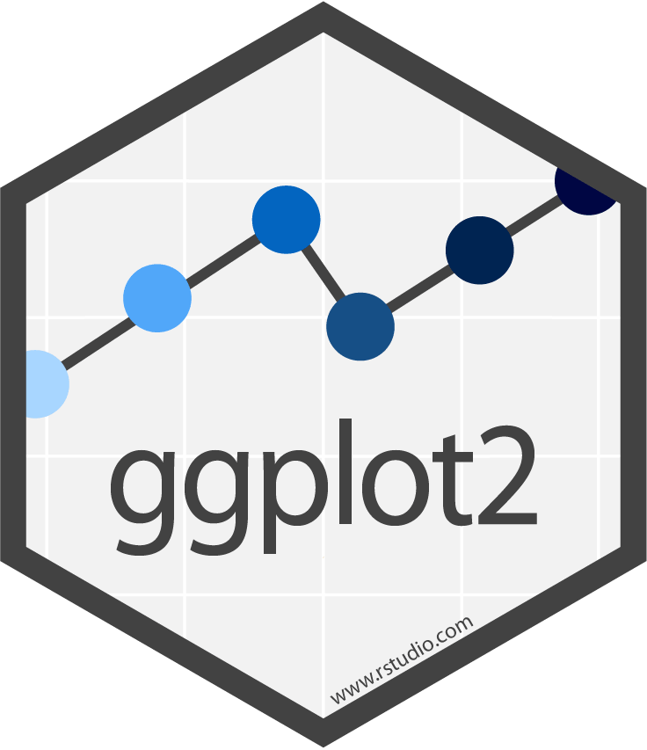
phyloseq
pseqMLR
Preprocessing
Machine Learning
Plotting
Transformations
Classification
Pre-ML
Dimensionality reduction
Regression
Post-ML
Survival
Longitudinal
Clustering

