Slide 1
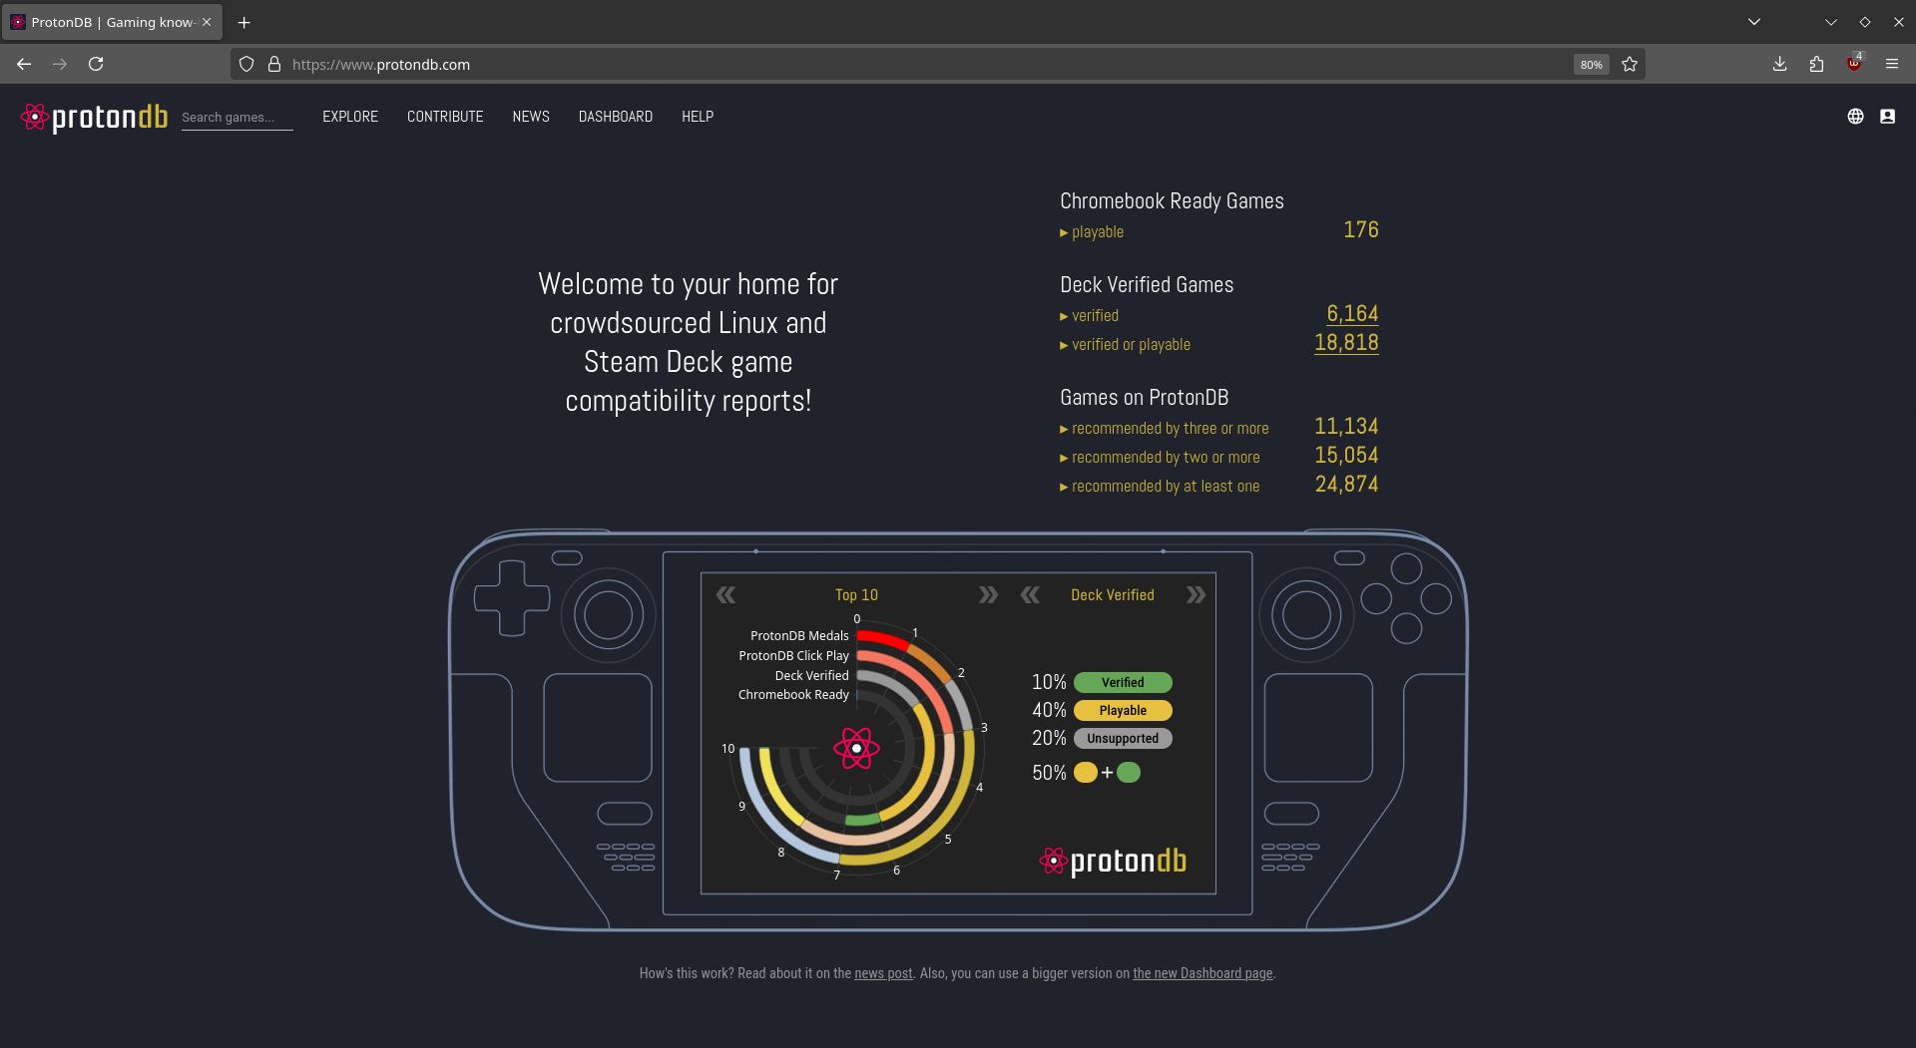
ProtonDB Time Series Analysis
A Deep Dive into Linux Gaming Progress Presented by Jonathan Lindsey

Slide 2
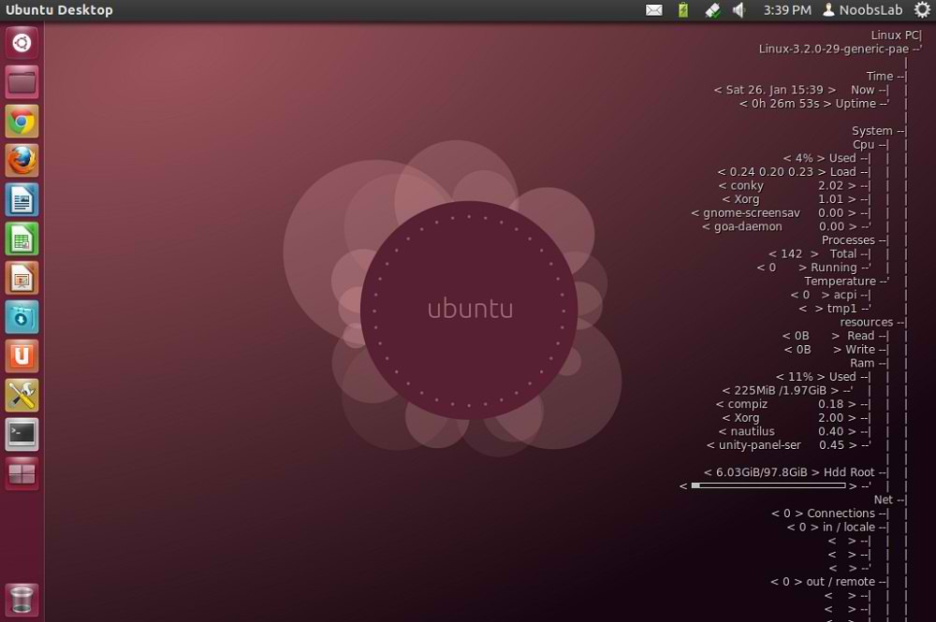
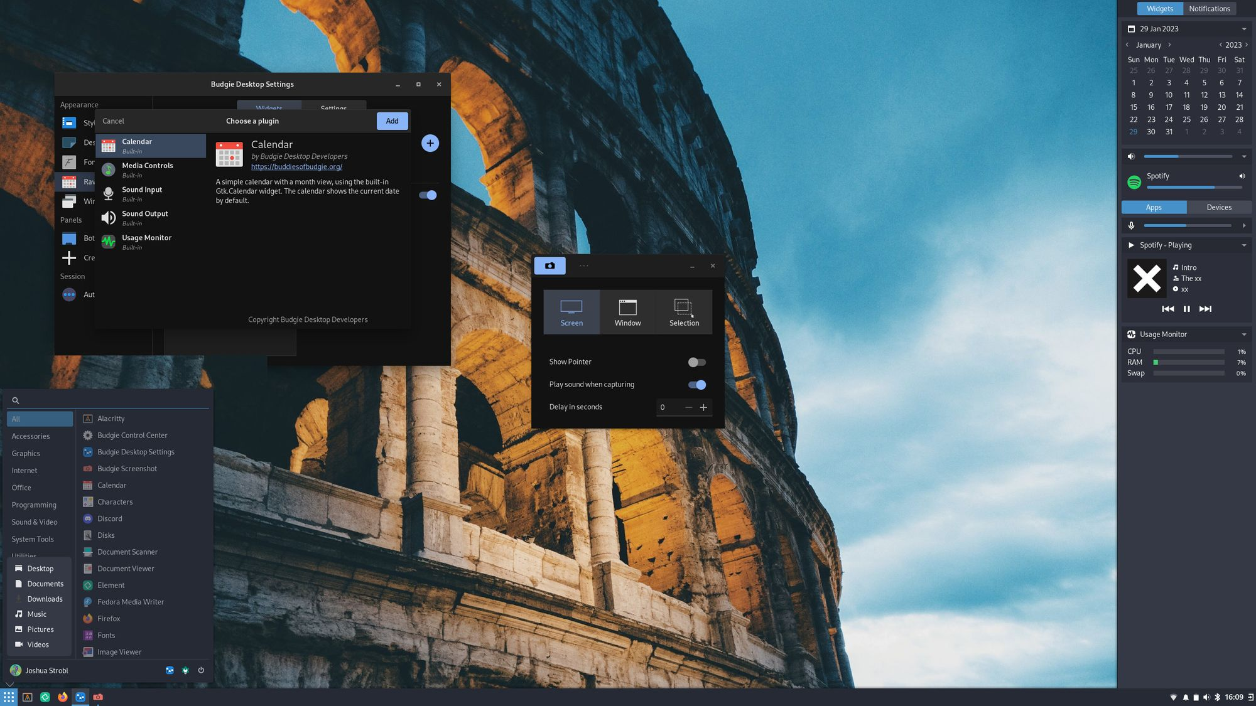
Why History & Hardware Matter
Snapshots only show today. Trends reveal how Linux gaming support has evolved.

Slide 3




Data Origins & Download
From Google Sheet → Web App → JSON archive. Imported to SQLite for structured querying.

Slide 4
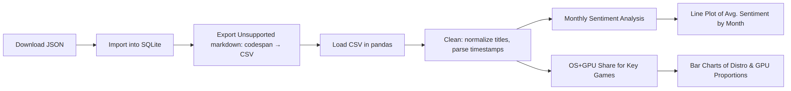
Pipeline Overview
JSON → SQLite → CSV → pandas Split into sentiment and hardware trend analysis.

Slide 5
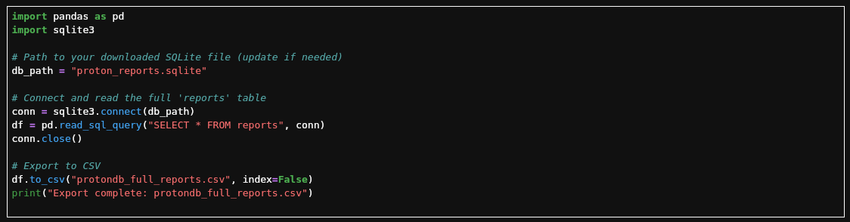
CSV Export & Setup
SQLite → pandas → Clean CSV export. Foundation for reproducible exploration.

Slide 6
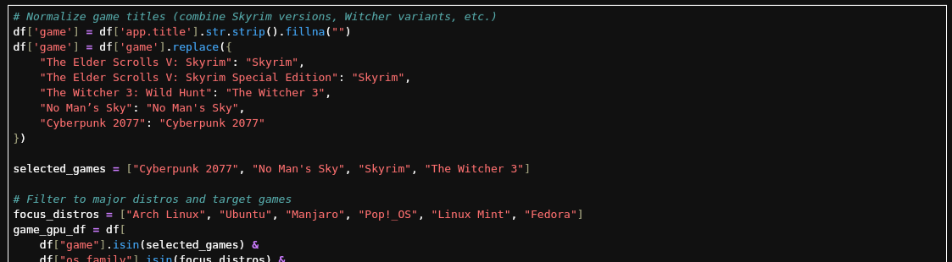
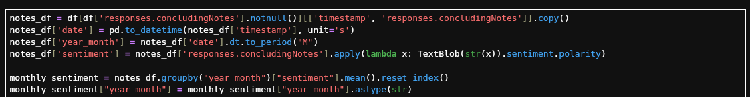
Data Cleaning
Parsed timestamps, normalized game titles. Merged editions for clean trendlines.

Slide 7
Jupyter Notebook Demo
Next: Sentiment Analysis, Distro & GPU trends, Game-specific setups, Common workarounds.

Slide 8
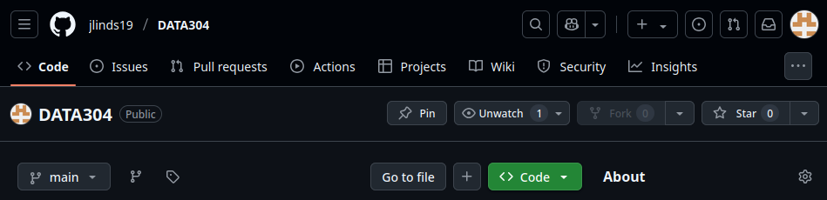
Wrap-Up
• Sentiment is trending upward • Hardware usage is diverse • Tweaks/tools still widely used
• https://github.com/jlinds19/DATA304/tree/main/project

