Slide 1
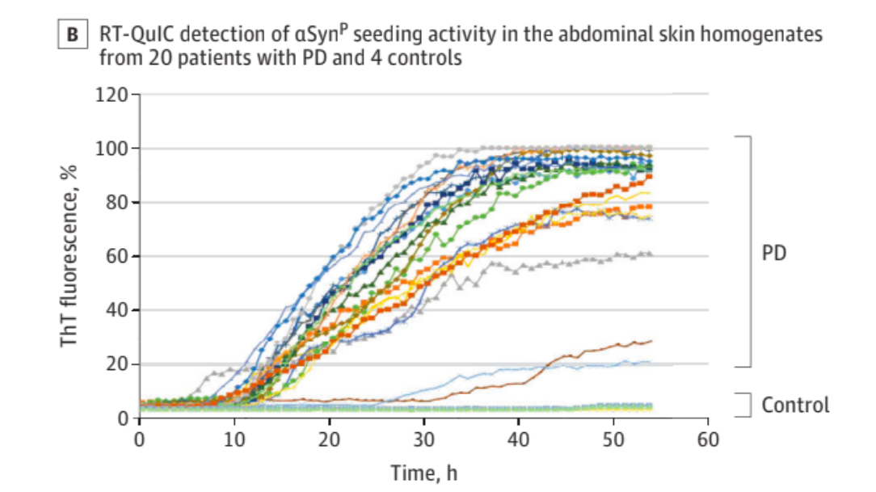
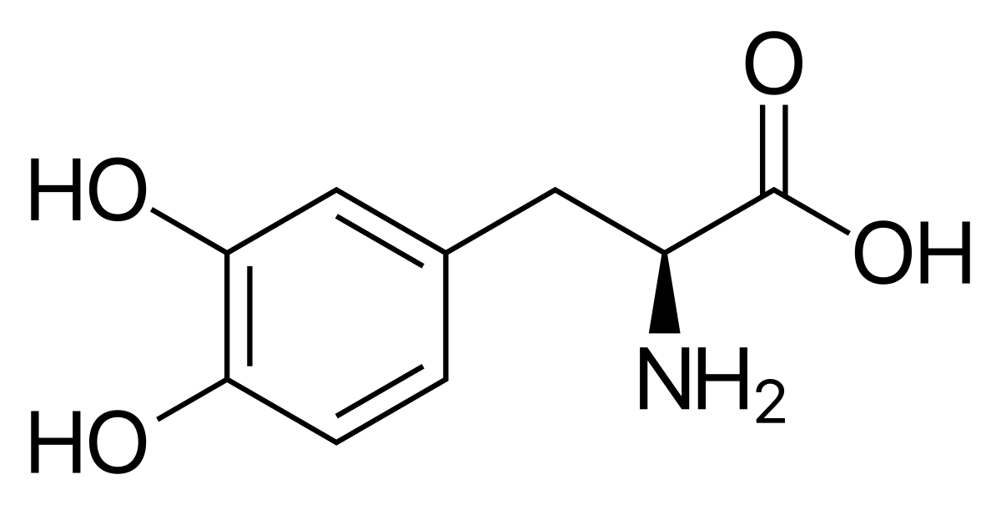
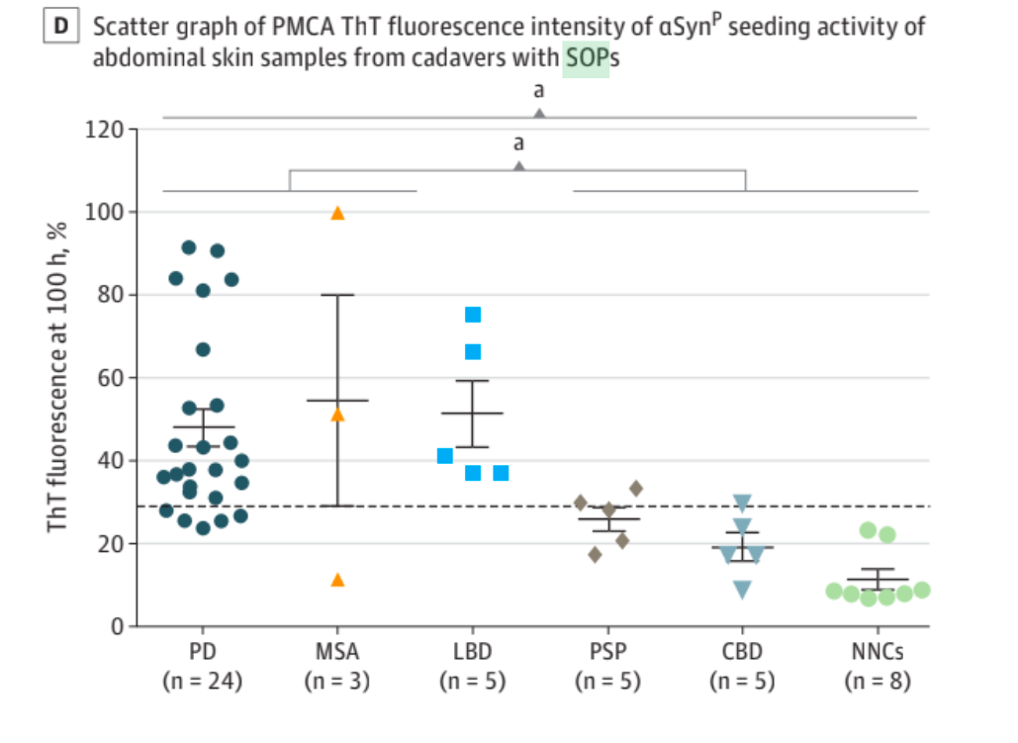
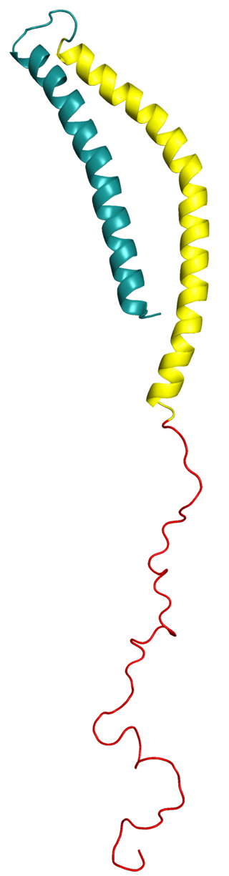
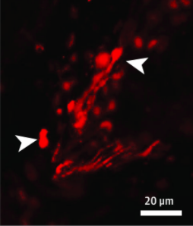
“Skin α-Synuclein Aggregation Seeding Activity as a Novel Biomarker for Parkinson Disease”
Presented by: Jackie Lindstrom
Parkinson’s Disease (PD) Background
Second most common neurodegenerative disease¹
Characterized by symptoms such as⁶
Shaking or tremors at rest
Bradykinesia (slowness of movement)
Muscle stiffness
Cognitive changes such as dementia, depression, and/or anxiety
No existing cure
Existing treatments target symptoms, not the source of disease
**Found that misfolded a-synuclein exhibits ”prion-like aggregation seeding ability”, meaning that it will trigger other proteins to also misfold, and the clumps of abnormal proteins will proliferate. This is a possible explanation for how neuronal death spreads through the brain**
L-dopa structure
Article Goal:
Assess α-synuclein presence in peripheral skin tissue as a contender for a synucleinopathic disease biomarker. This could be beneficial because….
Could show confirmation of PD before the disease progresses far and symptoms show
Would be a minimally invasive technique, as peripheral tissue is easier to access than the brain
Would provide a way to monitor changes induced by therapies that target α-synuclein (which currently exist!)
RT-QuIC & PMCA Assay:
Increased levels of fluorescence for synucleopathies compared to control
Diagnosis
Current diagnostic techniques are lacking. By the time of diagnosis a large amount of dopaminergic neurons have already died. Therefore, development of early diagnostic techniques are critical for early distribution of treatment.
Experimental Information
Skin samples from 130 autopsies
Cadavers had a variety of neurodegenerative diseases: PD, Lewy body dementia, multiple system atrophy, and tauopathic diseases, along with controls
Diagnosis was confirmed by neuropathological tissue exams
Skin samples from 41 biopsies
Diagnosed PD patients and controls only
Obtained from leg or posterior cervical region of neck
First confirmed presence of a-syn by IHC and IF
Used real-time quaking-induced conversion (RT-QuIC)
The presence of an abnormal a-syn protein prion protein will form aggregates known as amyloids that fluoresce
Used protein misfolding cyclic amplification (PMCA assays)
A technique conceptually similar to PCR that involves leaving prion with normal protein, so that the normal protein is converted. Ultrasound then breaks up protein so to repeat
α-synuclein
α-synuclein: a small, insoluble protein, composed of 140
amino acids and encoded by the SNCA gene²
Normal role: involved with vesicle tracking, vesicle docking,
and neurotransmitter release, however still uncertain
PD brains are have abnormal α-synuclein behavior…
which is why PD is classified as a synucleinopathy
Lewy Bodies: clumps of α-synuclein and other
proteins that aggregate in regions of the brain
Oligomerization of α-synuclein is hypothesized
to be toxic
Autopsies show neuronal death (specifically in dopaminergic neurons) that could be linked to the aggregation of α-synuclein
Neuronal death in basal ganglia region of brain
Immunohistochemistry and immunofluorescence has detected a-synuclein in peripheral tissues…. however inaccurate for diagnosis
“To our knowledge, this study has demonstrated for the first time that skin a-synuclein has aggregation seeding activity that was significantly higher in individuals with PD and other synucleopathies than in those with tauopathies and NNCs”
Limitations
Compared to PD and “normal” cases, not enough non-PD synonucleopathies examined
More skin biopsies would be helpful
(!)Remember, diagnosis of PD from clinical symptoms is not precise, so the separation of PD s non-PD may not be reliable
Follow up with autopsies

Slide 2
Sources
(1)Li, S.; Le, W. Milestones of Parkinson’s Disease Research: 200 Years of History and Beyond. Neuroscience Bulletin 2017, 33 (5), 598–602. https://doi.org/10.1007/s12264-017-0178-2.
(2)Jankovic, J.; Tan, E. K. Parkinson’s Disease: Etiopathogenesis and Treatment. Journal of Neurology, Neurosurgery & Psychiatry 2020, 91 (8), 795–808. https://doi.org/10.1136/jnnp-2019-322338.
(3)Galvan, A.; Devergnas, A.; Wichmann, T. Alterations in Neuronal Activity in Basal Ganglia-Thalamocortical Circuits in the Parkinsonian State. Frontiers in Neuroanatomy 2015, 9. https://doi.org/10.3389/fnana.2015.00005.
(4)Simon, D. K.; Tanner, C. M.; Brundin, P. Parkinson Disease Epidemiology, Pathology, Genetics, and Pathophysiology. Clinics in Geriatric Medicine 2020, 36 (1), 1–12. https://doi.org/10.1016/j.cger.2019.08.002.
(5)Ingelsson, M. Alpha-Synuclein Oligomers—Neurotoxic Molecules in Parkinson’s Disease and Other Lewy Body Disorders. Frontiers in Neuroscience 2016, 10. https://doi.org/10.3389/fnins.2016.00408.
(6)NHS Choices. Diagnosis - Parkinson’s disease https://www.nhs.uk/conditions/parkinsons-disease/diagnosis/.
(7)Gątarek, P.; Pawełczyk, M.; Jastrzębski, K.; Głąbiński, A.; Kałużna-Czaplińska, J. Analytical Methods Used in the Study of Parkinson’s Disease. TrAC Trends in Analytical Chemistry 2019, 118, 292–302. https://doi.org/10.1016/j.trac.2019.05.047.
(8)Tambasco, N.; Romoli, M.; Calabresi, P. Levodopa in Parkinson’s Disease: Current Status and Future Developments. Current Neuropharmacology 2018, 16 (8), 1239–1252. https://doi.org/10.2174/1570159x15666170510143821.
(9)Gravitz, L. The Promise and Potential of Stem Cells in Parkinson’s Disease. Nature 2021, 597 (7878), S8–S10. https://doi.org/10.1038/d41586-021-02622-3.
(10)Axelsen, T. M.; Woldbye, D. P. D. Gene Therapy for Parkinson’s Disease, an Update. Journal of Parkinson’s Disease 2018, 8 (2), 195–215. https://doi.org/10.3233/jpd-181331.
(11)Wang, Z.; Becker, K.; Donadio, V.; Siedlak, S.; Yuan, J.; Rezaee, M.; Incensi, A.; Kuzkina, A.; Orrú, C. D.; Tatsuoka, C.; Liguori, R.; Gunzler, S. A.; Caughey, B.; Jimenez-Capdeville, M. E.; Zhu, X.; Doppler, K.; Cui, L.; Chen, S. G.; Ma, J.; Zou, W.-Q. Skin α-Synuclein Aggregation Seeding Activity as a Novel Biomarker for Parkinson Disease. JAMA Neurology 2021, 78 (1), 30. https://doi.org/10.1001/jamaneurol.2020.3311.

