Slide 1
Recommending a Retention Strategy
Ideas for today and tomorrow

Slide 2
Introduction
Our company LLP Analytics is analyzing trends and factors affecting attrition for IBM
IBM has given a data set with 35 variables ranging from employee characteristics, employee benefits, and company job/departments
Exploratory data analysis is done to determine what variables are good determinants for attrition and job satisfaction for future reference and analysis
This will help IBM to lower turn over rate which will lower cost and time for the company

Slide 3
Scope of Analysis
Some fields were not analyzed as they are not controllable: gender, marital status and age
Performance Rating was not considered as only employees with Excellent or Outstanding were included in the dataset
Some variables were not included in the analysis as all employees in the dataset had the same value Standard Hours and Over 18

Slide 4
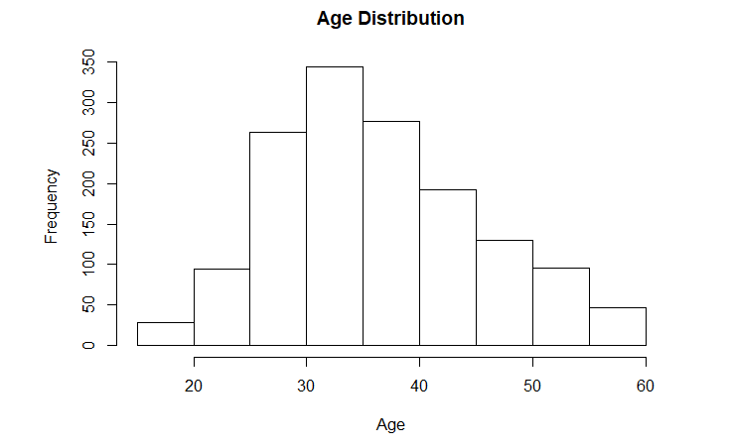
Age of the Population
From we can see the range of ages are from 20 to 60, where a majority of the people are around the age 25 to 35.
This indicates the population is young and may have different preferences compared to an older population

Slide 5
Areas of Concern Related to Attrition

Slide 6

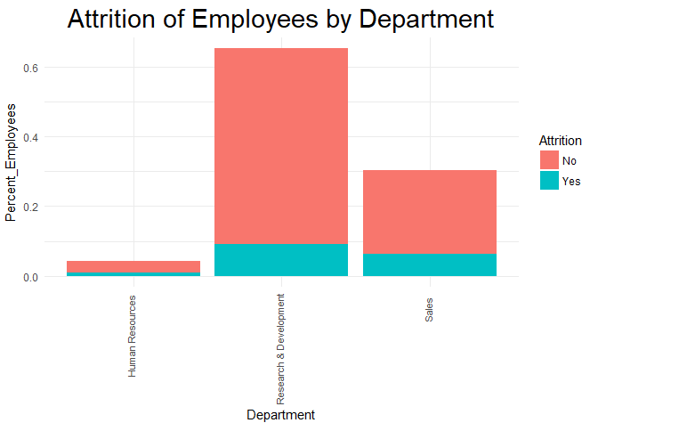
Attrition by Department
As can seen by the graph, Research & Development and Sales have higher attrition rate by percent when compared to human resources
Looking at the group Attrition = Yes, we can see that Research & Development has 56.12% quitting and Sales being 38.82%
Human Resources have the lowest percent with only 5.06%

Slide 7
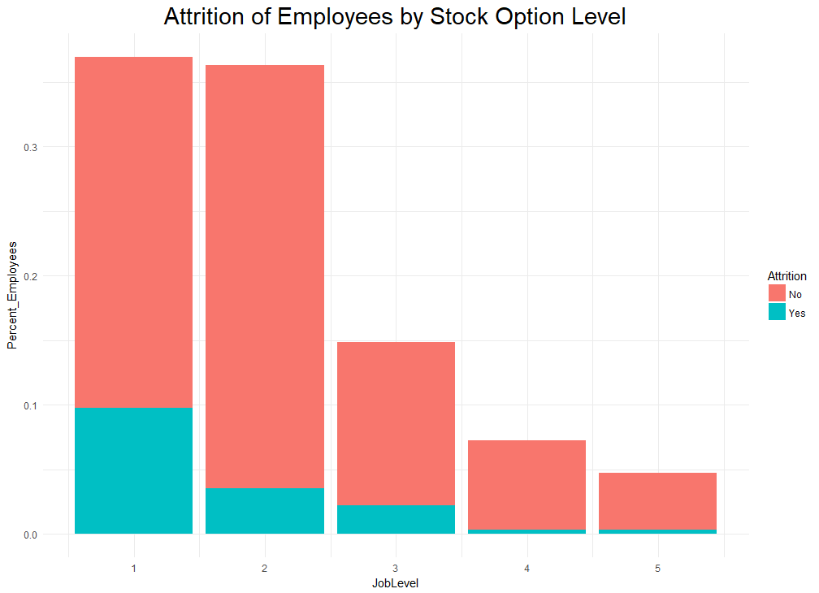
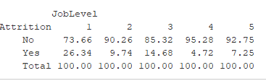
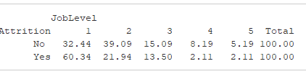
Attrition by Job Level
When looking at job level, we can see that Job Level =1 has the highest attrition rate.
This does follow reasoning that people of lower position are more likely to quit.

Slide 8
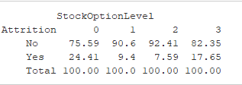
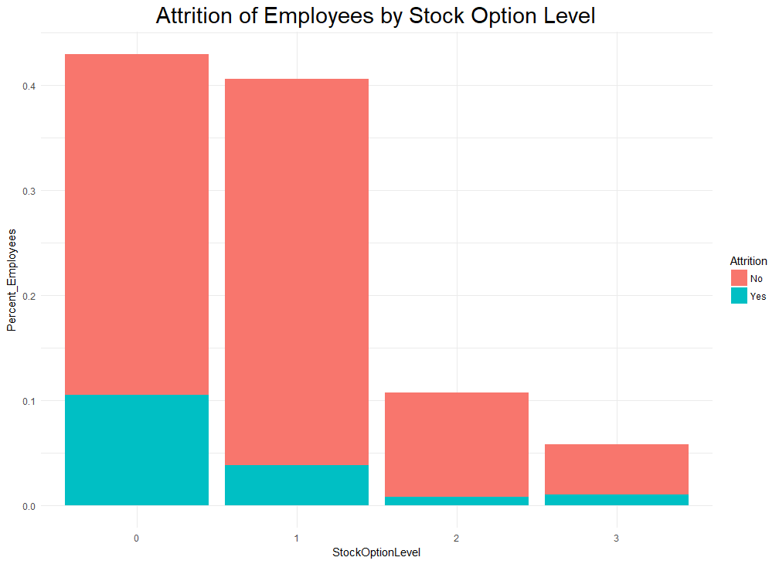

Attrition by Stock Option
When looking at Stock options, we can see that with either cut of the data, having no stock option has the highest attrition rate.
Having a Stock Option does have lower attrition rate, however, when looking at data grouped by StockOptionLevel, we can see that StockOption = 3 does increase.

Slide 9
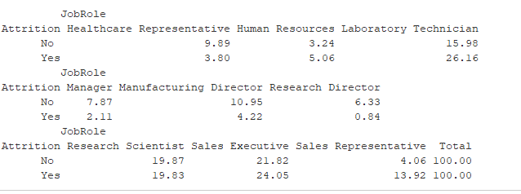
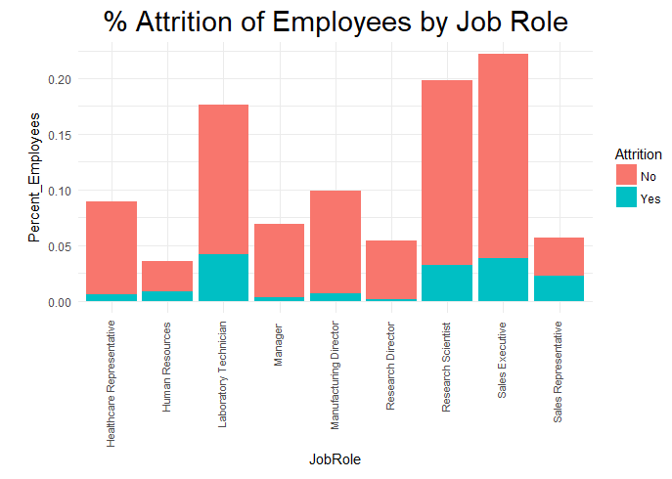
Attrition by Job Role
After examining department attrition rates, we delved further by looking at job roles.
We can further see that Laboratory Technicians and Sales Executives have high attrition rate when looking at the group Attrition = Yes
Research Scientist and Sales Representatives are a close second

Slide 10
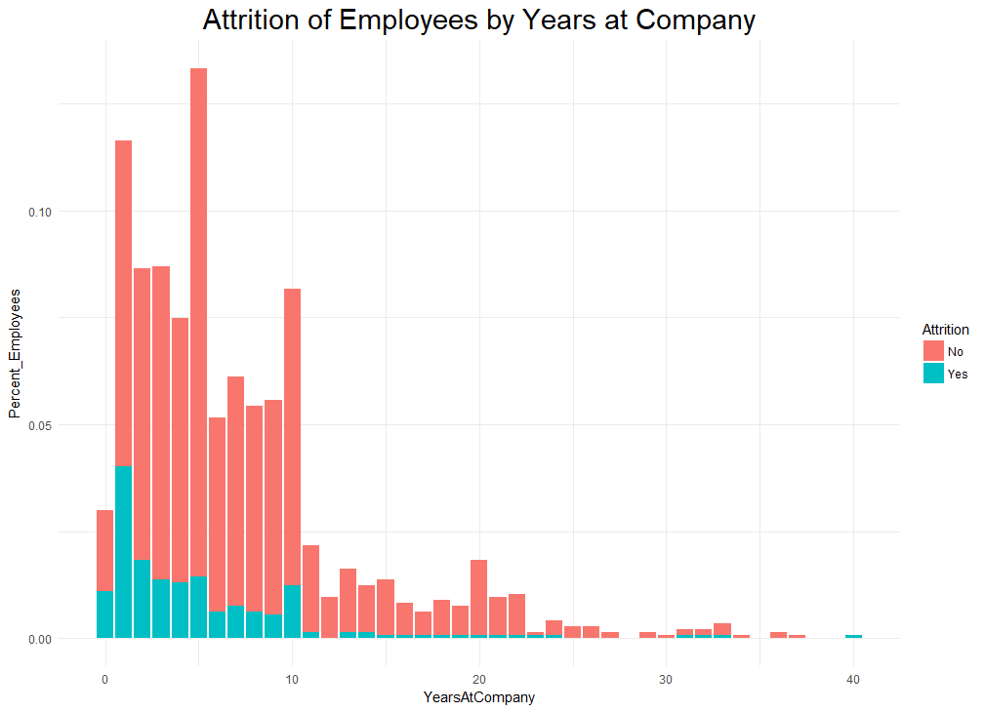
Attrition by Years at Company
68.35% of the employees who have left the company have been with IBM 5 years or less
91.56 of the employees who have left the company have been with IBM 10 years or less

Slide 11
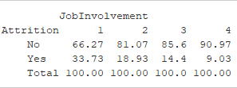
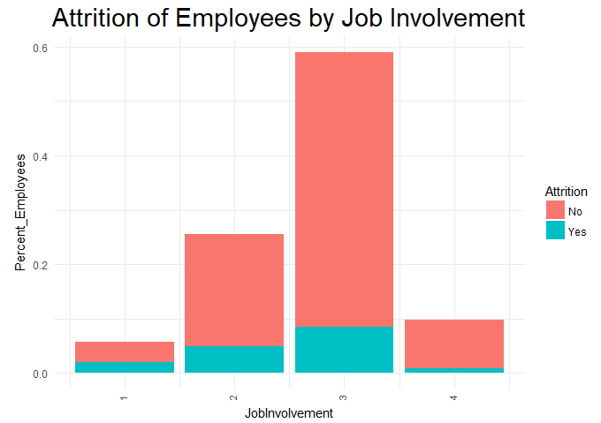

Attrition by Job Involvement
When looking at job involvement we can see that by looking at the number of people who quit versus the whole population, Job Involvement = 3 has high attrition
Splitting based on Job Involvement, we can see that Job Involvement = 1 has the highest attrition rate

Slide 12
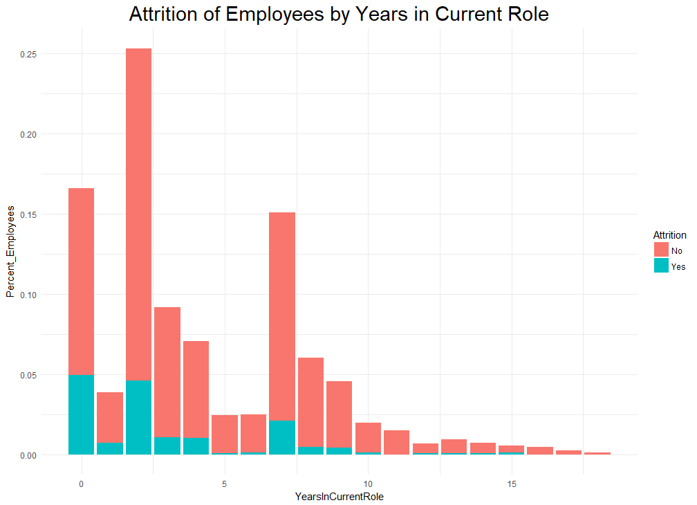
Attrition by Years in Current Role
Employees who have been in their roles between 0 and 2 years are responsible for 64.13% of all attrition
More alarming, close to 30% of employees who have been in their role for less than a year have left

Slide 13
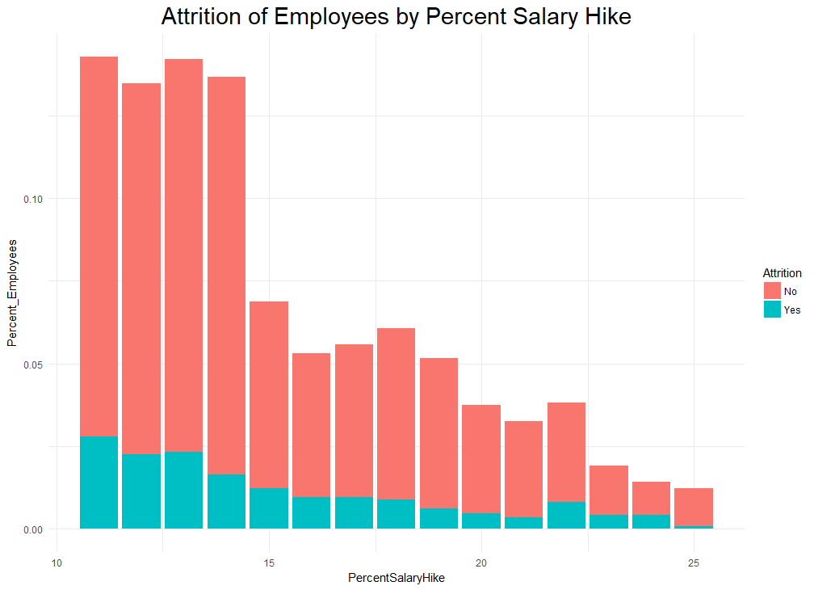
Attrition by Percent Salary Increase
When looking at % Salary Increase, employees who received smaller salary increases had higher attrition rates—specifically, customers who received increases from 11 to 14% account for 55.7%
While employees who received increases above 14% have lower attrition rates, employees who received increases between 21-24% have attrition rates above 20%

Slide 14
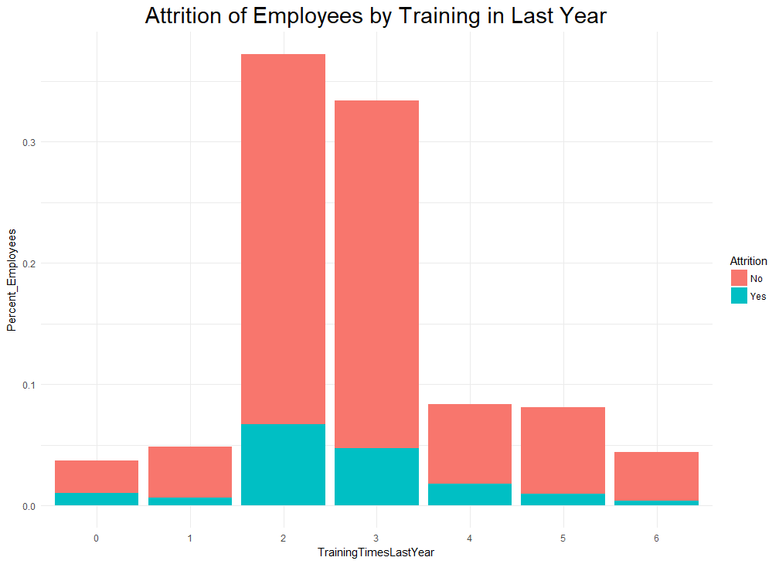
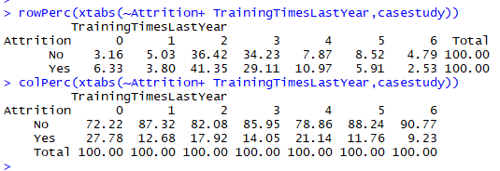
Attrition by Training in Last Year
Employees who received training 2 and 3 times had the highest % of attrition, totaling 70.46% of all attrition
27.8% of employees who received no training in the last year also left the company

Slide 15
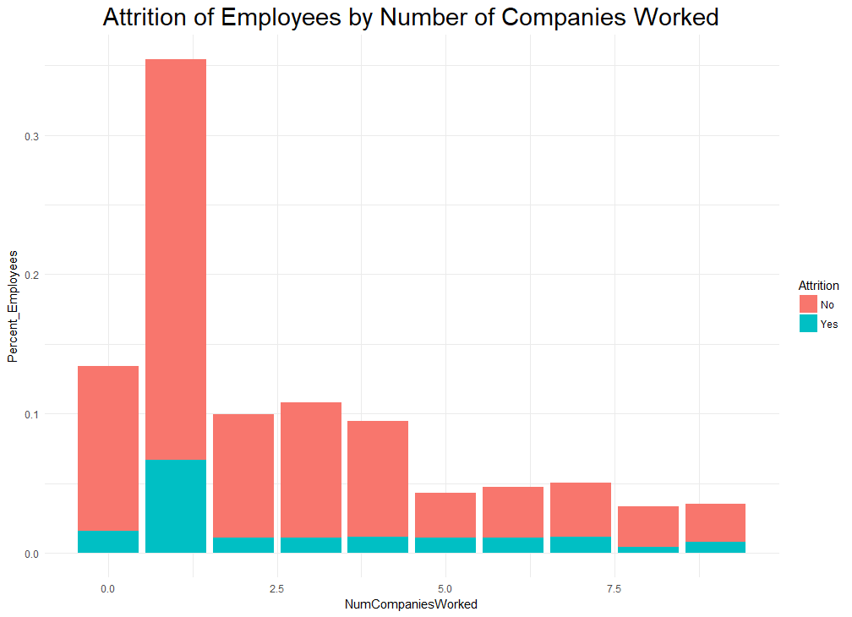
Attrition by Number of Companies Worked For
When looking at number of companies worked for, employees who have worked for no other companies or 1 other company are responsible for 51% of attrition

Slide 16
Areas Reviewed for Job Satisfaction

Slide 17
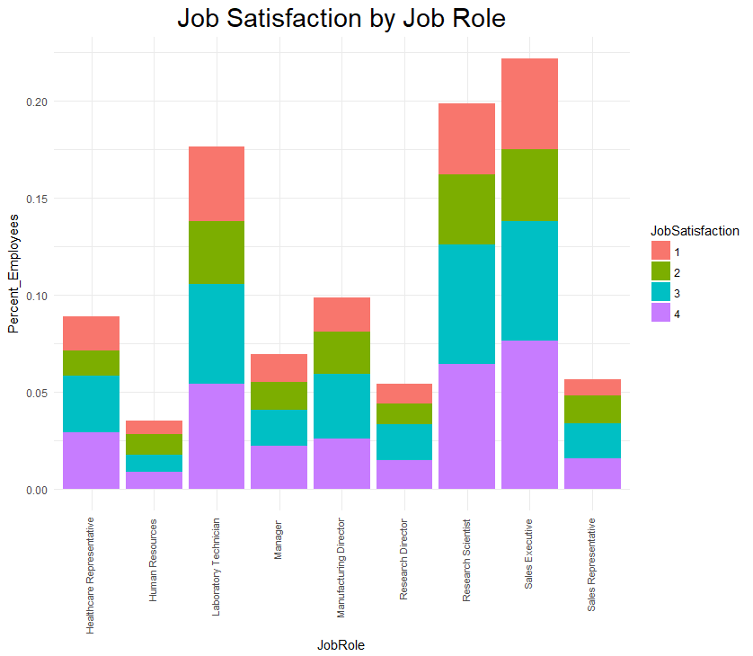
Job Satisfaction by Job Role
Healthcare representatives are reporting the highest satisfaction with 65% reporting high or very high
Research scientists and sales executives are close behind with 62% reporting high or very high job satisfaction
Employees in human resources is reporting the lowest job satisfaction with 50% reporting only low or job satisfaction

Slide 18
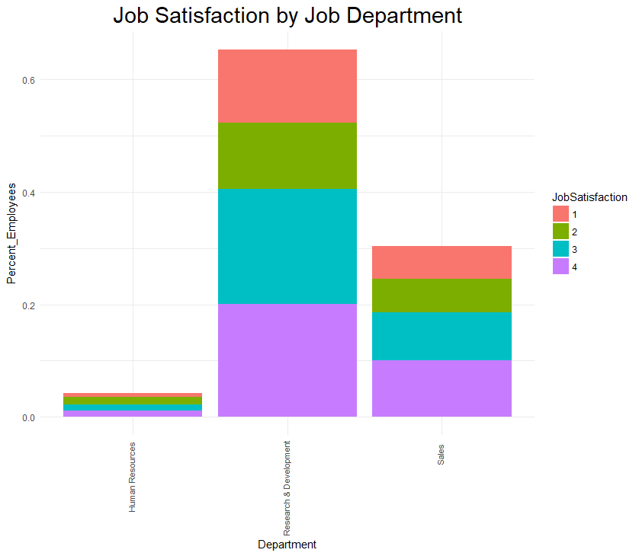

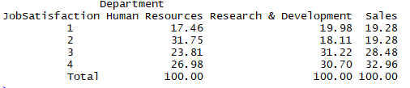
Job Satisfaction by Department
Roughly 61% of employees in sales and research & development are reporting either high or very high job satisfaction
Human Resources is reporting the lowest job satisfaction level

Slide 19
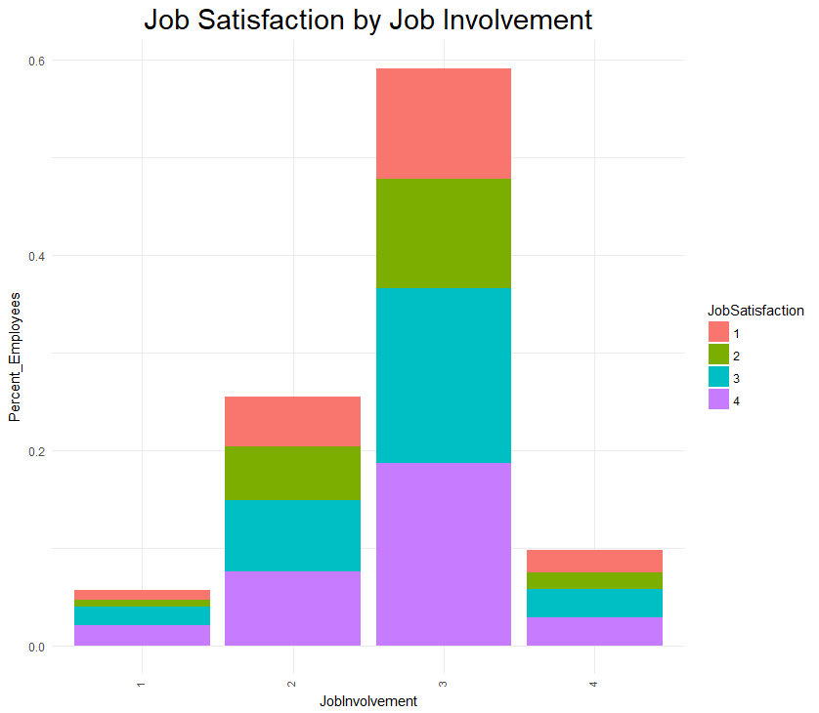

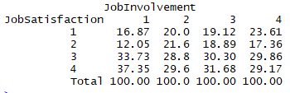
Job Satisfaction by Job Involvement
Employees with the lowest level of job involvement are actually reporting the highest level of job satisfaction with 71% reporting high or very high satisfaction

Slide 20
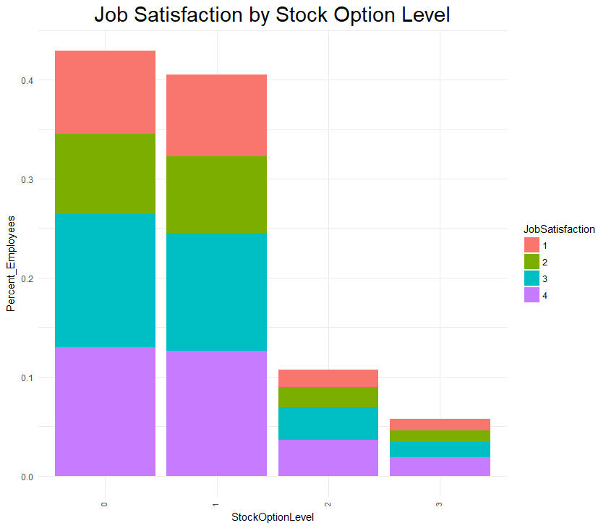

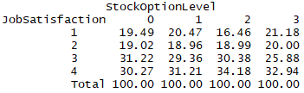
Job Satisfaction by Stock Option Level
While lack of stock options may lead to attrition, it does not appear to have an impact on job satisfaction—employees who have limited or no stock options have similar job satisfaction ratings to those with more options

Slide 21
Conclusion
This is high level analysis for determining if any variables show promise of being explanatory
The top three factors related to attrition that show promise for future analysis​
Department​
Job Level​
Job Involvement
Stock Option​
The top three areas with highest job satisfaction are:
Job Role
Department
Job Involvement
Further analysis should be done on benefits since it is an incentive for employees to stay​
Also work environment benefits, such as on site gym or paid lunch, should be collected to see if that contributes to attrition​
Additionally, the assumption of 80 hours being a standard work week within the company may be something that should be further evaluated
Next steps:
To review correlation of variables to see the magnitude and direction of the relationship
Create a scoring model to determine the probability of an individual quitting.

Slide 22
APPENDIX

Slide 23
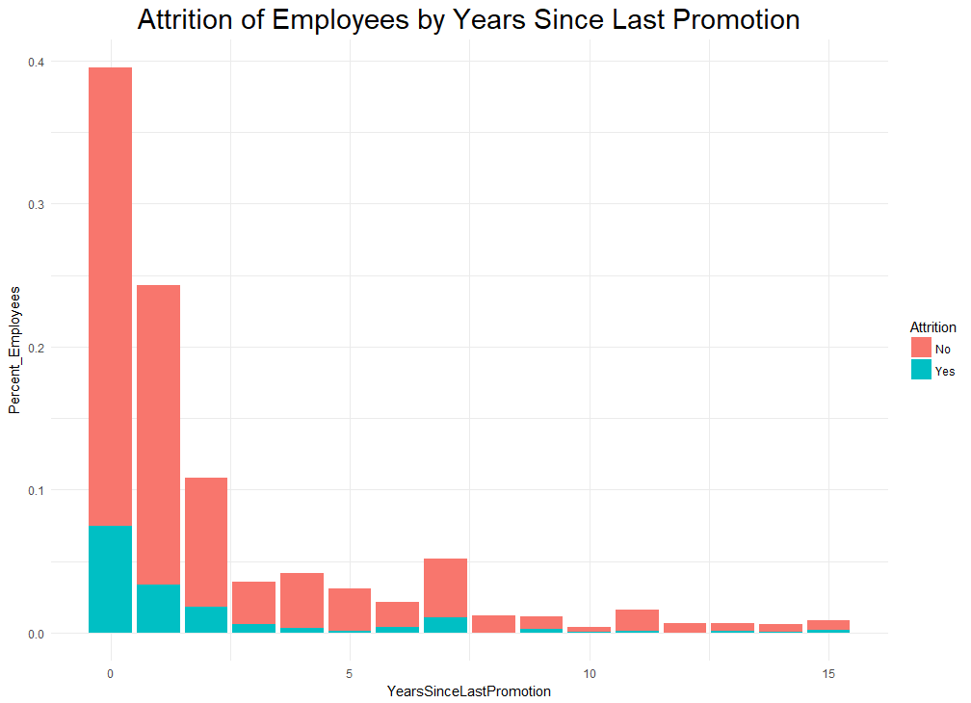
Attrition by Years Since Last Promotion
67.09% of employees who have left the company have been promoted in the last year or less

Slide 24

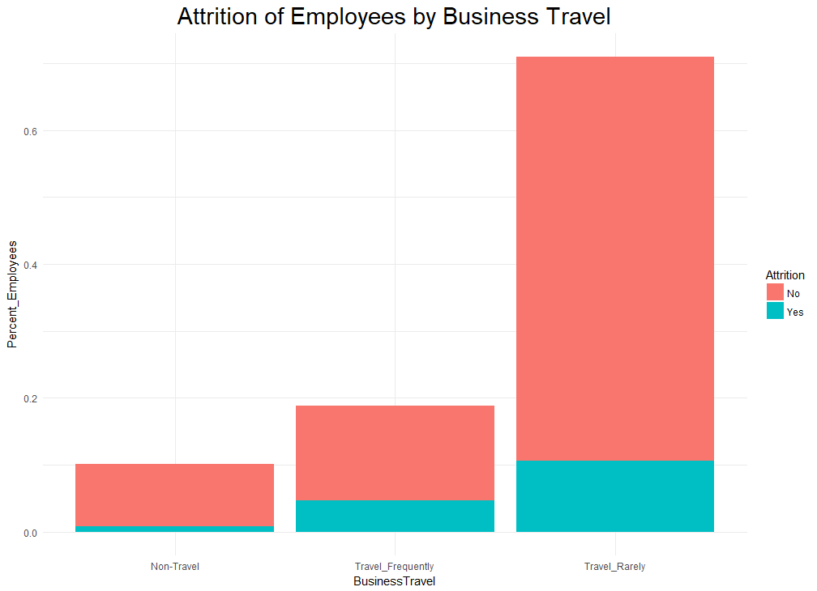

Attrition by Business Travel
The majority of employees leaving the company travel rarely (65.82%), but employees who travel frequently are leaving at a higher rate (25%)

Slide 25
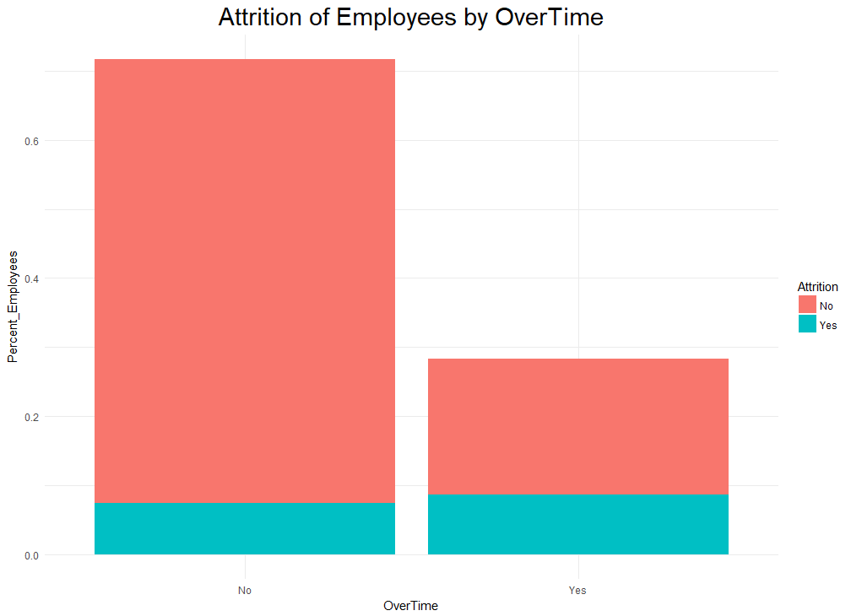


Attrition by Overtime
While 53.59% of employees who have left work overtime, there is not a significant difference in the % of employees leaving over those who do not work overtime

Slide 26

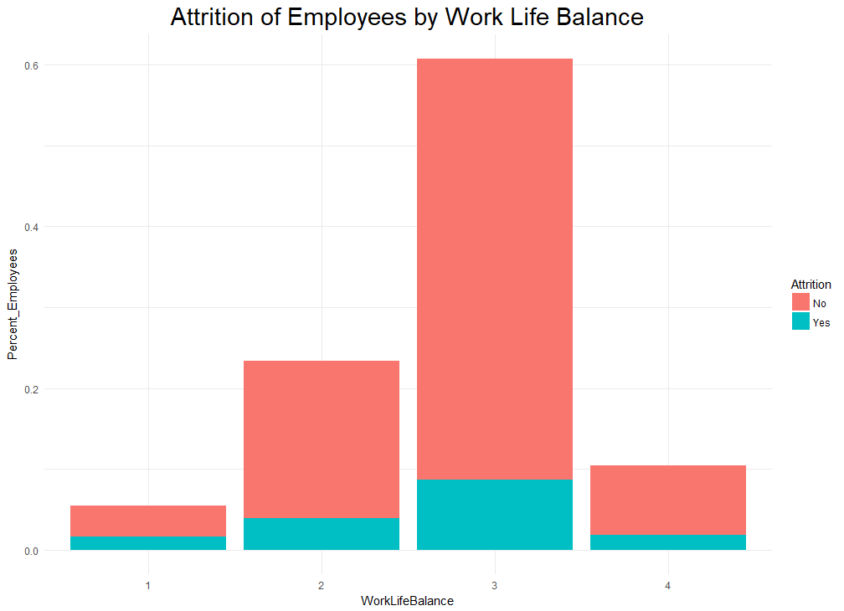

Attrition by Work Life Balance
The largest % of employees leaving the company have a work life balance level of 3 (Better)
Employees with a level of 1 (Bad) work life balance are leaving the company at a much higher rate (31.25% of those employees)

Slide 27
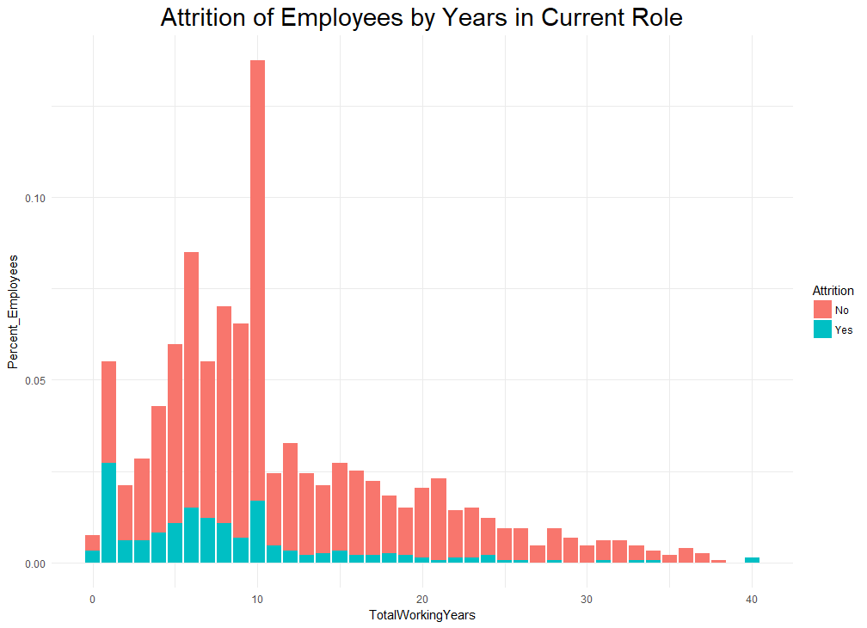
Attrition by Total Years Working
Employees who have worked 1 year make up the largest % of employees who have left at 16.88%, but there are no discernible trends

Slide 28

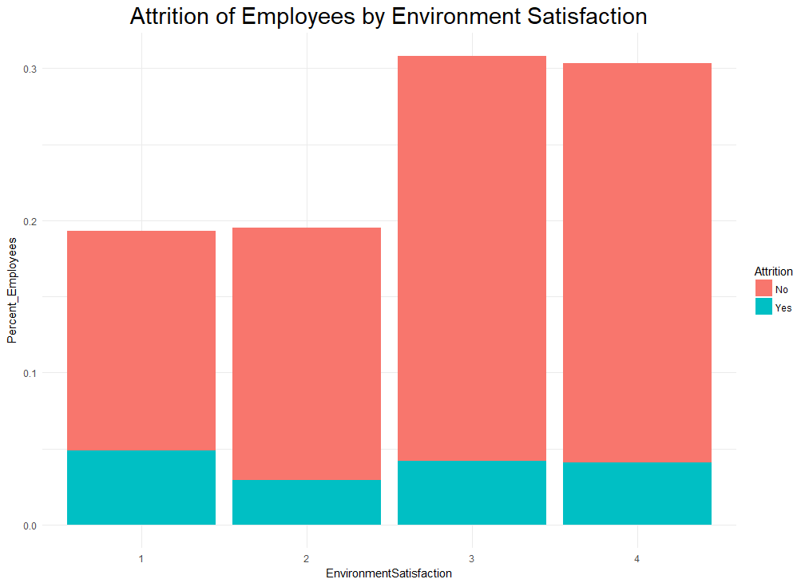

Attrition by Environment Satisfaction
There are no discernible trends in employees leaving based on their level of environment satisfaction

Slide 29
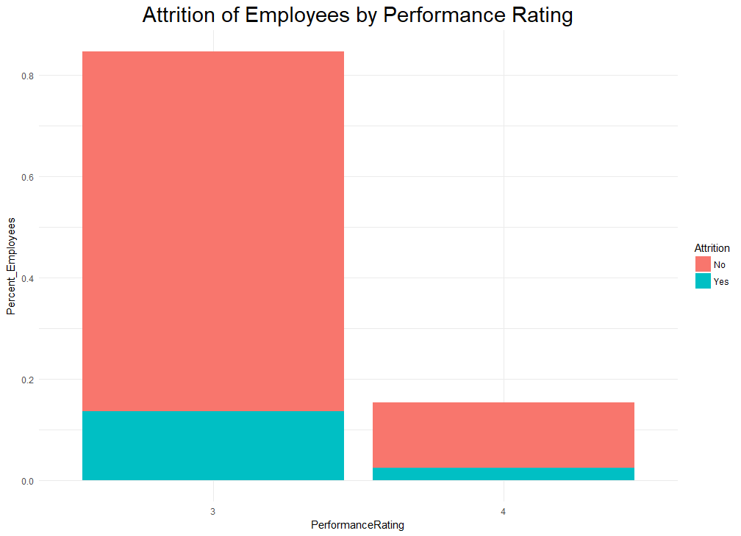


Attrition by Performance Rating

