Slide 1

Lab 4: Restricted Boltzmann Machines
and Deep Belief Nets
Artificial Neural Networks and Deep Architectures – DD2437
Group 3
Emma Palm
Fredrik Kalholm
Javier López Iniesta
KTH 2023 Spring semester

Slide 2
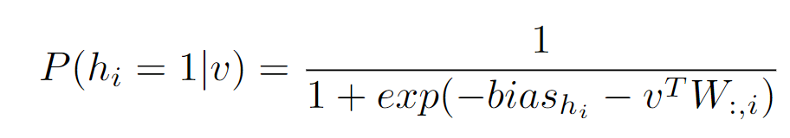
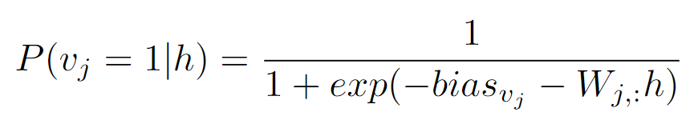
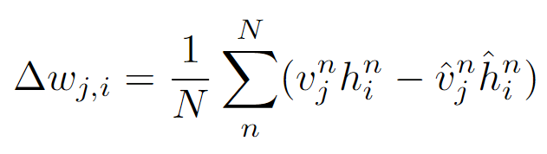
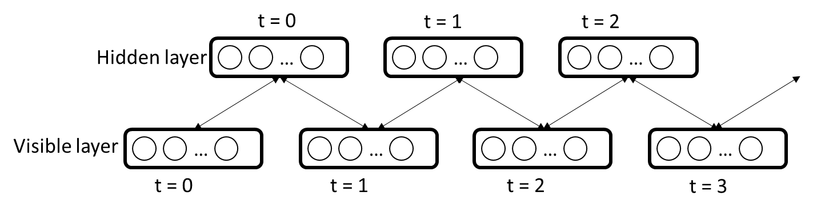
Background RBMs
Visible units are clamped to input vector and P(h = 1 | v)
In parallel the visible units are reconstructed P(v = 1 | h)
Statistics are collected and after x steps the weights are updated

Slide 3
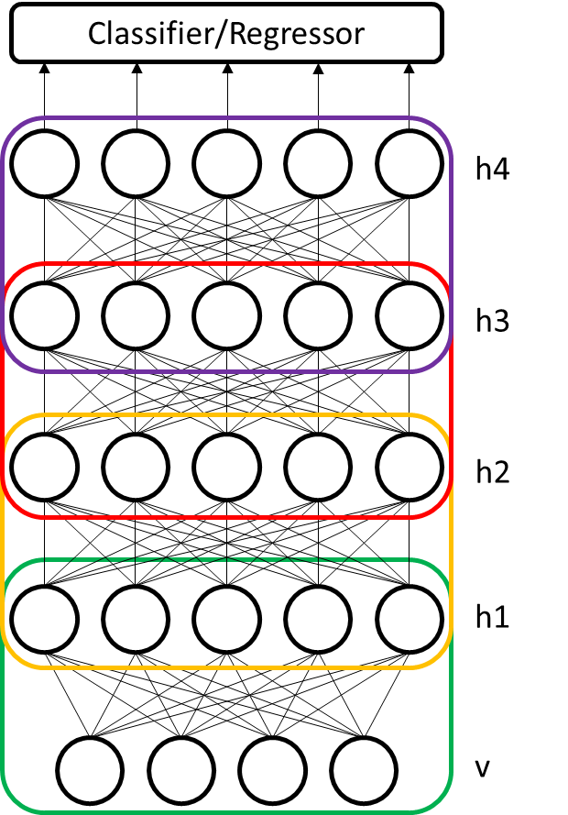
Background DBNs
DBNs are trained using greedy layerwise training
The hidden layers are stacked RBMs
The weights in the lower layers are frozen for the training of the upper layers
Finally labels are clamped to the network and the final layer(s) of weights are trained in a supervised manner

Slide 4
Aim
To understand the key ideas behind the learning process in RBMs
To apply algorithms for greedy layer wise unsupervised pre-training of RBM layers and fine tuning of the subsequent final layer in a DBN
Design multi layer neural networks based on RMB architectures for classification problems
Study the functionality of a DBN including its generative aspects

Slide 5

Method: Tasks
RBM for image reconstruction
Train RBM with 500 hidden units on the MNIST dataset
Evaluate reconstruction loss
Examine reconstructed images and receptive fields
DBN for classification and image generation
Train a DBN with 2 hidden layers for
Use the trained DBN to predict MNIST image classes and generate images based on labels

Slide 6
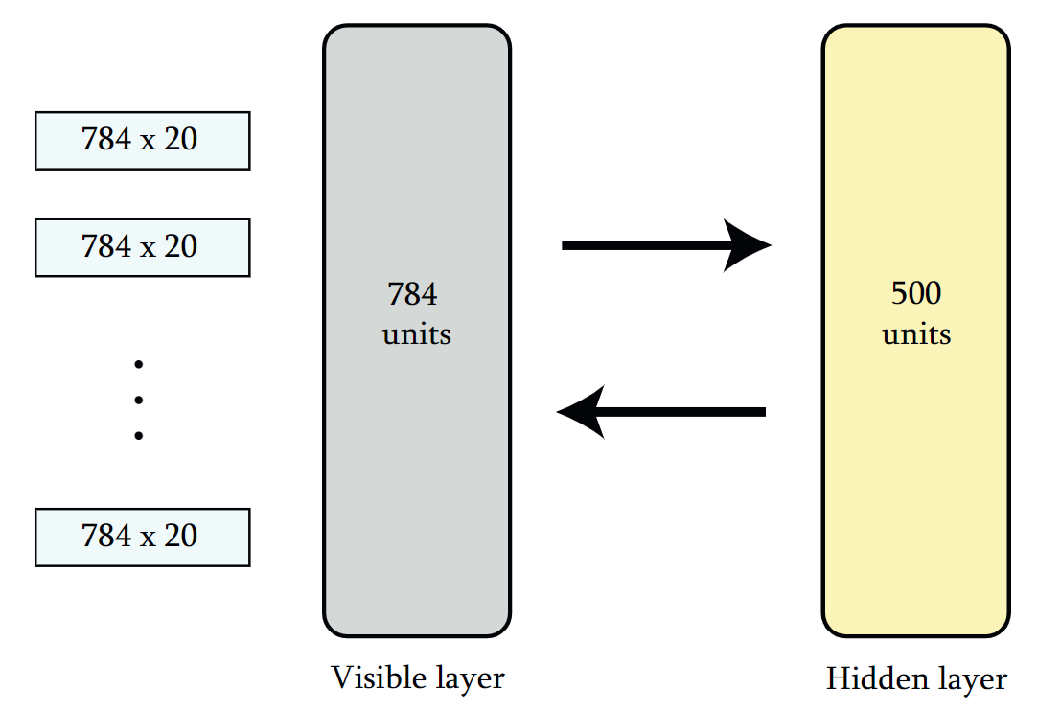
RBM for recognising MNIST images: Architecture
Dataset: MNIST
Minibatches of 20 units
20 epochs
Reconstruction error:
MSE

Slide 7
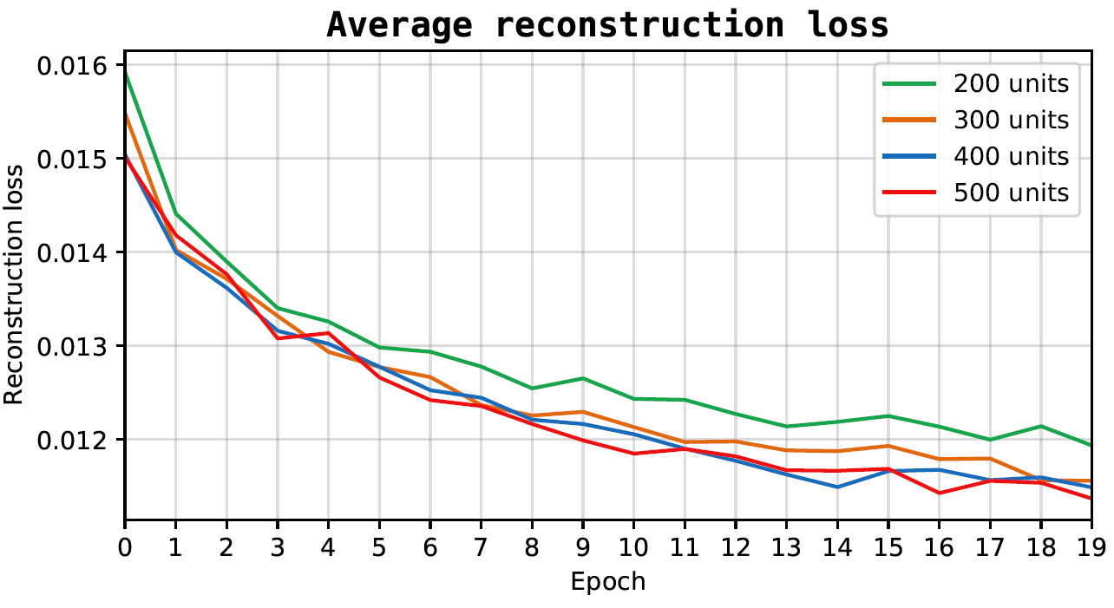
RBM for recognising MNIST images: Average reconstruction loss
Higher number of units
Lower reconstruction error throughout all training epochs
It converges to a lower level

Slide 8
RBM for recognising MNIST images: Average reconstruction loss
Higher number of units
Lower reconstruction error throughout all training epochs
It converges to a lower level

Slide 9
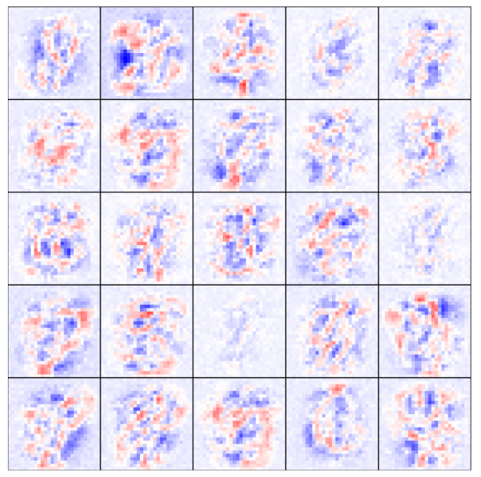
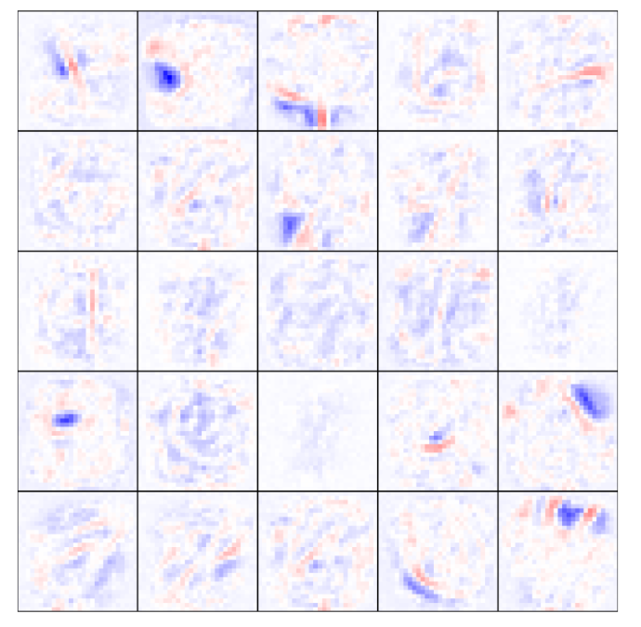
RBM for recognising MNIST images: weights of the visible layer
Weights of the visible layer
Each square: 784 weights of a single hidden layer
First iteration:
Quite complex
It can be recognize digits within them
Iteration 19:
Receptive fields more localized
Exhibit stroke-like features
Iteration 1
Iteration 19

Slide 10
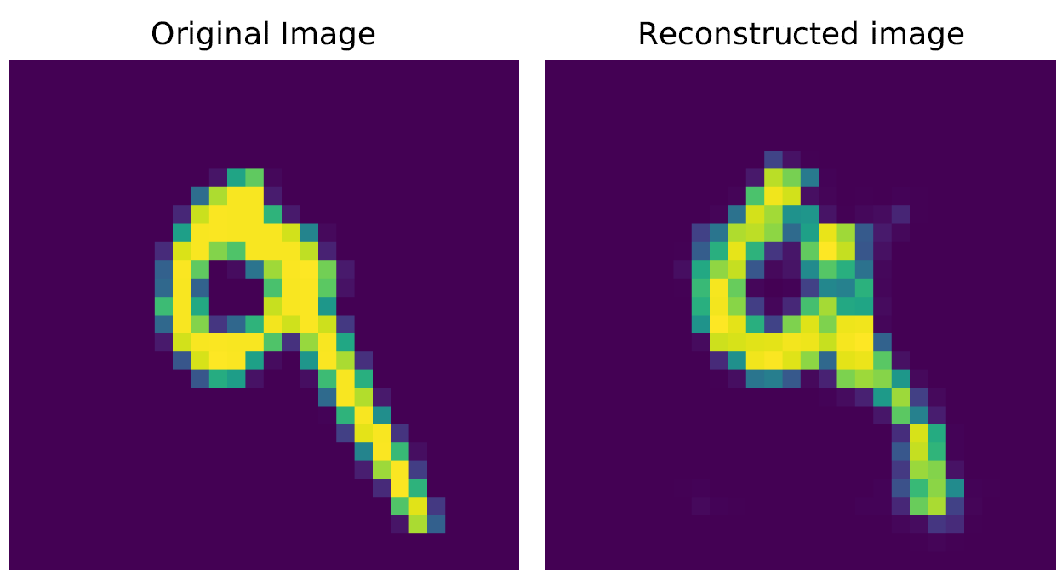
RBM for recognising MNIST images: reconstructed image examples
Reconstruction loss: 0.0478

Slide 11
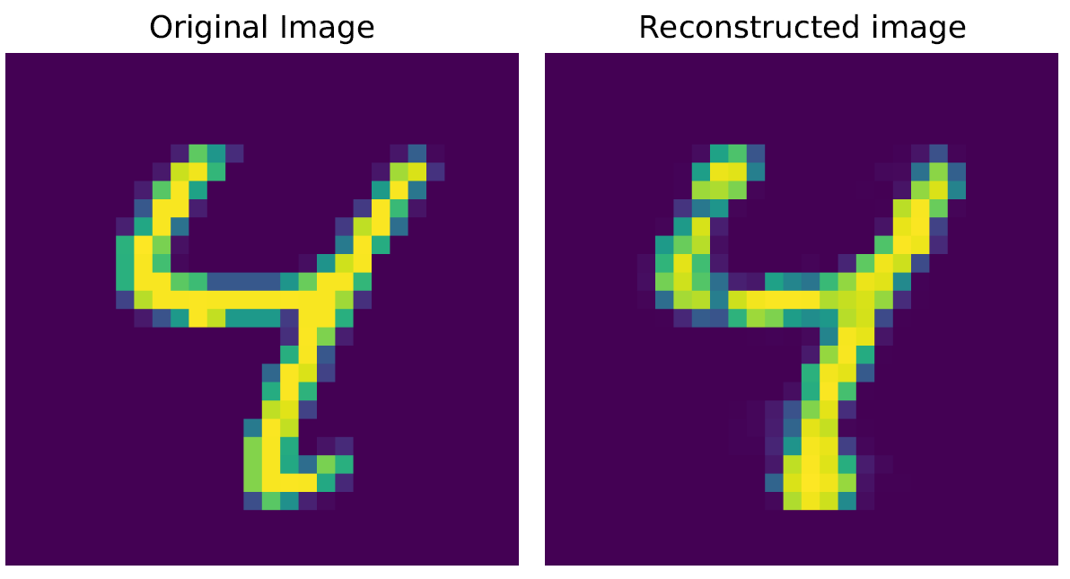
RBM for recognising MNIST images: reconstructed image examples
Reconstruction loss: 0.0344

Slide 12
RBM for recognising MNIST images: reconstructed image examples
Overall, the RBM with the contrastive divergence algorithm:
Good results
It depends on the complexity of the image
For some images bad results

Slide 13
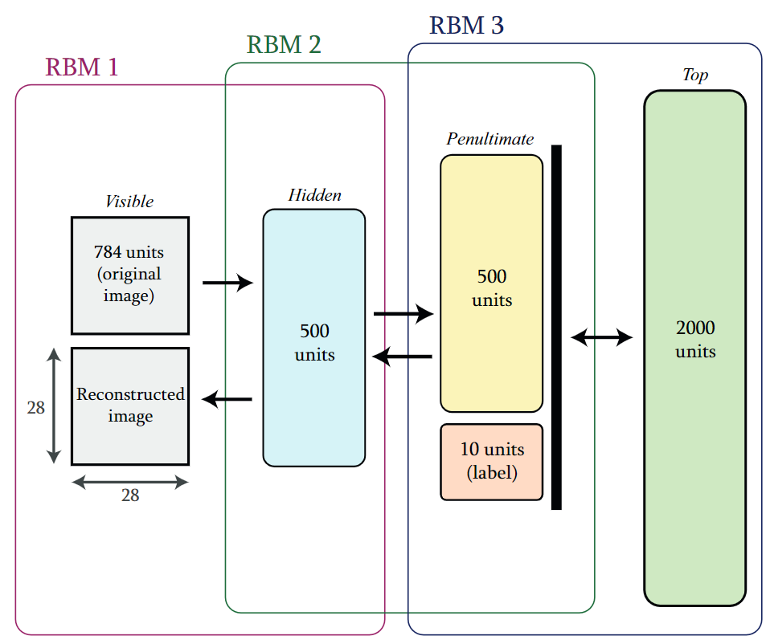
Towards deep networks

Slide 14
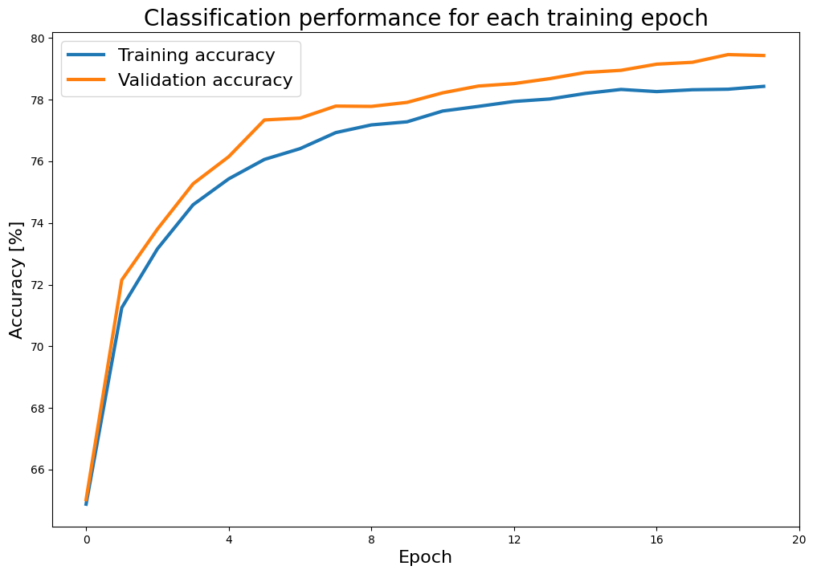
Classifying digits
Performance ~78% for both training and test set
Validation set performs slightly better -> Random chance: large training set and low number of epochs

Slide 15
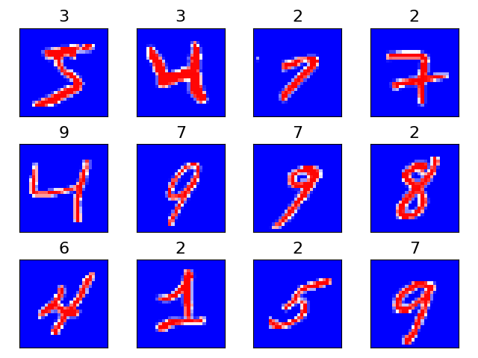
Miss-classified digits

Slide 16
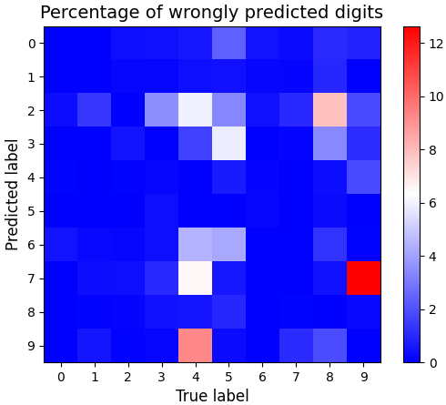
Miss-classified digits
Most common mistake:
Predict a 7 for a true label 9
Most miss-classified true labels:
4 and 9
Most inaccurate predictions:
2 and 7

Slide 17
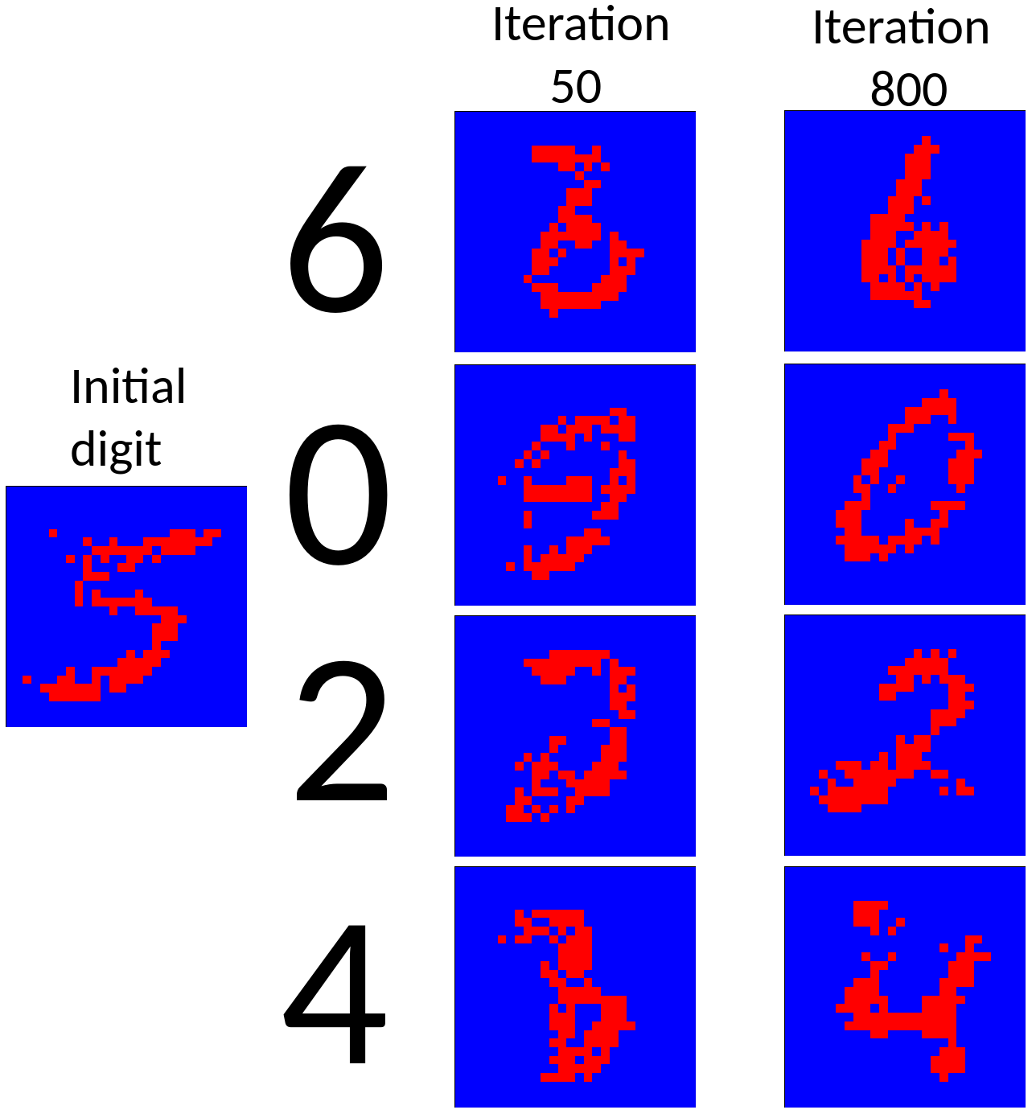
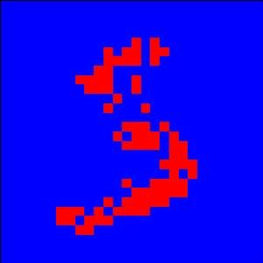

Generating digits

Slide 18
Conclusions
Adding more hidden units significantly improves performance
RBM image reconstruction was over all good
Both classification and reconstruction of images were generally good for the DBN

Slide 19
Thank you for listening
Any questions?

