Slide 1

Mechanisms of Action (MoA) Prediction Can you improve the algorithm that classifies drugs based on their biological activity?
Jie Liu, PH.D.

Slide 2
The Project
A Kaggle competition organized by MIT and Harvard
The dataset combines gene expression and cell viability data as measurements of human celllular responses to drug treatment
The task is to use this dataset to develop a machine learning model that automatically labels any new drug as one or more MoA types
My Objective
build all kinds of classification models and compare their performances

Slide 3

The Challenges
A multi-label classification, 206 labels in total
Custom evaluation metric required, logarithmic loss function, formula provided
Features are highly correlated to each other

Slide 4
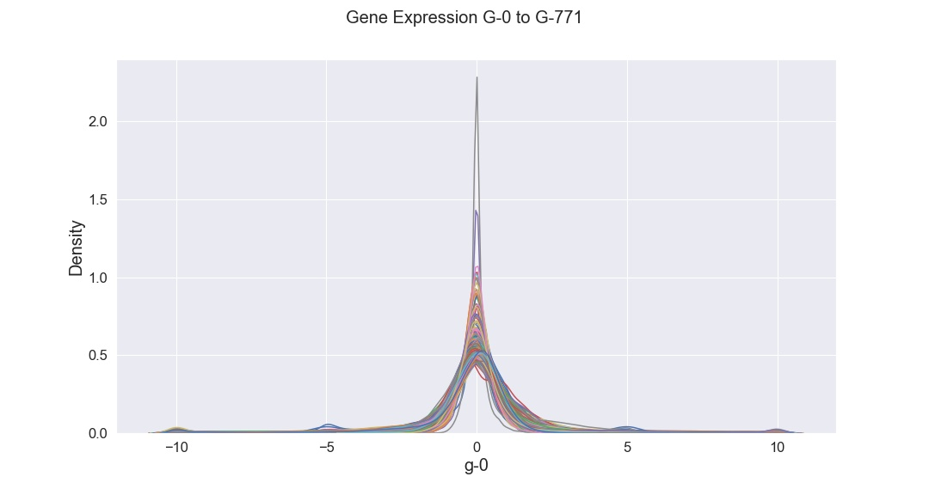
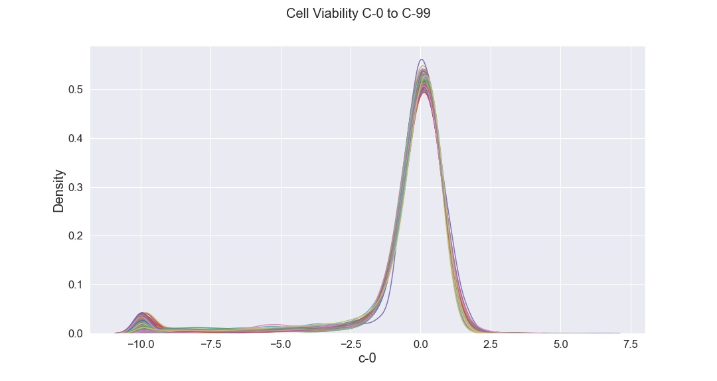
Exploratory Data Analysis
17860 drug samples, 875 features including gene expression and cell viability patterns in response to drug treatment, 206 labels
872 numerical features
Data pre-normalized, following normal-like distributions

Slide 5
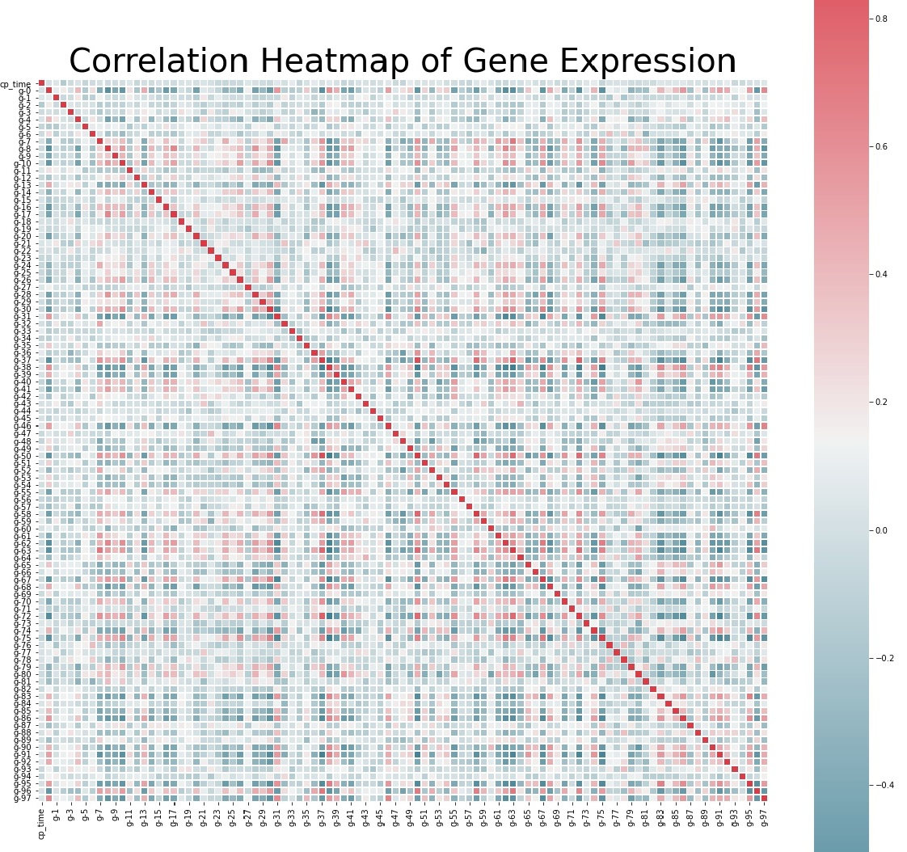
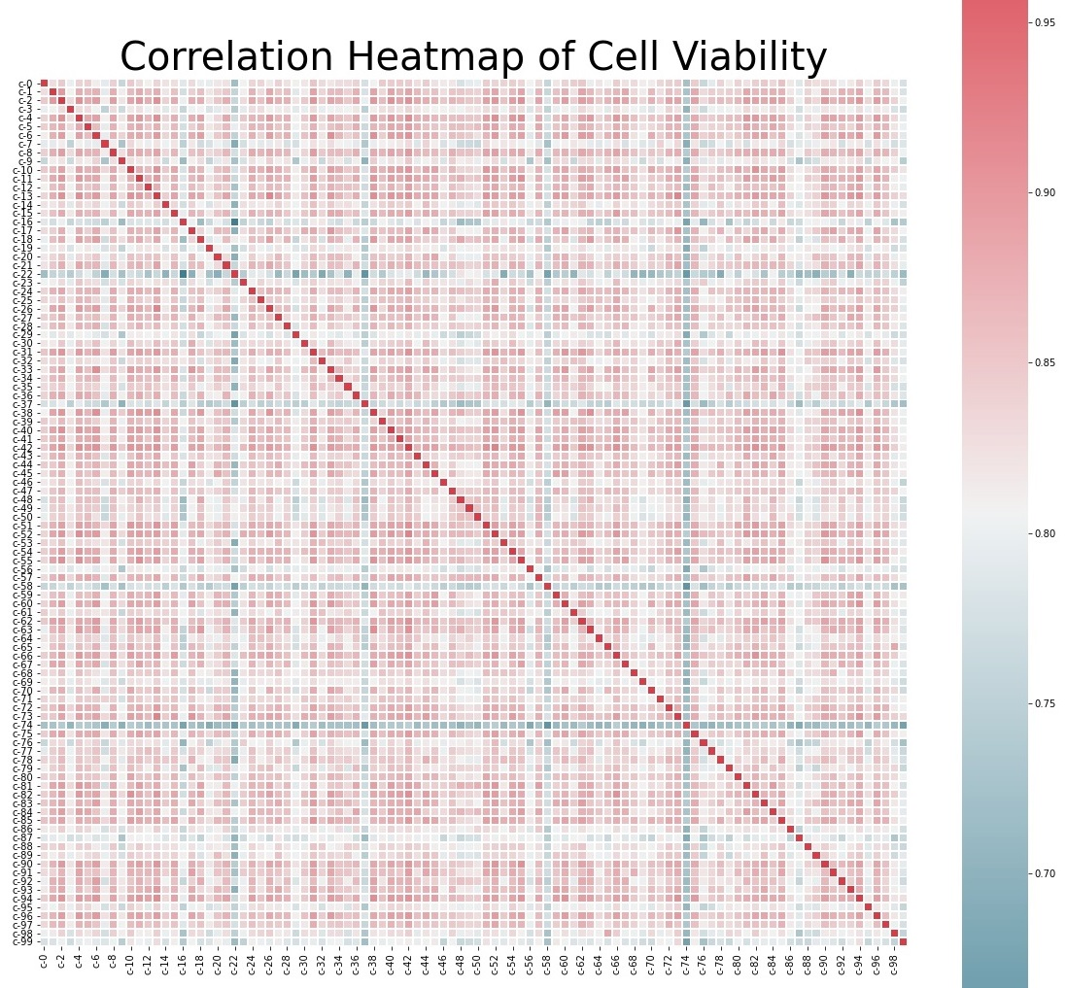
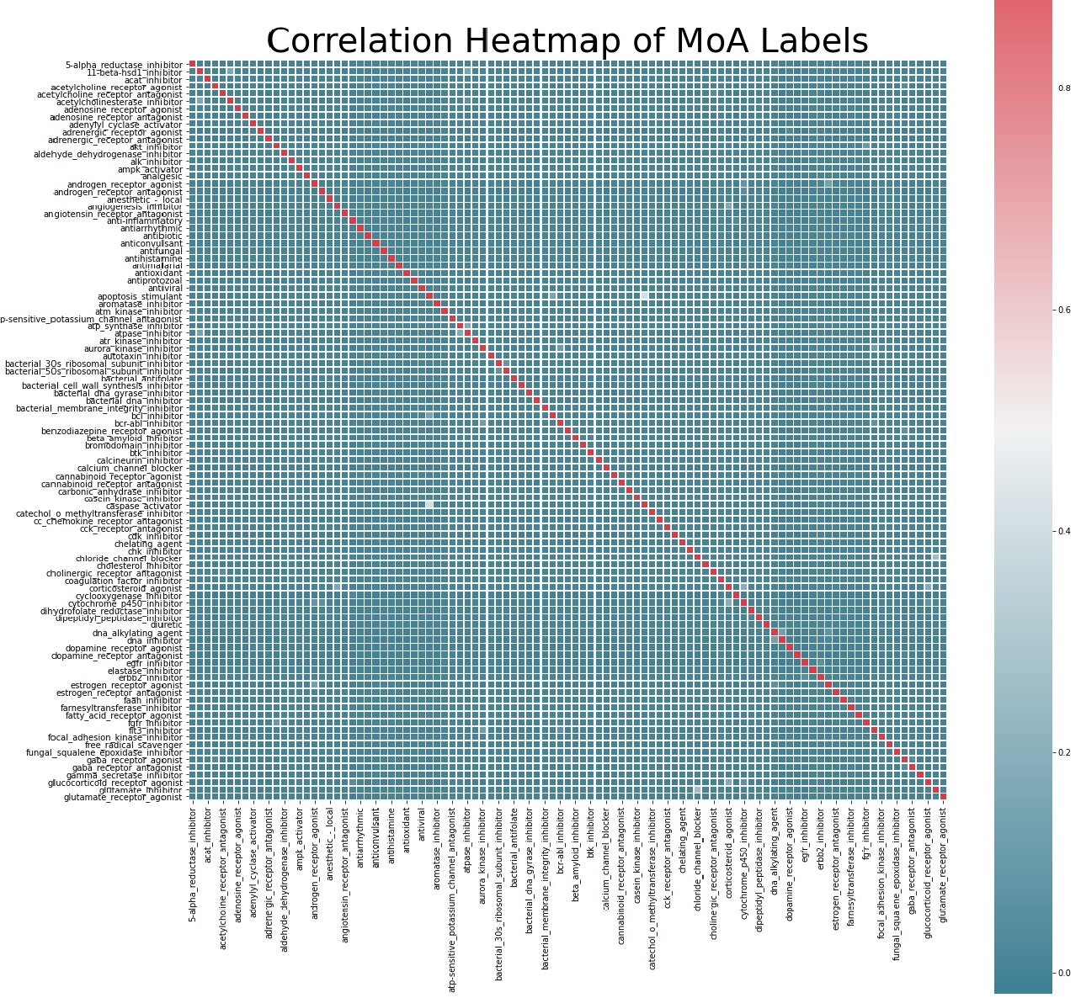
Exploratory Data Analysis (cont.) High correlation suggests PCA dimensionality reduction
Gene Expression
Cell Viability
MoA Labels
Moderately Correlated
Highlly Correlated
Independent to each other

Slide 6
Data Processing
No need to normalize data again
Data split into 60% train, 20% validation and 20% holdout
First Two Neural Network Models
Baseline Model | Neural Network Structure | Parameters | Log-loss
Multilayer Perceptron | 1 input, 1 hidden, 1 output layers | 91,470 | 0.0183
1-D Convolutional NN | 1 input, 2 hidden, 1 output layers | 905,102 | 0.0194
MLP model yields smaller thus better log-loss.

Slide 7
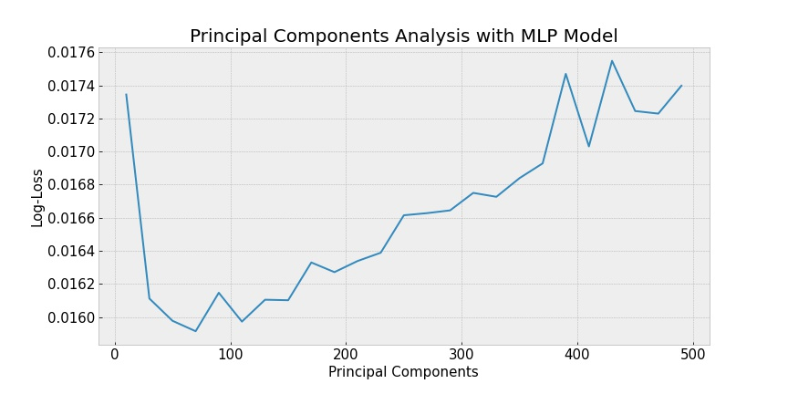
Principal Component Analysis (PCA) Dimensionality Reduction
Original feature number: 875
n_components scan:10 to 500
Best log-loss: at 70
Log-loss MLP: 0.0159 (down from 0.0183)
Log-loss 1D-CNN: 0.0180 (down from 0.0194)

Slide 8
15 Classification Models
MLP and All kinds of Convolutional Neural Networks
 | MLP | 1D-CNN | AlexNet | LeNet-5 | VGG-16 Net | ResNet | Inception Net
Parameters | 91,470 | 905,102 | 23,337,214 | 116,110 | 28,828,174 | 340,430 | 5,235,936
Log-loss | 0.0159 | 0.0180 | 0.0199 | 0.0170 | 0.0176 | 0.0191 | 0.0189
 | *Best |  |  | *
Other Classification Models
 | Random Forest | SVC | KNN | XGBoost | Adaboost | Logistic Regression | GaussianNB | Decision Tree
Log-loss | 0.0165 | 0.0167 | 0.0168 | 0.0170 | 0.0172 | 0.0177 | 0.0434 | 0.0684
 | * | * | * | *
* Six models selected for further optimization

Slide 9
Hyperparameter Tuning - Hyperopt
 | Log-loss Before Optimization | Log-loss After Optimization
Multilayer Perceptron (MLP) | 0.0159 | 0.0156
LeNet-5 | 0.0170 | 0.0161
C-Support Vector Classification (SVC) | 0.0167 | 0.0164
Gradient Boost XGBoost | 0.0170 | 0.0166
RandomForest | 0.0165 | 0.0166
K Nearest Neighbours (KNN) | 0.0168 | 0.0168
A powerful python library for hyperparameter tuning, using Bayesian optimization algorithm.
Allowing the optimization of hundreds of parameters efficiently.
Highly recommended over Sklearn RandomizedSearch and GridSearch optimization.

Slide 10


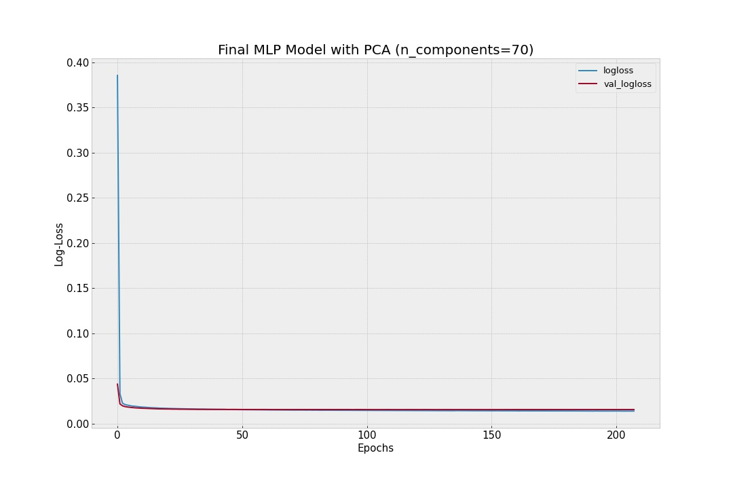
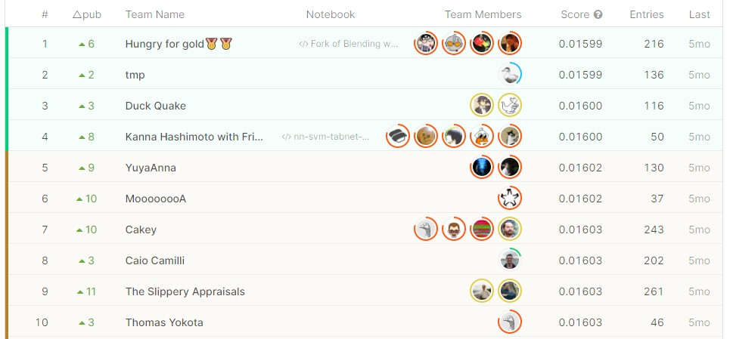



My Final MLP Model 1 Input layer, 2 Hidden Layers, 1 Output Layer, Batch Normalization and Dropout
Log-loss 0.0157 on holdout data
Top 10 Winners of the Competition

Slide 11
Conclusions
The simple MLP neural network model works best for my project.
Techniques Most Helpful
Principle component analysis (PCA)
Hyperparameter optimization with Hyperopt

Slide 12





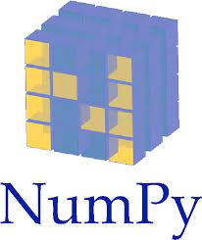






Jie Liu, Ph.D.
jliu1999@gmail.com
Tel: 917-306-8708
github.com/jliu1999
linkedin.com/in/jieliu1999

