Slide 1
EEL 6591
Wireless Networks
Wireless Information Networking Group (WING)
Radio Resource Management
(RRM)

Slide 2
Outline
Wireless Information Networking Group (WING)
Overview of Radio Resource Management (RRM)
Family of RRM functions
  power control
  channel allocation (channel assignment)
  admission control
  handover control (mobility management)
Discuss Later

Slide 3
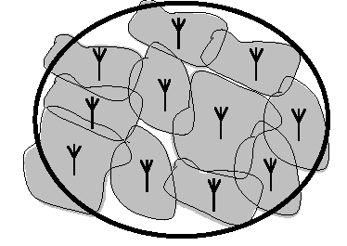
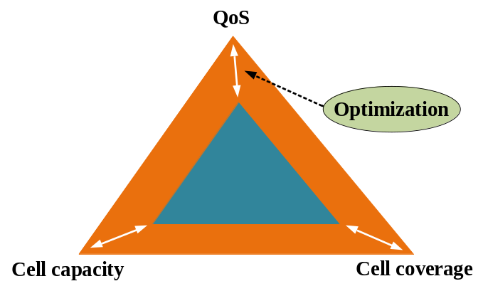
RRM Overview
Wireless Information Networking Group (WING)
RRM is an elementary part in 3G (and beyond) wireless cellular networks.
The importance of RRM is due to the feature of cellular system in that
  bandwidth-limited
  range-limited
  interference-limited
RRM is responsible for efficient utilization of network resources to
  guarantee QoS
  maintain the coverage area
  optimize the cell capacity

Slide 4
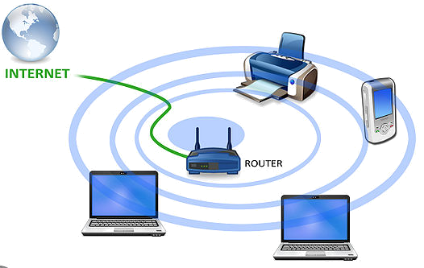
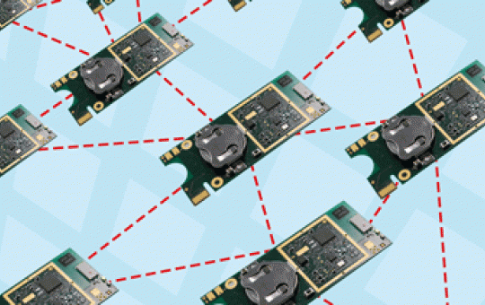
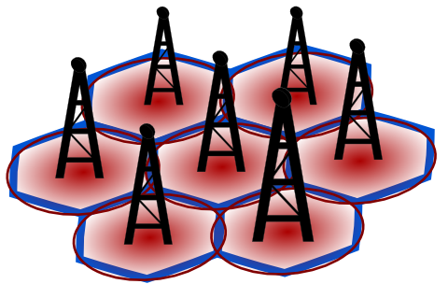
Introduction
Wireless Information Networking Group (WING)
Definition of power control
  Intelligent Selection: an optimization algorithm
  Communication System: cellular networks, WLANs, wireless sensor networks and etc.
  Good Performance: link data rate, network capacity, outage probability, lifetime of networks, geographic coverage and etc.
“Power control, broadly speaking, is the intelligent selection of transmitter power output in a communication system to achieve good performance within the system. [Wikipedia]”

Slide 5
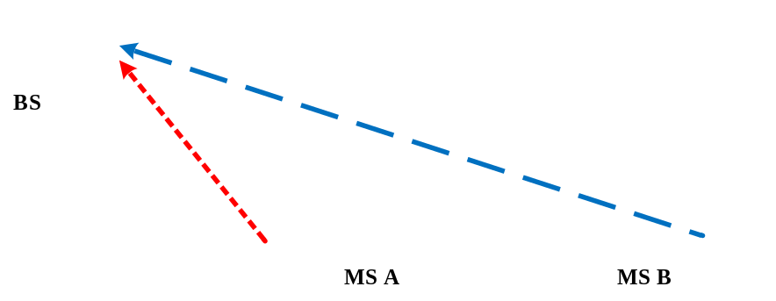
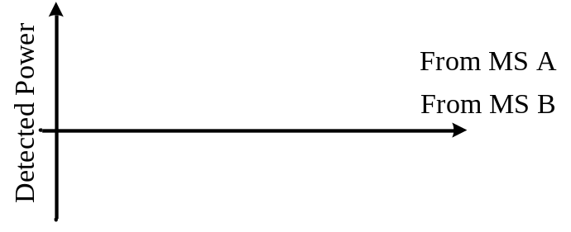
Introduction
Wireless Information Networking Group (WING)
Objective of power control in cellular networks
  Maintain link quality of uplink and downlink by controlling transmission powers
  Prevent near-far effect (e.g. W-CDMA system)
  Minimize effect of channel fading
  Minimize interference in networks
Near-far problem in uplink of W-CDMA system

Slide 6
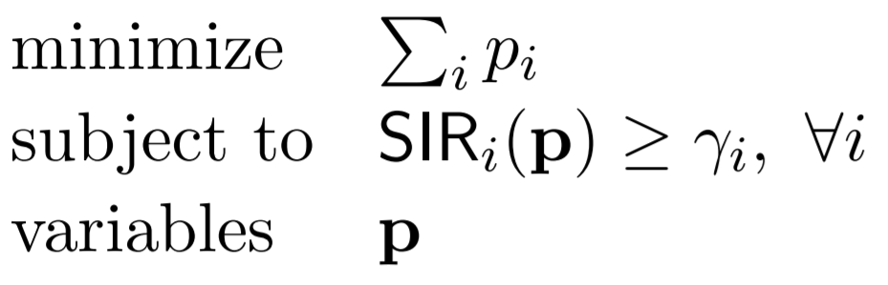
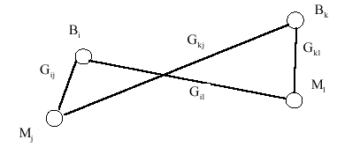
Introduction
Wireless Information Networking Group (WING)
Let’s give a demonstrative example to show the uplink power control optimization in a UMTS/WCDMA system.
Problem formulation
  Mobiles: (M1,M2, …, MM)
  BSs: (1,2,…, B)
  Codes: (1,2,…,C)
For instance, minimizing total transmitting powers while satisfying each user’s SIR.

Slide 7
Introduction
Wireless Information Networking Group (WING)
Problem formulation (cont)
  Link gain: Gij between BS i and mobile j, G=(Gij)
  Pj: transmitting power used by mobile terminal j
  θjm: normalized cross-correlation factor between signals (codes) from mobiles j and m
  N: receiver noise power
  Γj: SIR at the BS receiver j
  γ: the desired SIR to maintain the QoS

Slide 8

Introduction
Wireless Information Networking Group (WING)
Problem formulation (cont): choose the BS i, the codes (channels), the powers so that for all mobile j we have

Slide 9
Problem Formulation
Wireless Information Networking Group (WING)
Power control: Given BS i and the channel, find power set Pj such that
Variation: Given the BS i and the channel, find power set Pj so that PjGij=PmGim for j,m in the cell I
Minimization: minimize the total power with power constraints

Slide 10
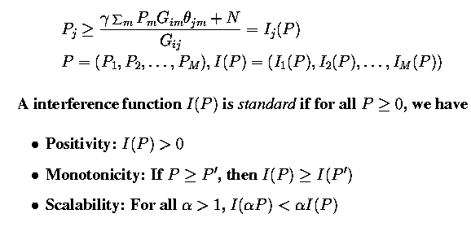
Power Control
Wireless Information Networking Group (WING)
Standard interference function

Slide 11
Power Control
Wireless Information Networking Group (WING)
New problem formulation: Find the power set P such that P >= I(P)
  a vector P is said to be feasible if P satisfies the above inequality
  I(P) is feasible if there exists a feasible P
Theorem: If I(P) is a feasible standard interference function, then power control algorithm P n+1=I(P n) will converge to the unique fixed point P’: P’=I(P’)

Slide 12
Power Control
Wireless Information Networking Group (WING)
Observations
  the fixed point P’ has the following property: PjGij are all equal--received powers are all equal
  powers are synchronously updated for all mobiles
Optimization problem
  minimize the total received power: enough is good
  minimize the total transmitted power: stingy is good
  Power control with adaptive sectorization: JSAC paper by Yener (2001)

Slide 13
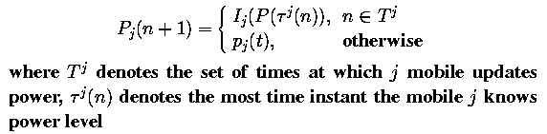
Power Control
Wireless Information Networking Group (WING)
Asynchronous power control algorithm: update whenever requested
Theorem: If I(P) is feasible, the asynchronous power control will converge to the unique equilibrium point P’: P’=I(P’)

Slide 14

Power Control
Wireless Information Networking Group (WING)
CDMA Standard (IS-95) power control
  Open-Loop Power Control: MS observes the forward link pilot signal strength and determines the power to transmit--pilot signal strength indicates the distance between MS and BS

Slide 15
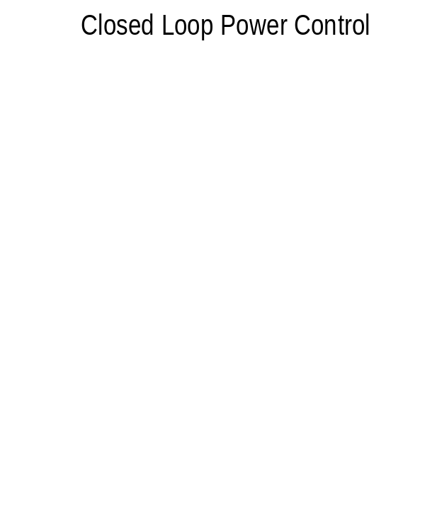
Power Control
Wireless Information Networking Group (WING)
CDMA Standard (IS-95) power control
  Centralized Closed-Loop Power Control: BS observes link quality such as energy-to-interference ratio EIR
    if measured EIR is greater than the current target EIR, BS informs the MS to decrease its power by 1 dB;
    Otherwise, BS informs the MS to increase its power by 1 dB.
  Convergence is slow (sluggish)

Slide 16
RRM for Current Systems
Wireless Information Networking Group (WING)
Next, let’s take a look at current 4G/LTE system and its radio resource management (RRM) functions.

Slide 17
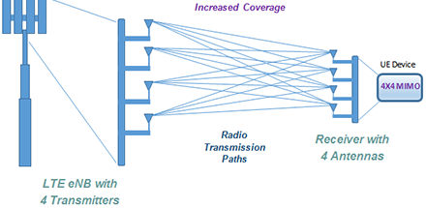
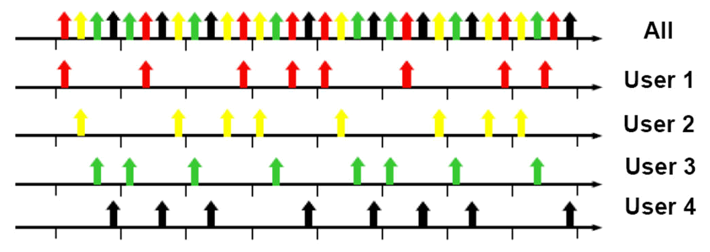
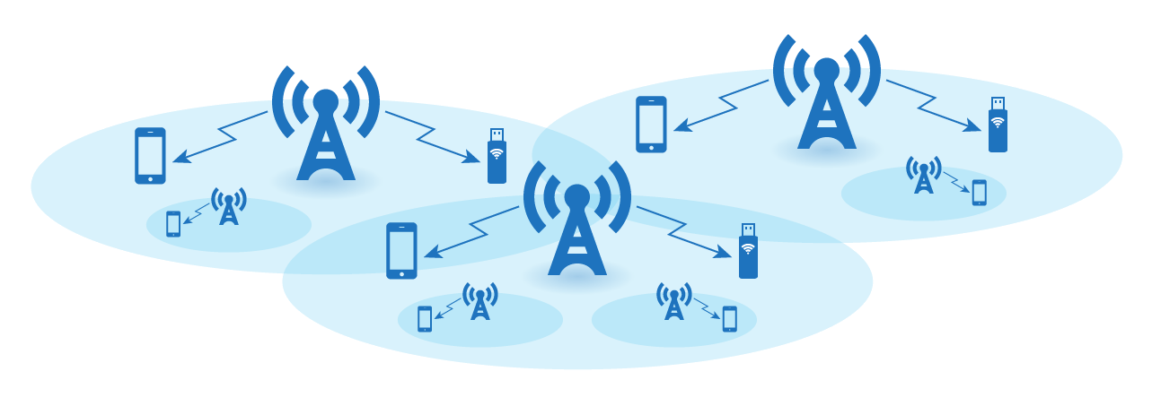
Overview of 4G/LTE
Wireless Information Networking Group (WING)
LTE is the successor technology for UMTS/WCDMA.
LTE provides high data rate and low latency services.
  300Mbps peak downlink
  75Mbps peak uplink
  10ms minimum latency
LTE incorporates several new techniques.
  Orthogonal Frequency-Division Multiple Access (OFDMA)
  Multiple-input and multiple-output (MIMO)
  Small cell (i.e. heterogeneous network (HetNet))

Slide 18
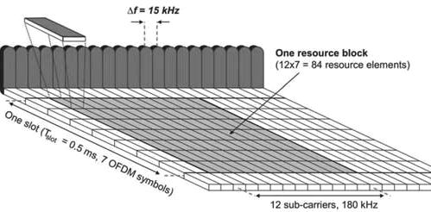
RRM in 4G/LTE
Wireless Information Networking Group (WING)
LTE uses multi-carrier OFDM for downlink
  Total carrier bandwidths range from 1.4MHz to 20MHz.
  BS (a.k.a. eNB) allocates resource blocks (RBs) to mobiles (a.k.a. UE) to transmit data.
  Resource block is in the form of time-frequency grid.
  Advantages
    Robust to fading and interference
  Drawbacks
    High peak-to-average ratio
    Sensitive to frequency offset
RRM in downlink LTE
mainly focuses on RBs allocation.

Slide 19
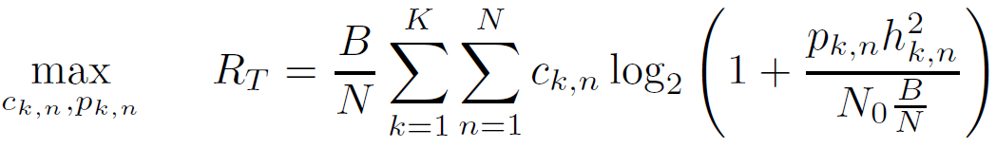
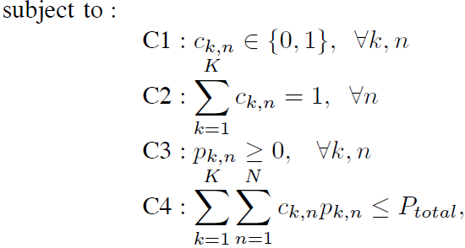
RRM in 4G/LTE
Wireless Information Networking Group (WING)
For instance, finding the optimal subcarrier and power allocation to achieve max. throughput. (a.k.a. rate adaptive (RA) optimization)
Each subcarrier is only assigned to one user.
Power should be positive.
Total power has a budget.

Slide 20
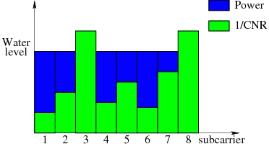
RRM in 4G/LTE
Wireless Information Networking Group (WING)
In specific, the optimal solution is obtained if each subcarrier is assigned to the user with the best channel gain on it and the power is distributed using water-filling policy.
  Good subcarriers get more power than poor subcarriers. (The rich becomes richer.)

Slide 21
RRM for Future Systems
Wireless Information Networking Group (WING)
Future wireless systems (e.g. 5G) have the following demands
  high bandwidth: multimedia applications or Internet applications tend to require high data rate
  bursty data traffic: Internet traffic tends to be bursty
  mixed traffic: voice, data, video/audio, images, …
  QoS: different traffic may need different QoS requirements
The diversity and heterogeneity of device & data traffic (e.g. from smart cities and IoT) along with multi-dimensional radio resource intertwining makes RRM for future system challenging!
New problems and new solutions!

