Slide 1


HaiDaBloke
2016
Data publishing made easy

Slide 2
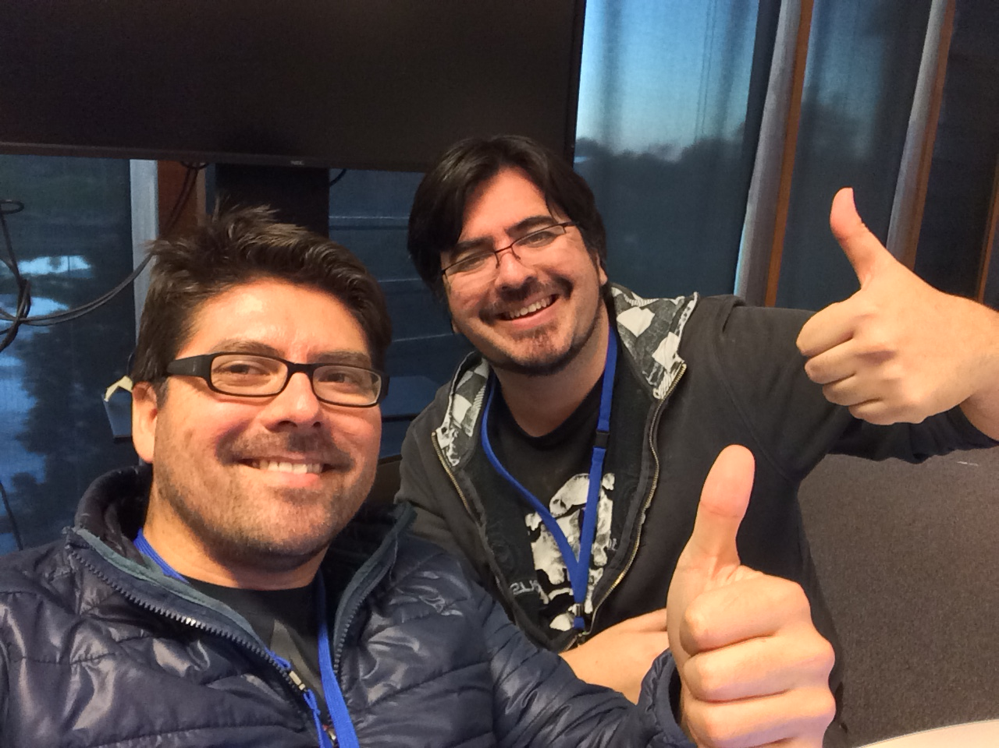

Who are we?
Two Chilean blokes
George
Christian

Slide 3
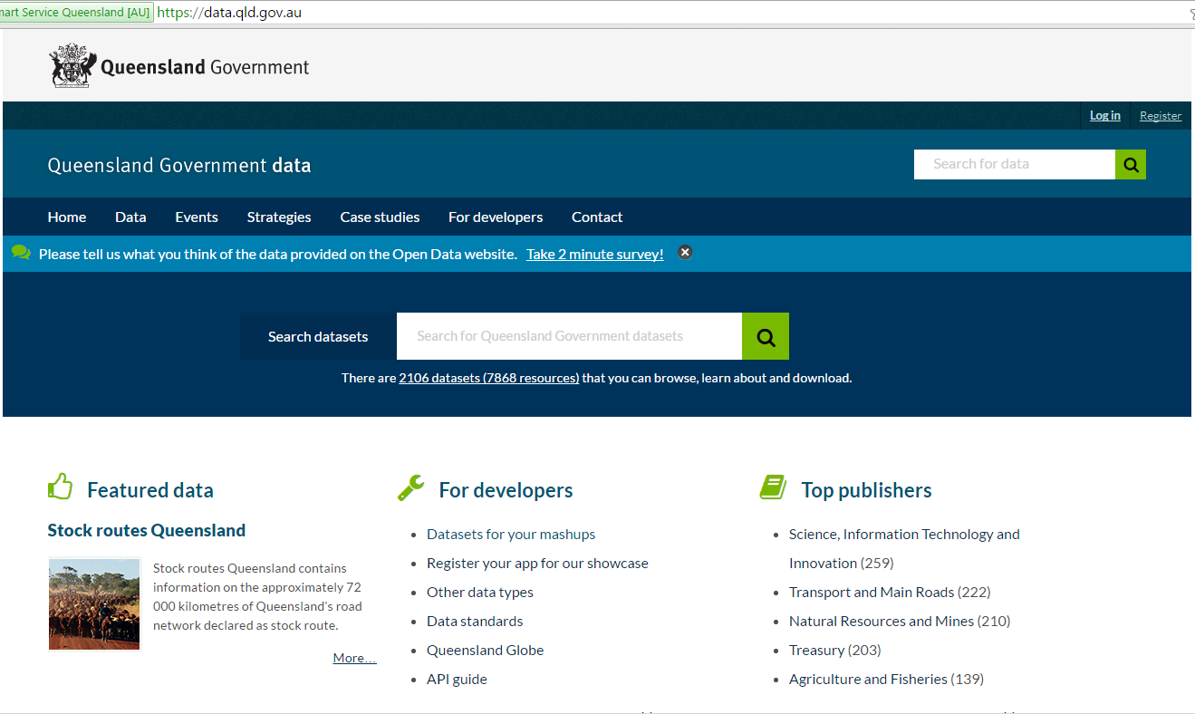
Queensland Open Data Portal
Provides Queenslanders access to data about national parks, sport and racing to be used for innovation, research and development opportunities.
Data principles:
Available for open use.
Available for free.
Available in accessible formats and easy to find.
Released within set standards and accountabilities.

Slide 4




The Challenge

Slide 5

What’s our hack?
HaiDaBloke

Slide 6
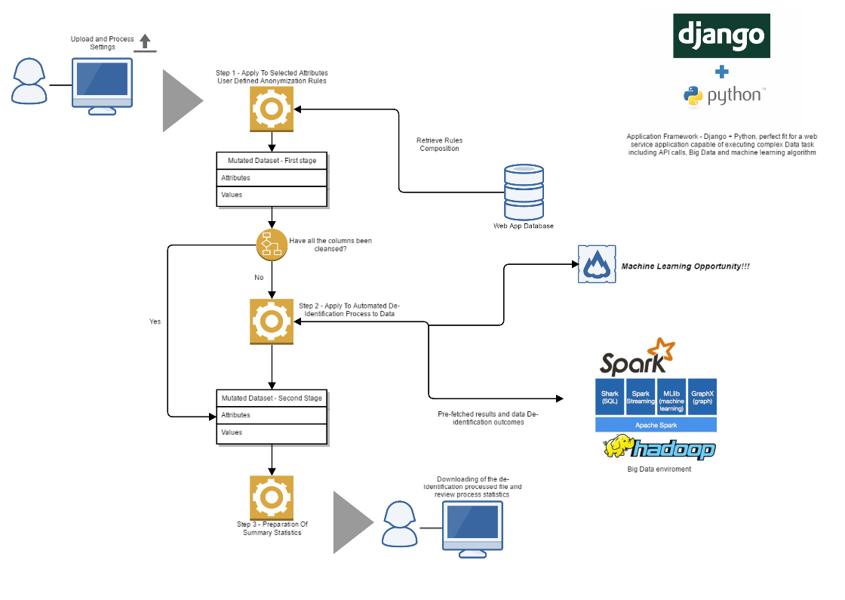
HaiDaBloke concept

Slide 7
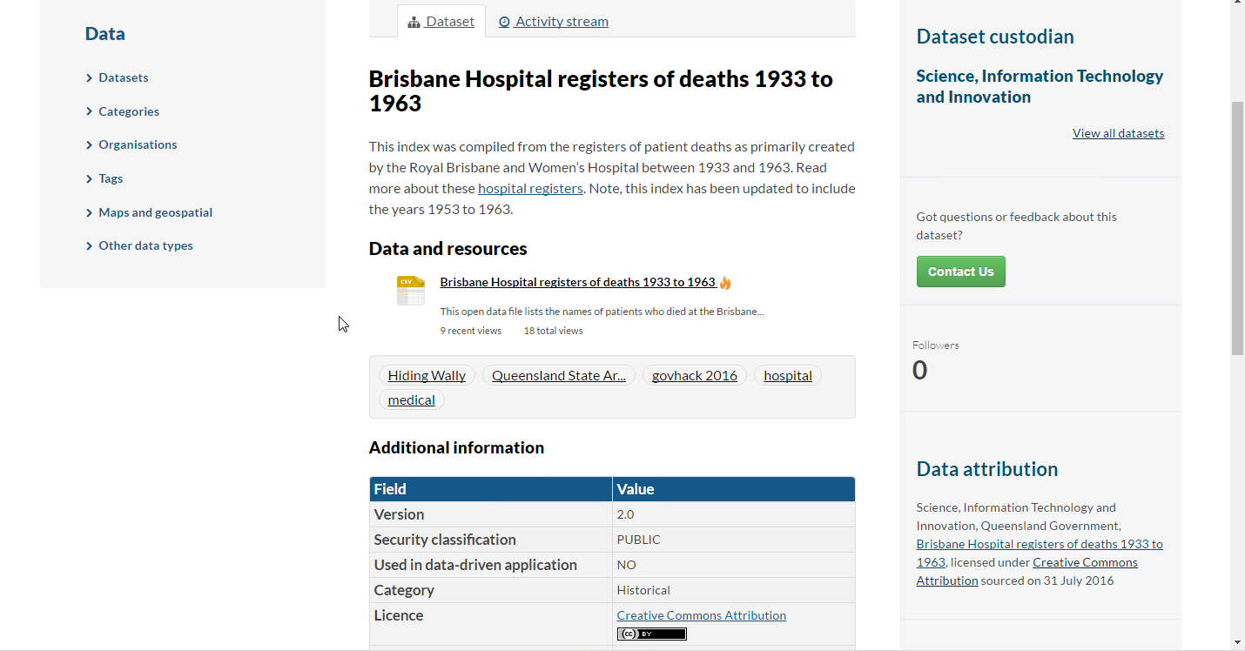
Data used

Slide 8
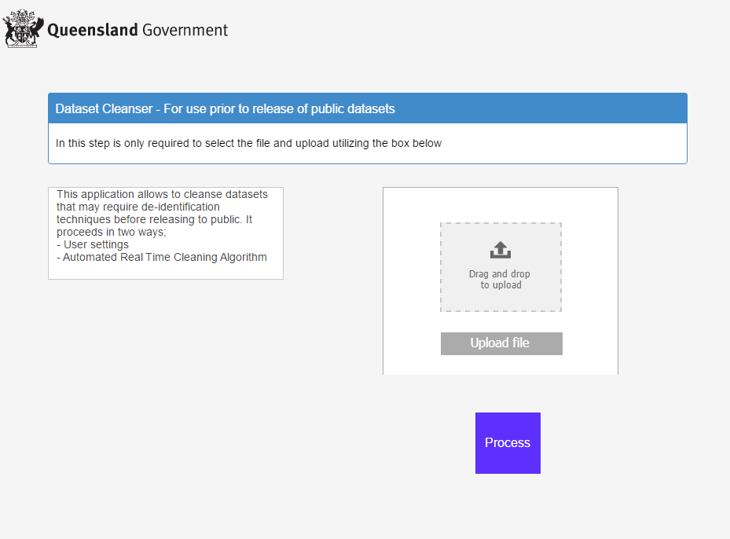
Application – First Step - Upload
https://collaborate.uxpin.com/6a9ca53f7d12af02905e01ecb0aae9e797c5639a#/pages/56694935

Slide 9
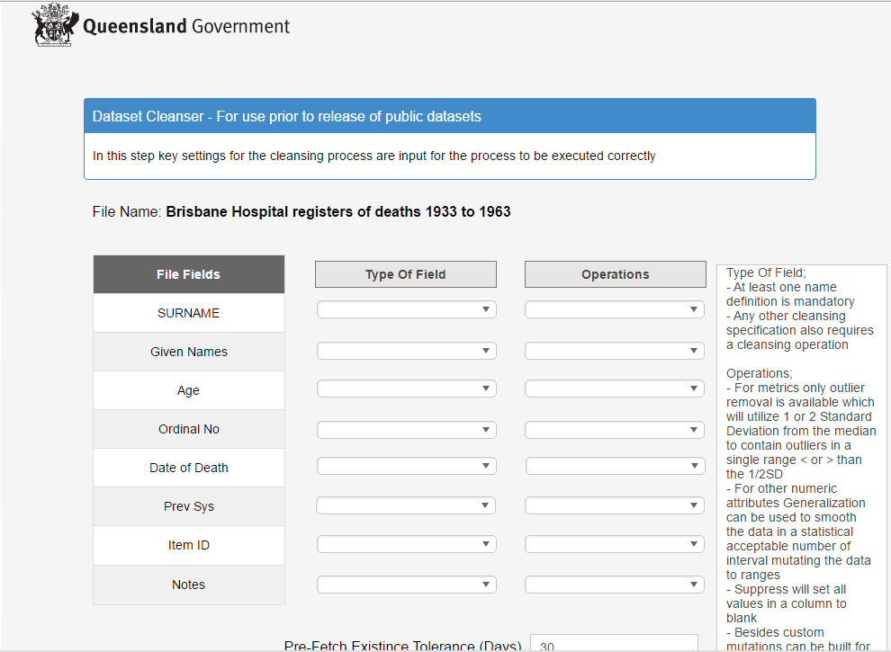
Application – Second Step – User Settings
https://collaborate.uxpin.com/6a9ca53f7d12af02905e01ecb0aae9e797c5639a#/pages/56694935

Slide 10
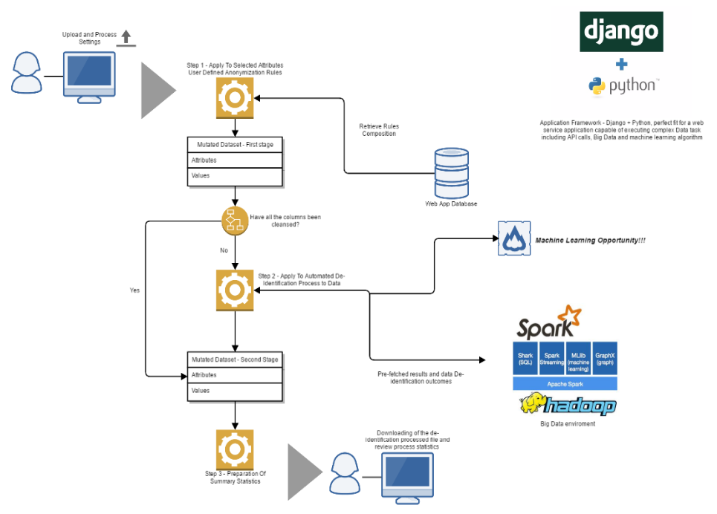
Application – Third Step - Execution
https://collaborate.uxpin.com/6a9ca53f7d12af02905e01ecb0aae9e797c5639a#/pages/56694935

Slide 11
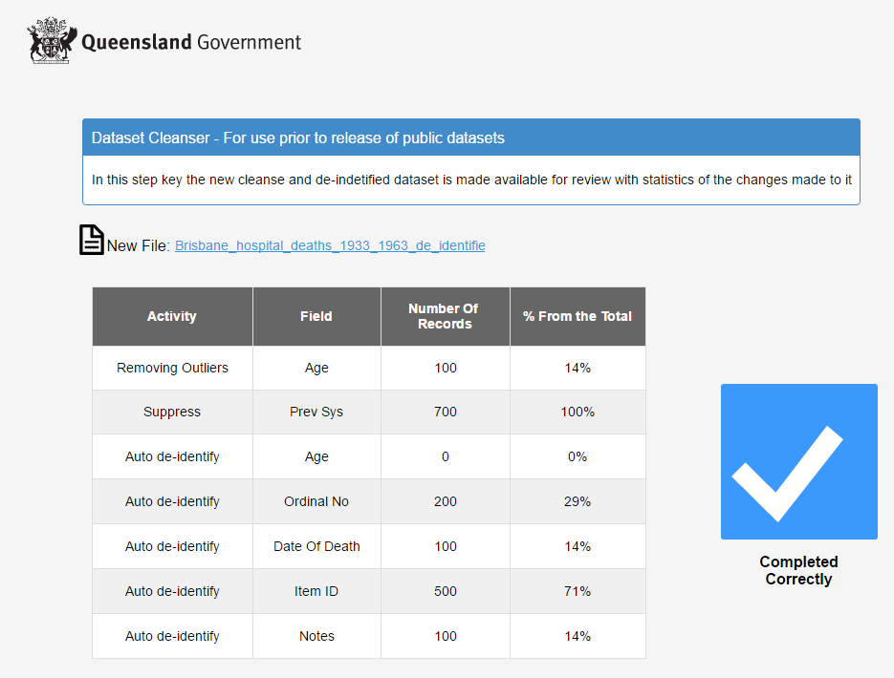
Application – Final Step – Outcome and Summary
https://collaborate.uxpin.com/6a9ca53f7d12af02905e01ecb0aae9e797c5639a#/pages/56694935

