Slide 2
Security Nutrition Labels for Cloud Native Projects
John Kinsella

Slide 3
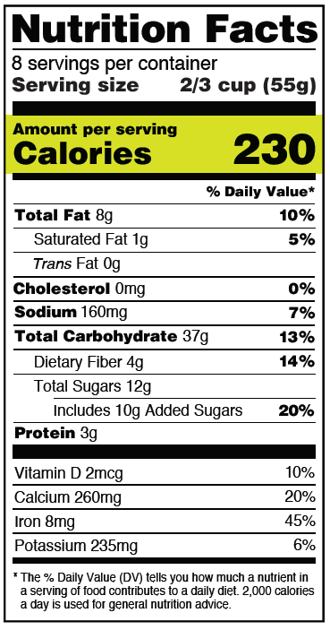
Nutrition label
Notes:
Thought of this while working on the security chapter for the operator whitepaper that sig-app-delivery is working on

Slide 4
History
First nutrition laws created in early 1900s – just after packaged food
1970s – First labels mandated
Tweaks to label requirements every decade or so

Slide 5
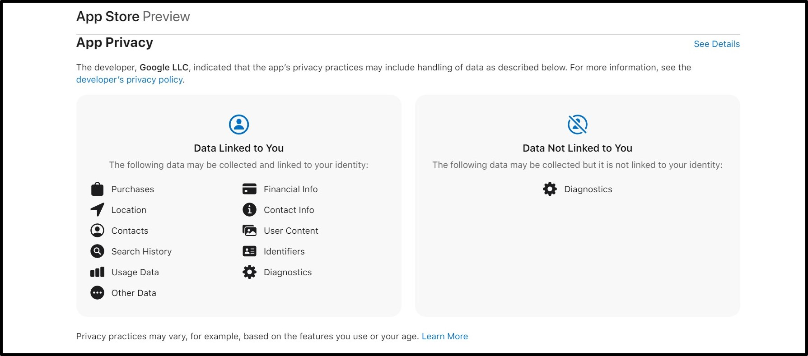
Apple App Store

Slide 6
Why is this needed?
New to a project – is this something I can trust, or even use?
Installation hell – every step has more requirements I didn’t know about

Slide 7
Security Label Goals
Security Label Goals
Advise, not admonish
Increase trust
Increase default security posture

Slide 8

Front of Package Labels
Front of Package Labels

Slide 9
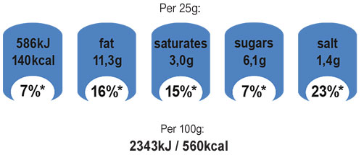
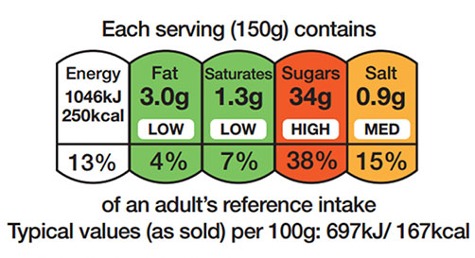
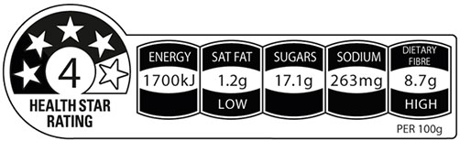





Front of Package Labels
Front of Package Labels

Slide 10
Label Contents
Network connectivity – send or receive
Root privileges required (cluster admin?)
Credential requirements (CSP, k8s roles, API keys)
Software supply chain status
Link to architecture diagram
Link to threat model
Link to self-assessment questionnaire
Link to 3rd party review
Security contact
Security page

Slide 11
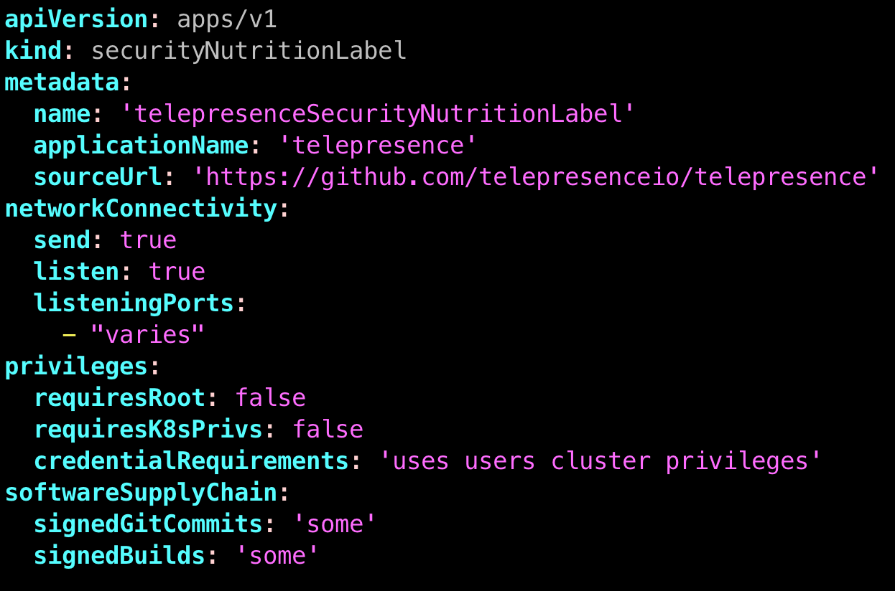
Example - telepresence

Slide 12
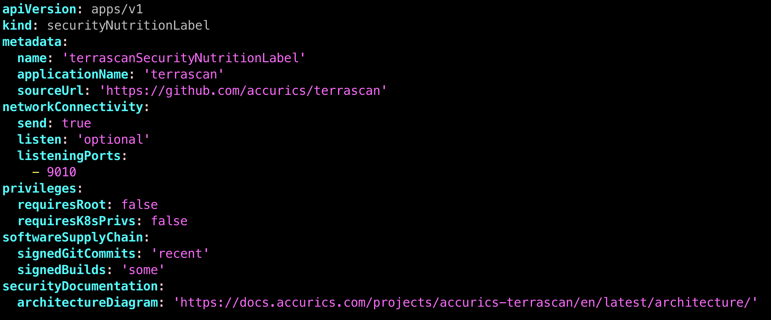
Example - terrascan

Slide 13
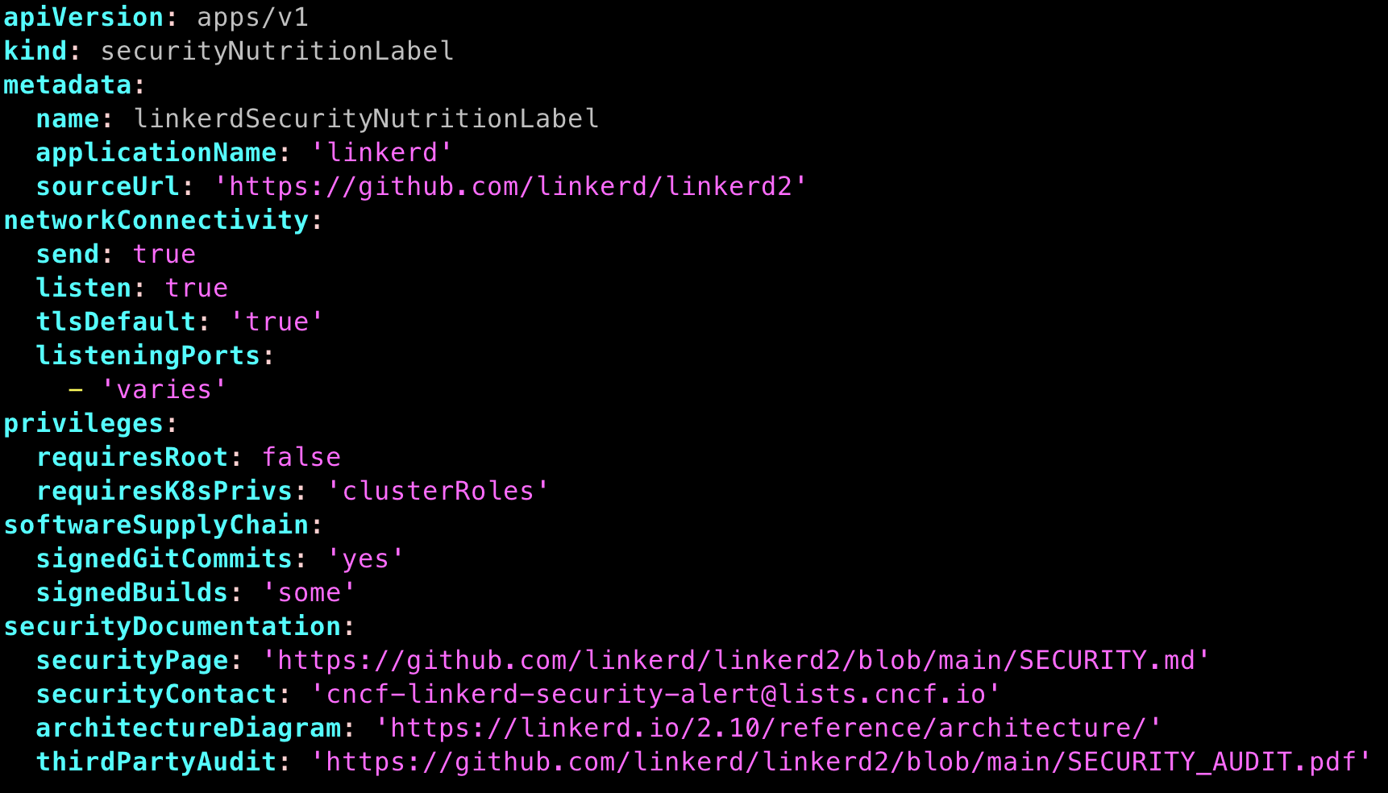
Example - linkerd

Slide 14
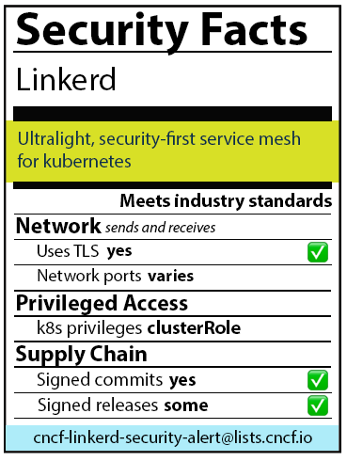
Example - label

Slide 15
Thanks!
Questions?
jlk on CNCF slack
@johnlkinsella on twitter
Notes:
Talk about status

Slide 16
References
https://www.fda.gov/food/new-nutrition-facts-label/calories-new-nutrition-facts-label
https://apps.who.int/iris/bitstream/handle/10665/42964/9241591714.pdf
https://www.igd.com/articles/article-viewer/t/front-of-pack-labelling-around-the-world/i/23126
https://www.telepresence.io/
https://cups.cs.cmu.edu/privacyLabel/files/CHI-finalPoster.pdf

