Slide 1
Data Science + The Podcast Industry
Using Text Mining + Machine Learning to Figure Out Episode Popularity

Slide 2
Introduction
Podcasts have emerged as the trendy new medium in media
Podcasts cultivate engaged listeners, have large audiences, and pose a legitimate challenge to the radio industry and other content mediums
It’s crucial to learn as much about Hollywood’s hottest new source for material as possible
We can use data to seek out emerging trends in the genre

Slide 3
Introduction
Ad revenue was $220 million in 2017, up 85 percent from $119 million in 2016*
Up until now there has been little data about podcast consumption, especially compared to other digital media
Until recently, podcast creators were unable to tell how their content performs
at best, they could only tell if someone downloaded an episode or started to stream it
Advertisers didn’t know if people were listening to ads
Many were doing a crude end run around this data void by asking listeners to use a show-specific code when they visit a site after hearing an ad
Data mining will be huge for the industry, which generates a lot of attention but a modest amount of revenue so far
*Recode

Slide 4
Hypothesis
I would like to prove that certain topics are more appealing to the podcast listener
Publishers can tailor their content around these subjects to
attract more listeners
garner more downloads
attract more advertisers
increase their revenue

Slide 5
Approach
Stick to the top 50 podcasts in the Society & Culture section on Apple Podcasts
Use podcast name, episode title, date, running time, episode description and popularity rating
Use a self-created dataset
Scrape Stitcher to obtain data
Use Apple Podcasts for popularity rating

Slide 6
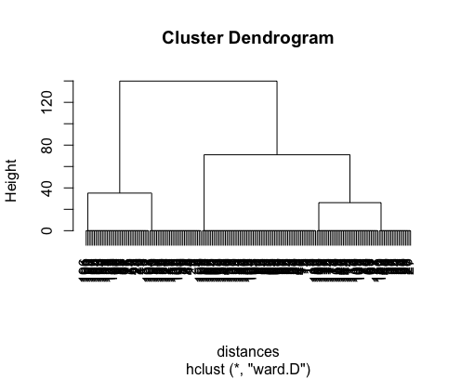
Machine Learning
I decided to use popularity ratings as a way to make a loose recommendation system for podcast episodes.
Collaborative filtering and clustering work well here
It looks like 4 clusters would be a good choice when making episode recommendations. We can take a subset of episodes rated 5 and pull recommendations just from that set.

Slide 7
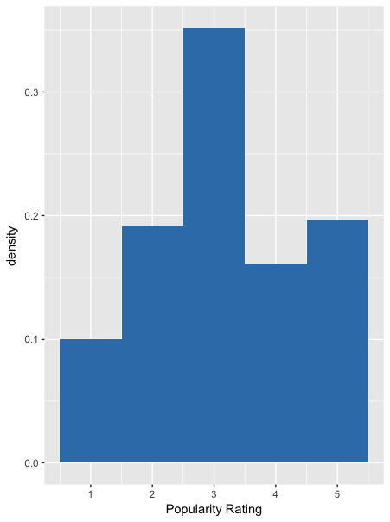
Histogram
The majority of podcast episodes are only somewhat popular (rated 3)
Podcasts rated 5 pop up only slightly more frequently than those that are ranked 2

Slide 8

Histogram
Episodes released in July & August appear most frequently
I collected data over the summer. Do these popularity ratings show a recency bias?

Slide 9
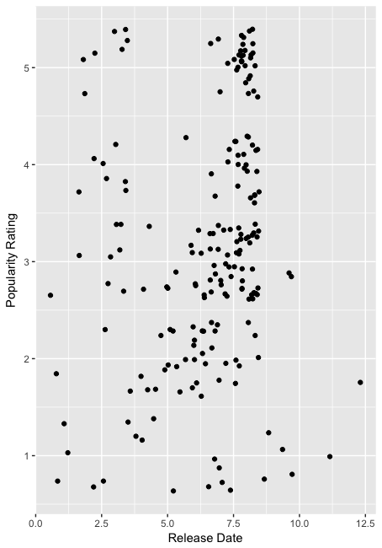
Scatterplot
There is a correlation between release date and popularity.
We can see a lot of 3s, 4s and 5s clustered around the 7.5 mark (correlating to July/August)

Slide 10
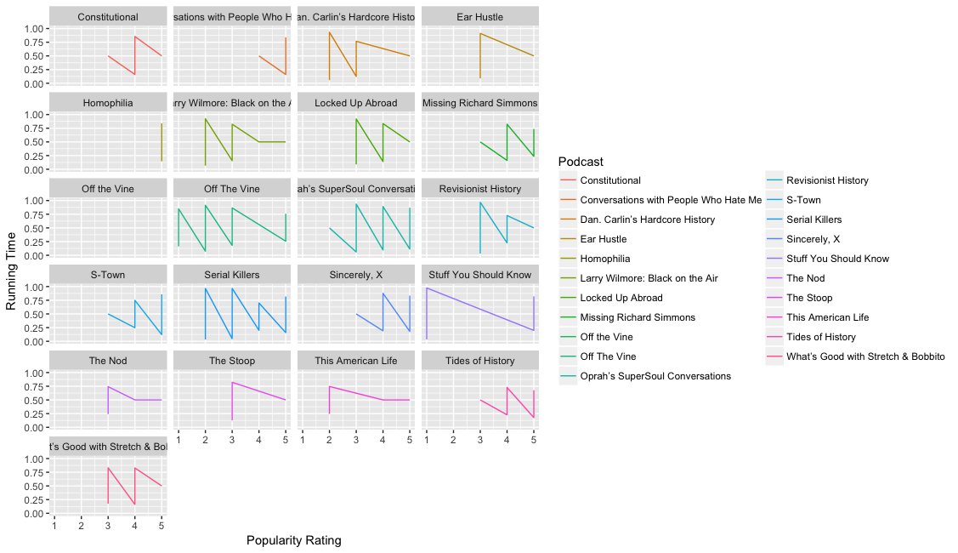
Time-series plot
There is no correlation between episode length and popularity.

Slide 11
Term Frequency
Other than recency, what makes a podcast popular?
Content is king
Let’s get into some text analysis
We can start to look for stories in our data
First, we’ll look at the most frequent words
Words occurring more than 20 times

Slide 12
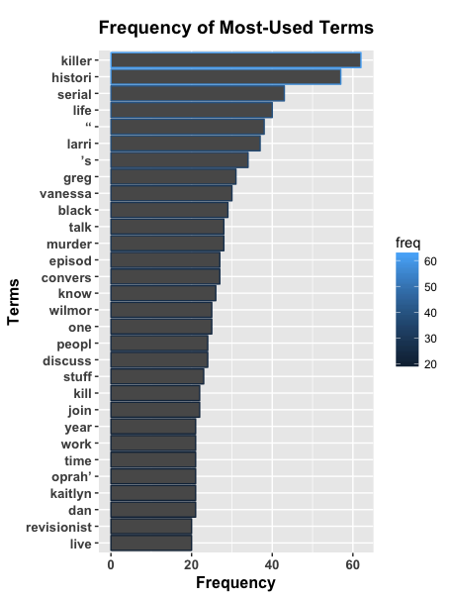
Term Frequency
True crime is a very popular Podcast topic
“killer”, “murder”, and “victim” all made it into our most used terms
This makes sense for a medium that exploded in popularity after the series “serial” premiered in late 2014
“Conversation” and “Discuss” are in our chart
This suggests that podcasts that featuring two hosts interacting with each other might be more engaging than one host telling a story or monologue.
We also see that the terms “historical,” “learn” and “political” pop up a lot
Listeners are interested in historical narratives or in learning something about our past to inform our present political climate
And of course, perennial favorites “love” and “life” make an appearance, too.

Slide 13
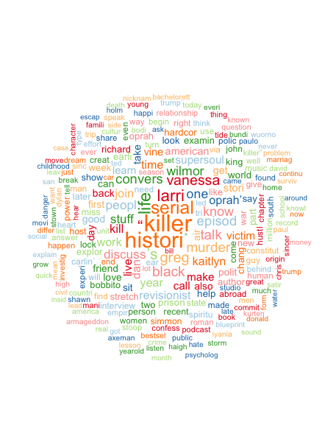
Word Cloud
To better visualize term frequency, we can also look at a wordcloud.

Slide 14
Conclusion + Recommendations
An excellent recommendation system can definitely be an advantage to companies trying to reach consumers
Recommendation algorithms can make Apple’s interface less intimidating and more fun and addictive for the listener
If they can successfully implement the “If You Liked X, Try Y” models popular on Netflix and Amazon, podcasts will become more mainstream and, ultimately, more lucrative
Publishers should focus on producing content with themes that popped up again and again in the Top 50 Society & Culture podcasts on Apple
true crime
historical and political content
lifestyle/wellness

