Slide 1
Machine Learning Project
By: Divya Manirajan and Jaylon Kiper

Slide 2
Intro
With the CSV file we acquired from Kaggle, this data covers the predictions on real estate prices in an area of Taiwan.
The data includes eight variables that dictate the relationship between:
Location(by latitude/longitude)
Age
Date of Transaction Sale
Number of Convenience Stores in the Area
House Price By its Unit Area

Slide 3
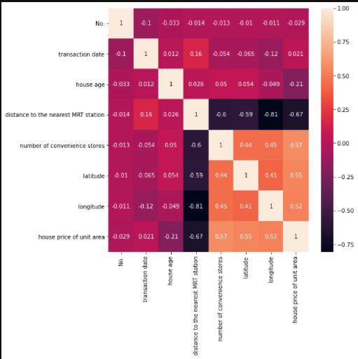
Correlation Matrix
In the correlation matrix we did not remove any variables.
However, the “No.” and “number of convenience stores” variables were discrete so we did not use them in the regression model.
We can also see that some of these variables have a strong correlation with each other
EX: distance to the nearest MRT station and longitude have a -.081 correlation

Slide 4
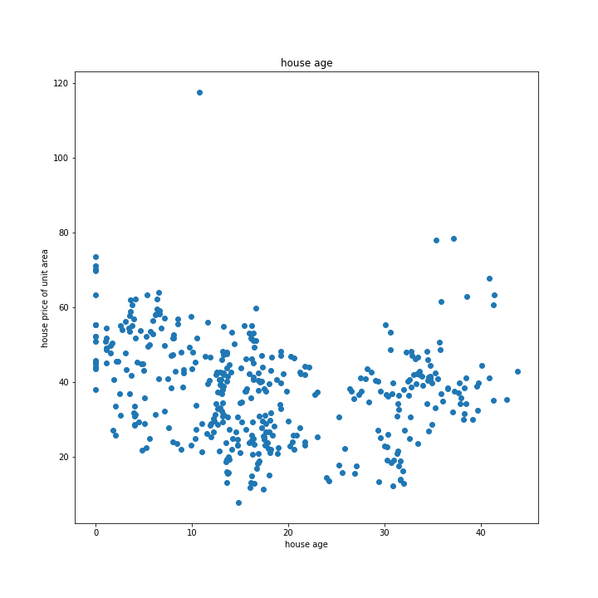
House Age vs. House Price of Unit Area
Using this scatterplot, we can see that there is a linear relationship between the age of a house and the house price of the unit area.
The two variables seem to have a negative correlation wherein as the age of a house increases, the house price decreases.

Slide 5
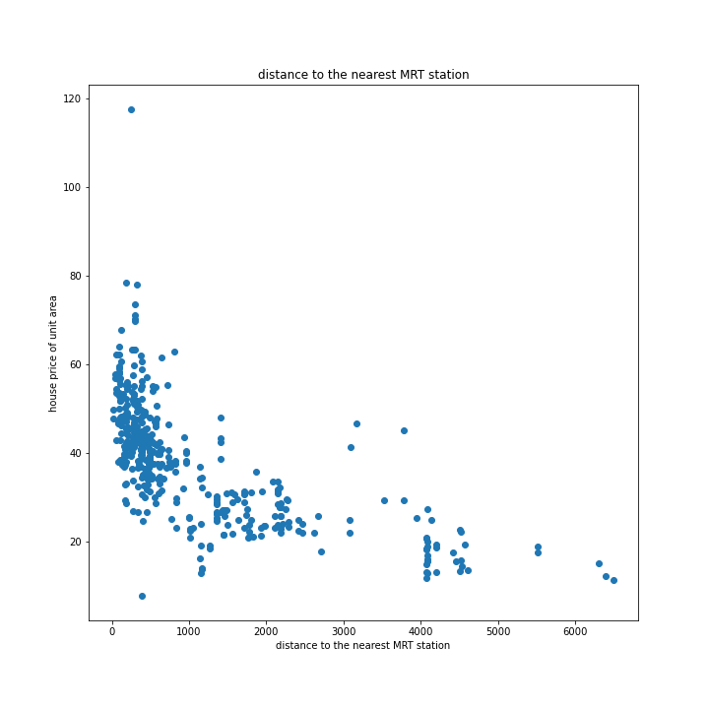
Distance to MRT Station vs. House Price of Unit Area
Using this scatterplot, we can see that there is a linear relationship between the distance to the nearest MRT station and the house price of the unit area.
The two variables seem to have a negative correlation wherein as the distance to the nearest MRT station increases, the house price of unit area decreases.

Slide 6
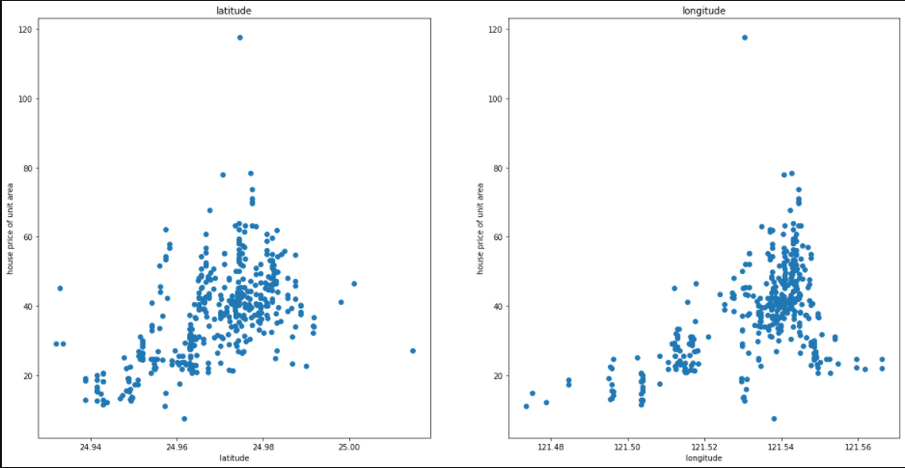
Latitude vs. House Price
Using this scatterplot, we can see that there is a linear relationship between the latitude and the house price of the unit area.
The two variables seem to have a positive correlation wherein as the latitude increases, the house price of unit area increases.

Slide 7
Longitude vs. House Price
Using this scatterplot, we can see that there is a linear relationship between the longitude and the house price of the unit area.
The two variables seem to have a positive correlation wherein as the latitude increases, the house price of unit area increases.

Slide 8
Latitude and Longitude
Latitude and longitude are related to each other and form a geographic coordinate system associated with positions on Earth.
In this dataset, the latitude and longitude values correspond with locations in Northern Taiwan.

Slide 9

Creating R-Squared Model

Slide 10
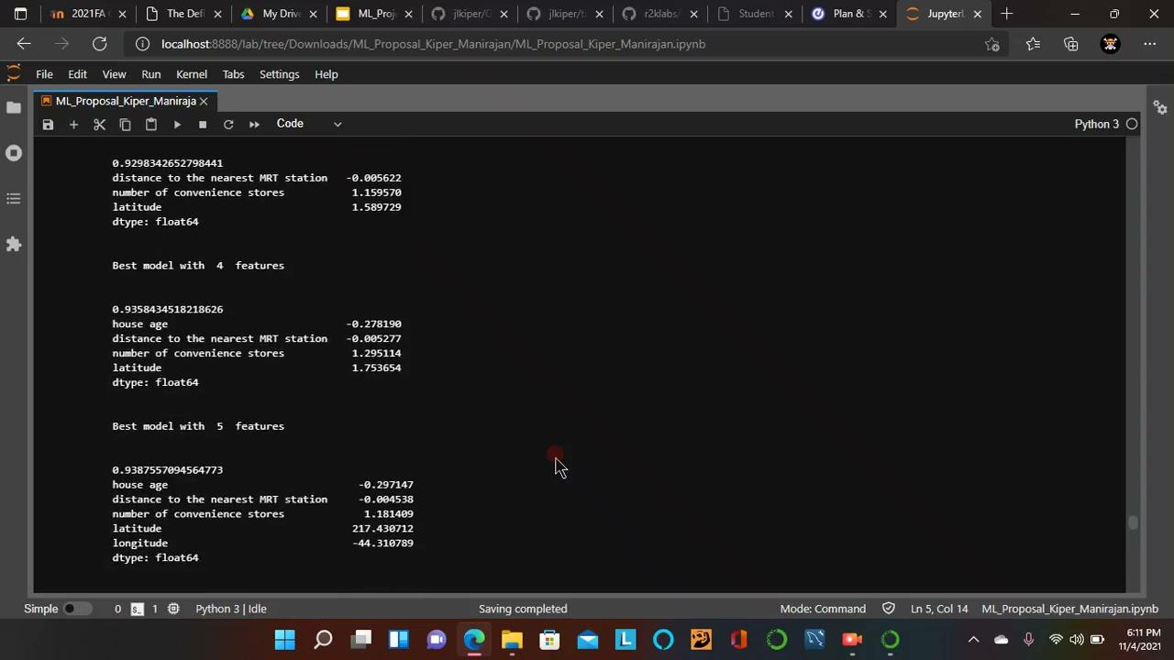
Best Subset Feature Selection

Slide 11
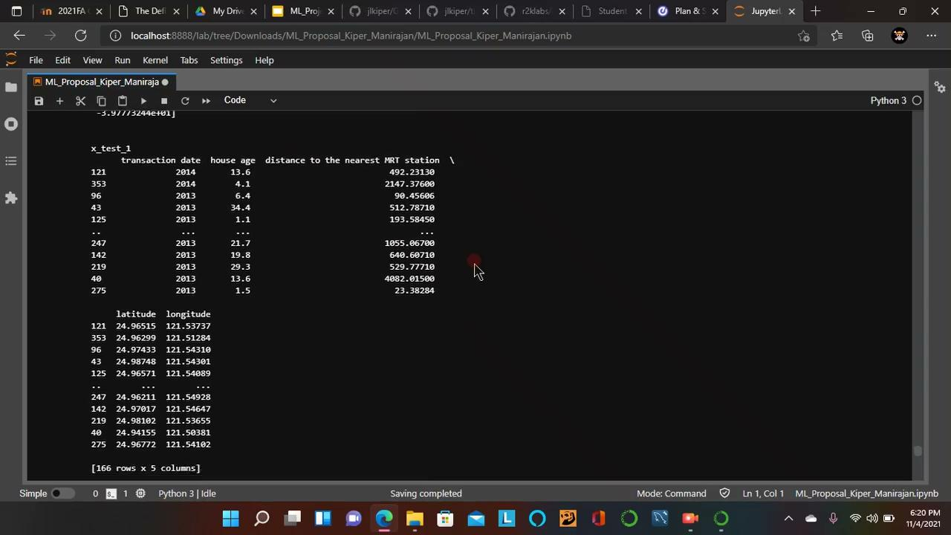
Model Against Your Test Set

Slide 12
Source of Data
Bruce. “Real Estate Price Prediction.” Kaggle.com, 2018, www.kaggle.com/quantbruce/real-estate-price-prediction. Accessed 19 Oct. 2021.

