Slide 1

Joomla! Reborn: coding in version 1.5
Joe LeBlanc

Slide 2
It finally works the way you always wanted
Completely overhauled codebase
Improved security
Better menu and URL controls
  Default item
  /better/link/structure

Slide 3
Goodbye Register Globals!
Gone even in Legacy Mode!
Many internal globals are also gone
  $database
  $my
  $mosConfig_…
Now retrieved through JFactory methods
  $user =& JFactory::getUser();

Slide 4
Valid XHTML Transitional
Entire page built before output
Get JDocument object
Add JS and CSS
$document =& JFactory::getDocument();
$document->addStyleSheet('path/to/style.css');
$document->addScript('path/to/script.js');

Slide 5
Streamlined Execution
Better organized execution process
  Fewer opportunities for security holes
  More plugin event possiblities

Slide 6
Streamlined Execution (contd.)
Joomla! 1.5
$mainframe->route();
$Itemid = JRequest::getInt( 'Itemid');
$mainframe->authorize($Itemid);
Joomla! 1.0
if ( $option == 'com_content' && $Itemid === 0 ) {
$id = intval( mosGetParam( $_REQUEST, 'id', 0 ) );
$Itemid = $mainframe->getItemid( $id );
}
if ( $Itemid === 0 ) {
$query = "SELECT id"
. "\n FROM #__menu"
. "\n WHERE menutype = 'mainmenu'"
. "\n AND published = 1"
. "\n ORDER BY parent, ordering"
;
$database->setQuery( $query, 0, 1 );
$Itemid = $database->loadResult();
}

Slide 7
Streamlined Execution (contd.)
index2.php deprecated
Now sets a flag and includes index.php
index.php 89 lines for 1.5 vs. 281 lines in 1.0

Slide 8
XML Configuration Improved
Linking to component views
Component views get parameters
Component parameters easier to implement

Slide 9

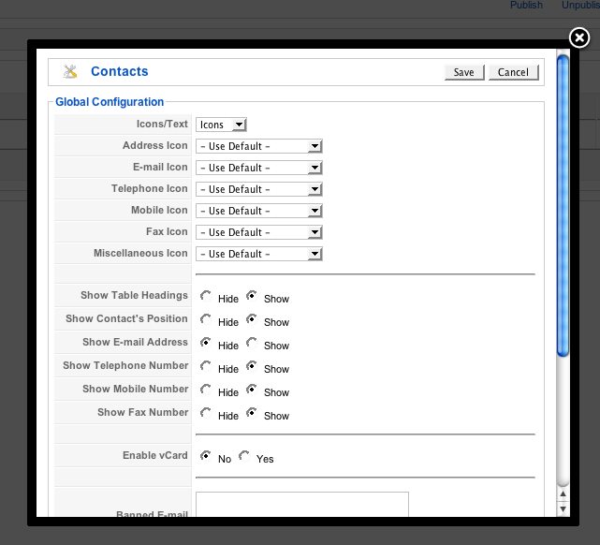
Component Parameters
Pulls from component XML

Slide 10
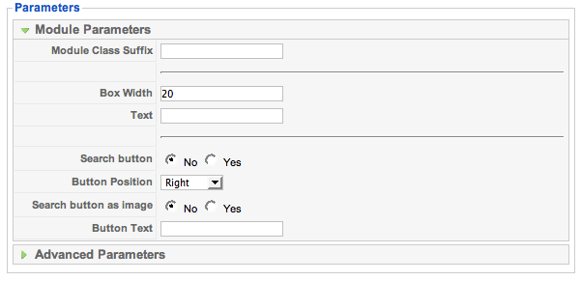
Modules are finally reusable!
Use XML parameters for different instances

Slide 11
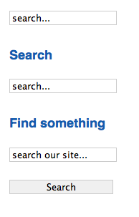
Modules are finally reusable! (contd.)
Without title, default settings
With title, default settings
With title, button, and overridden default text

Slide 12
Joomla! 1.0 was “MVC lite”
component.class.php
  Model/ActiveRecord
component.php
  Controller: long switch() statement
component.html.php
  View: set of functions

Slide 13
Real Model View Controller
Models organize queries
Individual views can be overridden
Controllers replace switch() statements

Slide 14
Models
Joomla! separates queries from tables
Models & Views can act “independently” of controller

Slide 15

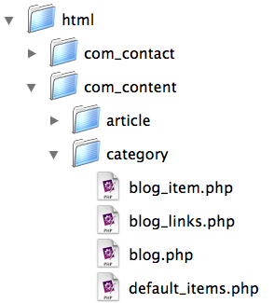
Views
Compare template overrides:
Joomla! 1.0
Joomla! 1.5

Slide 16
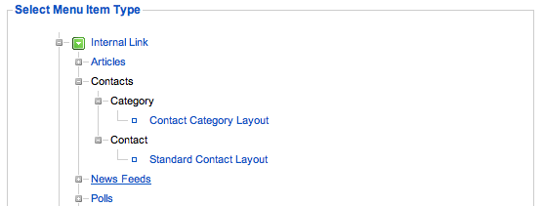
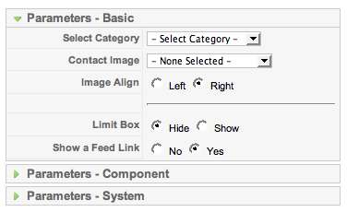
Views (contd.)
Views now have parameters that can be set for each menu link:

Slide 17
Controllers
Makes execution flow clear
Reduces number of $tasks
Defaults to internal display() method

Slide 18
Controllers (contd.)
Joomla! 1.0
Joomla! 1.5
switch ($task) {
case 'edit':
editRecord($id);
break;
default:
viewRecords();
break;
}
function editRecord($id)
{
...
}
...
class RecordsController extends JController
{
function edit()
{
...
}
function display()
{
parent::display();
}
}

Slide 19
Controllers - display()
No $task, calls display()
Finds ‘list’ view
‘list’ view calls model
Display
http://www.site.com/index.php?option=com_vegetables&view=list

Slide 20
Routing & SEF URLs
Use JRoute::_() on all links
Build logic in router.php
Transformation:
  index.php?option=com_vegetables&view=list&page=2
  /our_vegetables/list/2

Slide 21
router.php - Building Route
function VegetablesBuildRoute(&$query)
{
$segments = array();
$segments[] = $query['view'];
unset($query['view']);
$segments[] = $query['page'];
unset($query['page']);
return $segments;
}

Slide 22
router.php Parsing Route
function VegetablesParseRoute($segments)
{
$vars = array();
$vars['view'] = $segments[0];
$vars['page'] = $segments[1];
return $vars;
}

Slide 23
More information
developer.joomla.org - dev news
docs.joomla.org - wiki with API
www.jlleblanc.com

Slide 24
Shameless Plugs
Join the Bug Squad
Buy my book
Watch my videos (lynda.com, June)

