Slide 1

Writing Joomla! Extensions
  Joe LeBlanc

Slide 2
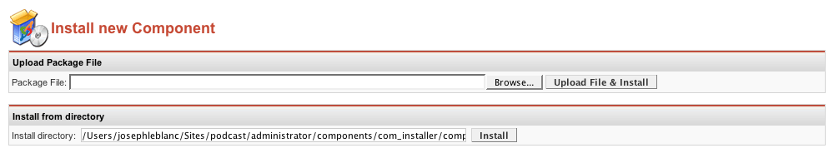

What makes Joomla! extensions unique?
They come in self-contained archives non-programmers can install: upload and you're done!

Slide 3
What makes Joomla! extensions unique?
Accommodating community:
  Any level of skill can contribute
  No extensions are trivial
  Commercial extensions welcome!

Slide 4
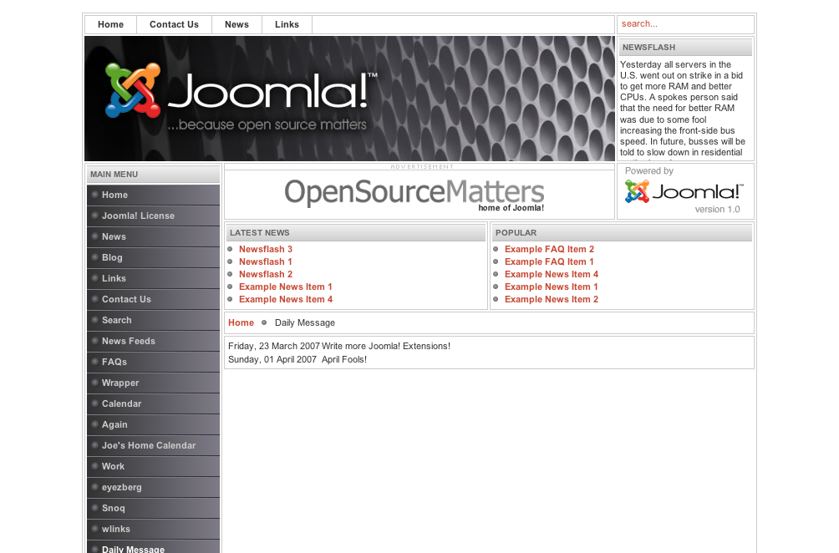
Modules, Plugins, and Components
The many
modules
The component

Slide 5
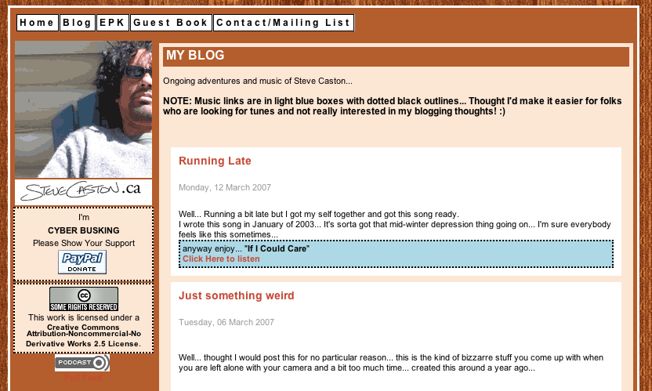
Modules, Plugins, Components
All three working together: Podcast Suite
Plugin
Module, linking to component

Slide 6
Modules, Plugins, Components
How do you execute a component?

Slide 7
1.0.x Components
General design: separate logic from output, centralize CRUD

Slide 8
1.0.x Components
Example of a native component:
Daily Message

Slide 9
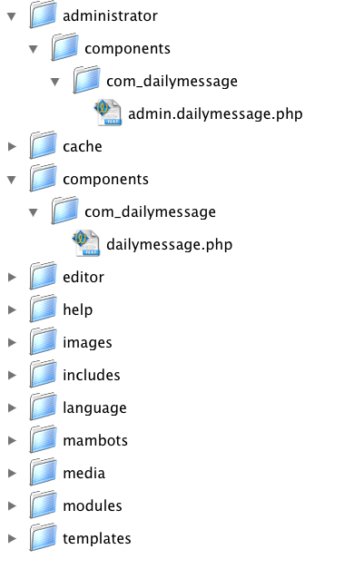
1.0.x Components: Daily Message
Minimum files

Slide 10
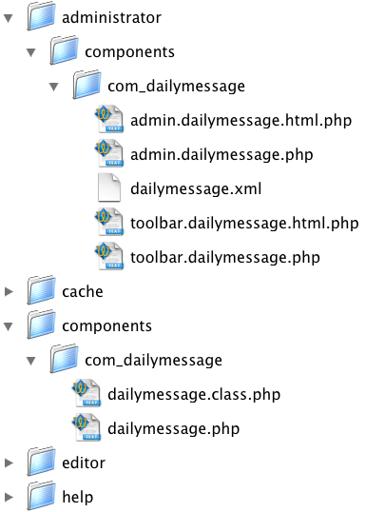
1.0.x Components: Daily Message
Typical set of files

Slide 11
Daily Message Frontend
dailymessage.php - Required
<?
defined( '_VALID_MOS' ) or die( 'Direct Access to this location is not allowed.' );
global $database;
...
$starttags = ...
$endtags = ...
...
$database->setQuery("SELECT * FROM #__joe_dailymessage WHERE published = '1'");
$rows = $database->loadObjectList();
?><table><?
foreach($rows as $row)
{
if($showdate == 1)
echo "<tr><td>" . mosFormatDate($row->date) . "</td>";
else
echo "<tr>";
echo "<td>" . $starttags . $row->message . $endtags . "</td></tr>";
}
?></table><?
?>

Slide 12
Daily Message Frontend
dailymessage.class.php – database class (used mainly by backend)
<?
defined( '_VALID_MOS' ) or die( 'Direct Access to this location is not allowed.' );
class joeDailyMessage extends mosDBTable {
var $id = null;
var $message = null;
var $date = null;
var $published = null;
function joeDailyMessage(&$db){
$this->mosDBTable('#__joe_dailymessage', 'id', $db);
}
}
class joeDailyMessageConf extends mosDBTable {
var $bold = null;
var $italic = null;
var $underline = null;
var $showdate = null;
var $configid = null;
function joeDailyMessageConf(&$db){
$this->mosDBTable('#__joe_dailymessage_conf', 'configid', $db);
}
}
?>

Slide 13
Daily Message Frontend

Slide 14
Daily Message Backend
admin.dailymessage.php - Required
<?php
defined('_VALID_MOS') or die('Direct Access to this location is not allowed.');
require_once( $mainframe->getPath( 'admin_html' ) );
require_once( $mainframe->getPath( 'class' ) );
...
switch($act)
{
case "configure":
switch($task) {
case "save":
saveConfiguration($option);
break;
default:
listConfiguration($option);
break;
}
break;
default:
switch ($task) {
case "save" :
save($option);
break;
...

Slide 15
Daily Message Backend
admin.dailymessage.php – Required - (contd.)
function edit($option, $uid) {
global $database;
$row = new joeDailyMessage($database);
if($uid){
$row -> load($uid[0]);
}
HTML_joeDailyMessage::edit($option, $row);
}
function listMessages($option) {
global $database;
$database->setQuery("SELECT * FROM #__joe_dailymessage ORDER BY id" );
$rows = $database -> loadObjectList();
if ($database -> getErrorNum()) {
echo $database -> stderr();
return false;
}
HTML_joeDailyMessage::listMessages($option, $rows);
}

Slide 16
Daily Message Backend
admin.dailymessage.html.php
class HTML_joeDailyMessage{
function edit( $option, &$row ) {
?>
<form action="index2.php" method="post" name="adminForm" id="adminForm" class="adminForm">
<table border="0" cellpadding="3" cellspacing="0">
<tr>
<td>Message: </td>
<td><input type="text" size="50" maxsize="100" name="message" value="<?php echo $row->message; ?>" /></td>
</tr>
<tr>
<td>Date: </td>
<td><input size="30" name="date" value="<? echo $row->date; ?>"></td>
</tr>
<tr>
<td>Published: </td>
<td><? echo mosHTML::yesnoSelectList( "published", "", $row->published ); ?></td>
</tr>
</table>
<input type="hidden" name="id" value="<?php echo $row->id; ?>" />
<input type="hidden" name="option" value="<?php echo $option; ?>" />
<input type="hidden" name="task" value="" />
</form>
<?
}
...

Slide 17
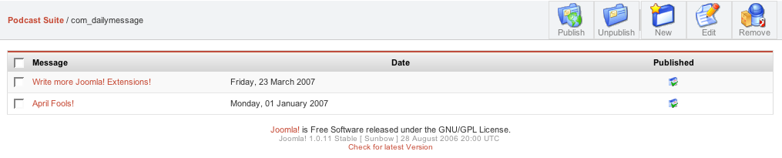
Daily Message Backend

Slide 18
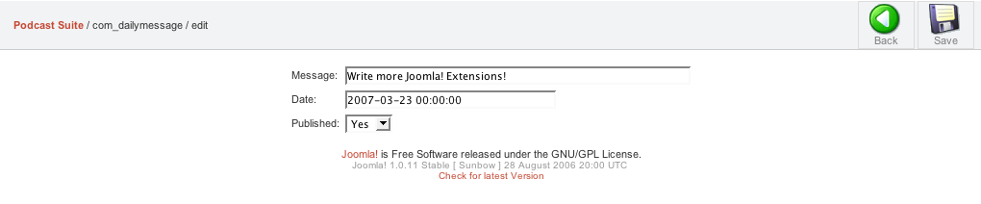
Daily Message Backend

Slide 19
Daily Message Backend
toolbar.dailymessage.php – Joomla! Backend autosearches for this file
<?
defined( '_VALID_MOS' ) or die( 'Direct Access to this location is not allowed.' );
require_once( $mainframe->getPath( 'toolbar_html' ) );
switch ( $task ) {
case 'edit':
menuDailyMessage::EDIT_MENU();
break;
case 'new':
menuDailyMessage::EDIT_MENU();
break;
default:
switch($act)
{
case "configure":
menuDailyMessage::CONFIGURE_MENU();
break;
default:
menuDailyMessage::DEFAULT_MENU();
break;
}
break;
}
?>

Slide 20
Daily Message Backend
toolbar.dailymessage.html.php
<?php
defined( '_VALID_MOS' ) or die( 'Direct Access to this location is not allowed.' );
class menuDailyMessage{
function DEFAULT_MENU() {
mosMenuBar::startTable();
mosMenuBar::publish('publish');
mosMenuBar::unpublish('unpublish');
mosMenuBar::divider();
mosMenuBar::addNew('new');
mosMenuBar::editList('edit', 'Edit');
mosMenuBar::deleteList( ' ', 'delete', 'Remove' );
mosMenuBar::endTable();
}
function EDIT_MENU() {
mosMenuBar::startTable();
mosMenuBar::back();
mosMenuBar::spacer();
mosMenuBar::save('save');
mosMenuBar::endTable();
}
function CONFIGURE_MENU() {
mosMenuBar::startTable();
mosMenuBar::save('save');
mosMenuBar::endTable();
}
}
?>

Slide 21
Daily Message Backend
dailymessage.xml
<?xml version="1.0" ?>
<mosinstall type="component">
<name>DailyMessage</name>
<creationDate>10/4/2005</creationDate>
<author>Joseph LeBlanc</author>
<copyright>This component in released under the GNU/GPL License</copyright>
<authorEmail>contact@jlleblanc.com</authorEmail>
<authorUrl>www.jlleblanc.com</authorUrl>
<version>1.0.3</version>
<files>
<filename>dailymessage.php</filename>
<filename>dailymessage.class.php</filename>
</files>
<install>
<queries>
...
</queries>
</install>
<uninstall>
...
</uninstall>
<installfile>
<filename>install.dailymessage.php</filename>
</installfile>
<uninstallfile>
<filename>uninstall.dailymessage.php</filename>
</uninstallfile>

Slide 22
Daily Message Backend
dailymessage.xml - Contd.
<administration>
<menu>Daily Message</menu>
<submenu>
<menu act="all">Edit Messages</menu>
<menu act="configure">Configure</menu>
</submenu>
<files>
<filename>admin.dailymessage.php</filename>
<filename>admin.dailymessage.html.php</filename>
<filename>toolbar.dailymessage.php</filename>
<filename>toolbar.dailymessage.html.php</filename>
</files>
</administration>
</mosinstall>

Slide 23
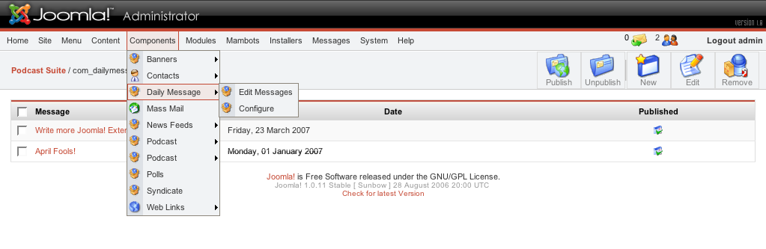
Daily Message Backend

Slide 24
Daily Message Backend
install.dailymessage.php – Optional
<?php
function com_install() {
}
?>
uninstall.dailymessage.php - Optional
<?
function com_uninstall() {
}
?>

Slide 25
1.0.x Components: iWebCal
A PHP script that reads in a .ics file (like the ones generated by iCal) and generates an HTML version

Slide 26
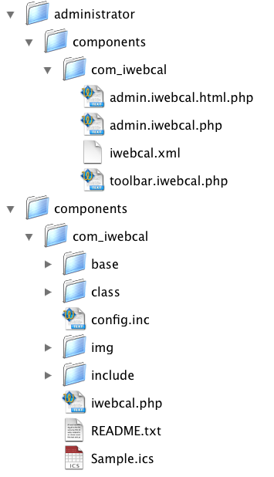
iWebCal File Structure
Required

Slide 27
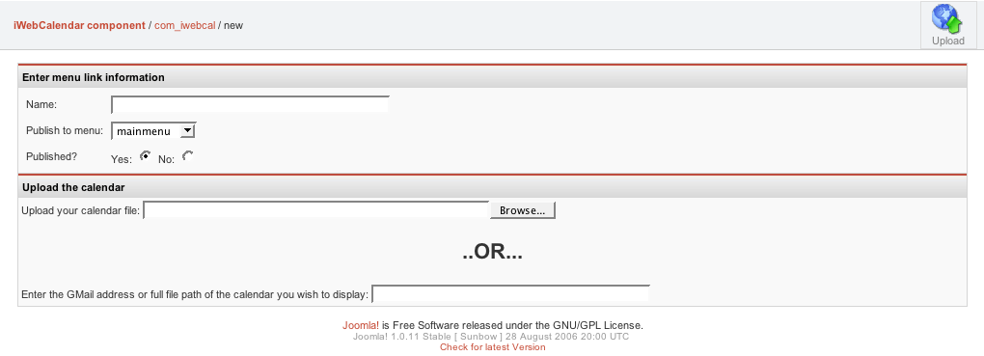
iWebCal File Backend

Slide 28
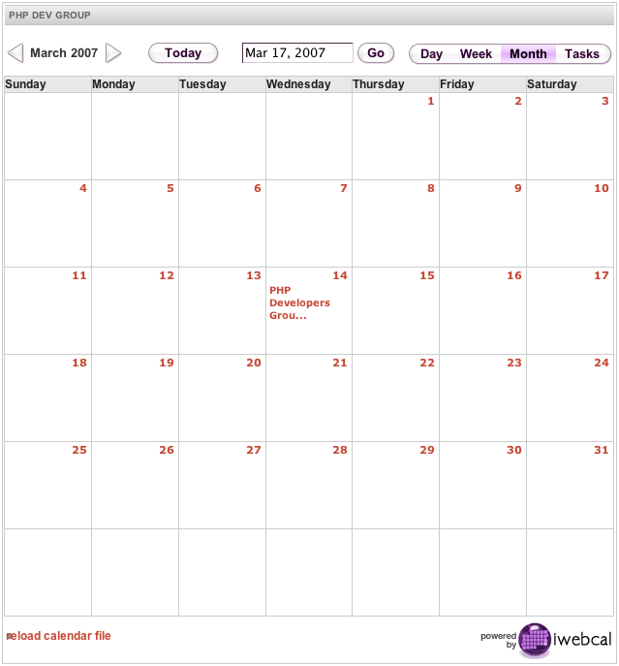
iWebCal Frontend

Slide 29
Daily Message: Moving to 1.5
Almost works out of the box:
<?php
defined('_VALID_MOS') or die('Direct Access to this location is not allowed.');
require_once( $mainframe->getPath( 'admin_html' ) );
require_once( $mainframe->getPath( 'class' ) );
...
$act = mosGetParam($_REQUEST, 'act', '');
switch($act)
{
...

Slide 30
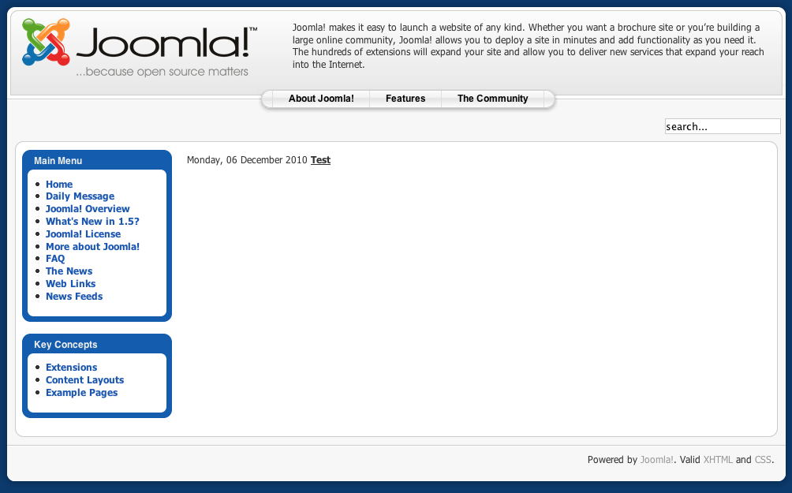
Daily Message: Moving to 1.5

Slide 31
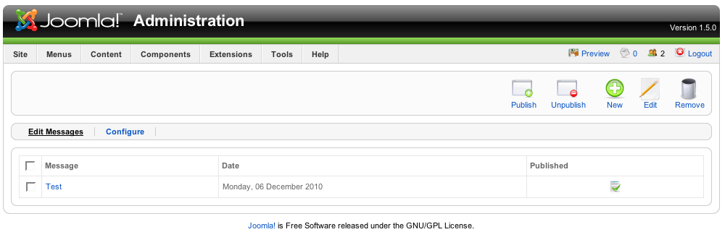
Daily Message: Moving to 1.5

Slide 32
Daily Message: Moving to 1.5
Idea in 1.5: Use a controller for logic, create your data models, and create a lot of views

Slide 33
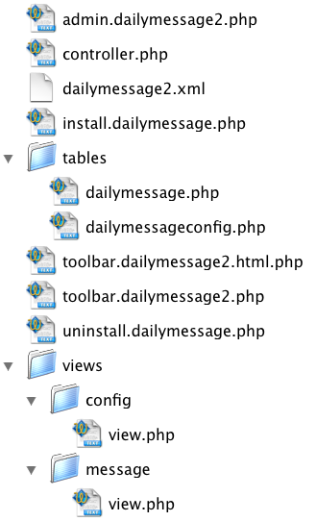

Daily Message: Moving to 1.5
What files would a 1.5 version of Daily Message need?
Backend
Frontend

Slide 34
Daily Message: Moving to 1.5
admin.dailymessage2.php
<?php
defined( '_JEXEC' ) or die( 'Restricted access' );
require_once( JPATH_COMPONENT.DS.'controller.php' );
JTable::addTableDir( JPATH_COMPONENT.DS.'tables' );
$controller = new DailyMessageController( array('default_task' => 'showMessages') );
$controller->execute( JRequest::getVar( 'task' ) );
$controller->redirect();
?>

Slide 35
Daily Message: Moving to 1.5
controller.php
<?
jimport( 'joomla.application.component.controller' );
class DailyMessageController extends JController
{
function __construct( $default = array())
{
parent::__construct( $default );
$this->registerTask( 'add' , 'edit' );
}
function save()
{
global $option, $mainframe;
$db =& JFactory::getDBO();
$row =& JTable::getInstance('DailyMessage', $db, 'Table');
if (!$row -> bind($_POST)) {
echo "<script> alert('" . $row->getError() ."'); window.history.go(-1); </script>\n";
exit();
}
if (!$row -> store()) {
echo "<script> alert('" . $row -> getError() ."'); window.history.go(-1); </script>\n";
exit();
}
$mainframe->redirect("index2.php?option=$option");
}

Slide 36
Daily Message: Moving to 1.5
controller.php - (contd.)
function edit()
{
global $option;
$cid = JRequest::getVar( 'cid', array(0), '', 'array' );
$db =& JFactory::getDBO();
$row =& JTable::getInstance('DailyMessage', $db, 'Table');
if($cid){
$row -> load($cid[0]);
}
require_once( JPATH_COMPONENT.DS.'views'.DS.'message'.DS.'view.php' );
MessageView::edit($option, $row);
}
...

Slide 37
Daily Message: Moving to 1.5
tables/dailymessage.php & tables/dailymessageconfig.php
<?php
class TableDailyMessage extends JTable
{
var $id = null;
var $message = null;
var $date = null;
var $published = null;
function __construct( &$db )
{
parent::__construct( '#__joe_dailymessage', 'id', $db );
}
}
?>
<?php
class TableDailyMessageConfig extends JTable
{
var $bold = null;
var $italic = null;
var $underline = null;
var $showdate = null;
var $configid = null;
function __construct( &$db )
{
parent::__construct( '#__joe_dailymessage_conf', 'configid', $db );
}
}
?>

Slide 38
Daily Message: Moving to 1.5
toolbar.dailymessage2.php
<?php
defined( '_JEXEC' ) or die( 'Restricted access' );
require_once( JApplicationHelper::getPath( 'toolbar_html' ) );
switch ($task)
{
case 'edit':
case 'add':
$cid = JRequest::getVar( 'cid', array(0), '', 'array' );
if (!is_array( $cid )) {
$cid = array(0);
}
TOOLBAR_dailymessage2::_EDIT($cid);
break;
case 'editConfiguration':
TOOLBAR_dailymessage2::_CONFIGURE();
break;
default:
TOOLBAR_dailymessage2::_DEFAULT();
break;
}
?>

Slide 39
Daily Message: Moving to 1.5
toolbar.dailymessage2.html.php
<?php
defined( '_JEXEC' ) or die( 'Restricted access' );
class TOOLBAR_dailymessage2 {
function _EDIT()
{
$cid = JRequest::getVar( 'cid', array(0));
$text = ( $cid[0] ? JText::_( 'Edit' ) : JText::_( 'New' ) );
JMenuBar::title( $text . " Message");
JMenuBar::save();
if ($cid[0]) {
JMenuBar::cancel( 'cancel', 'Close' );
} else {
JMenuBar::cancel();
}
}
function _DEFAULT() {
JMenuBar::title( 'Message Manager' );
JMenuBar::publishList();
JMenuBar::unpublishList();
JMenuBar::deleteList();
JMenuBar::editList();
JMenuBar::addNew();
}
...
}
?>

Slide 40
Daily Message: Moving to 1.5
views/config/view.php
<?php
defined( '_JEXEC' ) or die( 'Restricted access' );
class ConfigView
{
function editConfiguration($option, &$rows)
{
?>
<form action="index2.php" method="post" name="adminForm">
<table cellpadding="4" cellspacing="0" border="0" width="100%" class="adminlist">
<?
$row = $rows[0];
?>
<tr><td>Bold</td><td><? echo mosHTML::yesnoSelectList( "bold", "", $row->bold ); ?></td></tr>
<tr><td>Italic</td><td><? echo mosHTML::yesnoSelectList( "italic", "", $row->italic ); ?></td></tr>
<tr><td>Underline</td><td><? echo mosHTML::yesnoSelectList( "underline", "", $row->underline ); ?></td></tr>
<tr><td>Show Date</td><td><? echo mosHTML::yesnoSelectList( "showdate", "", $row->showdate ); ?></td></tr>
</table>
<input type="hidden" name="option" value="<?php echo $option; ?>" />
<input type="hidden" name="task" value="" />
<input type="hidden" name="configid" value=<? echo $row->configid ?> />
<input type="hidden" name="act" value="configure" />
</form>
<?
}
}
?>

Slide 41
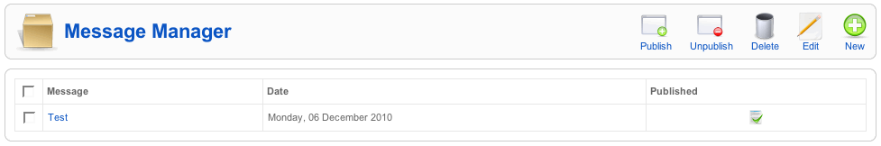
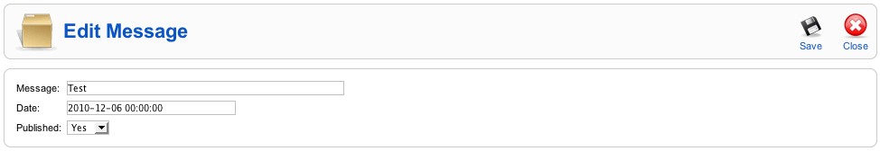
Daily Message: Moving to 1.5

Slide 42
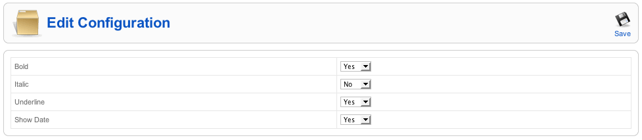
Daily Message: Moving to 1.5

Slide 43
Conclusions
  Joomla! 1.0.x lets you write standard PHP code at the point where you have component.php or component.admin.php, or you can use the framework.
  Joomla! 1.5 also lets you write standard PHP, 1.0.x code under the compatibility later, or you can use the new MVC goodies

Slide 44
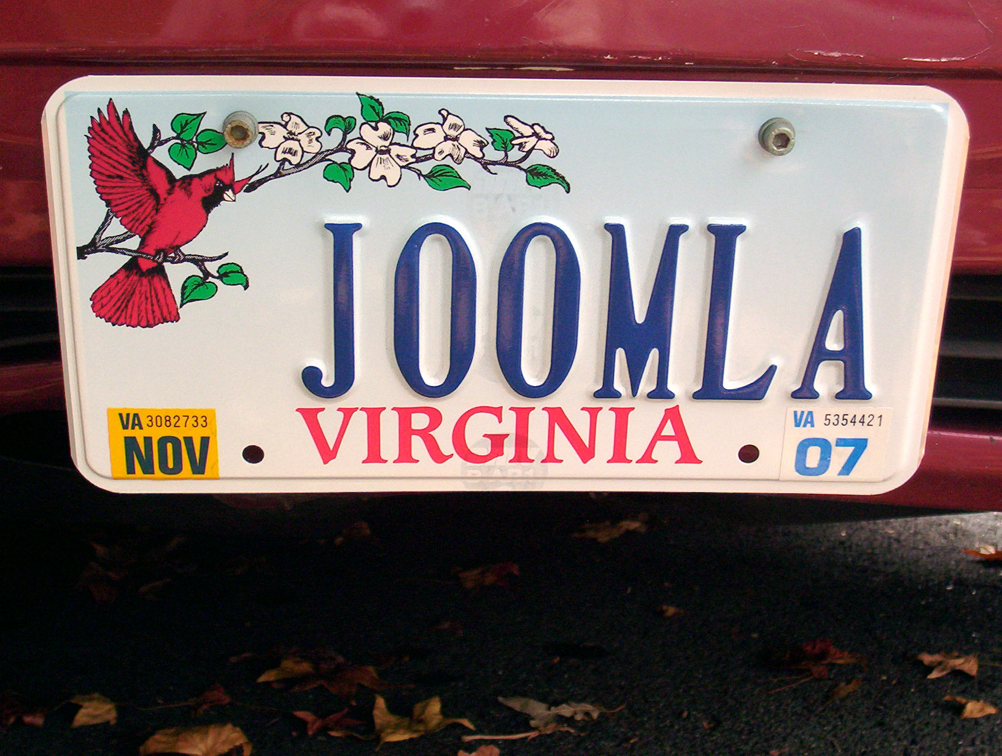
Questions?

