Slide 1
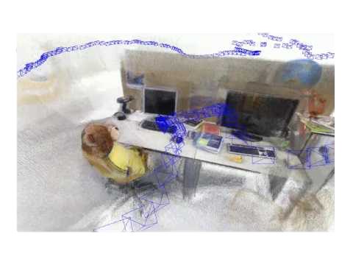
EuRoC MAV
ICL NUM
TUM
…
Elastic Fusion
ORB SLAM2
Kinect Fusion
…
Datasets
Algorithms
SLAMBench
Data File
SLAMBench
Library
I/O System
API Management
Loader
User Interface
Accuracy
Speed
Memory
Power
Benchmark Metric
Trajectory
SLAMBench

Slide 2
Loader
RGB Filter
Depth
Filter
…
Elastic Fusion
ORB SLAM2
Kinect Fusion
…
Flow Filtering System
Algorithms

Slide 3
Initializing
Processing
Graphic Rendering
update_frame
OutputManager
new_slam_configuration
process_once
init_slam_system
Finalizing
update_outputs
clean_slam_system

Slide 4
RGB
Sensor
RGB
Depth
IMU
RGB
Depth
Frame
IMU
Singular & Nonconcurrent Input Stream
Concurrent Input Stream

Slide 5
Elastic Fusion
ORB SLAM2
Kinect Fusion
…
Algorithms
Identity Filter
Random Drop Filter
…
Flow Filters
SLAMBench Configuration
Loader
EuRoC MAV
ICL NUM
TUM
…
Datasets

Slide 6
Elastic Fusion
ORB SLAM2
Kinect Fusion
…
Algorithms
SLAMBench Configuration
Loader
Resize Filter
Blur Filter
…
Sensor Filters
EuRoC MAV
ICL NUM
TUM
…
Datasets

Slide 7
Identity-flow-filter
Lifeline1: SLAMBenchConfiguration
Lifeline2: FlowFilter
Lifeline3: SLAMAlgorithm
input_stream_->GetNextFrame()
c_sb_update_frame_filter()
true
c_sb_process_once_filter()
true
true

