Slide 1
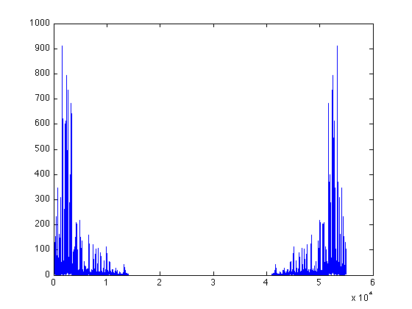
|X[k]|
k
0
15000
40000
54999

