Slide 1
ANALÒGIC
DIGITAL
MOSTREIG
T
QUANTITZACIÓ
Q
x(t)
x(nT)
x[n]
x
T
y

Slide 2
x[n]
x[-n]
x1[n]
+
x1[n]+x2[n]
R
x2[n]
x[n]
z⁻¹
x[n-1]
x1[n]
x
x1[n] · x2[n]
x[n]
z
x[n+1]
x2[n]
x[n]
Dk
x[kn]
x[n]
x
k · x[n]
k

Slide 3
x[n]
+
y[n]
y[n-1]
z⁻¹
x[n]
+
y[n]
-
z⁻¹
x[n-1]

Slide 4
x[n]
b0
+
+
y[n]
z⁻¹
z⁻¹
b1
+
+
-a1
z⁻¹
z⁻¹
b2
+
+
-a2
bM-1
+
+
-aN-1
z⁻¹
z⁻¹
bM
-aN
T1
T2

Slide 5
x[n]
+
b0
+
y[n]
z⁻¹
z⁻¹
+
-a1
b1
+
z⁻¹
z⁻¹
+
-a2
b2
+
+
-aN-1
bM-1
+
z⁻¹
z⁻¹
-aN
bM
T2
T1

Slide 6
x[n]
+
b0
+
y[n]
z⁻¹
+
-a1
b1
+
z⁻¹
+
-a2
b2
+
+
-aN-1
bM-1
+
z⁻¹
-aN
bM

Slide 7
a
x1[n]
x
+
T
y[n]
x2[n]
x
b
a
T
+
y[n]
x1[n]
x
T
x
x2[n]
b

Slide 8
x
T
y
z⁻¹
x
T
y
z⁻¹

Slide 9
x
T1
T2
y
TS
T1
x
+
y
T2
TP

Slide 10
x[n-1]
T ( x[n-1] )
x[n]
T
z⁻¹
y[n]=T ( x[n] )
x[n]
y[n-1]
T
z⁻¹

Slide 11
x(t)
Ta
y(t)
x(t)
x[n]
y[n]
y(t)
A/D
T
D/A

Slide 12
A/D
x
T/D
D/A
HП
D/T
F

Slide 13
x(t)
x[n]
y[n]
y(t)
A/D
H(ω)
D/A

Slide 14
x(t)
x[n]
y[n]
y(t)
A/D
H(ω)
D/A
T1
T2

Slide 15
A/D
x
T/D
T1
D/A
HП
D/T
F
T2

Slide 16
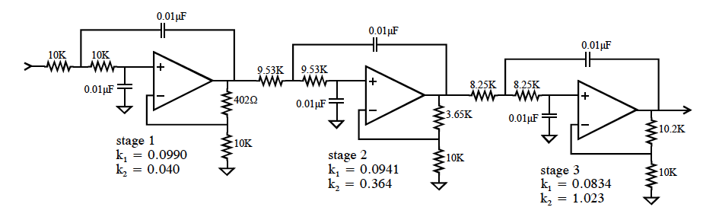

Slide 17
