Slide 1

PANG-KAT: A Dedicated Tokenizer for the Tagalog Language
Justin Louis L. Saavedra and Jaderick P. Pabico
JUNE 2025
2025 ICS UNDERGRADUATE RESEARCH SYMPOSIUM

Slide 2
INTRODUCTION
JUNE 2025
2025 ICS UNDERGRADUATE RESEARCH SYMPOSIUM

Slide 3
INTRODUCTION
Tokenization is a critical preprocessing step in many natural language processing (NLP) tasks, yet most general tokenization methods do not effectively recognize the unique grammatical features [2], named entities (NEs), and multi-word expressions (MWEs) [3] of a language.
JUNE 2025
2025 ICS UNDERGRADUATE RESEARCH SYMPOSIUM

Slide 4
INTRODUCTION
Low-resource languages are more prone to these issues [2], including the Tagalog language, which is the most spoken language in the Philippines, but lacks a suitable tokenizer for accurately processing its language resources to promote its further NLP advancements. These issues on tokenization is further complicated by code-switching [1].
JUNE 2025
2025 ICS UNDERGRADUATE RESEARCH SYMPOSIUM

Slide 5
OBJECTIVES
Develop a dedicated tokenizer for the Tagalog language to address its lack of a suitable tokenizer, which would also incorporate the recognition of Tagalog NEs and MWEs, and Tagalog-English (Taglish) tokenization in an attempt to make a general tokenizer for real-world Tagalog language processing applications.
JUNE 2025
2025 ICS UNDERGRADUATE RESEARCH SYMPOSIUM

Slide 6
OBJECTIVES
To create a dictionary containing Tagalog NEs and multi-word expressions to facilitate their recognition in the tokenization process.
To annotate a Taglish corpus into pre-segmented tokens, to be used for assessing the adaptability of the Tagalog tokenizer on Taglish data.
To construct a hybrid rule and dictionary-based tokenizer for the Tagalog language
To evaluate the tokenizer based on the following performance evaluation metrics:
a. Accuracy c. Recall
b. Precision d. F1-Score
JUNE 2025
2025 ICS UNDERGRADUATE RESEARCH SYMPOSIUM

Slide 7
METHODOLOGY
JUNE 2025
2025 ICS UNDERGRADUATE RESEARCH SYMPOSIUM

Slide 8
METHODOLOGY
To achieve its objectives, the study introduces PANG-KAT, a Python module developed as a hybrid rule and dictionary-based tokenizer due to the lack of pre-annotated Tagalog resources for a machine-learning approach [1].
JUNE 2025
2025 ICS UNDERGRADUATE RESEARCH SYMPOSIUM

Slide 9
DICTIONARY CREATION
To facilitate the recognition of Tagalog NEs and MWEs, a dictionary for PANG-KAT was manually created by extracting its vocabulary from various publicly available datasets and online resources [15-16] [25-32].
JUNE 2025
2025 ICS UNDERGRADUATE RESEARCH SYMPOSIUM

Slide 10
TWEETTAGLISH ANNOTATION
The author, in collaboration with two native Tagalog speaker annotators, annotated the TweetTaglish corpus [1] using Inside–Outside–Beginning (IOB) tagging, which was used in observing patterns in Tagalog and English (Taglish) code-switching that will be incorporated in the rule extraction phase to make PANG-KAT capable of Taglish tokenization.
JUNE 2025
2025 ICS UNDERGRADUATE RESEARCH SYMPOSIUM

Slide 11
RULE EXTRACTION
For PANG-KAT rules, these were manually extracted from two available Universal Dependencies (UD) treebanks in the Tagalog Language: Tagalog Reference Grammar (TRG) [18] and Ugnayan [8], cross-referenced with KWF’s Manwal sa Masinop na Pagsulat [33], and on the TweetTaglish corpus [1].
JUNE 2025
2025 ICS UNDERGRADUATE RESEARCH SYMPOSIUM

Slide 12
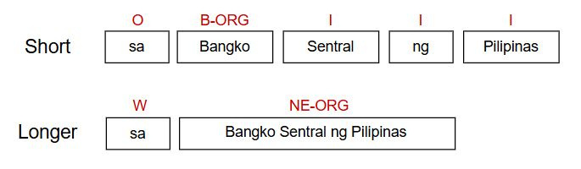
Example of short and longer unit tokenization with their corresponding labels. PANGKAT's dictionary categories include MWEs and NEs such as organization (NE-ORG), location (NE-LOC), and person (NE-PER) entities. Non-NEs and MWEs are labelled as "W", which corresponds to a word.
JUNE 2025
2025 ICS UNDERGRADUATE RESEARCH SYMPOSIUM
Notes:
The recognition of Tagalog NEs and MWEs is done through PANG-KAT's short and longer unit tokenization.
Where in short unit tokenization, tokens are labelled using IOB Tagging, with the B-tag used to indicate the beginning of entities, I for their insides, and O for the outsides or non-entity tokens.
In longer unit tokenization, tokens are grouped as Tagalog NEs or MWE, labelled based on the categories of PANG-KAT's dictionary and ruleset. The W-tag, which corresponds to a word, is used for non-NE and MWE tokens.

Slide 13
PERFORMANCE EVALUATION
PANG-KAT’s performance was evaluated through unit testing and external validation on the manually annotated NewsPH-NLI dataset [20] and May 2025 articles from Pilipino Star Ngayon [21] using the performance evaluation metrics of accuracy, precision, recall, and F1 Score.
JUNE 2025
2025 ICS UNDERGRADUATE RESEARCH SYMPOSIUM
Notes:
Pilipino Star Ngayon to evaluate PANG-KAT's adaptability to recent Tagalog language resources and full-length news texts.

Slide 14
RESULTS & DISCUSSION
JUNE 2025
2025 ICS UNDERGRADUATE RESEARCH SYMPOSIUM

Slide 15
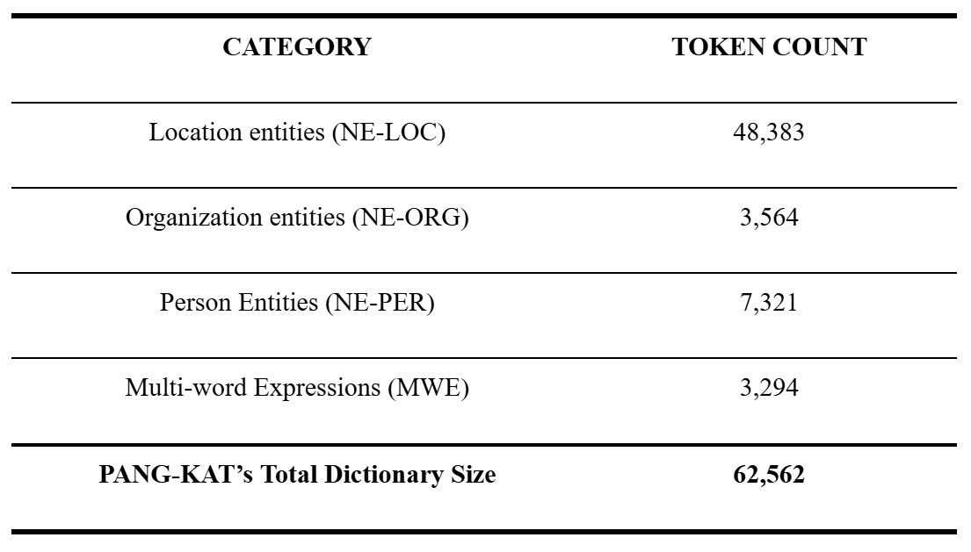
DICTIONARY CREATION
The dictionary size and composition of PANG-KAT
Notes:
LOC: Online Philippine Atlas, containing list of all regions, provinces, municipalities, cities, and barangays in the Philippines.
ORG: Department of Budget and Management's (DBM) list of national government offices, agencies, bureaus, GOCCs, and their respective abbreviations +
Philippine Council for NGO Certification's list of accredited non-government and non-profit organizations.
PER: From publicly available datasets, containing list of most common Filipino names, famous filipino personalities, CIA's list of renowned Filipino politicians, and list of all past senators from Senate's official website.
MWE: MWEs from KWF's Manwal sa Masinop na Pagsulat
Expanding PANG-KAT's dictionary is important for improving the overall performance of PANG-KAT in detecting and classifiying Tagalog NEs and MWEs

Slide 16
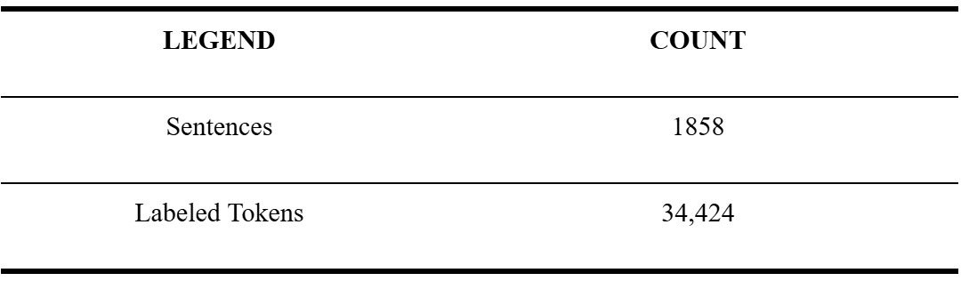
TWEETTAGLISH ANNOTATION
The composition of the annotated TweetTaglish Corpus

Slide 17
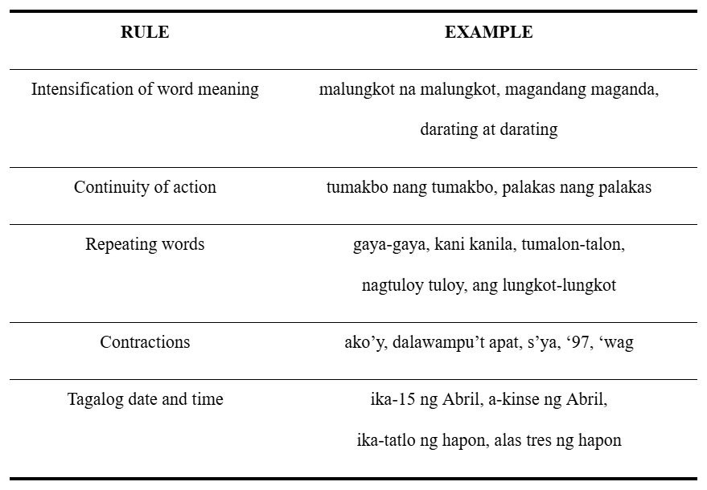
RULE EXTRACTION
The manually extracted rules of the Tagalog language

Slide 18
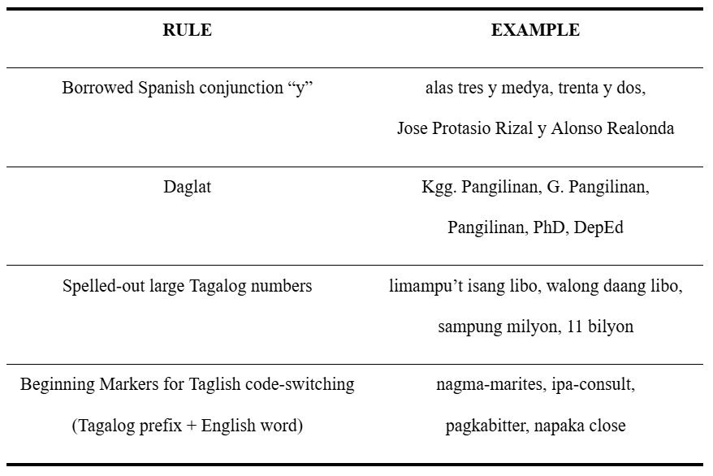
RULE EXTRACTION
The manually extracted rules of the Tagalog language

Slide 19
RULE SEQUENCING
PANG-KAT operates on a linear, first-match-wins architecture, wherein when a token is labeled, it won’t be reconsidered by later rules. Thus, rule sequencing is crucial for ensuring accurate token labeling, which starts with more structured, Tagalog-specific rules, followed by general rules on the proper usage of punctuation, and the broadest dictionary lookups.
JUNE 2025
2025 ICS UNDERGRADUATE RESEARCH SYMPOSIUM

Slide 20
RULE SEQUENCING
Token labels are only updated based on specific triggers that are mainly applicable for Tagalog NEs.
For instance, in the phrase “Pasig Mayor Vico Sotto,” the token Pasig would be initially labelled as a location (B-LOC), but would be updated as part of a person entity (B-PER) after matching the full entity using the B-PER dictionary.
JUNE 2025
2025 ICS UNDERGRADUATE RESEARCH SYMPOSIUM

Slide 21

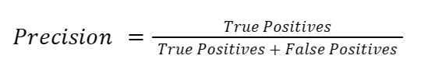

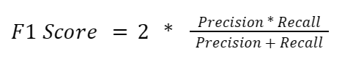
Performance evaluation metrics.

Slide 22
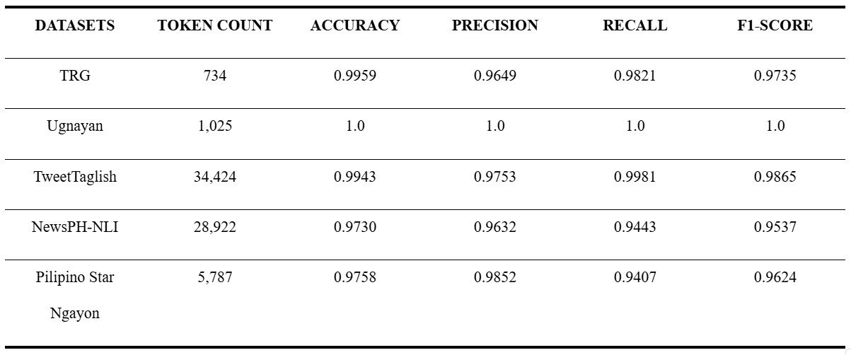
PERFORMANCE EVALUATION
Performance evaluation results of PANG-KAT's short-unit tokenization for both unit testing and external validation.

Slide 23

PERFORMANCE EVALUATION
Performance evaluation results of PANG-KAT's longer-unit tokenization for both unit testing and external validation.

Slide 24
PERFORMANCE EVALUATION
PANG-KAT achieved F1 scores exceeding 0.9 on both unit testing and external validation for both short and longer unit tokenization. Given that the F1-score ranges from 0 to 1, with 1 indicating perfect classification performance for the model [22], PANG-KAT F1 scores indicate good performance in accurately tokenizing and classifying Tagalog NEs and MWEs.
JUNE 2025
2025 ICS UNDERGRADUATE RESEARCH SYMPOSIUM

Slide 25
DISCUSSION
The deductions on PANG-KAT’s F1 score is mainly impacted by its strong reliance on the word patterns in its ruleset; it lacks the ability to recognize deeper contextual meanings and word relationships. Strict word patterns also lead to misclassifications when handling misspellings or incorrect usage of punctuation. Additionally, its dictionary has limited vocabulary and is specifically tailored to the Philippine context.
JUNE 2025
2025 ICS UNDERGRADUATE RESEARCH SYMPOSIUM

Slide 26
CONCLUSION
JUNE 2025
2025 ICS UNDERGRADUATE RESEARCH SYMPOSIUM

Slide 27
CONCLUSION
The main objective of this study is to develop PANG-KAT to address the lack of language-specific NLP tools for the Tagalog language, particularly a suitable tokenizer. Through rigorous development and testing, the performance evaluation results of PANG-KAT indicated good performance in accurately tokenizing and classifying Tagalog NEs and MWEs. These results affirm the effectiveness of its ruleset and dictionaries in capturing the patterns in Tagalog and Taglish texts.
JUNE 2025
2025 ICS UNDERGRADUATE RESEARCH SYMPOSIUM

Slide 28
RECOMMENDATIONS
Further improvements in PANG-KAT's performance can still be achieved by integrating it with additional Tagalog pre-processing modules and expanding its dictionary, all to develop a dedicated Tagalog tokenizer that could serve as a foundation for the development of more advanced Tagalog NLP tools and bridge the gap that impedes its potential NLP advancements.
JUNE 2025
2025 ICS UNDERGRADUATE RESEARCH SYMPOSIUM

Slide 29
REFERENCES
[1] M. Herrera, A. Aich, and N. Parde. “TweetTaglish: A Dataset for Investigating Tagalog-English Code-Switching”. In: Proceedings of the Thirteenth Language Resources and Evaluation Conference. Marseille, France: European Language Resources Association, pp. 2090–2097. 2022. URL: https://aclanthology. org/2022.lrec-1.225/.
[2] J. Gra¨en, M. Bertamini, and M. Volk. “Cutter – a Universal Multilingual Tokenizer”. In: Swiss Text Analytics Conference. Winterthur, 12 June 2018 - 13 June 2018: CEUR-WS, pp. 2090–2097. 2018. URL: https://doi.org/10.5167/uzh-157243.
[3] A. Akkasi, E. Varo˘glu, and N. Dimililer. “ChemTok: A New Rule Based Tokenizer for Chemical Named Entity Recognition”. In: BioMed Research International, pp. 1–9. 2016. URL: https://doi.org/10.1155/2016/4248026.
[4] K. Takaoka et al. “Sudachi: a Japanese Tokenizer for Business”. In: Proceedings of the Eleventh International Conference on Language Resources and Evaluation (LREC 2018). Miyazaki, Japan: European LanguageResources Association (ELRA). 2018. URL: https://aclanthology.org/L18-1355.pdf.

Slide 30
REFERENCES
[5] R. Gordon. “Ethnologue: Languages of the world”. In: SIL International. Dallas, p. 1272. 2005. ISBN:155671159X.
[6] K. Foote. “A Brief History of Natural Language Processing”. In: Dataversity Digital LLC. 2023. URL: https://www.dataversity.net/a-brief-history-of-natural-language-processing-nlp/.
[7] R. E. Roxas, J. M. Imperial, and A. De La Cruz. “Science Mapping of Publications in Natural Language Processing in the Philippines: 2006 to 2020”. In: Proceedings of the 35th Pacific Asia Conference on Language, Information and Computation. Shanghai, China: Association for Computational Linguistics (ACL), pp. 500–509. 2021.
URL: https://aclanthology.org/2021.paclic-1.76/.
[8] A. Aquino and F. de Leon. “Parsing in the absence of related languages: Evaluating low-resource dependency parsers on Tagalog”. In: Proceedings of the Fourth Workshop on Universal Dependencies (UDW 2020). Barcelona, Spain (Online): Association for Computational Linguistics, pp. 8–15. 2020. URL: https://aclanthology.org/2020.udw 1.2.pdf.

Slide 31
REFERENCES
[9] R. Friendman. “Tokenization in the Theory of Knowledge”. In: Encyclopedia. Vol. 3. 1, pp. 380–386. 2023. URL: https://doi.org/10.3390/encyclopedia3010024.
[10] V. Singh and B. Saini. “An Effective Tokenization Algorithm for Information Retrieval Systems”. In: Proceedings of the First International Conference on Data Mining
(DMIN-2014). Royal Archid, Banglore, India. 2014. URL: https://doi.org/10.5121/csit.2014.4910.
[11] D. Biber. “Representativeness in Corpus Design”. In: Literary and Linguistic Computing. Vol. 8. 4. Associa-tion for Computational Linguistics, pp. 243–257. 1993.
[12] T. McEnery and A. Wilson. “Corpus linguistics”. In: Davies G. (ed.) Information and Communications Technology for Language Teachers (ICT4LT). Slough, Thames Valley University [Online]: De Gruyter Mouton, pp. 1286–1304. 2012.
URL: http://www.ict4lt.org/en/en mod3-4.htm.
[13] D. Biber and J. Jones. “61. Quantitative methods incorpus linguistics”. In: L¨udeling M. Kyt¨o (Ed.), Volume 2: An International Handbook. Berlin, New York: De Gruyter Mouton, pp. 1286–1304. 2009. URL: https://doi.org/10.1515/9783110213881.2.1286.

Slide 32
REFERENCES
[14] S. D. Samson. “A treebank prototype of Tagalog”. In: Bachelor’s thesis. Germany: University of T¨ubingen. 2018.
[15] L. J. Miranda. Developing a Named Entity Recognition Dataset for Tagalog. arXiv: 2311 . 07161 [cs.CL]. 2023.
[16] R. Francisco and A. M. Asis. “Tagalog Dictionary Scraper”. In: GitHub repository. 2023. URL: https://github.com/raymelon/tagalog-dictionary-scraper.
[17] L. Villapando and J. Samaniego. “SApp: Data Visualization and Sentiment Analysis Tool From Twitter Data”. In: 2023. URL: https://lib.ics.uplb.edu.ph/research_paper/1691638468_
2023-07_Villapando_Samaniego.pdf
[18] J.L. Fleiss. “Measuring nominal scale agreement among many raters”. In: Psychological Bulletin. Vol. 76. 5, pp. 378–382. 1971.
[19] JSON Editor Online. JSON vs CSV: What is the difference and what should I use? URL: https://jsoneditoronline.org/indepth/compare/json-vs-csv/. 2023.

Slide 33
REFERENCES
[20] J. C. B. Cruz et al. “Exploiting News Article Structure for Automatic Corpus Generation of Entailment Datasets”. In: Pacific Rim International Conference on Artificial Intelligence. 2020. URL: https://doi.org/10.48550/arXiv.2010.11574.
[21] PhilStar. Pilipino Star Ngayon. URL: https://www.philstar.com/pilipino-star-ngayon/. 2025.
[22] C. Bhargava et al. “Depression Detection Using Sentiment Analysis of Tweets”. In: Turkish Journal of Computer and Mathematics Education. Vol. 12. 11. Slough, Thames Valley University [Online]: De Gruyter Mouton, pp. 5411–5418. 2021.
[23] G. Van Rossum and J. L. Drake. Python 3 Reference Manual. Scotts Valley, CA: CreateSpace. 2009. ISBN: 1441412697.
[24] PhilAtlas. Welcome to PhilAtlas. URL: https://www.philatlas.com. 2025.
[25] Department of Budget and Management. Result of Validation of DBM-OCIO for Transparency Seal. URL: https://www.dbm.gov.ph/index.php/result-of-validation-of-dbm-ocio-for-transparency-seal. 2023.

Slide 34
REFERENCES
[26] Department of Budget and Management. BESF2024-Acronyms.
URL: https://www.dbm.gov.ph/wp-content/uploads/BESF/BESF2024/ACRONYMS.pdf. 2024.
[27] Philippine Council for NGO Certification. Accredited NGO.
URL: https://pcnc.com.ph/accredited-ngos/. 2025.
[28] P. Remy. “First and Last Name Database”. In: GitHub repository. 2021.
URL: https://github.com/philipperemy/name-dataset.
[29] J. I. Villanueva. “Most Popular Names in the Philippines Dataset”. In: Kaggle. 2023. URL: https://www.kaggle.com/datasets/jorizivannvillanueva/most-popular-names-in-philippines-dataset?resource=download.
[30] Inc. Boo Enterprises. “Filipino Actors / Actresses Celebrities”. In:BooWorld. 2025.
URL: https://boo.world/database/celebrities/filipino-actors-actresses-celebrities.
[31] Central Intelligence Agency. World Leaders - Historical Data.
URL: https://www.cia.gov/resources/world-leaders/historical-data/

Slide 35
REFERENCES
[32] Senate of the Philippines. List of Previous Senators.
URL: https://legacy.senate.gov.ph/senators/senlist.asp. 2022.
[33] V. S. Almario. KWF Manwal sa Masinop Na Pagsulat (Ser. Aklat ng bayan). Komisyon sa Wikang Filipino. 2015. URL: https://kwf.gov.ph/wp-content/uploads/MMP_Full.pdf.
[34] F. De Vos. Essential tagalog grammar: A reference for learners of Tagalog. URL: https://learningtagalog.com/grammar/verbs/pseudoverbs//repeated_pseudoverbs.html.
[35] International Organization for Standardization. ISO 8601 - date and Time Format.
URL: https://www.iso.org/iso-8601-date-and-time-format.html. 2020.

Slide 36
THANK YOU AND
HAVE A GOOD DAY!
Justin Louis L. Saavedra and Jaderick P. Pabico
JUNE 2025
2025 ICS UNDERGRADUATE RESEARCH SYMPOSIUM

Slide 37
REVIEW OF LITERATURE
MAY 2025
SP2 PRESENTATION

Slide 38
Why create a dedicated tokenizer?
NLP tools developed for a specific language suffers in performance when used for other languages. Specificially designed tools for a particular language outperforms because it can better capture the grammatical complexities of the target language [8].
MAY 2025
SP2 PRESENTATION

Slide 39
Why tokenizer?
The performance of more advanced NLP tools depends on the quality of tokens generated by the tokenization process, as the quality of tokens is essential for generating a coherent and accurate sequence of tokens that collectively form knowledge [9].
MAY 2025
SP2 PRESENTATION

Slide 40
Why do a hybrid rule and dictionary-based approach?
Machine-learning approach for tokenizers requires adequate amount of pre-annotated training data, which the low-resourced Tagalog language lacks [1]. Numerous studies suggest an ideal corpus size of approximately a million tokens for a comprehensive studies on general language [11] [12] [13].
MAY 2025
SP2 PRESENTATION

