Slide 1
Developing Stateless, Concurrent Services with Spring Beans
September 2019
© 2019 Cognizant

Slide 2
Agenda
Objectives
Spring Beans Overview
Statelessness
Modularity
Loose-Coupling with DI
Scopes
© 2019 Cognizant

Slide 3

Objectives
  Statelessness
    Scalability
    Fault Tolerance
  Modularity
  Loose-Coupling
© 2019 Cognizant

Slide 4
Agenda
Objectives
Spring Beans Overview
Statelessness
Modularity
Loose-Coupling with DI
Scopes
© 2019 Cognizant

Slide 5
History of Beans
Core Java | JavaBeans
Java EE | EJBs CDI Beans
Spring | Spring Beans
http://mvpjava.com/brief-history-dependency-injection/
© 2019 Cognizant

Slide 6
Inversion Of Control (IoC)
  Frameworks call into your code – not the other way around
    @RestController
    @Scheduled
  Dependency Injection via IoC Container
    @Autowired
© 2019 Cognizant

Slide 7
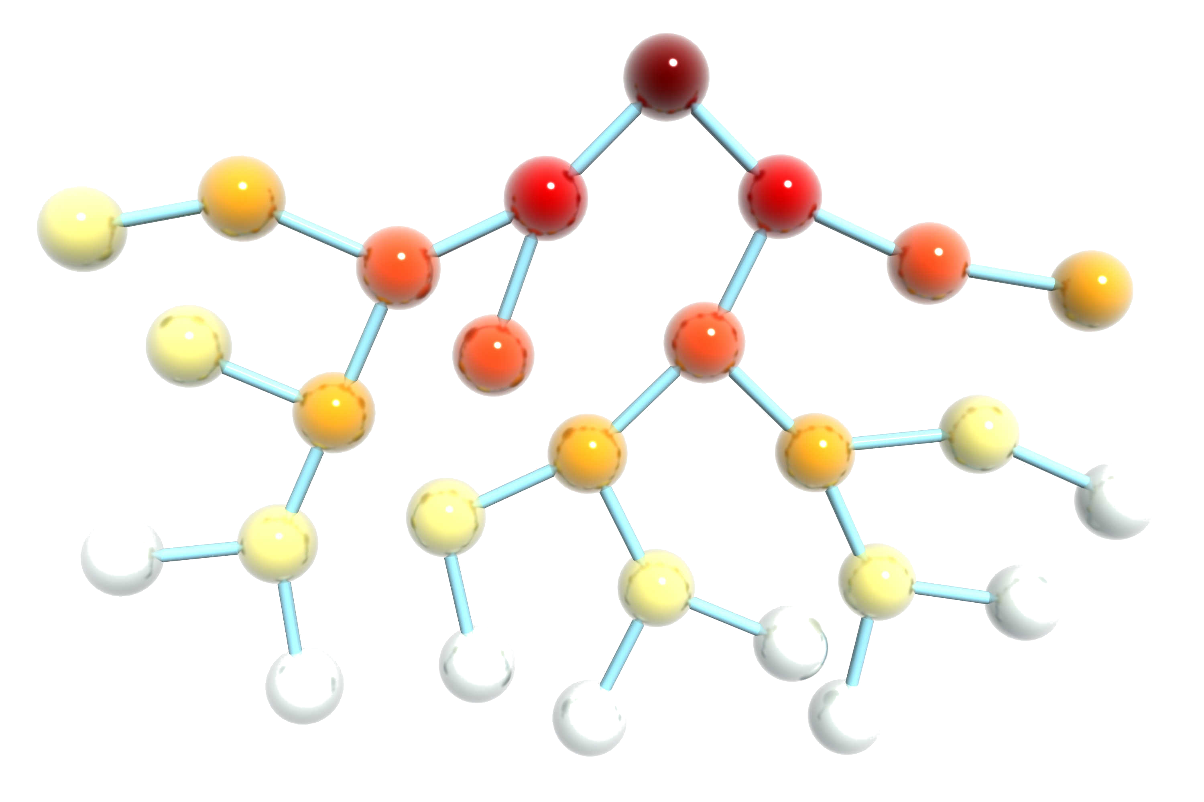
Top-Level Beans
  Do not need to be injected
    @RestController
    @Scheduled
  Create an “entry point” for other beans to be injected into the application
© 2019 Cognizant

Slide 8
Other Categories
  Stereotypes
    @Component, @Controller, @Service, @Repository
  Secondary Frameworks
    @FeignClient
  Internal / Out-of-the-Box
    HttpSession, HttpServletRequest
  Configured
    @Configuration
    XML (e.g. applicationContext.xml)
© 2019 Cognizant

Slide 9
Agenda
Objectives
Spring Beans Overview
Statelessness
Modularity
Loose-Coupling with DI
Scopes
© 2019 Cognizant

Slide 10
Statelessness
  State refers to memory of previous requests for the purpose of affecting subsequent requests
    E.g. shopping cart
    Requires behavior to change with changes in state
  Advantages of Statelessness
    Scalability
    Fault Tolerance
  What do we do if we need to implement a shopping cart?
© 2019 Cognizant

Slide 11
Rule Of Thumb
  A Bean only has the following instance variables:
    Bean dependencies
    Immutable, Constant variables
  As a last resort, an instance variable obeys the following:
    Affects performance, not functionality (e.g. cache, pool)
    Thread-safe
© 2019 Cognizant

Slide 12
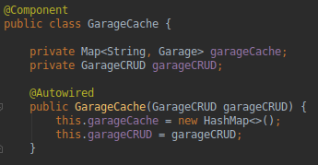
Last Resort Example
© 2019 Cognizant

Slide 13
Agenda
Objectives
Spring Beans Overview
Statelessness
Modularity
Loose-Coupling with DI
Scopes
© 2019 Cognizant

Slide 14
Modular Beans
  Beans were invented to be modular – not monolithic.
  The Service Layer (@Service) can delegate responsibility
    A Service Bean is monolithic if it contains all the business logic
  A Component (@Component) can be a:
    Unit of Business Logic
    Worker Bean
© 2019 Cognizant

Slide 15
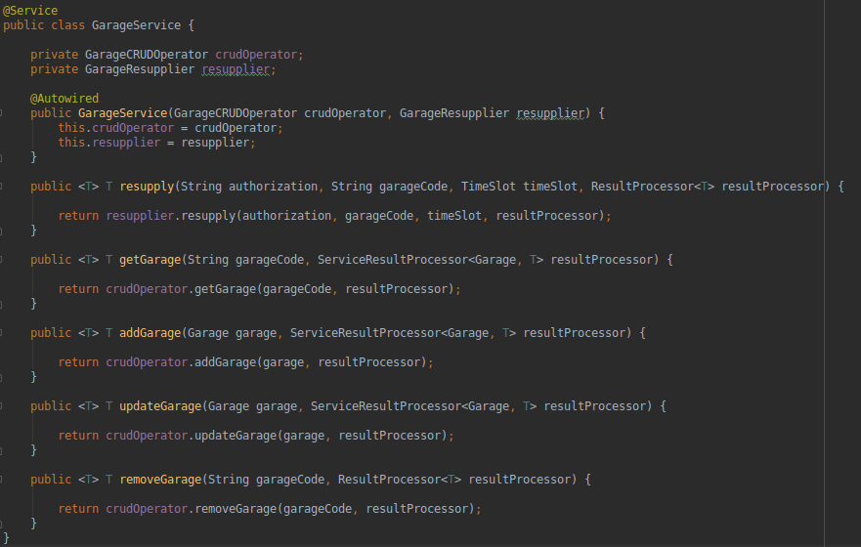
Modularity Example
© 2019 Cognizant

Slide 16
Agenda
Objectives
Spring Beans Overview
Statelessness
Modularity
Loose-Coupling with DI
Scopes
© 2019 Cognizant

Slide 17
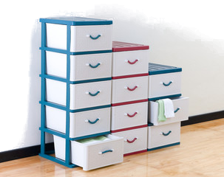
Why Loose-Coupling?
  Tight-Coupling = Spaghetti
  Separation of Concerns
  Plug-and-Playability (Liskov Substitution)
© 2019 Cognizant

Slide 18
Loose-Coupling with DI
  Beans are backed by Interfaces
  Interfaces injected instead of Beans
  During run-time, the Spring IoC Container resolves and injects the correct Spring Bean
© 2019 Cognizant

Slide 19
Agenda
Objectives
Spring Beans Overview
Statelessness
Modularity
Loose-Coupling with DI
Scopes
© 2019 Cognizant

Slide 20
Spring Bean Scopes
Category | Scope
Regular | Singleton
 | Prototype
Web Aware | Request
 | Session
 | Application
 | WebSocket
© 2019 Cognizant

Slide 21
Recommended Scopes
  Singleton, Application, WebSocket
  Request Scope pro:
    Easy Statelessness and Thread-Safety
  Request Scope con:
    Inferior Scalability
© 2019 Cognizant

Slide 22
Thank you
Sample code: https://code.cognizant.com/718967/icecream

