Slide 1
Macias Jose Luis
LTL Generator Individual Contribution

Slide 2
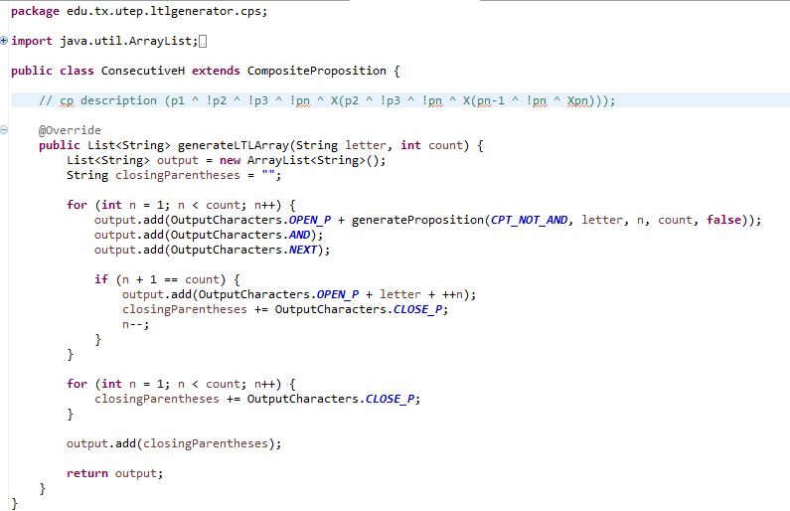
Added concrete class ConsecutiveH which extends Abstract class CompositeProposition.
Added the test cases to test the class’s output in Junit.
This concrete class implements abstract method generateLTLArray.
It returns the LTL description for Consecutive H given in table 1.

Slide 3
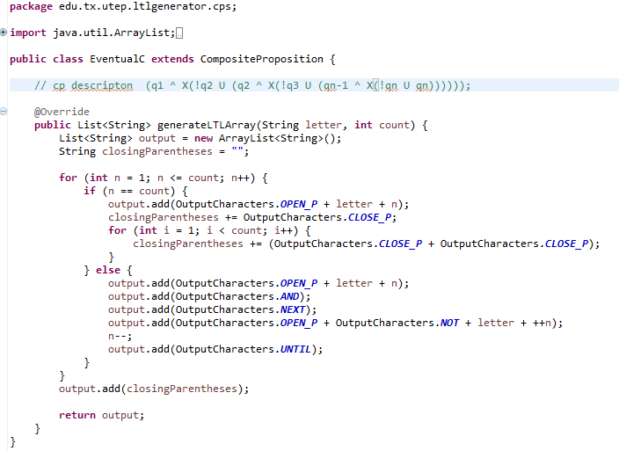
Added concrete class EventualC which extends Abstract class CompositeProposition.
Added the test cases to test the class’s output in Junit.
This concrete class implements abstract method generateLTLArray.
It returns the LTL description for EventualC given in table 1.

Slide 4
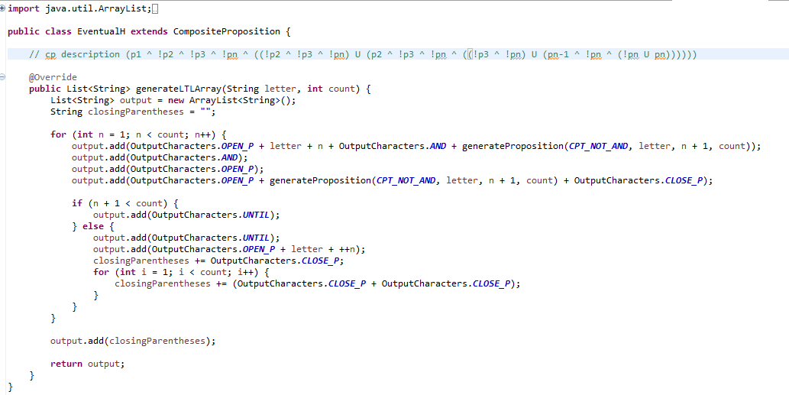
Added concrete class EventualH which extends Abstract class CompositeProposition.
Added the test cases to test the class’s output in Junit.
This concrete class implements abstract method generateLTLArray.
It returns the LTL description for EventualH given in table 1.

Slide 5
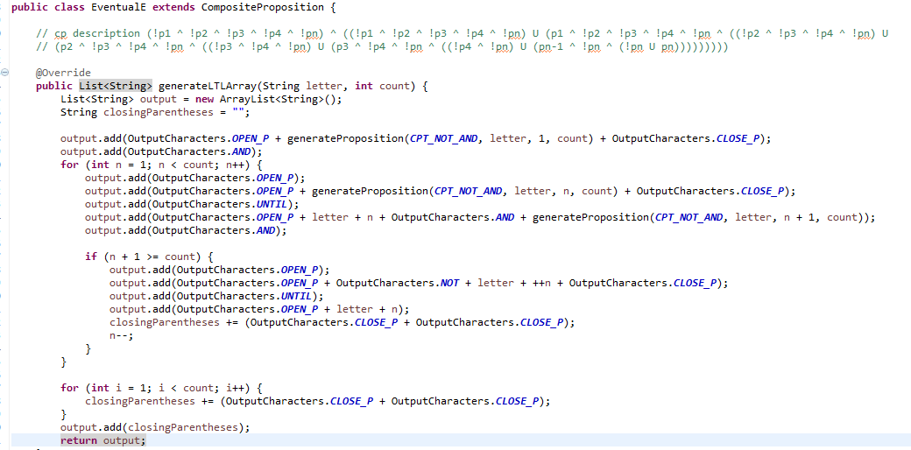
Added concrete class EventualE which extends Abstract class CompositeProposition.
Added the test cases to test the class’s output in Junit.
This concrete class implements abstract method generateLTLArray.
It returns the LTL description for EventualE given in table 1.

Slide 6
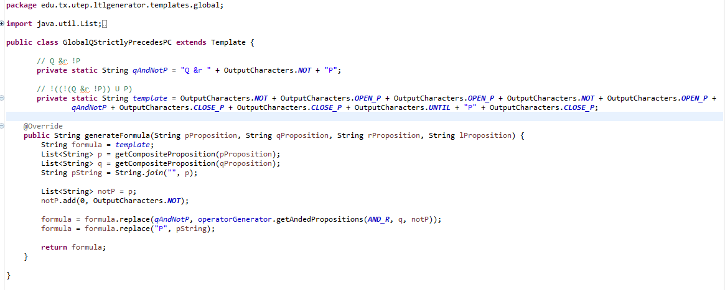
Added concrete class GlobalQStrictlyPrecedesPC which extends Abstract class Template.
Added the test cases to test the class’s output in Junit.
This concrete class implements abstract method generateformula.
It returns the LTL formula within the global scope given in table 3 for GlobalQStrictlyPrecedesPC using P Proposition and Q Propositions given.

Slide 7
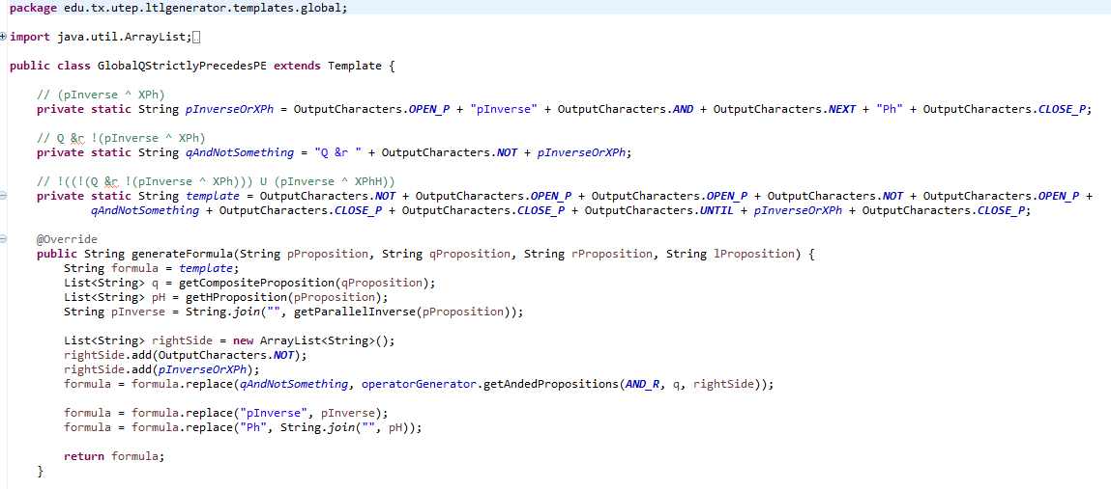
Added Concrete class GlobalQStrictlyPrecedesPE which extends Abstract class Template.
Added the test cases to test the class’s output in Junit.
This concrete class implements abstract method generateformula.
It returns the LTL formula within the global scope given in table 3 for GlobalQStrictlyPrecedesPE.
It converts Proposition of type Event to → Proposition of type Hold
Before creating the LTL formula using getHProposition method

Slide 8
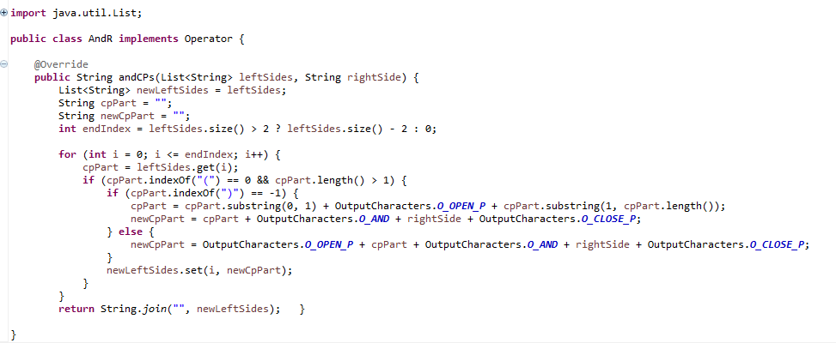
Added class AndR which implements Interface named Operator.
This class implements method andCPs on operator interface .
It returns the anded propositions given following the rules for &r.
public void testAtLeastOneC() throws Exception { //same as At least one H
List<String> leftSides = cpGenerator.getCompositeProposition("L_AtLeastOneC_3");
List<String> rightSides = cpGenerator.getCompositeProposition("P_AtLeastOneH_3");
String output = operatorGenerator.getAndedPropositions(ANDR, leftSides, rightSides);
assertEquals("[[(l1 v l2 v l3)] & [(p1 v p2 v p3)]]", output);
}

Slide 9
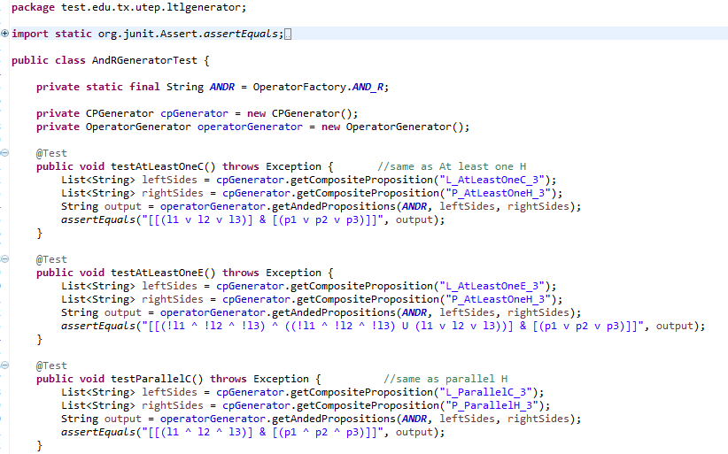
Generated test cases for using AndR with all the CPs in junit.
. . . . .

Slide 10
Code Refactoring

Slide 11
Duplicate code and Long Method Smells
This code is seen throughout the tables given to generate the LTL formula:
“!p1 ^ !p2 ^ !p3 ^ !p4….!pn”
Refactoring used: Extract Method.
Created subclass ParallelInverse which extends Composite Proposition class.
This class takes care of generating this piece of code throughout the system by implementing the method generateLTLArray.
By creating this class we took care of the code smell of duplicate code.
A simple call like the following one generates the composite proposition “!p1 ^ !p2 ^ !p3 ^ !p4….!pn”
cpClass = new CPFactory().getCPClass(cpName); //where cpName =P_ParallelInverse_n return cpClass.generateLTLArray(letter, count);

Slide 12
Duplicate code and Long Method Smells
In order for the template formulas to use the parallelInverse subclass they had to implement code to convert a given CP to parallelInverse.
for example:
Q Strictly Precedes PE= !((!(Q &r !( !p1 ^ !p2 ^ !pn ^ XP(H) )))U ( !p1 ^ !p2 ^ !pn ^ XPH))
Preposition PE = P_ParallelE_3
we need P_ParallelInverse_3.
So in order to generate this code we need to extract the CP letter and the number of Propositions from the given proposition and call
ParallelInverse method.
This extracting code was implemented at first within the template formula classes that needed it. We extracted this code to a method and moved it
into the superclass of the templates. This way, all the template formulas that need to use the code just call the method eliminating
duplicate code and Long methods in the template formula classes.
Refactoring used: Extract Method and Move Method.
protected List<String> getParallelInverse(String propositionName) {
// Get the letter and number from the proposition name
String[] splitCP = propositionName.split("_");
String inverseName = splitCP[0] + "_ParallelInverse_" + splitCP[2];
return cpGenerator.getCompositeProposition(inverseName);
}
NOTE: Problem, it creates another smell, Refused Bequest because some template formula classes don’t use this inherited method.

Slide 13
Duplicate code and Long Method Smells
Some of the formula templates require the use of P(H) instead of the given Proposition P(E).
for example:
Q Strictly Precedes PE= !((!(Q &r !(!p1 ^ !p2 ^ !pn ^ X P(H) )))U ( !p1 ^ !p2 ^ !pn ^ X P(H) ))
Preposition PE = P_ParallelE_3
This formula needs to use P(H) instead of the given PE, so code to convert this string for changing P_ParallelE_3 to
P_ParallelH_3 had to be included in the template classes before generating the given Proposition.
We extracted this code to a method and moved it into the superclass of the templates. This way, all the template
formulas that need to use the code just call the method eliminating duplicate code and Long methods in the template
formula classes.
Refactoring used: Extract Method and Move Method.
protected List<String> getHProposition(String propositionName) {
StringBuilder hProposition = new StringBuilder(propositionName);
int currentLetterIndex = propositionName.lastIndexOf("_")-1;
hProposition.setCharAt(currentLetterIndex, 'H');
return cpGenerator.getCompositeProposition(hProposition.toString());
}
NOTE: Problem, it creates another smell, Refused Bequest because some template formula classes don’t use this inherited method.

Slide 14
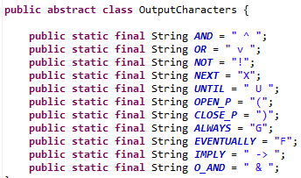
Magic Strings code smell
Magic Strings on all the template Formula classes were replaced by constants declared in a class called outputCharacters.
Makes code easier to read and maintain.
Before refactoring:
private static String template = "!((!(Q andMinusL !P)) U P)";
After Refactoring:
// !((!(Q &-l !P)) U P)
private static String template = OutputCharacters.NOT + OutputCharacters.OPEN_P +
OutputCharacters.OPEN_P + OutputCharacters.NOT + OutputCharacters.OPEN_P +
qAndNotP + OutputCharacters.CLOSE_P + OutputCharacters.CLOSE_P + OutputCharacters.UNTIL +
"P" + OutputCharacters.CLOSE_P;
Refactoring used: Introduce Constant.

Slide 15
Long Method Smell
Used Extract method refactoring in the Template Factory.
For example:
If you have an AfterLUntilRc, It checks once if it’s a Global instead of 11 different Global types.
If you have an BeforeR, It checks once if it’s a BeforeR instead of 14 different BeforeR types.
and so on with all the template LTL formulas. Until it gets to the AfterLUntilRc statement.
Code in next slide.

Slide 16
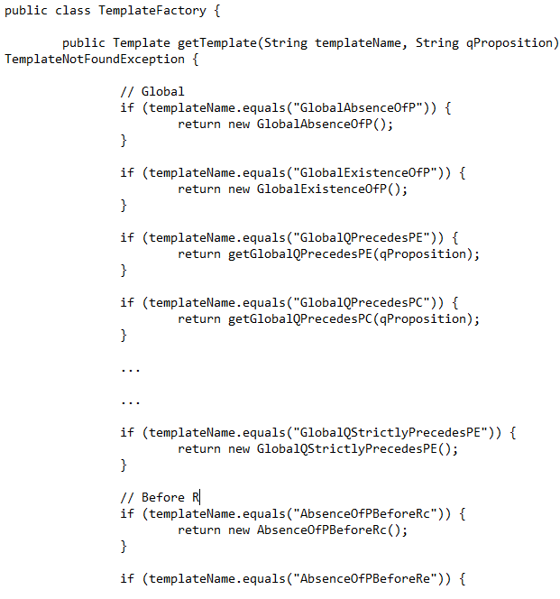
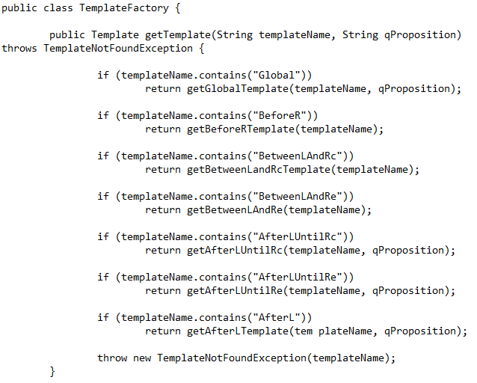
BEFORE REFACTORING we had 60 + if statements
AFTER REFACTORING we have 7 if statements
It makes the method smaller and easier to read and more
Efficient.

Slide 17
Magic number code smell
Changed Magic number to constant InputLinesToRead in LTLInputOutput class.
Makes code easier to read and maintain.
Before refactoring:
if (readingLineNumber < 7 ){
if (inputType.equals(SCOPE)){
scope = ProcessInput.getScope(lineReadFromInputFile);
} else if (inputType.equals(PATTERN)){……………………
After Refactoring:
protected static final int inputLinesToRead = 7;
……..
if (readingLineNumber < inputLinesToRead ){
if (inputType.equals(SCOPE)){
scope = ProcessInput.getScope(lineReadFromInputFile);
} else if (inputType.equals(PATTERN)){
Refactoring used: Introduce Constant.

Slide 18
Magic String code smell
Created types for LTLPatterns and LTL Scope to get rid of magic strings.
public enum LTLPatternType {
Absence,
Existence,
Precedence,
Response,
StricPrecedence;
}
public enum LTLScopeType {
AfterL,
AfterLUntilR,
BeforeR,
BetweenLAndR,
Global;
}
Example:
LTLScopeType scope = null;
if (inputType.equals(SCOPE)){
scope = ProcessInput.getScope(lineReadFromInputFile); which could be AfterL, AfterLUntilR…….
Refactoring used: Introduce Constant by creating a java class of type enum to define the collection of constants.

Slide 19
Long class Smell
Refactoring used: Extract Class.
Class LTLInputOutput was doing too much, so we split it up into three classes.
Classes created:
LTLInputOutput. Processes information, uses OutputToFile class and ProcessInput class.
OutputToFile. Handles everything related to creating output file and sending info to it.
ProcessInput . Handles everything related to reading a given input file.

