Slide 1


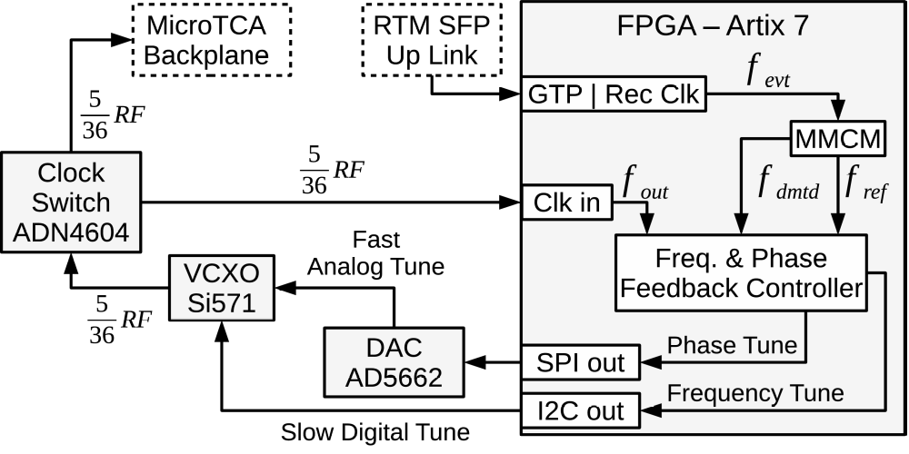
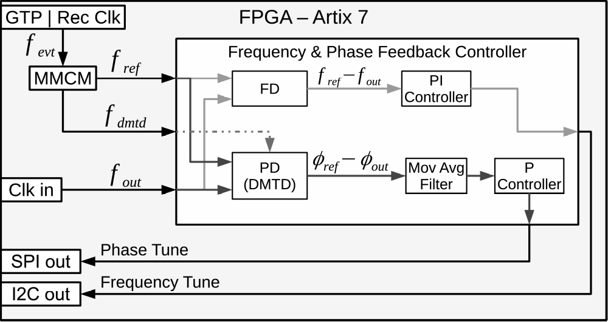
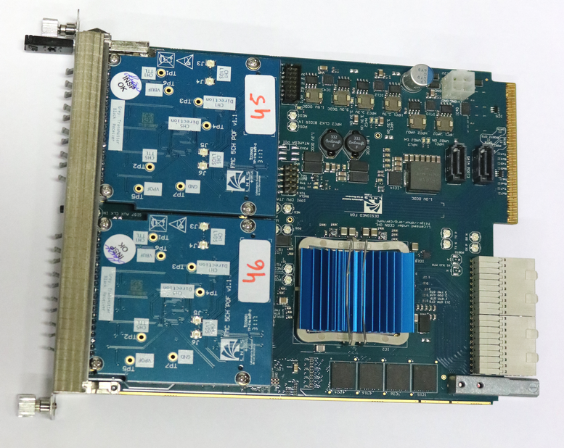
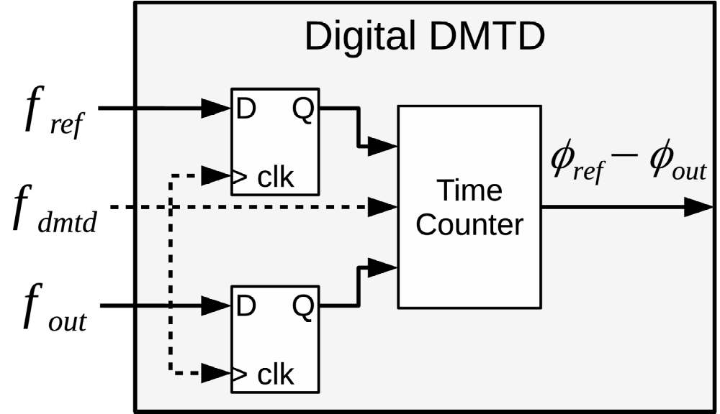
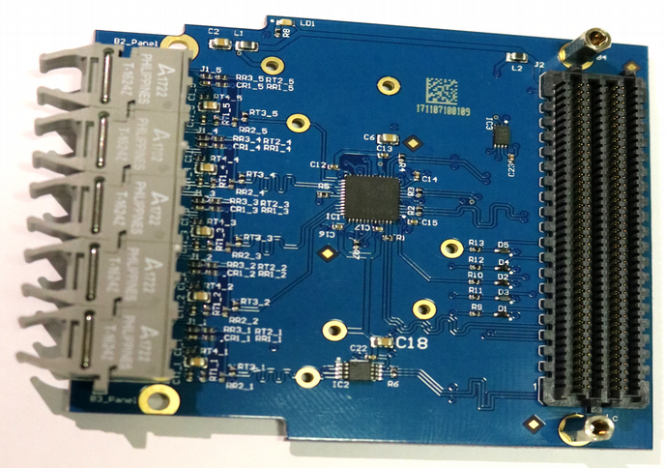
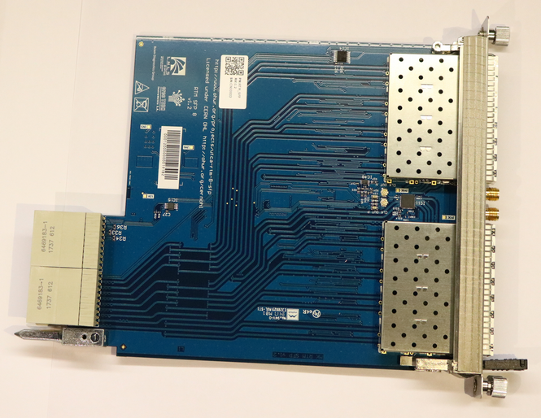

A MicroTCA.4 Timing Receiver for the Sirius Timing System
WEPA01
J.L.N. Brito, S.R. Marques, D.O. Tavares, L.M. Russo, G.B.M. Bruno, LNLS, Campinas, Brazil
joao.brito@lnls.br
Abstract
The AMC FMC carrier (AFC) is a MicroTCA.4 AMC board which has a very flexible clock circuit that enables any clock source to be connected to any clock input, including telecom clock, FMC clocks, programmable VCXO oscillator and FPGA. This paper presents the use of the AFC board as an event receiver connected to the Sirius timing system to provide low jitter synchronized clocks and triggers for Sirius BPM electronics and other devices.
Hardware
AFC board is an open hardware project developed to the Sirius BPM and orbit feedback systems. Now, it is also integrating the Sirius timing system, where more than 20 AFC timing receivers will generate synchronized clocks for the BPM electronics and hundreds of triggers around the accelerator.
FPGA Gateware
The AFC clocking resources were used to implemet a frequency and phase locked loop to generate a low-jitter synchronized reference clock to the BPM electronics using a Si571 VCXO.
Figure 4: Synchronized clock block diagram.
Figure 5: Frequency and phase feedback controller.
Figure 6: Digital Dual Mixer Time Difference.
Figure 1: AFC board with two FMC 5 POF mounted.
Phase Noise Performance
Integrated RMS jitter of about 4 ps (1 Hz – 5 MHz).
Figure 2: FMC 5 POF (5 plastic optical fiber outputs).
Figure 3: RTM with 8 SFP slots.
Figure 7: Phase noise characterization of VCXO controlled (1), VCXO free-running (2) and reference clock (3).

