Slide 1
MicroTCA
Backplane
RTM SFP
Up Link
FPGA – Artix 7
GTP | Rec Clk
MMCM
Clock
Switch
ADN4604
Clk in
Fast
Analog Tune
Freq. & Phase
Feedback Controller
VCXO
Si571
DAC
AD5662
Phase Tune
SPI out
Frequency Tune
I2C out
Slow Digital Tune

Slide 2
FPGA – Artix 7
GTP | Rec Clk
Frequency & Phase Feedback Controller
MMCM
FD
PI
Controller
PD
(DMTD)
Mov Avg
Filter
P
Controller
Clk in
Phase Tune
SPI out
Frequency Tune
I2C out

Slide 3
Digital DMTD
D Q
> clk
Deglitcher
&
Time
Counter
D Q
> clk

Slide 4
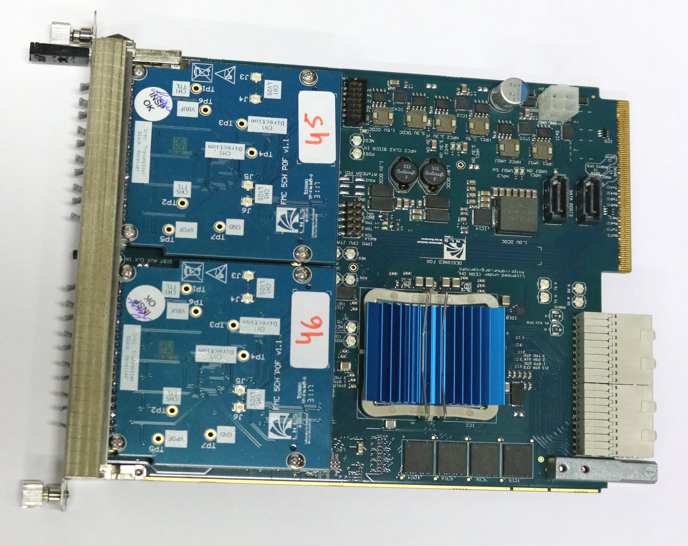

Slide 5
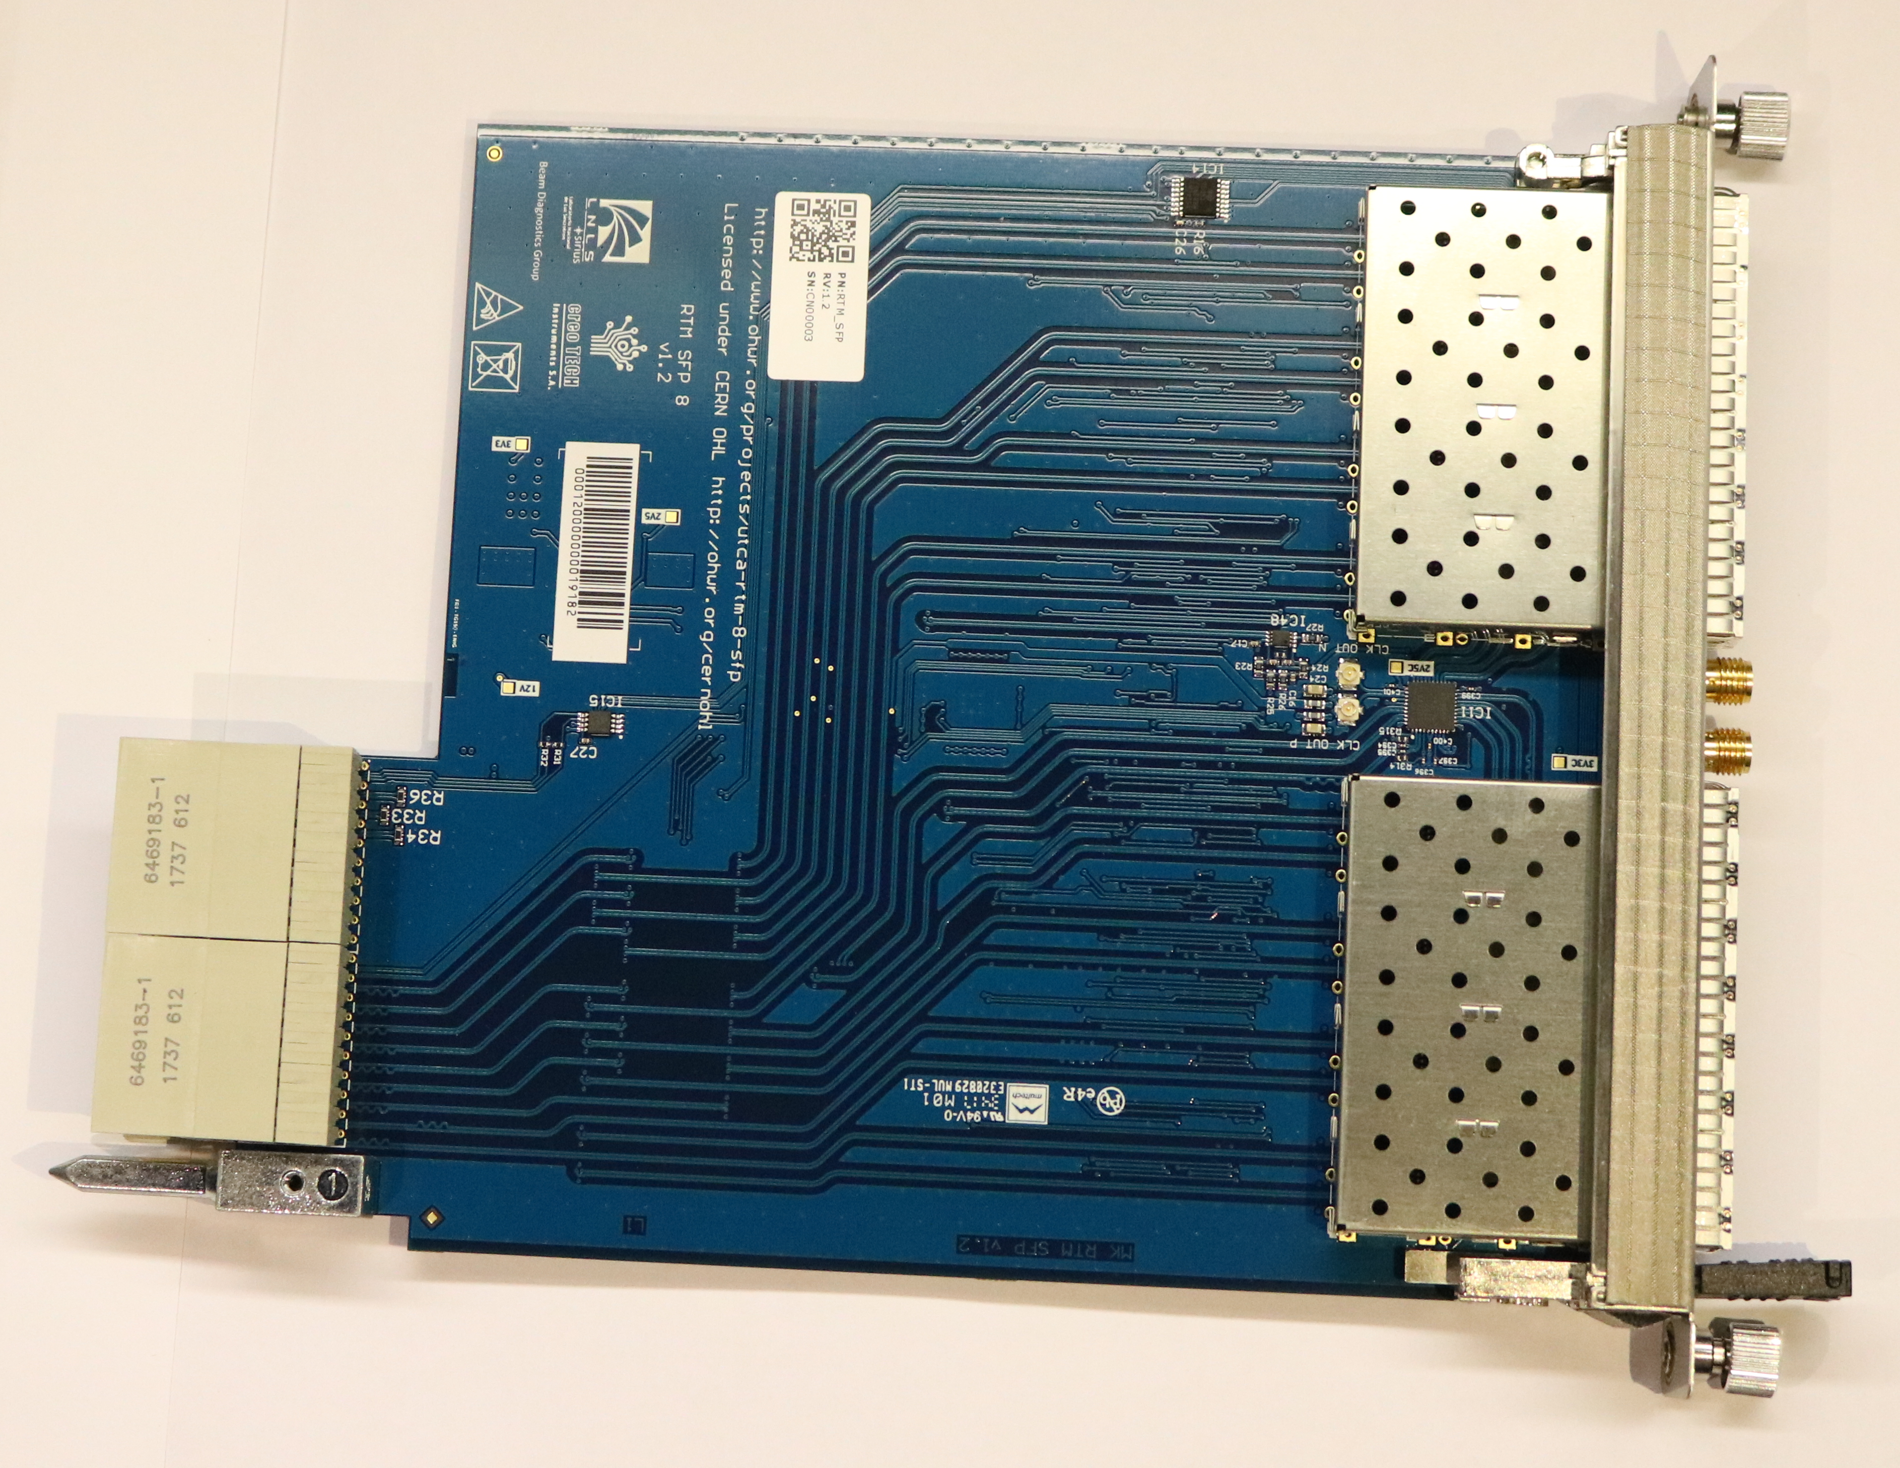

Slide 6


