Slide 1
Chapter 4: Memory Management
Part 1: Mechanisms for Managing Memory

Slide 2
Memory management
Basic memory management
Swapping
Virtual memory
Page replacement algorithms
Modeling page replacement algorithms
Design issues for paging systems
Implementation issues
Segmentation
CS 1550, cs.pitt.edu (originaly modified by Ethan L. Miller and Scott A. Brandt)
Chapter 4

Slide 3
In an ideal world…
The ideal world has memory that is
  Very large
  Very fast
  Non-volatile (doesn’t go away when power is turned off)
The real world has memory that is:
  Very large
  Very fast
  Affordable!
  Pick any two…
Memory management goal: make the real world look as much like the ideal world as possible
CS 1550, cs.pitt.edu (originaly modified by Ethan L. Miller and Scott A. Brandt)
Chapter 4

Slide 4
Memory hierarchy
What is the memory hierarchy?
  Different levels of memory
  Some are small & fast
  Others are large & slow
What levels are usually included?
  Cache: small amount of fast, expensive memory
    L1 (level 1) cache: usually on the CPU chip
    L2 & L3 cache: off-chip, made of SRAM
  Main memory: medium-speed, medium price memory (DRAM)
  Disk: many gigabytes of slow, cheap, non-volatile storage
Memory manager handles the memory hierarchy
CS 1550, cs.pitt.edu (originaly modified by Ethan L. Miller and Scott A. Brandt)
Chapter 4

Slide 5
Basic memory management
Components include
  Operating system (perhaps with device drivers)
  Single process
Goal: lay these out in memory
  Memory protection may not be an issue (only one program)
  Flexibility may still be useful (allow OS changes, etc.)
No swapping or paging
0xFFFF
0xFFFF
User program
(RAM)
Operating system
(ROM)
Device drivers
(ROM)
User program
(RAM)
User program
(RAM)
Operating system
(RAM)
Operating system
(RAM)
0
0
CS 1550, cs.pitt.edu (originaly modified by Ethan L. Miller and Scott A. Brandt)
Chapter 4

Slide 6
Fixed partitions: multiple programs
Fixed memory partitions
  Divide memory into fixed spaces
  Assign a process to a space when it’s free
Mechanisms
  Separate input queues for each partition
  Single input queue: better ability to optimize CPU usage
Partition 4
900K
Partition 4
900K
Partition 3
700K
Partition 3
700K
Partition 2
600K
Partition 2
600K
Partition 1
500K
Partition 1
500K
100K
100K
OS
OS
0
0
CS 1550, cs.pitt.edu (originaly modified by Ethan L. Miller and Scott A. Brandt)
Chapter 4

Slide 7
How many programs is enough?
Several memory partitions (fixed or variable size)
Lots of processes wanting to use the CPU
Tradeoff
  More processes utilize the CPU better
  Fewer processes use less memory (cheaper!)
How many processes do we need to keep the CPU fully utilized?
  This will help determine how much memory we need
  Is this still relevant with memory costing $150/GB?
CS 1550, cs.pitt.edu (originaly modified by Ethan L. Miller and Scott A. Brandt)
Chapter 4

Slide 8
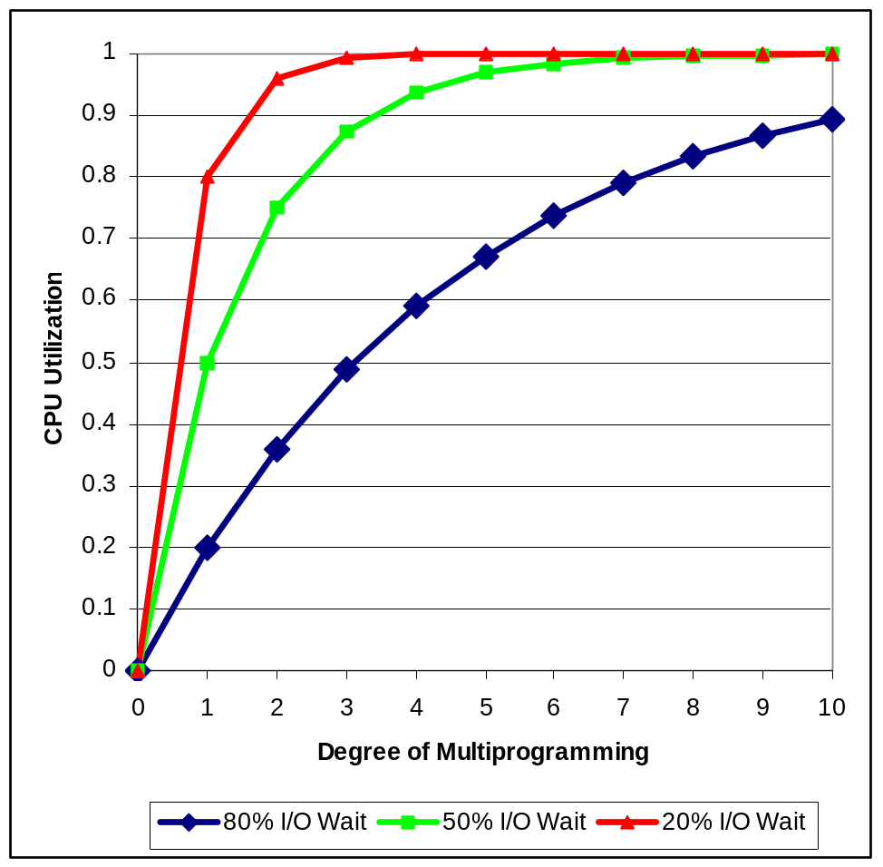
Modeling multiprogramming
More I/O wait means less processor utilization
  At 20% I/O wait, 3–4 processes fully utilize CPU
  At 80% I/O wait, even 10 processes aren’t enough
This means that the OS should have more processes if they’re I/O bound
More processes => memory management & protection more important!
CS 1550, cs.pitt.edu (originaly modified by Ethan L. Miller and Scott A. Brandt)
Chapter 4

Slide 9
Multiprogrammed system performance
Arrival and work requirements of 4 jobs
CPU utilization for 1–4 jobs with 80% I/O wait
Sequence of events as jobs arrive and finish
  Numbers show amount of CPU time jobs get in each interval
  More processes => better utilization, less time per process
Job | Arrival time | CPU needed
1 | 10:00 | 4
2 | 10:10 | 3
3 | 10:15 | 2
4 | 10:20 | 2
 | 1 | 2 | 3 | 4
CPU idle | 0.80 | 0.64 | 0.51 | 0.41
CPU busy | 0.20 | 0.36 | 0.49 | 0.59
CPU/process | 0.20 | 0.18 | 0.16 | 0.15
0
Time
10
15
20
22
27.6
28.2
31.7
1
2
3
4
CS 1550, cs.pitt.edu (originaly modified by Ethan L. Miller and Scott A. Brandt)
Chapter 4

Slide 10
Memory and multiprogramming
Memory needs two things for multiprogramming
  Relocation
  Protection
The OS cannot be certain where a program will be loaded in memory
  Variables and procedures can’t use absolute locations in memory
  Several ways to guarantee this
The OS must keep processes’ memory separate
  Protect a process from other processes reading or modifying its own memory
  Protect a process from modifying its own memory in undesirable ways (such as writing to program code)
CS 1550, cs.pitt.edu (originaly modified by Ethan L. Miller and Scott A. Brandt)
Chapter 4

Slide 11
Base and limit registers
Special CPU registers: base & limit
  Access to the registers limited to system mode
  Registers contain
    Base: start of the process’s memory partition
    Limit: length of the process’s memory partition
Address generation
  Physical address: location in actual memory
  Logical address: location from the process’s point of view
  Physical address = base + logical address
  Logical address larger than limit => error
0xFFFF
0x2000
Limit
Process
partition
Base
0x9000
OS
0
Logical address: 0x1204
Physical address:
0x1204+0x9000 = 0xa204
CS 1550, cs.pitt.edu (originaly modified by Ethan L. Miller and Scott A. Brandt)
Chapter 4

Slide 12
Swapping
C
C
C
C
C
B
B
B
B
A
A
A
A
D
D
D
OS
OS
OS
OS
OS
OS
OS
Memory allocation changes as
  Processes come into memory
  Processes leave memory
    Swapped to disk
    Complete execution
Gray regions are unused memory
CS 1550, cs.pitt.edu (originaly modified by Ethan L. Miller and Scott A. Brandt)
Chapter 4

Slide 13
Swapping: leaving room to grow
Need to allow for programs to grow
  Allocate more memory for data
  Larger stack
Handled by allocating more space than is necessary at the start
  Inefficient: wastes memory that’s not currently in use
  What if the process requests too much memory?
Stack
Room for
B to grow
Process
B
Data
Code
Stack
Room for
A to grow
Process
A
Data
Code
OS
CS 1550, cs.pitt.edu (originaly modified by Ethan L. Miller and Scott A. Brandt)
Chapter 4

Slide 14
Tracking memory usage: bitmaps
Keep track of free / allocated memory regions with a bitmap
  One bit in map corresponds to a fixed-size region of memory
  Bitmap is a constant size for a given amount of memory regardless of how much is allocated at a particular time
Chunk size determines efficiency
  At 1 bit per 4KB chunk, we need just 256 bits (32 bytes) per MB of memory
  For smaller chunks, we need more memory for the bitmap
  Can be difficult to find large contiguous free areas in bitmap
A
B
C
D
8
16
24
32
Memory regions
11111100
00111000
01111111
Bitmap
11111000
CS 1550, cs.pitt.edu (originaly modified by Ethan L. Miller and Scott A. Brandt)
Chapter 4

Slide 15
Tracking memory usage: linked lists
Keep track of free / allocated memory regions with a linked list
  Each entry in the list corresponds to a contiguous region of memory
  Entry can indicate either allocated or free (and, optionally, owning process)
  May have separate lists for free and allocated areas
Efficient if chunks are large
  Fixed-size representation for each region
  More regions => more space needed for free lists
A
B
C
D
8
16
24
32
Memory regions
A
0
6
-
6
4
B
10
3
-
13
4
C
17
9
D
26
3
-
29
3
CS 1550, cs.pitt.edu (originaly modified by Ethan L. Miller and Scott A. Brandt)
Chapter 4

Slide 16
Allocating memory
Search through region list to find a large enough space
Suppose there are several choices: which one to use?
  First fit: the first suitable hole on the list
  Next fit: the first suitable after the previously allocated hole
  Best fit: the smallest hole that is larger than the desired region (wastes least space?)
  Worst fit: the largest available hole (leaves largest fragment)
Option: maintain separate queues for different-size holes
Allocate 20 blocks first fit
Allocate 13 blocks best fit
Allocate 12 blocks next fit
Allocate 15 blocks worst fit
1
5
18
-
6
5
-
19
14
-
52
25
-
102
30
-
135
16
-
202
10
-
302
20
-
350
30
-
411
19
-
510
3
15
CS 1550, cs.pitt.edu (originaly modified by Ethan L. Miller and Scott A. Brandt)
Chapter 4

Slide 17
Freeing memory
Allocation structures must be updated when memory is freed
Easy with bitmaps: just set the appropriate bits in the bitmap
Linked lists: modify adjacent elements as needed
  Merge adjacent free regions into a single region
  May involve merging two regions with the just-freed area
A
X
B
A
B
A
X
A
X
B
B
X
CS 1550, cs.pitt.edu (originaly modified by Ethan L. Miller and Scott A. Brandt)
Chapter 4

Slide 18
Limitations of swapping
Problems with swapping
  Process must fit into physical memory (impossible to run larger processes)
  Memory becomes fragmented
    External fragmentation: lots of small free areas
    Compaction needed to reassemble larger free areas
  Processes are either in memory or on disk: half and half doesn’t do any good
Overlays solved the first problem
  Bring in pieces of the process over time (typically data)
  Still doesn’t solve the problem of fragmentation or partially resident processes
CS 1550, cs.pitt.edu (originaly modified by Ethan L. Miller and Scott A. Brandt)
Chapter 4

Slide 19
Virtual memory
Basic idea: allow the OS to hand out more memory than exists on the system
Keep recently used stuff in physical memory
Move less recently used stuff to disk
Keep all of this hidden from processes
  Processes still see an address space from 0 – max address
  Movement of information to and from disk handled by the OS without process help
Virtual memory (VM) especially helpful in multiprogrammed system
  CPU schedules process B while process A waits for its memory to be retrieved from disk
CS 1550, cs.pitt.edu (originaly modified by Ethan L. Miller and Scott A. Brandt)
Chapter 4

Slide 20
Virtual and physical addresses
Program uses virtual addresses
  Addresses local to the process
  Hardware translates virtual address to physical address
Translation done by the Memory Management Unit
  Usually on the same chip as the CPU
  Only physical addresses leave the CPU/MMU chip
Physical memory indexed by physical addresses
CPU chip
CPU
MMU
Virtual addresses
from CPU to MMU
Memory
Physical addresses
on bus, in memory
Disk
controller
CS 1550, cs.pitt.edu (originaly modified by Ethan L. Miller and Scott A. Brandt)
Chapter 4

Slide 21
Paging and page tables
Virtual addresses mapped to physical addresses
  Unit of mapping is called a page
  All addresses in the same virtual page are in the same physical page
  Page table entry (PTE) contains translation for a single page
Table translates virtual page number to physical page number
  Not all virtual memory has a physical page
  Not every physical page need be used
Example:
  64 KB virtual memory
  32 KB physical memory
60–64K
-
56–60K
-
52–56K
-
48–52K
6
44–48K
5
40–44K
1
36–40K
-
32–36K
-
28–32K
3
28–32K
24–28K
-
24–28K
20–24K
-
20–24K
16–20K
0
16–20K
12–16K
-
12–16K
8–12K
-
8–12K
4–8K
4
4–8K
0–4K
7
0–4K
Virtual
address
space
Physical
memory
CS 1550, cs.pitt.edu (originaly modified by Ethan L. Miller and Scott A. Brandt)
Chapter 4

Slide 22
What’s in a page table entry?
Each entry in the page table contains
  Valid bit: set if this logical page number has a corresponding physical frame in memory
    If not valid, remainder of PTE is irrelevant
  Page frame number: page in physical memory
  Referenced bit: set if data on the page has been accessed
  Dirty (modified) bit :set if data on the page has been modified
  Protection information
Protection
D
R
V
Page frame number
Dirty bit
Referenced bit
Valid bit
CS 1550, cs.pitt.edu (originaly modified by Ethan L. Miller and Scott A. Brandt)
Chapter 4

Slide 23
Mapping logical => physical address
Split address from CPU into two pieces
  Page number (p)
  Page offset (d)
Page number
  Index into page table
  Page table contains base address of page in physical memory
Page offset
  Added to base address to get actual physical memory address
Page size = 2^{d} bytes
Example:
• 4 KB (=4096 byte) pages
• 32 bit logical addresses
2^{d} = 4096
d = 12
32-12 = 20 bits
12 bits
p
d
32 bit logical address
CS 1550, cs.pitt.edu (originaly modified by Ethan L. Miller and Scott A. Brandt)
Chapter 4

Slide 24
Address translation architecture
page number
Page frame number
Page frame number
page offset
0
CPU
p
d
f
d
1
.
.
.
0
f-1
1
f
.
.
.
f+1
p-1
f+2
p
f
.
.
.
p+1
physical memory
page table
CS 1550, cs.pitt.edu (originaly modified by Ethan L. Miller and Scott A. Brandt)
Chapter 4

Slide 25
Memory & paging structures
Physical
memory
Page frame number
Page 0
6
Page 1
3
0
Page 1 (P1)
Page 2
4
1
Page 3
9
2
Page 4 (P0)
Page 4
2
3
Page 1 (P0)
Free
pages
4
Page 2 (P0)
Logical memory (P0)
Page table (P0)
5
6
Page 0 (P0)
Page 0
8
7
Page 1
0
8
Page 0 (P1)
9
Page 3 (P0)
Logical memory (P1)
Page table (P1)
CS 1550, cs.pitt.edu (originaly modified by Ethan L. Miller and Scott A. Brandt)
Chapter 4

Slide 26
Two-level page tables
.
.
.
Problem: page tables can be too large
  2³² bytes in 4KB pages need 1 million PTEs
Solution: use multi-level page tables
  “Page size” in first page table is large (megabytes)
  PTE marked invalid in first page table needs no 2nd level page table
1st level page table has pointers to 2nd level page tables
2nd level page table has actual physical page numbers in it
220
.
.
.
657
.
.
.
.
.
.
401
.
.
.
.
.
.
.
.
.
125
613
.
.
.
.
.
.
.
.
.
1st level
page table
961
.
.
.
884
960
.
.
.
2nd level
page tables
.
.
.
main
memory
955
CS 1550, cs.pitt.edu (originaly modified by Ethan L. Miller and Scott A. Brandt)
Chapter 4

Slide 27
More on two-level page tables
Tradeoffs between 1st and 2nd level page table sizes
  Total number of bits indexing 1st and 2nd level table is constant for a given page size and logical address length
  Tradeoff between number of bits indexing 1st and number indexing 2nd level tables
    More bits in 1st level: fine granularity at 2nd level
    Fewer bits in 1st level: maybe less wasted space?
All addresses in table are physical addresses
Protection bits kept in 2nd level table
CS 1550, cs.pitt.edu (originaly modified by Ethan L. Miller and Scott A. Brandt)
Chapter 4

Slide 28
Two-level paging: example
System characteristics
  8 KB pages
  32-bit logical address divided into 13 bit page offset, 19 bit page number
Page number divided into:
  10 bit page number
  9 bit page offset
Logical address looks like this:
  p₁ is an index into the 1st level page table
  p₂ is an index into the 2nd level page table pointed to by p₁
page number
page offset
p₁ = 10 bits
p₂ = 9 bits
offset = 13 bits
CS 1550, cs.pitt.edu (originaly modified by Ethan L. Miller and Scott A. Brandt)
Chapter 4

Slide 29
2-level address translation example
page number
page offset
p₁ = 10 bits
p₂ = 9 bits
offset = 13 bits
frame
number
0
Page
table
base
physical address
1
0
19
13
.
.
.
1
.
.
.
0
1
p₁
.
.
.
.
.
.
.
.
.
p₂
main memory
1st level page table
.
.
.
2nd level page table
CS 1550, cs.pitt.edu (originaly modified by Ethan L. Miller and Scott A. Brandt)
Chapter 4

Slide 30
Implementing page tables in hardware
Page table resides in main (physical) memory
CPU uses special registers for paging
  Page table base register (PTBR) points to the page table
  Page table length register (PTLR) contains length of page table: restricts maximum legal logical address
Translating an address requires two memory accesses
  First access reads page table entry (PTE)
  Second access reads the data / instruction from memory
Reduce number of memory accesses
  Can’t avoid second access (we need the value from memory)
  Eliminate first access by keeping a hardware cache (called a translation lookaside buffer or TLB) of recently used page table entries
CS 1550, cs.pitt.edu (originaly modified by Ethan L. Miller and Scott A. Brandt)
Chapter 4

Slide 31
Translation Lookaside Buffer (TLB)
Search the TLB for the desired logical page number
  Search entries in parallel
  Use standard cache techniques
If desired logical page number is found, get frame number from TLB
If desired logical page number isn’t found
  Get frame number from page table in memory
  Replace an entry in the TLB with the logical & physical page numbers from this reference
Logical
page #
Physical
frame #
8
3
unused
2
1
3
0
12
12
29
6
22
11
7
4
Example TLB
CS 1550, cs.pitt.edu (originaly modified by Ethan L. Miller and Scott A. Brandt)
Chapter 4

Slide 32
Handling TLB misses
If PTE isn’t found in TLB, OS needs to do the lookup in the page table
Lookup can be done in hardware or software
Hardware TLB replacement
  CPU hardware does page table lookup
  Can be faster than software
  Less flexible than software, and more complex hardware
Software TLB replacement
  OS gets TLB exception
  Exception handler does page table lookup & places the result into the TLB
  Program continues after return from exception
  Larger TLB (lower miss rate) can make this feasible
CS 1550, cs.pitt.edu (originaly modified by Ethan L. Miller and Scott A. Brandt)
Chapter 4

Slide 33
How long do memory accesses take?
Assume the following times:
  TLB lookup time = a (often zero - overlapped in CPU)
  Memory access time = m
Hit ratio (h) is percentage of time that a logical page number is found in the TLB
  Larger TLB usually means higher h
  TLB structure can affect h as well
Effective access time (an average) is calculated as:
  EAT = (m + a)h + (m + m + a)(1-h)
  EAT =a + (2-h)m
Interpretation
  Reference always requires TLB lookup, 1 memory access
  TLB misses also require an additional memory reference
CS 1550, cs.pitt.edu (originaly modified by Ethan L. Miller and Scott A. Brandt)
Chapter 4

Slide 34
Inverted page table
Reduce page table size further: keep one entry for each frame in memory
PTE contains
  Virtual address pointing to this frame
  Information about the process that owns this page
Search page table by
  Hashing the virtual page number and process ID
  Starting at the entry corresponding to the hash result
  Search until either the entry is found or a limit is reached
Page frame number is index of PTE
Improve performance by using more advanced hashing algorithms
CS 1550, cs.pitt.edu (originaly modified by Ethan L. Miller and Scott A. Brandt)
Chapter 4

Slide 35
Inverted page table architecture
page number
page offset
process ID
p = 19 bits
offset = 13 bits
Page frame
number
0
pid
p
physical address
1
19
13
.
.
.
search
0
pid₀
p₀
1
pid₁
p₁
.
.
.
.
.
.
k
k
pid_{k}
p_{k}
main memory
.
.
.
inverted page table
CS 1550, cs.pitt.edu (originaly modified by Ethan L. Miller and Scott A. Brandt)
Chapter 4

