Slide 1
Quantum Computing
A brief introduction
John Manferdelli
JohnManferdelli@hotmail.com
© 2021-2025, John L. Manferdelli.
This material is provided without warranty of any kind including, without limitation, warranty of non-infringement or suitability for any purpose. This material is not guaranteed to be error free and is intended for instructional use only.

Slide 2
Beam splitters and QM I can safely say that no one understands Quantum Mechanics - Feynman
Experiment 1
Detector 1
Detector 2
Photon source
Half silvered mirror
Photon source emits stream of photons.
P(photon arrives at Detector 1)= .5
P(photon arrives at Detector 2)= .5
So far, so good

Slide 3
Beam splitters and QM Mach-Zender Interferometer
Experiment 2
Detector 1
Half silvered mirror
Mirror
Detector 2
1
1
0
0
Mirror
Photon source
Half silvered mirror
Photon source emits stream of photons.
P(photon arrives at Detector 1)= 0
P(photon arrives at Detector 2)= 1
Huh?

Slide 4
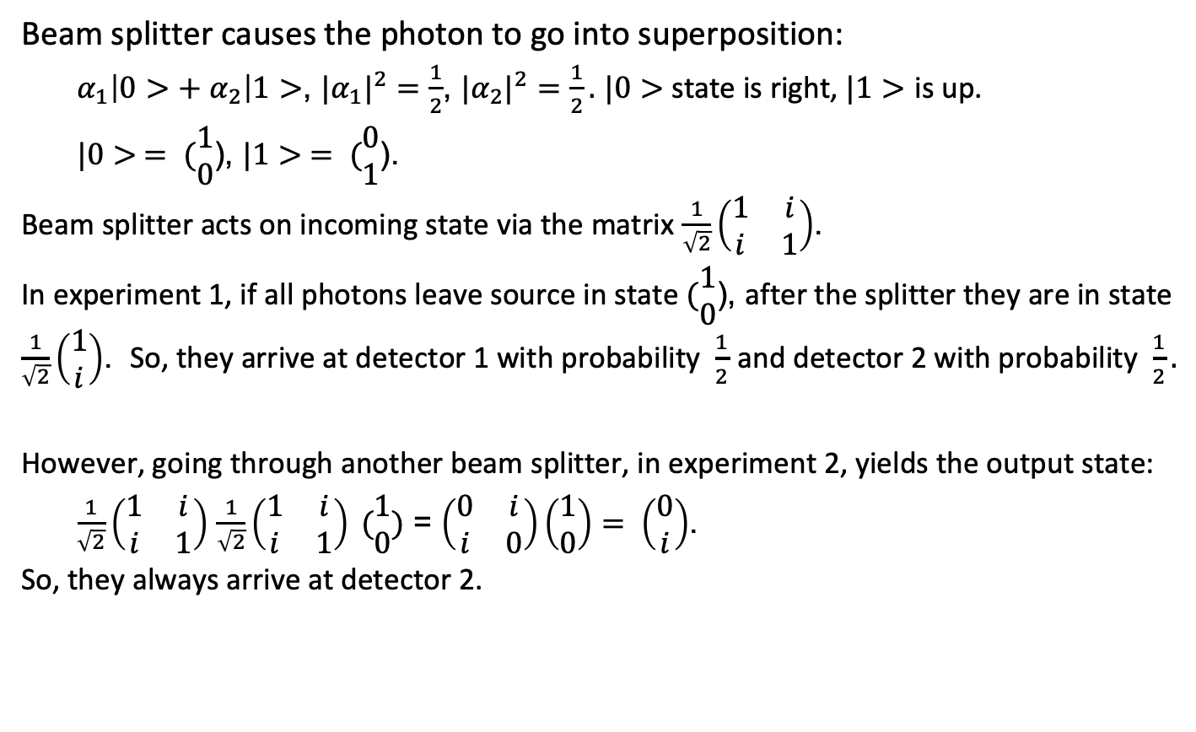
According to QM Analysis
Beam splitter causes the photon to go into superposition:
$α_{1}\left|0>+ α_{2}\right|1>$, ${|α_{1}|}^{2}=\frac{1}{2}$, ${|α_{2}|}^{2}=\frac{1}{2}.$ $|0>$state is right, $|1>$ is up.
$|0> = (\begin{matrix}1 \\ 0\end{matrix}$), $|1> = (\begin{matrix}0 \\ 1\end{matrix}$).
Beam splitter acts on incoming state via the matrix $\frac{1}{\sqrt{2}}\left(\begin{matrix}1 & i \\ i & 1\end{matrix}\right)$.
In experiment 1, if all photons leave source in state $(\begin{matrix}1 \\ 0\end{matrix}$), after the splitter they are in state $\frac{1}{\sqrt{2}}\left(\begin{matrix}1 \\ i\end{matrix}\right)$. So, they arrive at detector 1 with probability $\frac{1}{2}$ and detector 2 with probability $\frac{1}{2}.$
However, going through another beam splitter, in experiment 2, yields the output state:
$\frac{1}{\sqrt{2}}\left(\begin{matrix}1 & i \\ i & 1\end{matrix}\right)$ $\frac{1}{\sqrt{2}}\left(\begin{matrix}1 & i \\ i & 1\end{matrix}\right) (\begin{matrix}1 \\ 0\end{matrix})$ = $\left(\begin{matrix}0 & i \\ i & 0\end{matrix}\right)\left(\begin{matrix}1 \\ 0\end{matrix}\right)= \left(\begin{matrix}0 \\ i\end{matrix}\right)$.
So, they always arrive at detector 2.

Slide 5
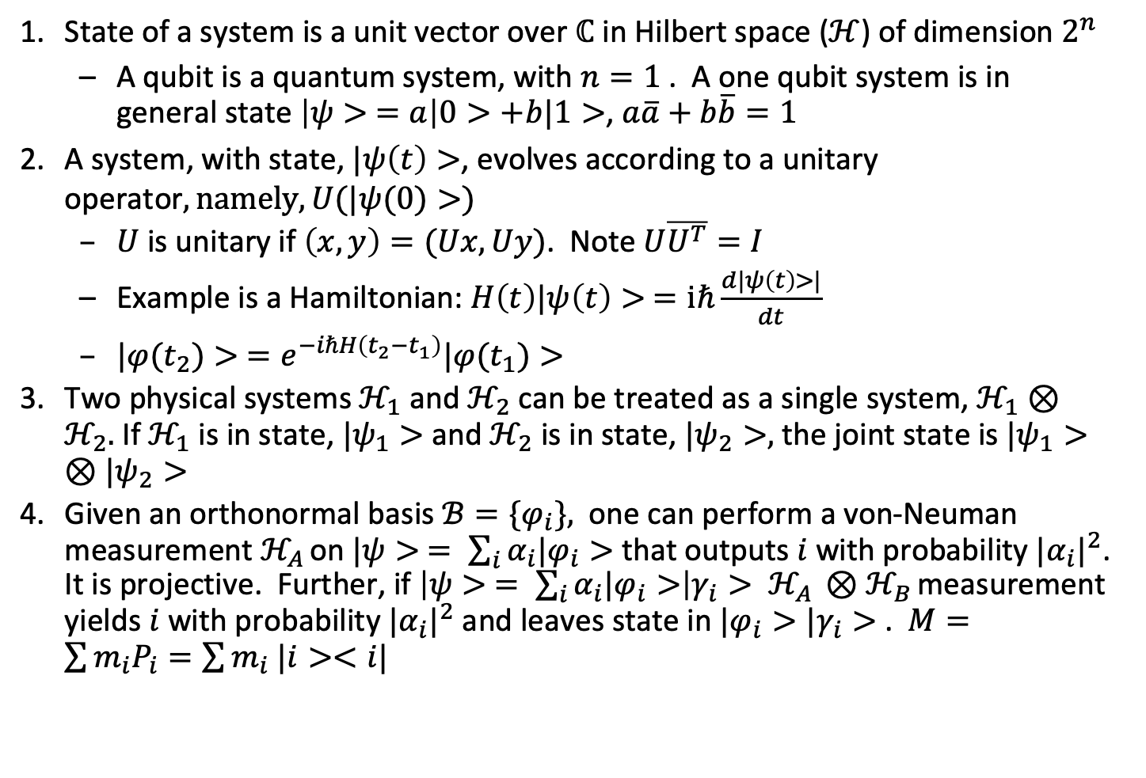
Postulates
State of a system is a unit vector over $ℂ$ in Hilbert space ($ℋ$) of dimension $2^{n}$
A qubit is a quantum system, with $n=1$ . A one qubit system is in general state $\left|ψ> =a\right|0>+b|1>$, $a\overline{a}+b\overline{b}=1$
A system, with state, $|ψ\left(t\right)>$, evolves according to a unitary operator$, namely, U(|ψ(0)>)$
$U$ is unitary if $\left(x,y\right)=(Ux, Uy)$. Note $U\overline{U^{T}}=I$
Example is a Hamiltonian: $H\left(t\right)|ψ\left(t\right)> =iℏ\frac{d|ψ\left(t\right)>|}{dt}$
$|φ(t_{2})> =e^{−iℏH\left(t_{2}−t_{1}\right)}|φ(t_{1})>$
Two physical systems $ℋ_{1}$ and $ℋ_{2}$ can be treated as a single system, $ℋ_{1}⊗ℋ_{2}.$ If $ℋ_{1}$ is in state, $|ψ_{1}>$ and $ℋ_{2}$ is in state, $|ψ_{2}>,$ the joint state is $|ψ_{1}>⊗|ψ_{2}>$
Given an orthonormal basis $ℬ=\{φ_{i}\},$ one can perform a von-Neuman measurement $ℋ_{A }$on $|ψ> = \sum_{i}{α_{i}|φ_{i}>}$that outputs $i$ with probability ${|α_{i}|}^{2}$. It is projective. Further, if $\left|ψ> = \sum_{i}{α_{i}|φ_{i}>}\right|γ_{i}> ℋ_{A }{⊗ℋ}_{B }$measurement yields $i$ with probability ${|α_{i}|}^{2}$ and leaves state in $|φ_{i}>{|γ}_{i}>$. $M=\sum{m_{i}P_{i}=\sum{m_{i} |i><i|}}$

Slide 6
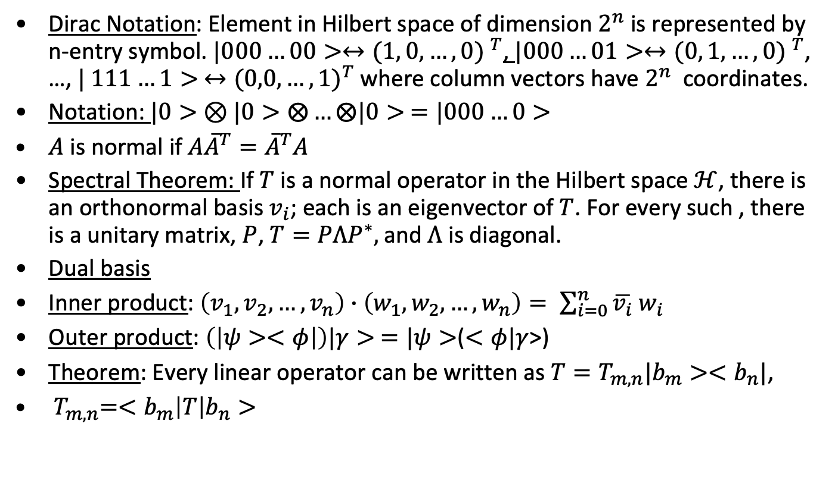
Linear Algebra
Dirac Notation: Element in Hilbert space of dimension $2^{n}$ is represented by n-entry symbol. $|000…00>↔{(1, 0,…,0) }^{T}$, $|000…01>↔{(0, 1,…,0) }^{T}$, …, $| 111…1> ↔{(0,0,…,1)}^{T}$ where column vectors have $2^{n}$ coordinates.
Notation: $|0> ⊗|0>⨂…⨂|0> =|000…0>$
$A$ is normal if $A{\overline{A}}^{T}={\overline{A}}^{T}A$
Spectral Theorem: If $T$ is a normal operator in the Hilbert space $ℋ$, there is an orthonormal basis $v_{i}$; each is an eigenvector of $T$. For every such , there is a unitary matrix, $P$, $T=PΛP^{∗},$and $Λ$ is diagonal.
Dual basis
Inner product: $\left(v_{1},v_{2},…,v_{n}\right)∙\left(w_{1},w_{2},…,w_{n}\right)= \sum_{i=0}^{n}{\overline{v_{i}} w_{i}}$
Outer product: $\left(\left|ψ><φ\right|\right)|γ> =|ψ>$($<φ|γ$>)
Theorem: Every linear operator can be written as $T=T_{m,n}|b_{m}><b_{n}|$,
${ T}_{m,n}=<b_{m}\left|T\right|b_{n}>$

Slide 7
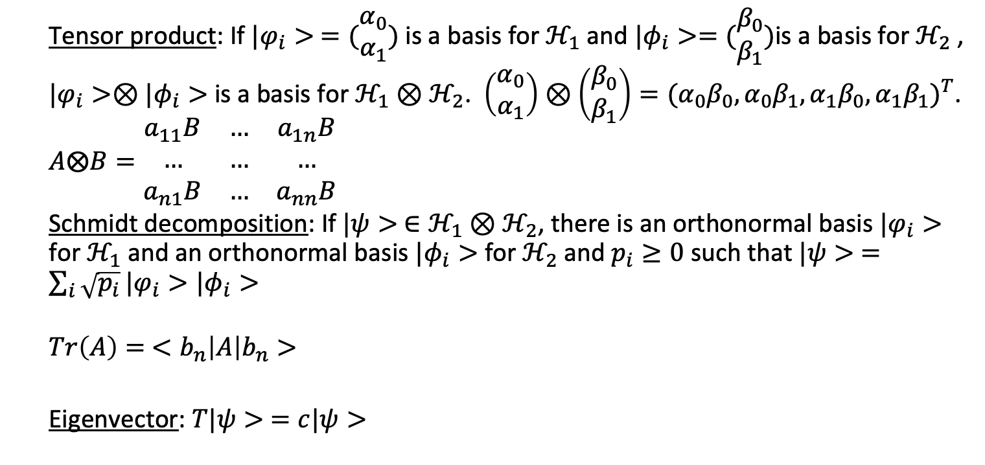
Linear Algebra (continued)
Tensor product: If $|φ_{i}> =(\begin{matrix}α_{0} \\ α_{1}\end{matrix})$ is a basis for $ℋ_{1}$ and $|φ_{i}>=(\begin{matrix}β_{0} \\ β_{1}\end{matrix})$is a basis for $ℋ_{2}$ ,
$|φ_{i}>⊗|φ_{i}>$ is a basis for $ℋ_{1}⊗ℋ_{2}$. $\left(\begin{matrix}α_{0} \\ α_{1}\end{matrix}\right)⊗\left(\begin{matrix}β_{0} \\ β_{1}\end{matrix}\right)={(α_{0}β_{0},α_{0}β_{1},α_{1}β_{0},α_{1}β_{1})}^{T}$. $A⨂B=\begin{matrix}a_{11}B & … & a_{1n}B \\ … & … & … \\ a_{n1}B & … & a_{nn}B\end{matrix}$
Schmidt decomposition: If $|ψ> ∈ℋ_{1}⊗ℋ_{2}$, there is an orthonormal basis $|φ_{i}>$ for $ℋ_{1}$ and an orthonormal basis $|φ_{i}>$ for $ℋ_{2}$and $p_{i}≥0$ such that $|ψ> =\sum_{i}{\sqrt{p_{i}}}|φ_{i}>|φ_{i}>$
$$Tr\left(A\right)= <b_{n}\left|A\right|b_{n}>$$
Eigenvector: $T|ψ> =c|ψ>$

Slide 8

More notation
$A⊗B=\left(\begin{matrix}a_{11}b_{11} & a_{11}b_{12} & a_{12}b_{11} & a_{12}b_{12} \\ a_{11}b_{21} & a_{11}b_{22} & a_{12}b_{21} & a_{12}b_{22} \\ a_{21}b_{11} & a_{21}b_{12} & a_{22}b_{11} & a_{22}b_{12} \\ a_{21}b_{21} & a_{21}b_{22} & a_{22}b_{21} & a_{22}b_{22}\end{matrix}\right)$, $x⊗y={\left(x_{1}y_{1}, x_{1}y_{2} , …,x_{n}y_{n}\right)}^{T}$
$|v> ={( v_{1}, v_{2}, …, v_{n} )}^{T}$ , $<w|=( w_{1}, w_{2}, …, w_{n} )$ then
$\left|v><w\right|= \begin{matrix}v_{1}\overline{w_{1}} & v_{1}\overline{w_{2}} & … & v_{1}\overline{w_{n}} \\ … & … & … & … \\ v_{n}\overline{w_{1}} & v_{n}\overline{w_{2}} & … & v_{n}\overline{w_{n}}\end{matrix}$ , so $I=\sum{|i><i|}$ and $M=\sum{M_{ij}|i><j|}$
Pauli matricies
$σ_{0}=I$ , $σ_{1}=X=\left[\begin{matrix}0 & 1 \\ 1 & 0\end{matrix}\right]$, $σ_{2}=Y=\left[\begin{matrix}0 & −i \\ i & 0\end{matrix}\right]$, $σ_{3}=Z=\left[\begin{matrix}1 & 0 \\ 0 & −1\end{matrix}\right]$
$\left[X, Y\right]=iZ,$ $\left[Y,Z\right]=iX$, $\left[Z,X\right]=iY$
$|+> =\frac{1}{\sqrt{2}}(|0> + |1>)$, $|−> =\frac{1}{\sqrt{2}}(|0>− |1>)$, $|i> =\frac{1}{\sqrt{2}}(|0>+i|1>)$, $|−i> =\frac{1}{\sqrt{2}}(|0>− i|1>)$

Slide 9
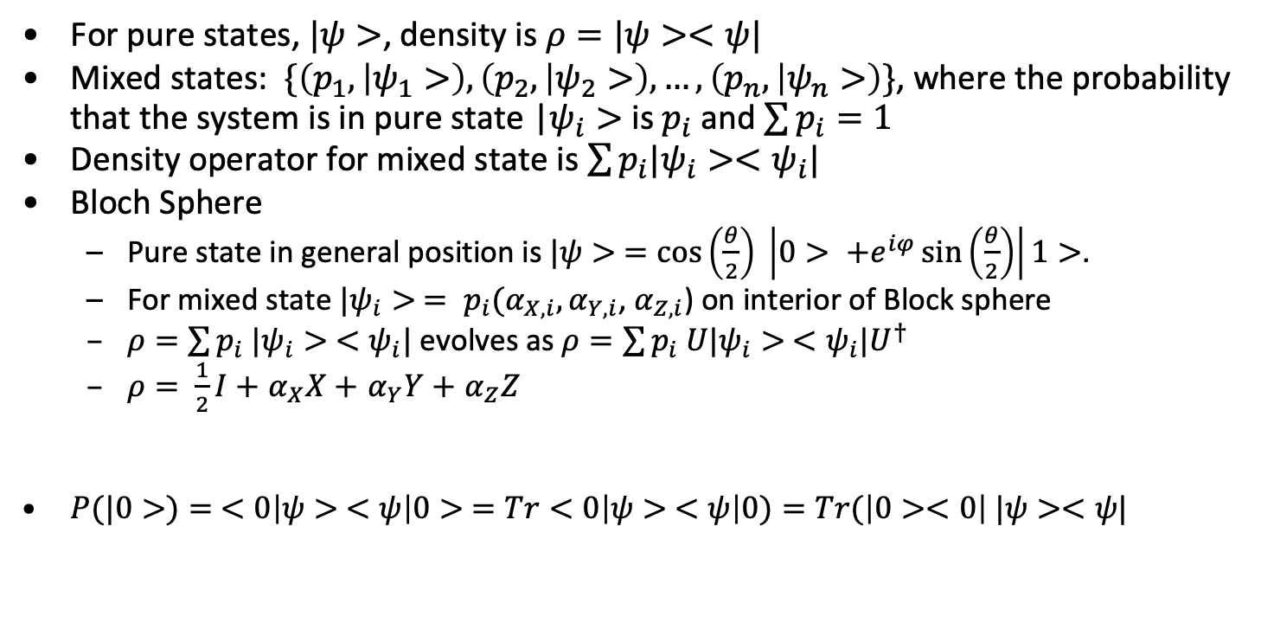
Mixed states and density
For pure states, $|ψ>$, density is $ρ=|ψ><ψ|$
Mixed states: $\{\left(p_{1}, | ψ_{1}>\right),\left(p_{2}, | ψ_{2}>\right),…,\left(p_{n}, | ψ_{n}>\right)\}$, where the probability that the system is in pure state |$ψ_{i}>$ is $p_{i}$ and $\sum{p_{i}}=1$
Density operator for mixed state is $\sum{p_{i}|ψ_{i}><ψ_{i}|}$
Bloch Sphere
Pure state in general position is $|ψ> =\cos\left(\frac{θ}{2}\right) \left|0> +e^{iφ}\sin\left(\frac{θ}{2}\right)\right|1>$.
For mixed state $|ψ_{i}> = p_{i}(α_{X,i},α_{Y,i}$, $α_{Z,i}$) on interior of Block sphere
$ρ=\sum{p_{i} |ψ_{i}> <}$ $ψ_{i}|$ evolves as $ρ=\sum{p_{i} U|ψ_{i}> <}$ $ψ_{i}|U^{†}$
$ρ= \frac{1}{2}I+$ $α_{X}X+$ $α_{Y}Y+$ $α_{Z}Z$
$P(|0>)= <0\left|ψ> <ψ\right|0> =Tr<0\left|ψ> <ψ\right|0)=Tr(\left|0><0\right| |ψ><ψ|$

Slide 10
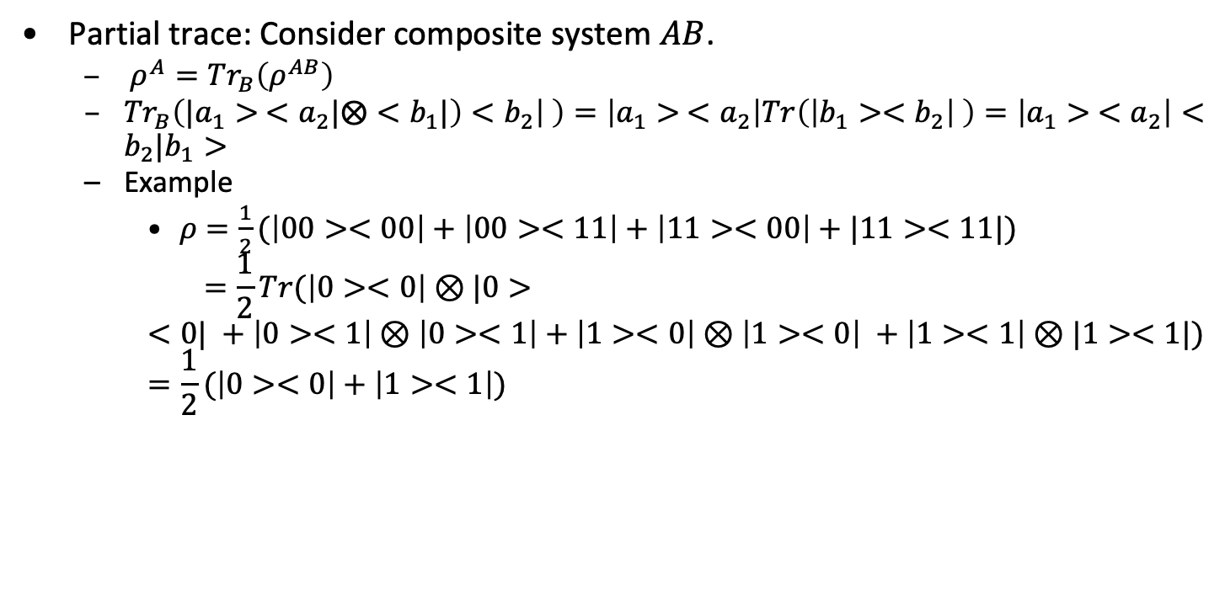
Mixed states and density
Partial trace: Consider composite system $AB$.
$ρ^{A}={Tr}_{B}\left(ρ^{AB}\right)$
${Tr}_{B}\left(|a_{1}> <a_{2}|⨂<b_{1}|\right)<b_{2}\left| \right)=\left|a_{1}> <a_{2}\right|Tr\left(\left|b_{1}><b_{2}\right| \right)=\left|a_{1}> <a_{2}\right|<b_{2}|b_{1}>$
Example
$ρ=\frac{1}{2}(\left|00><00\right|+\left|00><11\right|+\left|11><00\right|+|11><11|)$
$$=\frac{1}{2}Tr(\left|0><0\right|⊗|0><0| +\left|0><1\right|⊗\left|0><1\right|+\left|1><0\right|⊗\left|1><0\right| +\left|1><1\right|⊗|1><1|)=\frac{1}{2}(\left|0><0\right|+\left|1><1\right|)$$

Slide 11
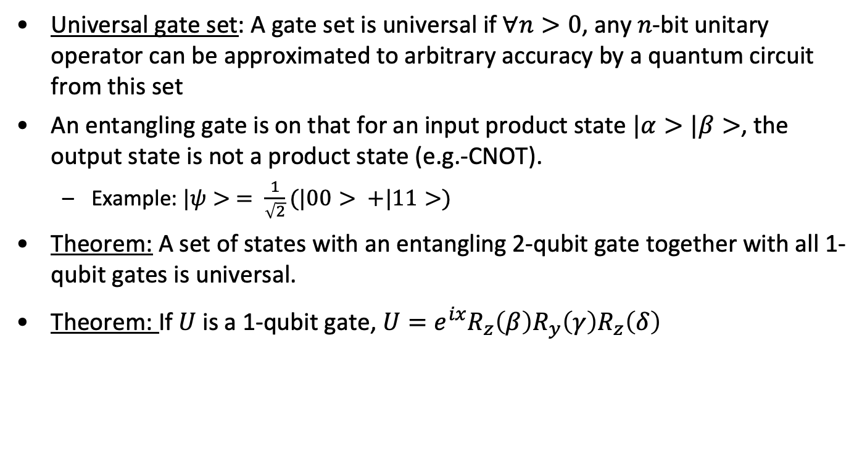
Circuits and gates
Universal gate set: A gate set is universal if $∀n>0$, any $n$-bit unitary operator can be approximated to arbitrary accuracy by a quantum circuit from this set
An entangling gate is on that for an input product state $|α>|β>$, the output state is not a product state (e.g.-CNOT).
Example: $|ψ> = \frac{1}{\sqrt{2}}(|00> +|11>)$
Theorem: A set of states with an entangling 2-qubit gate together with all 1-qubit gates is universal.
Theorem: If $U$ is a 1-qubit gate, $U=e^{ix}R_{z}\left(β\right)R_{y}\left(γ\right)R_{z}\left(δ\right)$

Slide 12
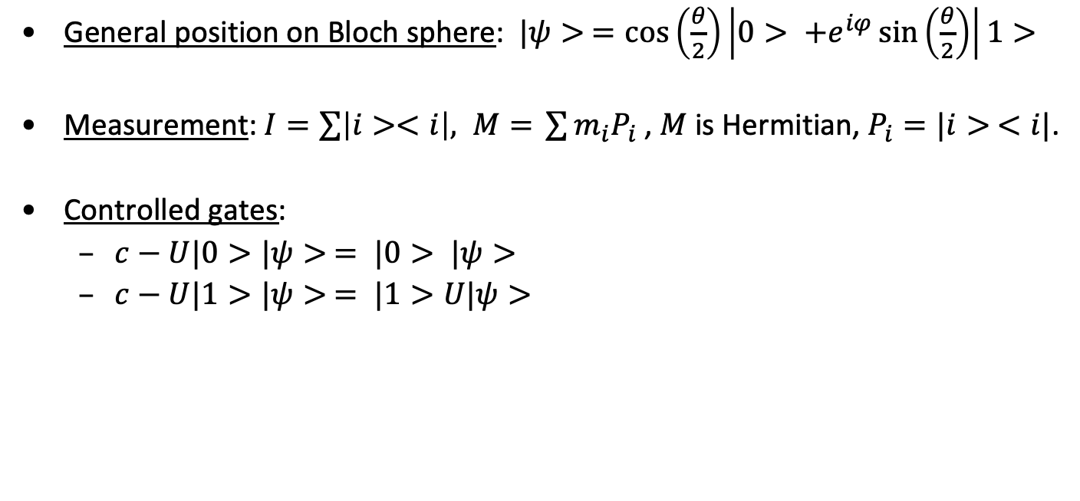
Gates and states
General position on Bloch sphere: $|ψ> =\cos\left(\frac{θ}{2}\right)\left|0> +e^{iφ}\sin\left(\frac{θ}{2}\right)\right|1>$
Measurement: $I=\sum{\left|i><i\right|, M= }\sum{m_{i}P_{i} }$, $M$ is Hermitian, $P_{i}=|i> <i|$.
Controlled gates:
$c−U|0>|ψ> = |0> |ψ>$
$c−U|1>|ψ> = |1>U|ψ>$

Slide 13


Common gates
Pauli gates
$$I=\left(\begin{matrix}1 & 0 \\ 0 & 1\end{matrix}\right)$$
$$X=\left(\begin{matrix}0 & 1 \\ 1 & 0\end{matrix}\right)$$
$$Y=\left(\begin{matrix}0 & −i \\ i & 0\end{matrix}\right)$$
$$Z=\left(\begin{matrix}1 & 0 \\ 0 & −1\end{matrix}\right)$$
Note: $X^{2}=Y^{2}=Z^{2}=I$
Hadamard
$H=\frac{1}{\sqrt{2}}\left(\begin{matrix}1 & 1 \\ 1 & −1\end{matrix}\right)$.
$H^{⨂n}(|0000…0>)=\frac{1}{\sqrt{2}}(|0>+|1>)⨂\frac{1}{\sqrt{2}}(|0>+\left|1>\right)⨂$… $⨂\frac{1}{\sqrt{2}}(|0>+\left|1>\right)$
Rotation
$$R_{X}\left(θ\right)=\left(\begin{matrix}1 & 0 \\ 0 & e^{iXθ}\end{matrix}\right)=\left(\begin{matrix}e^{−iXθ/2} & 0 \\ 0 & e^{iXθ/2}\end{matrix}\right)$$
2 qubit gate
$$CNOT(|xy>)=|x, x⨁y>$$
$$CNOT=\left(\begin{matrix}\begin{matrix}1 & 0 \\ 0 & 1\end{matrix} & \begin{matrix}0 & 0 \\ 0 & 0\end{matrix} \\ \begin{matrix}0 & 0 \\ 0 & 0\end{matrix} & \begin{matrix}0 & 1 \\ 1 & 0\end{matrix}\end{matrix}\right)$$
If $A^{2}=1$, $e^{iθX}=\operatorname{Icos}\left(θ\right)+iXsin(θ)$

Slide 14
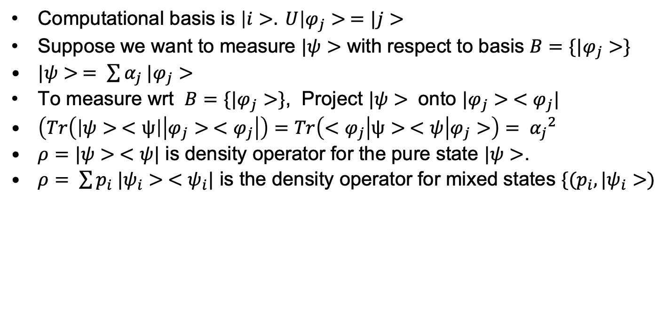
Measurement in alternate basis
Computational basis is $\left|i>. U\right|φ_{j}> =|j>$
Suppose we want to measure $|ψ>$ with respect to basis $B=\{|φ_{j}>\}$
$|ψ> = \sum{α_{j} |φ_{j}>}$
To measure wrt $B=\{|φ_{j}>\}$, Project $|ψ>$ onto $|φ_{j}> <φ_{j}|$
$\left(Tr\left(\left|ψ> <ψ\right|\left|φ_{j}> <φ_{j}\right|\right)=Tr\left(<φ_{j}\right|ψ> <ψ | φ_{j}>\right)= {α_{j}}^{2}$
$ρ=|ψ> <ψ|$ is density operator for the pure state $|ψ>$.
$ρ= \sum{p_{i} |ψ_{i}> <ψ_{i}|}$ is the density operator for mixed states $\{(p_{i},|ψ_{i}>)$

Slide 15

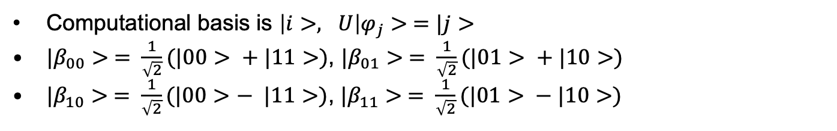


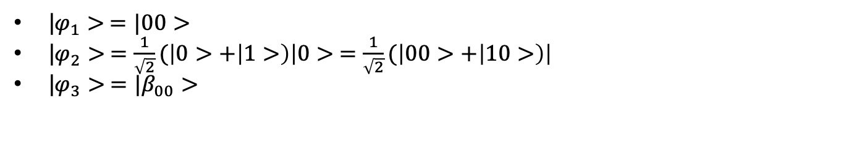




Converting to Bell Basis
Computational basis is $\left|i>, U\right|φ_{j}> =|j>$
${|β}_{00}> = \frac{1}{\sqrt{2}}(|00> + |11>)$, ${|β}_{01}> = \frac{1}{\sqrt{2}}(|01> + |10>)$
${|β}_{10}> = \frac{1}{\sqrt{2}}(|00>− |11>)$, ${|β}_{11}> = \frac{1}{\sqrt{2}}(|01> − |10>)$
$$|i>$$
H
$${|β}_{ij}>$$
$$≡$$
$$|j>$$
X
Bell
$$|φ_{1}>$$
$$|φ_{2}>$$
$$|φ_{3}>$$
|$φ_{1}> =|00>$
|$φ_{2}> =\frac{1}{\sqrt{2}}(\left|0>+\left|1>\right)\right|0> =\frac{1}{\sqrt{2}}(\left|00>+\left|10>\right)\right|$
|$φ_{3}> ={|β}_{00}>$

Slide 16


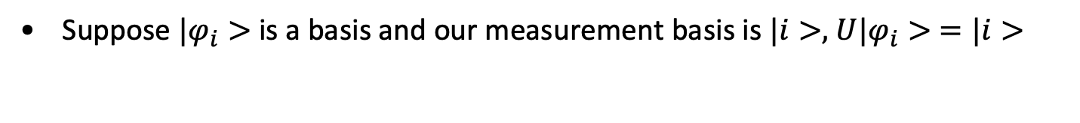







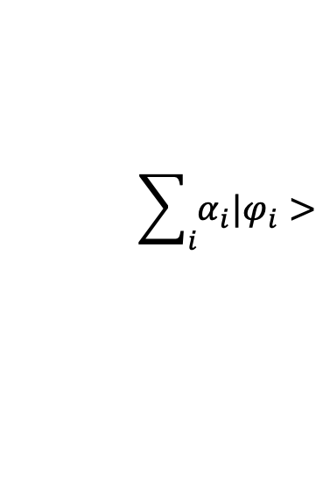
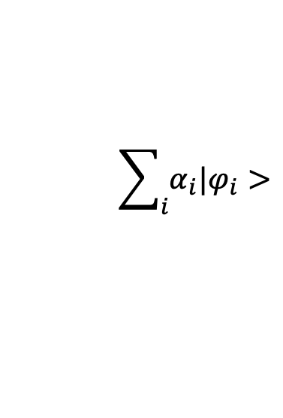


Changing Measurement Basis
Suppose $|φ_{i}>$ is a basis and our measurement basis is $|i>,$ $U|φ_{i}> =|i>$
With probability ${|α_{j}|}^{2}$
$$\sum_{i}{α_{i}|φ_{i}>}$$
$$U$$
$$|j>$$
$$U^{−1}$$
$$|φ_{j}>$$
$$\sum_{i}{α_{i}|φ_{i}>}$$
$$U^{−1}$$
$$|φ_{j}>$$
$$U$$
X
With probability ${|α_{j}|}^{2}$
$$|000..>$$
X
$$|j>$$
X

Slide 17
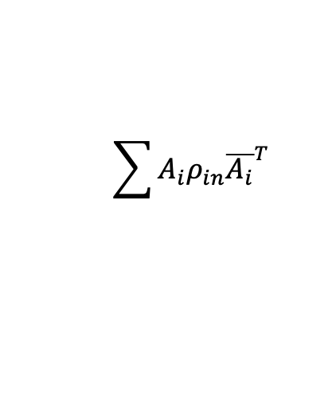
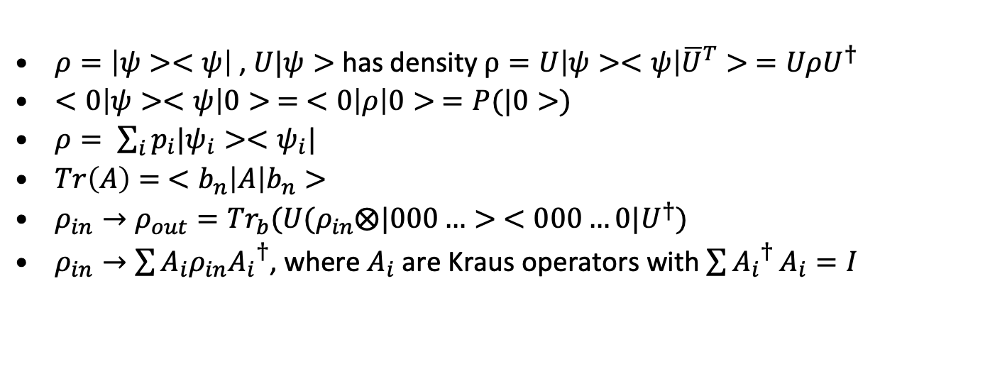


Superoperator and mixed states
$${|ρ}_{in}>$$
$$\sum{A_{i}ρ_{in}{\overline{A_{i}}}^{T}}$$
U
$$|0000>$$
Garbage
$ρ=\left|ψ><ψ\right|$ , $U|ψ>$ has density $ρ=U\left|ψ><ψ\right|{\overline{U}}^{T}> =UρU^{†}$
$<0\left|ψ><ψ\right|0> = <0\left|ρ\right|0> =P(|0>)$
$ρ= \sum_{i}{p_{i}|ψ_{i}><ψ_{i}|}$
$Tr\left(A\right)= <b_{n}\left|A\right|b_{n}>$
$ρ_{in}→ρ_{out}={Tr}_{b}(U(ρ_{in}⨂|000…> <000…0|U^{†})$
$ρ_{in}→\sum{A_{i}ρ_{in}{A_{i}}^{†}}$, where $A_{i}$ are Kraus operators with $\sum{{A_{i}}^{†}}A_{i}=I$

Slide 18
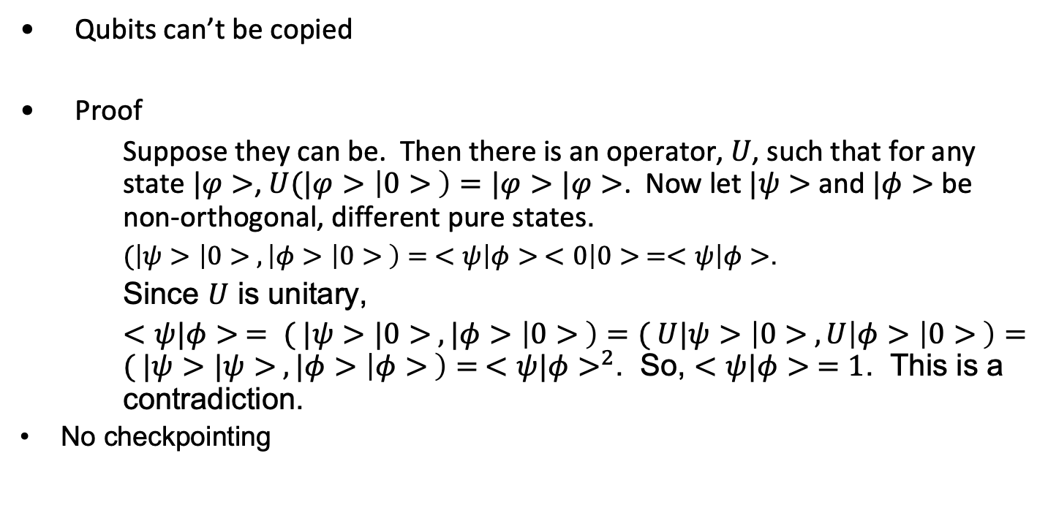
No Cloning Theorem
Qubits can’t be copied
Proof
Suppose they can be. Then there is an operator, $U$, such that for any state $|φ>$, $U(|φ>\left|0> \right)=|φ>|φ>$. Now let $|ψ>$ and $|φ>$ be non-orthogonal, different pure states.
$(\left|ψ>\left|0> , \left|φ>\left|0> \right)= <ψ\right|φ> <0\right|0> =<ψ\right|φ>$.
Since $U$ is unitary,
$<ψ|φ> = ( |ψ>|0> , |φ>\left|0> \right)=( U|ψ>\left|0> , U\right|φ>\left|0> \right)=( |ψ>|ψ> , |φ>\left|φ> \right)= {<ψ|φ>}^{2}$. So, $<ψ|φ> =1$. This is a contradiction.
No checkpointing

Slide 19





Parity Circuit
$$|x_{1}>$$
$$|x_{2}>$$
$$|x_{3}>$$
$$|0>$$
X
X
X
$$x_{1}⊕x_{2}⊕x_{3}$$

Slide 20
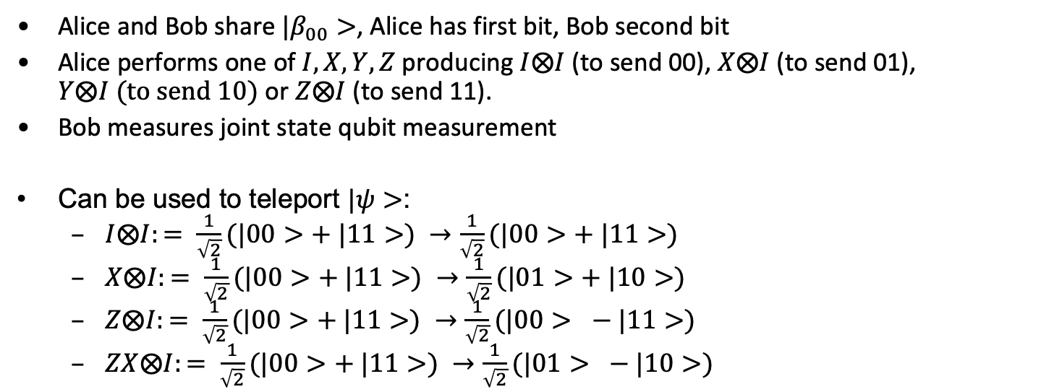



Superdense coding
Alice and Bob share ${|β}_{00}>$, Alice has first bit, Bob second bit
Alice performs one of $I, X,Y,Z$ producing $I⨂I$ (to send 00), $X⨂I$(to send 01), $Y⨂I (to send 10)$ or $Z⨂I$ (to send 11).
Bob measures joint state qubit measurement
Can be used to teleport $|ψ>$:
$I⨂I:= \frac{1}{\sqrt{2}}(|00>+ |11>) →\frac{1}{\sqrt{2}}(|00>+ |11>)$
$X⨂I:= \frac{1}{\sqrt{2}}(|00>+ |11>) →\frac{1}{\sqrt{2}}(|01>+ |10>)$
$Z⨂I:= \frac{1}{\sqrt{2}}(|00>+ |11>) →\frac{1}{\sqrt{2}}(|00> − |11>)$
$ZX⨂I:= \frac{1}{\sqrt{2}}(|00>+ |11>) →\frac{1}{\sqrt{2}}(|01> − |10>)$
$$|ψ>$$
b
Bell
a
$$|β_{00}>$$
X
Z
$$|ψ>$$

Slide 21
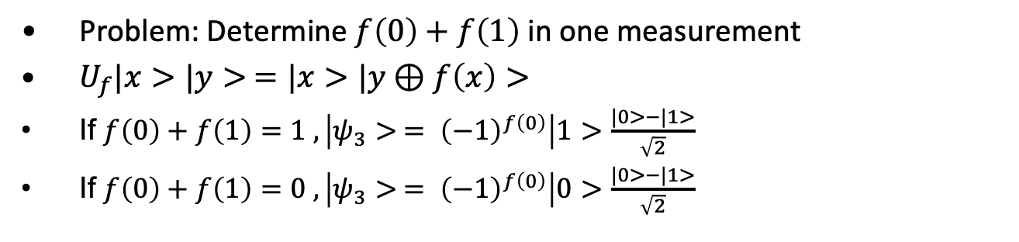
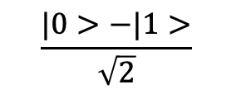

Deutch
Problem: Determine $f\left(0\right)+f\left(1\right)$ in one measurement
$U_{f}|x>|y> =|x>|y⊕f\left(x\right)>$
If $f\left(0\right)+f\left(1\right)=1 , \left|ψ_{3}> = {\left(−1\right)}^{f\left(0\right)}\right|1>$ $\frac{|0>−|1>}{\sqrt{2}}$
If $f\left(0\right)+f\left(1\right)=0 , \left|ψ_{3}> = {\left(−1\right)}^{f\left(0\right)}\right|0>$ $\frac{|0>−|1>}{\sqrt{2}}$
$$|0>$$
H
H
U_{f}
$$\frac{|0>−|1>}{\sqrt{2}}$$

Slide 22

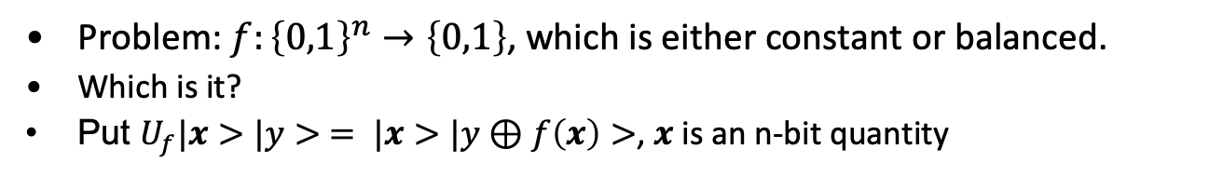


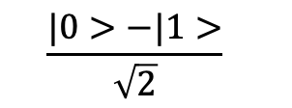





Deutch-Josza
Problem: $f:{\left\{0,1\right\}}^{n}→\left\{0,1\right\}$, which is either constant or balanced.
Which is it?
Put $U_{f}|x>|y> = |x>|y⊕f\left(x\right)>$, $x$ is an n-bit quantity
$$|0>$$
H
H
$$|0>$$
H
H
…
…
$$|0>$$
H
H
$$\frac{|0>−|1>}{\sqrt{2}}$$
$$\frac{|0>−|1>}{\sqrt{2}}$$
U_{f}
$$|φ_{0}>$$
$$|φ_{1}>$$
$$|φ_{2}>$$
$$|φ_{3}>$$

Slide 23

DJ
$|φ_{0}> = {|0>}^{⊗n}\frac{|0>−|1>}{\sqrt{2}}$
$|φ_{1}> = \frac{1}{\sqrt{2^{n}}} \sum_{x}{|x>\frac{|0>−|1>}{\sqrt{2}}}$
$|φ_{2}> = \frac{1}{\sqrt{2^{n}}} \sum_{x}{{(−1)}^{f(x)}|x>\frac{|0>−|1>}{\sqrt{2}}}$
$|φ_{3}> = \frac{1}{2^{n}} \sum_{x}{\sum_{z}{|{(−1)}^{f\left(x\right)+x∙z}z>}\frac{|0>−|1>}{\sqrt{2}}}$

Slide 24
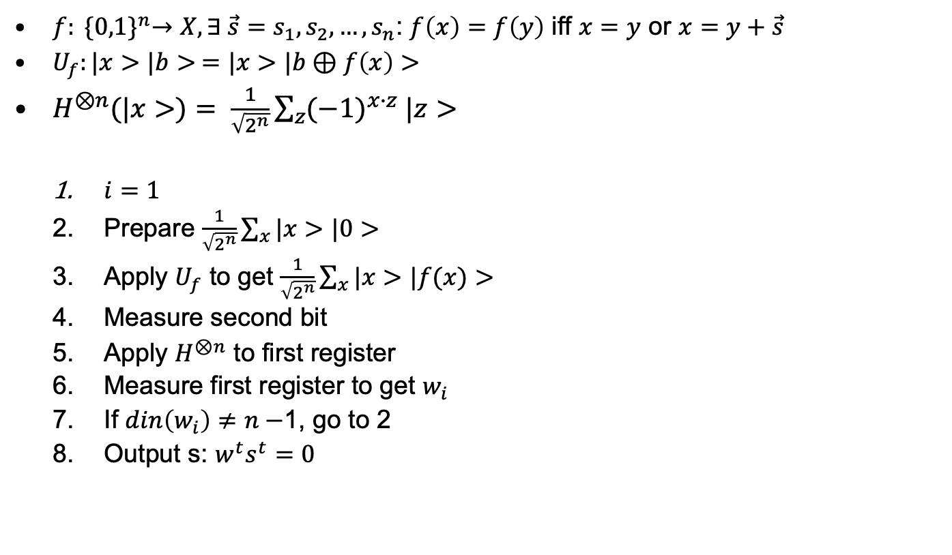
Simon
$f: {\{0,1\}}^{n}→X, ∃ {\vec{s}=s}_{1},s_{2},…,s_{n}$: $f\left(x\right)=f\left(y\right)$ iff $x=y$ or $x=y+\vec{s}$
$U_{f}:|x>|b> =|x>|b⊕f\left(x\right)>$
$H^{⊗n}(|x>)= \frac{1}{\sqrt{2^{n}}}\sum_{z}{{(−1)}^{x∙z} |z>}$
$i=1$
Prepare $\frac{1}{\sqrt{2^{n}}}\sum_{x}{|x>|0>}$
Apply $U_{f}$ to get $\frac{1}{\sqrt{2^{n}}}\sum_{x}{|x>|f(x)>}$
Measure second bit
Apply $H^{⊗n}$ to first register
Measure first register to get $w_{i}$
If $din\left(w_{i}\right)≠n−$1, go to 2
Output s: $w^{t}s^{t}=0$

Slide 25

Phase kick back
$CNOT\left(\frac{|0> +|1>}{\sqrt{2}}\frac{|0> − |1>}{\sqrt{2}}\right)=$ $\frac{|0> − |1>}{\sqrt{2}}$ $\frac{|0> − |1>}{\sqrt{2}}$

Slide 26
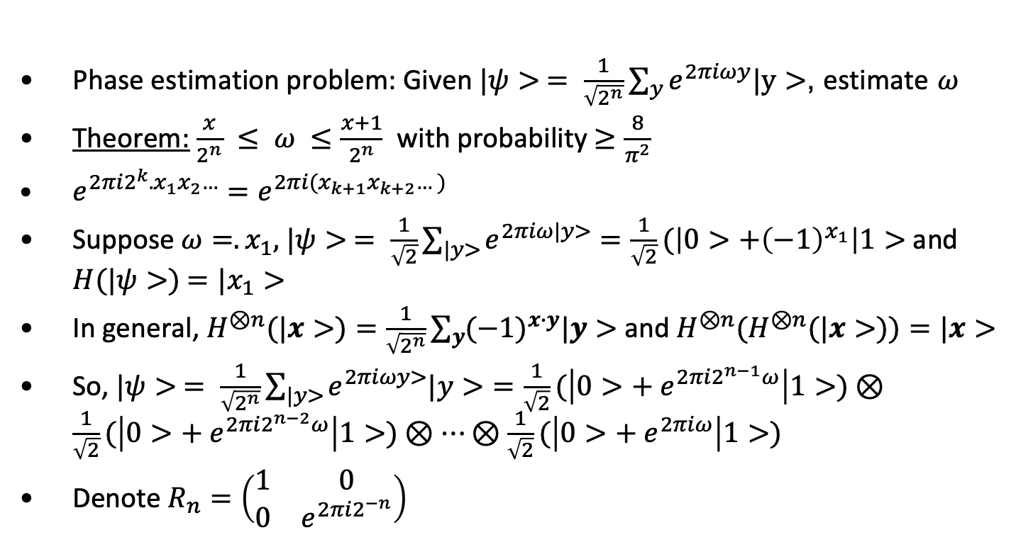
Phase Estimation
Phase estimation problem: Given $|ψ> = \frac{1}{\sqrt{2^{n}}}\sum_{y}{e^{2πiωy}|y>}$, estimate $ω$
Theorem: $\frac{x}{2^{n}} ≤ ω ≤$ $\frac{x+1}{2^{n}}$ with probability $≥\frac{8}{π^{2}}$
$e^{2πi2^{k}.x_{1}x_{2}…}=e^{2πi(x_{k+1}x_{k+2}…)}$
Suppose $ω=.x_{1},$ $|ψ> = \frac{1}{\sqrt{2}}\sum_{|y>}{e^{2πiω|y>}}=\frac{1}{\sqrt{2}}(\left|0>+{\left(−1\right)}^{x_{1}}\right|1>$ and $H(|ψ>)$ $=|x_{1}>$
In general, $H^{⊗n}(|x>)=\frac{1}{\sqrt{2^{n}}}\sum_{y}{{(−1)}^{x∙y}|y>}$ and ${H^{⊗n}(H}^{⊗n}(|x>))=|x>$
So, $|ψ> = \frac{1}{\sqrt{2^{n}}}\sum_{|y>}{e^{2πiωy>}|y>}=\frac{1}{\sqrt{2}}(\left|0>+ e^{2πi2^{n−1}ω}\right|1>)⊗\frac{1}{\sqrt{2}}(\left|0>+ e^{2πi2^{n−2}ω}\right|1>)⊗…⊗\frac{1}{\sqrt{2}}(\left|0>+ e^{2πiω}\right|1>)$
Denote $R_{n}=\left(\begin{matrix}1 & 0 \\ 0 & e^{2πi2^{−n}}\end{matrix}\right)$

Slide 27
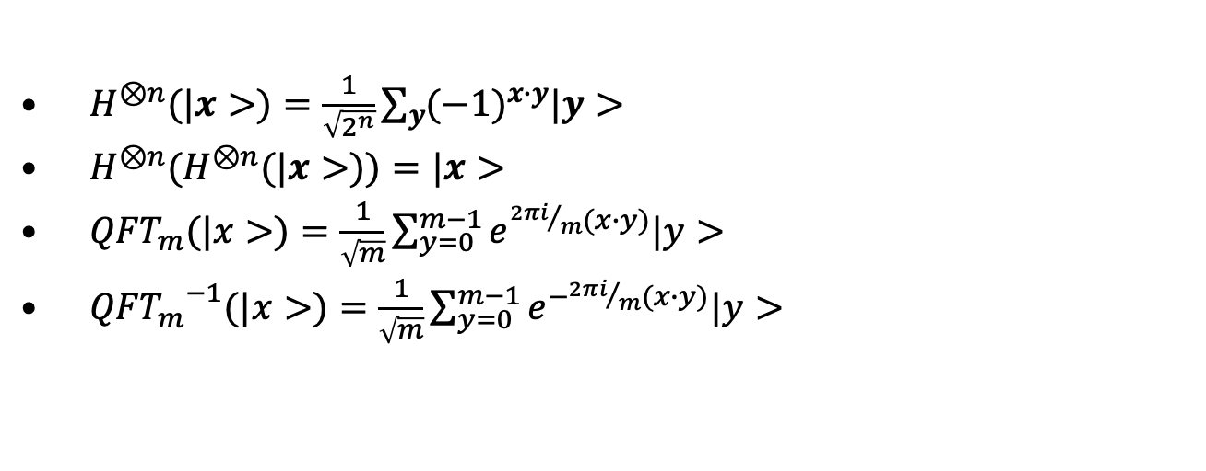
Quantum Fourier Transform
$H^{⊗n}(|x>)=\frac{1}{\sqrt{2^{n}}}\sum_{y}{{(−1)}^{x∙y}|y>}$
${H^{⊗n}(H}^{⊗n}(|x>))=|x>$
${QFT}_{m}(|x>)=\frac{1}{\sqrt{m}}\sum_{y=0}^{m−1}{e^{{2πi}/m(x∙y)}|y>}$
${{QFT}_{m}}^{−1}(|x>)=\frac{1}{\sqrt{m}}\sum_{y=0}^{m−1}{e^{−{2πi}/m(x∙y)}|y>}$

Slide 28

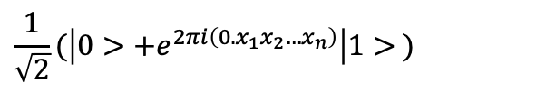
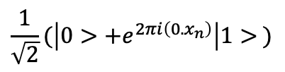


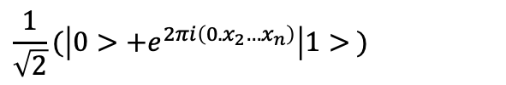
Quantum Fourier Circuit
…
$$\frac{1}{\sqrt{2}}(\left|0>+e^{2πi\left(0.x_{1}x_{2}…x_{n}\right)}\right|1> )$$
$$|x_{1}>$$
H
R₂
R₃
R_{n}
$$|x_{2}>$$
H
R₂
R₃
…
R_{n-1}
$$\frac{1}{\sqrt{2}}(\left|0>+e^{2πi\left(0. x_{2}…x_{n}\right)}\right|1> )$$
…
$$|x_{n}>$$
$$\frac{1}{\sqrt{2}}(\left|0>{+e}^{2πi\left(0. x_{n}\right)}\right|1> )$$
H

Slide 29


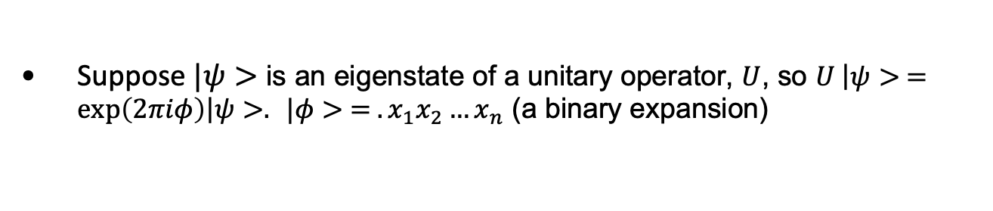





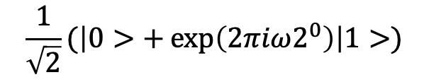



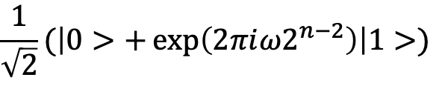
Eigenvalue Estimation
Suppose $|ψ>$ is an eigenstate of a unitary operator, $U$, so $U \left|ψ> =exp\left(2πiφ\right)\right|ψ>.$ $|φ> = .x_{1}x_{2}…x_{n}$ (a binary expansion)
$\frac{1}{\sqrt{2}}(\left|0>+\exp\left(2πi{ω2}^{n−1}\right)\right|1>$)
$$|0>$$
H
$$\frac{1}{\sqrt{2}}(\left|0>+\exp\left(2πi{ω2}^{n−2}\right)\right|1>)$$
H
$$|0>$$
$$ξ$$
…
$$\frac{1}{\sqrt{2}}(\left|0>+\exp\left(2πiω2^{0}\right)\right|1>)$$
$$|0>$$
H
$$|ψ>$$
$$U^{2^{n−1}}$$
$$U^{2^{n−2}}$$
…
$$U^{2^{0}}$$
$$|ψ>$$

Slide 30
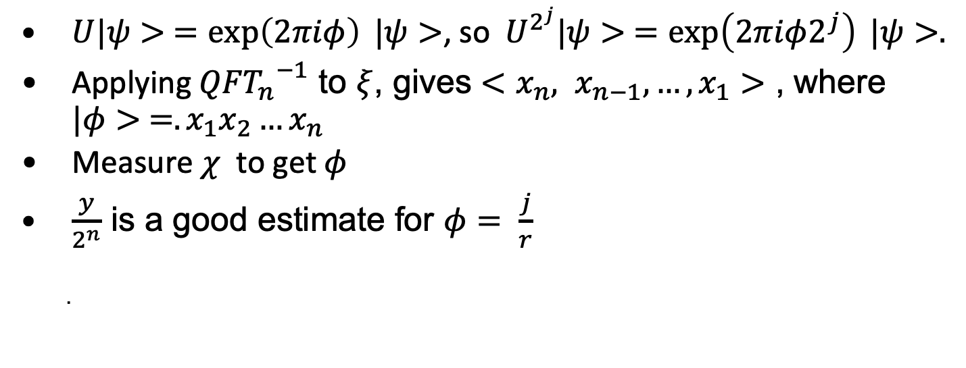
Eigenvalue Estimation
$U|ψ> =\exp\left(2πiφ\right) |ψ>$, so$U^{2^{j}}|ψ> =\exp\left(2πiφ2^{j}\right) |ψ>.$
Applying ${{QFT}_{n}}^{−1}$ to $ξ$, gives $<x_{n}, x_{n−1}, …,x_{1}>$ , where $|φ> =.x_{1}x_{2}…x_{n}$
Measure $χ$to get $φ$
$\frac{y}{2^{n}}$ is a good estimate for $φ= \frac{j}{r}$
.

Slide 31
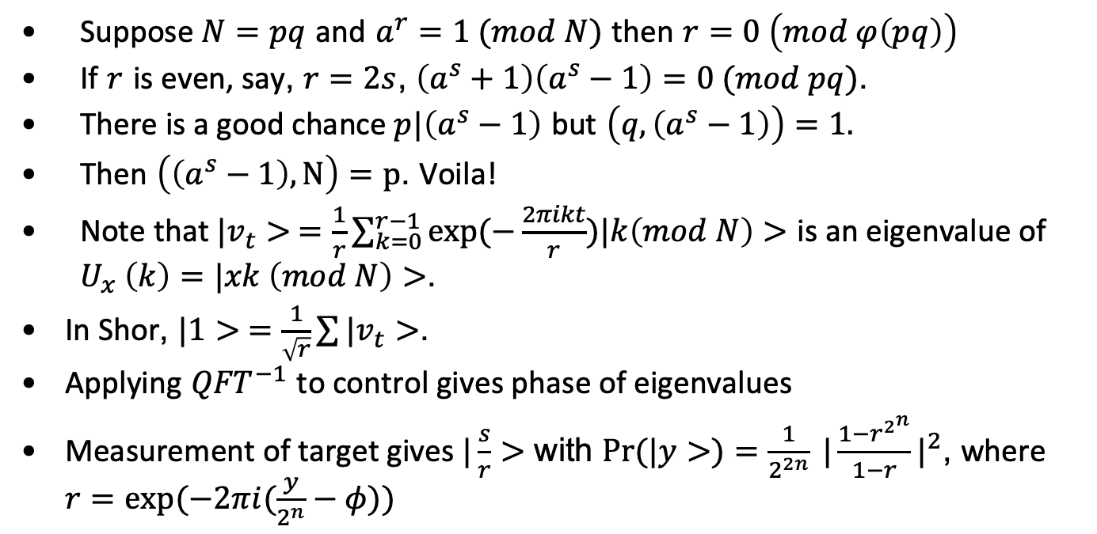
Factorization using order finding (Shor)
Suppose $N=pq$ and $a^{r}=1 (mod N)$ then $r=0 \left(mod φ\left(pq\right)\right)$
If $r$ is even, say, $r=2s$, $\left(a^{s}+1\right)\left(a^{s}−1\right)=0 (mod pq)$.
There is a good chance $p|\left(a^{s}−1\right)$ but $\left(q,\left(a^{s}−1\right)\right)=1.$
Then $\left(\left(a^{s}−1\right), N\right)=p$. Voila!
Note that $|v_{t}> =\frac{1}{r}\sum_{k=0}^{r−1}{exp⁡(−\frac{2πikt}{r})|k\left(mod N\right)>}$ is an eigenvalue of $U_{x} \left(k\right)=|xk \left(mod N\right)>$.
In Shor, $|1> =\frac{1}{\sqrt{r}}\sum{|v_{t}>}$.
Applying ${QFT}^{−1}$ to control gives phase of eigenvalues
Measurement of target gives $|\frac{s}{r}>$ with $\operatorname{Pr}{(|y>)}=\frac{1}{2^{2n}} {|\frac{1−r^{2^{n}}}{1−r}|}^{2}$, where $r=exp⁡(−2πi(\frac{y}{2^{n}}−φ))$

Slide 32
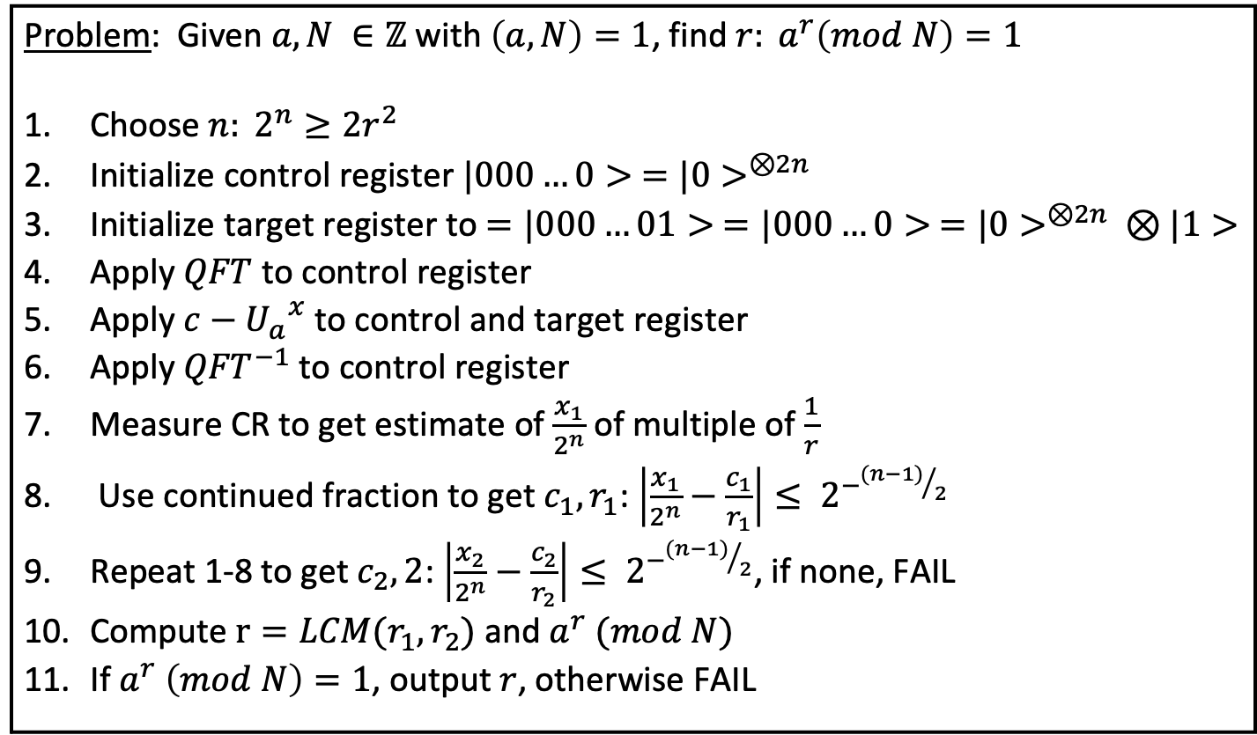
Order Finding
Problem: Given $a, N ∈ℤ$ with $\left(a,N\right)=1$, find $r: a^{r}\left(mod N\right)=1$
Choose $n: 2^{n}≥2r^{2}$
Initialize control register ${|000…0> =|0>}^{⊗2n}$
Initialize target register to $=|000…01> ={|000…0> =|0>}^{⊗2n} ⊗|1>$
Apply $QFT$ to control register
Apply $c−{U_{a}}^{x}$ to control and target register
Apply ${QFT}^{−1}$ to control register
Measure CR to get estimate of $\frac{x_{1}}{2^{n}}$ of multiple of $\frac{1}{r}$
Use continued fraction to get $c_{1}, r_{1}$: $\left|\frac{x_{1}}{2^{n}}−\frac{c_{1}}{r_{1}}\right|≤ 2^{−{(n−1)}/2}$
Repeat 1-8 to get $c_{2}, 2$: $\left|\frac{x_{2}}{2^{n}}−\frac{c_{2}}{r_{2}}\right|≤ 2^{−{(n−1)}/2}$, if none, FAIL
Compute $r=LCM(r_{1},r_{2})$ and $a^{r} (mod N)$
If $a^{r} \left(mod N\right)=1$, output $r$, otherwise FAIL

Slide 33

Order Finding
Order finding has quantum complexity $O({\lg\left(N\right)}^{2}\lg\left(\lg\left(N\right)\right)lg⁡(lg⁡(\lg\left(N\right))$
Classical complexity is $exp⁡(O(\sqrt{\lg\left(N\right)lg⁡(\lg\left(N\right)))}$

Slide 34
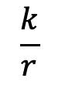

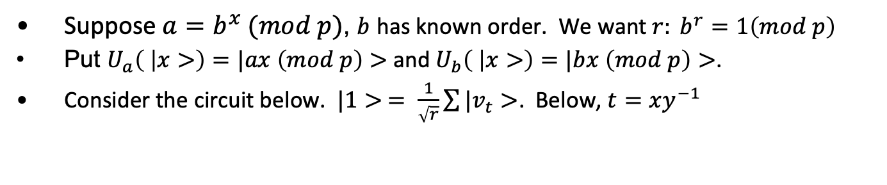








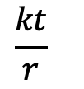
Discrete log
Suppose $a=b^{x} (mod p)$, $b$ has known order. We want $r: b^{r}=1\left(mod p\right)$
Put $U_{a}\left( | x>\right)=|ax \left(mod p\right)>$and $U_{b}\left( | x>\right)=|bx \left(mod p\right)>$.
Consider the circuit below. $|1> = \frac{1}{\sqrt{r}}\sum{|v_{t}>}$. Below, $t=xy^{−1}$
$${QFT}^{−1}$$
$$\frac{k}{r}$$
$${|0>}^{⊗n}$$
$$QFT$$
$${|0>}^{⊗n}$$
$$QFT$$
$${QFT}^{−1}$$
$$\frac{kt}{r}$$
$$|1>$$
$${U_{a}}^{x}$$
$${U_{b}}^{x}$$
$$χ$$

Slide 35
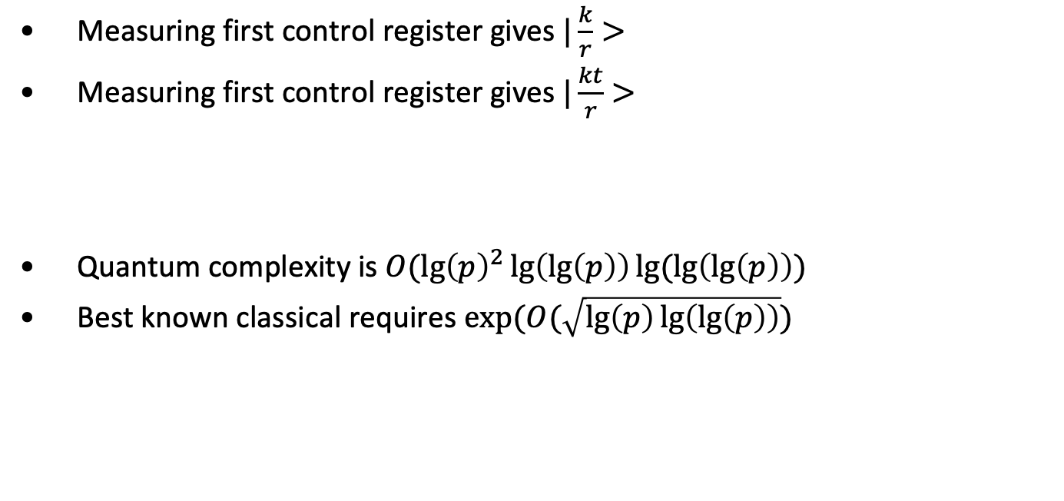
Discrete log
Measuring first control register gives $|\frac{k}{r}>$
Measuring first control register gives $|\frac{kt}{r}>$
Quantum complexity is $O({\lg\left(p\right)}^{2}\lg\left(\lg\left(p\right)\right)lg⁡(\lg\left(\lg\left(p\right)\right))$
Best known classical requires $exp⁡(O(\sqrt{\lg\left(p\right)\lg\left(\lg\left(p\right)\right)})$

Slide 36

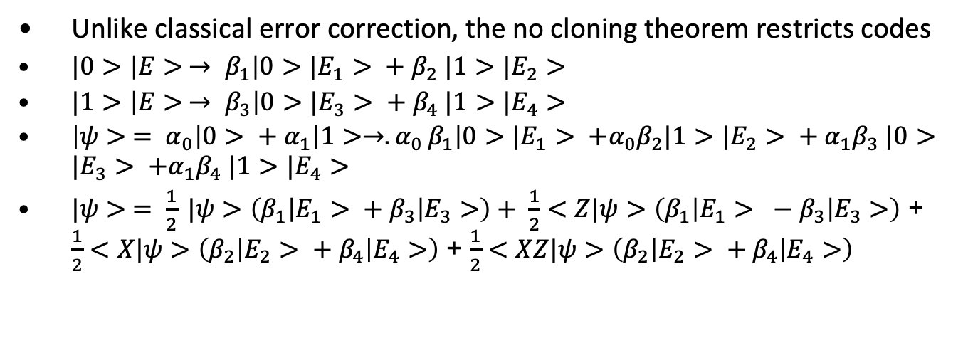




Error Correction
$$|b>$$
$$G_{enc}$$
$${ℇ_{i}}^{C}$$
$$ℛ^{C}$$
$$|b>$$
$$|000>$$
Unlike classical error correction, the no cloning theorem restricts codes
$|0>\left|E> → β_{1}\right|0>|E_{1}> + β_{2} |1>|E_{2}>$
$|1>\left|E> → β_{3}\right|0>|E_{3}> + β_{4} |1>|E_{4}>$
$\left|ψ> = α_{0}\right|0> + α_{1}\left|1>→{.α}_{0}β_{1}\right|0>|E_{1}> +α_{0}β_{2}|1>|E_{2}> + α_{1}β_{3} |0>|E_{3}> +α_{1}β_{4} |1>|E_{4}>$
$|ψ> = \frac{1}{2} |ψ>\left(β_{1}\left|E_{1}> + β_{3}\right|E_{3}>\right)+ \frac{1}{2}<Z|ψ>\left(β_{1}\left|E_{1}> − β_{3}\right|E_{3}>\right)$ + $\frac{1}{2}<X|ψ>\left(β_{2}\left|E_{2}> + β_{4}\right|E_{4}>\right)$ + $\frac{1}{2}<XZ|ψ>\left(β_{2}\left|E_{2}> + β_{4}\right|E_{4}>\right)$

Slide 37
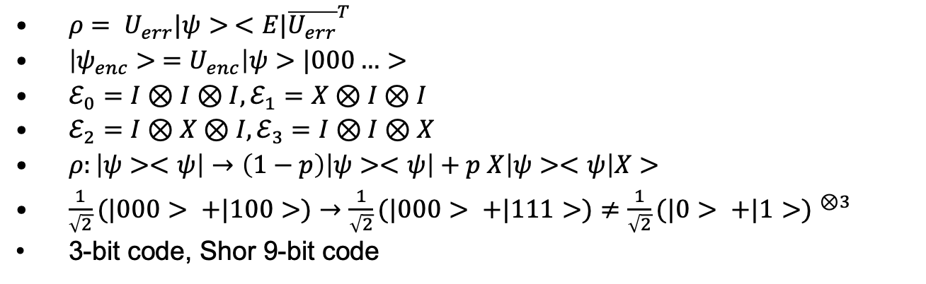



Error Correction
$ρ= U_{err}|ψ> <E|{\overline{U_{err}}}^{T}$
$\left|ψ_{enc}> =U_{enc}\right|ψ>|000…>$
$ℰ_{0}=I⊗I⊗I, ℰ_{1}=X⊗I⊗I$
$ℰ_{2}=I⊗X⊗I, ℰ_{3}=I⊗I⊗X$
$ρ:\left|ψ><ψ\right|→\left(1−p\right)\left|ψ><ψ\right|+p X\left|ψ><ψ\right|X>$
$\frac{1}{\sqrt{2}}(|000> +|100>)→\frac{1}{\sqrt{2}}(|000> +|111>)≠\frac{1}{\sqrt{2}}{(|0> +|1>) }^{⊗3}$
3-bit code, Shor 9-bit code
$$|ψ>$$
H
$$|0>$$
X
H
$$|0>$$
X
H

Slide 38
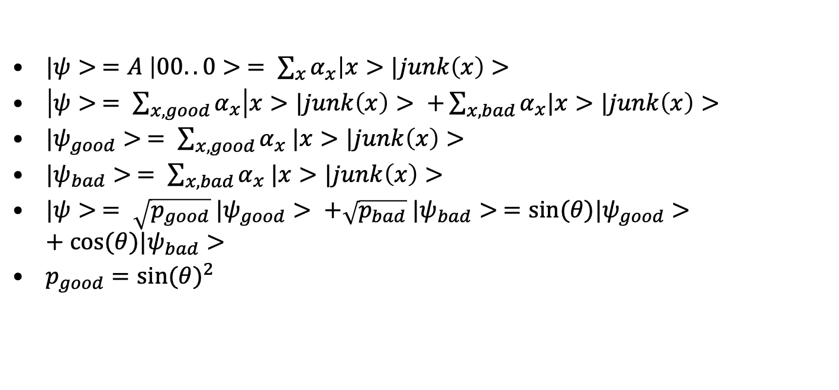
Amplitude Amplification
$|ψ> =A \left|00..0> = \sum_{x}{α_{x}}\right|x>|junk\left(x\right)>$
$\left|ψ> = \sum_{x, good}{α_{x}}\right|x>|junk\left(x\right)> +\sum_{x, bad}{α_{x}|x>|junk\left(x\right)>}$
$|ψ_{good}> = \sum_{x, good}{α_{x} |x>|junk\left(x\right)>}$
$|ψ_{bad}> = \sum_{x, bad}{α_{x} |x>|junk\left(x\right)>}$
$|ψ> = \sqrt{p_{good}} |ψ_{good}> +\sqrt{p_{bad}} |ψ_{bad}> =sin⁡(θ)|ψ_{good}>+cos⁡(θ)|ψ_{bad}>$
$p_{good}={sin⁡(θ)}^{2}$

Slide 39
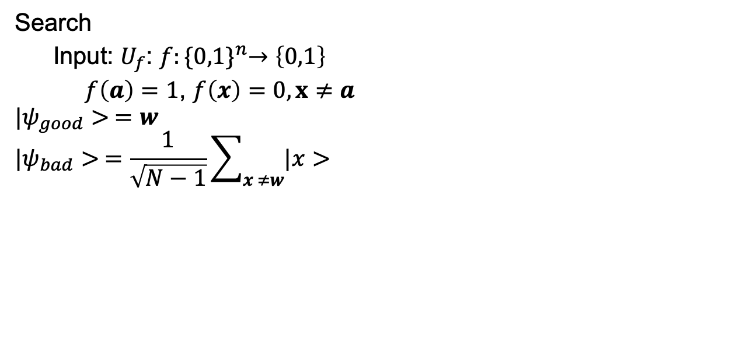
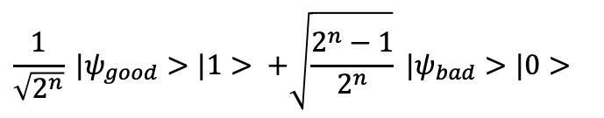

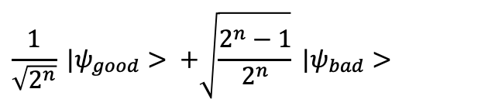
Grover
Search
Input: $U_{f}$: $f:{\{0,1\}}^{n}→\left\{0,1\right\}$
$f\left(a\right)=1$, $f\left(x\right)=0, x≠a$
$$|ψ_{good}> =w$$
$$|ψ_{bad}> =\frac{1}{\sqrt{N−1}}\sum_{x ≠w}{|x>}$$
$$\frac{1}{\sqrt{2^{n}}} |ψ_{good}> +\sqrt{\frac{2^{n}−1}{2^{n}}} |ψ_{bad}>$$
$$\frac{1}{\sqrt{2^{n}}} |ψ_{good}>|1> +\sqrt{\frac{2^{n}−1}{2^{n}}} |ψ_{bad}>|0>$$
U_{f}
$$|0>$$

Slide 40




Grover
Initialize $n$-qubits $|0000…0>$.
Apply $H^{⨂n}$ to get $\frac{1}{\sqrt{N}}\sum_{x=0}^{N−1}{|x}$
Apply Grover $G$ $\frac{π}{4\sqrt{n}}$ times
Measure output
Search
Input: $U_{f}$: $f:{\{0,1\}}^{n}→\left\{0,1\right\}$
$f\left(a\right)=1$, $f\left(x\right)=0, x≠a$
$$|ψ_{good}> =w$$
$$|ψ_{bad}> =\frac{1}{\sqrt{N−1}}\sum_{x ≠w}{|x>}$$
Algorithm $G$
Apply $U_{f}$
Apply $H^{⨂n}$
Apply $U_{0^{⊥}}$
Apply $H^{⨂n}$
Algorithm${ U}_{0^{⊥}}$
$${ U}_{0^{⊥}}:|x> ⟶−|x>, x≠0$$
$${ U}_{0^{⊥}}:|0> ⟶0|x>$$

Slide 41
End

Slide 42

Hidden subgroup
$S≤G,$ $f\left(x\right)=f\left(y\right)iff x+S=y+S$

