Slide 1
Internet of Things: Frameworks and resilience
John L. Manferdelli
johnmanferdelli@hotmail.com
April 6, 2020, 13:00

Slide 2
IoT Device Management
Managing IoT
Provisioning
Updates
Surveillance and risk assessment
Resilience a cost risk models
Agility, diversity and replacement
Supply chain risk and assessment
Software and configuration assurance
Privacy and situational awareness

Slide 3
Frameworks: AWS

Slide 4
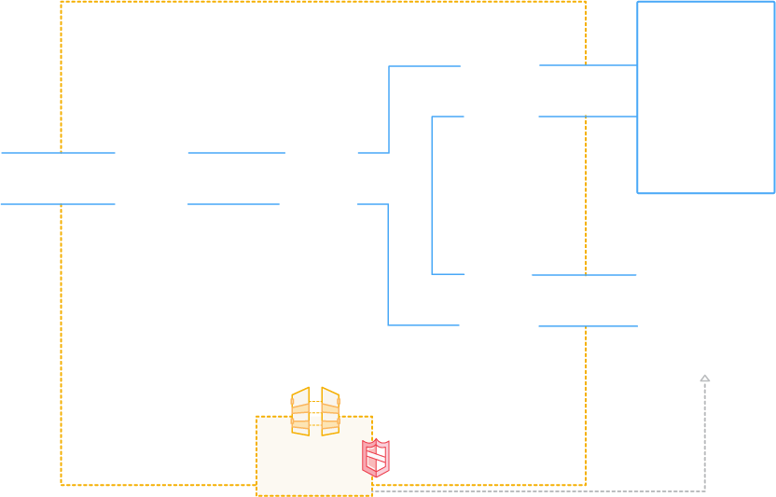








AWS IoT
AUTHENTICATION
AUTHORIZATION
Secure with mutual authentication and encryption
AWS Services
- - - - -
3rd party Services
RULES ENGINE
Transform messages based on rules and route to AWS Services
DEVICE SDK
Set of client libraries to connect, authenticate and exchange messages
DEVICE GATEWAY
Communicate with devices via MQTT and HTTP
APPLICATIONS
DEVICE SHADOW
Persistent thing state during intermittent connections
DEVICE REGISTRY
Identity and Management of your things
AWS IoT API

Slide 5
AWS IoT Components
Message broker
A secure relay between users (subscribers and publishers)
Protocols: MQTT, HTTP REST interface
Rules engine
Rules directing data to other AWS services such as Amazon S3, Amazon DynamoDB, and AWS Lambda
Thing Registry (Device Registry)
Virtual devices in the cloud, corresponding to physical things
Up to three custom attributes for a thing.
Association of certificates and MQTT client IDs with a thing

Slide 6
Frameworks: Azure sphere

Slide 7
Azure Sphere Introduction
Microsoft description is here.
Basic concepts
Azure cloud backend service: data collection, device health
Authenticated boot
Update process
Managed exclusion

Slide 8
MT3620
MT3620 development board is first implementation. Documentation is here.
ARM Cortex A7 core @500MHz , 4MB RAM
ARM Cortex M4 core @200MHz , 64KB RAM with FPU
ADC, I2S, and PWM peripheral interfaces (GPIO, I2C [1MHz], SPI [40MHz] and UART [3Mbps])
Wi-Fi 802.11a/b/g/n
RTC with clock selection and battery backup
Pluton Security system, hardware RNG
Visual Studio IDE, Windows required
Azure Sphere OS
Application containers compartmentalize code for agility, robustness, and security.
On-chip connectivity services secure your connection to the cloud and provide access to the Azure Sphere Security Service.
Custom Linux kernel.
A security monitor guards integrity and access to critical resources.

Slide 9
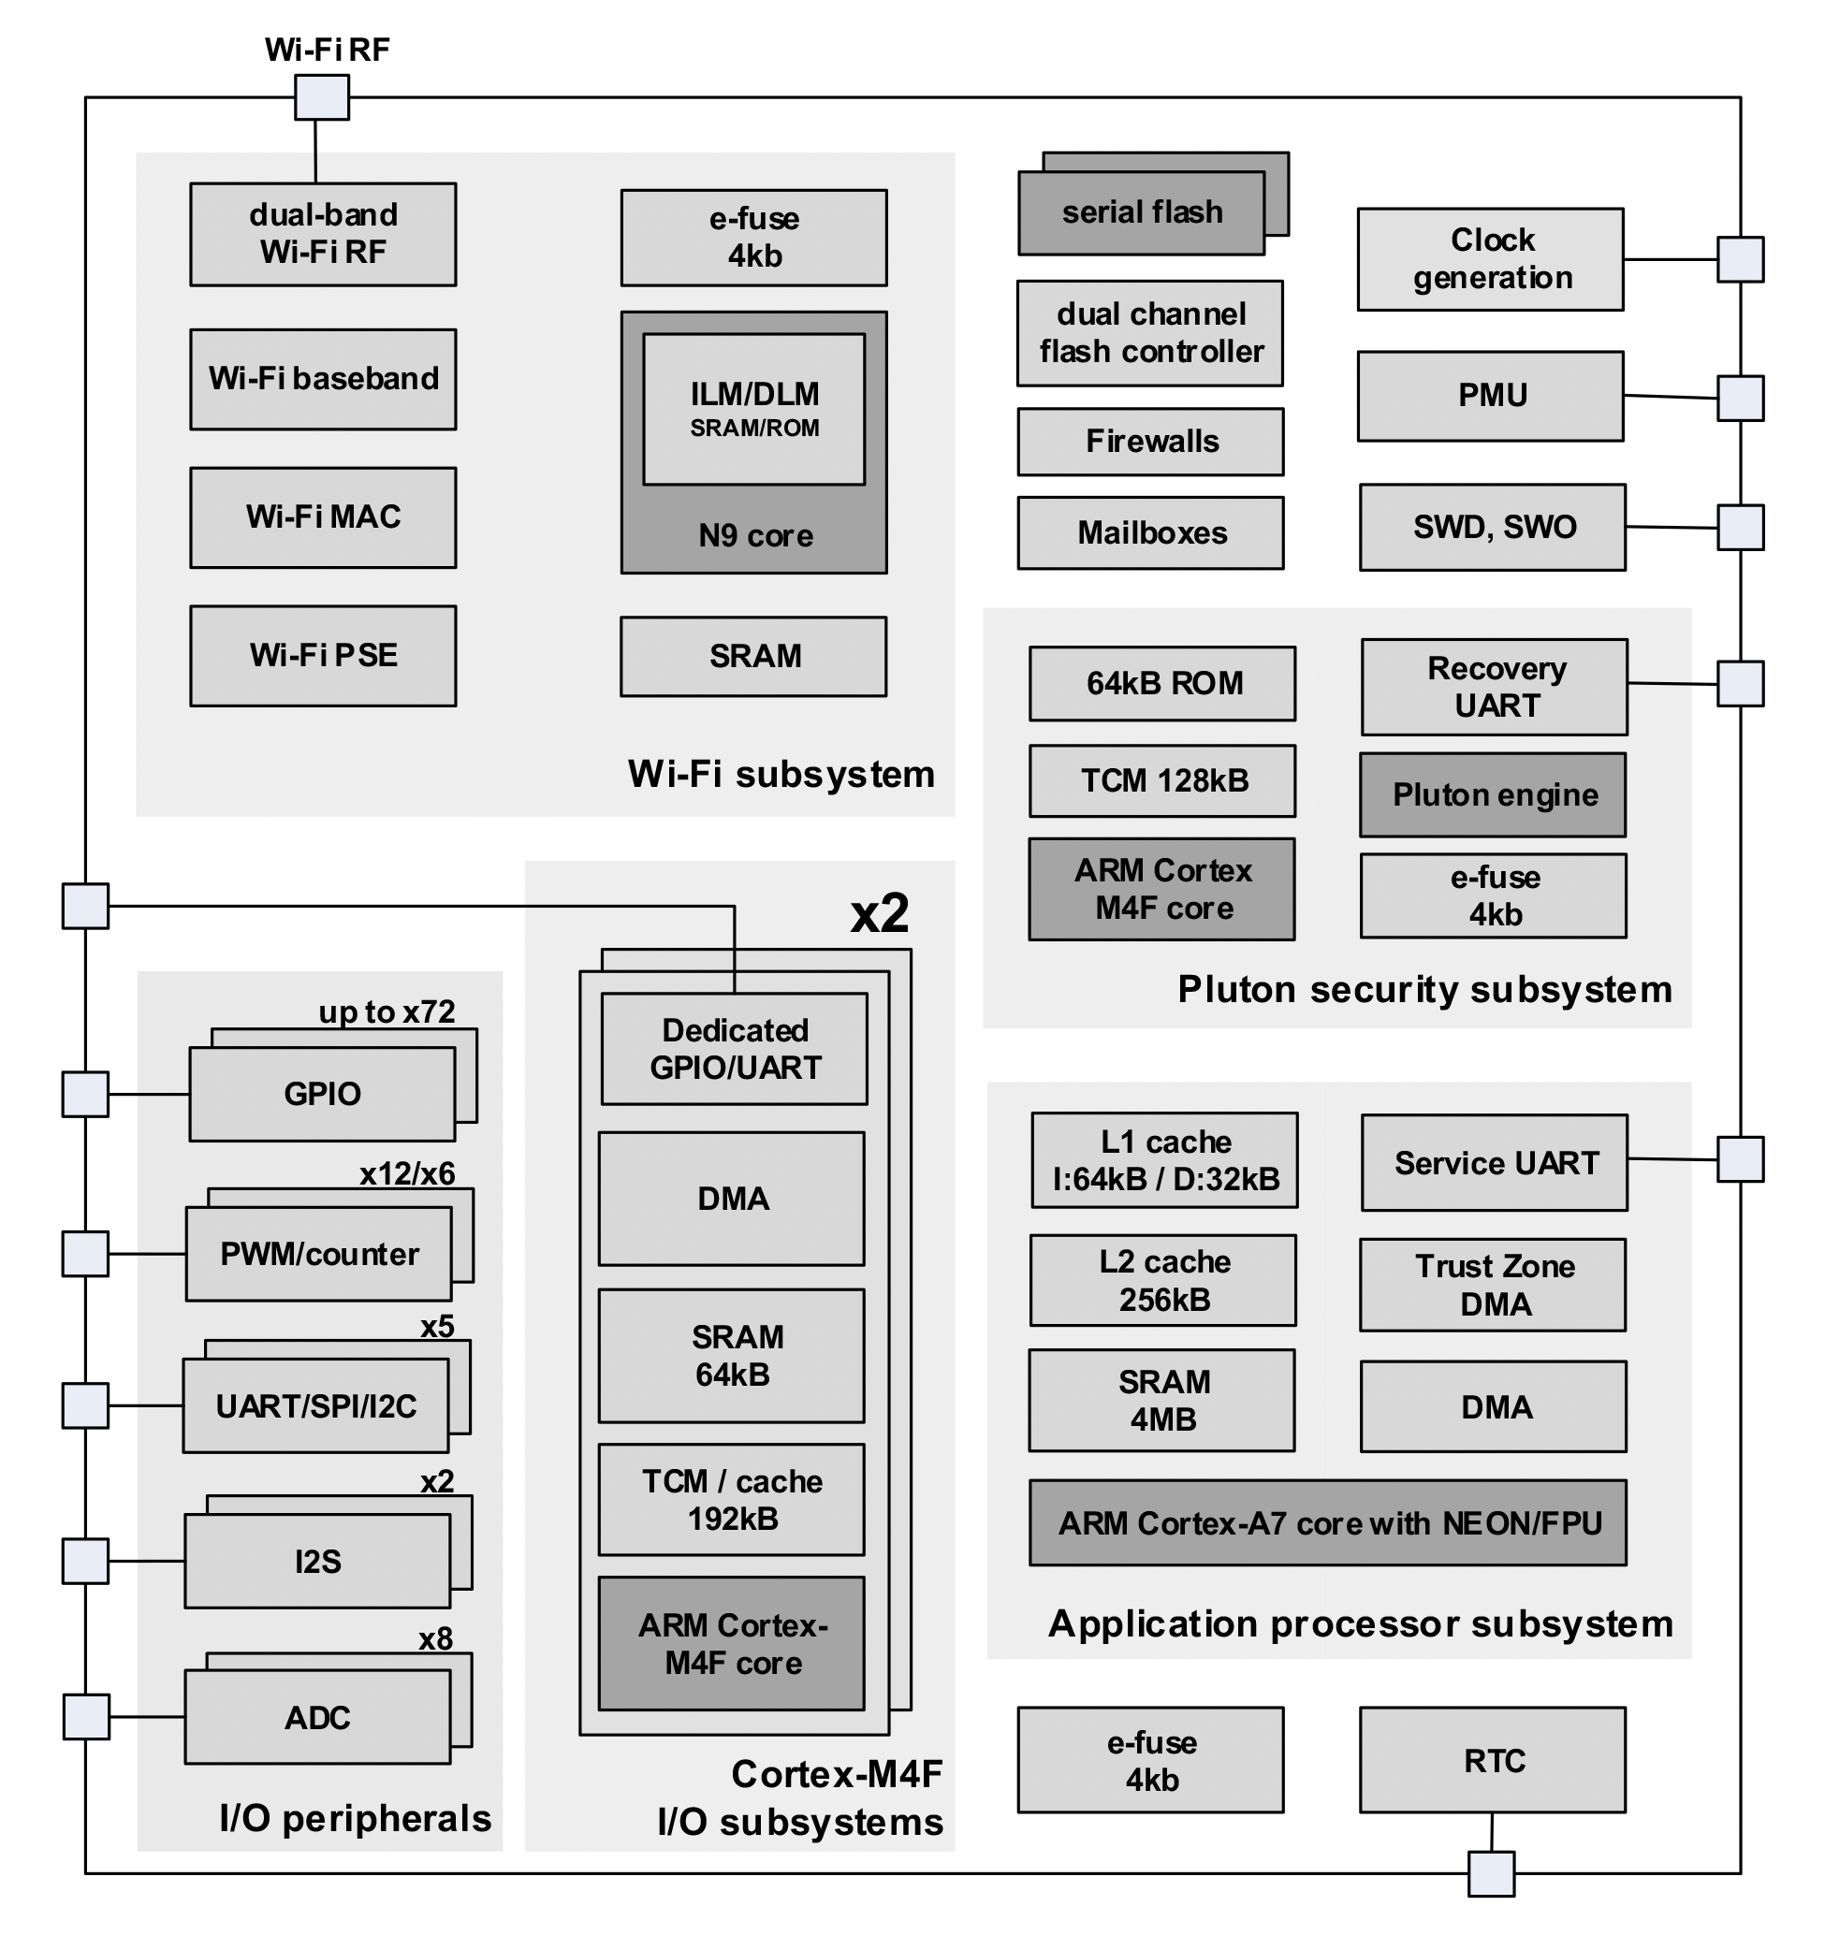
MT3620
Some features not yet implemented in development environment.

Slide 10
IoT protocols

Slide 11
MQTT
MQTT is a messaging broker system, documentation is here.
Clients can publish (Pub) messages and subscribe (Sub) to topics.
Clients can both publish and subscribe.
A broker communicates with clients.

Slide 12
IoT Security design

Slide 13
Development, curation and test
x

Slide 14
Configuration, software and boot
x

Slide 15
Monitoring
x

Slide 16
Redundancy
x

Slide 17
Supply Chain
x

Slide 18
Top ten vulnerabilities
Weak, guessable passwords (poor authentication)
Insecure network services (poor configuration/software)
Insecure APIs and service (poor software security)
Lack of update
Insecure, outdated components (hardware and software)
Poor privacy protection for data stored on devices
Insecure data storage and transfer
Lack of device management
Insecure default settings (poor configuration)
Lack of physical hardening (including physical security)
Refernce: https://www.owasp.org/index.php/OWASP_Internet_of_Things_Project

Slide 19
Todo
Busybox
REST/Json
Mesh
Contrast with industrial control

Slide 20
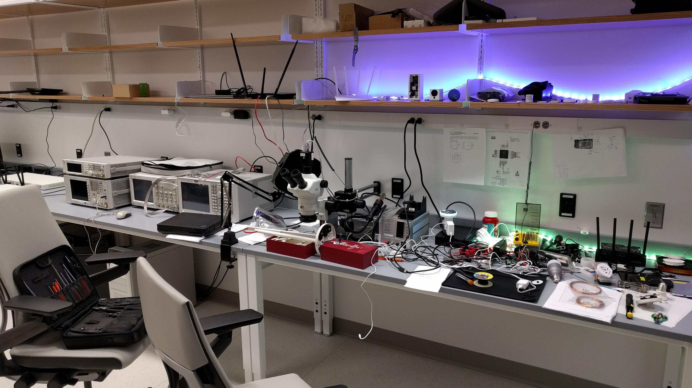
An IoT Lab

Slide 21
Typical IoT devices and their cost
Vacuum Cleaning Robot Gen2: ~ 400$
Smart Home Gateway: ~25$
Sensors: ~5-14$
Wifi-Lightbulbs: ~6-12$

Slide 22
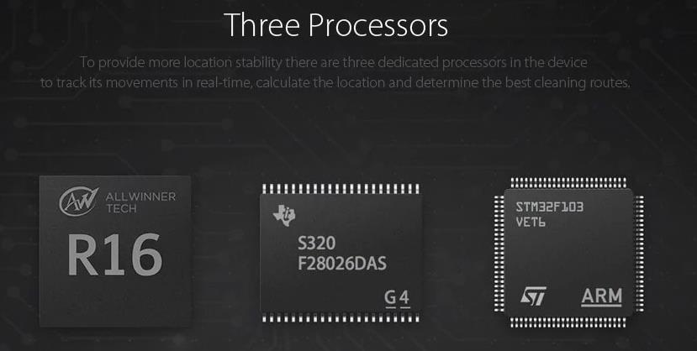
Commercial processors

Slide 23
Typical ecosystem

Slide 24
App to cloud communication
REQ: api.io.mi.com/home/device_list method:POST params:[]
RES: {"message":"ok","result":{"list":[{"did":"65981234","token":“a bc...zzz","name":"Mi PlugMini","localip":"192.168.99.123", "mac":"34:CE:00:AA:BB:CC","ssid":"IoT","bssid":"FA:1A:67:CC: DD:EE","model":"chuangmi.plug.m1", "longitude":“-71.0872248","latitude":"42.33794500“, "adminFlag":1,"shareFlag":0,"permitLevel":16,"isOnline":true, "desc":"Power plug on ","rssi":-47}

Slide 25
Nexmon patching

Slide 26
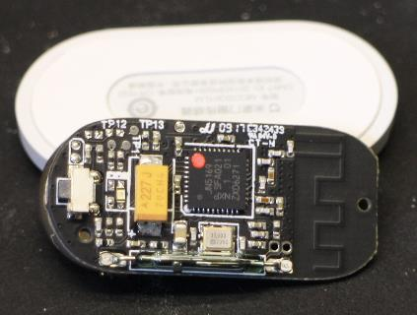
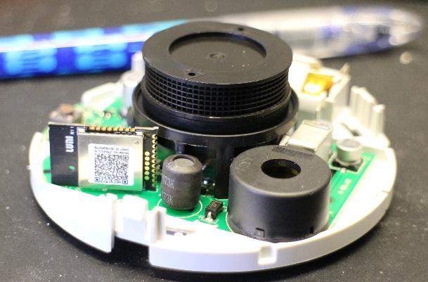
Sensors connected via gateway
Zigbee (NXP JN5169) based
Door Sensor (Reed contact)
Temperature sensor
Power Plug
Motion Sensor
Button
Smoke Detector
Smart Door Lock

Slide 27
eMMc layout
Label | Content | Size in MByte
boot-res | bitmaps & some wav files | 8
env | uboot cmd line | 16
app | device.conf (DID, key, MAC), adb.conf, vinda | 16
recovery | fallback copy of OS | 512
system_a | copy of OS (active by default) | 512
system_b | copy of OS (passive by default) | 512
Download | temporary unpacked OS update | 528
reserve | config + calibration files, blackbox.db | 16
UDISK/Data | logs, maps, pcap files | ~1900

Slide 28
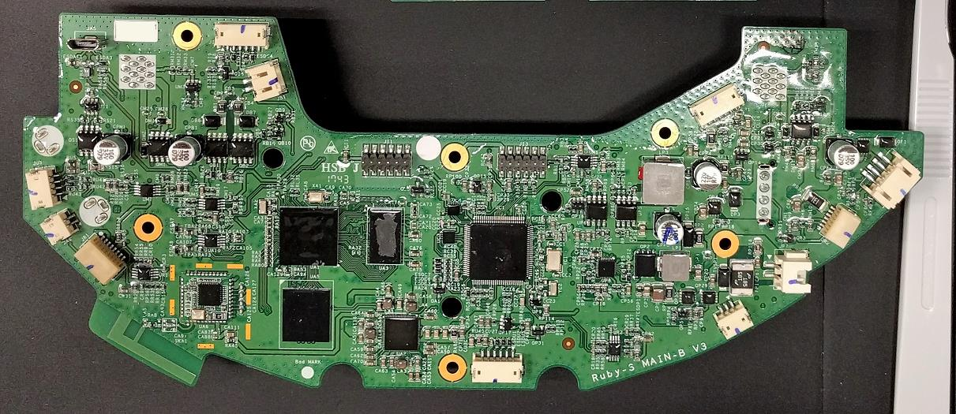
Xiaomi vacuum

Slide 29
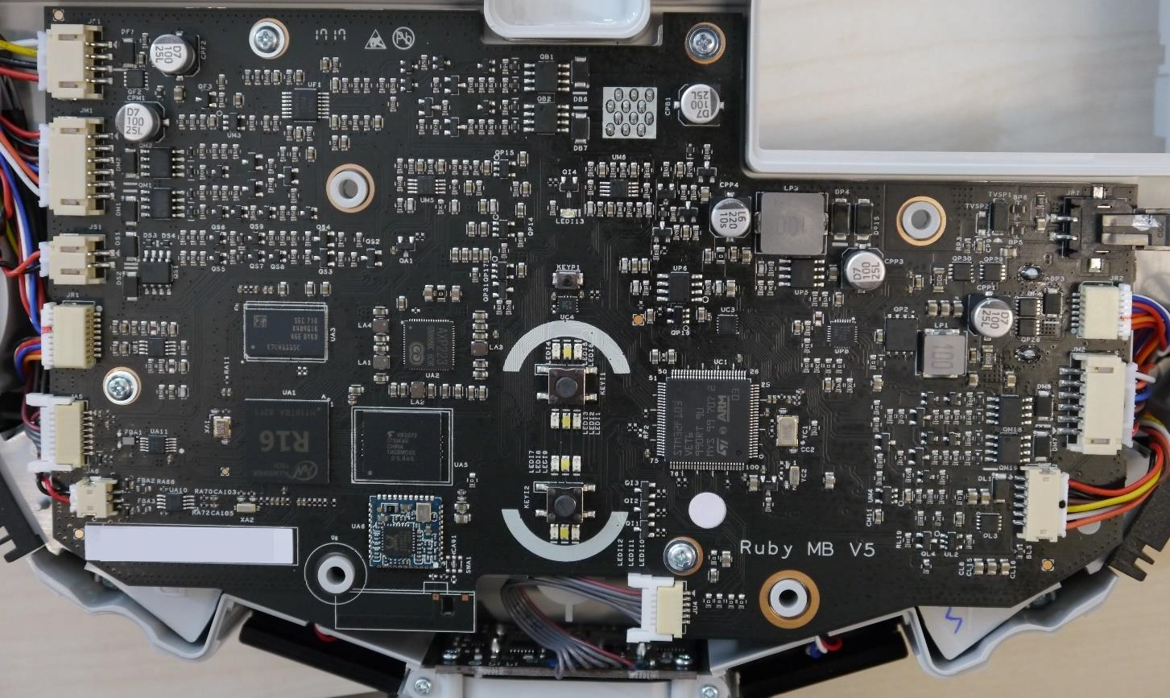
Xiaomi vacuum

