Slide 1
Entropy and NIST 800-90b
A personal journey
John Manferdelli
JohnManferdelli@hotmail.com
© 2004-2021, John L. Manferdelli.
This material is provided without warranty of any kind including, without limitation, warranty of non-infringement or suitability for any purpose. This material is not guaranteed to be error free and is intended for instructional use only. Apache 2.0 License applies

Slide 2
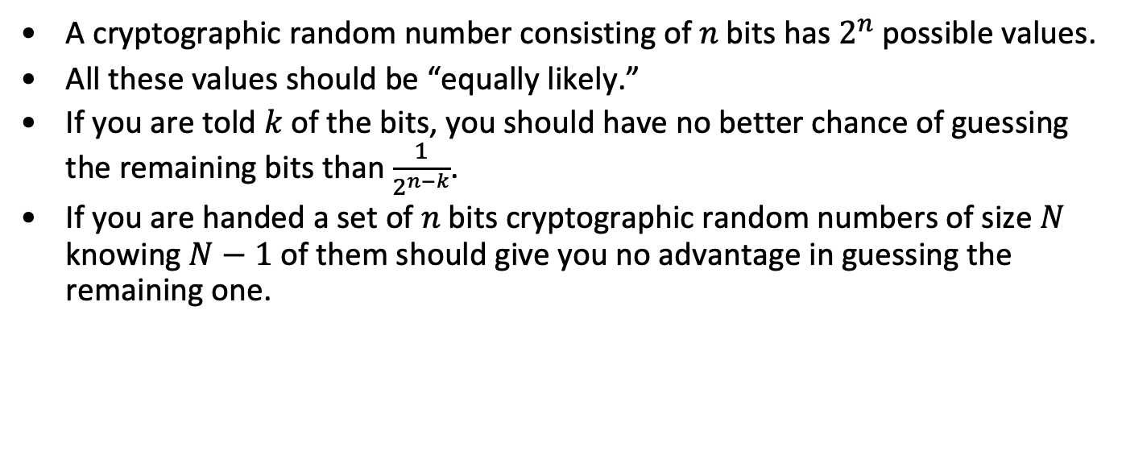
What are cryptographic random numbers?
A cryptographic random number consisting of $n$bits has $2^{n}$ possible values.
All these values should be “equally likely.”
If you are told $k$ of the bits, you should have no better chance of guessing the remaining bits than $\frac{1}{2^{n−k}}$.
If you are handed a set of $n$bits cryptographic random numbers of size $N$ knowing $N−1$of them should give you no advantage in guessing the remaining one.

Slide 3
Cryptographic random numbers
Critical in cryptographic algorithms and protocols
Past weaknesses have been catastrophic.
Random number weakness and bad key management are greatest points of attack on cryptographic systems.
Bad entropy is principal basis for practical attacks
Netscape browser attack is famous example.
More recent Debian entropy attack (Mind your p’s and q’s) is another.
More recent still: Kaspersky’s Password Generator
Hall of fame, epic fails for bad entropy
“But the entropy looked random”
“No one could guess the sample values, it’s too complex”
Other attacks
Intrusion (read privileged entropy pool)
Incremental guessing attacks

Slide 4
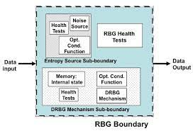
How can you produce cryptographic random numbers in the real world?
NIST 800-90C specifies overall design of a cryptographic random number system.
Components are:
Entropy Subsystem including characterized noise source, health tests, entropy conditioning. This is the critical component which prevents adversaries from guessing keys. The output of this system is a seed containing enough “entropy” (more later) to generate keys. The entropy subsystem is specified in NIST 800-90B. This is the hard part.
A deterministic random number generator (DRNG). This takes a seed and safely produces a long sequence of cryptographically secure random numbers. This is specified in NIST 800-90A. This is the easy part.

Slide 5
The easy part of cryptographic random number generation: DBRG
Full entropy seed
DBRG
State
Pseudo random
Stream, 2³² CRNs
“Anyone discussing deterministic generation of random number is, strictly speaking, already in a state of sin” – von Neuman.
A “seed” with full entropy is critical
Smooths and stretches entropy
DBRG’s can be built using
Block ciphers
Hash functions
Stream ciphers
Even public key systems
Building good, certifiable DRBG’s is a “solved problem”
Only a few “gotcha’s” to be careful about

Slide 6
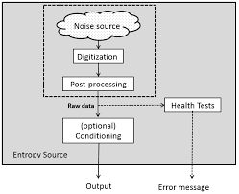
The hard part of cryptographic random number generation: entropy
This is the hard part we’ll talk about.
No finite number of statistical tests can “prove” entropy but that’s all people talk about.
800-90b Entropy collection subsystem

Slide 7
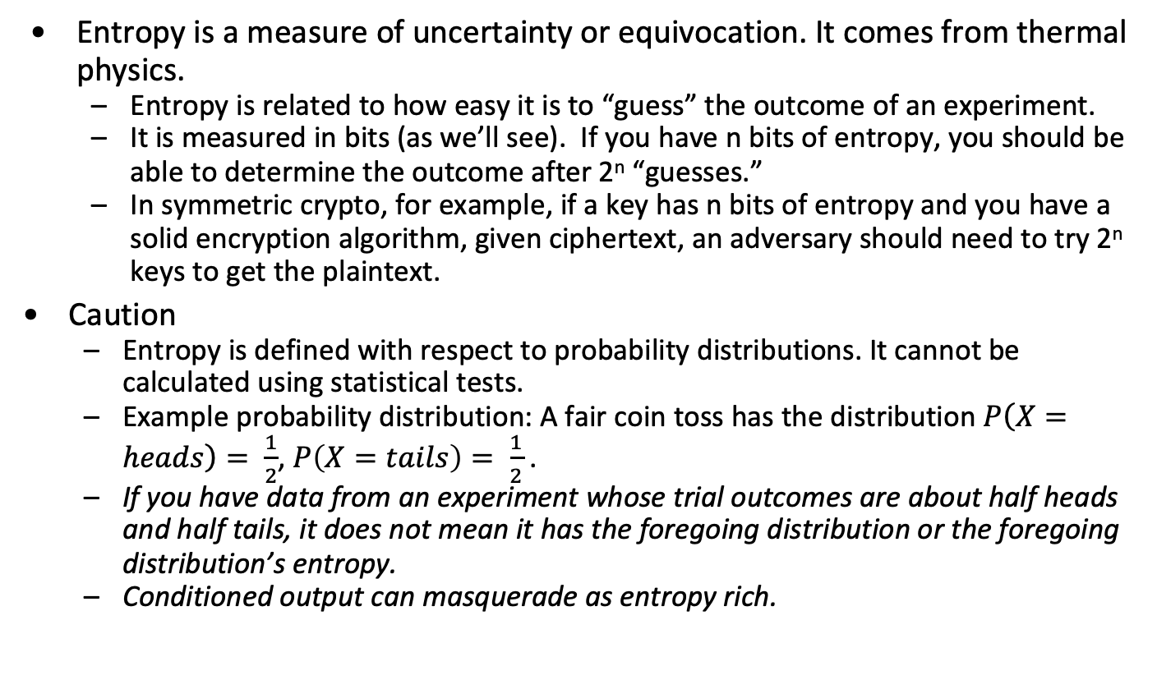
What is entropy?
Entropy is a measure of uncertainty or equivocation. It comes from thermal physics.
Entropy is related to how easy it is to “guess” the outcome of an experiment.
It is measured in bits (as we’ll see). If you have n bits of entropy, you should be able to determine the outcome after 2^{n} “guesses.”
In symmetric crypto, for example, if a key has n bits of entropy and you have a solid encryption algorithm, given ciphertext, an adversary should need to try 2^{n} keys to get the plaintext.
Caution
Entropy is defined with respect to probability distributions. It cannot be calculated using statistical tests.
Example probability distribution: A fair coin toss has the distribution $P\left(X=heads\right)= \frac{1}{2}$, $P\left(X=tails\right)= \frac{1}{2}$.
If you have data from an experiment whose trial outcomes are about half heads and half tails, it does not mean it has the foregoing distribution or the foregoing distribution’s entropy.
Conditioned output can masquerade as entropy rich.

Slide 8
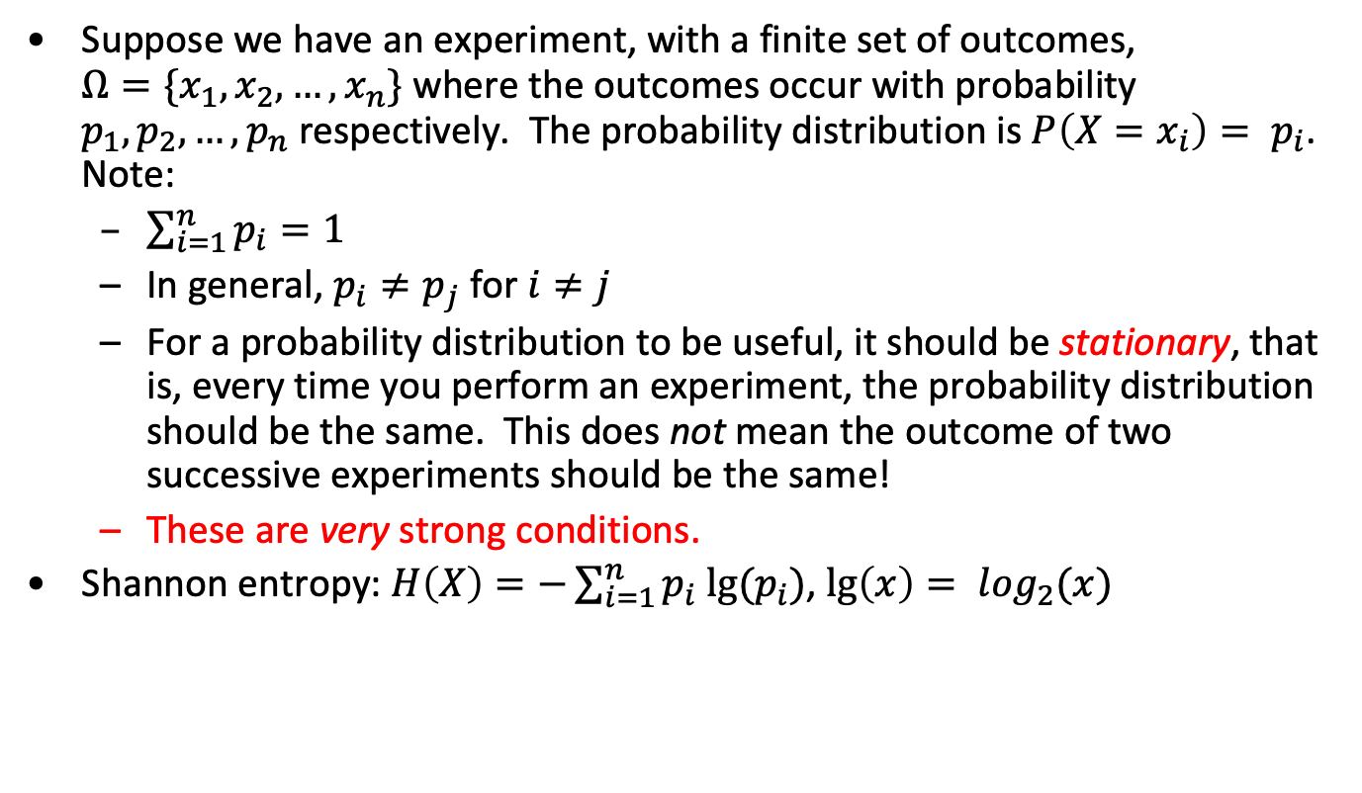
Shannon’s mathematical definition
Suppose we have an experiment, with a finite set of outcomes, ${Ω=\{x}_{1}, x_{2},…, x_{n}\}$ where the outcomes occur with probability $p_{1}, p_{2},…, p_{n}$respectively. The probability distribution is $P\left(X=x_{i}\right)= p_{i}$. Note:
$\sum_{i=1}^{n}{p_{i}}=1$
In general, $p_{i}≠p_{j}$ for $i≠j$
For a probability distribution to be useful, it should be stationary, that is, every time you perform an experiment, the probability distribution should be the same. This does not mean the outcome of two successive experiments should be the same!
These are very strong conditions.
Shannon entropy: $H\left(X\right)=−\sum_{i=1}^{n}{p_{i} lg⁡(p_{i})}$, $\lg\left(x\right)= \log_{2}(x)$

Slide 9
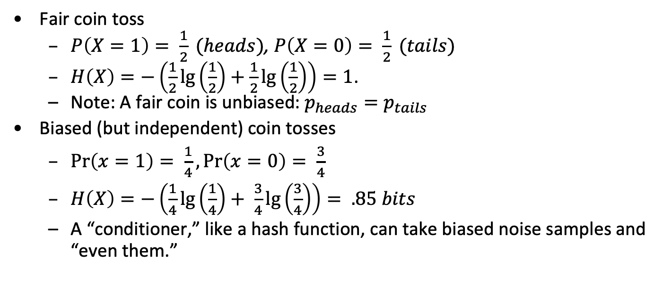
Some entropy source calculations
Fair coin toss
$P\left(X=1\right)= \frac{1}{2} (heads)$, $P\left(X=0\right)= \frac{1}{2} (tails)$
$H\left(X\right)=−\left(\frac{1}{2}\lg\left(\frac{1}{2}\right)+\frac{1}{2}\lg\left(\frac{1}{2}\right)\right)=1$.
Note: A fair coin is unbiased: $p_{heads}=p_{tails}$
Biased (but independent) coin tosses
$\operatorname{Pr}\left(x=1\right)= \frac{1}{4},\operatorname{Pr}\left(x=0\right)= \frac{3}{4}$
$H\left(X\right)=−\left(\frac{1}{4}\lg\left(\frac{1}{4}\right)+ \frac{3}{4}\lg\left(\frac{3}{4}\right)\right)= .85 bits$
A “conditioner,” like a hash function, can take biased noise samples and “even them.”

Slide 10
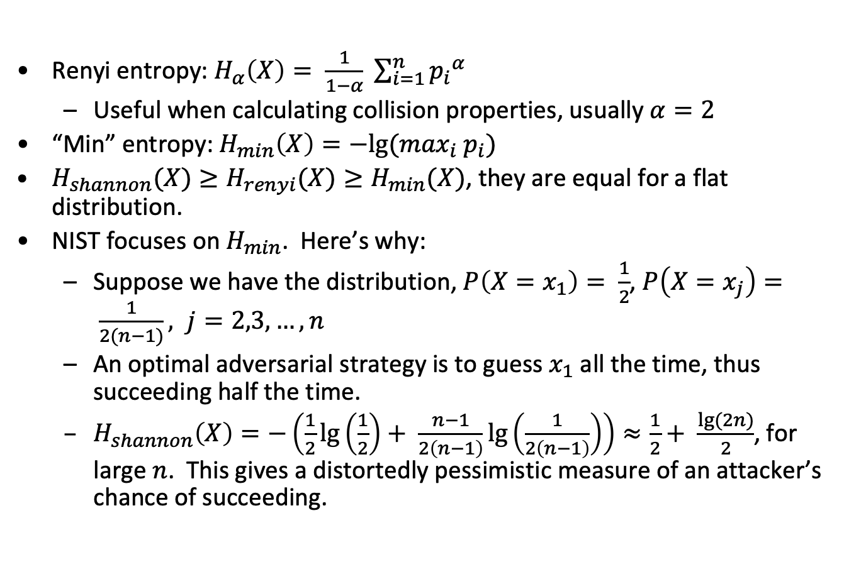
Other measures of entropy
Renyi entropy: $H_{α}\left(X\right)= \frac{1}{1−α} \sum_{i=1}^{n}{{p_{i}}^{α}}$
Useful when calculating collision properties, usually $α=2$
“Min” entropy: $H_{min}\left(X\right)=−lg⁡(\max_{i} p_{i})$
$H_{shannon}(X)≥H_{renyi}(X)≥H_{min}(X)$, they are equal for a flat distribution.
NIST focuses on $H_{min}$. Here’s why:
Suppose we have the distribution, $P\left(X=x_{1}\right)= \frac{1}{2}$, $P\left(X=x_{j}\right)= \frac{1}{2(n−1)}, j=2,3, …,n$
An optimal adversarial strategy is to guess $x_{1}$ all the time, thus succeeding half the time.
$H_{shannon}\left(X\right)=−\left(\frac{1}{2}\lg\left(\frac{1}{2}\right)+ \frac{n−1}{2\left(n−1\right)}\lg\left(\frac{1}{2\left(n−1\right)}\right)\right)≈\frac{1}{2}+ \frac{lg⁡(2n)}{2}$, for large $n$. This gives a distortedly pessimistic measure of an attacker’s chance of succeeding.

Slide 11
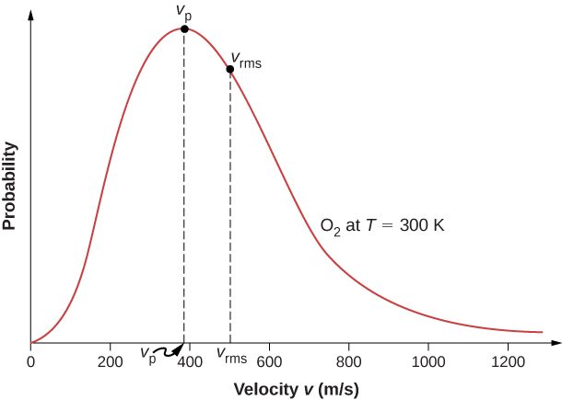
HW sources of entropy (God)
Hardware
Radioactive decay
Thermodynamics (Johnson noise, …)
Oscillator jitter
Unsynchronized ring oscillators (Intel’s HW RNG is based on this)
Noisy diodes
“Open pins” on Raspberry Pi’s
Coin tosses (with a fair coin)
Finding the probability
distribution is easy: ask a physicist
Easy to implement in microelectronics

Slide 12
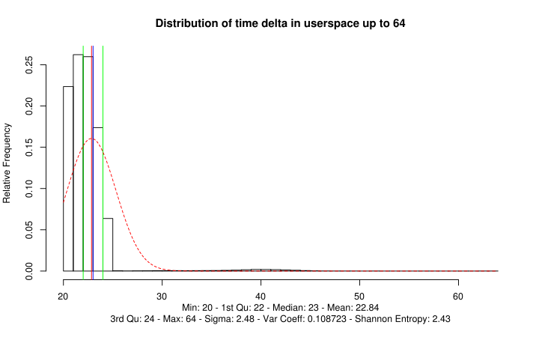
SW sources of entropy (the devil)
Software sources have been pseudo-science based
Here is a list (Red is bad. Why? Don’t know distribution, also entropy starvation, non-stationarity. Vulnerable to side channels. Green is new and evidently does not have these drawbacks.)
Disk arm speed variation
Process id, thread id (predictable)
Interrupt arrival time
Ticks since boot
Cursor, mouse
New: execution jitter
Finding the probability
distribution is hard
or impossible except for jitter
then you can ask a
cryptographer
Jitter entropy from Mueller

Slide 13
NIST 800-90B evolution
2008: Basic structure: We know it’s hard. Document it.
2012: We’re worried about entropy, here are a bunch of tests to run
Justification for software entropy is ad hoc or non-existent: “interrupt arrival times are impossible to guess.” (wrong).
Use HW if you can: Intel’s Ivy bridge RNG (launched 2012)
2016: People who don’t have a good probability model for their noise sources, don’t have entropy.
Let’s use hardware as a model, hardware sources have distributions
Health tests are important because there can be failures
Should software entropy have more lax standards? [No!]
2018: No, seriously, you have to justify entropy estimators even for a software noise source, so you need source probability models.
Here are more tests (restart) so it’s harder to cheat especially at boot
New software techniques arise (jitter)
Linux and some BSD entropy is justified
By the way, future standard will be stricter [2021]

Slide 14
A new hope
Jitter execution entropy
High quality and relatively easy (i.e.- possible) to analyze.
Adopted by Linux, some BSD’s and Apple plus others.
Prediction: Eventually everyone will adopt it.
History
B. Sunar, W. J. Martin, D. R. Stinson, A Provably Secure True Random Number Generator with Built-in Tolerance to Active Attacks IEEE. Mostly HW focused.
Stinson, part 2: What about software jitter entropy based on execution time on modern processor?
Works on small processors too: Keaton Mowery, Michael Wei, David Kohlbrenner, Hovav Shacham, and Steven Swanson, Welcome to the Entropics: Boot-Time Entropy in Embedded Devices.
Mueller, CPU Time Jitter Based Non-Physical True Random Number Generator.
There’s lots more

Slide 15
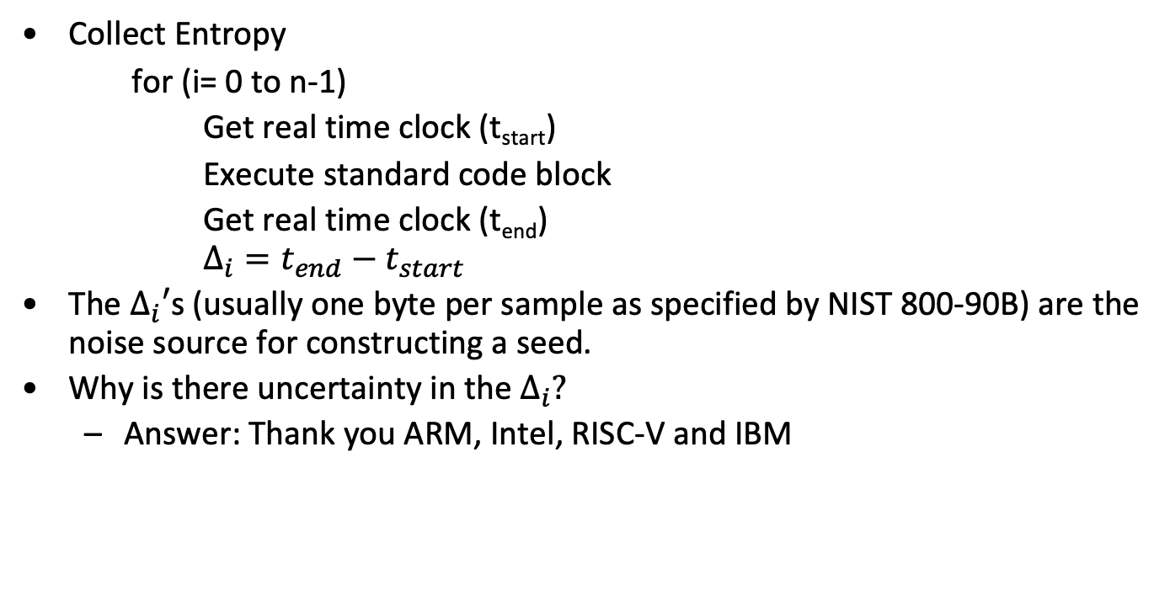
How does Jitter execution work?
Collect Entropy
for (i= 0 to n-1)
Get real time clock (t_{start})
Execute standard code block
Get real time clock (t_{end})
$$Δ_{i}=t_{end}−t_{start}$$
The $Δ_{i}′$s (usually one byte per sample as specified by NIST 800-90B) are the noise source for constructing a seed.
Why is there uncertainty in the $Δ_{i}?$
Answer: Thank you ARM, Intel, RISC-V and IBM

Slide 16
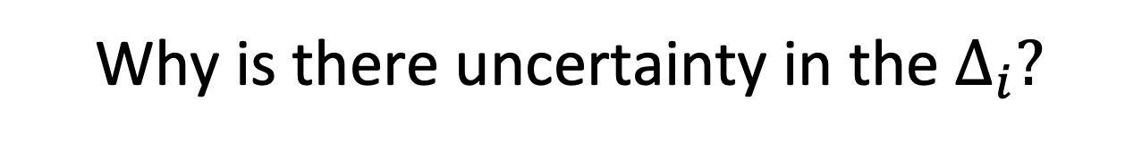
Why is there uncertainty in the $Δ_{i}?$
CPU instruction pipelines fill level affects execution time of an instruction. These pipelines add to execution jitter.
The CPU clock cycle is different than the memory bus clock speed. Wait states for the synchronization of memory access adds to time variances (this also reflects hardware variability effects).
The CPU frequency scaling alters the processing speed of instructions.
The CPU power management may disable CPU features.
Instruction and data caches
Tests showed that before the caches are filled, the time deltas are bigger by a factor of two to three.
CPU topology and caches used jointly by multiple CPUs affect execution time.

Slide 17
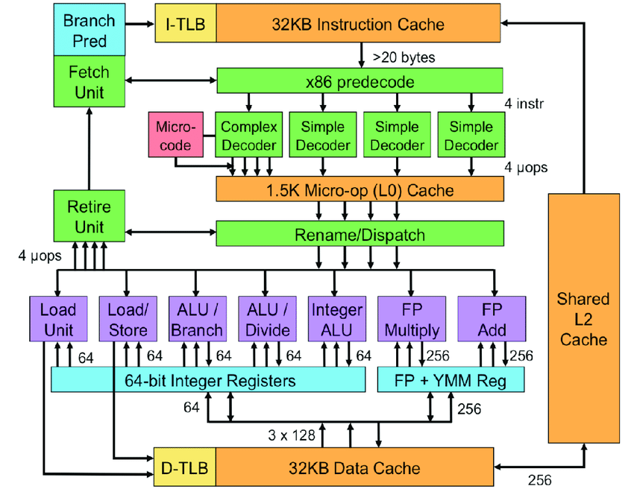
Machine state (Intel x64)

Slide 18
But wait, there’s more
CPU frequency scaling depending on the work-load.
Branch prediction units
TLB hits and misses
Kernel locks
Moving processes from one CPU to another
Hardware interrupts can occur regardless what the operating system was doing in the meanwhile. [This is not the same as interrupt arrival time.]
Large memory segments whose access times vary due to the physical distance from the CPU.
Aren’t these variations predictable?
Amazingly, no
An adversary outside the kernel basically can’t affect them.

Slide 19
Translating machine state to execution jitter
Intuition: We want to show that the evolution of the machine state as modified by “unpredictable” events in recreating execution jitter purporting to provide n bits of entropy requires 2^{n} operations (this includes guesses and conditioning).
Reduction to scheduling problem (given actual physical jitter)
Thousands of bits of machine state contribute to producing the precise environment:
Cache state, TLB, branches, precise timing of board level interrupts and their affect on state, races that affect physical maps, microcode.
Not all internal state can be “set.” Some require reproducing execution traces and interrupts as well as full knowledge of all associated software affecting the platform and even data associated with the computation.
Evolution, predictable state
Computationally protected entropy
Physical jitter
Machine State
Interrupts

Slide 20
Why is Jitter execution entropy “good”
Can be modelled
Jitter execution depends only on “core” hardware: CPU’s, memory system, interconnect.
Component probability models are relatively simple (like HW): normal distributions around an average performance (memory, interconnect, speculation and prediction).
Some sources of variation derived from physical phase jitter (HW).
Easy to pick good, short blocks to measure on any CPU even as architectures change.
You can validate stationarity with chi squared tests.
Important for “boot entropy,” where critical machine keys are derived.
Naturally “unobservable” by adversary. Protected from side channels.
Gives very high entropy rates
Doesn’t need to be in “critical sections.” Works well in kernel and user mode. Works well on all CPU’s, under all workloads.

Slide 21
Why interrupt arrival time sources are problematic
Interrupt arrival modelling difficult (actually impossible, I think)
Presumptive distribution is Poisson arrival which is complicated and depends critically on stable average arrival time.
Definitely not stationary.
Depends on analysis of potentially huge number of devices.
Terrible during boot.
Past attacks exploited “observable” interrupt artifacts by adversary. Also subject to side channel attacks (see Dodis et. al., 2014).
Dependent on workloads and their imposed interrupt activity so accurate estimate would be painfully complex even with a few devices.
Gives low entropy rates (even “guessed” rates) so more intermediate processing. It takes much longer to “reseed.”
Requires ongoing care to measure interrupt times correctly (If you measure arrival time in the wrong place the entropy is greatly reduced).
Kernel mode only
I don’t know of any credible analysis of interrupt noise and I’ve looked hard.

Slide 22
Three weekends and a NIST reading
I built a (basically) fully NIST compliant RNG in my existing open-source crypto project (which I use for teaching) with justified HW and SW entropy in about three weekends.
Used standard NIST 800-90A certified SHA-256 hash-df based DBRG.
Used Intel analyzed HW noise source (Noise justification: Rachael J Parker, Justification for Metastability Based Nondeterministic Random Bit Generator, Intel and previous papers by Kocher, Cox, Walker, Gueron, Brickell, et al).
Developed SW Jitter based noise source (Noise justification: You’ll see.)
Implemented full health and restart tests.
Both HW and SW entropy qualified.
All in user mode (kernel version is almost identical).

Slide 23
RNG
jlm@New-MacBook-Pro cryptobin % ./test_full_rng.exe --print_all=true
Hardware test
HW noise : 2efccc36185532aecc5714c76a328d2e55bb5b6868cf6ee28ce7c0dd9178c43e
dffda69eb78b66ec
Entropy from pool: 300 bits.
seed: 2efccc36185532aecc5714c76a328d2e55bb5b6868cf6ee28ce7c0dd9178c43e
dffda69eb78b66ec
Hardware derived random numbers:
random number 0: 38c4606144d00c417be407466237b3e08b8f08f81fd98b8a94dd54d74f914fed
random number 1: 74283705ff3ad67c00d029ba8344cc9d014ef98a58edc9c93259cc8cf042cf37
random number 2: 272f7b36a8694254368ca0f534ee45fd56756ef7e90bd49a3d35e87019f9ee68
random number 3: d81302e1a5d30dc7735e62cc2c790ab3595c5cce34665c590556293f1f61e826
random number 4: c804ada32bbe35d75a16cde90ec044d1f09350a82b8355ff50a7ef00f3a90ec3
random number 5: c3b090ddf0c9d6dcd54a3d25ac9ba24813df5dd9119f683cff52c0a4487db23a
random number 6: d25fa7625b34646d2d5402e3b8f65dff2fb806c4a9cfa978303b27a133fd9dbe
random number 7: 5baa492e703d63b3074e40cbb041723203659f42951ce70db1d083dcb25777a6
random number 8: 88210cb9e669ecf79dd13091c4da7de0beb60f553dd6bf6ad39360c587d2370a
random number 9: 7943f321315f440803a377e9ddce3696b4f30515b05510e8f368c15837c4b63d

Slide 24
RNG
Software test
SW noise: 8604aa5c9683f61c5765fb4bf610ff4026afcde5
SW noise: d24e2528dc24a560b5ecdde9f941ff555ba18758
SW noise: 3758ba50858922f3bd919b14b0da4375e3281129
…10 more
Entropy from pool: 259 bits.
seed: 56580a6f33dffb67271838514b72609d292960989636c17b593018764b2c3caf36ebf42e
Software derived random numbers:
random number 0: 5704f41ef758d66ef82483217c9291fd79f5aa18b5bd1dc114049df5e81c1d34
random number 1: c1ae285d23a91a399f5e2c095a769c4195f4c3753a4aca0d78b7d8197378c672
random number 2: b860d249bbddcaf87666815de2def42d8e73c6de798b667d68f55068a5b79d7c
random number 3: 4370488c2a28ed85161cd216b3caf2caae2705e9b893c9e082666a4c93622337
random number 4: 21f3a1438634aa05d4071617ce420786aa574ab4c4258fbbc8d975b2f6c205bb
random number 5: 10e1fc08d6df99515727b7d68c973deee25b52a28304d29db85aec71735939dc
random number 6: d9cd2731623a3ee43ba2652bb07e41d00c153d72ab814a24df29883f5c234fb4
random number 7: 18b9e00e397c7ef8c05f61078ce1884c30f3b74e61286574abac5d01991a8c6b
random number 8: f2d71f29ee1aeec8109da2a3e83a1aa9f1ded83bb573441c7202e6892381106e
random number 9: cb467402c79b90e02959d35e0ffe39cf0c2b4da75583f30b2921c0b4073fcc5b

Slide 25
Software jitter sources in my code
Used five different blocks for jitter including two from Mueller
For each 8-bit (as required by NIST) noise sample, the estimated entropy varied from 1.8 bit/sample to over 6 bits/sample (!) over the jitter blocks
Jitter gives amazingly high rate independent of other activity Can’t be tampered with by adversary
Most important: Can be analyzed and justified.
Isn’t this just an academic concern?
No!

Slide 26
Simple Jitter Block 0
Based on a simple loop adding to an accumulator (Optimization turned off!)
Simple jitter test 0, cpc: 1999533010
largest: 63, smallest: 31, non-zero: 1000, mean: 37.204, adjusted mean: 37.141
44 bins, lower 30, upper: 42, bins from 30 to 42 selected:
0000 0005 0015 0059 0078 0181 0055 0146 0080 0217 0034 0094 0033
Samples: 1000, num loops: 5, expected bin: 37.097, deviation: 32.243
probabilities:
31,0.005 32,0.015 33,0.059 34,0.078 35,0.181 36,0.055 37,0.146
38,0.080 39,0.217 40,0.034 41,0.094
Shannon entropy: 3.168, renyi entropy: 2.927, min entropy: 2.204

Slide 27
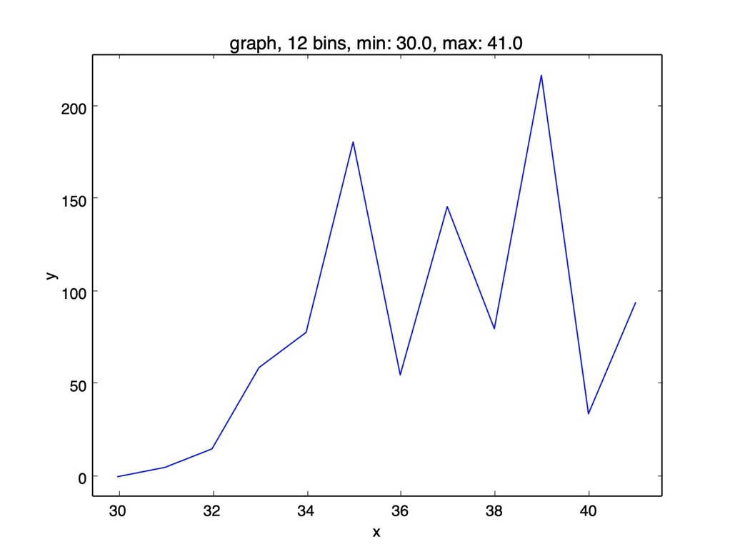
Simple Jitter Block 0

Slide 28
Simple Jitter Block 1
Simple jitter test 1, cpc: 2003954612
largest: 125, smallest: 32, non-zero: 1000, mean: 39.565, adjusted mean: 39.440
47 bins, lower 31, upper: 45, bins from 31 to 45 selected:
0000 0001 0010 0024 0045 0073 0090 0038 0286 0094 0110 0073 0104 0036 0013
Samples: 1000, num loops: 5, Expected bin: 39.286, deviation: 33.994
probabilities:
32,0.001 33,0.010 34,0.024 35,0.045 36,0.073 37,0.090 38,0.038
39,0.286 40,0.094 41,0.110 42,0.073 43,0.104 44,0.036
Shannon entropy: 3.231, renyi entropy: 2.858, min entropy: 1.806

Slide 29
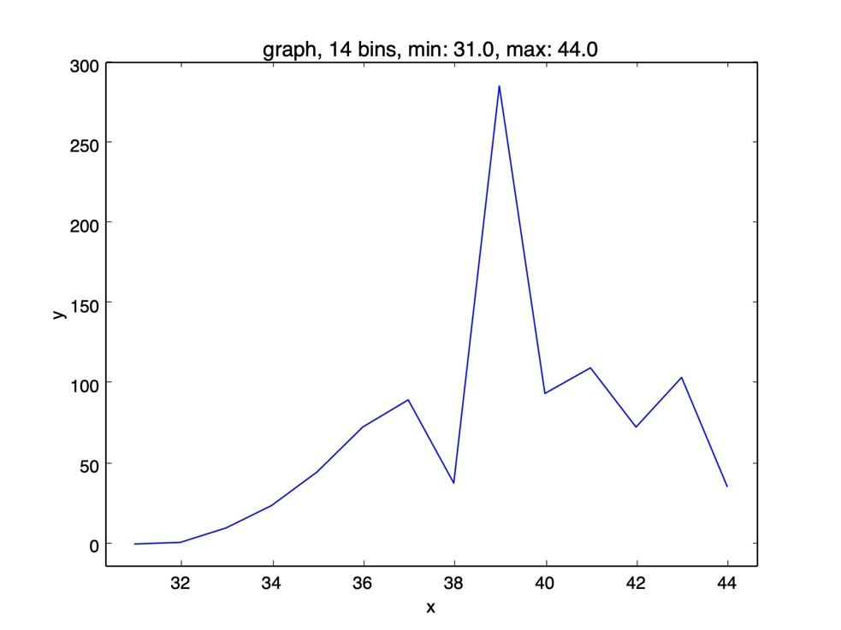
Simple Jitter Block 1

Slide 30
Simple Jitter Block 2
Simple jitter test 2, cpc: 2003743142
largest: 165, smallest: 49, non-zero: 1000, mean: 64.158, adjusted mean: 63.993
79 bins, lower 50, upper: 73, bins from 50 to 73 selected:
0002 0000 0012 0010 0032 0009 0046 0082 0050 0079 0088 0103 0031 0067 0079 0100 0031 0043 0022 0028 0025 0014 0003 0007
Samples: 1000, num loops: 5, Expected bin: 59.797, deviation: 54.901
probabilities:
50,0.002 52,0.012 53,0.010 54,0.032 55,0.009 56,0.046 57,0.082 …
Shannon entropy: 4.034, renyi entropy: 3.967, min entropy: 3.279

Slide 31
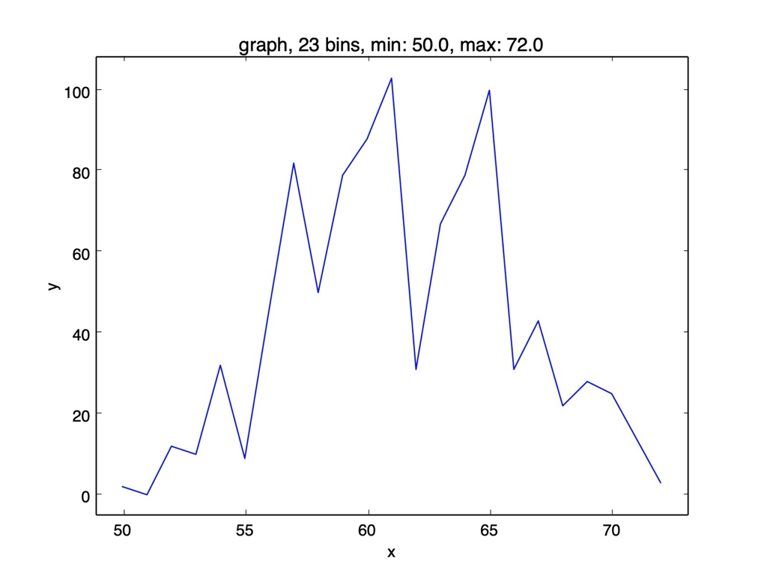
Simple Jitter Block 2

Slide 32
Memory Jitter
Memory jitter comes from CPU/DRAM clock differences and cache fill wait states.
Memory jitter test, cpc: 1998883639
largest: 255, smallest: 2, non-zero: 1000, mean: 71.828, adjusted mean: 71.573
141 bins, lower 30, upper: 71, bins from 30 to 71 selected:
0004 0003 0018 0010 0015 0006 0017 0011 0020 0028 0014 0022 …
Samples: 1000, num loops: 5, Expected bin: 50.529, deviation: 46.755
probabilities:
30,0.004; 31,0.003; 32,0.018; 33,0.010; 34,0.015; 35,0.006; …
…
Shannon entropy: 5.476, renyi entropy: 5.873, min entropy: 4.573

Slide 33
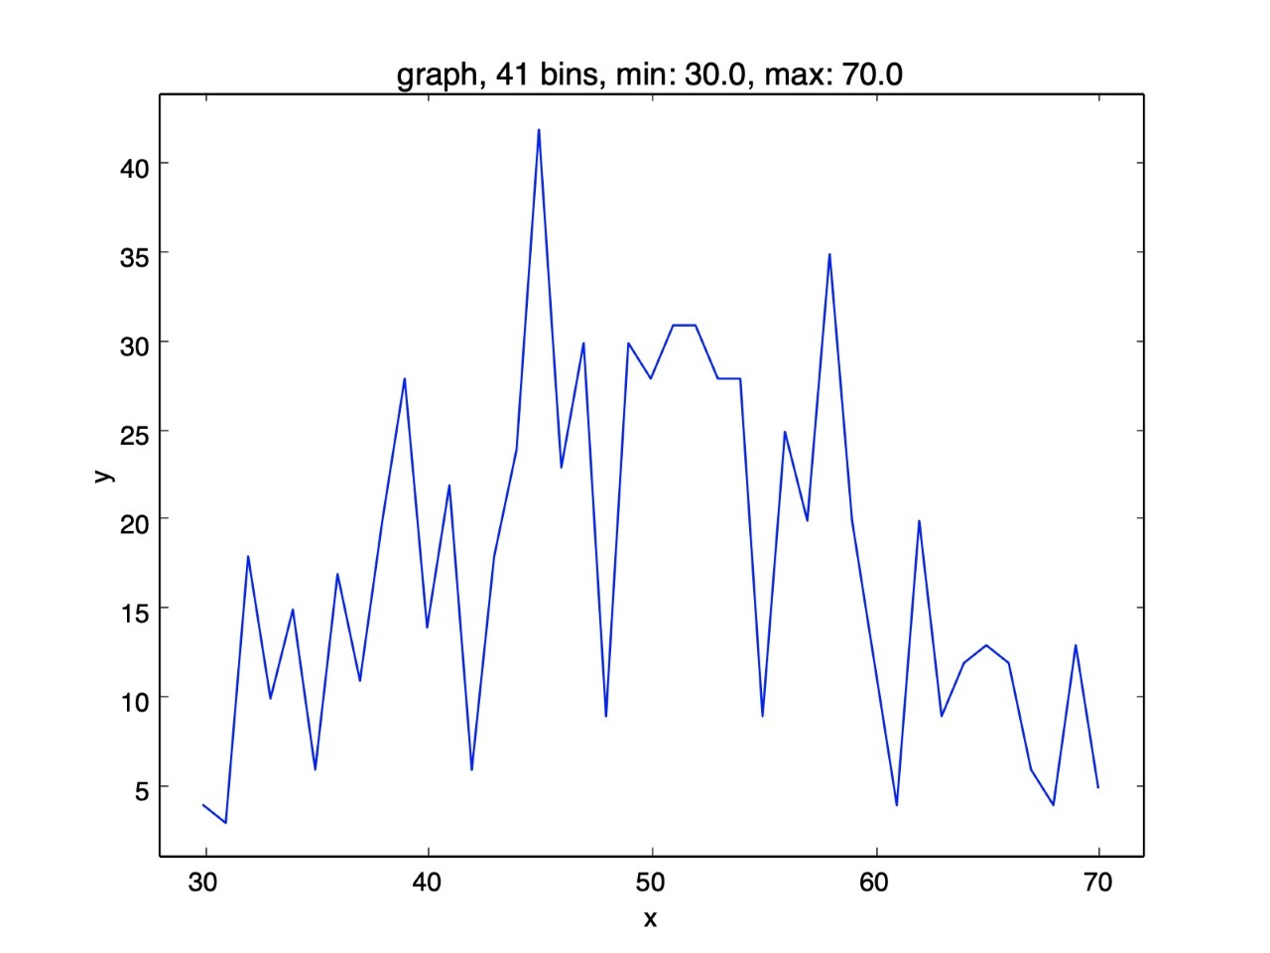
Memory Jitter

Slide 34
Hash based execution jitter
Hash jitter is based on the combined effect of all the sources of variation exhibited in the course of multiple SHA-3 digest computations.
Hash jitter test, cpc: 2003971500
largest: 255, smallest: 0, non-zero: 1000, mean: 132.188, adjusted mean: 131.933
264 bins, lower 66, upper: 237, bins from 66 to 237 selected:
…
Samples: 1000, num loops: 5, Expected bin: 132.188, deviation: 131.502
probabilities:
66,.004 67,.001 68,.011 69,.001 70,.003 71,.005 72,.003 73,.004
…
Shannon entropy: 7.791, renyi entropy: 7.637, min entropy: 6.506

Slide 35
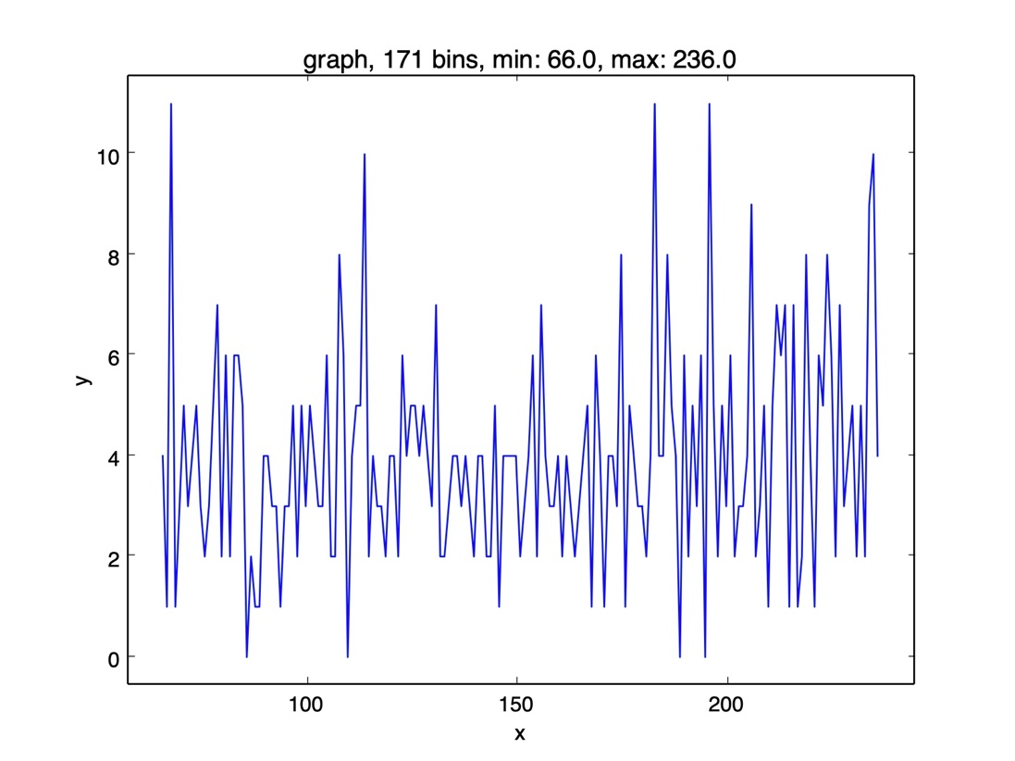
Hash based execution jitter

Slide 36
Future work
Work out hardware model in detail for individual sources of entropy (memory jitter, …).
Combine complicated jitter sources to obtain different distributions (the “mixture problem”). Done accurately, this is interesting research!
The level of proof in this presentation is informal or “heuristic,” which is all NIST demands for now.
NIST will increase level of rigor required in future standards. These arguments can be developed to justify a full stochastic model NSA would be proud of.

Slide 37
Conclusion
NIST was completely right!
I apologize for earlier skepticism
New standard greatly improves security (if you follow it)
In cryptography, don’t trust anything you can’t quantifiably analyze --- you’re only fooling yourself.
In cryptography, sometimes there are good surprises (jitter).
Benefits from Jitter
No entropy starvation at boot.
Defense in depth (qualified HW and SW entropy).
Simpler than interrupts and less performance impact
Works on all devices (even embedded devices).
Widely accepted despite initial skepticism: Linux, (some) BSD versions and Apple (during boot).
You can stop drinking the kool-aid: Jettison previous software entropy “pseudo-science.”

Slide 38
Postscript
How do we turn this into a real argument supporting entropy production in the real world?

Slide 39
Security Model --- symmetric crypto
Two security models
One time pad corresponds to “physical entropy.” Safe regardless of computational assumptions.
Real security based on computation
Model: Given a known cipher (say AES) with a prescribed key size (say 128 bits) and one block of corresponding known plain and ciphertext. What is “gold standard” to evaluate its security?
Answer: If best adversary’s most efficient attack is brute force, cipher is good. Guaranteed success in 2¹²⁸ steps, expected cost is 2¹²⁷ steps.
Computational entropy
If I produce n bits of entropy and any successful adversary must carry out 2^{n} operations (say, to recreate a deterministic process used to produce the entropy), the entropy generation has “equivalent” security to the underlying cipher that uses it.
So, we have to “prove” an adversary must perform 2^{n} operations to condition machine state to produce the environment that generated the entropy scheme.

Slide 40
How would proofs work in the computational security model
There are two different computational barriers for “execution jitter” as an entropy source.
Unpredictable timing artifacts that are caused by pure physical processes that affect jitter. For example, cross domain clocking environments which affects timing jitter. This is physical.
The computational barrier to recreate complex CPU state: caches, branch prediction, frequency scaling, intervening interrupts, locks, cross CPU performance differences, TLB misses, speculative execution.
We want to use these to show an adversary must do 2n units of work to recreate the machine state that produces n bits of jitter execution entropy.

Slide 41
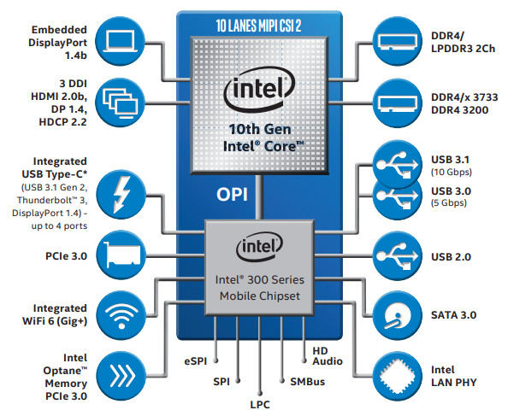
Machine state (Intel x64)

Slide 42
Machine state (Intel x64)
Feature | Core i7
Number of cores | 4 (each core hyperthreaded)
Pipeline | OoO
Number of stages | 19
Width of fetch | 6 instructions
Width of decode | 4-7 fused u-ops
Size of decode queue | 56 entries
Width of reissue/rename | 4 fused u-ops
Width of dispatch | 8 u ops
Width of commit | 4 fused u-ops
Reservation station | 60 u-ops
Reorder buffer | 192 u-ops
L1 (Data cache) | 8 way, 32KB (8KB/core) 128 64B cache blocks, 16 sets
L1 (Instruction cache) | 8 way 32 KB (8KB/core)
L2 | 8 way, 256 KB
L3 | 16 way, 16MB

Slide 43
Machine state (Intel x64)
Feature | Core i7
L1 latency | 4 cycles
L2 latency | 12 cycles
L3 latency | 36 cycles
Size of cache block | 64Bytes
BTB associativity | 4096, 4 way
RAS | 16 entries
Branch mispredict penalty | 14 cycles
Integer/float registers | 168/168
Instruction TLB | 128 entries
Data TLB, associativity | 64, 4 way
L2 TLB size, associativity | 1024 entries, 8 way

Slide 44
Machine state (Intel x64)
Time of day clock
CPU cycle rate
DRAM cycle and refresh rates
CPU instruction pipelines fill levels and stalls
The CPU frequency scaling
The CPU power management may disable CPU features.
Instruction and data caches
TLB (Miss penalty: 9 cycles)
CPU topology and caches used jointly by multiple CPUs affect execution time.
Branch prediction (Mis-predict penalty between 10 and 40 cycles)
Kernel locks/barriers
CPU configuration on multi-core machine
Hardware interrupts

Slide 45
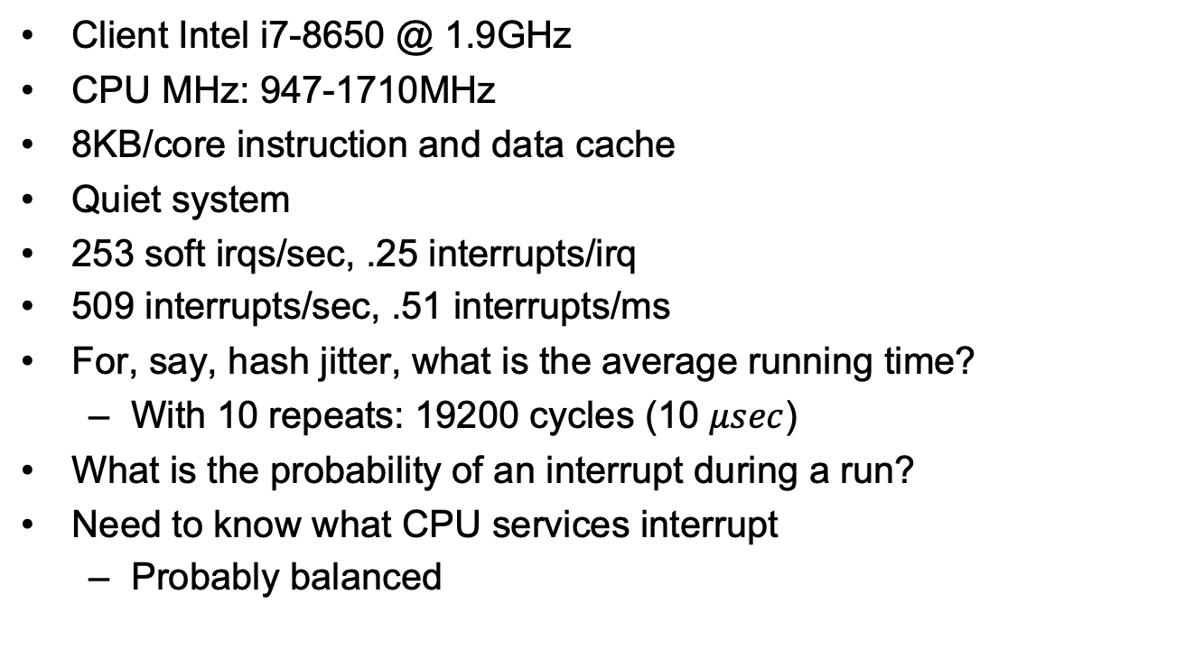
Machine Data
Client Intel i7-8650 @ 1.9GHz
CPU MHz: 947-1710MHz
8KB/core instruction and data cache
Quiet system
253 soft irqs/sec, .25 interrupts/irq
509 interrupts/sec, .51 interrupts/ms
For, say, hash jitter, what is the average running time?
With 10 repeats: 19200 cycles (10 $μsec$)
What is the probability of an interrupt during a run?
Need to know what CPU services interrupt
Probably balanced

Slide 46
Sources of Equivocation we study in Execution Jitter
CPU/DRAM jitter in cache misses
Unpredictability of initial state of caches, branch predictors, pipelines on entry to jitter execution sampling caused by evolution of state prior to entry.
Evolution caused by planned intermediate execution
Core assignment
“Unpredictable” interrupts affecting state evolution prior to sampling.
Interrupts occurring during an execution jitter sample
Delays processing (hence sample time)
Changes processor state

Slide 47
State evolution on x64
20% of code is branches. Branches correctly predicted about 80% of the time
Penalty: 40-80 cycles
L1 cache misses about 2% of the time
Cost: 4-5 cycles, penalty: 7-8 cycles.
L2 and L3 caches also effect execution. Should we model this?
Cost for L2: 12 cycles, penalty: 24 cycles. Cost for L3: 36 cycles, penalty: 62 cycles + 100 ns.
Locks and barriers in kernel
Pipeline improves performance by 20 – 100% (10 cycle deviation)
Effect of virtual to physical memory assignment and paging and TLB misses

Slide 48
Effect of CPU/DRAM physical jitter
Rambus

Slide 49
Effect of L1 miss jitter
Variability attributable or cache misses:
-(.98 lg(.98)+.02lg(.02))= .14 bit per access
Each miss causes 8 cycle difference
1 bit on entropy/sample (Rambus data)
How much physical jitter happens per cache miss

Slide 50
Effect of state randomization on jitter execution
Serial run of 50000 samples collected serially (jitter_block_0), establishes lower bound of 2 bits of “variability” in execution time caused by a routine of about 30 instructions.
As “jitter_block_0” shows, every series of 30 instructions contributes about 2 bits of apparent entropy to jitter execution, even in a single execution context, indicating that 15 instructions are sufficient to cause a state change which causes a difference in jitter execution time between two jitter execution measurements.
Markov model

Slide 51
Interrupts and state evolution
Things that are monotonic: TOD clock, counters
The data collected on my NUC which has a 4 core i7 running Ubuntu.
Each interrupt results in more than 40 instructions executed.
Give an example
Markov model of state affecting jitter samples
Data on the following pages, data was collected via
mpstat -I ALL 5 10 -P ALL

Slide 52
Interrupt data, 1
04:34:06 PM CPU intr/s
04:34:11 PM all 70.40
04:34:11 PM 0 12.80
04:34:11 PM 1 6.00
04:34:11 PM 2 0.60
04:34:11 PM 3 1.00
04:34:11 PM 4 24.20
04:34:11 PM 5 10.20
04:34:11 PM 6 34.00
04:34:11 PM 7 6.80
04:34:11 PM CPU intr/s
04:34:16 PM all 40.20
04:34:16 PM 0 4.40
04:34:16 PM 1 6.60
04:34:16 PM 2 0.60
04:34:16 PM 3 1.20
04:34:16 PM 4 7.20
04:34:16 PM 5 3.40
04:34:16 PM 6 15.60
04:34:16 PM 7 9.00
04:34:16 PM CPU intr/s
04:34:21 PM all 54.60
04:34:21 PM 0 17.60
04:34:21 PM 1 6.80
04:34:21 PM 2 1.80
04:34:21 PM 3 11.40
04:34:21 PM 4 10.80
04:34:21 PM 5 3.00
04:34:21 PM 6 14.80
04:34:21 PM 7 15.80
04:34:21 PM CPU intr/s
04:34:26 PM all 27.60
04:34:26 PM 0 11.20
04:34:26 PM 1 6.20
04:34:26 PM 2 1.20
04:34:26 PM 3 2.20
04:34:26 PM 4 5.20
04:34:26 PM 5 1.80
04:34:26 PM 6 6.40
04:34:26 PM 7 8.00

Slide 53
Interrupt data, 2
04:34:26 PM CPU intr/s
04:34:31 PM all 25.20
04:34:31 PM 0 7.60
04:34:31 PM 1 4.00
04:34:31 PM 2 0.80
04:34:31 PM 3 2.20
04:34:31 PM 4 7.00
04:34:31 PM 5 3.00
04:34:31 PM 6 4.40
04:34:31 PM 7 6.80
04:34:31 PM CPU intr/s
04:34:36 PM all 33.60
04:34:36 PM 0 11.40
04:34:36 PM 1 4.80
04:34:36 PM 2 1.80
04:34:36 PM 3 1.00
04:34:36 PM 4 2.20
04:34:36 PM 5 2.20
04:34:36 PM 6 9.40
04:34:36 PM 7 6.60
04:34:36 PM CPU intr/s
04:34:41 PM all 448.60
04:34:41 PM 0 81.80
04:34:41 PM 1 43.40
04:34:41 PM 2 6.60
04:34:41 PM 3 19.80
04:34:41 PM 4 70.60
04:34:41 PM 5 25.60
04:34:41 PM 6 252.80
04:34:41 PM 7 46.60
04:34:41 PM CPU intr/s
04:34:46 PM all 226.80
04:34:46 PM 0 21.20
04:34:46 PM 1 29.00
04:34:46 PM 2 4.60
04:34:46 PM 3 18.00
04:34:46 PM 4 19.20
04:34:46 PM 5 15.20
04:34:46 PM 6 103.40
04:34:46 PM 7 28.00

Slide 54
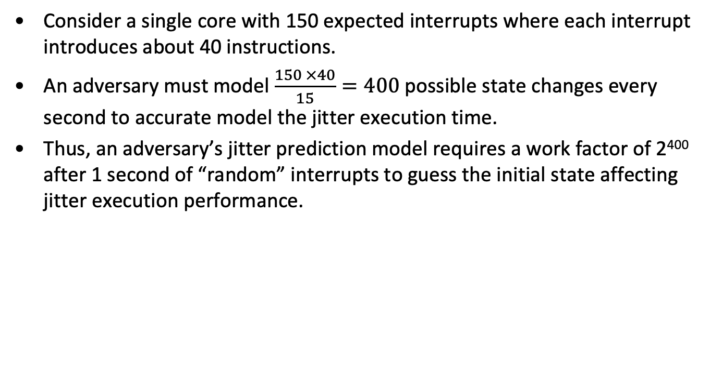
Effect of interrupts on state evolution and execution time - I
Consider a single core with 150 expected interrupts where each interrupt introduces about 40 instructions.
An adversary must model $\frac{150 ×40}{15}=400$ possible state changes every second to accurate model the jitter execution time.
Thus, an adversary’s jitter prediction model requires a work factor of 2⁴⁰⁰ after 1 second of “random” interrupts to guess the initial state affecting jitter execution performance.

Slide 55
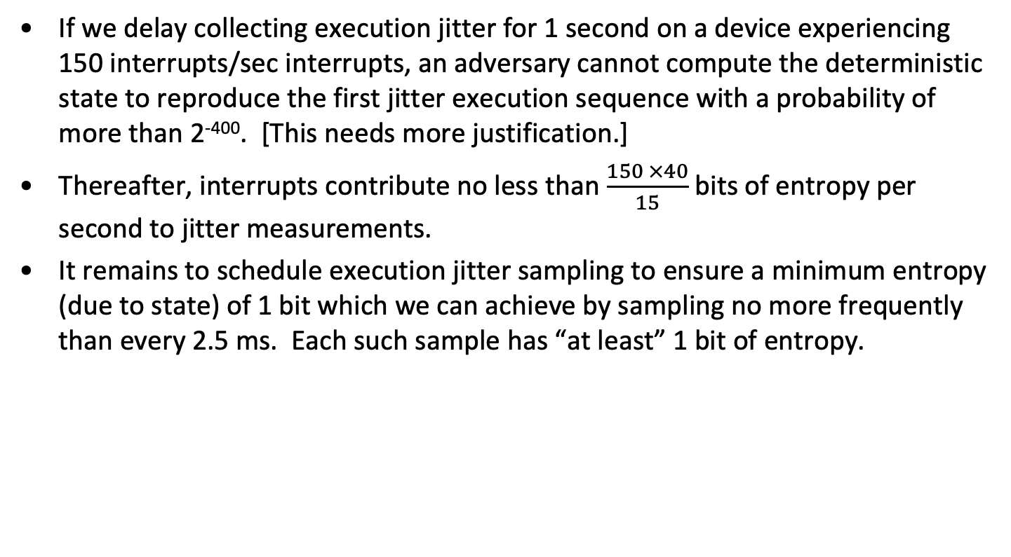
Effect of interrupts on state evolution and execution time -- II
If we delay collecting execution jitter for 1 second on a device experiencing 150 interrupts/sec interrupts, an adversary cannot compute the deterministic state to reproduce the first jitter execution sequence with a probability of more than 2⁻⁴⁰⁰. [This needs more justification.]
Thereafter, interrupts contribute no less than $\frac{150 ×40}{15}$ bits of entropy per second to jitter measurements.
It remains to schedule execution jitter sampling to ensure a minimum entropy (due to state) of 1 bit which we can achieve by sampling no more frequently than every 2.5 ms. Each such sample has “at least” 1 bit of entropy.

Slide 56
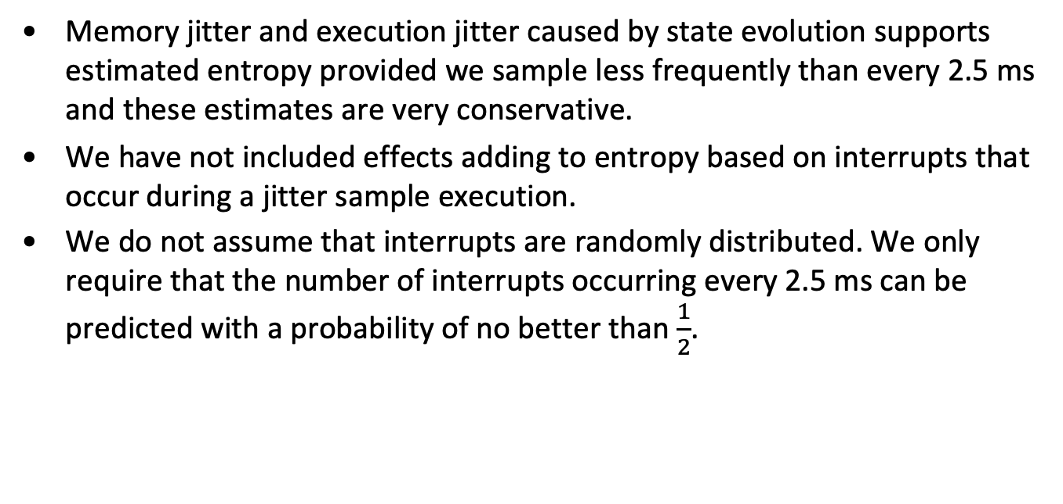
Bottom line
Memory jitter and execution jitter caused by state evolution supports estimated entropy provided we sample less frequently than every 2.5 ms and these estimates are very conservative.
We have not included effects adding to entropy based on interrupts that occur during a jitter sample execution.
We do not assume that interrupts are randomly distributed. We only require that the number of interrupts occurring every 2.5 ms can be predicted with a probability of no better than $\frac{1}{2}$.

Slide 57
Notes
L1 Data Cache Latency: 4 cycles for simple access via pointer
L1 Data Cache Latency: 5 cycles for access with complex address calculation.
L2 Cache Latency: 12 cycles
L3 Cache Latency: 36 cycles
L3 Cache Latency: 43 cycles
L3 Cache Latency: 58 cycles - 66 cycles
RAM Latency: 36-62 cycles + 57-100 ns

Slide 58
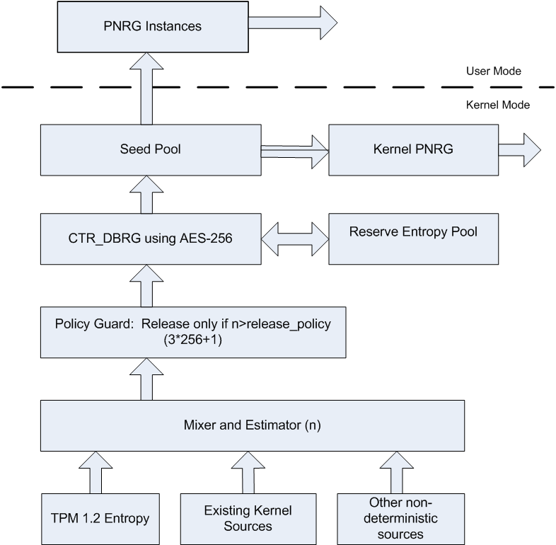
Sample 800-90 RNG System

