Slide 1
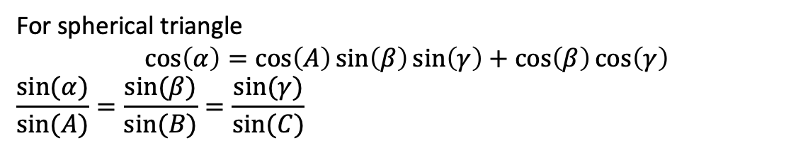





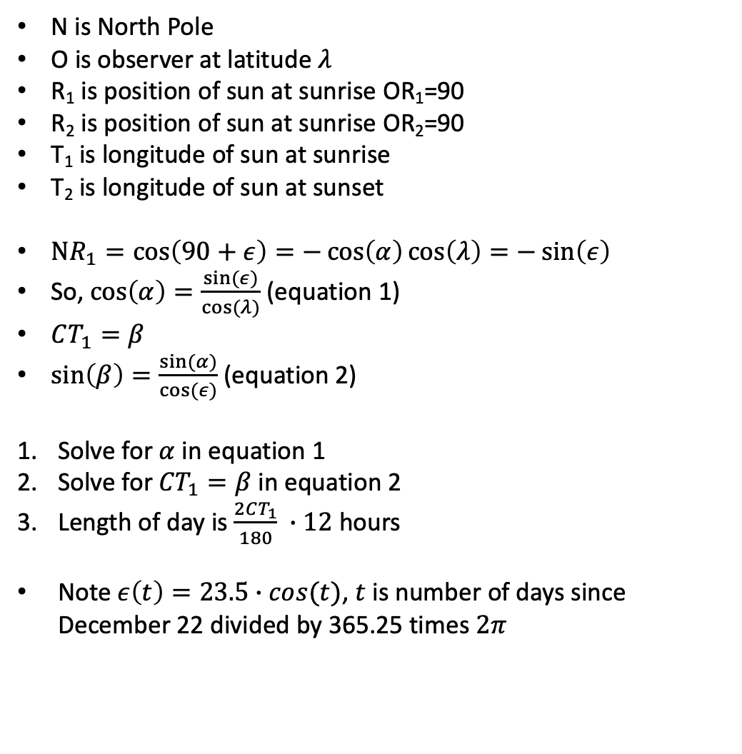
N
N is North Pole
O is observer at latitude $λ$
R₁ is position of sun at sunrise OR₁=90
R₂ is position of sun at sunrise OR₂=90
T₁ is longitude of sun at sunrise
T₂ is longitude of sun at sunset
$NR_{1}=cos\left(90+ε\right)=−\cos\left(α\right)\cos\left(λ\right)=−\sin\left(ε\right)$
So, $\cos\left(α\right)=\frac{sin⁡(ε)}{cos⁡(λ)}$ (equation 1)
$CT_{1}=β$
$\sin\left(β\right)=\frac{sin⁡(α)}{cos⁡(ε)}$ (equation 2)
Solve for $α$ in equation 1
Solve for ${CT}_{1}=β$ in equation 2
Length of day is $\frac{2CT_{1}}{180} ∙12$ hours
Note $ε\left(t\right)=23.5∙cos⁡(t)$, $t$ is number of days since December 22 divided by 365.25 times $2π$
$$β$$
$$\overline{λ}$$
O
$$α$$
Equator
$$λ$$
East
T₂
T₁
X₂
C
X₁
Sun’s path
$$ε$$
R₂
R₁
For spherical triangle
$$\cos\left(α\right)=\cos\left(A\right)\sin\left(β\right)\sin\left(γ\right)+\cos\left(β\right)\cos\left(γ\right)$$
$$\frac{sin⁡(α)}{sin⁡(A)}=\frac{sin⁡(β)}{sin⁡(B)}=\frac{sin⁡(γ)}{sin⁡(C)}$$

