Slide 1
Quantum Computing
A fast introduction
John Manferdelli
JohnManferdelli@hotmail.com
© 2021-2023, John L. Manferdelli.
This material is provided without warranty of any kind including, without limitation, warranty of non-infringement or suitability for any purpose. This material is not guaranteed to be error free and is intended for instructional use only.

Slide 2
Beam splitters and QM
x

Slide 3
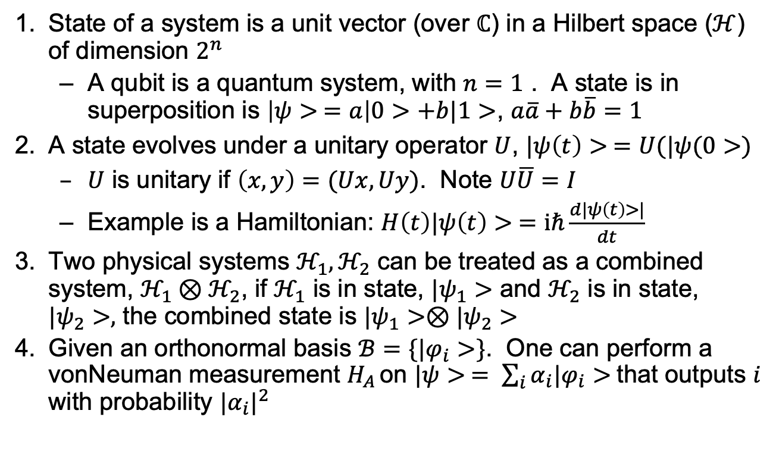
Postulates
State of a system is a unit vector (over $ℂ$) in a Hilbert space ($ℋ$) of dimension $2^{n}$
A qubit is a quantum system, with $n=1$ . A state is in superposition is $\left|ψ> =a\right|0>+b|1>$, $a\overline{a}+b\overline{b}=1$
A state evolves under a unitary operator $U$, $|ψ\left(t\right)> =U(|ψ(0>)$
$U$ is unitary if $\left(x,y\right)=(Ux, Uy)$. Note $U\overline{U}=I$
Example is a Hamiltonian: $H\left(t\right)|ψ\left(t\right)> =iℏ\frac{d|ψ\left(t\right)>|}{dt}$
Two physical systems $ℋ_{1}, ℋ_{2}$ can be treated as a combined system, $ℋ_{1}⊗ℋ_{2}$, if $ℋ_{1}$ is in state, $|ψ_{1}>$ and $ℋ_{2}$ is in state, $|ψ_{2}>,$ the combined state is $|ψ_{1}>⊗|ψ_{2}>$
Given an orthonormal basis $ℬ=\{|φ_{i}>\}$. One can perform a vonNeuman measurement $H_{A }$on $|ψ> = \sum_{i}{α_{i}|φ_{i}>}$that outputs $i$ with probability ${|α_{i}|}^{2}$

Slide 4
Superposition and entanglement
x

Slide 5
Definitions
Inner product
Outer product

Slide 6

Linear Algebra
Spectral Theorem: If $T$ is a normal operator in the Hilbert space $ℋ$, there is an orthonormal basis $v_{i}$; each is an eigenvector of $T$. For every such , there is a unitary matrix, $P$, $T=PΛP^{∗},$and $Λ$ is diagonal.
Dual basis

Slide 7

Stuff
Theorem: If $U$ is a 1-qubit gate, $U=e^{ix}R_{z}\left(β\right)R_{y}\left(γ\right)R_{z}\left(δ\right)$
$H^{⨂n}\left( | 000…0>\right)=\frac{1}{\sqrt{2}}(|0>+|1>)⨂\frac{1}{\sqrt{2}}(|0>+\left|1>\right)⨂$… $⨂\frac{1}{\sqrt{2}}(|0>+\left|1>\right)$

Slide 8

Mixed States and gate sets
Theorem: If $U$ is a 1-qubit gate, $U=e^{ix}R_{z}(β)R_{y}(γ)R_{z}(δ)$

Slide 9

No Cloning Theorem
Qubits can’t be copied
Proof
$U |ψ>|0> =|ψ$>| $ψ$> and $U |φ>|0> =|φ$>|$φ$> . Then $Ua\left|ψ>+b\right|φ> =a\left|φ>|φ>+b\right|ψ>|ψ>$ and $U\left(a\left|φ>+b\right|ψ>\right)(a|φ>+b|ψ\text{>)}$, a contradiction.
No checkpointing

Slide 10
Circuits and gates
Quantum circuits
Gates
Universal gate set

Slide 11

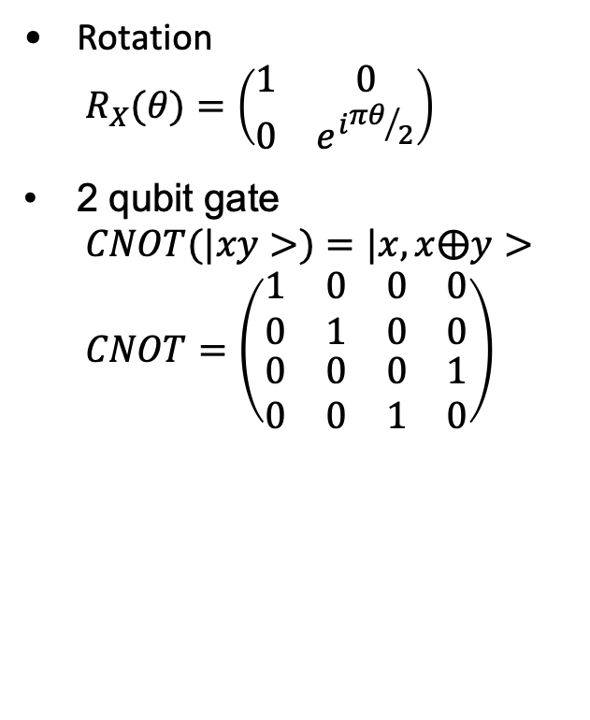
Common gates
Pauli gates
$$I=\left(\begin{matrix}1 & 0 \\ 0 & 1\end{matrix}\right)$$
$$X=\left(\begin{matrix}0 & 1 \\ 1 & 0\end{matrix}\right)$$
$$Y=\left(\begin{matrix}0 & −i \\ i & 0\end{matrix}\right)$$
$$Z=\left(\begin{matrix}1 & 0 \\ 0 & −1\end{matrix}\right)$$
Hadamard
$H=\frac{1}{\sqrt{2}}\left(\begin{matrix}1 & 1 \\ 1 & −1\end{matrix}\right)$.
Rotation
$$R_{X}(θ)=\left(\begin{matrix}1 & 0 \\ 0 & e^{i{πθ}/2}\end{matrix}\right)$$
2 qubit gate
$$CNOT(|xy>)=|x, x⨁y>$$
$$CNOT=\left(\begin{matrix}\begin{matrix}1 & 0 \\ 0 & 1\end{matrix} & \begin{matrix}0 & 0 \\ 0 & 0\end{matrix} \\ \begin{matrix}0 & 0 \\ 0 & 0\end{matrix} & \begin{matrix}0 & 1 \\ 1 & 0\end{matrix}\end{matrix}\right)$$

Slide 12

Bell Basis
${|β}_{00}> = \frac{1}{\sqrt{2}}(|00> + |11>)$, ${|β}_{01}> = \frac{1}{\sqrt{2}}(|01> + |10>)$
${|β}_{10}> = \frac{1}{\sqrt{2}}(|00>− |11>)$, ${|β}_{11}> = \frac{1}{\sqrt{2}}(|01> − |10>)$
Measuring in Bell Basis

Slide 13
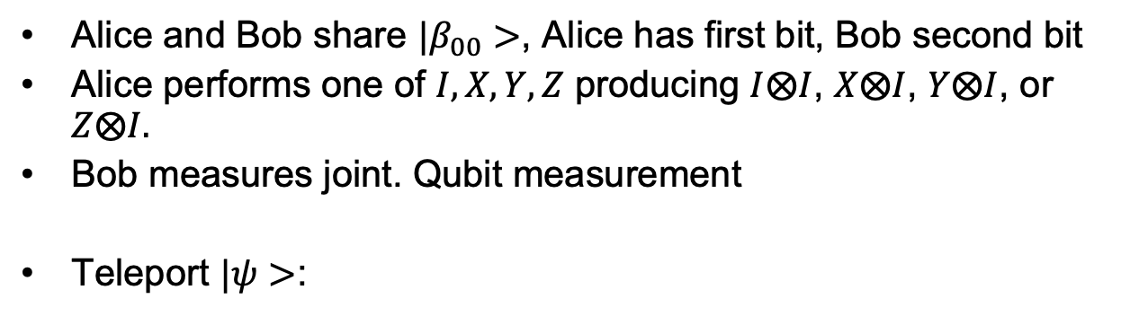



Superdense coding
Alice and Bob share ${|β}_{00}>$, Alice has first bit, Bob second bit
Alice performs one of $I, X,Y,Z$ producing $I⨂I$, $X⨂I$, $Y⨂I$, or $Z⨂I.$
Bob measures joint. Qubit measurement
Teleport $|ψ>$:
$$|ψ>$$
b
a
$$|β_{00}>$$
$$|ψ>$$
X
Z

Slide 14
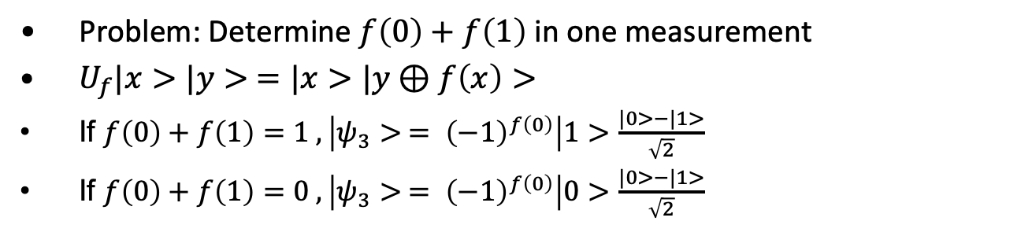
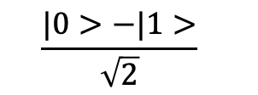

Deutch
Problem: Determine $f\left(0\right)+f\left(1\right)$ in one measurement
$U_{f}|x>|y> =|x>|y⊕f\left(x\right)>$
If $f\left(0\right)+f\left(1\right)=1 , \left|ψ_{3}> = {\left(−1\right)}^{f\left(0\right)}\right|1>$ $\frac{|0>−|1>}{\sqrt{2}}$
If $f\left(0\right)+f\left(1\right)=0 , \left|ψ_{3}> = {\left(−1\right)}^{f\left(0\right)}\right|0>$ $\frac{|0>−|1>}{\sqrt{2}}$
$$|0>$$
H
U_{f}
H
$$\frac{|0>−|1>}{\sqrt{2}}$$

Slide 15
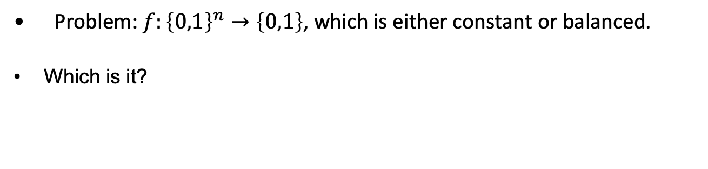
Deutch-Josza
Problem: $f:{\left\{0,1\right\}}^{n}→\left\{0,1\right\}$, which is either constant or balanced.
Which is it?
$$|0>$$
H
U_{f}
H
$$\frac{|0>−|1>}{\sqrt{2}}$$

Slide 16
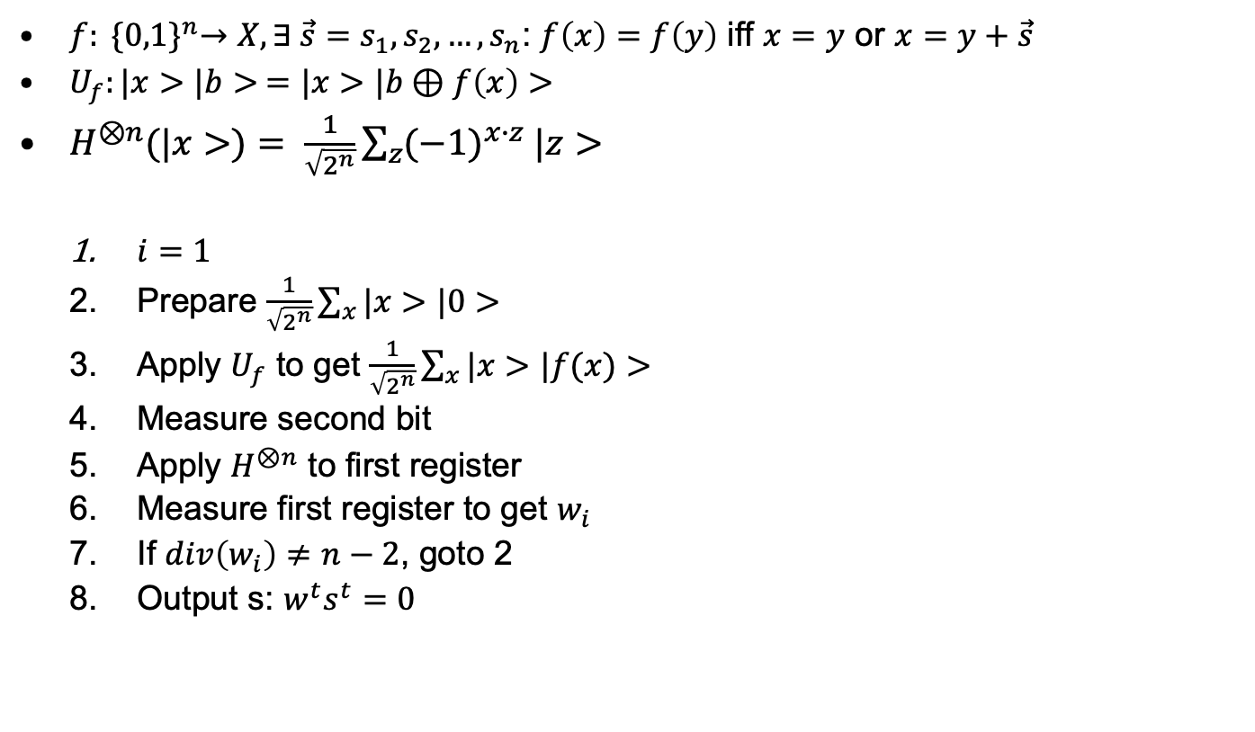
Simon
$f: {\{0,1\}}^{n}→X, ∃ {\vec{s}=s}_{1},s_{2},…,s_{n}$: $f\left(x\right)=f\left(y\right)$ iff $x=y$ or $x=y+\vec{s}$
$U_{f}:|x>|b> =|x>|b⊕f\left(x\right)>$
$H^{⊗n}(|x>)= \frac{1}{\sqrt{2^{n}}}\sum_{z}{{(−1)}^{x∙z} |z>}$
$i=1$
Prepare $\frac{1}{\sqrt{2^{n}}}\sum_{x}{|x>|0>}$
Apply $U_{f}$ to get $\frac{1}{\sqrt{2^{n}}}\sum_{x}{|x>|f(x)>}$
Measure second bit
Apply $H^{⊗n}$ to first register
Measure first register to get $w_{i}$
If $div\left(w_{i}\right)≠n−2$, goto 2
Output s: $w^{t}s^{t}=0$

Slide 17
Error Correction
x

Slide 18
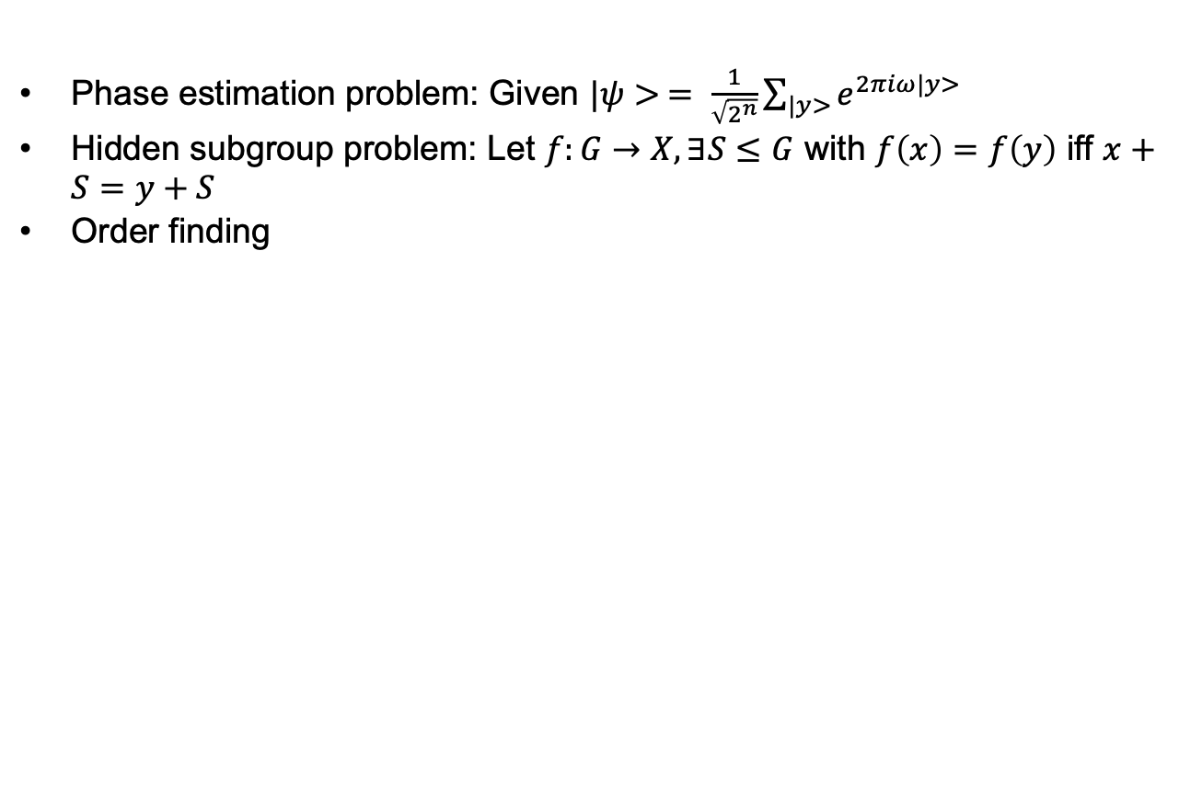
Important problems
Phase estimation problem: Given $|ψ> = \frac{1}{\sqrt{2^{n}}}\sum_{|y>}{e^{2πiω|y>}}$
Hidden subgroup problem: Let $f:G→X, ∃S≤G$ with $f\left(x\right)=f\left(y\right)$ iff $x+S=y+S$
Order finding

Slide 19
Phase
x

Slide 20
Quantum Fourier Transform
x

Slide 21
Shor
x

Slide 22
Grover
x

Slide 23
End
x

