Slide 1
Cryptanalysis
Cryptographic Hashes
John Manferdelli
JohnManferdelli@hotmail.com
© 2004-2025, John L. Manferdelli.
This material is provided without warranty of any kind including, without limitation, warranty of non-infringement or suitability for any purpose. This material is not guaranteed to be error free and is intended for instructional use only.

Slide 2
Cryptographic Hashes
A cryptographic hash (“CH”) is a “one way function,” h, from all binary strings (of arbitrary length) into a fixed block of size n (called the size of the hash) with the following properties:
Computing h is relatively cheap.
Given y=h(x) it is infeasible to calculate x. (“One way,” “non-invertibility” or “pre-image” resistance). Functions satisfying this condition are called One Way Hash Functions (OWHF)
Given u, it is infeasible to find w such that h(u)=h(w). (weak collision resistance, 2nd pre-image resistance).
It is infeasible to find u, w such that h(u)=h(w). (strong collision resistance). Note 4→3. Functions satisfying this condition are called Collision Resistant Functions (CRFs).

Slide 3
Observations
Collision Resistance → 2nd pre-image resistance
Let f(x)= x²-1 (mod p).
f(x) acts like a random function but is not a OWHF since square roots are easy to calculate mod p.
Let f(x)= x² (mod pq).
f(x) is a OWHF but is neither collision nor 2nd pre-image resistant
If either h₁(x) or h₂(x) is a CRHF so is h(x)= h₁(x)||h₂(x)
MDC+signature & MAC+unknown Key require all three properties
Ideal Work Factors:
Type | Work | Property
OWHF | 2^{n} | Pre-image 2nd Pre-image
CRHF | 2^{n/2} | Collision
MAC | 2^{t} | Key recovery, computational resistance

Slide 4
One-Way Functions
Hashes come from two basic classes of one-way functions
Mathematical
Multiplication: Z=X•Y
Modular Exponentiation: Z = Y^{X} (mod n) (Chaum vP Hash)
Ad-hoc (Symmetric cipher-like constructions)
Custom Hash functions (MD4, SHA, MD5, RIPEMD)

Slide 5
Chaum-vanHeijst-Pfitzmann Compression Function
Suppose p is prime, q=(p-1)/2 is prime, a is a primitive root in F_{p}, b is another primitive root so a^{x}=b (mod p) for some unknown x).
g: {1,2,…,q-1}² → {1,2,…,p-1}, q=(p-1)/2 by:
g(s, t) = a^{s} b^{t} (mod p)
Reduction to discrete log:
Suppose g(s, t)= g(u, v) can be found. Then a^{s} b^{t} (mod p)= a^{u} b^{v} (mod p).
So a^{s-u} (mod p)= b^{v-t} (mod p). Let b= a^{x} (mod p). Then (s-u)=x(y-t) (mod p-1).
But p-1= 2q so we can solve for x, thus determining the discrete log of b.

Slide 6
A Cryptographic Hash: SHA-1
512-bit Input
(IV ) – 160 bits
Compression
Function
160-bit Output
_{Slide by Josh Benaloh}

Slide 7
SHA-1: State and message schedule
Compression function takes 160-bit state and 512 bit input and produces new 160 bit state (one Merkle Damgard round)
512-bit message input block: 16 32-bit words (M₀, …, M₁₅)
Compression consists of 80 rounds
Each round uses one 32 bit word derived from input block
Message expansion algorithm produces subsequent rounds
W_{t} =M_{t}, 0≤t<16
W_{t}= (W_{t-3}⨁W_{t-8}⨁W_{t-14}⨁W_{t-16}) <<<1, 16≤t<80
Structure of round is same for all 80 rounds:
X= (a<<<5)+f_{t}(b,c,d)+e+W_{t}+K_{t}
E= d; d=c; c= b<<<30; b=a; a= x;
Three f_{t} functions. First used in rounds 0 through 19,
Second used in rounds 20 through 39. Third used
in rounds 40-59. First reused in rounds 60-79

Slide 8
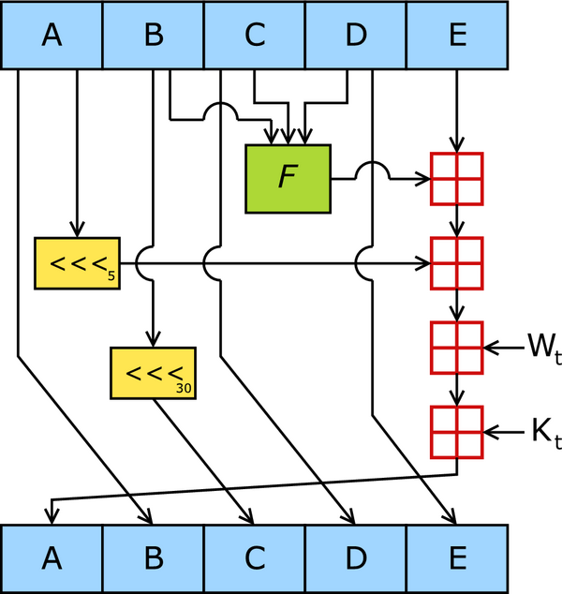
SHA-1round
_{Picture from Wikipedia}

Slide 9
A Cryptographic Hash: SHA -1
Depending on the round, the “function f is one of the following.
f(X,Y,Z)= (X⋀Y)⋁((¬X⋀Z)
f(X,Y,Z)= (X⋀Y)⋁(X⋀Z)⋁(Y⋀Z)
f(X,Y,Z)= X⨁Y⨁Z
Note first two are non-linear. Third is linear and provides diffusion.

Slide 10
SHA-0/1
Absence of this term is only
difference between SHA-0 and SHA-1
A= 0x67452301, B= 0xefcdab89,
C= 0x98badcfe, D= 0x10325476
E= 0xc3d2e1f0
F_{t}(X,Y,Z)= (X⋀Y)⋁((¬X)⋀Z),
t= 0,…,19
F_{t}(X,Y,Z)= X⨁Y⨁Z,
t= 20,…,39
F_{t}(X,Y,Z)= (X⋀Y)⋁(X⋀Z)⋁(Y⋀Z),
t= 40,…,59
F_{t}(X,Y,Z)= X⨁Y⨁Z, t= 60,…,79
K_{t}= 0x5a827999, t= 0,…,19
K_{t}= 0x6ed9eba1, t=20,…,39
K_{t}= 0x8f1bbcdc, t= 40,…,59
K_{t}= 0xca62c1d6, t=60,…,79
Do until no more input blocks {
If last input block
Pad to 512 bits by adding 1
then 0s then 64 bits of length.
M_{i}= input block(32 bits)
i= 0,…,15
W_{t}= M_{t}, t= 0,…,15;
W_{t}= (W_{t-3}⨁W_{t-8}⨁W_{t-14}⨁W_{t-16}) <<<1,
t= 16,…,79
a= A; b= B; c= C; d= D; e= E;
for(t=0 to 79) {
x= (a<<<5)+f_{t}(b,c,d)+e+W_{t}+K_{t}
e= d; d=c; c= b<<<30;
b=a; a= x;
}
A+= a; B+=b; C+= c; D+= d; E+= e;
}
Output (A, B, C, D, E)

Slide 11
MD4
Invented by Rivest, ca 1990
Weaknesses found by 1992
Rivest proposed improved version (MD5), 1992
SHA-0/1, 1993/1995
SHA-2, 2001
SHA-3, 2012
Dobbertin found MD4 collision in 1998

Slide 12
A Cryptographic Hash: MD-4
(IV ) – 128 bits
512-bit Input
Compression
Function
128-bit Output
_{Slide by Josh Benaloh}

Slide 13
MD4: State and message schedule
Compression function takes 128-bit state and 512-bit input and produces new 128-bit state (one Merkle Damgard round)
512-bit message input block: 16 32-bit words (M₀, …, M₁₅)
Compression consists of 48 rounds
Each round uses one 32-bit word derived from input block
Message expansion algorithm produces subsequent rounds
W_{t} =M_{s(t)}, 0≤t<15 (three rounds)
Structure of round is same for all 48 rounds, 3 round functions
t | 0 | 1 | 2 | 3 | 4 | 5 | 6 | 7 | 8 | 9 | 10 | 11 | 12 | 13 | 14 | 15
s(t) | 0 | 1 | 2 | 3 | 4 | 5 | 6 | 7 | 8 | 9 | 10 | 11 | 12 | 13 | 14 | 15
s(t) | 0 | 4 | 8 | 12 | 1 | 5 | 9 | 13 | 2 | 6 | 10 | 14 | 3 | 7 | 11 | 15
s(t) | 0 | 8 | 4 | 12 | 2 | 10 | 6 | 14 | 1 | 9 | 5 | 13 | 3 | 11 | 7 | 15
Slide by Mark Stamp

Slide 14
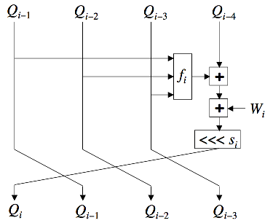

MD4 round
f_{i}(A,B,C)
(A⋀B)⋁(¬A⋀C), 0≤i<16
(A⋀B)⋁(A⋀C)⋁(B⋀C), 16≤i<32
A⨁B⨁C, 32≤i<48
K₀ = 0x00000000,
K₁ = 0x5a827999,
K₂ = 0x6ed9eba1.
i | 0 | 1 | 2 | 3 | 4 | 5 | 6 | 7 | 8 | 9 | 10 | 11 | 12 | 13 | 14 | 15
s¹_{i} | 3 | 7 | 11 | 19 | 3 | 7 | 11 | 19 | 3 | 7 | 11 | 19 | 3 | 7 | 11 | 19
s²_{i} | 3 | 5 | 9 | 13 | 3 | 5 | 9 | 13 | 3 | 5 | 9 | 13 | 3 | 5 | 9 | 13
s³i | 3 | 9 | 11 | 15 | 3 | 9 | 11 | 15 | 3 | 9 | 11 | 15 | 3 | 9 | 11 | 15
Slide by Mark Stamp

Slide 15
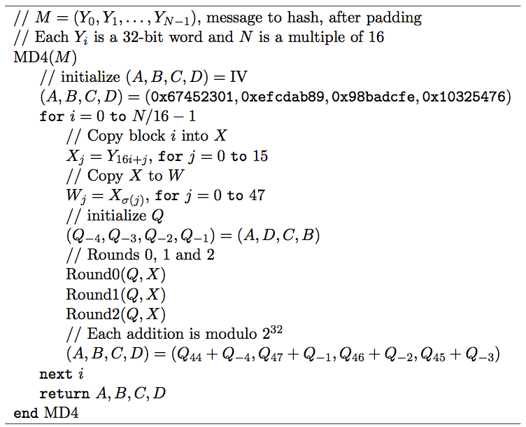
MD4 Algorithm
Slide by Mark Stamp

Slide 16
Overview of pre-image attack
Try to find one block collision
Denote M = (X₀,X₁,…,X₁₅)
Define M′ by X′_{i} = X_{i} for i≠12 and X′₁₂= X₁₂+1
Word X₁₂ only appears in steps 12, 19, 35
This provides a “natural” round division of the attack
We have the freedom to choose X₀,X₁,…,X₁₁ at our convenience
Goal is to find pair M and M′ with Δ₃₅= (0,0,0,0) [Distance is subtraction mod 2³².]
Slide by Mark Stamp

Slide 17
Dobbertin’s attack strategy
Specify a differential condition
If condition holds, there’s a probability of collision---try enough times for overall probability to be high.
Derive system of nonlinear equations: solution satisfies differential condition
Find efficient method to solve equations
Find enough solutions to yield a collision
Find one-block collision, where M= (X₀,X₁,…,X₁₅), M′= (X′₀,X′₁,…,X′₁₅)
Difference is subtraction mod 2³²
Blocks differ in only 1 word
Difference in that word is exactly 1
Limits avalanche effect to steps 12 thru19
Only 8 of the 48 steps are critical to attack!
System of equations applies to these 8 steps
Slide by Mark Stamp

Slide 18
Notation
Suppose (Q_{j},Q_{j−1},Q_{j−2},Q_{j−3}) = MD4_{0…j}(IV,M)
and (Q′_{j},Q′_{j−1},Q′_{j−2},Q′_{j−3}) = MD4_{0…j}(IV,M′)
Define Δ_{j} = (Q_{j}−Q′_{j}, Q_{j−1}−Q′_{j−1}, Q_{j−2}−Q′_{j−2}, Q_{j−3}−Q′_{j−3} )
where subtraction is modulo 2³²
Let ±2^{n} denote ±2^{n} mod 2³².
2²⁵ = 0x02000000 and −2⁵ = 0xffffffe0
All arithmetic is modulo 2³²

Slide 19
Three phases of MD4 attack
Show: Δ₁₉= (2²⁵,−2⁵,0,0) implies probability at least 1/2³⁰ that the Δ₃₅ condition holds
Uses differential cryptanalysis
“Backup” to step 12: We can start at step 12 and have Δ₁₉ condition hold
By solving system of nonlinear equations
“Backup” to step 0: And find collision
In each phase of attack, some words of M are determined
When completed, have M and M′
Where M ≠ M′ but h(M) = h(M′)
Equation solving step is tricky part
Nonlinear system of equations
Must be able to solve efficiently
Slide by Mark Stamp

Slide 20
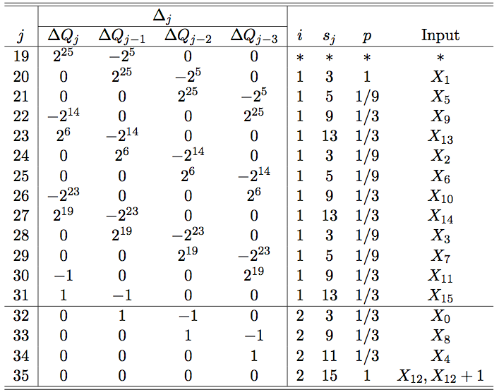
Steps 19 to 35
Differential phase of the attack
M and M′ as given above
Only differ in word 12
Assume that Δ₁₉= (2²⁵,−2⁵,0,0)
G(Q₁₉,Q₁₈,Q₁₇)=
G(Q′₁₉,Q′₁₈,Q′₁₇)
Then we compute probabilities of “Δ” conditions at steps 19 thru 35
Total probability: 2⁻³⁰, actually 2⁻²⁹
Slide by Mark Stamp

Slide 21
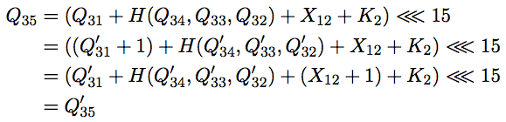
Computing p
Consider Δ₃₅
Suppose j = 34 holds: Then Δ₃₄= (0,0,0,1) and
Implies Δ₃₅= (0,0,0,0) with probability 1
As summarized in j = 35 row of table
Slide by Mark Stamp

Slide 22
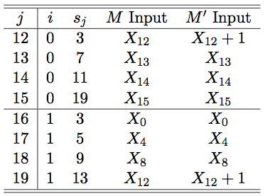
Steps 12 to 19
Analyze steps 12 to 19, find conditions that ensure Δ₁₉ = (2²⁵,−2⁵,0,0)
G(Q₁₉,Q₁₈,Q₁₇)= G(Q′₁₉,Q′₁₈,Q′₁₇), as required in differential phase
Step 12 to 19—equation solving phase
This is most complex part of attack
Last phase, steps 0 to 11, is easy
Slide by Mark Stamp

Slide 23
Steps 12 to 19
To apply differential phase, must have Δ₁₉= (2²⁵,−2⁵,0,0)
Q₁₉= Q′₁₉+2²⁵
Q₁₈+2⁵ = Q′₁₈
Q₁₇= Q′₁₇
Q₁₆= Q′₁₆
At step 12 we have
Q₁₂= (Q₈ + F(Q₁₁,Q₁₀,Q₉) + X₁₂) <<< 3
Q′₁₂=(Q′₈ + F(Q′₁₁,Q′₁₀,Q′₉) + X′₁₂) <<< 3
Since X′₁₂= X₁₂+1 and (Q₈,Q₉,Q₁₀,Q₁₁)= (Q′₈,Q′₉,Q′₁₀,Q′₁₁),
(Q′₁₂<<<29)−(Q₁₂<<<29)= 1
Slide by Mark Stamp

Slide 24
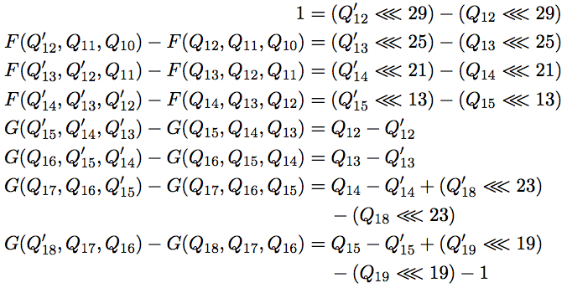
Equations for 12 to 19
Similar analysis for remaining steps yields system of equations:
Slide by Mark Stamp

Slide 25
Solving the equations
To solve this system must find
so that all equations hold.
Since there are 14 variables and 8 equations, we have wiggle room
Given such a solution, we determine X_{j} for j = 13, 14, 15, 0, 4, 8, 12
so that we begin at step 12 and arrive at step 19 with Δ₁₉ condition satisfied
This phase reduces to solving (nonlinear) system of equations
Can manipulate the equations so that
Choose (Q₁₄,Q₁₅,Q₁₆,Q₁₇,Q₁₈,Q₁₉) arbitrary
Which determines (Q₁₀,Q₁₃,Q′₁₃ ,Q′₁₄ ,Q′₁₅)
Slide by Mark Stamp

Slide 26

Conditions for solution
Three conditions must be satisfied:
First 2 are “check” equations
Third is “admissible” condition
Naïve algorithm: choose six Q_{j}, yields five Q_{j}, Q′_{j} until 3 equations satisfied
How much work is this?
Slide by Mark Stamp

Slide 27
Message conditions for equations
Using this we can solve for seven message words:
X₁₃= anything
X₁₄= (Q₁₄<<<21)-Q₁₀-F(Q₁₃, Q₁₂, Q₁₁)
X₁₅= (Q₁₅<<<21)-Q₁₁-F(Q₁₄, Q₁₃, Q₁₂)
X₀= (Q₁₆<<<21)-Q₁₂-G(Q₁₅, Q₁₄, Q₁₃) –K₁
X₄= (Q₁₇<<<21)-Q₁₃-G(Q₁₆, Q₁₅, Q₁₄) –K₁
X₈= (Q₁₈<<<21)-Q₁₄-G(Q₁₇, Q₁₆, Q₁₅) –K₁
X₁₂= (Q₁₉<<<21)-Q₁₅-G(Q₁₈, Q₁₇, Q₁₆) –K₁
Slide by Mark Stamp

Slide 28
Solution
Choose Q₁₂= -1, Q₁₂’=0, Q₁₁=0. Then
Q₁₅’= Q₁₅-G(Q₁₈’,Q₁₇,Q₁₆)+G(Q₁₈,Q₁₇,Q₁₆)+(Q₁₉’<<<19)-(Q₁₉<<<19)-1
Q₁₄’= Q₁₄-G(Q₁₈’,Q₁₇,Q₁₆)+G(Q₁₈,Q₁₇,Q₁₆)+(Q₁₈’<<<23)-(Q₁₉<<<23)
Q₁₃= (Q₁₄<<<21)-(Q₁₄’<<<21)
Q₁₃’= Q₁₃-G(Q₁₆,Q₁₅’,Q₁₄’)+G(Q₁₆,Q₁₅,Q₁₄)
Q₁₀= (Q₁₃’<<<25)-(Q₁₃<<<25)
F(Q₁₈’,Q₁₇,Q₁₆)-F(Q₁₈,Q₁₇,Q₁₆)= (Q₁₅’<<<13)-(Q₁₅<<<13)
G(Q₁₈’,Q₁₇,Q₁₆)-G(Q₁₈,Q₁₇,Q₁₆)= Q₁₂-Q₁₁’
Choose Q₁₄, …, Q₁₉ arbitrarily and solve for Q₁₀, Q₁₃, Q₁₃’, Q₁₄’, Q₁₅’
G(Q₁₅,Q₁₄,Q₁₃)-G(Q₁₅’, Q₁₄’, Q₁₃’)= 1
F(Q₁₄’, Q₁₃’, 0)-F(Q₁₄, Q_{13,}, -1)= 0
G(Q₁₉’, Q₁₈’, Q₁₇)= G(Q₁₉, Q_{18,}, Q₁₇)
Slide by Mark Stamp

Slide 29
Continuous Approximation
Each equation holds with probability 1/2³²
Appears that 2⁹⁶ iterations required
Since three 32-bit check equations
Birthday attack on MD4 is only 2⁶⁴ work!
Solution
A “continuous approximation”
Small changes, converge to a solution
Slide by Mark Stamp

Slide 30
Approximation technique
Generate random Q_{i} values until first check equation is satisfied
Random one-bit modifications to Q_{i}
Save if 1st check equation still holds and 2nd check equation is “closer” to holding
Else try different random modifications
Modifications converge to solution
Then 2 check equations satisfied
Repeat until admissible condition holds
Slide by Mark Stamp

Slide 31
Steps 0 to 11
At this point, we have (Q₈,Q₉,Q₁₀,Q₁₁) and
MD4_{12…47}(Q₈,Q₉,Q₁₀,Q₁₁,X)= MD4_{12…47}(Q₈,Q₉,Q₁₀,Q₁₁,X′)
To finish, we must have
MD4_{0…11}(IV,X) = MD4_{0…11}(IV,X′)= (Q₈,Q₉,Q₁₀,Q₁₁)
Recall, X₁₂ is only difference between M, M′
Also, X₁₂ first appears in step 12
Have already found X_{j} for j= 0,4,8,12,13,14,15
Free to choose X_{j} for j= 1,2,3,5,6,7,9,10,11 so that MD4_{0…11} equation holds easily!
Slide by Mark Stamp

Slide 32
Recap
Attack proceeds as follows…
Steps 12 to 19: Find (Q₈,Q₉,Q₁₀,Q₁₁) and X_{j} for j= 0,4,8,12,13,14,15
Steps 0 to 11: Find X_{j} for remaining j
Steps 19 to 35: Check Δ₃₅= (0,0,0,0)
If so, have found a collision!
If not, go to 2.
Slide by Mark Stamp

Slide 33
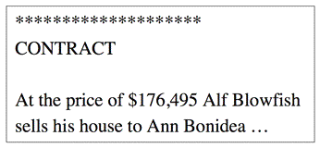
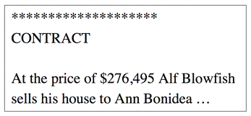
Meaningful Collision
Different contracts, same hash value
Slide by Mark Stamp

Slide 34
Nostradamus (“herding") attack
Let h be a Merkle-Damgard hash with compression function f and initial value IV . Goal is to hash a prefix value (P) quickly by appending random suffixes (S).
Procedure
Phase 1: Pick k, generate K= 2^{k} random d_{0i} from each pair of the values f(IV||d_{i,i+1}) and two messages M_{0,j} ; M_{1,j} which collide under f. Call this value d_{1,j} this takes effort 2^{n/2} for each pair. Do this (colliding d_{i,j} ; d_{i+1,j} under M_{i,j} ;M_{i+1,j} to produce d_{i,j+1} until you reach d_{K,0}). This is the diamond.
Publish y = w(d_{K,0}) where w is the final transformation in the hash as the hash [i.e. - claim y = h(P||S)].

Slide 35
Diamond structure
h(0,0)
h(0,1)
h(1, 0)
M₀
h(0,2)
h(0,3)
h(1, 1)
h(2,0)
P
M₅
h(0,4)
M₇
h(0,5)
h(1, 2)
h(0,6)
Published hash
h(0,7)
h(1, 3)
h(2, 1)
h(3,0)
w(h(3,0))

Slide 36
Nostradamus (“herding") attack
The cost of phase 1 is (2^{k} -1)2^{n/2}.
In phase 2, guess S’ and compute T= f(IV||P||S’).
Keep guessing until T is one of the d_{ij}. Once you get a collision, follow a path through the M_{ij} to d_{K,0}. Append these M_{ij} to P||S’ and apply w to get right hash.
Total cost: W= 2^{n-k-1}+2^{n/2+k/2}+k2^{n/2+1}. k=(n-5)/3 is a good choice. For 160 bit hash, k=52.

Slide 37
Cryptographic Hashes and Performance
Hash Name | Block Size | Relative Speed
MD4 | 128 | 1
MD5 | 128 | .68
RIPEMD-128 | 128 | .39
SHA-1 | 160 | .28
RIPEMD-160 | 160 | .24

Slide 38
What to take home
Symmetric ciphers and hashes provide key ingredients for “distributed security”
Fast data transformation to provide confidentiality
Integrity
Public key crypto provides critical third component (trust negotiation, key distribution)
It’s important to know properties of cryptographic primitives and how likely possible attacks are, etc.
Most modern ciphers are designed so that knowing output of n-1 messages provides no useful information about n^{th} message.
This has an effect on some modes of operation.

Slide 39
Jesse Walker, Ph.D.

Slide 40
The Early Years
Historical Context
Rabin’s Hash Function
Davies-Meyer
MDC2

Slide 41
Historical Context
Computer scientists introduced hash functions to create a compact table index optimizing search
Requirement: a hash function H : Objects → Indices acts like a random mapping
Minimize probability that H(m) = H(m′) when m ≠ m′
m₁ . . . m_{k} ← m; h₀ ← 0
do j = 1 to k ⇒ h_{j} ← f(h_{j–1}, m_{j}) od
return h_{k}
f usually chosen to be a number theoretic mixer, e.g., f(h,m) = (h + am + b) mod c for primes a, b, c

Slide 42
Digital Signatures
In 1978 M. Rabin wanted to create a digital signature scheme
Rabin needed something like a hash function to “compress” the message into a fixed sized “index”
Requirements:
Act like a random mapping
Collision resistance: it is hard find two documents with same hash or digest
2nd pre-image resistance: given a hash of a document, it is hard to find a second document with same hash
Pre-image resistance: given a hash value, it is to find a document that produces that hash

Slide 43
Rabin’s Hash Function
Rabin realized DES, being a strong pseudo-random mixer, can replace the non-cryptographic f in conventional hash function designs
RabinHash (h₀, m)
m₁ . . . m_{k} ← m
do j = 1 to k ⇒ h_{j} ← DES(m_{j}, h_{j–1}) od
return (h₀, h_{m})
Must return (h₀, h_{m}) instead of h_{m} to obtain collision resistance
RabinHash (h₀, m₁ m₂) = DES (m₂, DES (m₁, h₀)) = DES (m₂, h₁) = RabinHash (h₁, m₂)
Lesson 1: The initial value h₀ must be fixed to obtain collision resistance

Slide 44
Birthday Problems
The standard Birthday Problem:
Given q people who live on a planet with an n day year, what is the probability two share a birthday?
Answer: Assuming birthdays are uniformly distributed, approximately q²/2n if q ≤ n^{1/2}
The Birthday Problem for two sets:
Given a population of q₁ boys and q₂ girls who live on a planet with an n day year, what is the probability a boy and girl share a birthday?
Answer: When q = q₁ = q₂, assuming birthdays are uniformly distributed, approximately q²/n if q ≤ n^{1/2}

Slide 45
Attacking Rabin Hash
Coppersmith: To find a 2nd pre-image for RabinHash (h₀, m₁ m₂) :
Let h₂ = RabinHash (h₀, m₁ m₂) Then compute
do j = 1 to 2³² ⇒ s_{j} ←$ {0,1}⁵⁶; u_{j} ← DES (s_{j}, h₀) od
do j = 1 to 2³² ⇒ t_{j} ←$ {0,1}⁵⁶; v_{j} ← DES^{–1} (t_{j}, h₂) od
By the Birthday problem for two lists the probability that j, j′ exists with u_{j} = v_{j′} is approximately (2³²)(2³²)/2⁶⁴ = 1
Then RabinHash (h₀, s_{j} t_{j′}) = DES (t_{j′}, DES (s_{j}, h₀)) = DES (t_{j′}, u_{j}) = DES (t_{j′}, v_{j′}) = h₂ = RabinHash (h₀, m₁ m₂)
Notes:
a ←$ A means to choose a uniformly at random from the set A
DES^{–1} denotes the DES decryption function

Slide 46
Discussion
Collision resistance implies 2nd pre-image resistance, because if we produce a 2nd pre-image then we also produce a collision
Exercise: modify the attack to produce pre-images
Lesson 2: We must somehow neutralize the decryption function to build successful hash functions from block ciphers
Lesson 3: Hash functions are attacked by multi-block messages, which enables various forms of the Birthday problem to govern their security

Slide 47
Neutralizing Decryption
In the early 1980s Davies and Meyer observed that (h, m) → DES (m, h) ⨁ h is one-way
Given h′ it is hard to find m and h such that
h′ = DES (m, h) ⨁ h
The Davies-Meyer construction replaces DES in the Rabin hash function:
DaviesMeyerHash (m)
m₁ . . . m_{k} ← m; h₀ ← iv
do j = 1 to k ⇒ h_{j} ← DES(m_{j}, h_{j–1}) ⨁ h_{j–1} od
return h_{m}
Does this work?

Slide 48
The Ideal Cipher Model
Davies and Meyer reasoned as if DES were an ideal cipher E.
For each “key” m, DES (m, ⋅) acts like a random permutation of 64 bits strings {0,1}⁶⁴
It is easy to reason about an ideal cipher E:
Pr[E (m, h) ⨁ h = h′] = Pr[E (m, h) = h′⨁h] = Pr[E (m, h) = h″] = 1/2^{n} (pre-image resistance)
Also easy to show Pr[E (m, h) ⨁ h = E (m′, h′) ⨁ h′] = 2^{– n/2} (collision resistance) in the ideal cipher model
Lesson 4. Nearly all hash function rationales or “security proofs” rely on the ideal cipher model
Lesson 5. The digest size must be at least twice the block size of the underlying block cipher

Slide 49
2nd-Preimages with Davies-Meyer Compression Functions
It is easy to find fixed points for the Davies-Meyer construction
E (m, h) ⨁ h = h ⇔ E (m, h) = 0 ⇔ h = E^{–1} (m, 0)
The Attack: Given a message m = m₁ . . . m_{k} compute h = DaviesMeyerHash (m) (with E replacing DES) and
do j = 1 to 2^{n/2} ⇒ s_{j} ←$ {0,1}^{n}; u_{j} = E (s_{j}, iv) ⨁ iv od
do j = 1 to 2^{n/2} ⇒ t_{j′} ←$ {0,1}^{n}; v_{j′} = E^{–1} (t_{j′}, 0) ⨁ iv od
By the Birthday problem for two lists with high probability there are j, j′ with u_{j} = v_{j′}
Then DaviesMeyerHash (iv, m) = DaviesMeyerHash (iv, s_{j} t_{j′}) = DaviesMeyerHash (iv, s_{j} t_{j′} t_{j′}) = DaviesMeyerHash (iv, s_{j} t_{j′} t_{j′} t_{j′}) = . . .
Conclusion: With Davies-Meyer 2nd pre-image resistance is no more expensive than collision resistance

Slide 50
MDC2: Widening the Block Size
The Davies-Meyer enhancement can only provide collision resistance to O(2^{64/2}) = O(2³²) DES operations
In 1987 IBM proposed MDC2 to obtain O(2⁶⁴) collision resistance
MDC2 (m)
m₁ . . . m_{k} ← m; h₀ ← iv
do j = 1 to k ⇒
h_{left} h_{right} ← h_{j–1}
d ← DES(h_{left}, m_{j}) ⨁ m_{j}
e ← DES(h_{right}, m_{j}) ⨁ m_{j}
h_{j} ← d_{left} e_{right} e_{left} d_{right}
od
return h_{m}

Slide 51
Discussion
The construction (h,m) → DES (h, m) ⨁ m offers the same collision and pre-image bounds as Davies-Meyer
Nearly an identical argument in the ideal cipher model
This is the Matyas-Meyer-Oseas construction
Swapping the left and right digest halves is essential for security
Collisions could be found in 2³² + 2³² = 2³³ instead of 2⁶⁴ DES operations, because without the swap the digest is just the concatenation of digests from two independent hashes
Steinberger proved MDC2 is collision resistant in 2007

Slide 52
Length Problems 1
Let m ∈ ({0,1}⁵⁶)⁺, i.e., m is a string whose bit length is a multiple of 56
For any string n it is easy to verify hash (m n) = hash (hash (m) n) for each of the hash constructions we have considered
This is called a length extension attack
Length extension attacks succeed even if the attacker never sees m
Length extension attacks indicate something is still missing from our construction

Slide 53
Length Problems 2
Suppose the message digest of a hash function is n bits wide
Consider the message m = m₁ . . . m_{k} for k ≥ 2^{n/2}
By the standard birthday problem there is at probability of at least 0.5 that at least two messages in {m₁, m₁ m₂, m₁ m₂ m₃, . . . , m₁ . . . m_{k}} collide.
Lesson 6. To achieve collision resistance the length of all the combined inputs to a hash function must be less than 2^{n/2} bits

Slide 54
Early Years Summary
The Davies-Meyer hash is too weak for practical applications
Collisions found in 2³² DES operations
The MDC2 hash is too expensive for practical use
1 DES operation ≈ 500 cycles; 1 MDC2 operation ≈ 1000 cycles = 125 cycles per byte
There is something wrong in the way early hash functions deal with the length of their inputs
Question: Even though the inner loop is collision/pre-image/2nd pre-image resistant, why do we believe the hash function is?

Slide 55
Revolution
At Crypto 1989 Merkle and Damgård published papers revolutionizing hash function design
Replace the DES construction by a clean compression function abstraction compress : {0,1}^{s} × {0,1}^{n} → {0,1}^{n} operating on s bit message blocks and an n bit chaining variable
Define a padding scheme to block length extension attacks
Because it blocks length extension attacks, the padding scheme extends compression function’s collision resistance to the entire hash function
MD-Hash (m)
m′ ← pad (m); m₁ . . . m_{k} ← m′; h₀ ← iv
do j = 1 to k ⇒ h_{j} ← compress(h_{j–1}, m_{j}) od
return h_{m}

Slide 56
Merkle-Damgård Padding
If the compression function compress operates on s bit message blocks and n bit chaining variables then
pad (m)
l ← |m| -- find m’s length in bits
t ← s – (l mod s) – n/2 – 1 -- compute number of 0
if t < 0 ⇒ t ← s + t fi -- bits needed
m′ ← m 1 0^{t} <l>_{n/2} -- append a 1 bit, t 0 bits, and l
return m′ -- encoded as an n/2 bit integer
Key property: pad (m) gives the number of bits l of m
This scheme makes it unambiguous where the message m ends and where the padding ends

Slide 57
Collision Resistance
Why does collision resistance of compress imply collision resistance of md-hash?
Suppose we can easily find m ≠ m′ with md-hash (m) = md-hash (m′)
Two cases: md-hash (m) = md-hash (m′) with |m| = |m′|, m = m₁ m₂ . . . m_{k}, m′ = m₁′ m₂′ . . . m_{i}′
Case 1: Since |m| = |m′|, we know k = i and the last block (of padding) is the same (m_{k} = m_{i}). There must be some 1 ≤ j < k such that compress (h_{j–1}, m_{j}) = compress (h_{j–1}′, m_{j}′) but m_{j} ≠ m_{j}′. This contradicts the assumption it is hard to find collisions for compress
Case 2: Since |m| ≠ |m′| we know that the final (padding) blocks m_{k} ≠ m_{i}′ and compress (h_{k–1}, m_{k}) = compress (h_{i–1}′, m_{i}′), a contradiction since it is hard to find collisions for compress

Slide 58
Example: SHA-1
algorithm SHA-1 ( M )
return sha-md ( 5a827999 || 6ed9eba1 || 8f1bbcdc || ca62c1dc, M )
algorithm sha-md ( K, M )
M := pad ( M )
parse M into 512-bit blocks M₁ . . . M_{k}
IV := 67452301 || efcdab89 || 98badcfe || 10325476 || c3d2e1f0
do i = 1 to k ⇒ IV := sha-compress ( K, IV, M_{i} ) od
return IV
Merkle-Damgård construction
algorithm sha-compress ( K, IV, M )
parse K into 32-bit blocks K₁ . . . K₄ and IV into IV₁ . . . IV₅
parse M into 32-bit blocks W₁ . . . W₁₆
do i = 17 to 80 ⇒ W_{i} := LROT ( 1, W_{i–3} ⨁ W_{i–8} ⨁ W_{i–14} ⨁ W_{i–16} ) od
A := IV₁, B := IV₂, C := IV₃, D := IV₄, E := IV₅
do i = 1 to 20 ⇒ L_{i} := K₁, L_{i+20} := K₂, L_{i+40} := K₃, L_{i+60} := K₄ od
do i = 1 to 80 ⇒
if 1 ≤ i ≤ 20 ⇒ f := (B⋀C)⋁((¬B)⋀D)
else if 41 ≤ i ≤ 80 ⇒ f := (B⋀C)⋁(B⋀D)⋁(C⋀D)
else f := B ⨁ C ⨁ D fi
t := LROT ( 5, A) + f + E + W_{i} + L_{i}
E := D, D := C, C := LROT ( 30, B ), B := A, A := t
od
IV₁ := IV₁ + A, IV₂ := IV₂ + B, IV₃ := IV₃ + C, IV₄ := IV₄ + D, IV₅ := IV₅ + E
return IV₁ || IV₂ || IV₃ || IV₄ || IV₅
Block cipher key schedule
Block cipher
Davies-Meyer feed-forward

Slide 59
Structural Problems
Second pre-image attacks
Random Mapping properties
Multi-block Differential Attacks

Slide 60
Joux’s Multi-collision Attack
Let compress : {0,1}^{s} × {0,1}^{n} → {0,1}^{n} be a collision resistant compression function and m₁ m₂ be a 2s bit message
By assumption we can find m₁′ ≠ m₁ such that compress (iv, m₁) = compress (iv, m₁′) in 2^{s/2} operations
Similarly we can find m₂′ ≠ m₂ such that compress (iv, m₂) = compress (iv, m₂′) in 2^{s/2} operations
Therefore m₁ m₂′, m₁′ m₂, and m₁′ m₂′ are three 2nd preimages of m₁ m₂ under md-hash that we have found in 2^{s/2} + 2^{s/2} = 2^{s/2+1} operations instead of 2^{s}
Clearly the attack can be extended to k block messages to find 2^{k}–1 2nd pre-images in time k2^{s/2} instead of 2^{s}
Conclusion: 2nd pre-image resistance from the Merkle-Damgård construction is no stronger than collision resistance

Slide 61
The Random Mapping Property
A random oracle is a public random mapping
A random oracle returns a fixed length random string in response to any input
It is widely assumed in practice that hash functions behave like random oracles
Let m = m₁ m₂. Then it is easy to see that
md-hash(m₁ pad(m₁) m₂) = md-hash(md-hash(m₁) m₂)
If hash acted like a random oracle, then hash (m pad (m) n) and hash (hash (m) n) should assume independent values
This makes Merkle-Damgård hash functions hard to use in practice
We don’t know that constructions using Merkle-Damgård hash functions deliver the security claimed
Merkle-Damgård hash functions leak that they are iterative constructions

Slide 62
Random Oracles
D. Simon showed that random oracles cannot be instantiated
Random oracles assume an infinite world, so can always be distinguished from real-word constructions
Maurer introduced the notion of indifferentiability to replace the notion of distinguishability when reasoning about hash functions
Collision resistance is not enough; hash functions should be indifferentiable from random oracles

Slide 63

Indifferentiability
Question: When can an iterated construction replace a monolithic construction?
Answer: When for every adversary a simulation environment exists wherein the adversary cannot distinguish the real construction from the monolithic construction operating in the simulation
Iterated Ideal Primitive
Simulation Environment
Iterated Construction
Monolithic Ideal Primitive

Slide 64
Relationships
Random oracle
Collision resistance
2nd pre-image resistance
+
Pre-image resistance
Non-trivial compression

Slide 65
Multi-block Differential Attacks
Differential cryptanalysis was introduced to study block ciphers
Given a key K and X, X′ with difference X⨁X′, what is the difference E(K,X)⨁E(K,X′)?
This often yields useful information about K and deep insight into E’s structure
Since compression functions for Merkle-Damgård hashing are based on block ciphers, there should be some way to extend differential cryptanalysis to hashing
Since hashing is multi-block, we need some way to extend differential cryptanalysis to multi-block attacks

Slide 66
The Multi-Block Technique
Step 1. Find a near collision m ≠ m′ producing a designated output difference h ≈ h′
IV
compress (IV, m) ≈ compress (IV, m′)
h
h′
compress (h, n) = compress (h′, n′)
Step 2. Find a pseudo collision n ≠ n′ from a designated input difference h ≈ h′ producing the same result
result
m n and m′ n′ are colliding messages when successful

Slide 67
Wang’s Attack
In 2004 Xiayuan Wang applied the multi-block technique to break the collision resistance of MD4, MD5, and Ripe-MD
In 2009 their attack was extended to forge the certificate of real CA that supported MD5
In 2005 Wang and colleagues used the technique to defeat the collision resistance of SHA-1
They showed a collision could be found at cost 2⁶² instead of 2⁸⁰ operations
These attacks caused deep trauma and introspection in the crypto community
“Do we know what a hash function is?”

Slide 68
What Went Wrong?
algorithm SHA-1 ( M )
return sha-md ( 5a827999 || 6ed9eba1 || 8f1bbcdc || ca62c1dc, M )
algorithm sha-md ( K, M )
M := pad ( M )
parse M into 512-bit blocks M₁ . . . M_{k}
IV := 67452301 || efcdab89 || 98badcfe || 10325476 || c3d2e1f0
do i = 1 to k ⇒ IV := sha-comp ( K. IV, M ) od
return IV
algorithm sha-comp ( K, IV, M )
parse K into 32-bit blocks K₁ . . . K₄ and IV into IV₁ . . . IV₅
parse M into 32-bit blocks W₁ . . . W₁₆
do i = 17 to 80 ⇒ W_{i} := LROT ( 1, W_{i–3} ⨁ W_{i–8} ⨁ W_{i–14} ⨁ W_{i–16} ) od
A := IV₁, B := IV₂, C := IV₃, D := IV₄, E := IV₅
do i = 1 to 20 ⇒ L_{i} := K₁, L_{i+20} := K₂, L_{i+40} := K₃, L_{i+60} := K₄ od
do i = 1 to 80 ⇒
if 1 ≤ i ≤ 20 ⇒ f := (B⋀C)⋁((¬B)⋀D)
else if 41 ≤ i ≤ 80 ⇒ f := (B⋀C)⋁(B⋀D)⋁(C⋀D)
else f := B ⨁ C ⨁ D fi
t := LROT ( 5, A) + f + E + W_{i} + L_{i}
E := D, D := C, C := LROT ( 30, B ), B := A, A := t
od
IV₁ := IV₁ + A, IV₂ := IV₂ + B, IV₃ := IV₃ + C, IV₄ := IV₄ + D, IV₅ := IV₅ + E
return IV₁ || IV₂ || IV₃ || IV₄ || IV₅
Key schedule doesn’t resist related key attacks or compensate for cipher’s poor diffusion
Poor diffusion

Slide 69
Discussion
Davies-Meyer elevates the importance of related key attacks in block cipher designs, because the attacker has control over differences between encryption key
The block being hashed is the encryption key
The attacks exploit the fact that making small changes in one block can be canceled by a later block
We have learned that hash functions and block ciphers are attacked in similar ways
No longer surprising, given how hash function have been built
All of the state-of-the-art design techniques for design and validation of block ciphers should be applied to hash function designs
e.g., show that every input bit flows to every output bit after a few rounds

Slide 70
The Merkle-Damgård Years
Merkle-Damgård theory finally puts collision resistance, 2nd pre-image resistance, and pre-image resistance on a firm foundation
Merkle-Damgård 2nd pre-image is much weaker than anticipated
Merkle-Damgård hash functions do not act like random oracles
So we don’t know many of our constructions are safe
The Multi-block technique appears to threaten Merkle-Damgård designs

Slide 71
SHA-3 and Modern Hash Function Construction
The SHA-3 competition
HAIFA
Domain Switching
The Sponge Construction
And the winner is . . .

Slide 72
The SHA-3 Competition
NIST adopted the SHA-2 family in 2003
Block sizes of 224, 256, 384, and 512 bits to address Moore’s Law
Design of SHA-2 family very similar to that for SHA-1
Is SHA-2 vulnerable to Wang’s attack? No, but this was not established until after SHA-3 competition was under way
Due to similarity of SHA-2 family to SHA-1, consensus was we need a new hash algorithm design
Crypto community’s BKM for designing new algorithms: hold a contest
NIST published RFP January 7, 2007 announcing competition
Submissions due October 31, 2007, with 64 designs received

Slide 73
The SHA-3 Competition
NIST accepted 51 of the 64 submissions into Round 1
Extensive cryptanalysis of all designs by the international community
All designs independently analyzed by multiple parties
Majority of designs broken
Extensive performance data collected at the e-BACS site
NIST selected 14 designs for Round 2 in July 2009
NIST selected 5 finalist algorithms in December 2010

Slide 74














Round 2 Candidates and Finalists
Candidate | Designer Origins | Design Type
BLAKE |  | ARX, HAIFA
Blue Midnight Wish |  | ARX, MD + FT
CubeHash |  | ARX, MD + FT
ECHO |  | AES, HAIFA
Fugue |  | AES, MD + FT
Grøstl |  | AES, MD + FT
Hamsi |  | s-box, MD + FT
JH |  | s-box, Sponge
Keccak |  | s-box, Sponge
Luffa |  | s-box, MD + FT
Shabal |  | Mix, MD
SHAvite-3 |  | AES, HAIFA
SIMD |  | Mix, MD + FT
Skein |  | ARX, MD(+ FT)

Slide 75
Addressing Merkle-Damgård Weaknesses
3 Approaches proposed
The HAIFA construction
Domain switching (aka “Final Transform”)
The Sponge construction
HAIFA and domain switching patch Merkle-Damgård, while a sponge is something entirely new
All five finalists employ one or more of these approaches
All five finalists appear to have comparable security levels
Significantly better safety margins than SHA-2
All are indifferentiable from random oracles

Slide 76
HAIFA Construction
Developed by Biham and Dunkleman
Idea: hash each message block through the compression function with the number of bits hashed so far and an optional salt
Intuition: This makes each compression function invocation independent
Theoretical foundation:
The mapping m → (0, m₁) (s, m₂) (2s, m₃) . . . ((k–1)s, m_{k}) is a prefix-free encoding of m
Coron et al proved that the Merkle-Damgård hash of a prefix-free encoded message is indifferentiable from a random oracle

Slide 77
HAIFA Example: Skein’s UBI Construction
M₁
M₂
M₃
3fish
3fish
3fish
+
+
+
IV
+
+
Type = Msg,
Length = 64
First = 1
Last = 0
Type = Msg
Length = 128
First = 0
Last = 0
Type = Msg
Length = 192
First = 0
Last = 1
Tweak

Slide 78
Domain Switching
Developed by Bellare and Ristenpart
Idea: Rehash the output from Merkle-Damgård under an independent compression function
Intuition: Hide the iterative structure with an independent hash (“domain switch”)
Theoretical foundation:
If the compression function acts like a random oracle, then so is a Merkle-Damgård digest after being post-processed in this way

Slide 79
Domain Switching Example: Grøstl
M₁
M₂
Q
Q
IV
⨁
P
⨁
⨁
P
⨁
P
Message hashed in 1st domain
Digest rehashed in a 2nd domain

Slide 80
The Sponge Construction
Developed by Bertoni, Daemen, Peeters, and Van Assche
Idea: We don’t know the right design criteria except that a hash function act like a random oracle, so make the design act as much like a random oracle as possible
Intuition: A permutation with a large state space, only some of which can be updated by the environment, acts like a random oracle
Theoretical foundation:
Can prove a sponge is indifferentiable from a random oracle

Slide 81
The Sponge Construction
M₁
M₂
M₃
h₁
h₂
r bits = “bit rate”
0
⨁
⨁
⨁
p
p
p
p
0
c bits = “sponge capacity”
Absorbing
Squeezing
p = permutation of {0,1}^{c+r}

Slide 82
And the Winner is . . .
Keccak
Keccak was designed by Guido Bertoni, Joan Daemen, Michael Peeters, Gilles Van Assche
Joan Daemen and Vincent Rijman designed AES
NIST announced the SHA-3 winner on October 2, 2012
AES winner announced on October 2, 2000
NIST indicated design diversity drove their choice
SHA-2, BLAKE, Grøstl, Skein are Merkle-Damgård based

Slide 83
High Level Design
Keccak uses a 24 round permutation in the sponge construction
Keccak’s permuation is called Keccak-f and parameterized by rate r and capacity c
r+c = 1600 = 25 × 64
Keccak-512: r = 512, c = 1088 ⇒ faster with 2⁵⁴⁴ security bound
Keccak-256: r = 256, c = 1344 ⇒ slower with 2⁶⁷² security bound
Design goal: Keccak-f has no exploitable properties
Keccak-f ’s design based on the wide-trail design strategy
Spread a round’s non-linear across across the entire round using well-chosen linear transformations to get provable resistance to linear and differential cryptanalysis
Keccak-f round: ι°χ°π°ρ°θ(state) = ι(χ(π(ρ(θ(state)))))

Slide 84
Keccak State
Keccak represents its 1600 bit state as a 5 × 5 × 64 bit cube

Slide 85
The Keecak θ Function
ι°χ°π°ρ°θ(state) = 1 of 24 Keccak-f rounds
θ provides diffusion – each bit affects 11 adjacent bits
θ implemented by 50 XORs and 5 rotations

Slide 86
The Keccak ρ Function
ι°χ°π°ρ°θ(state) = 1 of 24 Keccak-f rounds
ρ provides inter-slice dispersion by moving 25 bits of a slice to 25 different slices
Implemented by 24 rotations

Slide 87
The Keccak π Function
ι°χ°π°ρ°θ(state) = 1 of 24 Keccak-f rounds
π distributes horizontal/vertical alignment using a period 24 cycle about a fixed origin
Implemented as a linear mapping of GF(5) × GF(5)

Slide 88
The Keccak χ Function
⨁
⨁
⨁
⨁
⨁
ι°χ°π°ρ°θ(state) = 1 of 24 Keccak-f rounds
χ provides non-linearity
Note it is a Feistel construction

Slide 89
The Keccak ι Function
ι°χ°π°ρ°θ(state) = 1 of 24 Keccak-f rounds
ι breaks symmetry, to
Defend against slide attacks
Reduce the effectiveness of cross-round attacks
Implemented by adding a round constant to state

Slide 90
SHA-3 Summary
All of the SHA-3 finalists offer excellent security
Design diversity drove NIST’s selection of Keccak as the SHA-3 winner
Keccak is indifferentiable from a random oracle, and so meets any conceivable hash function requirement

Slide 91
Key Takeways
Cryptographic hash function design has deep roots in conventional computer science, but only received a firm foundation with Merkle-Damgård
Identifying the right problems to solve has been a treacherous adventure
New hash function designs should strive to construct random oracles
Keccak is a worthy winner of the SHA-3 competition

Slide 92
Suggested Reading
B. Preneel, Analysis and Design of Cryptographic Hash functions, Ph.D. thesis
J. Black, P. Rogaway, and T. Shrimpton, Black-Box Analysis of Block-Cipher-Based Hash Function Constructions from PGV, Crypto 2002, pp 320-355
P. Rogaway and T. Shrimpton, Cryptographic Hash-Function Basics: Definitions, Implications, and Separations for Preimage Resistance, Second-Preimage Resistance, and Collision Resistance, FSE 2004, pp 371-388
R. Merkle, One way hash functions and DES, Crypto 1989, pp 228-246
I. Damgård, A Design Principle for Hash Functions, Crypto 1989, pp 416-427
J.S. Coron, Y. Dodis, C. Malinaud, and P. Puniya. Merkle-Damgard Revisited: How to Construct a Hash Function, Crypto 2005, pp 21-39
X. Wang and H. Yu. How to Break MD5 and Other Hash Functions, EuroCrypt 2005, pp 19-35

Slide 93
Suggested Reading
M. Bellare, and T. Ristenpart, Multi-Property-Preserving Hash Domain Extension and the EMD Transform, AsiaCrypt, 2006
S. Lucks, A Failure-Friendly Design Principle for Hash Functions, AsiaCrypt 2005
J. Black, M. Cochran, and T. Shrimpton, On the Impossibility of Highly Efficient Blockcipher-Based Hash Functions, Eurocrypt 2005, pp 526-541
A. Joux, Multicollisions in Iterated Hash Functions: Application to Cascaded Constructions, Crypto 2004
E. Biham, and O. Dunklemann, A Framework for Iterative Hash Functions – HAIFA, eprints 2007/278
G. Berton, J. Daemen, M. Peeters, and G. Van Gilles, On the Indifferentiability of the Sponge Construction, EuroCrypt 2008
U. Maurer, R. Reener, and C. Holenstein, Indifferentiability, Impossibility Results on Reductions, and Applications to the Random Oracle Methodology, TCC 2004, pp 21-39

Slide 94
Suggested Reading
J.P. Aumasson, L. Henzen, W. Meier, and R. Phan, SHA-3 Proposal BLAKE, https://131002.net/blake/blake.pdf
L. Gauravaram, Knudsen, K. Matusiewicz, C. Rechberger, M. Shläffer, and S. Thomsen, Grøstl – a SHA-3 Candidate, http://www.groestl.info/Groestl.pdf
H. Wu, The Hash Function JH, http://www3.ntu.edu.sg/home/wuhj/research/jh/jh_round3.pdf
G. Bertoni, J. Daemen, M. Peeters, and G. Van Gilles, The Keccak SHA-3 submission, http://keccak.noekeon.org/Keccak-submission-3.pdf
N. Ferguson, S. Lucks, B. Schneier, D. Whiting, M. Bellare, T. Kohno, J. Callas, J. Walker, The Skein Hash Function Family, http://www.skein-hash.info/sites/default/files/skein1.1.pdf

Slide 95
End

