Slide 1
Electronics of Radio (Supplement) Notes on David Rutledge’s book
John Manferdelli
johnmanferdelli@hotmail.com
11062021 12:12

Slide 2

Modulation
AM: $V\left(t\right)=a\left(t\right)\cos\left(ω_{c}t\right)+V_{c}cos⁡(ω_{c}t)$
FM: $V\left(t\right)=V_{c}cos⁡({[ω}_{c}+a\left(t\right)]t)$
FSK: $V\left(t\right)= V_{c}cos⁡(ω_{1}t)$, if 1 [mark]; $V_{c}cos⁡(ω_{0}t)$, if 0 [space]
PSK: $V\left(t\right)= V_{p}cos⁡(ω_{c}t)$, if 1; ${−V}_{p}cos⁡(ω_{c}t)$, if 0 [space]
Gain: $G=\frac{P_{o}}{P_{i}}$, Loss: $L=\frac{P_{o}}{P_{max}}$, Rejection: $R=\frac{P_{max}}{P_{pb}}$,

Slide 3
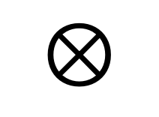

Direct conversion receivers
Mixer
$V\left(t\right)=\cos\left(ω_{1}t\right)\cos\left(ω_{2}t\right)= \frac{1}{2}[\cos\left(\left(ω_{1}+ω_{2}\right)t\right)+\cos\left(\left(ω_{1}−ω_{2}\right)t\right)]$
Image frequency
$ω_{vi}=ω_{LO}+ω_{a}$
$ω_{rf}=ω_{LO}−ω_{a}$
RF filter removes image
Downside:
Not tunable
RF
Filter
$$⊗$$
RF Mixer
LO
Audio
Amp
Direct conversion
audio
RF
LO
image

Slide 4
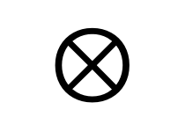
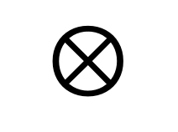
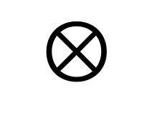
Norcal 40A
7 MHz
2W
<10 MHz
Harmonic
Filter
RF
Filter
Power
Amp
7 MHz
$$⊗$$
RF Mixer
20 mW
4.9 MHz, 9.1 MHz
Driver
IF Filter
300 uW
VFO
2.1 MHz
4.9 MHz
Product
Detector
Buffer
$$⊗$$
BFO
4.9 MHz
10 uW
Transmit
Filter
9.8 MHz, Audio
AGC
7 MHz
2.8 MHz
$$⊗$$
Transmit
Mixer
AGC
Detector
Audio
Amp
Key
Transmit oscillator
4.9 MHz

Slide 5
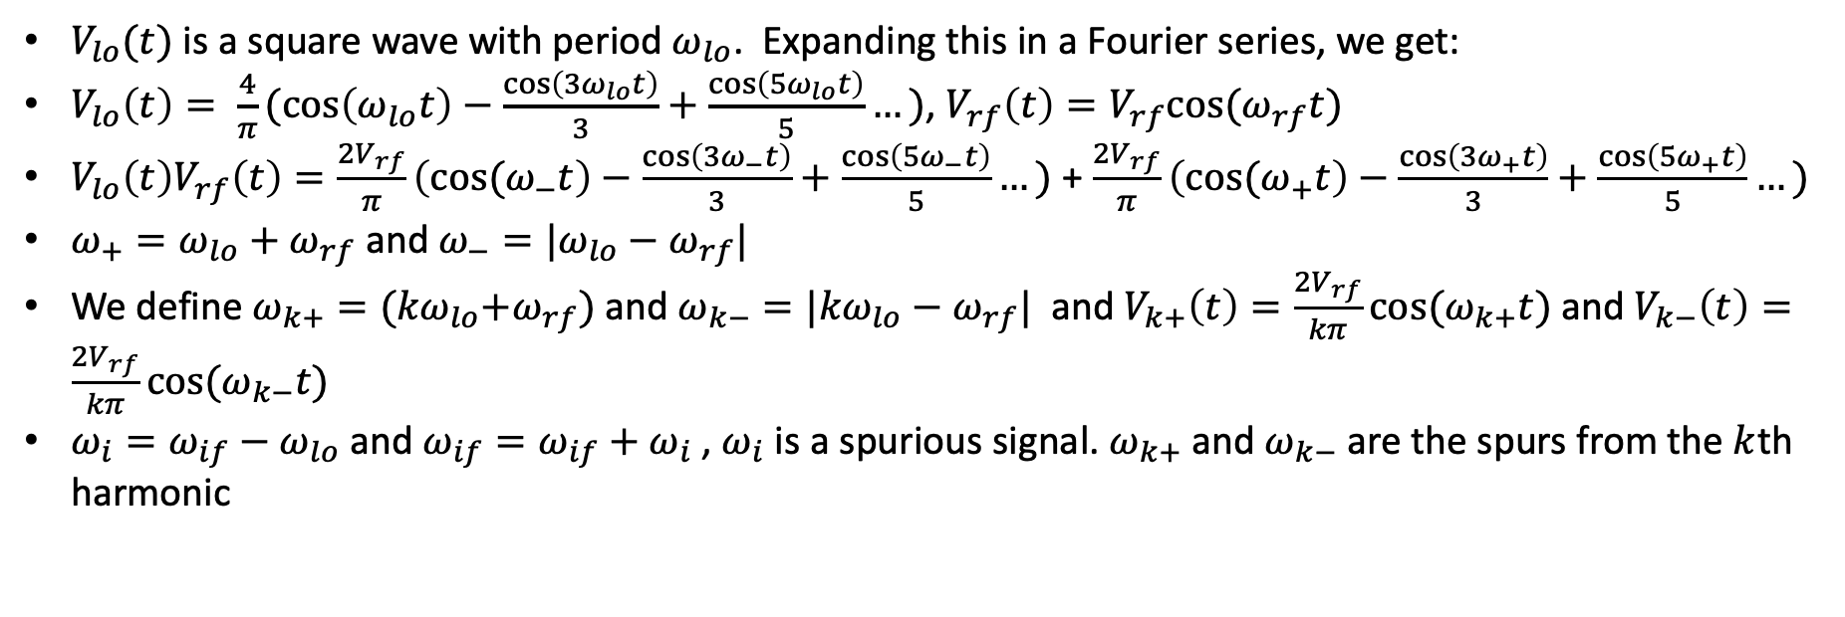


Mixers
$V_{lo}(t)$ is a square wave with period $ω_{lo}$. Expanding this in a Fourier series, we get:
$V_{lo}\left(t\right)= \frac{4}{π}(\cos\left(ω_{lo}t\right)−\frac{\cos\left(3ω_{lo}t\right)}{3}+\frac{\cos\left(5ω_{lo}t\right)}{5}…)$, $V_{rf}\left(t\right)=V_{rf}cos⁡(ω_{rf}t)$
$V_{lo}\left(t\right)V_{rf}\left(t\right)=\frac{2V_{rf}}{π}\left({cos⁡(ω}_{−}t\right)−\frac{\cos\left(3ω_{−}t\right)}{3}+\frac{\cos\left(5ω_{−}t\right)}{5}…)$ + $\frac{2V_{rf}}{π}\left({cos⁡(ω}_{+}t\right)−\frac{\cos\left(3ω_{+}t\right)}{3}+\frac{\cos\left(5ω_{+}t\right)}{5}…)$
$ω_{+}=ω_{lo}+ω_{rf}$ and $ω_{−}=|ω_{lo}−ω_{rf}|$
We define $ω_{k+}={(kω}_{lo}+ω_{rf})$ and $ω_{k−}=|{kω}_{lo}−ω_{rf}|$ and $V_{k+}\left(t\right)=\frac{2V_{rf}}{kπ}cos⁡(ω_{k+}t)$ and $V_{k−}\left(t\right)=\frac{2V_{rf}}{kπ}cos⁡(ω_{k−}t)$
$ω_{i}=ω_{if}−ω_{lo}$ and $ω_{if}=ω_{if}+ω_{i}$ , $ω_{i}$ is a spurious signal. $ω_{k+}$ and $ω_{k−}$ are the spurs from the $k$th harmonic
LO
Image
IF
RF
$$3↑$$
$$5↑$$

Slide 6
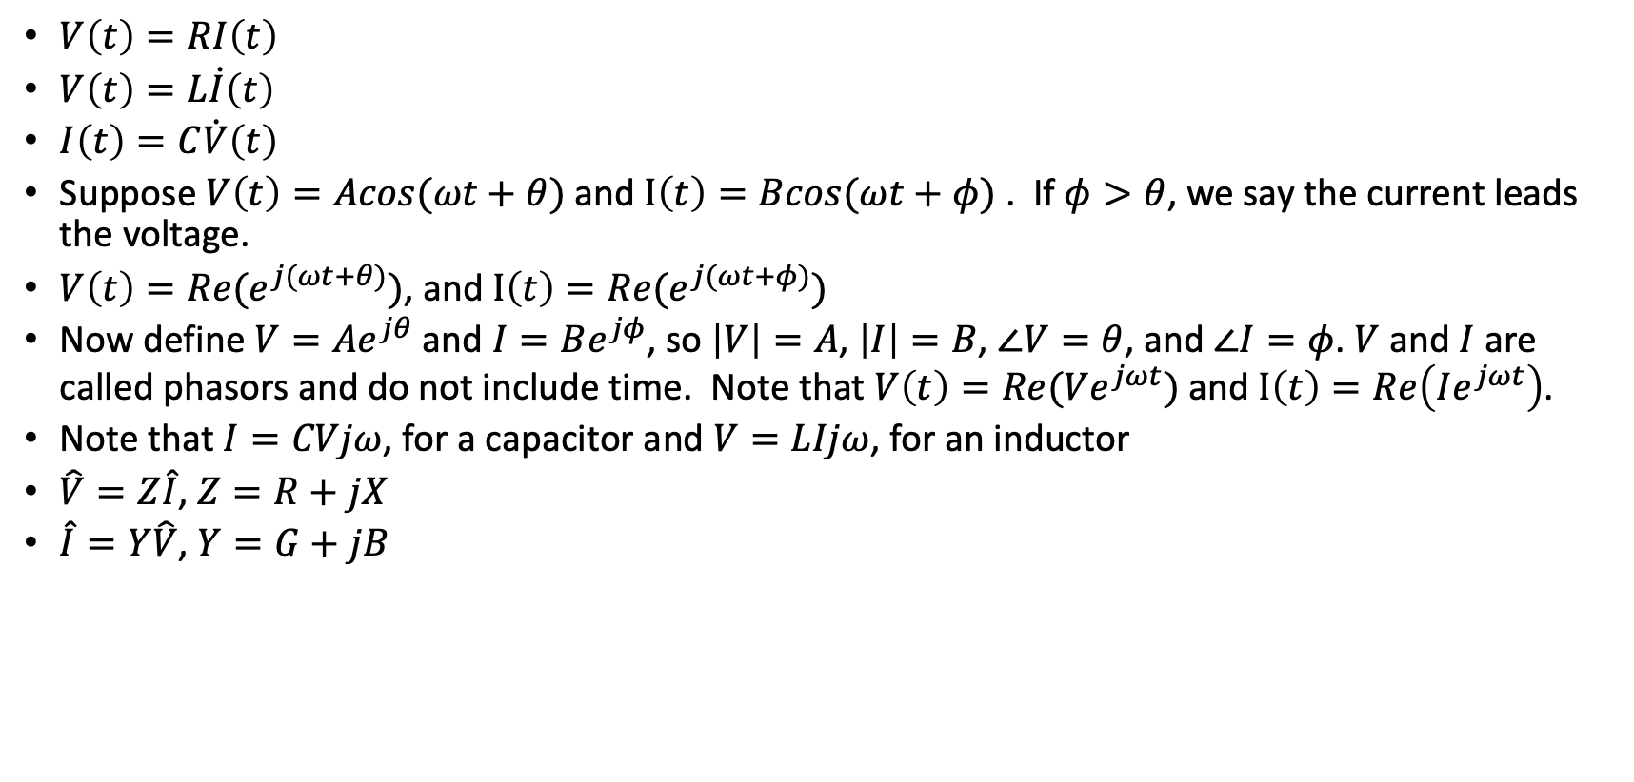
Phasors
$V\left(t\right)=RI\left(t\right)$
$V\left(t\right)=L\dot{I}\left(t\right)$
$I\left(t\right)=C\dot{V}\left(t\right)$
Suppose $V\left(t\right)=Acos(ωt+θ)$ and $I\left(t\right)=Bcos(ωt+φ)$ . If $φ>θ$, we say the current leads the voltage.
$V\left(t\right)=Re(e^{j(ωt+θ)})$, and $I\left(t\right)=Re(e^{j(ωt+φ)})$
Now define $V=Ae^{jθ}$ and $I=Be^{jφ}$, so $\left|V\right|=A$, $\left|I\right|=B$, $∠V=θ$, and $∠I=φ$. $V$ and $I$ are called phasors and do not include time. Note that $V\left(t\right)=Re(Ve^{jωt})$ and $I\left(t\right)=Re\left(Ie^{jωt}\right)$.
Note that $I=CVjω$, for a capacitor and $V=LIjω$, for an inductor
$\hat{V}=Z\hat{I}$, $Z=R+jX$
$\hat{I}=Y\hat{V}$, $Y=G+jB$

Slide 7

Series resonance and Q
At $ω_{u}$ and $ω_{l}$, $X=±R$ [$ω_{u}$ is upper 3dB cutoff and $ω_{l}$ is lower 3dB cutoff]
$ω_{u}L−\frac{1}{ω_{u}C}=R$, $ω_{l}L−\frac{1}{ω_{l}C}=−R$
Define $Q=\frac{X}{R}$
$\frac{ω_{u}}{ω_{0}}−\frac{ω_{0}}{ω_{u}}=\frac{R}{ω_{0}L}= \frac{1}{Q}$ and $\frac{ω_{l}}{ω_{0}}−\frac{ω_{0}}{ω_{l}}=−\frac{R}{ω_{0}L}$ $=−\frac{1}{Q}$
$\frac{ω_{u}}{ω_{0}}−\frac{ω_{0}}{ω_{u}}=\frac{ω_{0}}{ω_{l}}−\frac{ω_{l}}{ω_{0}}$, so ${ω_{0}}^{2}=ω_{u}ω_{l}$ and $\frac{ω_{u}−ω_{l}}{ω_{0}}=\frac{1}{Q}$

Slide 8

Parallel resonance and Q
$\frac{ω_{u}}{ω_{0}}−\frac{ω_{0}}{ω_{u}}=\frac{G}{ω_{0}C}= \frac{1}{Q_{p}} \text{and} \frac{ω_{l}}{ω_{0}}−\frac{ω_{0}}{ω_{l}}=−\frac{G}{ω_{0}C} =−\frac{1}{Q_{p}}$

Slide 9

Power
$P\left(t\right)=I\left(t\right)V\left(t\right)$
Complex power: $P=\frac{V\overline{I}}{2}=Z\frac{{|I|}^{2}}{2}= P_{a}+jP_{r}=R\frac{{|I|}^{2}}{2}+jX\frac{{|I|}^{2}}{2}$
$P_{a}$ is power delivered to resistor, $P_{r}$ is power stored in inductor and capacitor
$P_{r}=\frac{ωL{|I|}^{2}}{2}−\frac{ωC{\left|V_{c}\right|}^{2}}{2}= ω(E_{L}−E_{C})$
$Q= ω\frac{L{|I|}^{2}}{R{|I|}^{2}}=ω\frac{L}{R}= ω\frac{E_{L}}{P_{a}}$

Slide 10

General formulas for Q
$x$

Slide 11
Exercises
Calculate wave form through bridge and after “smoothing capacitor”

Slide 12

Misc-1
$\frac{V}{V_{i}}=\frac{C_{1}}{C_{1}+C_{2}}$
$I=\frac{V}{R}=−CV^{′}$, $τ=RC$,
$\frac{L}{R}{I_{R}}^{′}+I_{R}=0$
$i_{s}=i_{r}+i_{L}$
C₁
V_{i}
C₂
V
i
C
R
V
i_{s}
i_{L}
L
i_{R}
R

Slide 13
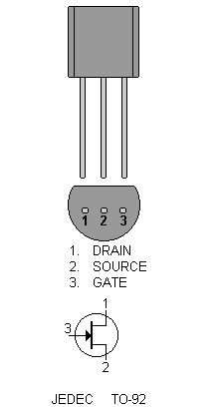
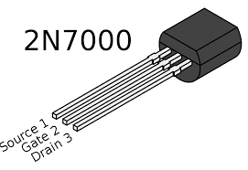
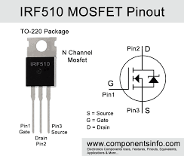
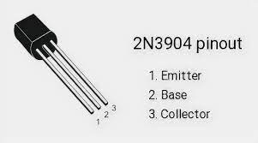
Pinouts
J309

Slide 14
Blank

