Slide 1
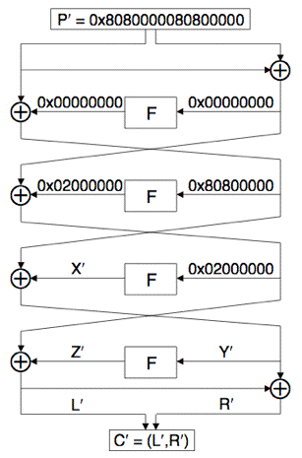
FEAL-4 Basic Differential Attack
If A₀⨁A₁ = 0 then F(A₀) = F(A₁), p=1.
If A₀⨁A₁= 0x80800000 then F(A₀)⨁F(A₁)= 0x02000000, p=1
Choose (P₀, P₁):
P₀⨁P₁=0x8080000080800000
P’= P₀⨁P₁, C’=C₀⨁C₁
L’=0x02000000⨁Z’, Y’=0x80800000 ⨁ X’
For C= (L,R) we have Y = L⨁R
Solve for sub-key K₃: Z’= 0x02000000⨁L’
Compute Y₀= L₀⨁R₀, Y₁= L₁⨁R₁
Guess K₃ and compute guessed Z₀, Z₁
Note: Z_{i}= F(Y_{i}⨁K₃)
Compare true Z’ to guessed Z’
R’
S’
T’

