Slide 1
Quantum Computing
Introduction
John Manferdelli
JohnManferdelli@hotmail.com
© 2021-2023, John L. Manferdelli.
This material is provided without warranty of any kind including, without limitation, warranty of non-infringement or suitability for any purpose. This material is not guaranteed to be error free and is intended for instructional use only.

Slide 2
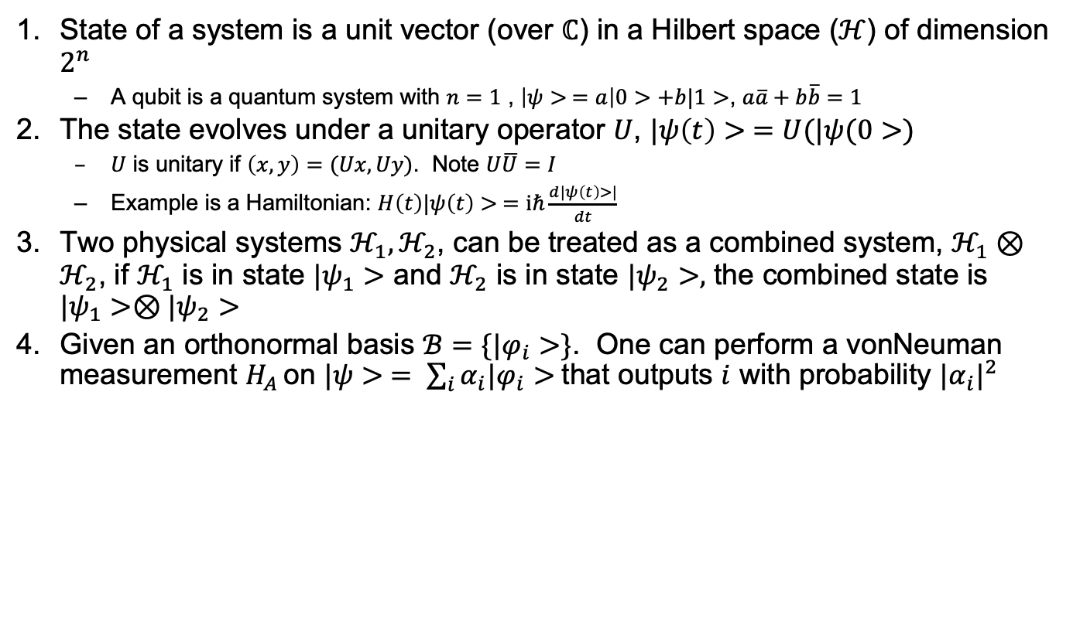
Postulates
State of a system is a unit vector (over $ℂ$) in a Hilbert space ($ℋ$) of dimension $2^{n}$
A qubit is a quantum system with $n=1$ , $\left|ψ> =a\right|0>+b|1>$, $a\overline{a}+b\overline{b}=1$
The state evolves under a unitary operator $U$, $|ψ\left(t\right)> =U(|ψ(0>)$
$U$ is unitary if $\left(x,y\right)=(Ux, Uy)$. Note $U\overline{U}=I$
Example is a Hamiltonian: $H\left(t\right)|ψ\left(t\right)> =iℏ\frac{d|ψ\left(t\right)>|}{dt}$
Two physical systems $ℋ_{1}, ℋ_{2}$, can be treated as a combined system, $ℋ_{1}⊗ℋ_{2}$, if $ℋ_{1}$ is in state $|ψ_{1}>$ and $ℋ_{2}$ is in state $|ψ_{2}>,$ the combined state is $|ψ_{1}>⊗|ψ_{2}>$
Given an orthonormal basis $ℬ=\{|φ_{i}>\}$. One can perform a vonNeuman measurement $H_{A }$on $|ψ> = \sum_{i}{α_{i}|φ_{i}>}$that outputs $i$ with probability ${|α_{i}|}^{2}$

Slide 3
Superposition and entanglement
x

Slide 4
Definitions
Inner product
Outer product

Slide 5

Stuff
Spectral Theorem
Theorem: If $U$ is a 1-qubit gate, $U=e^{ix}R_{z}(β)R_{y}(γ)R_{z}(δ)$

Slide 6
Mixed States
Spectral Theorem
Theorem: If $U$ is a 1-qubit gate, $U=e^{ix}R_{z}(β)R_{y}(γ)R_{z}(δ)$

Slide 7

No Cloning Theorem
Qubits can’t be copied
Proof
$U |ψ>|0> =|ψ$>| $ψ$> and $U |φ>|0> =|φ$>|$φ$> . Then $Ua\left|ψ>+b\right|φ> =a\left|φ>|φ>+b\right|ψ>|ψ>$ and $U\left(a\left|φ>+b\right|ψ>\right)(a|φ>+b|ψ\text{>)}$, a contradiction.
No checkpointing

Slide 8

Bell Basis
${|β}_{00}> = \frac{1}{\sqrt{2}}(|00> + |11>)$, ${|β}_{01}> = \frac{1}{\sqrt{2}}(|01> + |10>)$
${|β}_{10}> = \frac{1}{\sqrt{2}}(|00>− |11>)$, ${|β}_{11}> = \frac{1}{\sqrt{2}}(|01> − |10>)$
Measuring in Bell Basis

Slide 9
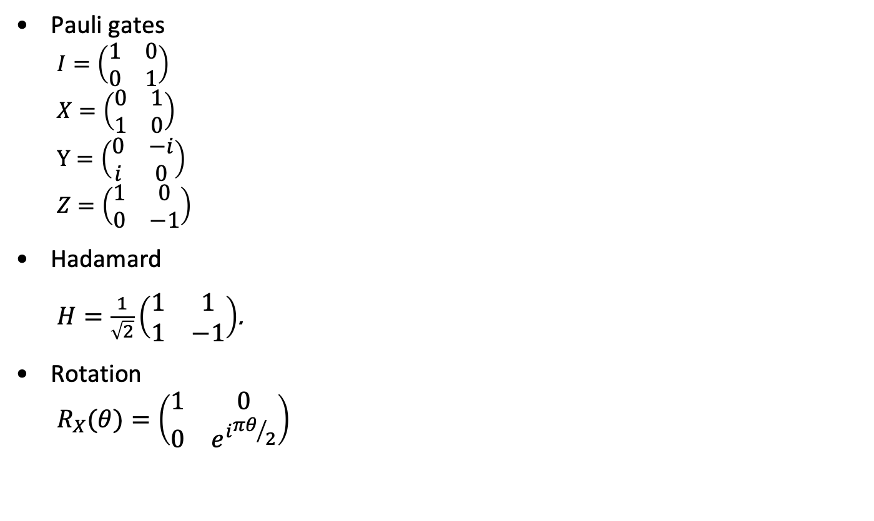
Circuits and gates
Pauli gates
$$I=\left(\begin{matrix}1 & 0 \\ 0 & 1\end{matrix}\right)$$
$$X=\left(\begin{matrix}0 & 1 \\ 1 & 0\end{matrix}\right)$$
$$Y=\left(\begin{matrix}0 & −i \\ i & 0\end{matrix}\right)$$
$$Z=\left(\begin{matrix}1 & 0 \\ 0 & −1\end{matrix}\right)$$
Hadamard
$H=\frac{1}{\sqrt{2}}\left(\begin{matrix}1 & 1 \\ 1 & −1\end{matrix}\right)$.
Rotation
$$R_{X}(θ)=\left(\begin{matrix}1 & 0 \\ 0 & e^{i{πθ}/2}\end{matrix}\right)$$

Slide 10
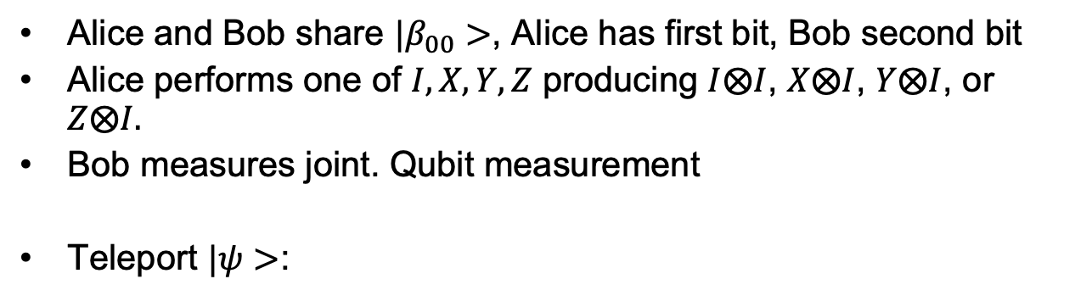



Superdense coding
Alice and Bob share ${|β}_{00}>$, Alice has first bit, Bob second bit
Alice performs one of $I, X,Y,Z$ producing $I⨂I$, $X⨂I$, $Y⨂I$, or $Z⨂I.$
Bob measures joint. Qubit measurement
Teleport $|ψ>$:
$$|ψ>$$
b
a
$$|β_{00}>$$
$$|ψ>$$
X
Z

Slide 11
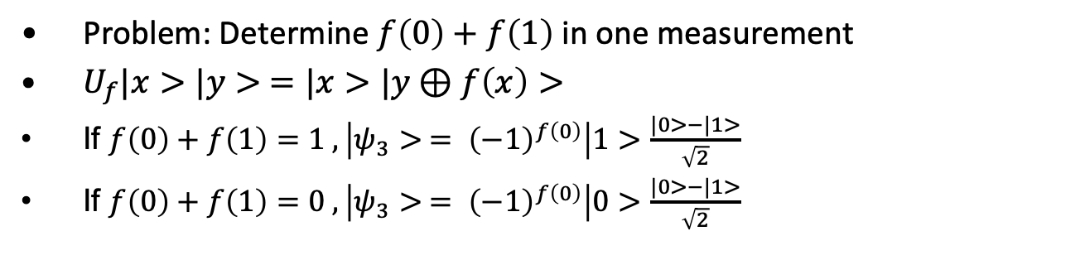
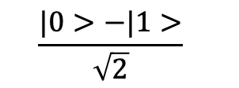

Deutch
Problem: Determine $f\left(0\right)+f\left(1\right)$ in one measurement
$U_{f}|x>|y> =|x>|y⊕f\left(x\right)>$
If $f\left(0\right)+f\left(1\right)=1 , \left|ψ_{3}> = {\left(−1\right)}^{f\left(0\right)}\right|1>$ $\frac{|0>−|1>}{\sqrt{2}}$
If $f\left(0\right)+f\left(1\right)=0 , \left|ψ_{3}> = {\left(−1\right)}^{f\left(0\right)}\right|0>$ $\frac{|0>−|1>}{\sqrt{2}}$
$$|0>$$
H
U_{f}
H
$$\frac{|0>−|1>}{\sqrt{2}}$$

Slide 12
Deutch-Josza
Problem: Determine $f\left(0\right)+f\left(1\right)$ in one measurement
$U_{f}|x>|y> =|x>|y⊕f\left(x\right)>$
If $f\left(0\right)+f\left(1\right)=1 , \left|ψ_{3}> = {\left(−1\right)}^{f\left(0\right)}\right|1>$ $\frac{|0>−|1>}{\sqrt{2}}$
If $f\left(0\right)+f\left(1\right)=0 , \left|ψ_{3}> = {\left(−1\right)}^{f\left(0\right)}\right|0>$ $\frac{|0>−|1>}{\sqrt{2}}$
$$|0>$$
H
U_{f}
H
$$\frac{|0>−|1>}{\sqrt{2}}$$

Slide 13

Simon
$f: {\{0,1\}}^{n}→X$

Slide 14
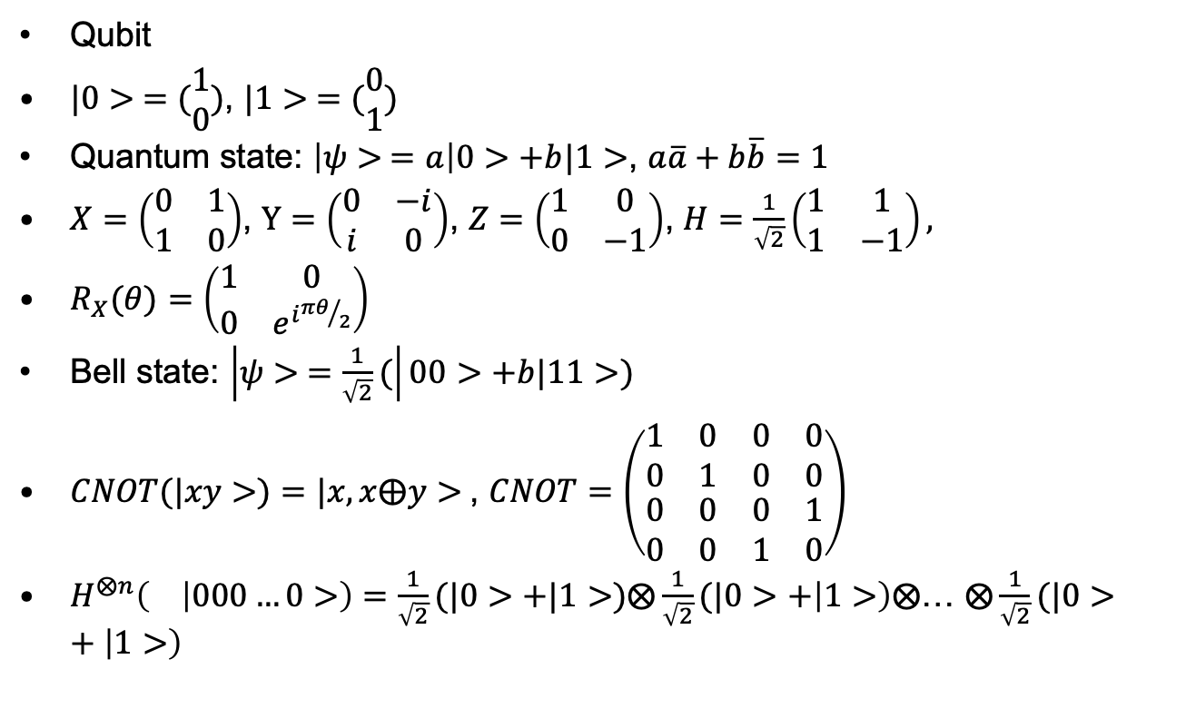
Notation and postulates
Qubit
$|0> =(\begin{matrix}1 \\ 0\end{matrix})$, $|1> =(\begin{matrix}0 \\ 1\end{matrix})$
Quantum state: $\left|ψ> =a\right|0>+b|1>$, $a\overline{a}+b\overline{b}=1$
$X=\left(\begin{matrix}0 & 1 \\ 1 & 0\end{matrix}\right)$, $Y=\left(\begin{matrix}0 & −i \\ i & 0\end{matrix}\right)$, $Z=\left(\begin{matrix}1 & 0 \\ 0 & −1\end{matrix}\right)$, $H=\frac{1}{\sqrt{2}}\left(\begin{matrix}1 & 1 \\ 1 & −1\end{matrix}\right),$
$R_{X}(θ)=\left(\begin{matrix}1 & 0 \\ 0 & e^{i{πθ}/2}\end{matrix}\right)$
Bell state: $\left|ψ> =\frac{1}{\sqrt{2}}(\right|00>+b|11>)$
$CNOT(|xy>)=|x, x⨁y>$, $CNOT=\left(\begin{matrix}\begin{matrix}1 & 0 \\ 0 & 1\end{matrix} & \begin{matrix}0 & 0 \\ 0 & 0\end{matrix} \\ \begin{matrix}0 & 0 \\ 0 & 0\end{matrix} & \begin{matrix}0 & 1 \\ 1 & 0\end{matrix}\end{matrix}\right)$
$H^{⨂n}\left( | 000…0>\right)=\frac{1}{\sqrt{2}}(|0>+|1>)⨂\frac{1}{\sqrt{2}}(|0>+\left|1>\right)⨂$… $⨂\frac{1}{\sqrt{2}}(|0>+\left|1>\right)$

Slide 15
Phase
x

Slide 16
Quantum Fourier Transform
x

Slide 17
Shor
x

Slide 18
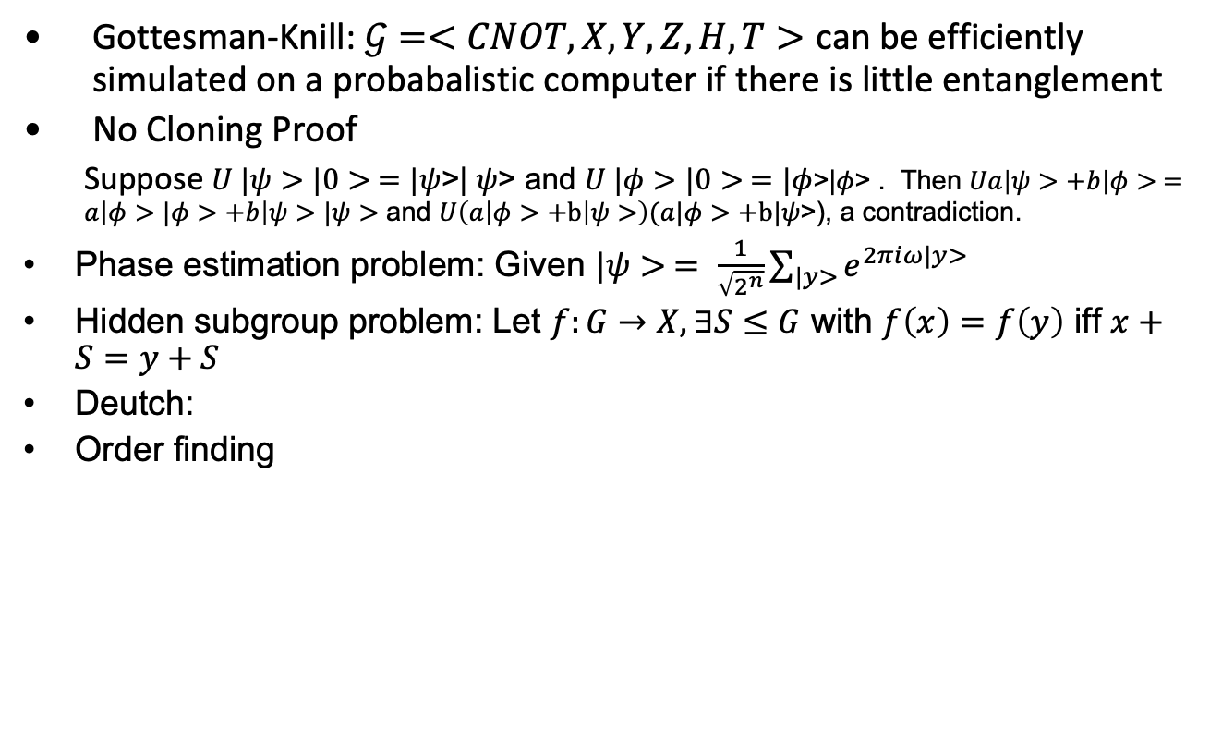
1
Gottesman-Knill: $𝒢=<CNOT, X, Y,Z,H, T>$ can be efficiently simulated on a probabalistic computer if there is little entanglement
No Cloning Proof
Suppose $U |ψ>|0> =|ψ$>| $ψ$> and $U |φ>|0> =|φ$>|$φ$> . Then $Ua\left|ψ>+b\right|φ> =a\left|φ>|φ>+b\right|ψ>|ψ>$ and $U\left(a\left|φ>+b\right|ψ>\right)(a|φ>+b|ψ\text{>)}$, a contradiction.
Phase estimation problem: Given $|ψ> = \frac{1}{\sqrt{2^{n}}}\sum_{|y>}{e^{2πiω|y>}}$
Hidden subgroup problem: Let $f:G→X, ∃S≤G$ with $f\left(x\right)=f\left(y\right)$ iff $x+S=y+S$
Deutch:
Order finding

