Slide 1
Cryptanalysis
Protocols and Random Numbers
John Manferdelli
JohnManferdelli@hotmail.com
© 2004-2025, John L. Manferdelli.
This material is provided without warranty of any kind including, without limitation, warranty of non-infringement or suitability for any purpose. This material is not guaranteed to be error free and is intended for instructional use only.

Slide 2
Random Numbers
Critical in Cryptographic Algorithms
No single test
Unpredictability
Statistical Tests
Random Number weaknesses and Key management are greatest points of attack for otherwise “safe” cryptosystem.
Can’t generate enough Random bits so use Pseudo Random Number Generators
Reference
J. Kelsey, B. Schneier, D. Wagner, and C. Hall, “Cryptanalytic Attacks on Pseudorandom Number Generators”, Fast Software Encryption, Fifth International Workshop Proceedings (March 1998), Springer-Verlag, 1998, pp. 168-188.

Slide 3
Random Numbers
Requirements
Attacks
Entropy
Mixing
PRNG
800-90

Slide 4
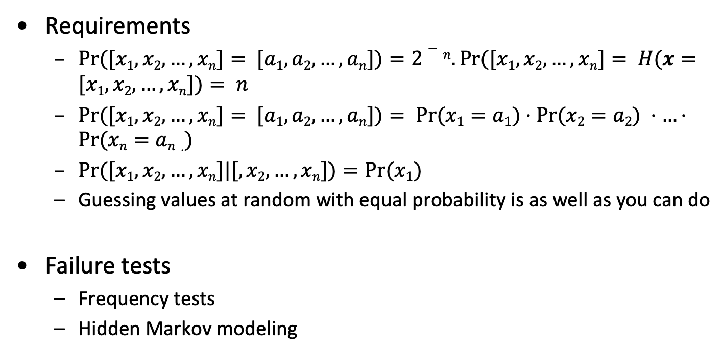
Cryptographic Random Numbers
Requirements
$Pr⁡([x1,x2,…,xn]= [a1,a2,…,an])=2−n. Pr⁡([x1,x2,…,xn]= H(x=[x1,x2,…,xn])= n$
$Pr⁡([x1,x2,…,xn]= [a1,a2,…,an])= Pr⁡(x1=a1)⋅Pr⁡(x2=a2) ⋅…⋅Pr⁡(xn=an⋅)$
$Pr⁡([x1,x2,…,xn]|[,x2,…,xn])=Pr⁡(x1)$
Guessing values at random with equal probability is as well as you can do
Failure tests
Frequency tests
Hidden Markov modeling

Slide 5
Remember: H for the key distributions
Distribution A: H(X)= ¼ lg(4) + ¼ lg(4) + ¼ lg(4) +1/4 lg(4) = 2 bits
Distribution B: H(X)= 16x(1/16) lg(16)= 4 bits
Distribution C: H(X)= 2^{n}x(1/2^{n}) lg(2^{n}) = n bits
Expected time for key search is ~ 2^{n}.
Distribution A’: H(X) = ½ lg(2) + 3 x(1/6 lg(6))= 1.79 bits
Distribution B’: H(X) = ½ lg(2) + 15 x(1/30 lg(30))= 2.95 bits
Distribution C’: H(X) = ½ lg(2) + ½(2^{n}-1)x(1/(2^{n}-1) lg(2^{n}-1))= n/2+1 bits
Expected time for key search is ~ 2^{n/2}+1.

Slide 6
Sources of Entropy
Coin Tosses
Radioactive decay
Typing Speed
Thermal noise
Ring Oscillator
Lava Lamps
Noisy diode
Disk arm speed variation
Process id, thread id
Drift between clock and timer interrupts
Ticks since boot
Memory stats
Disk Free
Cursor
Counters
Execution time (Jitter)

Slide 7
Some entropy source calculations
Fair coin toss:
Each coin toss adds 1 bit of entropy
Biased (but independent) coin tosses
Pr(x=1)= 1/4, Pr(x=0)= 3/4.
Entropy: -1/4 lg(1/4)-3/4 lg(3/4)= 1/2 + 1/4 lg(3) ≈ .85 bit
If John wears red shoes, x_{i}=1 otherwise x_{i}=0. x_{i+1}=x_{i}⊕1
Even if John wears red shoes randomly with p=1/2, every 2n bits only have n bits of entropy.
Calculate entropy with a different “wear red shoes” distribution”

Slide 8
Pseudo random number generation
Entropy
Mixer
State
Pseudo random
stream
Smooth and stretch entropy
Must first estimate entropy input and maintain sufficient entropy
Idea is to generate n bit key state should maintain n bits of entropy

Slide 9
Pseudo-Random Generators (PRNGs)
“Anyone discussing deterministic generation of random number is, strictly speaking, already in a state of sin” – von Neuman.
Output of pseudo-random number generators must produce output that looks random
Start with a fixed state S and collect inputs with high entropy
Generators can be built using
Block ciphers
Hash functions
Stream Cipher

Slide 10
Guidelines for PRNG
Base the PRNG on something strong.
Make sure the whole PRNG state changes over time..
Do “catastrophic reseeding” of the PRNG.
Resist backtracking.
Resist Chosen-Input Attacks.
Recover from Compromises Quickly
Use a hash function to protect vulnerable PRNG outputs and entropy mixing.
Hash PRNG inputs with a counter or timestamp before use.
Occasionally generate a new starting PRNG state.

Slide 11
RNG Attacks
Direct Cryptanalytic attack
Entropy Input Guessing
Input-based attack
Known input
Replayed input
Chosen input
State compromise extension attacks
Backtracking attacks (forward immunity)
Permanent compromise attacks (backward immunity)
Iterative guessing attacks
Meet-in-the-middle attacks
Oversampling

Slide 12
Popular PRNGs
FIPS 186
t, c 160 bits
H= t₁ || t₂ || … || t₅
Pad c with 0s to get 512 bit giving M
Apply SHA-1 step
ANSI 9.17
I= E_{k}(D). D= timestamp.
x_{i}= E_{k}(I ⨁ s), s= State
s= E_{k}(x_{i} ⨁ s)
Current NIST 800-90
HASH-256
CTR-AES-256
Dual Elliptic Curve

Slide 13
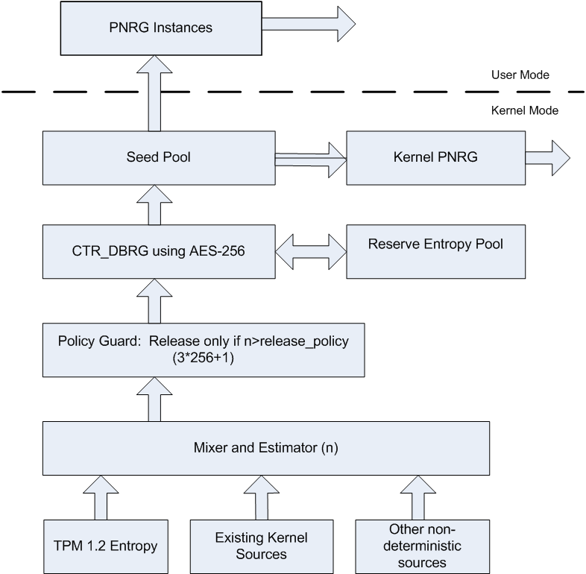
Sample 800-90 RNG System

Slide 14
HASH-256
Initiate
seed_material = entropy_input || nonce || personalization_string.
seed = Hash_df (seed_material, seedlen).
V = seed.
C = Hash_df ((0x00 || V), seedlen).
reseed_counter = 1.
Return V, C, and reseed_counter as initial_working_state.

Slide 15
HASH-256
Generate
If reseed_counter > reseed_interval, then return reseed required.
If (additional_input != Null), then do
w = Hash (0x02 || V || additional_input).
V = (V+w) mod 2^{seedlen}.
(returned_bits) = Hashgen (requested_number_of_bits, V).
H = Hash(0x03 || V).
V = (V+H+C+reseed_counter) mod 2^{seedlen}.
reseed_counter= reseed_counter+1.
Return SUCCESS, returned_bits, and the new values of V, C, and reseed_counter for the new_working_state.

Slide 16
HASH-256
Hash_df
temp = the Null string.
len =no_of _bits_to_return/outlen
counter = 8-bit binary value representing 1.
for i = 1 to len do
temp= temp||Hash(counter||no_of_bits_to_return||input_string).
counter= counter+1.
requested_bits= Leftmost (no_of_bits_to_return) of temp.
Return SUCCESS and requested_bits.

Slide 17
HASH-256
Hashgen
m =requested_no_of _bits/outlen
data = V.
W = the Null string.
For i = 1 to m
w_{i} = Hash (data).
W = W || w_{i}.
data = (data + 1) mod 2^{seedlen}.
returned_bits = Leftmost (requested_no_of_bits) bits of W.
Return returned_bits.

Slide 18
CTR-AES-256
Initiate
temp= len (personalization_string).
If (temp<seedlen), then
personalization_string= personalization_string ||0^{seedlen – temp}.
seed_material = entropy_input⊕personalization_string
Key = 0^{keylen}.
V = 0^{outlen}.
(Key, V)= CTR_DRBG_Update(seed_material, Key, V).
reseed_counter= 1.
Return V, Key, and reseed_counter as the initial_working_state.

Slide 19
CTR-AES-256
Generate
If reseed_counter > reseed_interval, then return reseed required.
If (additional_input ≠ Null), then
temp = len (additional_input).
If (temp<seedlen) then additional_input= additional_input||0^{seedlen - temp}.
(Key, V) = CTR_DRBG_Update (additional_input, Key, V).
temp= Null.
While (len (temp) < requested_number_of_bits)
V = (V+1) mod 2^{outlen}.
output_block = Block_Encrypt(Key, V).
temp = temp || output_block.
returned_bits = Leftmost requested_number_of_bits of temp.
(Key, V) = CTR_DRBG_Update(additional_input, Key, V).
reseed_counter = reseed_counter + 1.
Return SUCCESS and returned_bits; also return Key, V, and reseed_counteras the new_working_state.

Slide 20
CTR-AES-256
Update
temp = Null.
While(len (temp)<seedlen)
V = (V+1) mod 2^{outlen}.
output_block = Block_Encrypt(Key, V).
temp = temp || ouput_block.
temp = Leftmost seedlen bits of temp.
temp = temp⊕provided_data.
Key = Leftmost keylen bits of temp.
V = Rightmost outlen bits of temp.
Return the new values of Key and V.

Slide 21
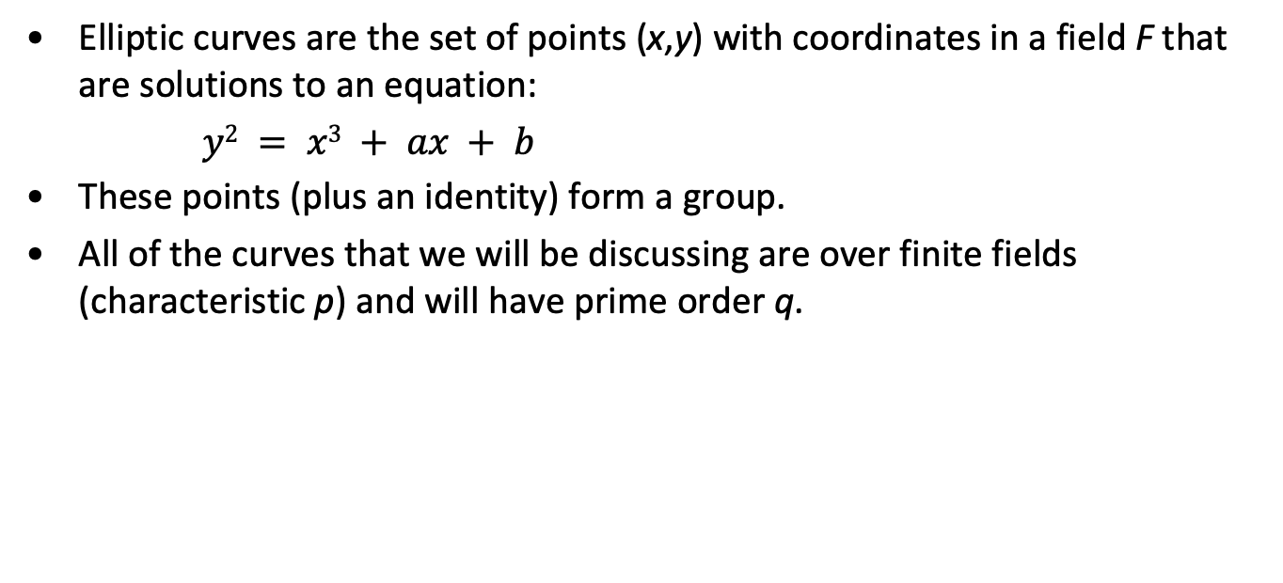
Preliminaries: Elliptic Curves
Elliptic curves are the set of points (x,y) with coordinates in a field F that are solutions to an equation:
$y2 = x3 + ax + b$
These points (plus an identity) form a group.
All of the curves that we will be discussing are over finite fields (characteristic p) and will have prime order q.

Slide 22
The Dual EC PRNG
φ : prime curve → integers φ (x,y) = x
P, Q points on the curve (per SP800-90)
φ(r_{i}*P)
s_{i+1}
s_{i}
r_{i}
φ(r_{i}*Q)
t_{i}
LSB_{bitlen-16}(t_{i})
Equations:
r_{i} = φ(s_{i}*P) t_{i} = φ(r_{i}*Q) s_{i+1} = φ(r_{i}*P)

Slide 23
Protocols
Unless otherwise noted, remaining slides
courtesy of Mark Stamp, SJSU
See: Information Security: Principles and Practice,
Mark Stamp

Slide 24
Protocol
Human protocols ⎯ the rules followed in human interactions
Example: Asking a question in class
Networking protocols ⎯ rules followed in networked communication systems
Examples: HTTP, FTP, etc.
Security protocol ⎯ the (communication) rules followed in a security application
Examples: SSL, IPSec, Kerberos, etc.

Slide 25
Protocols
Protocol flaws can be very subtle
Several well-known security protocols have serious flaws
Including IPSec, GSM and WEP
Common to find implementation errors
Such as IE implementation of SSL
Difficult to get protocols right…

Slide 26
Ideal Security Protocol
Satisfies security requirements
Requirements must be precise
Efficient
Minimize computational requirement ⎯ in particular, costly public key operations
Minimize delays/bandwidth
Not fragile
Must work when attacker tries to break it
Works even if environment changes
Easy to use and implement, flexible, etc.
Very difficult to satisfy all of these!

Slide 27
Simple Security Protocols

Slide 28
ATM Machine Protocol
Insert ATM card
Enter PIN
Correct PIN?
Yes? Conduct your transaction(s)
No? Machine eats card

Slide 29
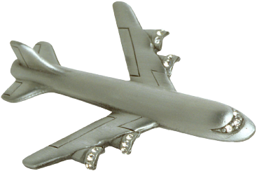


Identify Friend or Foe (IFF)
Russian
MIG
Angola
SAAF
Impala
2. E(N,K)
1. N
Namibia

Slide 30
MIG in the Middle
3. N
SAAF
Impala
4. E(N,K)
Angola
2. N
5. E(N,K)
6. E(N,K)
Russian
MiG
1. N
Namibia

Slide 31
Authentication Protocols

Slide 32
Authentication
Alice must prove her identity to Bob
Alice and Bob can be humans or computers
May also require Bob to prove he’s Bob (mutual authentication)
May also need to establish a session key
May have other requirements, such as
Use only public keys
Use only symmetric keys
Use only a hash function
Anonymity, plausible deniability, etc., etc.

Slide 33
Authentication
Authentication on a stand-alone computer is relatively simple
“Secure path” is the primary issue
Main concern is an attack on authentication software (we discuss software attacks later)
Authentication over a network is much more complex
Attacker can passively observe messages
Attacker can replay messages
Active attacks may be possible (insert, delete, change messages)

Slide 34
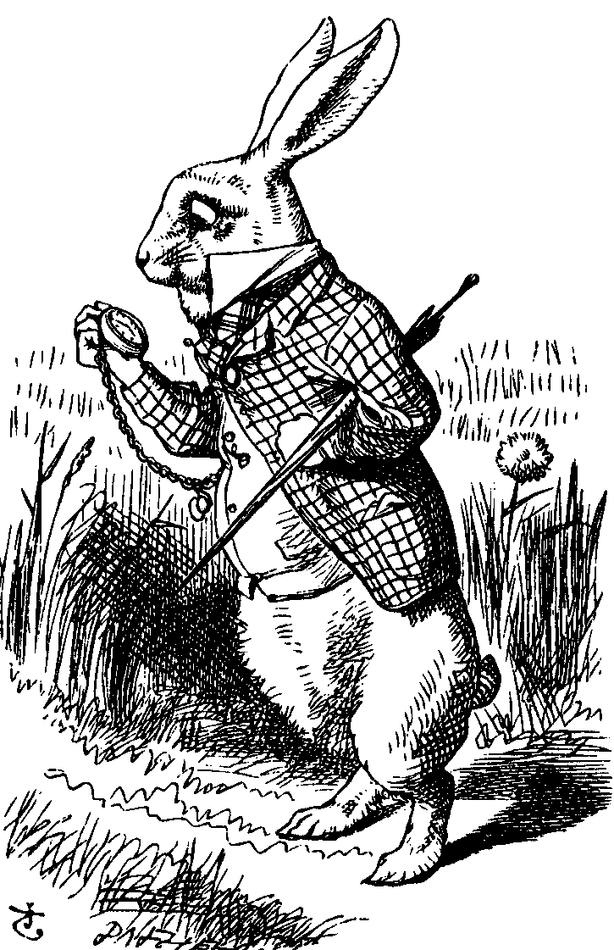
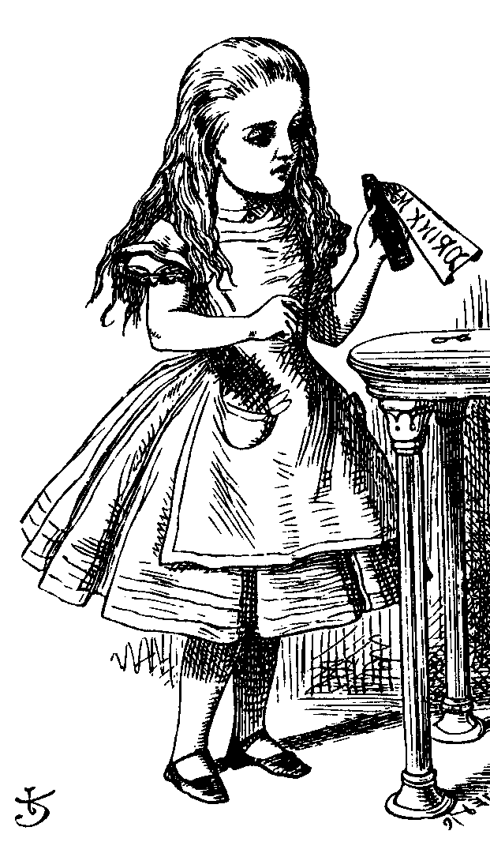
Simple Authentication
“I’m Alice”
Prove it
My password is “frank”
Alice
Bob
Simple and may be OK for standalone system
But insecure for networked system
Subject to a replay attack (next 2 slides)
Bob must know Alice’s password

Slide 35
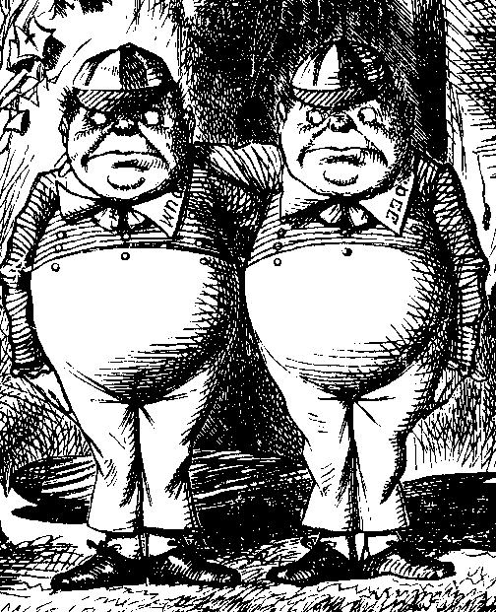
Authentication Attack
“I’m Alice”
Prove it
My password is “frank”
Alice
Bob
Trudy

Slide 36
Authentication Attack
“I’m Alice”
Prove it
My password is “frank”
Trudy
Bob
This is a replay attack
How can we prevent a replay?

Slide 37
Simple Authentication
I’m Alice, My password is “frank”
Alice
Bob
More efficient…
But same problem as previous version

Slide 38
Better Authentication
“I’m Alice”
Prove it
h(Alice’s password)
Alice
Bob
Better since it hides Alice’s password
From both Bob and attackers
But still subject to replay

Slide 39
Challenge-Response
To prevent replay, challenge-response used
Suppose Bob wants to authenticate Alice
Challenge sent from Bob to Alice
Only Alice can provide the correct response
Challenge chosen so that replay is not possible
How to accomplish this?
Password is something only Alice should know…
For freshness, a “number used once” or nonce

Slide 40
Challenge-Response
“I’m Alice”
Nonce
h(Alice’s password, Nonce)
Alice
Bob
Nonce is the challenge
The hash is the response
Nonce prevents replay, insures freshness
Password is something Alice knows
Note that Bob must know Alice’s password

Slide 41
Challenge-Response
“I’m Alice”
Nonce
Something that could only be
Alice
from Alice (and Bob can verify)
Bob
What can we use to achieve this?
Hashed passwords works, crypto might be better

Slide 42
Symmetric Key Notation
Encrypt plaintext P with key K
C = E(P,K)
Decrypt ciphertext C with key K
P = D(C,K)
Here, we are concerned with attacks on protocols, not directly on the crypto
We assume that crypto algorithm is secure

Slide 43
Symmetric Key Authentication
Alice and Bob share symmetric key K_{AB}
Key K_{AB} known only to Alice and Bob
Authenticate by proving knowledge of shared symmetric key
How to accomplish this?
Must not reveal key
Must not allow replay attack

Slide 44
Authentication with Symmetric Key
“I’m Alice”
R
E(R,K_{AB})
Alice, K_{AB}
Bob, K_{AB}
Secure method for Bob to authenticate Alice
Alice does not authenticate Bob
Can we achieve mutual authentication?

Slide 45
Mutual Authentication?
“I’m Alice”, R
E(R,K_{AB})
E(R,K_{AB})
Alice
Bob
What’s wrong with this picture?
“Alice” could be Trudy (or anybody else)!

Slide 46
Mutual Authentication
Since we have a secure one-way authentication protocol…
The obvious thing to do is to use the protocol twice
Once for Bob to authenticate Alice
Once for Alice to authenticate Bob
This has to work…

Slide 47
Mutual Authentication
“I’m Alice”, R_{A}
R_{B}, E(R_{A},K_{AB})
E(R_{B},K_{AB})
Alice
Bob
This provides mutual authentication…
…or does it? See the next slide

Slide 48
Mutual Authentication Attack
1. “I’m Alice”, R_{A}
2. R_{B}, E(R_{A},K_{AB})
5. E(R_{B},K_{AB})
Trudy
Bob
3. “I’m Alice”, R_{B}
4. R_{C}, E(R_{B},K_{AB})
Trudy
Bob

Slide 49
Mutual Authentication
Our one-way authentication protocol not secure for mutual authentication
Protocols are subtle!
The “obvious” thing may not be secure
Also, if assumptions or environment changes, protocol may not work
This is a common source of security failure
For example, Internet protocols

Slide 50
Symmetric Key Mutual Authentication
“I’m Alice”, R_{A}
R_{B}, E(“Bob”,R_{A},K_{AB})
E(“Alice”,R_{B},K_{AB})
Alice
Bob
Do these “insignificant” changes help?
Yes!

Slide 51
Public Key Notation
Encrypt M with Alice’s public key: {M}_{Alice}
Sign M with Alice’s private key: [M]_{Alice}
Then
[{M}_{Alice} ]_{Alice} = M
{[M]_{Alice} }_{Alice} = M
Anybody can do public key operations
Only Alice can use her private key (sign)

Slide 52
Public Key Authentication
“I’m Alice”
{R}_{Alice}
R
Alice
Bob
Is this secure?
Trudy can get Alice to decrypt anything!
Must have two key pairs

Slide 53
Public Key Authentication
“I’m Alice”
R
[R]_{Alice}
Alice
Bob
Is this secure?
Trudy can get Alice to sign anything!
Must have two key pairs

Slide 54
Public Keys
Never use the same key pair for encryption and signing
One key pair for encryption/decryption
A different key pair for signing/verifying signatures

Slide 55
Session Key
Usually, a session key is required
Symmetric key for a particular session
Can we authenticate and establish a shared symmetric key?
Key can be used for confidentiality
Key can be used for integrity
In some cases, we may also require perfect forward secrecy (PFS)
Discussed later…

Slide 56
Authentication & Session Key
“I’m Alice”, R
{R,K}_{Alice}
{R +1,K}_{Bob}
Alice
Bob
Is this secure?
OK for key, but no mutual authentication
Note that K is acting as Bob’s nonce

Slide 57
Public Key Authentication and Session Key
“I’m Alice”, R
[R,K]_{Bob}
[R +1,K]_{Alice}
Alice
Bob
Is this secure?
Mutual authentication but key is not secret!

Slide 58
Public Key Authentication and Session Key
“I’m Alice”, R
{[R,K]_{Bob}}_{Alice}
{[R +1,K]_{Alice}}_{Bob}
Alice
Bob
Is this secure?
Seems to be OK
Mutual authentication and session key!

Slide 59
Public Key Authentication and Session Key
“I’m Alice”, R
[{R,K}_{Alice}]_{Bob}
[{R +1,K}_{Bob}]_{Alice}
Alice
Bob
Is this secure?
Seems to be OK
Anyone can see {R,K}_{Alice} and {R +1,K}_{Bob}

Slide 60
Perfect Forward Secrecy
The concern…
Alice encrypts message with shared key K_{AB} and sends ciphertext to Bob
Trudy records ciphertext and later attacks Alice’s (or Bob’s) computer to find K_{AB}
Then Trudy decrypts recorded messages
Perfect forward secrecy (PFS): Trudy cannot later decrypt recorded ciphertext
Even if Trudy gets key K_{AB} or other secret(s)
Is PFS possible?

Slide 61
Perfect Forward Secrecy
Suppose Alice and Bob share key K_{AB}
For perfect forward secrecy, Alice and Bob cannot use K_{AB} to encrypt
Instead, they must use a session key K_{S} and forget it after it’s used
Problem: How can Alice and Bob agree on session key K_{S} and ensure PFS?

Slide 62
Naïve Session Key Protocol
E(K_{S}, K_{AB})
E(messages, K_{S})
Alice, K_{AB}
Bob, K_{AB}
Trudy could also record E(K_{S},K_{AB})
If Trudy gets K_{AB}, she gets K_{S}

Slide 63
Perfect Forward Secrecy
Can use Diffie-Hellman for PFS
Recall Diffie-Hellman: public g and p
gª mod p
g^{b} mod p
Alice, a
Bob, b
But Diffie-Hellman is subject to MiM
How to get PFS and prevent MiM?

Slide 64
Perfect Forward Secrecy
E(gª mod p, K_{AB})
E(g^{b} mod p, K_{AB})
Alice, a
Bob, b
Session key K_{S} = g^{ab} mod p
Alice forgets a, Bob forgets b
Ephemeral Diffie-Hellman
Not even Alice and Bob can later recover K_{S}
Other ways to do PFS?

Slide 65
Mutual Authentication, Session Key and PFS
“I’m Alice”, R_{A}
R_{B}, [{R_{A}, g^{b} mod p}_{Alice}]_{Bob}
[{R_{B}, gª mod p}_{Bob}]_{Alice}
Alice
Bob
Session key is K = g^{ab} mod p
Alice forgets a and Bob forgets b
If Trudy later gets Bob’s and Alice’s secrets, she cannot recover session key K

Slide 66
Timestamps
A timestamp T is the current time
Timestamps used in many security protocols (Kerberos, for example)
Timestamps reduce number of messages
Like a nonce that both sides know in advance
But, use of timestamps implies that time is a security-critical parameter
Clocks never exactly the same, so must allow for clock skew ⎯ risk of replay
How much clock skew is enough?

Slide 67
Public Key Authentication with Timestamp T
“I’m Alice”, {[T,K]_{Alice}}_{Bob}
{[T +1,K]_{Bob}}_{Alice}
Alice
Bob
Is this secure?
Seems to be OK

Slide 68
Public Key Authentication with Timestamp T
“I’m Alice”, [{T,K}_{Bob}]_{Alice}
[{T +1,K}_{Alice}]_{Bob}
Alice
Bob
Is this secure?
Trudy can use Alice’s public key to find
{T,K}_{Bob} and then…

Slide 69
Public Key Authentication with Timestamp T
“I’m Trudy”, [{T,K}_{Bob}]_{Trudy}
[{T +1,K}_{Trudy}]_{Bob}
Trudy
Bob
Trudy obtains Alice-Bob session key K
Note: Trudy must act within clock skew

Slide 70
Public Key Authentication
Sign and encrypt with nonce…
Secure
Encrypt and sign with nonce…
Secure
Sign and encrypt with timestamp…
Secure
Encrypt and sign with timestamp…
Insecure
Protocols can be subtle!

Slide 71
Public Key Authentication with Timestamp T
“I’m Alice”, [{T,K}_{Bob}]_{Alice}
[{T +1}_{Alice}]_{Bob}
Alice
Bob
Is this “encrypt and sign” secure?
Yes, seems to be
Does “sign and encrypt” also work here?

Slide 72
Kerberos
In Greek mythology, Kerberos is 3-headed dog that guards entrance to Hades
“Wouldn’t it make more sense to guard the exit?”
In security, Kerberos is an authentication system based on symmetric key crypto
Originated at MIT
Based on work by Needham and Schroeder
Relies on a trusted third party (TTP)

Slide 73
Motivation for Kerberos
Authentication using public keys
N users ⇒ N key pairs
Authentication using symmetric keys
N users requires about N² keys
Symmetric key case does not scale!
Kerberos based on symmetric keys but only requires N keys for N users
But must rely on TTP
Advantage is that no PKI is required

Slide 74
Kerberos KDC
Kerberos Key Distribution Center or KDC
Acts as a TTP
TTP must not be compromised!
KDC shares symmetric key K_{A} with Alice, key K_{B} with Bob, key K_{C} with Carol, etc.
Master key K_{KDC} known only to KDC
KDC enables authentication and session keys
Keys for confidentiality and integrity
In practice, the crypto algorithm used is DES

Slide 75
Kerberos Tickets
KDC issues a ticket containing info needed to access a network resource
KDC also issues ticket-granting tickets or TGTs that are used to obtain tickets
Each TGT contains
Session key
User’s ID
Expiration time
Every TGT is encrypted with K_{KDC}
TGT can only be read by the KDC

Slide 76
Kerberized Login
Alice enters her password
Alice’s workstation
Derives K_{A} from Alice’s password
Uses K_{A} to get TGT for Alice from the KDC
Alice can then use her TGT (credentials) to securely access network resources
Plus: Security is transparent to Alice
Minus: KDC must be secure ⎯ it’s trusted!

Slide 77
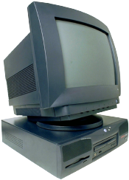

Kerberized Login
Alice wants
Alice’s
a TGT
password
E(S_{A},TGT,K_{A})
Alice
Computer
KDC
Key K_{A} derived from Alice’s password
KDC creates session key S_{A}
Workstation decrypts S_{A}, TGT, forgets K_{A}
TGT = E(“Alice”, S_{A}, K_{KDC})

Slide 78
Alice Requests Ticket to Bob
I want to
talk to Bob
Talk to Bob
REQUEST
REPLY
Alice
Computer
KDC
REQUEST = (TGT, authenticator) where
authenticator = E(timestamp,S_{A})
REPLY = E(“Bob”, K_{AB}, ticket to Bob, S_{A})
ticket to Bob = E(“Alice”, K_{AB}, K_{B})
KDC gets S_{A} from TGT to verify timestamp

Slide 79
Alice Uses Ticket to Bob
ticket to Bob, authenticator
E(timestamp + 1,K_{AB})
Alice’s
Computer
Bob
ticket to Bob = E(“Alice”,K_{AB}, K_{B})
authenticator = E(timestamp, K_{AB})
Bob decrypts “ticket to Bob” to get K_{AB} which he then uses to verify timestamp

Slide 80
Kerberos
Session key S_{A} used for authentication
Can also be used for confidentiality/integrity
Timestamps used for mutual authentication
Recall that timestamps reduce number of messages
Acts like a nonce that is known to both sides
Note: time is a security-critical parameter!

Slide 81
Kerberos Questions
When Alice logs in, KDC sends E(S_{A},TGT,K_{A}) where TGT = E(“Alice”,S_{A},K_{KDC})
Q: Why is TGT encrypted with K_{A}?
A: Extra work and no added security!
In Alice’s Kerberized login to Bob, why can Alice remain anonymous?
Why is “ticket to Bob” sent to Alice?
Where is replay prevention in Kerberos?

Slide 82
Kerberos Alternatives
Could have Alice’s workstation remember password and use that for authentication
Then no KDC required
But hard to protect password on workstation
Scaling problem
Could have KDC remember session key instead of putting it in a TGT
Then no need for TGTs
But stateless KDC is big feature of Kerberos

Slide 83
Kerberos Keys
In Kerberos, K_{A} = h(Alice’s password)
Could instead generate random K_{A} and
Compute K_{h} = h(Alice’s password)
And workstation stores E(K_{A}, K_{h})
Then K_{A} need not change (on workstation or KDC) when Alice changes her password
But E(K_{A}, K_{h}) subject to password guessing
This alternative approach is often used in applications (but not in Kerberos)

Slide 84
Zero Knowledge Proof (ZKP)
Alice wants to prove that she knows a secret without revealing any info about it
Bob must verify that Alice knows secret
Even though he gains no info about the secret
Process is probabilistic
Bob can verify that Alice knows the secret to an arbitrarily high probability
An “interactive proof system”

Slide 85
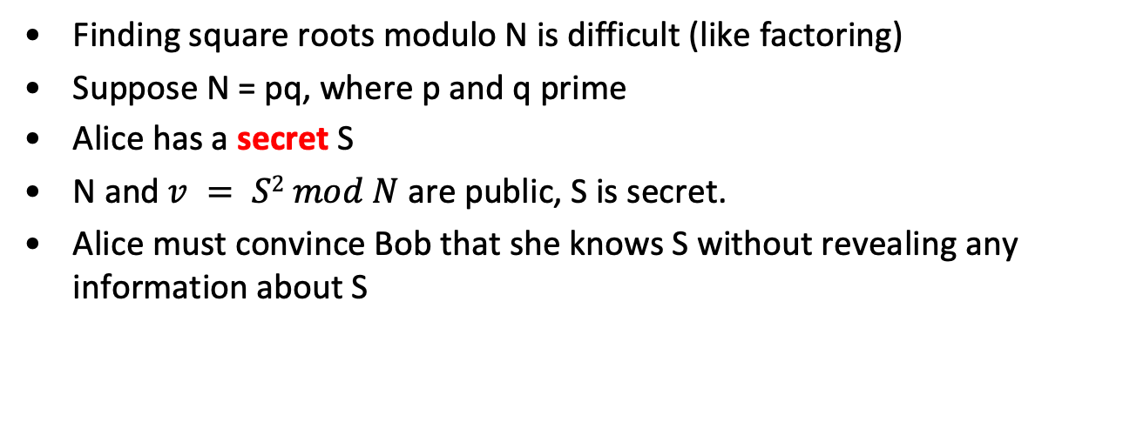
Fiat-Shamir Protocol
Finding square roots modulo N is difficult (like factoring)
Suppose N = pq, where p and q prime
Alice has a secret S
N and$v = S2 mod N$are public, S is secret.
Alice must convince Bob that she knows S without revealing any information about S

Slide 86
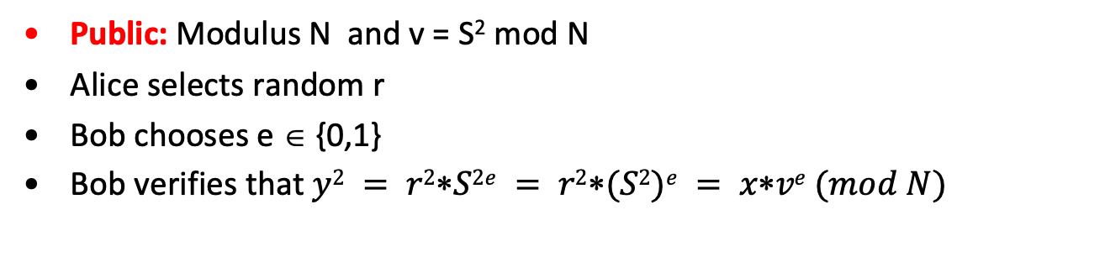
Fiat-Shamir
x = r² mod N
e ∈ {0,1}
y = r∗S^{e} mod N
Alice
secret S
random r
Bob
Public: Modulus N and v = S² mod N
Alice selects random r
Bob chooses e ∈ {0,1}
Bob verifies that $y2 = r2S2e = r2(S2)e = xve (mod N)$

Slide 87
Fiat-Shamir: e = 1
x = r² mod N
e = 1
y = r∗S mod N
Alice
secret S
random r
Bob
Public: Modulus N and v = S² mod N
Alice selects random r
Suppose Bob chooses e =1
Bob must verify that y² = x∗v mod N
Alice must know S in this case

Slide 88
Fiat-Shamir: e = 0
x = r² mod N
e = 0
y = r mod N
Alice
secret S
random r
Bob
Public: Modulus N and v = S² mod N
Alice selects random r
Suppose Bob chooses e = 0
Bob must verify that y² = x mod N
Alice does not need to know S in this case!

Slide 89
Fiat-Shamir
Public: modulus N and v = S² mod N
Secret: Alice knows S
Alice selects random r and commits to r by sending x = r² mod N to Bob
Bob sends challenge e ∈ {0,1} to Alice
Alice responds with y = r∗S^{e} mod N
Bob checks that y² = x∗v^{e} mod N
Does this prove response is from Alice?

Slide 90
Does Fiat-Shamir Work?
The math works since
Public: v = S²
Alice to Bob: x = r² and y = r∗S^{e}
Bob verifies y² = x∗v^{e} mod N
Can Trudy convince Bob she is Alice?
If Trudy expects e = 0, she can send x = r² in msg 1 and y = r in msg 3 (i.e., follow protocol)
If Trudy expects Bob to send e = 1, she can send x = r²∗v⁻¹ in msg 1 and y = r in msg 3
If Bob chooses e ∈ {0,1} at random, Trudy can only fool Bob with probability 1/2

Slide 91
Fiat-Shamir Facts
Trudy can fool Bob with prob 1/2, but…
…after n iterations, the probability that Trudy can fool Bob is only 1/2^{n}
Bob’s e ∈ {0,1} must be unpredictable
Alice must use new r each iteration or else
If e = 0, Alice sends r in message 3
If e = 1, Alice sends r∗S in message 3
Anyone can find S given both r and r∗S

Slide 92
Fiat-Shamir Zero Knowledge?
Zero knowledge means that Bob learns nothing about the secret S
Public: v = S² mod N
Bob sees r² mod N in message 1
Bob sees r∗S mod N in message 3 (if e = 1)
If Bob can find r from r² mod N, he gets S
But that requires modular square root
If Bob can find modular square roots, he can get S from public v
The protocol does not “help” Bob to find S

Slide 93
ZKP in the Real World
Public key certificates identify users
No anonymity if certificates transmitted
ZKP offers a way to authenticate without revealing identities
ZKP supported in Microsoft’s Next Generation Secure Computing Base (NGSCB)
ZKP used to authenticate software “without revealing machine identifying data”

Slide 94
Secure Socket Layer

Slide 95
Socket layer
“Socket layer” lives between application and transport layers
SSL usually lies between HTTP and TCP
Socket
“layer”
application
User
transport
OS
network
link
NIC
physical

Slide 96
What is SSL?
SSL is the protocol used for most secure transactions over the Internet
For example, if you want to buy a book at amazon.com…
You want to be sure you are dealing with Amazon (authentication)
Your credit card information must be protected in transit (confidentiality and/or integrity)
As long as you have money, Amazon doesn’t care who you are (authentication need not be mutual)

Slide 97
Simple SSL-like Protocol
I’d like to talk to you securely
Here’s my certificate
{K_{AB}}_{Bob}
Alice
protected HTTP
Bob
Is Alice sure she’s talking to Bob?
Is Bob sure he’s talking to Alice?

Slide 98
Simplified SSL Protocol
Can we talk?, cipher list, R_{A}
certificate, cipher, R_{B}
{S}_{Bob}, E(h(msgs,CLNT,K),K)
h(msgs,SRVR,K)
Alice
Data protected with key K
Bob
S is pre-master secret
K = h(S,R_{A},R_{B})
msgs = all previous messages
CLNT and SRVR are constants

Slide 99
SSL Keys
6 “keys” derived from K = hash(S,R_{A},R_{B})
2 encryption keys: send and receive
2 integrity keys: send and receive
2 IVs: send and receive
Why different keys in each direction?
Q: Why is h(msgs,CLNT,K) encrypted (and integrity protected)?
A: It adds no security…

Slide 100
SSL Authentication
Alice authenticates Bob, not vice-versa
How does client authenticate server?
Why does server not authenticate client?
Mutual authentication is possible: Bob sends certificate request in message 2
This requires client to have certificate
If server wants to authenticate client, server could instead require (encrypted) password

Slide 101
SSL MiM Attack
R_{A}
R_{A}
certificate_{T}, R_{B}
certificate_{B}, R_{B}
{S₁}_{Trudy},E(X₁,K₁)
{S₂}_{Bob},E(X₂,K₂)
h(Y₁,K₁)
h(Y₂,K₂)
Alice
E(data,K₁)
Trudy
E(data,K₂)
Bob
Q: What prevents this MiM attack?
A: Bob’s certificate must be signed by a certificate authority (such as Verisign)
What does Web browser do if sig. not valid?
What does user do if signature is not valid?

Slide 102
SSL Sessions vs Connections
SSL session is established as shown on previous slides
SSL designed for use with HTTP 1.0
HTTP 1.0 usually opens multiple simultaneous (parallel) connections
SSL session establishment is costly
Due to public key operations
SSL has an efficient protocol for opening new connections given an existing session

Slide 103
SSL Connection
session-ID, cipher list, R_{A}
session-ID, cipher, R_{B,}
h(msgs,SRVR,K)
h(msgs,CLNT,K)
Alice
Protected data
Bob
Assuming SSL session exists
So S is already known to Alice and Bob
Both sides must remember session-ID
Again, K = h(S,R_{A},R_{B})
No public key operations! (relies on known S)

Slide 104
SSL vs IPSec
IPSec ⎯ discussed in next section
Lives at the network layer (part of the OS)
Has encryption, integrity, authentication, etc.
Is overly complex (including serious flaws)
SSL (and IEEE standard known as TLS)
Lives at socket layer (part of user space)
Has encryption, integrity, authentication, etc.
Has a simpler specification

Slide 105
SSL vs IPSec
IPSec implementation
Requires changes to OS, but no changes to applications
SSL implementation
Requires changes to applications, but no changes to OS
SSL built into Web application early on (Netscape)
IPSec used in VPN applications (secure tunnel)
Reluctance to retrofit applications for SSL
Reluctance to use IPSec due to complexity and interoperability issues
Result? Internet less secure than it should be!

Slide 106
IPSec

Slide 107
IPSec and SSL
IPSec lives at the network layer
IPSec is transparent to applications
application
User
SSL
transport
OS
IPSec
network
link
NIC
physical

Slide 108
IPSec and Complexity
IPSec is a complex protocol
Over-engineered
Lots of generally useless extra features
Flawed
Some serious security flaws
Interoperability is serious challenge
Defeats the purpose of having a standard!
Complex
Did I mention, it’s complex?

Slide 109
IKE and ESP/AH
Two parts to IPSec
IKE: Internet Key Exchange
Mutual authentication
Establish shared symmetric key
Two “phases” ⎯ like SSL session/connection
ESP/AH
ESP: Encapsulating Security Payload ⎯ for encryption and/or integrity of IP packets
AH: Authentication Header ⎯ integrity only

Slide 110
IKE

Slide 111
IKE
IKE has 2 phases
Phase 1 ⎯ IKE security association (SA)
Phase 2 ⎯ AH/ESP security association
Phase 1 is comparable to SSL session
Phase 2 is comparable to SSL connection
Not an obvious need for two phases in IKE
If multiple Phase 2’s do not occur, then it is more expensive to have two phases!

Slide 112
IKE Phase 1
Four different “key” options
Public key encryption (original version)
Public key encryption (improved version)
Public key signature
Symmetric key
For each of these, two different “modes”
Main mode
Aggressive mode
There are 8 versions of IKE Phase 1!
Evidence that IPSec is over-engineered?

Slide 113
IKE Phase 1
We’ll discuss 6 of 8 phase 1 variants
Public key signatures (main and aggressive modes)
Symmetric key (main and aggressive modes)
Public key encryption (main and aggressive)
Why public key encryption and public key signatures?
Always know your own private key
May not (initially) know other side’s public key

Slide 114
IKE Phase 1
Uses ephemeral Diffie-Hellman to establish session key
Achieves perfect forward secrecy (PFS)
Let a be Alice’s Diffie-Hellman exponent
Let b be Bob’s Diffie-Hellman exponent
Let g be generator and p prime
Recall p and g are public

Slide 115
IKE Phase 1: Digital Signature (Main Mode)
IC, CP
IC,RC, CS
IC,RC, gª mod p, R_{A}
IC,RC, g^{b} mod p, R_{B}
IC,RC, E(“Alice”, proof_{A}, K)
Alice
IC,RC, E(“Bob”, proof_{B}, K)
Bob
CP = crypto proposed, CS = crypto selected
IC = initiator “cookie”, RC = responder “cookie”
K = h(IC,RC,g^{ab} mod p,R_{A},R_{B})
SKEYID = h(R_{A}, R_{B}, g^{ab} mod p)
proof_{A} = [h(SKEYID,gª,g^{b},IC,RC,CP,“Alice”)]_{Alice}

Slide 116
IKE Phase 1: Public Key Signature (Aggressive Mode)
IC, “Alice”, gª mod p, R_{A}, CP
IC,RC, “Bob”, R_{B},
g^{b} mod p, CS, proof_{B}
IC,RC, proof_{A}
Alice
Bob
Main difference from main mode
Not trying to protect identities
Cannot negotiate g or p

Slide 117
Main vs Aggressive Modes
Main mode MUST be implemented
Aggressive mode SHOULD be implemented
In other words, if aggressive mode is not implemented, “you should feel guilty about it”
Might create interoperability issues
For public key signature authentication
Passive attacker knows identities of Alice and Bob in aggressive mode
Active attacker can determine Alice’s and Bob’s identity in main mode

Slide 118
IKE Phase 1: Symmetric Key (Main Mode)
IC, CP
IC,RC, CS
IC,RC, gª mod p, R_{A}
IC,RC, g^{b} mod p, R_{B}
IC,RC, E(“Alice”, proof_{A}, K)
Alice
Bob
IC,RC, E(“Bob”, proof_{B}, K)
Same as signature mode except
K_{AB} = symmetric key shared in advance
K = h(IC,RC,g^{ab} mod p,R_{A},R_{B},K_{AB})
SKEYID = h(K, g^{ab} mod p)
proof_{A} = h(SKEYID,gª,g^{b},IC,RC,CP,“Alice”)

Slide 119
Problems with Symmetric Key (Main Mode)
Catch-22
Alice sends her ID in message 5
Alice’s ID encrypted with K
To find K Bob must know K_{AB}
To get K_{AB} Bob must know he’s talking to Alice!
Result: Alice’s ID must be IP address!
Useless mode for the “road warrior”
Why go to all of the trouble of trying to hide identities in 6 message protocol?

Slide 120
IKE Phase 1: SymmetricKey (Aggressive Mode)
IC, “Alice”, gª mod p, R_{A}, CP
IC,RC, “Bob”, R_{B},
g^{b} mod p, CS, proof_{B}
IC,RC, proof_{A}
Alice
Bob
Same format as digital signature aggressive mode
Not trying to hide identities…
As a result, does not have problems of main mode
But does not (pretend to) hide identities

Slide 121
IKE Phase 1: Public Key Encryption (Main Mode)
IC, CP
IC,RC, CS
IC,RC, gª mod p, {R_{A}}_{Bob}, {“Alice”}_{Bob}
IC,RC, g^{b} mod p, {R_{B}}_{Alice}, {“Bob”}_{Alice}
IC,RC, E(proof_{A}, K)
Alice
Bob
IC,RC, E(proof_{B}, K)
CP = crypto proposed, CS = crypto selected
IC = initiator “cookie”, RC = responder “cookie”
K = h(IC,RC,g^{ab} mod p,R_{A},R_{B})
SKEYID = h(R_{A}, R_{B}, g^{ab} mod p)
proof_{A} = h(SKEYID,gª,g^{b},IC,RC,CP,“Alice”)

Slide 122
IKE Phase 1: Public Key Encryption (Aggressive Mode)
IC, CP, gª mod p,
{“Alice”}_{Bob}, {R_{A}}_{Bob}
IC,RC, CS, g^{b} mod p,
{“Bob”}_{Alice}, {R_{B}}_{Alice}, proof_{B}
IC,RC, proof_{A}
Alice
Bob
K, proof_{A}, proof_{B} computed as in main mode
Note that identities are hidden
The only aggressive mode to hide identities
Then why have main mode?

Slide 123
Public Key Encryption Issue?
Public key encryption, aggressive mode
Suppose Trudy generates
Exponents a and b
Nonces R_{A} and R_{B}
Trudy can compute “valid” keys and proofs: g^{ab} mod p, K, SKEYID, proof_{A} and proof_{B}
Also true of main mode

Slide 124
Public Key Encryption Issue?
IC, CP, gª mod p,
{“Alice”}_{Bob}, {R_{A}}_{Bob}
IC,RC, CS, g^{b} mod p,
{“Bob”}_{Alice}, {R_{B}}_{Alice}, proof_{B}
Trudy
as Alice
IC,RC, proof_{A}
Trudy
as Bob
Trudy can create exchange that appears to be between Alice and Bob
Appears valid to any observer, including Alice and Bob!

Slide 125
Plausible Deniability
Trudy can create “conversation” that appears to be between Alice and Bob
Appears valid, even to Alice and Bob!
A security failure?
In this mode of IPSec, it is a feature
Plausible deniability: Alice and Bob can deny that any conversation took place!
In some cases, it might be a security failure
If Alice makes a purchase from Bob, she could later repudiate it (unless she had signed)

Slide 126
IKE Phase 1 Cookies
Cookies (or “anti-clogging tokens”) supposed to make denial of service more difficult
No relation to Web cookies
To reduce DoS, Bob wants to remain stateless as long as possible
But Bob must remember CP from message 1 (required for proof of identity in message 6)
Bob must keep state from 1st message on!
These cookies offer little DoS protection!

Slide 127
IKE Phase 1 Summary
Result of IKE phase 1 is
Mutual authentication
Shared symmetric key
IKE Security Association (SA)
But phase 1 is expensive (in public key and/or main mode cases)
Developers of IKE thought it would be used for lots of things ⎯ not just IPSec
Partly explains over-engineering…

Slide 128
IKE Phase 2
Phase 1 establishes IKE SA
Phase 2 establishes IPSec SA
Comparison to SSL
SSL session is comparable to IKE Phase 1
SSL connections are like IKE Phase 2
IKE could be used for lots of things
But in practice, it’s not!

Slide 129
IKE Phase 2
IC,RC,CP,E(hash1,SA,R_{A},K)
IC,RC,CS,E(hash2,SA,R_{B},K)
IC,RC,E(hash3,K)
Alice
Bob
Key K, IC, RC and SA known from Phase 1
Proposal CP includes ESP and/or AH
Hashes 1,2,3 depend on SKEYID, SA, R_{A} and R_{B}
Keys derived from KEYMAT = h(SKEYID,R_{A},R_{B},junk)
Recall SKEYID depends on phase 1 key method
Optional PFS (ephemeral Diffie-Hellman exchange)

Slide 130
IPSec
After IKE Phase 1, we have an IKE SA
After IKE Phase 2, we have an IPSec SA
Both sides have a shared symmetric key
Now what?
We want to protect IP datagrams
But what is an IP datagram?
From the perspective of IPSec…

Slide 131
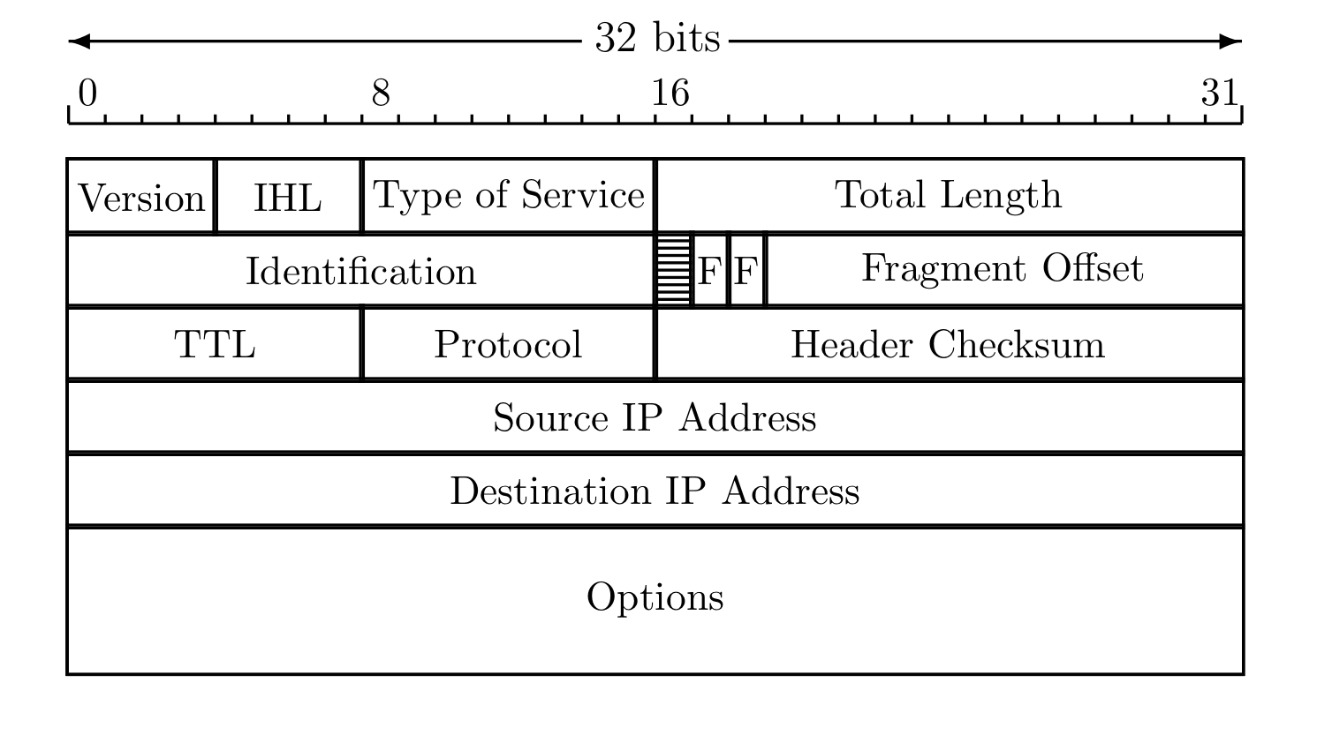
IP Review
IP datagram is of the form
IP header
data
Where IP header is

Slide 132
IP and TCP
Consider HTTP traffic (over TCP)
IP encapsulates TCP
TCP encapsulates HTTP
IP header
data
IP header
TCP hdr
HTTP hdr
app data
IP data includes TCP header, etc.

Slide 133
IPSec Transport Mode
IPSec Transport Mode
IP header
data
IP header
ESP/AH
data
Transport mode designed for host-to-host
Transport mode is efficient
Adds minimal amount of extra header
The original header remains
Passive attacker can see who is talking

Slide 134
IPSec Tunnel Mode
IPSec Tunnel Mode
IP header
data
new IP hdr
ESP/AH
IP header
data
Tunnel mode for firewall to firewall traffic
Original IP packet encapsulated in IPSec
Original IP header not visible to attacker
New header from firewall to firewall
Attacker does not know which hosts are talking

Slide 135
Comparison of IPSec Modes
Transport Mode
Transport Mode
Host-to-host
Tunnel Mode
Firewall-to-firewall
Transport mode not necessary
Transport mode is more efficient
IP header
data
IP header
ESP/AH
data
Tunnel Mode
IP header
data
new IP hdr
ESP/AH
IP header
data

Slide 136
IPSec Security
What kind of protection?
Confidentiality?
Integrity?
Both?
What to protect?
Data?
Header?
Both?
ESP/AH do some combinations of these

Slide 137
AH vs ESP
AH
Authentication Header
Integrity only (no confidentiality)
Integrity-protect everything beyond IP header and some fields of header (why not all fields?)
ESP
Encapsulating Security Payload
Integrity and confidentiality
Protects everything beyond IP header
Integrity only by using NULL encryption

Slide 138
ESP’s NULL Encryption
According to RFC 2410
NULL encryption “is a block cipher the origins of which appear to be lost in antiquity”
“Despite rumors”, there is no evidence that NSA “suppressed publication of this algorithm”
Evidence suggests it was developed in Roman times as exportable version of Caesar’s cipher
Can make use of keys of varying length
No IV is required
Null(P,K) = P for any P and any key K
Security people have a strange sense of humor!

Slide 139
Why Does AH Exist? (1)
Cannot encrypt IP header
Routers must look at the IP header
IP addresses, TTL, etc.
IP header exists to route packets!
AH protects immutable fields in IP header
Cannot integrity protect all header fields
TTL, for example, must change
ESP does not protect IP header at all

Slide 140
Why Does AH Exist? (2)
ESP encrypts everything beyond the IP header (if non-null encryption)
If ESP encrypted, firewall cannot look at TCP header (e.g., port numbers)
Why not use ESP with null encryption?
Firewall sees ESP header, but does not know whether null encryption is used
End systems know, but not firewalls
Aside 1: Do firewalls reduce security?
Aside 2: Is IPSec compatible with NAT?

Slide 141
Why Does AH Exist? (3)
The real reason why AH exists
At one IETF meeting “someone from Microsoft gave an impassioned speech about how AH was useless…”
“…everyone in the room looked around and said `Hmm. He’s right, and we hate AH also, but if it annoys Microsoft let’s leave it in since we hate Microsoft more than we hate AH.”

Slide 142
Best Authentication Protocol?
What is best depends on many factors…
The sensitivity of the application
The delay that is tolerable
The cost (computation) that is tolerable
What crypto is supported
Public key, symmetric key, hash functions
Is mutual authentication required?
Is a session key required?
Is PFS a concern?
Is anonymity a concern?, etc.

Slide 143
End

