Slide 1
GPS, Ligado, the FCC and all that
John Manferdelli
johnmanferdelli@hotmail.com

Slide 2
Agenda
The FCC rule that motivated the study
The Mobile Satellite and GNSS band
How GPS works
Satellites
Coarse acquisition and navigation
Noise
Signal structure and “coding gain”
Noise and interference metrics
Study outcome and recommendations

Slide 3
The FCC order
On April 20, 2020, the FCC licensed Ligado to operate ATC downlinks in the 1526-1536 MHz frequency band under certain conditions.
Ligado’s ATC base stations operating at 1526-1536 MHz band shall not exceed an equivalent isotopically radiated power (EIRP) of 9.8 dBW (10 W) with a +/- 45 degree cross-polarized base station antenna
Ligado ATC base station antenna in the 1526-1536 MHz band may not be located less than 250 feet laterally or less than 30 feet below an obstacle clearance surface established by the FAA; and
Ligado is required to comply with specific reporting, notification, and monitoring obligations.
The emissions are further limited as follows by the order:
ATC Mobile Terminal Emissions.
-67 dBW/4kHz at 1627.5 MHz
a level determined by linear interpolation from -67 dBW/4kHz at 1627.5 MHz to -100 dBW/MHz at 1610 MHz in the 1627.5-1610 MHz frequency range
a level determined by linear interpolation from -100 dBW/MHz at 1610 MHz to -105 dBW/MHz at 1608 MHz in the 1610-1608 MHz frequency range
-105 dBW/MHz in the 1541-1608 MHz frequency range
-58 dBW/4 kHz at a 1 megahertz offset beyond the edges of the authorized and internationally coordinated MSS frequency assignment at 1646.5-1656.5 MHz

Slide 4
The FCC order
ATC Mobile Terminal Discrete Emissions.
a level determined by linear interpolation from -44 dBW/700 Hz at 1625 MHz to -110 dBW/700 Hz at 1610 MHz in the 1625-1610 MHz frequency range
a level determined by linear interpolation from -110 dBW/700 Hz at 1610 MHz to -115 dBW/700 Hz at 1608 MHz in the 1610-1608 MHz frequency range
-115 dBW/700 Hz in the 1608-1559 MHz frequency range
-132 dBW/2 kHz in the 1559-1541 MHz frequency range
ATC Base Station Emissions.
-85 dBW/MHz in the 1541-1559 MHz and 1610-1650 MHz frequency ranges
-100 dBW/MHz in the 1559-1610 MHz frequency range
ATC Base Station Discrete Emissions.
-112 dBW/2 kHz in the 1541-1559 MHz frequency range
-110 dBW/700 Hz in the 1559-1610 MHz frequency range
-95 dBW/700 Hz in the 1610-1650 MHz frequency range

Slide 5
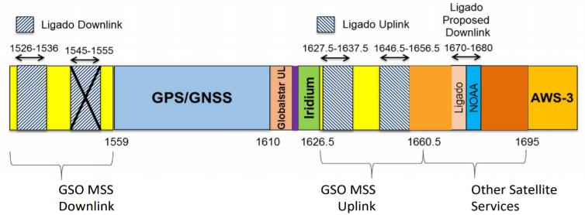
GNSS/MSS Spectrum

Slide 6
Study Focus
What methods should be used to assess possible interference
SNR
Study of individual receivers
Will there be “harmful interference” to GNSS and MSS services
Anyone
DoD missions
How practical and effective are the mitigation techniques being proposed

Slide 7
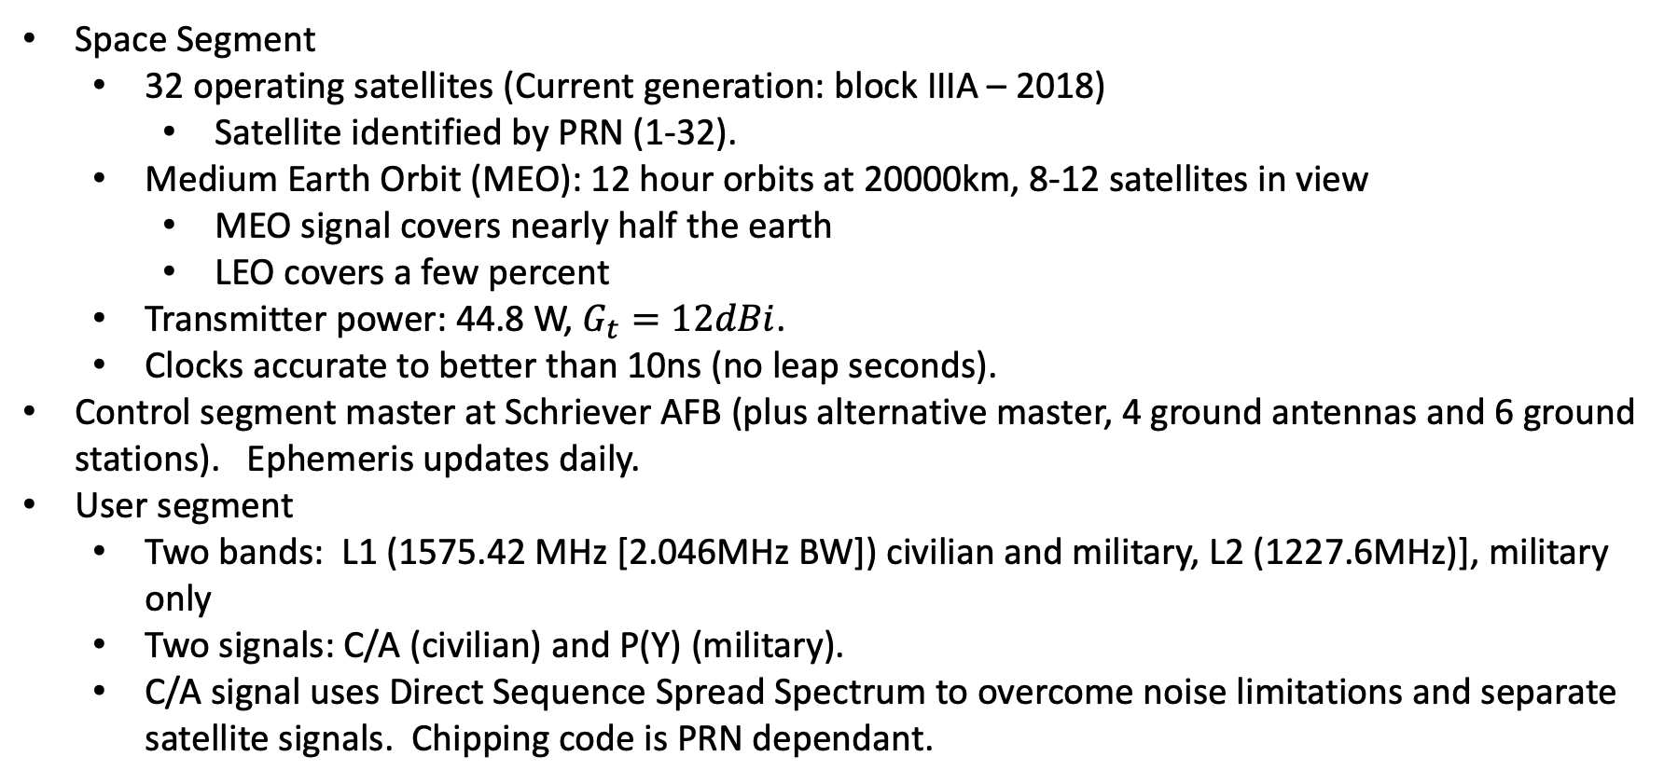
GPS
Space Segment
32 operating satellites (Current generation: block IIIA – 2018)
Satellite identified by PRN (1-32).
Medium Earth Orbit (MEO): 12 hour orbits at 20000km, 8-12 satellites in view
MEO signal covers nearly half the earth
LEO covers a few percent
Transmitter power: 44.8 W, $G_{t}=12dBi$.
Clocks accurate to better than 10ns (no leap seconds).
Control segment master at Schriever AFB (plus alternative master, 4 ground antennas and 6 ground stations). Ephemeris updates daily.
User segment
Two bands: L1 (1575.42 MHz [2.046MHz BW]) civilian and military, L2 (1227.6MHz)], military only
Two signals: C/A (civilian) and P(Y) (military).
C/A signal uses Direct Sequence Spread Spectrum to overcome noise limitations and separate satellite signals. Chipping code is PRN dependant.

Slide 8
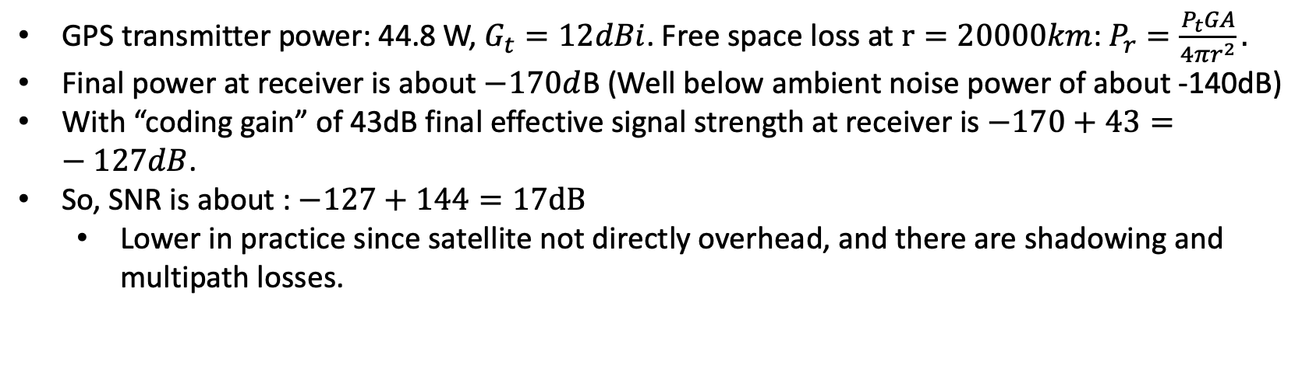

Some data and rough calculations
GPS transmitter power: 44.8 W, $G_{t}=12dBi$. Free space loss at $r=20000km$: $P_{r}=\frac{P_{t}GA}{4πr^{2}}.$
Final power at receiver is about $−170d$B (Well below ambient noise power of about -140dB)
With “coding gain” of 43dB final effective signal strength at receiver is $−170+43=−127dB$.
So, SNR is about : $−127+144=17dB$
Lower in practice since satellite not directly overhead, and there are shadowing and multipath losses.
First aid: $P\left(dB\right)=10 log⁡(\frac{P}{P_{ref}})$

Slide 9
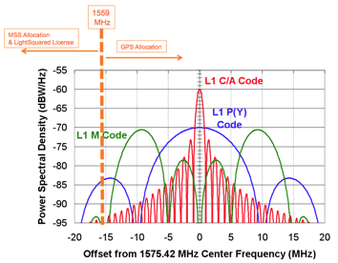
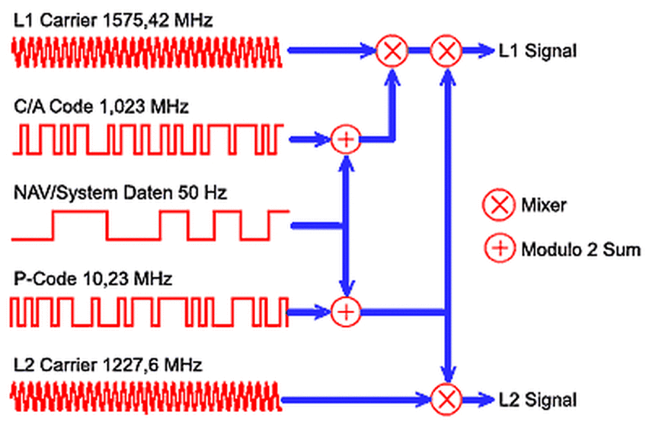
Signal Structure

Slide 10
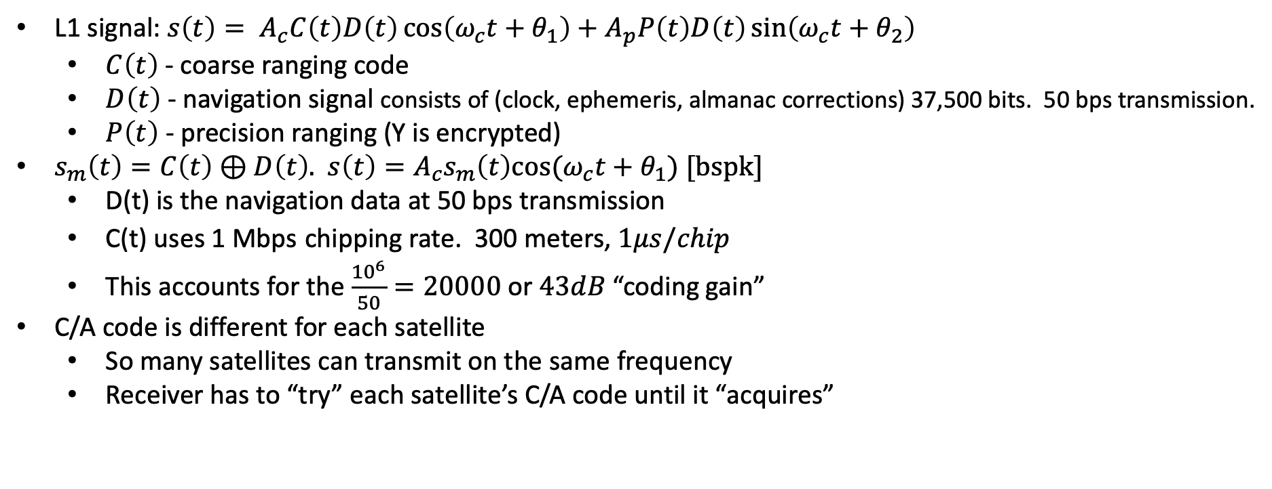
L1 Signal Structure
L1 signal: $s\left(t\right)= A_{c}C\left(t\right)D\left(t\right)\cos\left(ω_{c}t+θ_{1}\right)+A_{p}P\left(t\right)D\left(t\right)\sin\left(ω_{c}t+θ_{2}\right)$
$C\left(t\right)$ - coarse ranging code
$D\left(t\right)$ - navigation signal consists of (clock, ephemeris, almanac corrections) 37,500 bits. 50 bps transmission.
$P\left(t\right)$ - precision ranging (Y is encrypted)
$s_{m}\left(t\right)=C\left(t\right)⊕D\left(t\right)$. $s\left(t\right)={A_{c}s}_{m}\left(t\right)cos⁡(ω_{c}t+θ_{1})$ [bspk]
D(t) is the navigation data at 50 bps transmission
C(t) uses 1 Mbps chipping rate. 300 meters, $1μs/chip$
This accounts for the $\frac{{10}^{6}}{50}=20000$ or $43dB$ “coding gain”
C/A code is different for each satellite
So many satellites can transmit on the same frequency
Receiver has to “try” each satellite’s C/A code until it “acquires”

Slide 11
Acquisition, tracking and navigation
Acquisition
Receiver generates known C/A code and attempts to correlate with signal.
To generate C/A code, receiver needs to know which satellite it’s attempting to acquire to determine code
Tracking via delay loop to maintain C/A code alignment
The Navigation Message includes the Ephemeris parameters, the Time parameters and Clock Corrections, the Service Parameters with satellite health information, Ionospheric parameters model, and the Almanacs, allowing the computation of the position of ”all satellites in the constellation”. The ephemeris and clocks parameters are usually updated every two hours, while the almanac is updated at least every six days.

Slide 12
Navigation Message
The navigation message contains 25 pages (’frames’) of 30 seconds each. Entire message takes 12.5 minutes to be transmitted. Every frame is subdivided into 5 sub-frames of 6 seconds each; every sub-frame consists of 10 words, with 30 bits per word.
Every sub-frame starts with the telemetry word (TLM), needed for synchronism. Next, the transference word (HOW) which provides time information (seconds of the GPS week), allowing the receiver to acquire the week-long P(Y)-code segment.
Sub-frame 1: contains information the satellite clock. It also has information about satellite health condition.
Sub-frames 2 and 3: contain satellite ephemeris.
Sub-frame 4: provides ionospheric model parameters, UTC information (Universal Coordinate Time), part of the almanac, and indications whether the Anti-Spoofing, A/S, is activated.
Sub-frame 5: contains data from the almanac and the constellation status. It allows to quickly identify the satellite from which the signal comes. A total of 25 frames are needed to complete the almanac.
Sub-frames 1, 2 and 3 are transmitted with each frame. The content of sub-frames 4 and 5 is common for all satellites. So, the almanac data for all in orbit satellites can be obtained from a single tracked satellite.

Slide 13
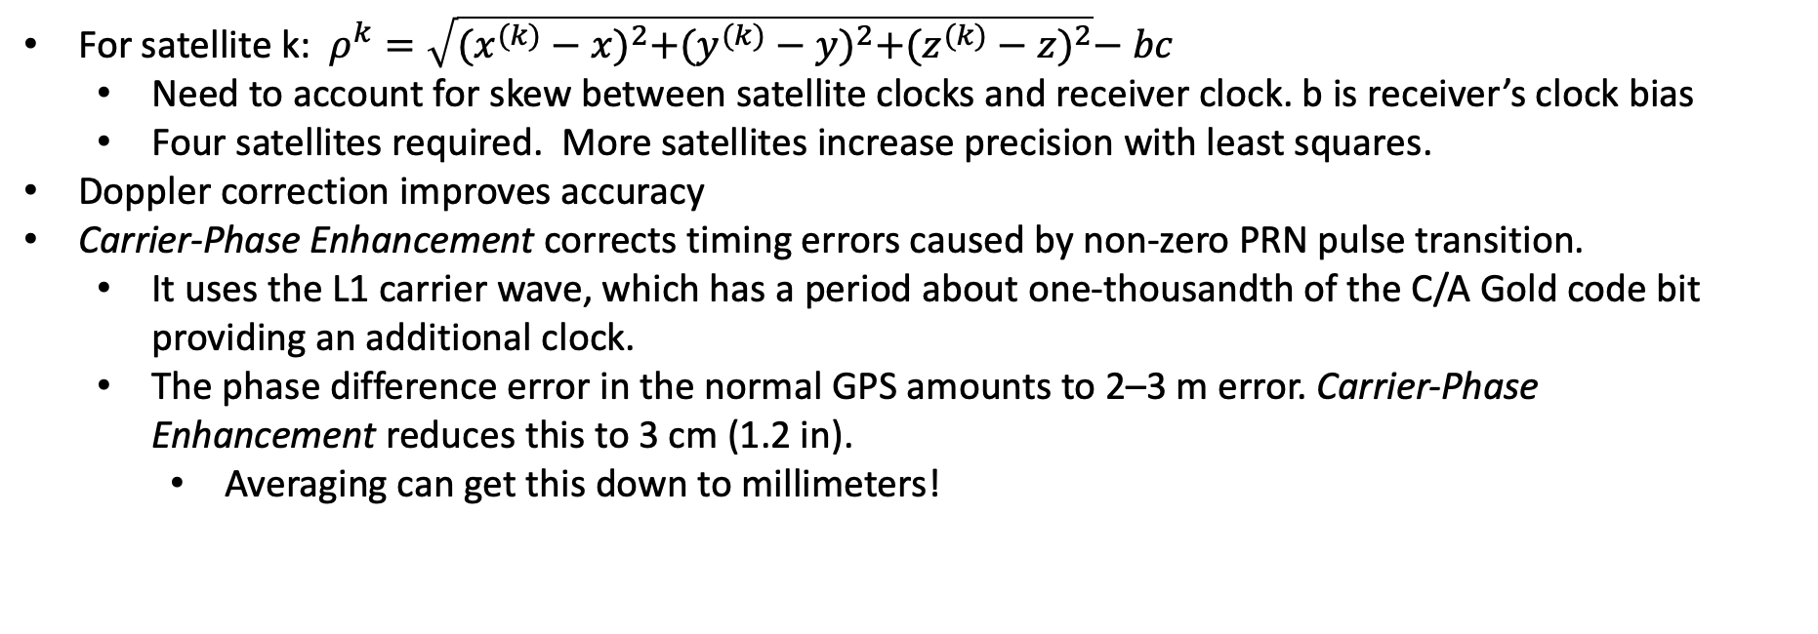
Processing and Accuracy
For satellite k: $ρ^{k}=\sqrt{{(x^{(k)}−x)}^{2}+{(y^{(k)}−y)}^{2}+{(z^{(k)}−z)}^{2}}−bc$
Need to account for skew between satellite clocks and receiver clock. b is receiver’s clock bias
Four satellites required. More satellites increase precision with least squares.
Doppler correction improves accuracy
Carrier-Phase Enhancement corrects timing errors caused by non-zero PRN pulse transition.
It uses the L1 carrier wave, which has a period about one-thousandth of the C/A Gold code bit providing an additional clock.
The phase difference error in the normal GPS amounts to 2–3 m error. Carrier-Phase Enhancement reduces this to 3 cm (1.2 in).
Averaging can get this down to millimeters!

Slide 14
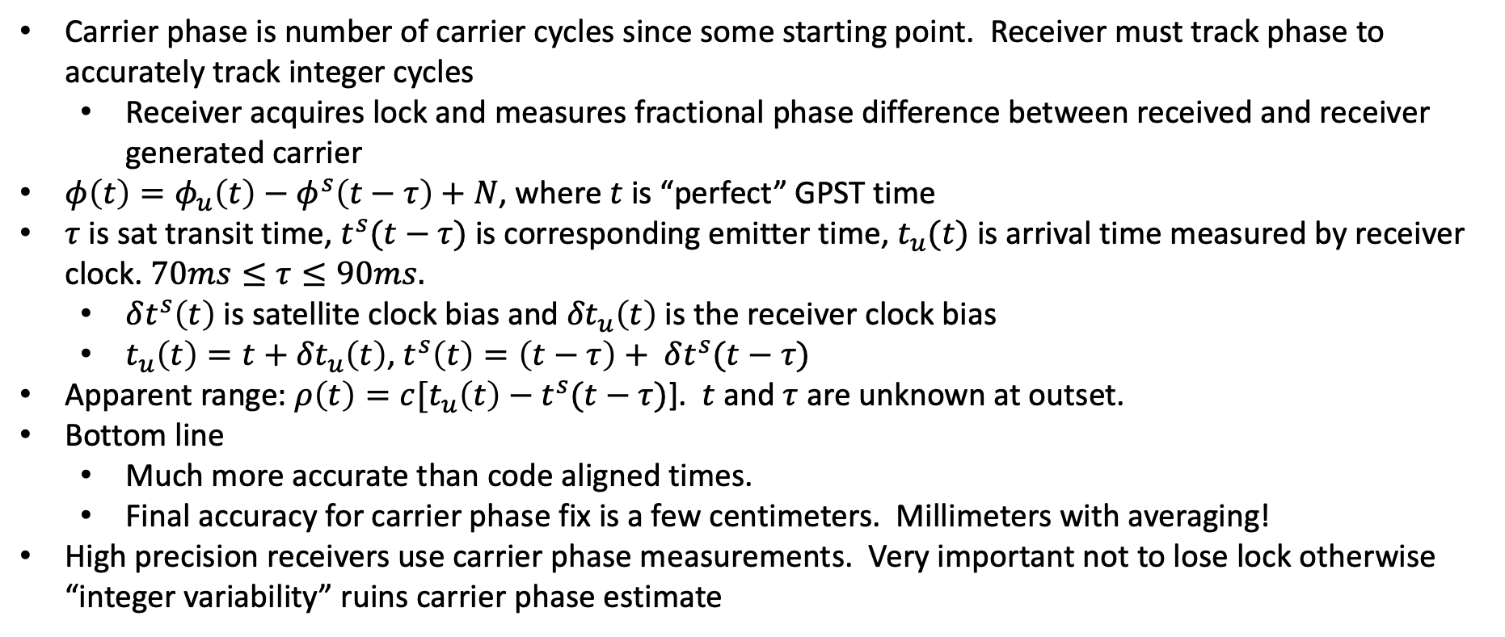
Carrier phase measurements
Carrier phase is number of carrier cycles since some starting point. Receiver must track phase to accurately track integer cycles
Receiver acquires lock and measures fractional phase difference between received and receiver generated carrier
$φ\left(t\right)=φ_{u}\left(t\right)−φ^{s}\left(t−τ\right)+N$, where $t$ is “perfect” GPST time
$τ$ is sat transit time, $t^{s}(t−τ)$ is corresponding emitter time, $t_{u}(t)$ is arrival time measured by receiver clock. $70ms≤τ≤90ms.$
$δt^{s}\left(t\right)$ is satellite clock bias and ${δt}_{u}\left(t\right)$ is the receiver clock bias
$t_{u}\left(t\right)=t+{δt}_{u}\left(t\right)$, $t^{s}\left(t\right)=\left(t−τ\right)+ δt^{s}(t−τ)$
Apparent range: $ρ\left(t\right)=c[t_{u}\left(t\right)−t^{s}(t−τ)$]. $t$ and $τ$ are unknown at outset.
Bottom line
Much more accurate than code aligned times.
Final accuracy for carrier phase fix is a few centimeters. Millimeters with averaging!
High precision receivers use carrier phase measurements. Very important not to lose lock otherwise “integer variability” ruins carrier phase estimate

Slide 15
GPS receiver
Code
NCO
IF
Phase rotation
LNA
X
A/D
Correlator
Accumulator

Slide 16
Interference and Harmful Interference
The ITU’s definition of “interference” is:
The effect of unwanted energy due to one or a combination of emissions, radiations, or inductions upon reception in a radio communication system, manifested by any performance degradation, misinterpretation, or loss of information which could be extracted in the absence of such unwanted energy.
ITU definition of “harmful interference” (ITU) :
Interference which endangers the functioning of a radio navigation service or of other safety services or seriously degrades, obstructs, or repeatedly interrupts a radio communication service operating in accordance with [the] Radio Regulations
These international regulations also include two related terms:
permissible interference
accepted interference
Harmful Interference
Roughly “harmful interference” to a service operating in accordance with FCC regulations

Slide 17
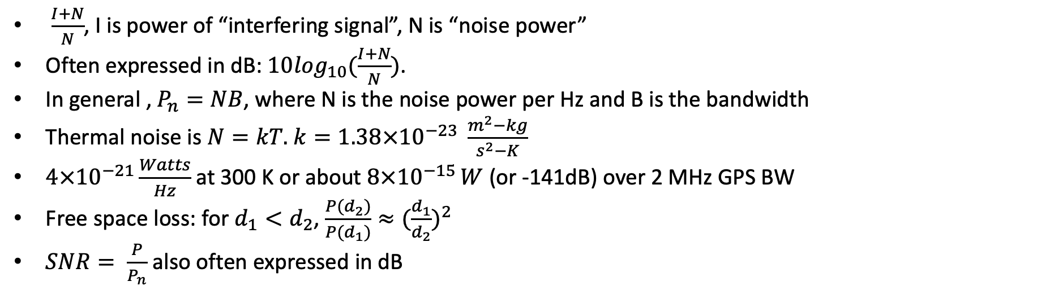
Noise Power and Interference Power
$\frac{I+N}{N}$, I is power of “interfering signal”, N is “noise power”
Often expressed in dB: $10\log_{10}(\frac{I+N}{N})$.
In general , $P_{n}=NB$, where N is the noise power per Hz and B is the bandwidth
Thermal noise is $N=kT.$ $k=1.38×{10}^{−23} \frac{m^{2}−kg}{s^{2}−K}$
$4×{10}^{−21}\frac{Watts}{Hz}$ at 300 K or about $8×{10}^{−15 }W$ (or -141dB) over 2 MHz GPS BW
Free space loss: for $d_{1}<d_{2}$, $\frac{P(d_{2})}{P(d_{1})}≈{(\frac{d_{1}}{d_{2}})}^{2}$
$SNR= \frac{P}{P_{n}}$ also often expressed in dB
(I+N)/N (dB) | (I+N)/N
1 | 1.26
2 | 1.58
3 | 2
4 | 2.51
5 | 3.16
(I+N)/N (dB) | (I+N)/N
6 | 4
7 | 5
8 | 6.3
9 | 7.0
10 | 10

Slide 18
Evidence presented to committee
Receiver classes: General Navigation (GLN), Timing (TIM), Cellular (CEL), High Precision (HP)
Presentations
DoT report (ABC) report
Roberson report
Ligado presentation
FCC
Many experimental studies had fundamental problems
“Harmful Interference” characterized at imputed (I+N)/N of 1dB under worst conditions
Almost no receiver started losing function until 4dB (6 times the power of 1dB metric)
Many did not to degrade until 8dB (21 times power of 1dB)
Imputed because it was receiver reported (so bad filters and receiver design influenced metric)
Receivers were not identified and old. (Newer receivers are much better)
High precision were designed to receive outside GPS including: one that received directly in Ligado’s band
Except for HP receivers, almost no receiver experienced “harmful interference” from Ligado
About half of the HP receivers experienced harmful interference at the closest allowed distance from emitter
Biggest problem: Real Time Kinematics (RTK)
Substantially no evidence of interference with HP receivers sold after around 2012

Slide 19
Study Committee
Michael McQuade Carnegie Mellon University (Chair)
Jennifer Alvarez Aurora Insight Inc.
Kristine Larson, NAS University of Colorado Boulder
John Manferdelli VMware
Preston Marshall Google
Mark Psiaki Virginia Tech
Richard Reaser, Jr. Independent Consultant
Jeffry Reed Virginia Tech
Nambi Seshadri, NAE University of California San Diego
Scott Stadler MIT Lincoln Laboratory
Stephen Stafford Johns Hopkins University Applied Physics Laboratory

Slide 20
Presentations to the Committee
DOD CIO
Ligado Networks
National Telecommunications and Information Administration, Dept. of Commerce
Roberson and Associates
Volpe Center, Department of Transportation
National Advanced Spectrum and Communications Test Network
Brad Parkinson, Stanford University
Garmin International
Trimble, Inc.
Iridium
Resilient Navigation and Timing Foundation
AMS Committee on Radio Frequency Allocation
National Society of Professional Surveyors
Air Line Pilots Association
Aviation Spectrum Resources, Inc.
Collins Aerospace
Helicopter Association International
National Agricultural Aviation Association
Office of Engineering and Technology, Federal Communications Commission

Slide 21
Reviewers
Alison K. Brown, NAE NAVSYS Corporation
Alden Fuchs Fuchs Consulting
Christopher Hegarty MITRE Corporation
Todd Humphreys University of Texas at Austin
Mark Lofquist Aerospace Corporation/University of Colorado Boulder
Douglas Loverro Loverro Consulting
Jon Peha Carnegie Mellon University
William Press, NAS University of Texas at Austin
Dorothy Robyn Boston University
Douglas Sicker University of Colorado Denver

Slide 22
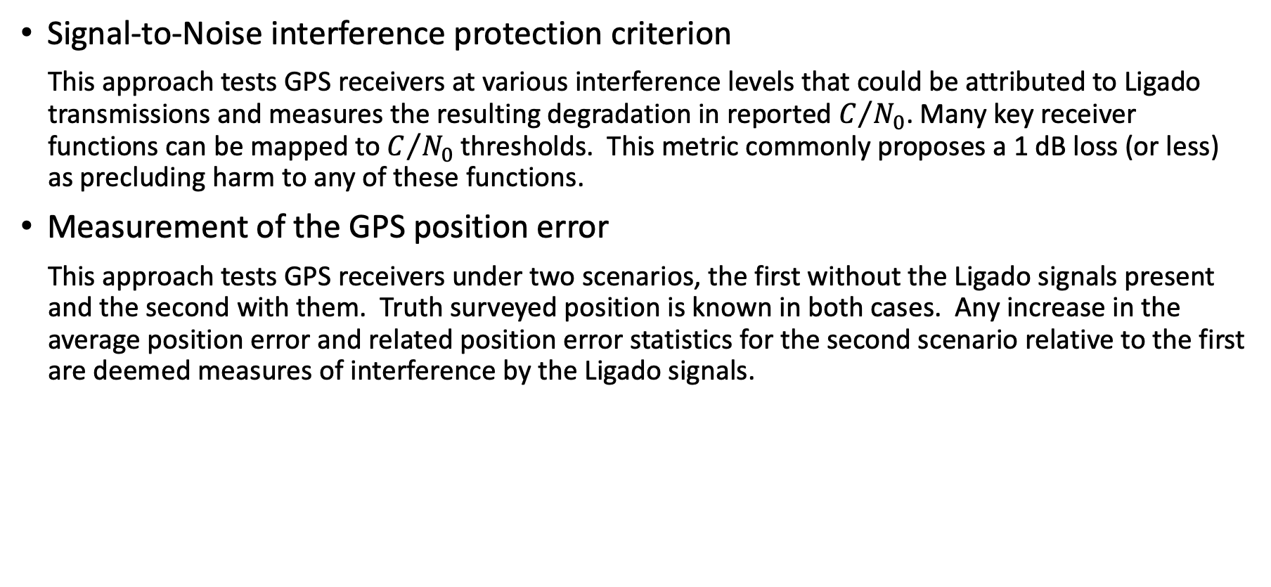
Approaches to Predicting Interference
Signal-to-Noise interference protection criterion
This approach tests GPS receivers at various interference levels that could be attributed to Ligado transmissions and measures the resulting degradation in reported $C/{N_{0}}$. Many key receiver functions can be mapped to $C/{N_{0}}$ thresholds. This metric commonly proposes a 1 dB loss (or less) as precluding harm to any of these functions.
Measurement of the GPS position error
This approach tests GPS receivers under two scenarios, the first without the Ligado signals present and the second with them. Truth surveyed position is known in both cases. Any increase in the average position error and related position error statistics for the second scenario relative to the first are deemed measures of interference by the Ligado signals.

Slide 23
FCC Definition of Harmful Interference
“[i]nterference which endangers the functioning of a radionavigation service or of other safety services or seriously degrades, obstructs, or repeatedly interrupts a radiocommunication service operating in accordance with [the ITU] Radio Regulations.”
This implies two conditions:
The emission, radiation or induction must (a) endanger the functioning of the radio navigation or safety service or (b) seriously degrade, obstruct or repeatedly interrupt any other radiocommunication service and
The service claiming Harmful Interference must be operating in accordance with regulations (as in United States Code (USC), Title 47 Telecommunications, Chapter 1, Subchapter A, Part 15, Section 15.3)).
Report uses the uncapitalized term ‘harmful interference’ meaning degraded receiver operations without assessing whether such degradation is actually causing a degradation of function or whether the receiver is operating in accordance with FCC rules.
Notes:
Note: Parties differ in how to interpret these regulations

Slide 24

The Frequency Bands of Interest
RF transmitters do not operate with arbitrarily sharp cutoff frequencies and thus, depending on how rapidly (as a function of frequency) their emitted power spectrum falls off, may emit power beyond their authorized spectral bands.
RF receivers do not ‘listen’ only within a band defined with arbitrarily sharp boundaries and thus may receive power from frequencies outside their designed band.

Slide 25
Approaches to Evaluating Harmful Interference Concerns
Conclusion: Neither of the prevailing approaches to evaluating harmful interference concerns effectively effectively characterizes the risk of harmful interference.
Neither approach provides analytical, repeatable, or straightforward criteria to evaluate new entrants. Both approaches depend on sampling a subset of the many and varied GPS receivers in the marketplace. Both approaches have a role to play in evaluating harmful interference to existing receivers.
The signal-to-noise approach is inflexible as a determinant or threshold, providing what in some circumstances may be an overly conservative emission limit because no single value for signal-to-noise degradation determines when the various types of possible harm to receiver performance will become significant.
The position measurement approach is too narrow in its applicability to the many and varied uses of the GPS system.

Slide 26
Further Comments
While commonly argued in the FCC proceedings and in input to the committee the committee does not believe that a 1 dB Interference Protection Criteria is appropriate as a general standard. Often receivers can tolerate 6-15 times this level of interfering power before the objective performance of a receiver is degraded. The 1 dB criterion is prophylactic, but conservative.
With more well-defined receiver standards, and frequency masks for potentially interfering signals, a straightforward SNR standard could be highly predictive of harmful interference and hence inform emitter characteristics that are calculated to prevent such interference.
This SNR standard will likely be higher than 1dB signal degradation and the standard may change over time as technology improves.

Slide 27
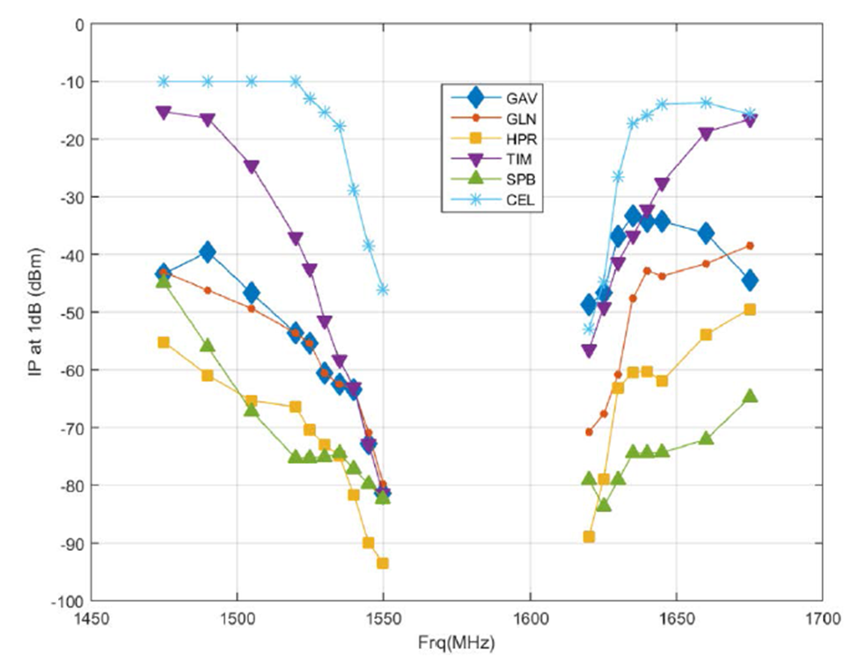
Harmful Interference to GPS and Mobile Satellite Services
GPS Receiver Sensitivity to Interference
Susceptibility spans up to 60 dB.
GPS receivers encountering a different environment from when they were designed.
Source: Drocella, Wang, and LaSorte, 2020, NTIA-TM-20-536

Slide 28
Harmful Interference to GPS and Mobile Satellite Services
Conclusion for GPS interference caused by Ligado emissions in 1526-1536MHz:
Most commercially produced general navigation, timing, cellular or certified aviation GPS receivers will not experience significant harmful interference from Ligado emissions as authorized by the FCC.
High precision receivers are the most vulnerable receiver class, with the largest proportion of units tested that will experience significant harmful interference from Ligado operations as authorized by the FCC.
Conclusion: It is within the state-of-the-practice of current technology to build a receiver that is robust to Ligado signals for any GPS application, and all GPS receiver manufacturers could field new designs that could coexist with the authorized Ligado signals and achieve good performance even if their existing designs cannot.
Conclusion: Iridium terminals will experience harmful interference on their downlink caused by Ligado user terminals operating in the UL1 band while those Iridium terminals are within a significant range of a Ligado emitter — up to 732 meters.

Slide 29
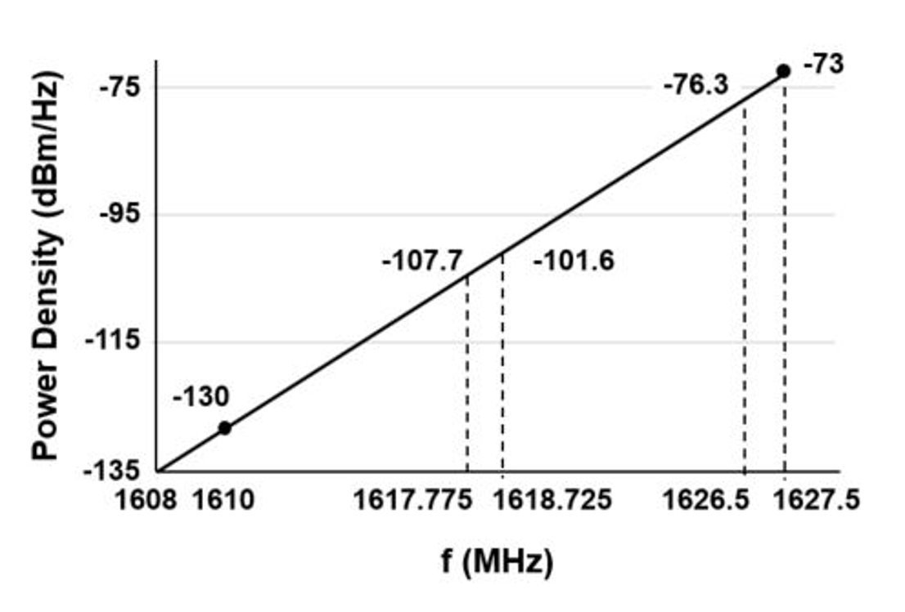
Potential interference with Iridium Downlink
Iridium says their noise floor is -170 dBm/Hz, which is consistent with a noise-limited system​.
At the high side of the Iridium band, channels will see an interference level of -76 dBm/Hz from a single user​.
Requires 94 dB of attenuation to be reduced to the noise floor which occurs at a distance of 732 m (free space path loss)
Out-of-band emissions spectral mask

Slide 30
DoD statement on second study task
‘DoD and interagency partners conducted testing to determine the impacts to GPS (captures FCC Order 20-48’s authorized deployment). The tests demonstrated that the proposed signal introduces harmful interference to critical national security mission capabilities.’
‘The terrestrial network authorized by FCC Order 20-48 will create unacceptable harmful interference for DoD missions. The mitigation techniques and other regulatory provisions in FCC Order 20-48 are insufficient to protect national security missions.’
The committee discusses these issues in a classified annex to this report.

Slide 31
Mitigations
Although the mitigation procedures proposed in the order may be effective, in many cases such mitigation may be impractical without the extensive dialog among the affected parties presumed in the Order.
In some cases, mitigation may not be practical at operationally relevant timescales or at reasonable cost.

Slide 32
Better means of assessing harmful interference
The committee believes that a sensible criterion for harmful interference could be developed that accounts for position error effects, acquisition and tracking challenges, and continuity of service.
Such a criterion might be based on a maximum limit for degradation of C/N₀ in the designated frequency range for a reasonably well-designed receiver.
This analysis would then dictate an adjacent-band power mask that the FCC would guarantee going forward for a given period of time.

Slide 33
Managing Future Controversies - Receiver standards
Many of the current spectrum controversies arise from receiver designs that were predicated on different environments than would emerge after FCC rulemakings.
Assumptions about receiver performance would be highly beneficial in focusing the discussion, without impacting the marketplace or equipment cost and performance of future receiver designs.

Slide 34
Managing future controversies
It is essential that spectrum decisions be flexible enough to be adjusted or changed completely.
A cohesive policy about rights of current users, the impact of equipment lifetime, business models, and all other considerations is essential, and should be established outside the pressures of any one spectrum decision.

Slide 35
Administrative processes
FCC regulatory decisions have both a policy component, and a technical fact finding one.
The process appeared to the committee to be resolving questions of fact, e.g., ‘Will Ligado interfere with GPS,’ through administrative and/or procedural processes rather than a technical one. While it is keenly aware of the constraints inherent in the Administrative Procedures Act, it is the committee's opinion that selecting from specific filings may not be an appropriate technique to answer questions of fact. This proceeding might have had a more accepted outcome if the FCC was in a position to provide its own positions on factual questions.
A useful step to meeting the U.S. Government objectives (as compared to the individual objectives of the FCC and NTIA) would be to jointly study and test the impact of proposed regimes. Criteria would be agreed in advance, experiments agreed by all parties to be the relevant and inclusive cases.

