Slide 1
Electronics of Radio, Part 1 Notes on David Rutledge’s book
John Manferdelli
johnmanferdelli@hotmail.com
11052024 12:12

Slide 2
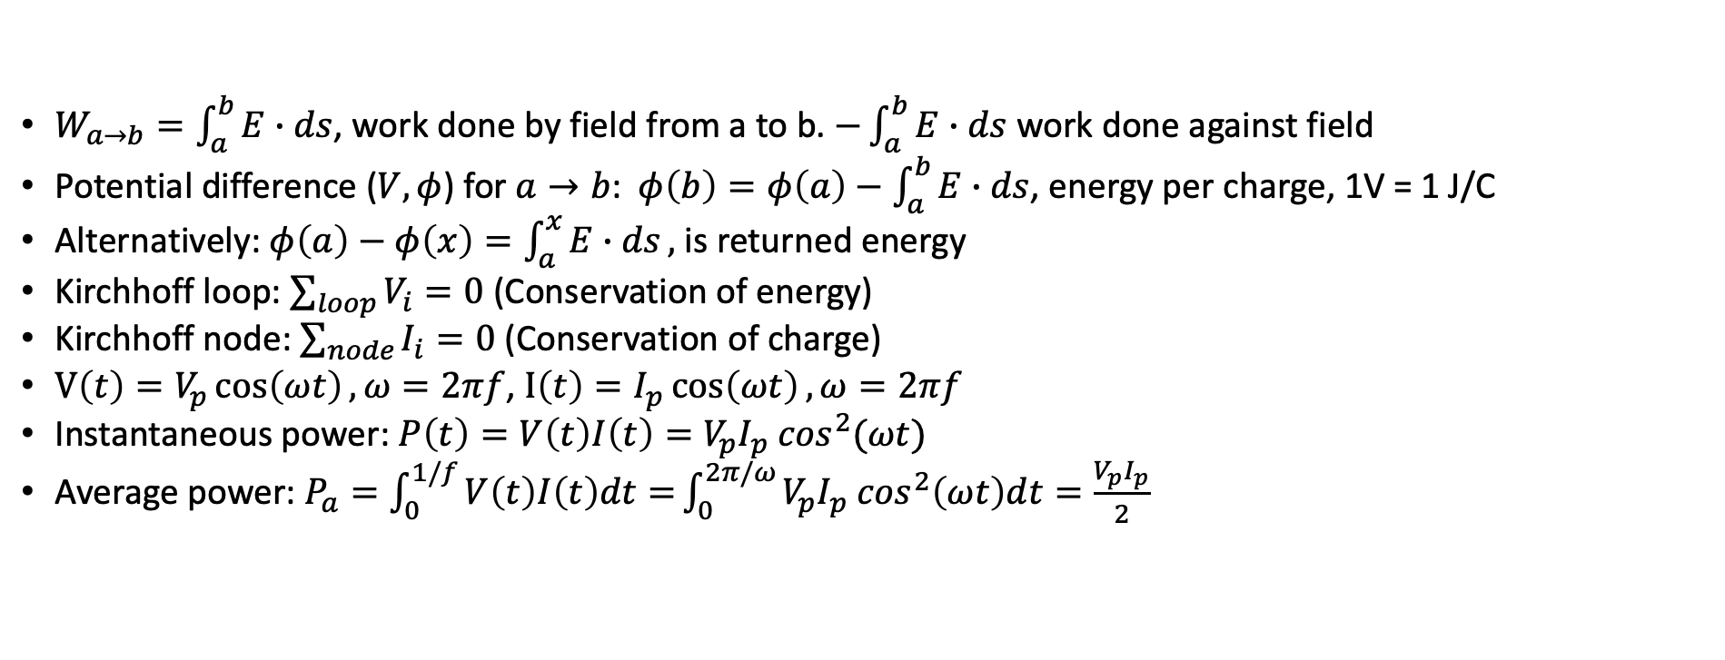
Basic concepts
$W_{a→b}=\int_{a}^{b}{E∙ds}$, work done by field from a to b. $−\int_{a}^{b}{E∙ds}$ work done against field
Potential difference ($V, φ$) for $a→b$:$φ\left(b\right)=φ\left(a\right)−\int_{a}^{b}{E∙ds}$, energy per charge, 1V = 1 J/C
Alternatively: $φ\left(a\right)−φ\left(x\right)=\int_{a}^{x}{E∙ds},$ is returned energy
Kirchhoff loop: $\sum_{loop}{V_{i}=0}$ (Conservation of energy)
Kirchhoff node: $\sum_{node}{I_{i}=0}$ (Conservation of charge)
$V\left(t\right)=V_{p}\cos\left(ωt\right), ω=2πf$, $I\left(t\right)=I_{p}\cos\left(ωt\right), ω=2πf$
Instantaneous power: $P\left(t\right)=V\left(t\right)I\left(t\right)=V_{p}I_{p} \cos^{2}(ωt)$
Average power: $P_{a}=\int_{0}^{1/f}{V\left(t\right)I\left(t\right)dt=}\int_{0}^{2π/ω}{V_{p}I_{p} \cos^{2}\left(ωt\right)dt}=\frac{V_{p}I_{p}}{2}$
Name | Frequency
VLF | 3-30kHz
LW | 20-300kHz
MW | 300kHz-3MHz
HF | 3MHz-30MHz
VHF | 30-300MHz
Band Names
Name | Frequency
UHF | 300MHz-1GHz
uW | 1-30GHz
milliW | 30-300GHz
submilliF | >300GHz

Slide 3

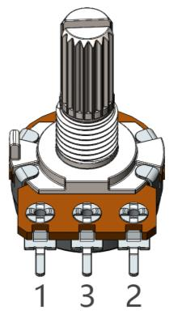
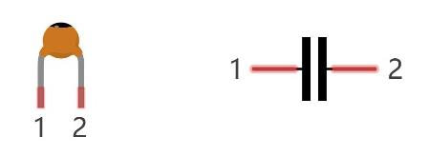
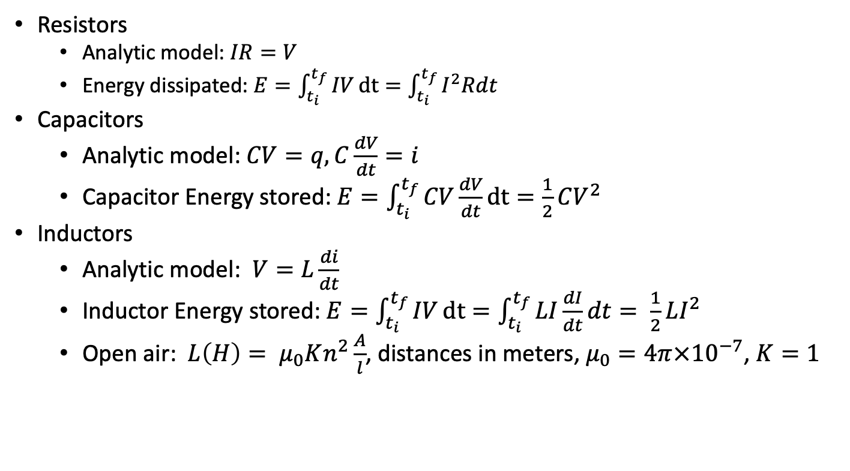
Resistors, capacitors, inductors
Resistors
Analytic model: $IR=V$
Energy dissipated: $E=\int_{t_{i}}^{t_{f}}{IV}dt=\int_{t_{i}}^{t_{f}}{I^{2}Rdt}$
Capacitors
Analytic model: $CV=q, C\frac{dV}{dt}=i$
Capacitor Energy stored: $E=\int_{t_{i}}^{t_{f}}{CV\frac{dV}{dt}}dt=\frac{1}{2}CV^{2}$
Inductors
Analytic model: $V=L\frac{di}{dt}$
Inductor Energy stored: $E=\int_{t_{i}}^{t_{f}}{IV}dt=\int_{t_{i}}^{t_{f}}{LI\frac{dI}{dt}dt= \frac{1}{2}LI^{2}}$
Open air: $L\left(H\right)= μ_{0}Kn^{2}\frac{A}{l}$, distances in meters, $μ_{0}=4π×{10}^{−7}$, $K=1$
R
Credit: Make Electronics

Slide 4

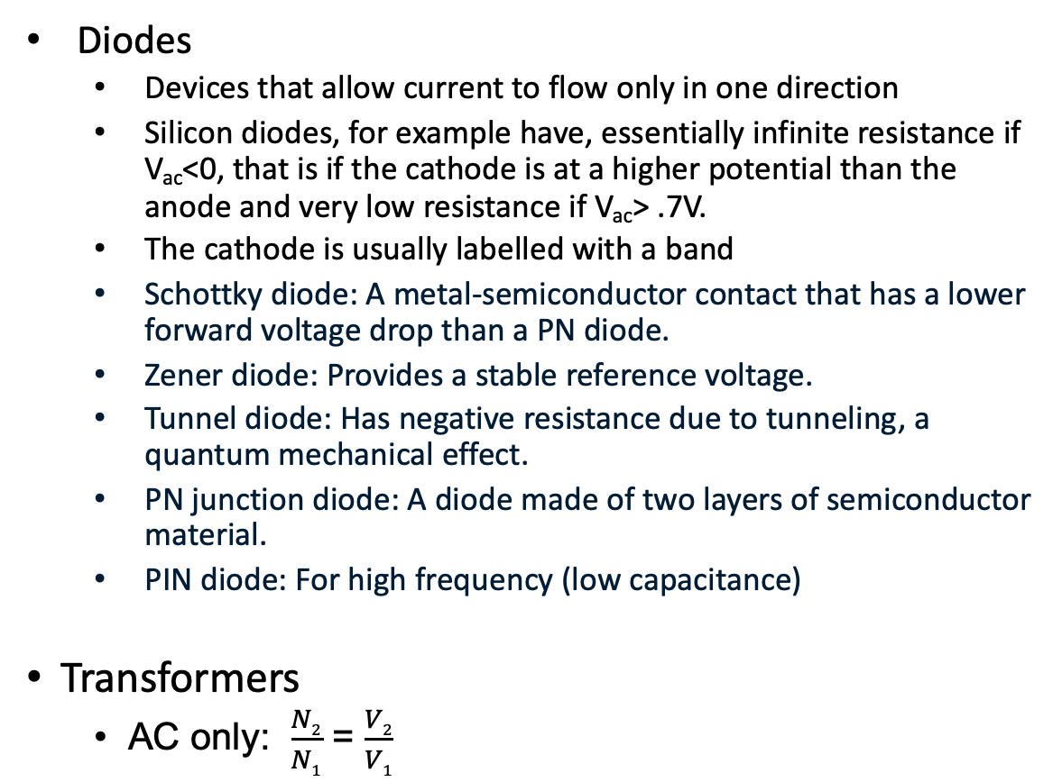
Diodes, transformers
Diodes
Devices that allow current to flow only in one direction
Silicon diodes, for example have, essentially infinite resistance if V_{ac}<0, that is if the cathode is at a higher potential than the anode and very low resistance if V_{ac}> .7V.
The cathode is usually labelled with a band
Schottky diode: A metal-semiconductor contact that has a lower forward voltage drop than a PN diode.
Zener diode: Provides a stable reference voltage.
Tunnel diode: Has negative resistance due to tunneling, a quantum mechanical effect.
PN junction diode: A diode made of two layers of semiconductor material.
PIN diode: For high frequency (low capacitance)
Transformers
AC only: $\frac{N2}{N1}$ = $\frac{V2}{V1}$
Credit: Make Electronics

Slide 5
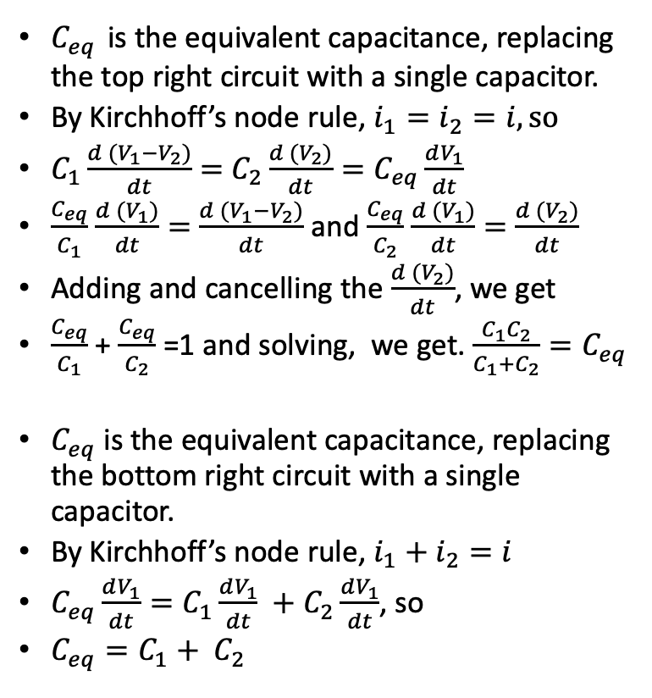
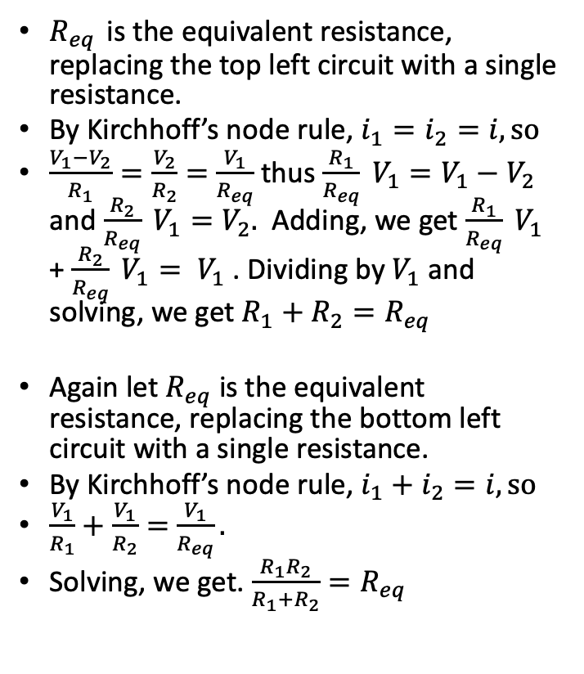
Simple circuit analysis with Kirchhoff
$R_{eq}$ is the equivalent resistance, replacing the top left circuit with a single resistance.
By Kirchhoff’s node rule, $i_{1}=i_{2}=i, so$
$\frac{V_{1}−V_{2}}{R_{1}}=\frac{V_{2}}{R_{2}}=$ $\frac{V_{1}}{R_{eq}}$ thus $\frac{R_{1}}{R_{eq}} V_{1}=V_{1}−V_{2}$ and $\frac{R_{2}}{R_{eq}} V_{1}=V_{2}.$ Adding, we get $\frac{R_{1}}{R_{eq}} V_{1}$ + $\frac{R_{2}}{R_{eq}} V_{1}= V_{1}$ . Dividing by $V_{1}$ and solving, we get $R_{1}+R_{2}=R_{eq}$
Again let $R_{eq}$ is the equivalent resistance, replacing the bottom left circuit with a single resistance.
By Kirchhoff’s node rule, $i_{1}+i_{2}=i, so$
$\frac{V_{1}}{R_{1}}+\frac{V_{1}}{R_{2}}=$ $\frac{V_{1}}{R_{eq}}.$
Solving, we get. $\frac{R_{1}R_{2}}{R_{1}+R_{2}}=R_{eq}$
$C_{eq}$ is the equivalent capacitance, replacing the top right circuit with a single capacitor.
By Kirchhoff’s node rule, $i_{1}=i_{2}=i, so$
$C_{1}\frac{d (V_{1}−V_{2})}{dt}=$ $C_{2}\frac{d (V_{2})}{dt}=C_{eq}\frac{dV_{1}}{dt}$
$\frac{C_{eq}}{C_{1}}$ $\frac{d (V_{1})}{dt}=$ $\frac{d (V_{1}−V_{2})}{dt}$ and $\frac{C_{eq}}{C_{2}}$ $\frac{d (V_{1})}{dt}=$ $\frac{d (V_{2})}{dt}$
Adding and cancelling the $\frac{d (V_{2})}{dt}$, we get
$\frac{C_{eq}}{C_{1}}$ + $\frac{C_{eq}}{C_{2}}$ =1 and solving, we get. $\frac{C_{1}C_{2}}{C_{1}+C_{2}}=C_{eq}$
$C_{eq}$ is the equivalent capacitance, replacing the bottom right circuit with a single capacitor.
By Kirchhoff’s node rule, $i_{1}+i_{2}=i$
$C_{eq}\frac{dV_{1}}{dt}=C_{1}\frac{dV_{1}}{dt} +C_{2}\frac{dV_{1}}{dt}$, so
$C_{eq}=C_{1}+ C_{2}$
V₁
V₁
R₁
i₁
C₁
i₁
i
i
V₂
V₂
R₂
i₂
C₂
i₂
V=0
V=0
V₁
i
i₁
V₁
R₁
R₂
i₂
i
C₁
i₁
C₂
i₂
V=0
V=0

Slide 6
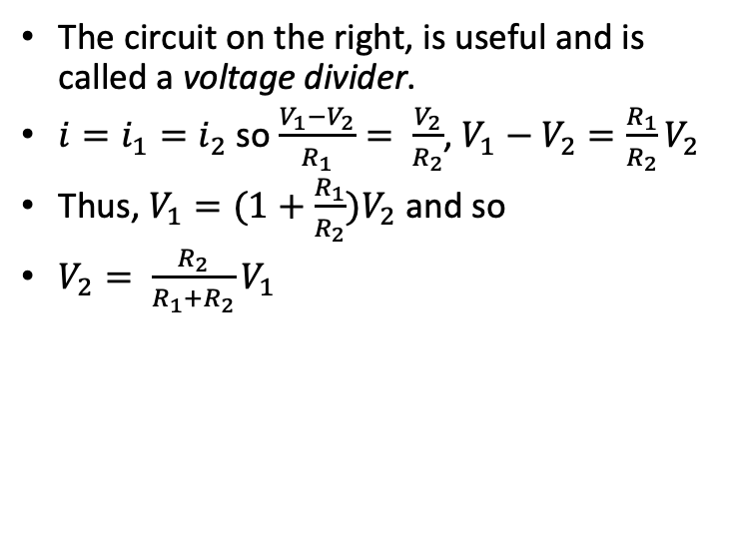
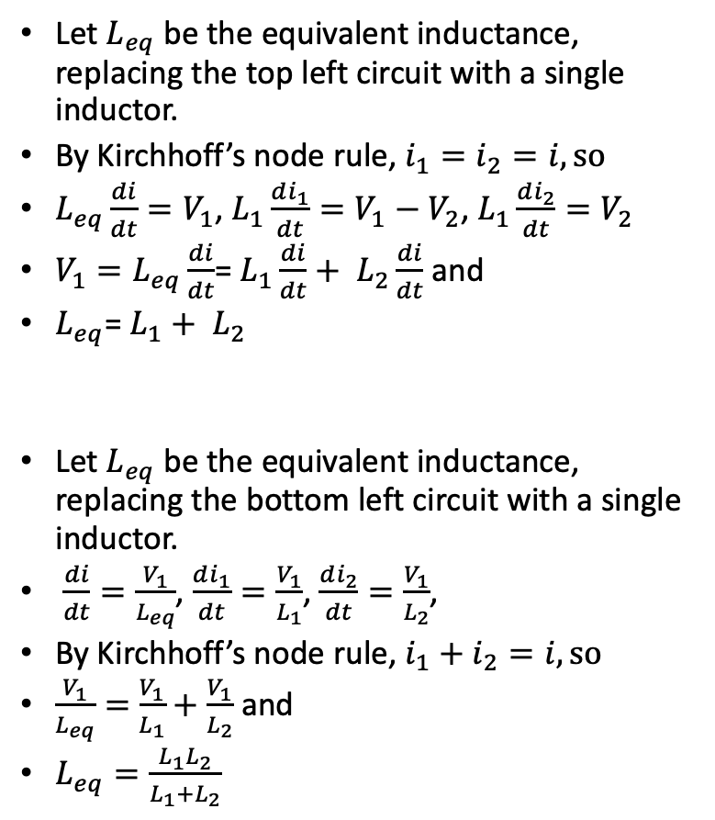
Simple circuit analysis with Kirchhoff
Let $L_{eq}$ be the equivalent inductance, replacing the top left circuit with a single inductor.
By Kirchhoff’s node rule, $i_{1}=i_{2}=i, so$
$L_{eq}\frac{di}{dt}=V_{1}$, $L_{1}\frac{di_{1}}{dt}=V_{1}−V_{2}$, $L_{1}\frac{di_{2}}{dt}=V_{2}$
${V_{1}=L}_{eq}\frac{di}{dt}$= $L_{1}\frac{di}{dt}+ L_{2}\frac{di}{dt}$ and
$L_{eq}$= $L_{1}+ L_{2}$
Let $L_{eq}$ be the equivalent inductance, replacing the bottom left circuit with a single inductor.
$\frac{di}{dt}=\frac{V_{1}}{L_{eq}}$, $\frac{di_{1}}{dt}=\frac{V_{1}}{L_{1}}$, $\frac{di_{2}}{dt}=\frac{V_{1}}{L_{2}}$,
By Kirchhoff’s node rule, $i_{1}+i_{2}=i, so$
$\frac{V_{1}}{L_{eq}}=$ $\frac{V_{1}}{L_{1}}+\frac{V_{1}}{L_{2}}$ and
$L_{eq}=\frac{L_{1}L_{2}}{L_{1}+L_{2}}$
The circuit on the right, is useful and is called a voltage divider.
$i=i_{1}=i_{2}$ so $\frac{V_{1}−V_{2}}{R_{1}}= \frac{V_{2}}{R_{2}}$, $V_{1}−V_{2}=\frac{R_{1}}{R_{2}}V_{2}$
Thus, $V_{1}=(1+\frac{R_{1}}{R_{2}})V_{2}$ and so
$V_{2}= \frac{R_{2}}{R_{1}+R_{2}}V_{1}$
V₁
L₁
i₁
i
V₂
L₂
i₂
V₁
V=0
R₁
i₁
i
V₂
R₂
i₂
V₁
V=0
i
L₁
i₁
L₂
i₂
V=0

Slide 7
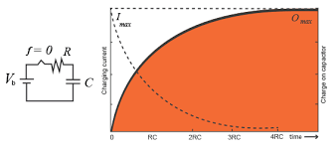
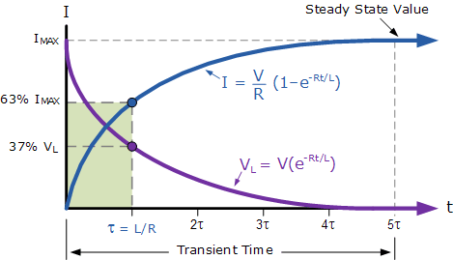
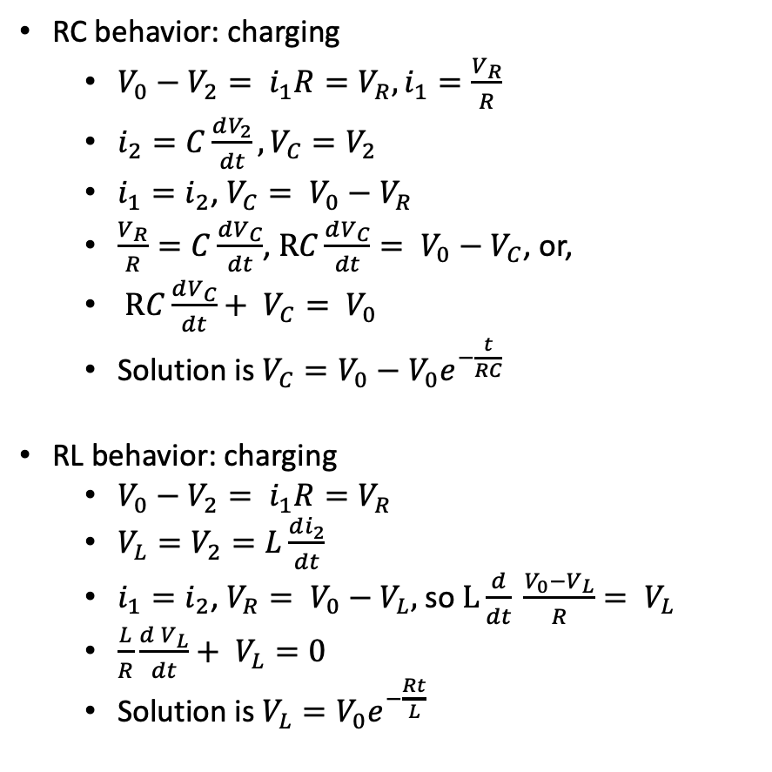
RC/RL circuit analysis with Kirchhoff
RC behavior: charging
$V_{0}−V_{2}= i_{1}R=V_{R}, i_{1}=\frac{V_{R}}{R}$
$i_{2}=C\frac{dV_{2}}{dt},V_{C}=V_{2}$
$i_{1}=i_{2}$, $V_{C}= V_{0}−V_{R}$
$\frac{V_{R}}{R}=C\frac{dV_{C}}{dt}$,$RC\frac{dV_{C}}{dt}= V_{0}−V_{C}$, or,
$RC\frac{dV_{C}}{dt}+ V_{C}= V_{0}$
Solution is $V_{C}=V_{0}−V_{0}e^{−\frac{t}{RC}}$
RL behavior: charging
$V_{0}−V_{2}= i_{1}R=V_{R}$
$V_{L}=V_{2}=L\frac{di_{2}}{dt}$
$i_{1}=i_{2}$, $V_{R}= V_{0}−V_{L},$ so $L\frac{d}{dt} \frac{V_{0}−V_{L}}{R}= V_{L}$
$\frac{L}{R}\frac{d V_{L}}{dt}+ V_{L}=0$
Solution is $V_{L}=V_{0}e^{−\frac{Rt}{L}}$
V₀
R
i₁
+
V₂
-
C
i₂
V₀
R
i₁
+
V₂
-
L
i₂
C₂

Slide 8
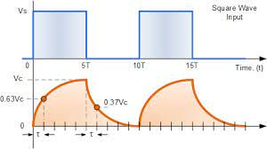
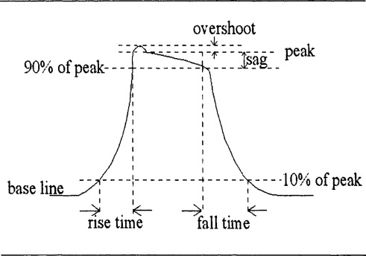
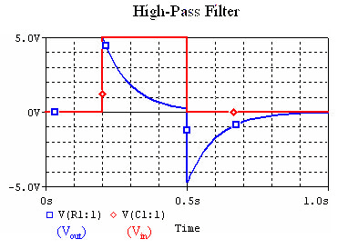

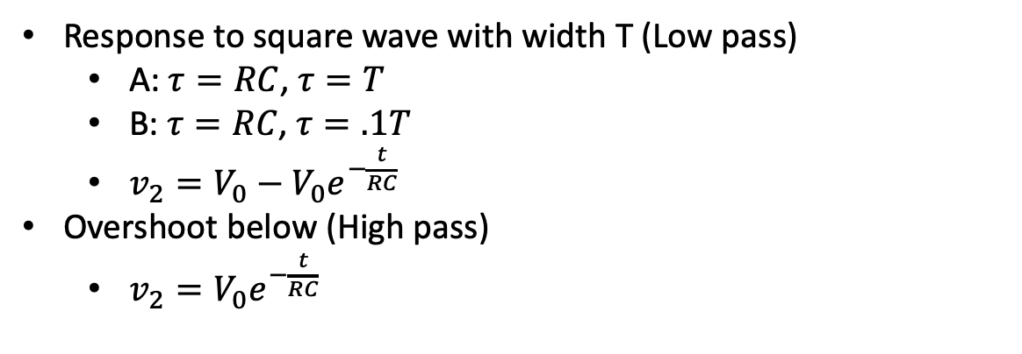

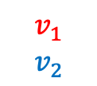








Voltage responses
$$R$$
$$v_{1}$$
$$v_{2}$$
Low pass
A
$$C$$
Response to square wave with width T (Low pass)
A: $τ=RC$, $τ=T$
B: $τ=RC$, $τ=.1T$
$v_{2}=V_{0}−V_{0}e^{−\frac{t}{RC}}$
Overshoot below (High pass)
$v_{2}=V_{0}e^{−\frac{t}{RC}}$
$$v_{1}$$
$$v_{2}$$
$$C$$
High pass
$$v_{1}$$
$$v_{2}$$
$$R$$
B
$$v_{1}$$
$$v_{2}$$

Slide 9
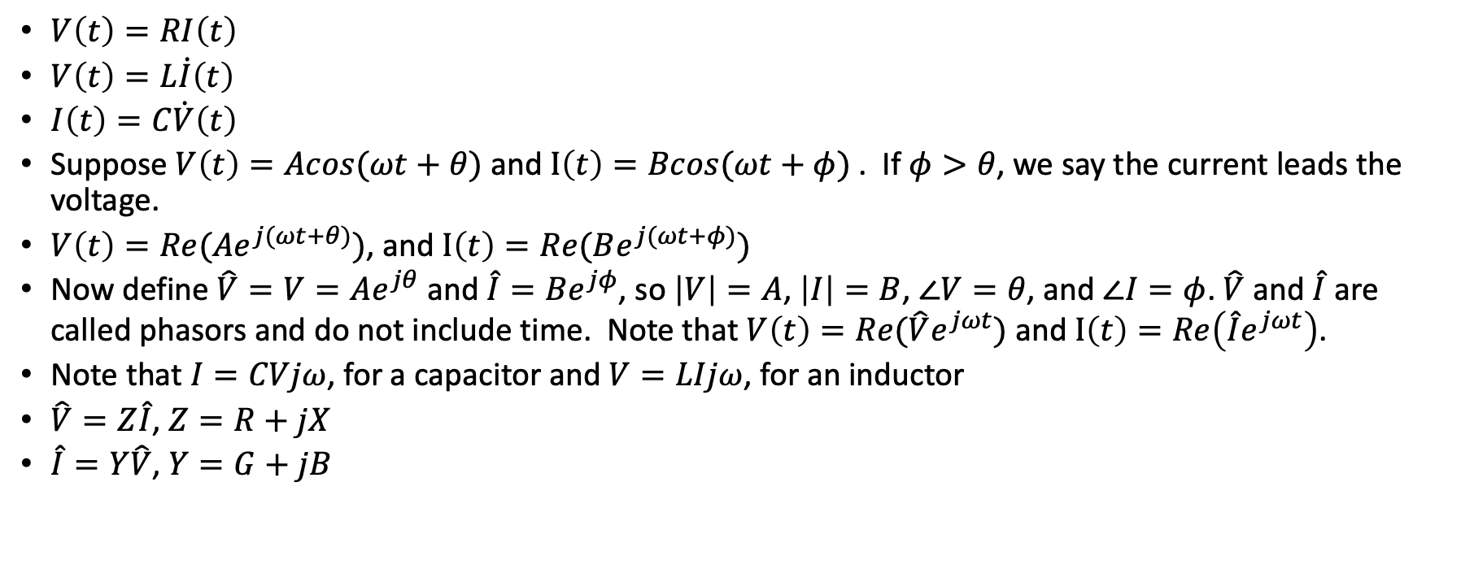
Phasors
$V\left(t\right)=RI\left(t\right)$
$V\left(t\right)=L\dot{I}\left(t\right)$
$I\left(t\right)=C\dot{V}\left(t\right)$
Suppose $V\left(t\right)=Acos(ωt+θ)$ and $I\left(t\right)=Bcos(ωt+φ)$ . If $φ>θ$, we say the current leads the voltage.
$V\left(t\right)=Re({Ae}^{j(ωt+θ)})$, and $I\left(t\right)=Re(Be^{j(ωt+φ)})$
Now define $\hat{V}=V=Ae^{jθ}$ and $\hat{I}=Be^{jφ}$, so $\left|V\right|=A$, $\left|I\right|=B$, $∠V=θ$, and $∠I=φ$. $\hat{V}$ and $\hat{I}$ are called phasors and do not include time. Note that $V\left(t\right)=Re(\hat{V}e^{jωt})$ and $I\left(t\right)=Re\left(\hat{I}e^{jωt}\right)$.
Note that $I=CVjω$, for a capacitor and $V=LIjω$, for an inductor
$\hat{V}=Z\hat{I}$, $Z=R+jX$
$\hat{I}=Y\hat{V}$, $Y=G+jB$

Slide 10
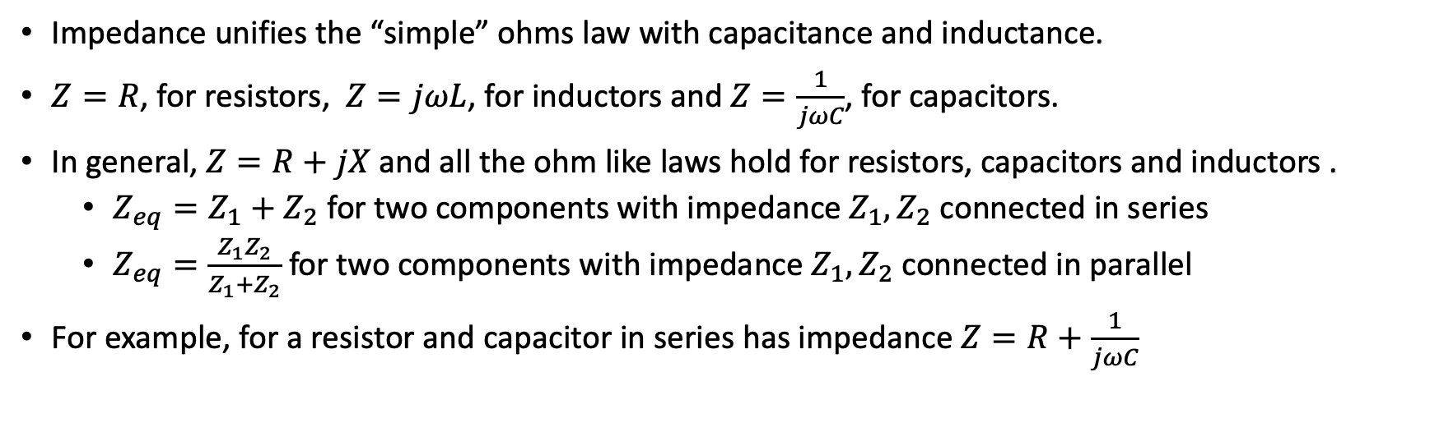
Circuit analysis and impedance
Impedance unifies the “simple” ohms law with capacitance and inductance.
$Z=R$, for resistors, $Z=jωL$, for inductors and $Z=\frac{1}{jωC}$, for capacitors.
In general, $Z=R+jX$ and all the ohm like laws hold for resistors, capacitors and inductors .
$Z_{eq}=Z_{1}+Z_{2}$ for two components with impedance $Z_{1}, Z_{2}$ connected in series
$Z_{eq}=\frac{Z_{1}Z_{2}}{Z_{1}+Z_{2}}$ for two components with impedance $Z_{1}, Z_{2}$ connected in parallel
For example, for a resistor and capacitor in series has impedance $Z=R+\frac{1}{jωC}$

Slide 11
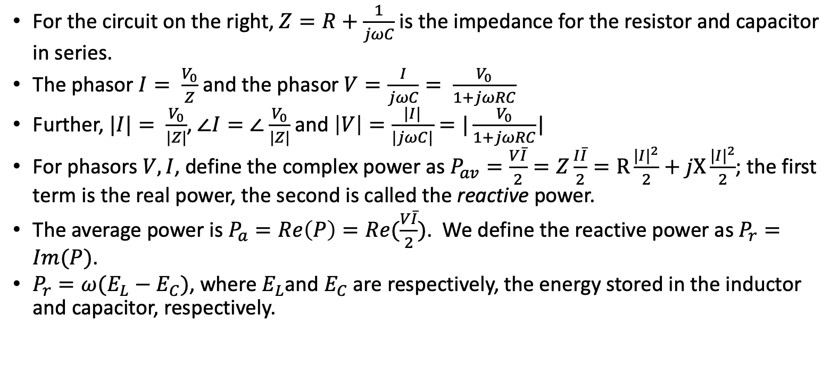
Phasors, impedance and power
For the circuit on the right, $Z=R+\frac{1}{jωC}$ is the impedance for the resistor and capacitor in series.
The phasor $I= \frac{V_{0}}{Z}$ and the phasor $V=\frac{I}{jωC}= \frac{V_{0}}{1+jωRC}$
Further, $|I|= \frac{V_{0}}{|Z|}$, $∠I=∠$ $\frac{V_{0}}{|Z|}$ and $\left|V\right|=\frac{|I|}{|jωC|}=|\frac{V_{0}}{1+jωRC}$|
For phasors $V,I$, define the complex power as $P_{av}=\frac{V\overline{I}}{2}=Z\frac{I\overline{I}}{2}=R\frac{{|I|}^{2}}{2}+jX\frac{{|I|}^{2}}{2}$; the first term is the real power, the second is called the reactive power.
The average power is $P_{a}=Re\left(P\right)=Re(\frac{V\overline{I}}{2})$. We define the reactive power as $P_{r}=Im(P)$.
$P_{r}=ω(E_{L}−E_{C})$, where $E_{L}$and $E_{C}$ are respectively, the energy stored in the inductor and capacitor, respectively.
R
V₀
C
I
V

Slide 12
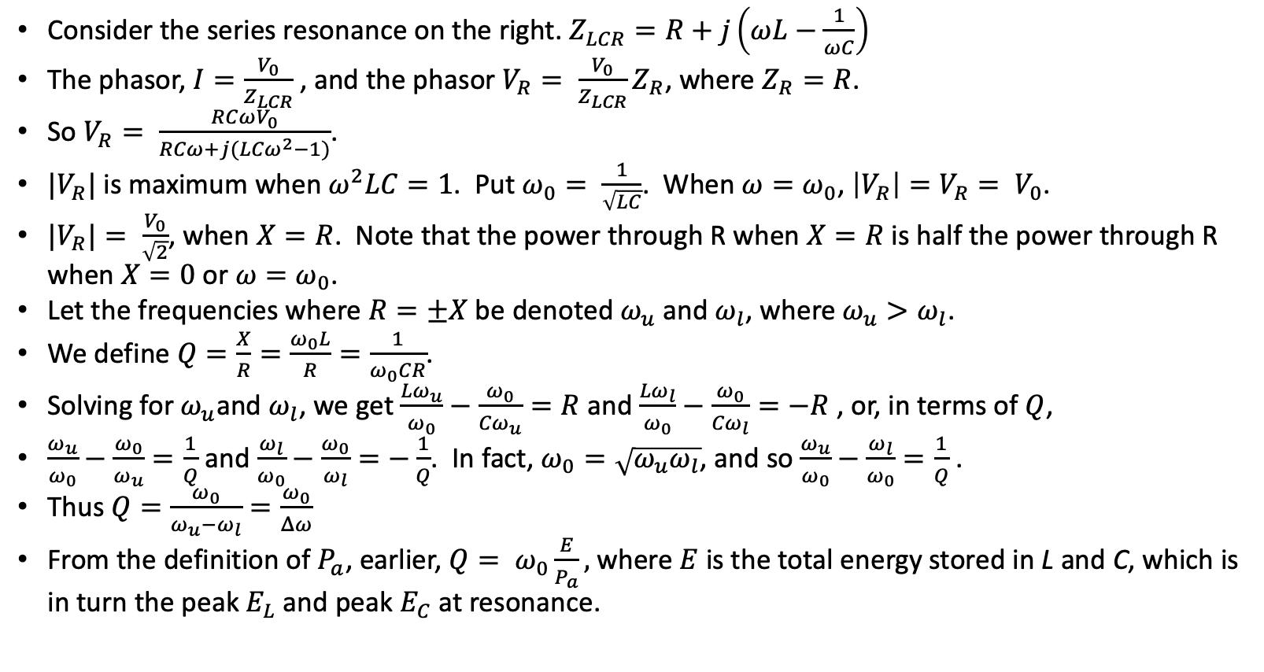
Q and phasors
L
Consider the series resonance on the right. $Z_{LCR}=R+j\left(ωL−\frac{1}{ωC}\right)$
The phasor, $I=\frac{V_{0}}{Z_{LCR}}$, and the phasor $V_{R}= \frac{V_{0}}{Z_{LCR}}Z_{R}$, where $Z_{R}=R$.
So $V_{R}= \frac{RCωV_{0}}{RCω+j({LCω}^{2}−1)}$.
$|V_{R}|$ is maximum when$ω^{2}LC=1$. Put $ω_{0}= \frac{1}{\sqrt{LC}}$. When $ω=ω_{0}$, $\left|V_{R}\right|=V_{R}= V_{0}$.
${|V}_{R}|= \frac{V_{0}}{\sqrt{2}}$, when $X=R$. Note that the power through R when $X=R$ is half the power through R when $X=0$ or $ω=ω_{0}$.
Let the frequencies where $R=±X$ be denoted $ω_{u}$ and $ω_{l}$, where $ω_{u}>ω_{l}$.
We define $Q=\frac{X}{R}=\frac{ω_{0}L}{R}=\frac{1}{ω_{0}CR}$.
Solving for $ω_{u}$and $ω_{l}$, we get $\frac{{Lω}_{u}}{ω_{0}}−\frac{ω_{0}}{{Cω}_{u}}=R$ and $\frac{{Lω}_{l}}{ω_{0}}−\frac{ω_{0}}{{Cω}_{l}}=−R$ , or, in terms of $Q$,
$\frac{ω_{u}}{ω_{0}}−\frac{ω_{0}}{ω_{u}}=\frac{1}{Q}$ and $\frac{ω_{l}}{ω_{0}}−\frac{ω_{0}}{ω_{l}}=−\frac{1}{Q}$. In fact, $ω_{0}=\sqrt{ω_{u}ω_{l}}$, and so $\frac{ω_{u}}{ω_{0}}−\frac{ω_{l}}{ω_{0}}=\frac{1}{Q}$ .
Thus $Q=\frac{ω_{0}}{ω_{u}−ω_{l}}=\frac{ω_{0}}{Δω}$
From the definition of $P_{a}$, earlier, $Q= ω_{0}\frac{E}{P_{a}},$ where $E$ is the total energy stored in L and C, which is in turn the peak $E_{L}$ and peak $E_{C}$ at resonance.
C
V₀
R
V_{R}

Slide 13
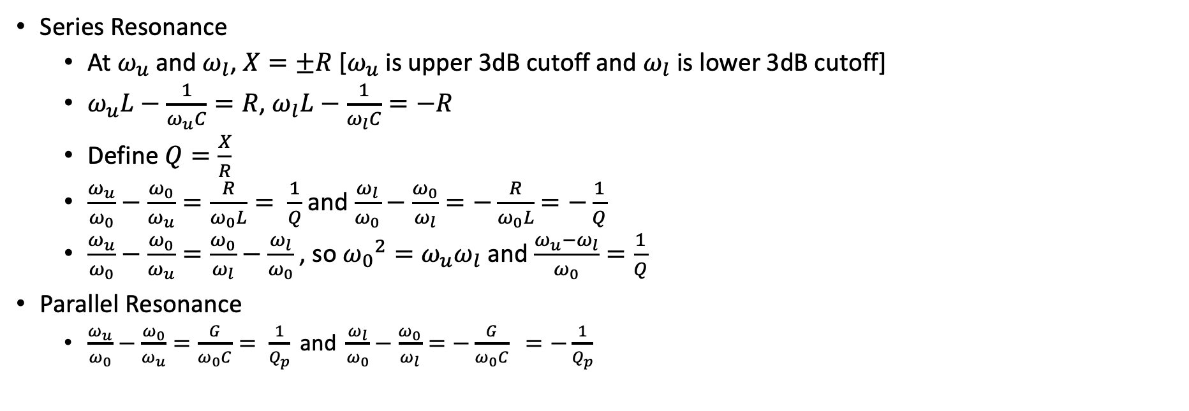
Resonance and Q
Series Resonance
At $ω_{u}$ and $ω_{l}$, $X=±R$ [$ω_{u}$ is upper 3dB cutoff and $ω_{l}$ is lower 3dB cutoff]
$ω_{u}L−\frac{1}{ω_{u}C}=R$, $ω_{l}L−\frac{1}{ω_{l}C}=−R$
Define $Q=\frac{X}{R}$
$\frac{ω_{u}}{ω_{0}}−\frac{ω_{0}}{ω_{u}}=\frac{R}{ω_{0}L}= \frac{1}{Q}$ and $\frac{ω_{l}}{ω_{0}}−\frac{ω_{0}}{ω_{l}}=−\frac{R}{ω_{0}L}$ $=−\frac{1}{Q}$
$\frac{ω_{u}}{ω_{0}}−\frac{ω_{0}}{ω_{u}}=\frac{ω_{0}}{ω_{l}}−\frac{ω_{l}}{ω_{0}}$, so ${ω_{0}}^{2}=ω_{u}ω_{l}$ and $\frac{ω_{u}−ω_{l}}{ω_{0}}=\frac{1}{Q}$
Parallel Resonance
$\frac{ω_{u}}{ω_{0}}−\frac{ω_{0}}{ω_{u}}=\frac{G}{ω_{0}C}= \frac{1}{Q_{p}}\text{ and }\frac{ω_{l}}{ω_{0}}−\frac{ω_{0}}{ω_{l}}=−\frac{G}{ω_{0}C} =−\frac{1}{Q_{p}}$

Slide 14
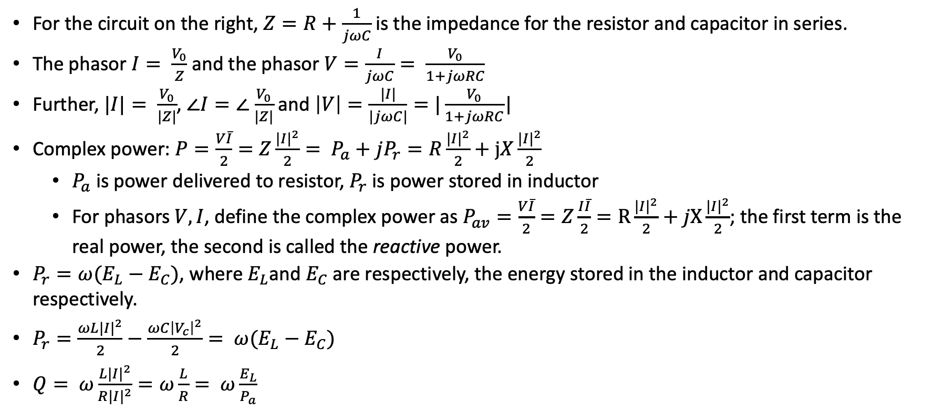
Phasors, impedance and power
For the circuit on the right, $Z=R+\frac{1}{jωC}$ is the impedance for the resistor and capacitor in series.
The phasor $I= \frac{V_{0}}{Z}$ and the phasor $V=\frac{I}{jωC}= \frac{V_{0}}{1+jωRC}$
Further, $|I|= \frac{V_{0}}{|Z|}$, $∠I=∠$ $\frac{V_{0}}{|Z|}$ and $\left|V\right|=\frac{|I|}{|jωC|}=|\frac{V_{0}}{1+jωRC}$|
Complex power: $P=\frac{V\overline{I}}{2}=Z\frac{{|I|}^{2}}{2}= P_{a}+jP_{r}=R\frac{{|I|}^{2}}{2}+jX\frac{{|I|}^{2}}{2}$
$P_{a}$ is power delivered to resistor, $P_{r}$ is power stored in inductor
For phasors $V,I$, define the complex power as $P_{av}=\frac{V\overline{I}}{2}=Z\frac{I\overline{I}}{2}=R\frac{{|I|}^{2}}{2}+jX\frac{{|I|}^{2}}{2}$; the first term is the real power, the second is called the reactive power.
$P_{r}=ω(E_{L}−E_{C})$, where $E_{L}$and $E_{C}$ are respectively, the energy stored in the inductor and capacitor respectively.
$P_{r}=\frac{ωL{|I|}^{2}}{2}−\frac{ωC{\left|V_{c}\right|}^{2}}{2}= ω(E_{L}−E_{C})$
$Q= ω\frac{L{|I|}^{2}}{R{|I|}^{2}}=ω\frac{L}{R}= ω\frac{E_{L}}{P_{a}}$
R
V₀
C
I
V

Slide 15
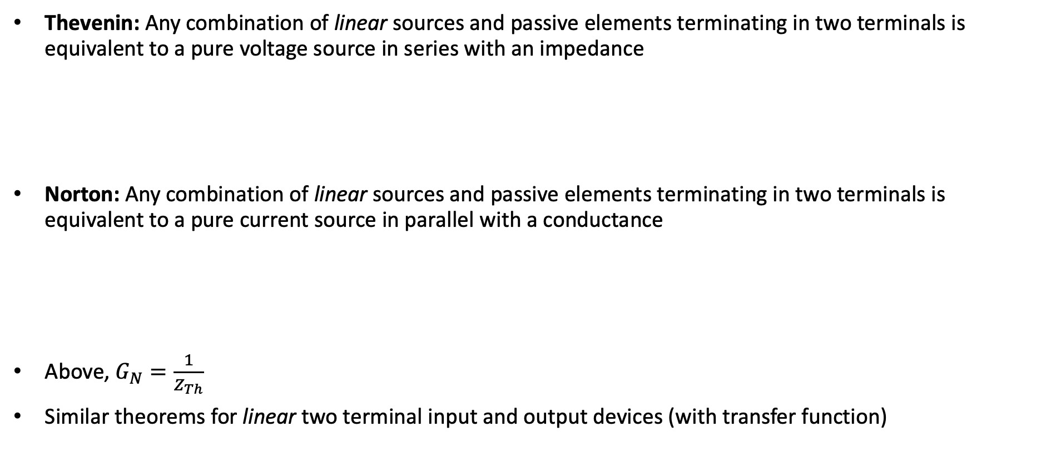
Thevenin and Norton
Thevenin: Any combination of linear sources and passive elements terminating in two terminals is equivalent to a pure voltage source in series with an impedance
Norton: Any combination of linear sources and passive elements terminating in two terminals is equivalent to a pure current source in parallel with a conductance
Above, $G_{N}=\frac{1}{Z_{Th}}$
Similar theorems for linear two terminal input and output devices (with transfer function)
Z_{Th}
V_{Th}
I_{N}
G_{N}

Slide 16

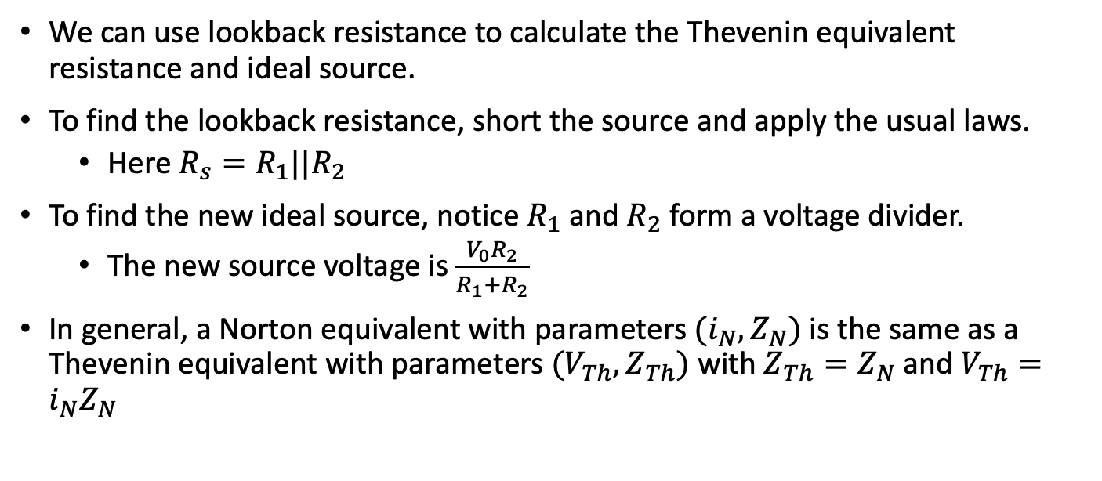

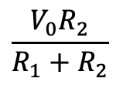
Thevenin and Norton
R₁
We can use lookback resistance to calculate the Thevenin equivalent resistance and ideal source.
To find the lookback resistance, short the source and apply the usual laws.
Here $R_{s}=R_{1}||R_{2}$
To find the new ideal source, notice $R_{1}$ and $R_{2}$ form a voltage divider.
The new source voltage is $\frac{V_{0}R_{2}}{R_{1}+R_{2}}$
In general, a Norton equivalent with parameters $(i_{N}, Z_{N})$ is the same as a Thevenin equivalent with parameters $(V_{Th}, Z_{Th})$ with $Z_{Th}=Z_{N}$ and $V_{Th}=i_{N}Z_{N}$
$$V0$$
R₂
is Thevenin equivalent to
$$R_{1}||R_{2}$$
$$\frac{V_{0}R_{2}}{R_{1}+R_{2}}$$

Slide 17
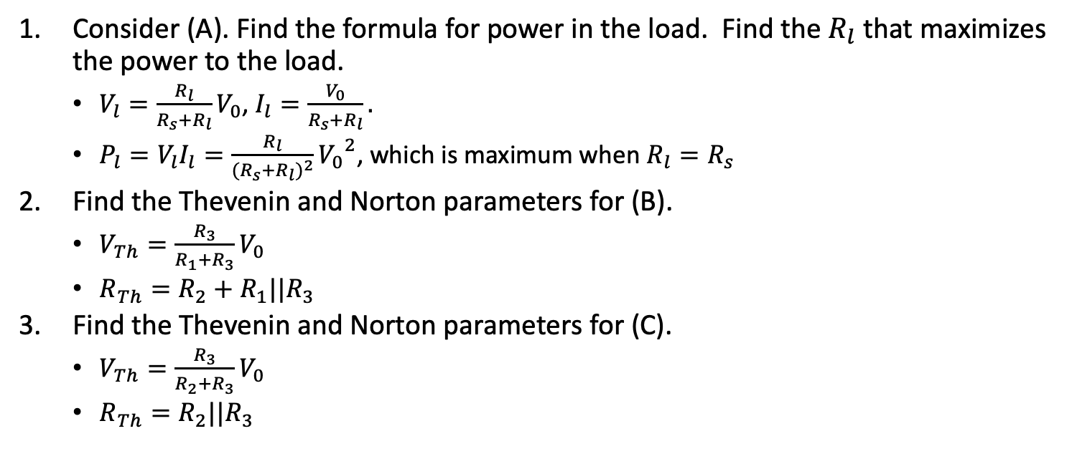
Exercise 1: Resistors
R_{s}
V_{l}
+
V₀
Consider (A). Find the formula for power in the load. Find the $R_{l}$ that maximizes the power to the load.
$V_{l}=\frac{R_{l}}{R_{s}+R_{l}}V_{0}$, $I_{l}=\frac{V_{0}}{R_{s}+R_{l}}.$
$P_{l}=V_{l}I_{l}=\frac{R_{l}}{{(R_{s}+R_{l})}^{2}}{V_{0}}^{2}$, which is maximum when $R_{l}=R_{s}$
Find the Thevenin and Norton parameters for (B).
$V_{Th}=\frac{R_{3}}{R_{1}+R_{3}}V_{0}$
$R_{Th}=R_{2}+R_{1}||R_{3}$
Find the Thevenin and Norton parameters for (C).
$V_{Th}=\frac{R_{3}}{R_{2}+R_{3}}V_{0}$
$R_{Th}=R_{2}||R_{3}$
-
R_{l}
A
R₁
R₂
+
R₃
V₀
-
B
R₂
+
R₁
V₀
R₃
-
C

Slide 18
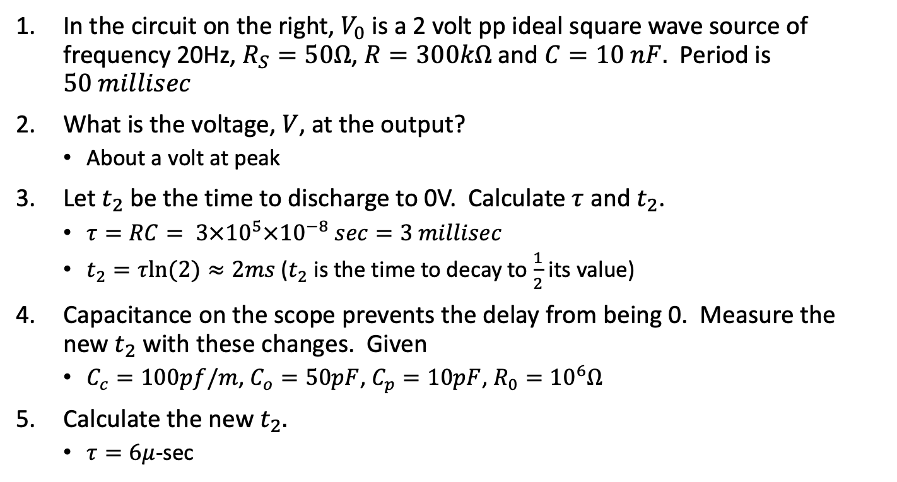
Exercise 3: Capacitors
In the circuit on the right, $V_{0}$ is a 2 volt pp ideal square wave source of frequency 20Hz, $R_{S}=50Ω$, $R=300kΩ$ and $C=10 nF.$ Period is $50 millisec$
What is the voltage, $V$, at the output?
About a volt at peak
Let $t_{2}$ be the time to discharge to 0V. Calculate $τ$ and $t_{2}$.
$τ=RC= 3×{10}^{5}×{10}^{−8} sec=3 millisec$
$t_{2}=τln⁡(2)≈2ms$($t_{2}$ is the time to decay to $\frac{1}{2}$ its value)
Capacitance on the scope prevents the delay from being 0. Measure the new $t_{2}$ with these changes. Given
$C_{c}=100pf/m$, $C_{o}=50pF$, $C_{p}=10pF$, $R_{0}={10}^{6}Ω$
Calculate the new $t_{2}.$
$τ=6μ$-sec
R_{s}
R
C
V
V₀
Probe
C_{c}
R_{p}
V
V_{i}
C_{p}
C_{o}
R₀

Slide 19
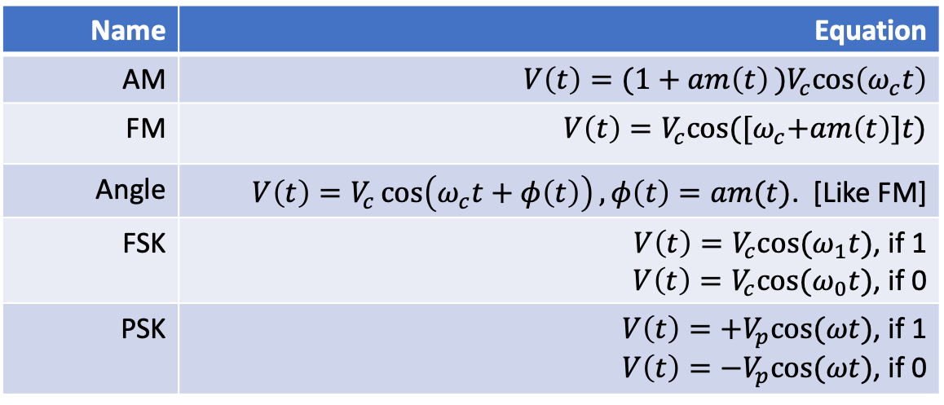
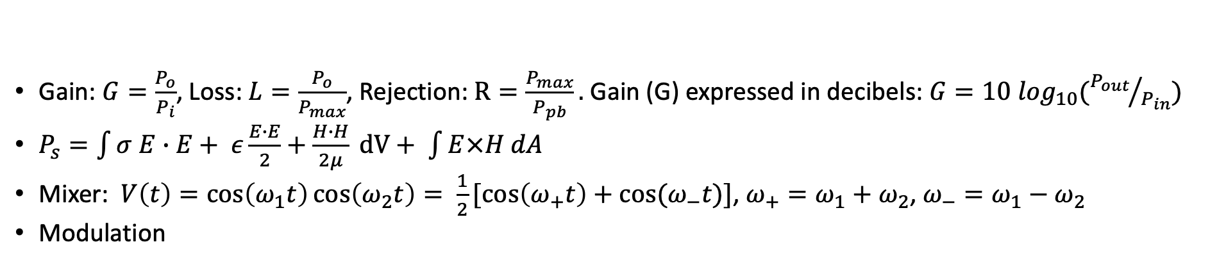
Signals and modulation
Gain: $G=\frac{P_{o}}{P_{i}}$, Loss: $L=\frac{P_{o}}{P_{max}}$, Rejection: $R=\frac{P_{max}}{P_{pb}}.$ Gain (G) expressed in decibels: $G=10 \log_{10}({P_{out}}/{P_{in}})$
$P_{s}=\int{σ E∙E+ ε\frac{E∙E}{2}+\frac{H∙H}{2μ}} dV+ \int{E×H dA}$
Mixer: $V\left(t\right)=\cos\left(ω_{1}t\right)\cos\left(ω_{2}t\right)= \frac{1}{2}[\cos\left(ω_{+}t\right)+cos⁡(ω_{−}t)]$, $ω_{+}=ω_{1}+ω_{2}$, $ω_{−}=ω_{1}−ω_{2}$
Modulation
Name | Equation
AM | $$V\left(t\right)=(1+am\left(t\right))V_{c}cos\left(ω_{c}t\right)$$
FM | $$V\left(t\right)=V_{c}cos⁡({[ω}_{c}+am\left(t\right)]t)$$
Angle | $V\left(t\right)=V_{c}\cos\left(ω_{c}t+φ\left(t\right)\right),φ\left(t\right)=am(t)$. [Like FM]
FSK | $V\left(t\right)=V_{c}cos⁡(ω_{1}t)$, if 1 $V\left(t\right)=V_{c}cos⁡(ω_{0}t)$, if 0
PSK | $V\left(t\right)={+V}_{p}cos⁡(ωt)$, if 1 $V\left(t\right)=−V_{p}cos⁡(ωt)$, if 0

Slide 20
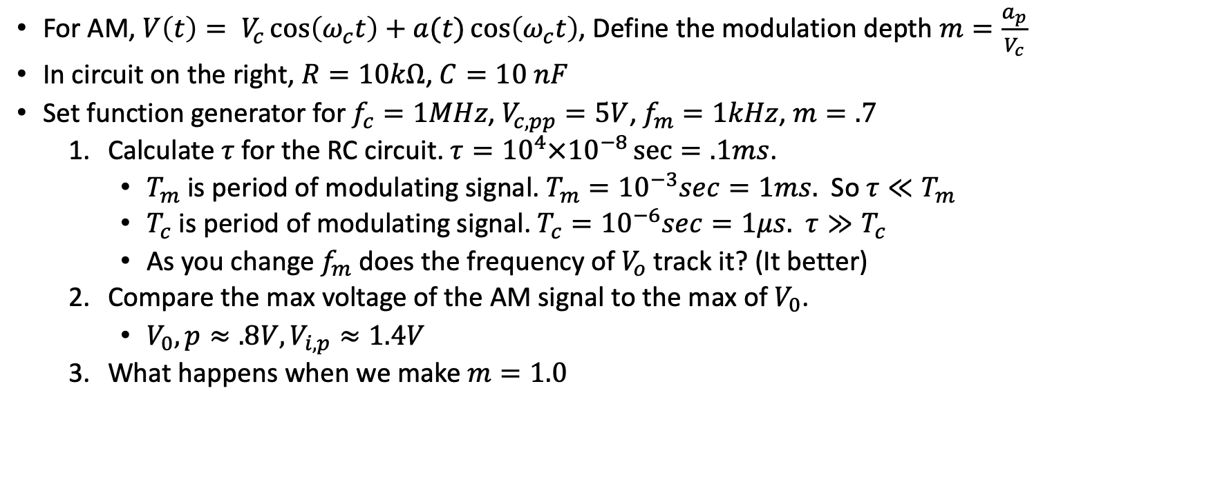
Exercise 4: Diode detectors
For AM, $V\left(t\right)= V_{c}\cos\left(ω_{c}t\right)+a(t)\cos\left(ω_{c}t\right)$, Define the modulation depth $m=\frac{a_{p}}{V_{c}}$
In circuit on the right, $R=10kΩ$, $C=10 nF$
Set function generator for $f_{c}=1MHz$, $V_{c,pp}=5V$, $f_{m}=1kHz$, $m=.7$
Calculate $τ$ for the RC circuit. $τ={10}^{4}×{10}^{−8}\sec{=.1ms}$.
$T_{m}$ is period of modulating signal. $T_{m}={10}^{−3}sec=1ms.$ So $τ≪T_{m}$
$T_{c}$ is period of modulating signal. $T_{c}={10}^{−6}sec=1μs.$ $τ≫T_{c}$
As you change $f_{m}$ does the frequency of $V_{o}$ track it? (It better)
Compare the max voltage of the AM signal to the max of $V_{0}$.
$V_{0},p≈.8V, V_{i,p}≈1.4V$
What happens when we make $m=1.0$
V_{i}
R
C
V_{o}

Slide 21
AM Modulator for previous exercise
12V
I didn’t have a signal generator that produced an AM signal, so I used the modulator on the right with the indicated inputs to produce the AM needed for the detector in the previous exercise.
47k
10k
.1uF
.1uF
Carrier signal
.8 Vpp, 1MHz
2.2k
10k
680
1nF
Modulation signal
4.2 V_{pp}, 1kHz

Slide 22

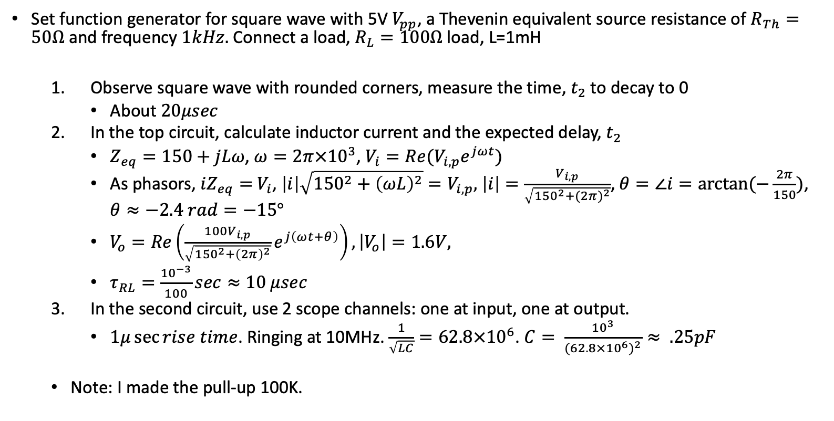

Exercise 5: Inductors
Set function generator for square wave with 5V $V_{pp}$, a Thevenin equivalent source resistance of $R_{Th}=50Ω$ and frequency $1kHz.$ Connect a load, $R_{L}=100Ω$ load, L=1mH
Observe square wave with rounded corners, measure the time, $t_{2}$ to decay to 0
About $20μsec$
In the top circuit, calculate inductor current and the expected delay, $t_{2}$
$Z_{eq}=150+jLω$, $ω=2π{×10}^{3}$, $V_{i}={Re(V}_{i,p}e^{jωt})$
As phasors, $iZ_{eq}=$ $V_{i}$, $\left|i\right|\sqrt{{150}^{2}+{\left(ωL\right)}^{2}}=V_{i,p},$ $\left|i\right|=\frac{V_{i,p}}{\sqrt{{150}^{2}+{(2π)}^{2}}}$, $θ=∠i=arctan⁡(−\frac{2π}{150})$, $θ≈−2.4 rad=−15°$
$V_{o}=Re\left(\frac{100V_{i,p}}{\sqrt{{150}^{2}+{\left(2π\right)}^{2}}}e^{j\left(ωt+θ\right)}\right), \left|V_{o}\right|=1.6V,$
$τ_{RL}=\frac{{10}^{−3}}{100}sec≈10 μsec$
In the second circuit, use 2 scope channels: one at input, one at output.
$1μ\sec{rise time}$. Ringing at 10MHz. $\frac{1}{\sqrt{LC}}=62.8×{10}^{6}$. $C= \frac{{10}^{3}}{{(62.8×{10}^{6})}^{2}}≈ .25pF$
Note: I made the pull-up 100K.
R_{Th}
L
V_{i}
R_{L}
V_{o}
12V
L
2k$Ω$
2N2222A
out
2k$Ω$

Slide 23
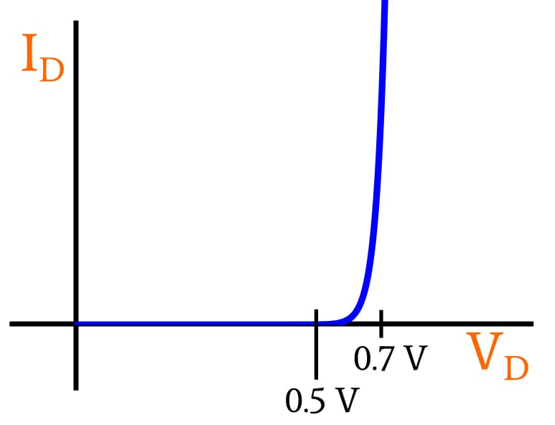
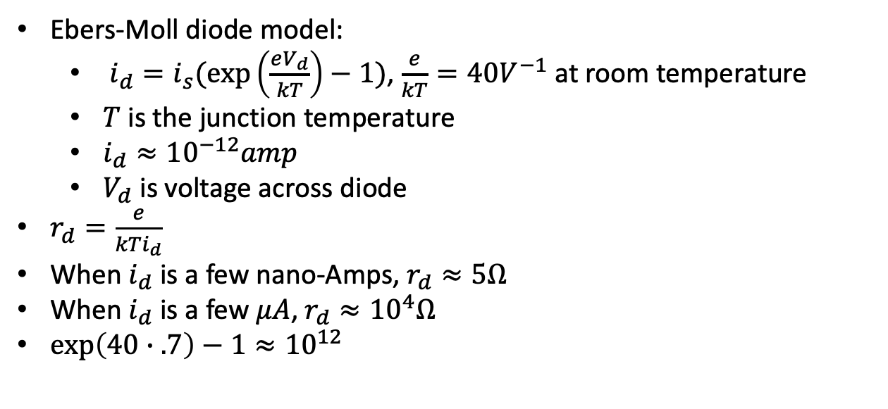
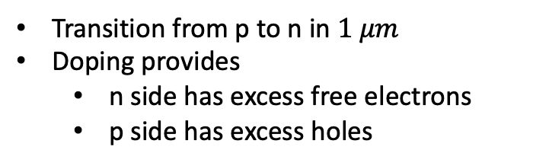
Diodes and bipolar small signal models
Ebers-Moll diode model:
$i_{d}=i_{s}(\exp\left(\frac{eV_{d}}{kT}\right)−1)$, $\frac{e}{kT}=40V^{−1}$ at room temperature
$T$ is the junction temperature
$i_{d}≈{10}^{−12}amp$
$V_{d}$ is voltage across diode
$r_{d}=\frac{e}{kTi_{d}}$
When $i_{d}$ is a few nano-Amps, $r_{d}≈5Ω$
When $i_{d}$ is a few $μA$, $r_{d}≈{10}^{4}Ω$
$\exp\left(40∙.7\right)−1≈{10}^{12}$
Transition from p to n in $1 μm$
Doping provides
n side has excess free electrons
p side has excess holes
p
n

Slide 24

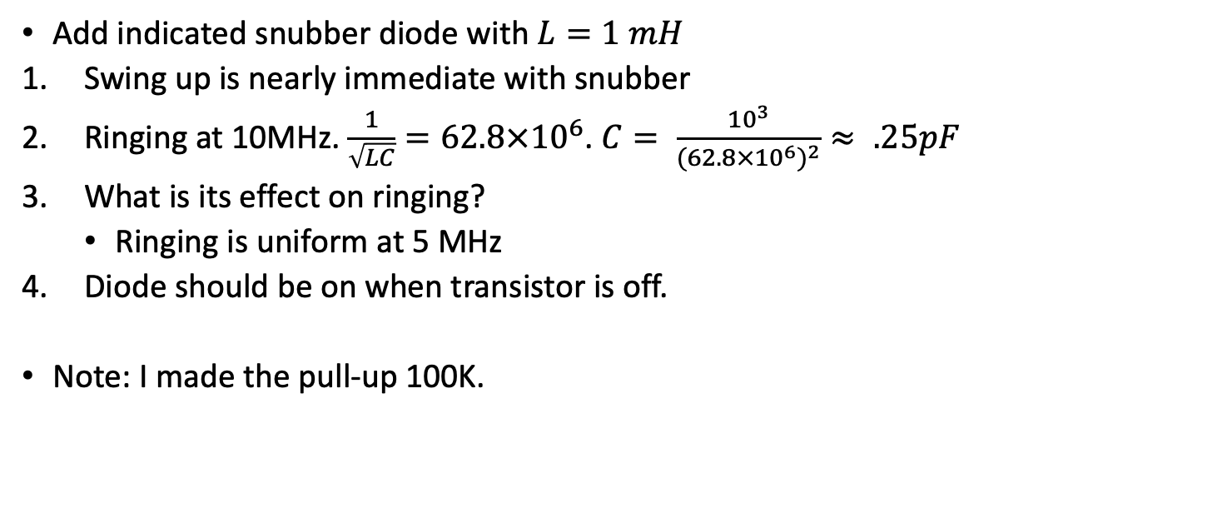
Exercise 6: Diodes and snubbers
Add indicated snubber diode with $L=1 mH$
Swing up is nearly immediate with snubber
Ringing at 10MHz. $\frac{1}{\sqrt{LC}}=62.8×{10}^{6}$. $C= \frac{{10}^{3}}{{(62.8×{10}^{6})}^{2}}≈ .25pF$
What is its effect on ringing?
Ringing is uniform at 5 MHz
Diode should be on when transistor is off.
Note: I made the pull-up 100K.
12 V
L
2k$Ω$
2N2222A
out
2k$Ω$

Slide 25
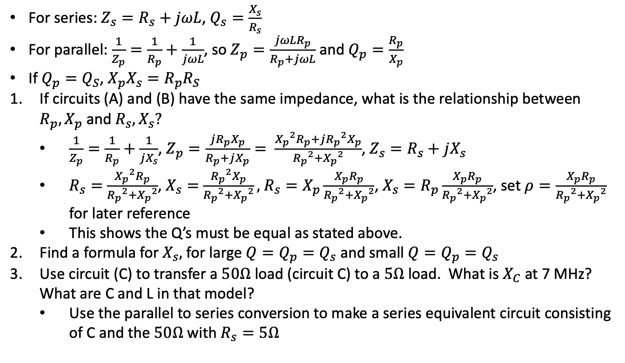


Exercise 7: Parallel to series conversion
For series: $Z_{s}=R_{s}+jωL$, $Q_{s}=\frac{X_{s}}{R_{s}}$
For parallel: $\frac{1}{Z_{p}}=\frac{1}{R_{p}}+\frac{1}{jωL}$, so $Z_{p}=\frac{jωLR_{p}}{R_{p}+jωL}$ and $Q_{p}=\frac{R_{p}}{X_{p}}$
If $Q_{p}=Q_{S}$, $X_{p}X_{s}=R_{p}R_{S}$
If circuits (A) and (B) have the same impedance, what is the relationship between $R_{p},X_{p}$ and $R_{s},X_{s}?$
$\frac{1}{Z_{p}}=\frac{1}{R_{p}}+\frac{1}{jX_{s}}$, $Z_{p}=\frac{j{R_{p}X}_{p}}{R_{p}+jX_{p}}= \frac{{X_{p}}^{2}R_{p}+j{R_{p}}^{2}X_{p}}{{R_{p}}^{2}+{X_{p}}^{2}}$, $Z_{s}=R_{s}+jX_{s}$
$R_{s}=$ $\frac{{X_{p}}^{2}R_{p}}{{R_{p}}^{2}+{X_{p}}^{2}}$, $X_{s}=$ $\frac{{R_{p}}^{2}X_{p}}{{R_{p}}^{2}+{X_{p}}^{2}},$ $R_{s}=X_{p}\frac{X_{p}R_{p}}{{R_{p}}^{2}+{X_{p}}^{2}}$, $X_{s}=R_{p}\frac{X_{p}R_{p}}{{R_{p}}^{2}+{X_{p}}^{2}}$, set $ρ=\frac{X_{p}R_{p}}{{R_{p}}^{2}+{X_{p}}^{2}}$ for later reference
This shows the Q’s must be equal as stated above.
Find a formula for $X_{s},$ for large $Q=Q_{p}=Q_{s}$ and small $Q=Q_{p}=Q_{s}$
Use circuit (C) to transfer a $50Ω$ load (circuit C) to a $5Ω$ load. What is $X_{C}$ at 7 MHz? What are C and L in that model?
Use the parallel to series conversion to make a series equivalent circuit consisting of C and the $50Ω$ with $R_{s}=5Ω$
A
R_{p}
jX_{p}
B
R_{s}
jX_{s}
L
C
$$Z_{i}=50Ω$$
C
$$50Ω$$

Slide 26
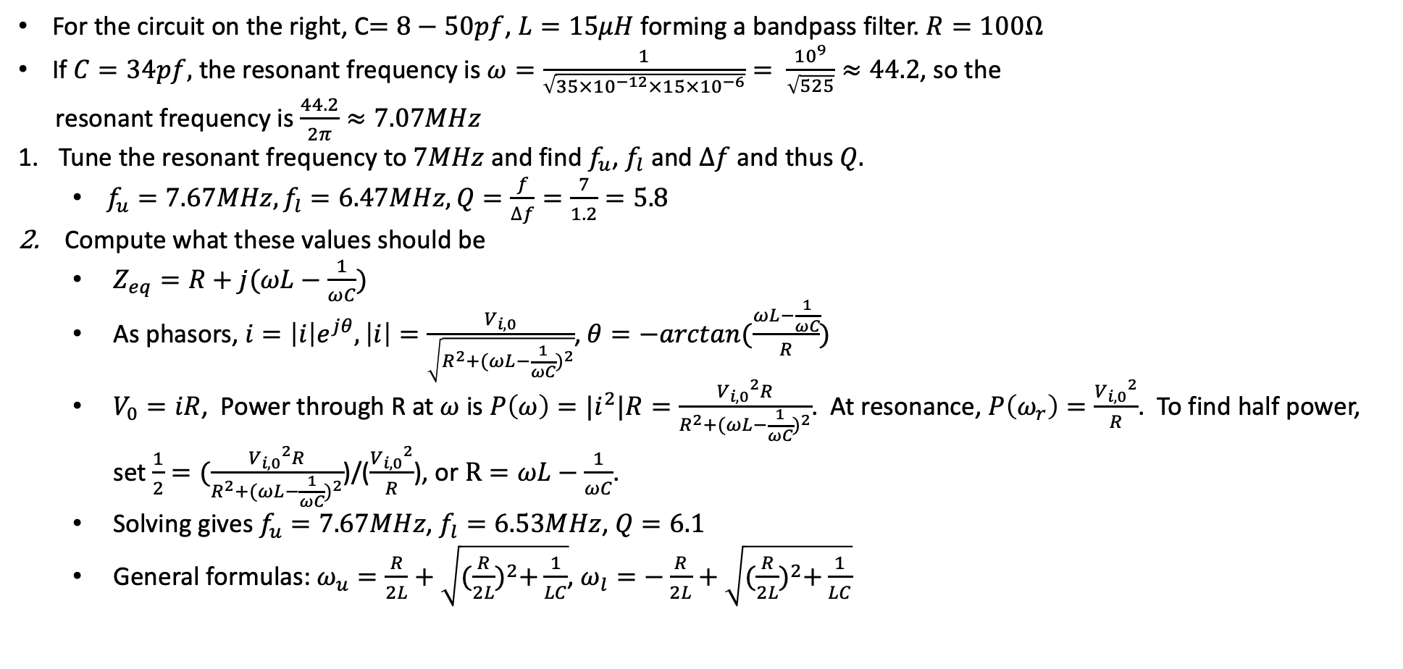
Exercise 8: Series resonance
For the circuit on the right, C$=8−50pf$, $L=15μH$ forming a bandpass filter. $R=100Ω$
If $C=34pf,$ the resonant frequency is $ω=\frac{1}{\sqrt{35×{10}^{−12}×15×{10}^{−6}}}= \frac{{10}^{9}}{\sqrt{525}}≈44.2$, so the
resonant frequency is $\frac{44.2}{2π}≈7.07MHz$
Tune the resonant frequency to $7MHz$ and find $f_{u}$, $f_{l}$ and $∆f$ and thus $Q.$
$f_{u}=7.67MHz, f_{l}=6.47MHz, Q=\frac{f}{∆f}=\frac{7}{1.2}=5.8$
Compute what these values should be
$Z_{eq}=R+j(ωL−\frac{1}{ωC})$
As phasors, $i=\left|i\right|e^{jθ}, \left|i\right|=\frac{V_{i,0}}{\sqrt{R^{2}+{(ωL−\frac{1}{ωC})}^{2}}}$, $θ=−arctan(\frac{ωL−\frac{1}{ωC}}{R})$
$V_{0}=iR$, Power through R at $ω$ is $P\left(ω\right)={|i}^{2}|R=\frac{{V_{i,0}}^{2}R}{R^{2}+{(ωL−\frac{1}{ωC})}^{2}}$. At resonance, $P\left(ω_{r}\right)=\frac{{V_{i,0}}^{2}}{R}$. To find half power, set $\frac{1}{2}=(\frac{{V_{i,0}}^{2}R}{R^{2}+{(ωL−\frac{1}{ωC})}^{2}}$)/($\frac{{V_{i,0}}^{2}}{R}$), or $R=ωL−\frac{1}{ωC}$.
Solving gives $f_{u}=7.67MHz$, $f_{l}=6.53MHz$, $Q=6.1$
General formulas: $ω_{u}=\frac{R}{2L}+\sqrt{{(\frac{R}{2L})}^{2}+\frac{1}{LC}}$, $ω_{l}=−\frac{R}{2L}+\sqrt{{(\frac{R}{2L})}^{2}+\frac{1}{LC}}$
C
L
V_{i}
R
V_{o}

Slide 27
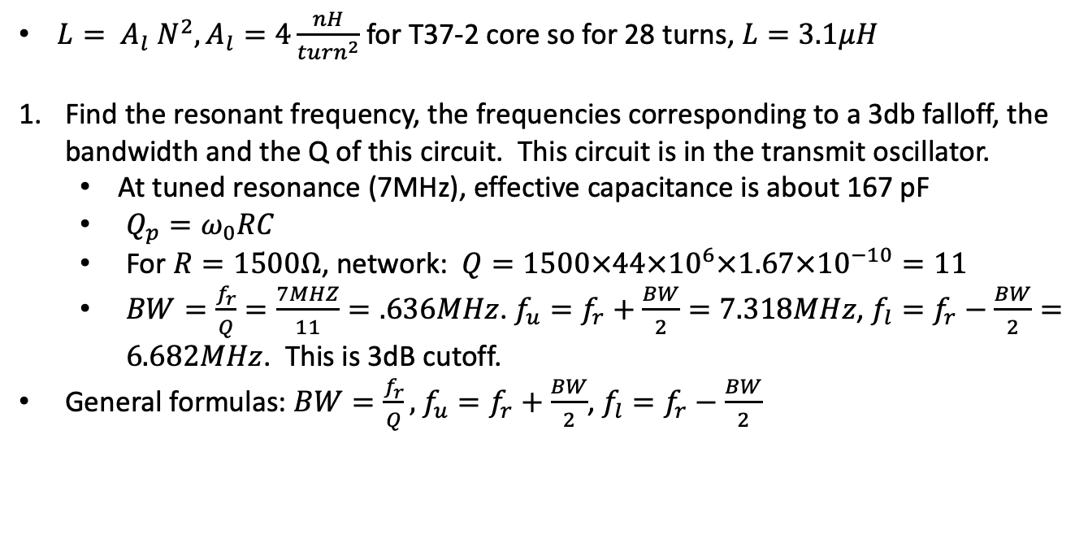
Exercise 9: Parallel resonance
$L= A_{l} N^{2}, A_{l}=4\frac{nH}{{turn}^{2}}$ for T37-2 core so for 28 turns, $L=3.1μH$
Find the resonant frequency, the frequencies corresponding to a 3db falloff, the bandwidth and the Q of this circuit. This circuit is in the transmit oscillator.
At tuned resonance (7MHz), effective capacitance is about 167 pF
$Q_{p}=ω_{0}RC$
For $R=1500Ω$, network: $Q=1500×44×{10}^{6}×1.67×{10}^{−10}=11$
$BW=\frac{f_{r}}{Q}=\frac{7MHZ}{11}=.636MHz$. $f_{u}=f_{r}+\frac{BW}{2}=7.318MHz$, $f_{l}=f_{r}−\frac{BW}{2}=6.682MHz$. This is 3dB cutoff.
General formulas: $BW=\frac{f_{r}}{Q},$ $f_{u}=f_{r}+\frac{BW}{2}$, $f_{l}=f_{r}−\frac{BW}{2}$
5pF
V_{i}
V_{o}
R
100pF
3.1uH
50pF

Slide 28
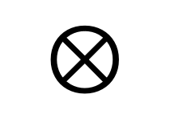
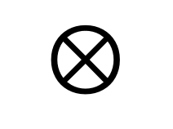
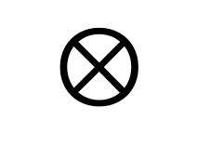
Norcal 40A
7 MHz
2W
<10 MHz
Harmonic
Filter
RF
Filter
Power
Amp
7 MHz
$$⊗$$
RF Mixer
20 mW
4.9 MHz, 9.1 MHz
Driver
IF Filter
300 uW
VFO
2.1 MHz
4.9 MHz
Product
Detector
Buffer
$$⊗$$
BFO
4.9 MHz
10 uW
Transmit
Filter
9.8 MHz, Audio
AGC
7 MHz
2.8 MHz
$$⊗$$
Transmit
Mixer
AGC
Detector
Audio
Amp
Key
Transmit oscillator
4.9 MHz

Slide 29


NorCal power levels
log(P)
Power
log(P)
1W
Driver
1W
Audio out
1mW
Buffer
1mW
Space
2000km
Detector
1$μ$W
1$μ$W
VFO
Mixer
1nW
AGC
1nW
Antenna
Crystal
1pW
1pW
RF filter

Slide 30
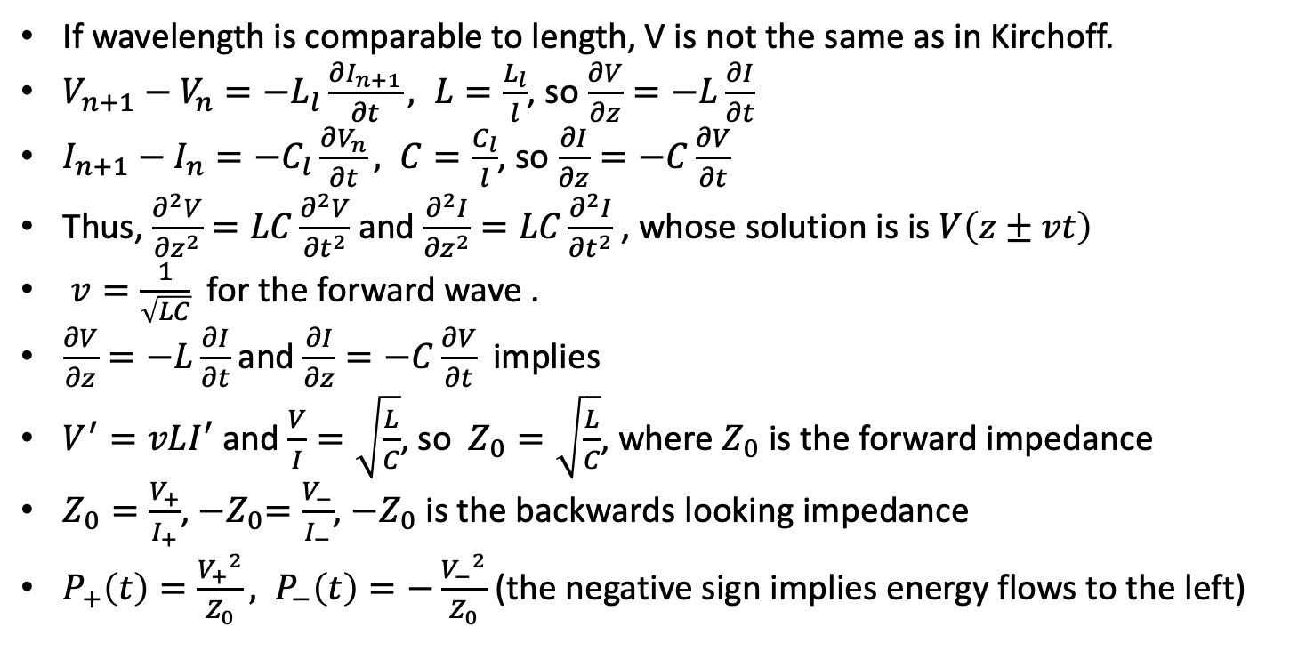


Transmission Lines
If wavelength is comparable to length, V is not the same as in Kirchoff.
$V_{n+1}−V_{n}=−L_{l}\frac{∂I_{n+1}}{∂t}, L=\frac{L_{l}}{l}$, so $\frac{∂V}{∂z}=−L\frac{∂I}{∂t}$
$I_{n+1}−I_{n}=−C_{l}\frac{∂V_{n}}{∂t}, C=\frac{C_{l}}{l}$, so $\frac{∂I}{∂z}=−C\frac{∂V}{∂t}$
Thus, $\frac{∂^{2}V}{{∂z}^{2}}=LC\frac{∂^{2}V}{{∂t}^{2}}$ and $\frac{∂^{2}I}{{∂z}^{2}}=LC\frac{∂^{2}I}{{∂t}^{2}}$ , whose solution is is $V\left(z±vt\right)$
$v=\frac{1}{\sqrt{LC}}$for the forward wave .
$\frac{∂V}{∂z}=−L\frac{∂I}{∂t}$ and $\frac{∂I}{∂z}=−C\frac{∂V}{∂t}$ implies
$V^{′}=vLI^{′}$ and $\frac{V}{I}=\sqrt{\frac{L}{C}}$, so $Z_{0}=\sqrt{\frac{L}{C}}$, where $Z_{0}$ is the forward impedance
$Z_{0}=\frac{V_{+}}{I_{+}}$, ${−Z}_{0}=\frac{V_{−}}{I_{−}}$, ${−Z}_{0}$ is the backwards looking impedance
$P_{+}\left(t\right)=\frac{{V_{+}}^{2}}{Z_{0}}, P_{−}\left(t\right)=−\frac{{V_{−}}^{2}}{Z_{0}}$ (the negative sign implies energy flows to the left)
I_{n}
V_{n}
I_{n+1}
V_{n+1}
L_{n}
…
C_{n}
I₊
$$Z_{0}$$
P₊
V₊
I₋
P₋
$${−Z}_{0}$$
V₋

Slide 31
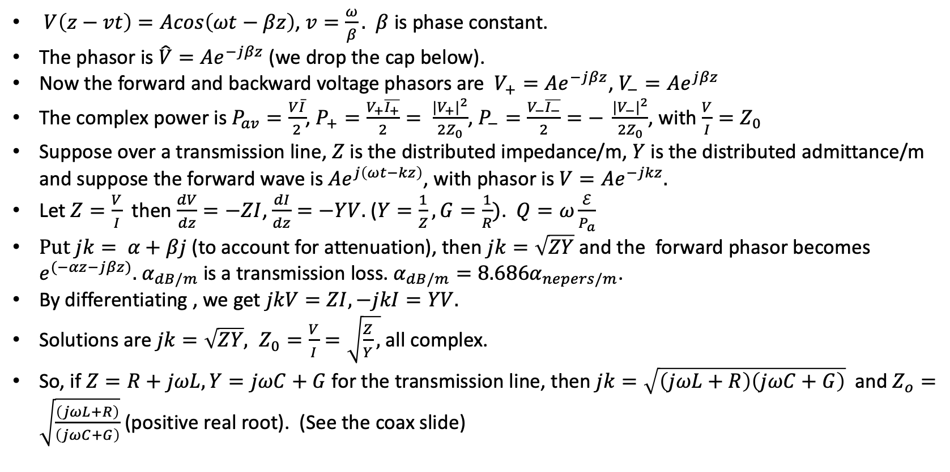
General transmission line
Z
$V\left(z−vt\right)=Acos\left(ωt−βz\right)$, $v=\frac{ω}{β}.$ $β$ is phase constant.
The phasor is $\hat{V}=Ae^{−jβz}$ (we drop the cap below).
Now the forward and backward voltage phasors are $V_{+}=Ae^{−jβz}$, $V_{−}=Ae^{jβz}$
The complex power is $P_{av}=\frac{V\overline{I}}{2}$, $P_{+}=\frac{V_{+}\overline{I_{+}}}{2}= \frac{|{V_{+}|}^{2}}{2Z_{0}}$, $P_{−}=\frac{V_{−}\overline{I_{−}}}{2}=− \frac{{{|V}_{−}|}^{2}}{2Z_{0}}$, with $\frac{V}{I}=Z_{0}$
Suppose over a transmission line, $Z$ is the distributed impedance/m, $Y$ is the distributed admittance/m and suppose the forward wave is $Ae^{j\left(ωt−kz\right)}$, with phasor is $V=Ae^{−jkz}.$
Let $Z=\frac{V}{I}$ then $\frac{dV}{dz}=−ZI$, $\frac{dI}{dz}=−YV.$ ($Y=\frac{1}{Z}, G=\frac{1}{R})$. $Q=ω\frac{ℰ}{P_{a}}$
$Put jk= α+βj$ (to account for attenuation), then $jk=\sqrt{ZY}$ and the forward phasor becomes $e^{(−αz−jβz)}.$ $α_{dB/m}$ is a transmission loss. $α_{dB/m}=8.686α_{nepers/m}$.
By differentiating , we get $jkV=ZI, −jkI=YV.$
Solutions are $jk=\sqrt{ZY}, Z_{0}=\frac{V}{I}=\sqrt{\frac{Z}{Y},}$ all complex.
So, if $Z=R+jωL, Y=jωC+G$ for the transmission line, then $jk=\sqrt{\left(jωL+R\right)\left(jωC+G\right)}$ and $Z_{o}=\sqrt{\frac{\left(jωL+R\right)}{\left(jωC+G\right)}}$ (positive real root). (See the coax slide)
Y

Slide 32
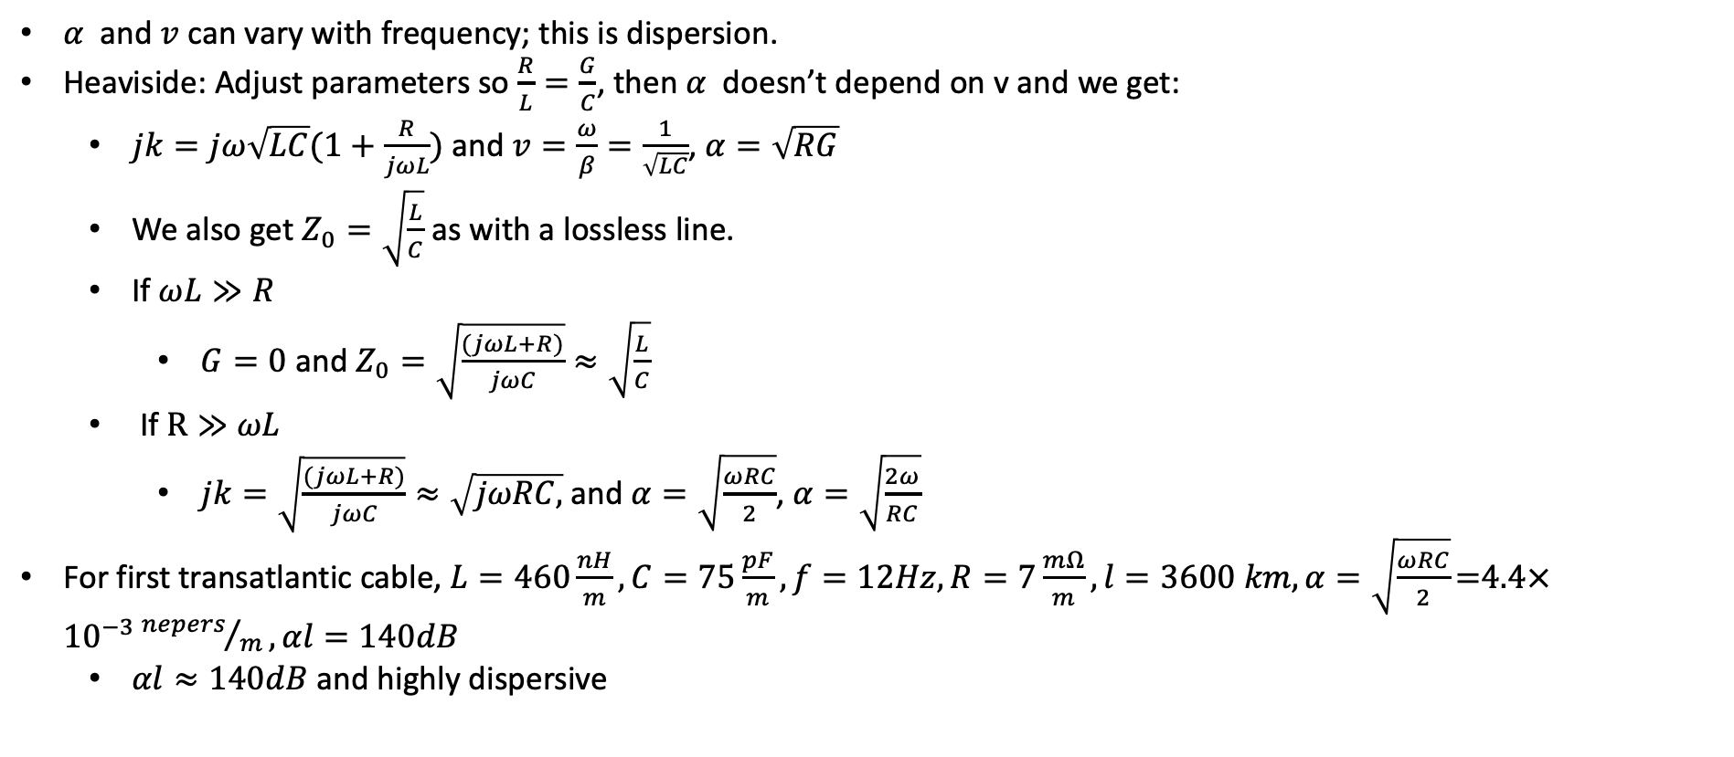
Transmission Lines - dispersion
$α$ and $v$ can vary with frequency; this is dispersion.
Heaviside: Adjust parameters so $\frac{R}{L}=\frac{G}{C}$, then $α$ doesn’t depend on v and we get:
$jk=jω\sqrt{LC}(1+\frac{R}{jωL})$ and $v=\frac{ω}{β}=\frac{1}{\sqrt{LC}}$, $α=\sqrt{RG}$
We also get $Z_{0}=\sqrt{\frac{L}{C}}$ as with a lossless line.
If $ωL≫R$
$G=0$ and $Z_{0}=\sqrt{\frac{(jωL+R)}{jωC}}≈\sqrt{\frac{L}{C}}$
If $R≫ωL$
$jk=\sqrt{\frac{(jωL+R)}{jωC}}≈\sqrt{jωRC,}$ and $α=\sqrt{\frac{ωRC}{2}}$, $α=\sqrt{\frac{2ω}{RC}}$
For first transatlantic cable, $L=460\frac{nH}{m}, C=75\frac{pF}{m}, f=12Hz, R=7\frac{mΩ}{m}, l=3600 km, α=\sqrt{\frac{ωRC}{2}}\text{=4.4}×{10}^{−3}{nepers}/m, αl=140dB$
$αl≈140dB$ and highly dispersive

Slide 33
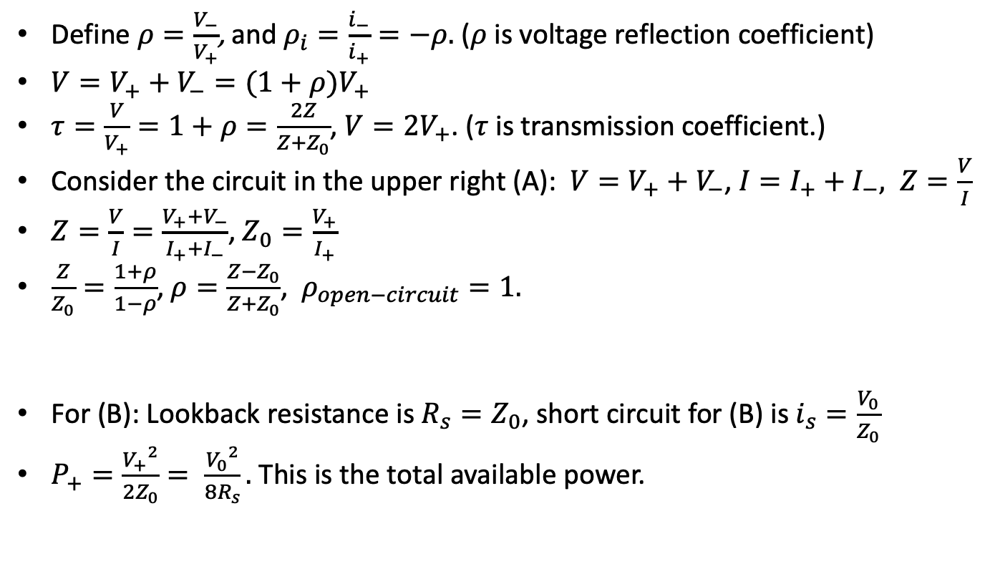

Transmission Lines-reflections
I₊
Define $ρ=\frac{V_{−}}{V_{+}}$, and $ρ_{i}=\frac{i_{−}}{i_{+}}=−ρ$. ($ρ$ is voltage reflection coefficient)
$V=V_{+}+V_{−}=(1+ρ)V_{+}$
$τ=\frac{V}{V_{+}}=1+ρ=\frac{2Z}{Z+Z_{0}}$, $V=2V_{+}$. ($τ$ is transmission coefficient.)
Consider the circuit in the upper right (A): $V=V_{+}+V_{−}$, $I=I_{+}+I_{−}, Z=\frac{V}{I}$
$Z=\frac{V}{I}=\frac{V_{+}+V_{−}}{I_{+}+I_{−}}$, $Z_{0}=\frac{V_{+}}{I_{+}}$
$\frac{Z}{Z_{0}}=\frac{1+ρ}{1−ρ}$, $ρ=\frac{Z−Z_{0}}{Z+Z_{0}}$, $ρ_{open−circuit}=1.$
For (B): Lookback resistance is $R_{s}=Z_{0}$, short circuit for (B) is $i_{s}=\frac{V_{0}}{Z_{0}}$
$P_{+}=\frac{{V_{+}}^{2}}{2Z_{0}}= \frac{{V_{0}}^{2}}{8R_{s}}.$ This is the total available power.
I
V₋
V₊
Z₀
Z
V
I₋
(A)
I₊
Z₀
V₋
V₀=${2V}_{+}$
V₊
Z₀
Thevinen
(B)

Slide 34
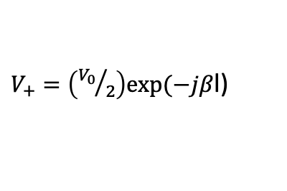

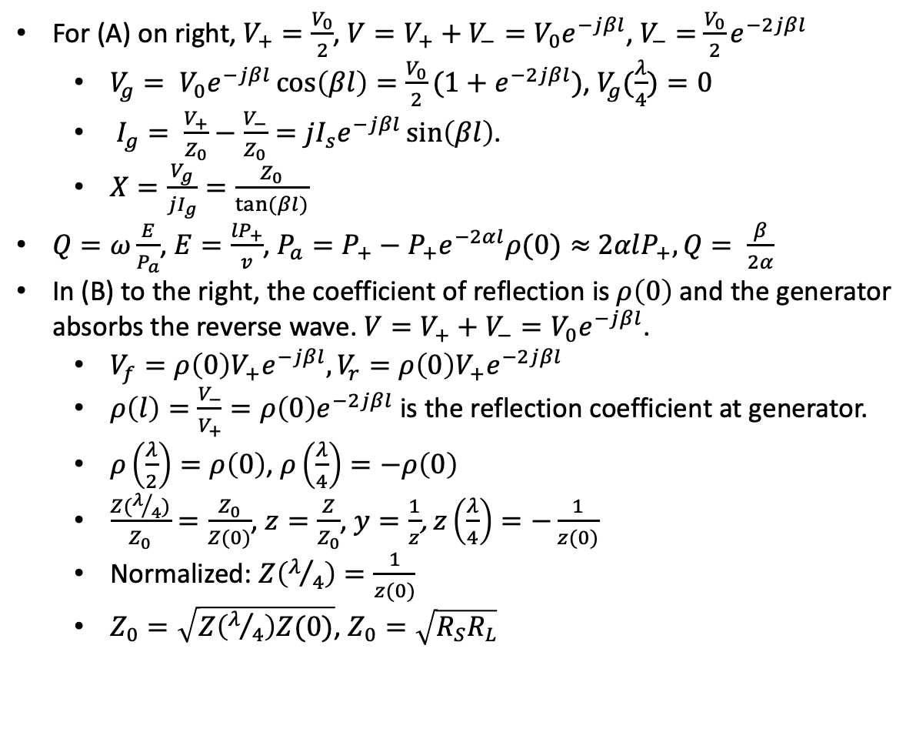


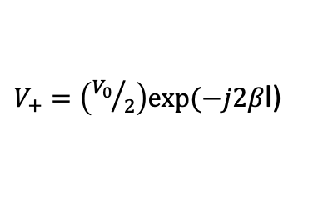
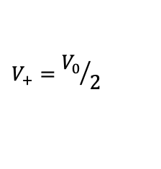



Transmission Lines – resonance and Q
For (A) on right, $V_{+}=\frac{V_{0}}{2}$, $V=V_{+}+V_{−}=V_{0}e^{−jβl}$, $V_{−}=$ $\frac{V_{0}}{2}e^{−2jβl}$
$V_{g}= V_{0}e^{−jβl}\cos\left(βl\right)=\frac{V_{0}}{2}(1+e^{−2jβl})$, $V_{g}(\frac{λ}{4})=0$
$I_{g}= \frac{V_{+}}{Z_{0}}−\frac{V_{−}}{Z_{0}}=jI_{s}e^{−jβl}\sin\left(βl\right)$.
$X=\frac{V_{g}}{jI_{g}}=\frac{Z_{0}}{tan⁡(βl)}$
$Q=ω\frac{E}{P_{a}}$, $E=\frac{{lP}_{+}}{v}$, $P_{a}=P_{+}−P_{+}e^{−2αl}ρ(0)≈$ $2αlP_{+}, Q= \frac{β}{2α}$
In (B) to the right, the coefficient of reflection is $ρ\left(0\right)$ and the generator absorbs the reverse wave. $V=V_{+}+V_{−}=V_{0}e^{−jβl}$.
$V_{f}={ρ\left(0\right)V}_{+}e^{−jβl}, V_{r}={ρ\left(0\right)V}_{+}e^{−2jβl}$
$ρ\left(l\right)=\frac{V_{−}}{V_{+}}={ρ\left(0\right)e}^{−2jβl}$ is the reflection coefficient at generator.
$ρ\left(\frac{λ}{2}\right)=ρ\left(0\right)$, $ρ\left(\frac{λ}{4}\right)=−ρ\left(0\right)$
$\frac{Z(λ/4)}{Z_{0}}=\frac{Z_{0}}{Z(0)}$, $z=\frac{Z}{Z_{0}}$, $y=\frac{1}{z}$, $z\left(\frac{λ}{4}\right)=−\frac{1}{z(0)}$
Normalized: $Z\left(λ/4\right)=\frac{1}{z(0)}$
$Z_{0}=\sqrt{Z\left(λ/4\right)Z(0)}$, $Z_{0}=\sqrt{R_{S}R_{L}}$
$V_{+}=\left({V_{0}}/2\right)exp⁡(−jβ$l)
$$V_{+}={V_{0}}/2$$
Z₀
Z₀
$$l$$
V
V_{g}
$V_{−}=\left({V_{0}}/2\right)exp⁡(−jβ$l)
V₀
A
$V_{+}=\left({V_{0}}/2\right)exp⁡(−j2β$l)
$$V_{+}e^{−jβl}$$
(B)
Z₀, l
$$ρ(0)$$
$${ρV(0)}_{+}e^{−jβl}$$
$${ρV(0)}_{+}e^{−2jβl}$$

Slide 35





Modelling Coaxial Cables
A small segment of coax (of length $Δx)$ can be modelled by the circuit to the right.
$R′$ and $L′$ are characteristic of the two parallel conductors.
$G′$ and C$′$are characteristic of the dielectric between the two conductors and the distance between them.
The characteristic impedance, $Z_{0}$, is the impedance of an infinitely long coax. For an RG-58 coax it’s about $53Ω$.
For a coax consisting of a series of segments on the right, $Z_{0}=\sqrt{\frac{R^{′}+jωL^{′}}{G^{′}+jωC^{′}}}$
In the last few slides, we have simplified the model considerably.
Notice that at high frequency, $Z_{0}≈\sqrt{\frac{L^{′}}{C^{′}}}$
In an earlier slide (with a simpler circuit model), we showed that the propagation speed of a signal of high frequency is $v=\frac{1}{\sqrt{C^{′}L^{′}}}$
Since $Z_{0}\sqrt{C^{′}}=\sqrt{L^{′}}$, $Z_{0}C^{′}=\sqrt{C^{′}L^{′}}$.
An RG-58 cable, has $C^{′}=82 {pf}/m$ and thus, $v=\frac{1}{53 × 82 ×{10}^{−12}}m/s≈.75c$
$$R^{′}Δx$$
$$L^{′}Δx$$
$$G^{′}Δx$$
$$C^{′}Δx$$

Slide 36











Exercise 10: Coax
$$Generator and scope 1$$
10m
$$scope 2$$
We’ll measure the velocity of waves in RG58U by connecting one channel of the scope to the input and one to the output.
Measure the velocity, v, in 10m coax at 7MHz. Try different frequencies. Use $50ns$, $5V_{pp}$using square waves at 20kHz. Ans: about $\frac{2}{3}c$
Do the same with an antenna.
Calculate $Z_{0}$ with $50Ω$ termination for the circuit on the right.
Remove the $50Ω$ and measure the V and use it and $Z_{0}$ to calculate L, and C for the coax
Measured speed is $v=2×{10}^{8} m/s$. $Z_{0}=50Ω$ . For high impedance, $Z_{0}=\sqrt{\frac{L}{C}}$ and $v= \frac{1}{\sqrt{LC}}$. So, ${Z_{0}}^{2}C=L$ and $v^{2}=\frac{1}{LC}$, so ${Z_{0}}^{2}C^{2}v^{2}$=1. $C=\frac{1}{Z_{0}v}={10}^{−10}F$. ${2500×10}^{−10}F=L=250nH,$ which is what we use in the next problem.
Z₀, l
$$V$$
$$V_{i}$$
50$Ω$
50$Ω$
Function generator
1:1
50$Ω$
scope channel 2 (I)
$$Z_{0}$$
1$Ω$
10m cable
50$Ω$
scope channel 1 (V)

Slide 37







Exercise 11: Waves
Suppose we want to send voice over 100km of coax, $Z_{L}=50Ω, l=100km.$
Measure the SWR which is the ratio of the maximum to minimum output
$V=V_{+}+V_{−}$, $ρ=\frac{Z−Z_{0}}{Z+Z_{0}}$, $Z=50Ω$, we get $Z_{0}$ from the previous exercise.
$\left|V_{max}\right|=\left|V_{f}\right|+\left|V_{r}\right|=(1+ρ)\left|V_{f}\right|,\left|V_{min}\right|=\left(1−ρ\right)\left|V_{f}\right|=\left|V_{f}\right|$. $SWR=\frac{V_{max}}{V_{min}}=\frac{1+ρ}{1−ρ},$
If $L=250\frac{nH}{m}, C=100pf/m$ and the distributed resistance at voice is $50 mΩ/m$, calculate total dB loss at 500, 1000 and 2000Hz using the high frequency approximation.
$Z\left(f\right)=jωL+R=50×{10}^{−3}+j∙2πf∙250×{10}^{−9}$
$Y(f)=jωC+\frac{1}{R}= \frac{1}{50×{10}^{−3}}+j$ $2πf∙{10}^{−10}$
$Z_{0}\left(f\right)= \sqrt{\frac{Z\left(f\right)}{Y\left(f\right)}}$
$Z_{0}(500)=400Ω$, $Z_{0}(1000)=282Ω$, $Z_{0}(500)=200Ω$,
High resistance approximation: $α(f)=\sqrt{\frac{ωRC}{2}}$,
$α\left(500\right)=8.8×{10}^{−5},α\left(1000\right)=12.6×{10}^{−5}$
$α\left(2000\right)=17.6×{10}^{−5}×{10}^{5}$
For $100km,$ loss is $α×{10}^{5}$
$$Generator and scope 1$$
$$scope 2$$
Z₀, l
$$V$$
$$V_{i}$$
50$Ω$
50$Ω$

Slide 38

Exercise 11: Waves
Add a 100mH inductor every 1km. Now what’s the loss?
$Z\left(f\right)=jωL+R=50×{10}^{−3}+j∙2πf∙{10}^{−4}, { Z}_{0}\left(f\right)= \sqrt{\frac{Z\left(f\right)}{Y\left(f\right)}}$
$Z_{0}\left(f\right)= \sqrt{\frac{Z\left(f\right)}{Y\left(f\right)}}$
$Z_{0}(500)=318Ω$, $Z_{0}(1000)=317Ω$, $Z_{0}(2000)=316Ω$
High reactance approximation: $α(f)=\frac{R}{2Z_{0}}$ , $Z_{0}=\sqrt{\frac{L}{C}}=1000Ω$
$α(f)=\frac{R}{2Z_{0}(f)}$, $α\left(500\right)=α\left(1000\right)=α\left(2000\right)=\frac{5×{10}^{−2}}{2000}=5.5×{10}^{−5} nepers/m$
For $100km,$ loss is $α×{10}^{5}$=5.5 or $5.5 ×8.868≈49dB$

Slide 39




Exercise 12: Resonance
$RG58U$ has a capacitance of about $100\frac{pF}{m}.$Let $α$ be the attenuation constant and $β$ be the phase
Derive an expression for $|\frac{V_{g}}{V}|$ and assuming $α$ is small by finding the first resonance where $V_{g}$ is minimum.
$V_{g}=V_{0}e^{−jβl}cos⁡(βl)$, $V=V_{0}\exp\left(−jβl\right)$. $\left|\frac{V_{g}}{V}\right|=cos⁡(βl)\text{.}$ So, at $l=\frac{λ}{2}$, $\left|V_{g}\right|=|V|$
Find $α$and the wave velocity by finding the resonant frequency (without the load, ${1V}_{pp}$) and noting the time delay with a scope on the input and output. Use $|\frac{V_{g}}{V}|$ to calculate $α$.
$|V|$ will be maximum at resonant frequency with unterminated line.
$|V_{g}(l)|$ is minimum when $l=\frac{λ_{r}}{4}$ and $βl=\frac{π}{4}$. This gives $β$.
At $l=\frac{λ}{2}$, $\left|\frac{V_{g}}{V}\right|=e^{−α(λ/2)}$
Use this to calculate the velocity, $v$. How large is the frequency shift caused?
$v=\frac{ω_{r}}{β}$. [$v$ should be about $2×{10}^{8} m/s$]
Find, as usual, $f_{u}$, $f_{l}$, and $Q.$
$Q=\frac{β}{2α}$
$Q= \frac{f_{r}}{BW}$, so $BW= \frac{f_{r}}{Q}$. $f_{u}=f_{r}+ \frac{BW}{2}$, and $f_{l}=f_{r}− \frac{BW}{.2}$
10m
Z₀
$$V$$
$$V_{g}$$
$$Z_{0}, l$$
V₀
Scope channel 2, no load
Scope channel 1 and function generator

Slide 40



Filters
L₂
L₄
Circuits on the left are called ladder filters.
Low pass (Butterworth equivalent): Tabled values for inductors and capacitors based on frequency and dB drop-off.
Can convert low pass into bandpass.
For low pass to high pass
Butterworth: $L=\frac{P_{i}}{P}=1+{(\frac{f}{f_{c}})}^{2n}$, $f_{c}$ is 3dB cutoff
Chebyshev: $L=1+{α{C_{n}}^{2}(\frac{f}{f_{c}})}^{2n}$, $f_{c}$ is 3dB cutoff
Normalized reactance's: $a_{i}=sin⁡(\frac{(2i−1)π}{2n})$
Ripple loss: $1+α={10}^{{L_{r}}/{10}}$
$β=sinh⁡(\frac{\tanh^{−1}(1/{\sqrt{1+α}})}{n})$, $c_{i}=\frac{a_{i}a_{i−1}}{c_{i−1}(β^{2}+\sin^{2}({(i−1)π}/n))}$
Example: cutoff at 10MHz, 4th order, 50ohm output, 3dB cutoff, $L\left(20MHz\right)=6n=24dB$, $a_{1}=0.765, X_{1}=x_{1}Z_{0}=38Ω$, $L_{1}=\frac{X_{1}}{ω_{c}}=610nH, b_{2}=a_{2}=1.848, B_{2}={b_{2}}/{Z_{0}}$, $C_{2}={B_{2}}/{ω_{c}}$
Yuck!
C₁
C₂
C₃
R_{L}
Low pass
C₁
C₂
C₃
Bandpass - WIkipedia
L₂
L₄
High pass
C₁ (34.5 pF)
L₂ (15 uH)
C₂ (6nF)
R_{L}
L₄ (8nH)
7 MHz bandpass
Lowpass - WIkipedia

Slide 41

Norcal transmit bandpass filter
$C_{39}=50pF$,
$L_{6}$ is 36 turns #28 on T37-2 which has $A_{l}=4\frac{nH}{{turn}^{2}}, L_{6}= A_{l} ∙{36}^{2}=3.1μH$
$Z_{2}=−\frac{j}{\left(C_{38}+C_{39}\right)ω_{o} }, Z_{3}=jL_{6}ω_{o}$, $Z_{1}= \frac{j}{C_{37}ω_{o}}$
$Z_{2,3−eq}= \frac{jL_{6}ω_{0}}{L_{6}\left(C_{38}+C_{39}\right){ω_{0}}^{2}−1}$
Resonance is when $Z_{2,3−eq}→∞, {ω_{o}}^{2}=\frac{1}{(C_{38}+C_{30})L_{6}} ≈ \frac{{10}^{18}}{465}$, when almost all the voltage drop is across $Z_{2,3−eq}$ $ω_{o}=\frac{{10}^{9}}{\sqrt{465}}≈50.8×{10}^{6}, f_{0}=\frac{ω_{o}}{2π}≈7.1 MHz$
Q of filter is: $Q_{s}=\frac{X_{s}}{R_{s}}$. $R_{s}$ comes from the other components and must be measured
Note that $Z_{2,3−eq}$ is small for the other modulation product
C37 (5pF)
C₃₉
C₃₈ (100pF)

Slide 42

Exercise 13: Norcal Harmonic Filter
L₇, L₈ use T37-2 core, 18 turns, 1.3uH. Use $50Ω$ termination and set function generator at 10V_{pp}.
Compute and compare loss at 7MHz and 14MHz.
From $A_{l}=5nH/{turn}^{2}$, calculate $L_{7}$ and $L_{8}.$
What is the spur strength at 7, 14 and 28MHz? Measure and calculate.
Need Puff (a simulator) to get losses. However, answer is there is a 6dB drop-off at every frequency doubling
L₇
L₈
C₄₅
330pF
Antenna
Jack out
C₄₆
820pF
C₄₇
330pF

Slide 43

Exercise 14: Norcal IF Cohn Filter
C₉
X₁
X₂
X₃
X₄
C₁₃
X₁ through X₄ are 4.91 MHz
C₁₀, C₁₁, C₁₂ are 270 pF
Set function generator to 50mV_{pp} from function generator
Calculate R and X for filter
Measure the resonant frequency of one of the crystals
Duh
Calculate the parameters of the crystal. Omitting $C_{s}$
$f_{r}=\frac{1}{2π\sqrt{LC}}$ and $Q=\frac{1}{R}\sqrt{\frac{L}{C}}$. We can measure $f_{r}$ and find Q using the 3dB bandwidth. $R$ is the resistance at resonance.
$Q≈80$
$25Ω<R<100Ω$
If $R=50$, $C=8.1pF$, $L=130μH$
C₁₀
C₁₁
C₁₂
L₉ (18 uH)
C₁₄
47pF
SA602 wants 1.5K
Matching network
C_{s}
L
C
R
Equivalent circuit for crystal

Slide 44

Transformers
For solenoid, $\oint{B∙}ds= μ_{0}nI$ inside
$LI=Φ_{B}$. Since there are n turns in the solenoid, over the solenoid, $LI=$ $μ_{0}n^{2}I$, so $L=μ_{0}n^{2}$.
This is the source of $L=A_{l}n^{2}$
$V_{s}=\frac{N_{s}}{N_{p}}V_{p}$
$Z_{p}={(\frac{N_{p}}{N_{s}})}^{2}Z_{s}$

Slide 45






Exercise 15: Norcal Driver Transformers (1)
$\text{T}\text{1}\text{ uses FT 37−43.}$ $L\left(μH\right)=\frac{A_{L}t^{2}}{1000}$, $A_{L}=350. f_{r}=7×{10}^{6}MHz$, $n_{p}=14, n_{s}=4$, $ω_{r}=2π×7×{10}^{6}MHz=4.4×{10}^{7}$
$\text{Measure the}$ output $V_{out}$.
Calculate $V_{out}$
$L_{p}=68.6μH$, $L_{s}=5.6μH$
$Z_{eq,in}(ω)=1250+j\left(ωL_{p}\right),{ Z}_{eq,in}(ω_{r})=1250+3016j$, $\left|Z_{eq,in}(ω_{r})\right|=3264$
$Z_{eq,out}\left(ω\right)=33+jωL_{s}, Z_{eq,out}(ω_{r})=33+j246,$ $\left|Z_{eq,out}(ω_{r})\right|=248$
$V_{t,in}=\frac{3016}{3264}V_{in}$
${V_{out}=V}_{t,out}= \frac{n_{s}}{n_{p}}V_{t,in}=.29V_{t,in}=.29×\frac{3016}{3264}×5=1.3V$
$i_{p}\left(ω\right)=\frac{V_{in}}{|Z_{eq,in}|}e^{jθ_{p}(ω)}$, $θ_{p}\left(ω\right)=\arctan\left(\frac{ωL_{p}}{1250}\right); i_{s}\left(ω\right)=\frac{V_{out}}{|Z_{eq,out}|}e^{jθ_{s}(ω)}$,$θ_{s}\left(ω\right)=\arctan\left(\frac{ωL_{s}}{33}\right)$.
$P_{in,a}=Re\left(\frac{V_{in}\overline{I_{in}}}{2}\right)=Re(\frac{{V_{in}}^{2}}{2\left|Z_{eq,in}\left(ω\right)\right|}e^{jθ_{p}\left(ω\right)})$
$P_{out,a}=Re\left(\frac{V_{out}\overline{I_{out}}}{2}\right)=Re(\frac{{V_{out}}^{2}}{2\left|Z_{eq,out}\left(ω\right)\right|}e^{jθ_{s}\left(ω\right)})$
T₁, 14:4
10V_{pp}
50$Ω$
200$Ω$
100$Ω$
50$Ω$
1K$Ω$

Slide 46

Exercise 15: Norcal Driver Transformers (2)
$\cos\left(θ_{s}\left(ω_{r}\right)\right)=.13,\cos\left(θ_{p}\left(ω_{r}\right)\right)=.38,$
$\frac{P_{out,a}(ω_{r})}{P_{in,a}(ω_{r})}={(\frac{V_{out}}{V_{in}})}^{2}\frac{\left|Z_{eq,in}\left(ω_{r}\right)\right|}{\left|Z_{eq,out}\left(ω_{r}\right)\right|}\frac{cos⁡(θ_{s}(ω_{r}))}{cos⁡(θ_{p}\left(ω_{r}\right))}={(\frac{1.3}{5})}^{2}×\frac{3264}{248}×\frac{.13}{.38}=.3$
Measure the 3dB cutoff, f_{c}.
$\frac{P_{out,a}(ω)}{P_{in,a}(ω)}={(\frac{V_{out}}{V_{in}})}^{2}\frac{\left|Z_{eq,in}\left(ω\right)\right|}{\left|Z_{eq,out}\left(ω\right)\right|}\frac{cos⁡(θ_{s}(ω))}{cos⁡(θ_{p}\left(ω\right))}= .15$

Slide 47





Exercise 16: Norcal Tuned Transformers
C₄
5pF
$\text{T}\text{2}\text{, }\text{T}\text{3} \text{are} \text{I}\text{F matchers using FT 37−61}$. $A_{L}=55 nH/{turn}^{2}$.
Measure 3dB bandwidth
Find P/P₊
T₂
$P_{a}=Re\left(\frac{V\overline{I}}{2}\right), V= V_{+}+V_{−}$, $ρ=\frac{V_{+}}{V_{−}}= \frac{Z−Z_{0}}{Z+Z_{0}},$ $Z$ is look forward, $Z_{0}$ is look back resistance. $P_{+}=\frac{{V_{+}}^{2}}{2Z_{0}}.$ $L_{in}=55nH, L_{out}=22μH$, $ω=4.4×{10}^{7}$
$Z=50+2.4j$, $Z_{0}=203−4030j$, $ρ=1$, so $V_{+}=V_{−}$, $V=2V_{+}$
$\frac{P}{P_{+}}=\frac{1}{4}$
Similar calculation for T₃.
50$Ω$
1V_{pp}
C₂
50pF
1.5K$Ω$
T₂, 1:20
T₃, 23:6
L₄, 18uH
10V_{pp}
750$Ω$
C₁₄
47pF
C₆
47pF
1.5K$Ω$

Slide 48

Acoustics
$P=P_{0}+P_{e}$,$ρ=ρ_{0}+ρ_{e}$
Gas moves and changes density: Displacement of undisturbed air is $x$. At time $t,$ it’s at $x+χ(x,t)$, so $ρ_{0}∆x= ρ(x+∆x+χ\left(x+∆x,t\right)−x−χ(x,t))$, or $ρ_{0}∆x=$ $ρ(\frac{∂χ(x,t)}{∂x}∆x$ + $∆x)$. So, $ρ_{e}=−ρ_{0}\frac{∂χ}{∂x}$ .
Change in density causes change in pressure: $P=f(ρ$),
$P_{0}+P_{e}=f(ρ)=f\left(ρ_{0}\right)+ρ_{e}f′(ρ_{0}$), $f^{′}\left(ρ_{0}\right)=κ={(\frac{dP}{dρ})}_{0}$, or $P_{e}=κρ_{e}$.
Pressure differences cause motion: $P\left(x,t\right)−P\left(x+∆x,t\right)=−\frac{∂P_{e}}{∂x}∆x$, Newton’s law gives $ρ_{0}\frac{∂^{2}χ}{{∂t}^{2}}=−\frac{∂P_{e}}{∂x}=−κ\frac{∂ρ_{e}}{∂x}$.
Substituting (1) into (3) gives $\frac{∂^{2}χ}{{∂t}^{2}}=κ\frac{∂^{2}χ}{{∂x}^{2}}$, put $κ=\frac{1}{{c_{s}}^{2}}$.
Solution is $χ\left(x,t\right)=f(x−vt)$ [Different $f$ than above].
To find, $κ={(\frac{dP}{dρ})}_{0}$, note that the flow is adiabatic so $PV^{γ}=C′$ and $ρ$ varies inversely as $V$, so $P=ρ^{γ}C$ , and finally, using $PV=Nkt,$ $κ={(\frac{dP}{dρ})}_{0}=\frac{γkT}{n}$
$L_{p}=20 log⁡(\frac{P}{P_{0}})$, $P_{0}=20 μPa$.
Sound | L_{p} | Power density
rustling leaves | 10dB | 1pW/m²
broadcast studio | 20dB | 1pW/m²
classroom | 50dB | 10nW/m²
heavy truck | 90dB | 1nW/m²
Shout at 1m | 100dB | 10mW/m²
jackhammer | 110db | 100mW/m²
jet takeoff at 50m | 120dB | 1W/m²

Slide 49









Bipolar Transistors - I
v_{s}
R_{S}
NPN Model
$V_{f}≈.7V, V_{s}≈.2V$
Conducts when $V_{be}>V_{f}$
Saturated when $V_{ce}=0$
$i_{c}=βi_{b}$
$i_{c}=αi_{e}$
$β= \frac{α}{1−α}$ [${=h}_{fe}$, small signal]
$β≈100, β_{r}≈10$
${r_{e}i}_{e}=25mV$, $r_{b}=(1+β)r_{e}$, $r_{e}≈33Ω$
$i_{b}=\frac{v_{be}}{(1+β)r_{e}}$
$g_{m}v_{be}=g_{m}r_{b}i_{b}$
Switch
$G_{s}=\frac{i_{b}}{15mV}$
$R_{S}=2Ω$
$$i_{c}$$
Saturation
Breakdown
Bipolar source model
Active
b
c
Reverse
Active
$$V_{cc}$$
$$r_{b}=(1+β)r_{e}$$
$$r_{o}$$
$$βi_{b}$$
e
Breakdown
Bipolar equivalent circuit
c
 | V_{be} | V_{bc} | V_{ce} | i_{c}
active | $$V_{f}$$ | $${<V}_{f}$$ | >$V_{s}$ | $$βi_{b}$$
rev saturated | <$V_{f}$ | $$V_{f}$$ | <-$V_{s}$ | $$−(β_{r}+1)i_{b}$$
saturated | $$V_{f}$$ | $$V_{f}$$ | $$V_{s}>V_{ce}≻−V_{s}$$ | >$−(β_{r}+1)i_{b}$ $$<βi_{b}$$
cutoff | $${<V}_{f}$$ | $${<V}_{f}$$ | * | 0
b
$${βi}_{f}−βi_{r}$$
e
Bipolar model

Slide 50

Bipolar Transistors - II
V_{cc}
c
<V_{f}
NPN Mode
$V_{f}=.7V$
$β=g_{m}r_{π}$
$g_{b}=\frac{i_{b}}{V_{t}}$, $V_{t}≈25mV$, $g_{m}=\frac{i_{c}}{V_{t}}$
DC
$\frac{V_{cc}−2V_{f}}{R_{C}}<i_{c}, βi_{b}=i_{c}$
$V_{c}=V_{cc}−i_{c}R_{C}$
$\frac{V_{cc}−V_{b}}{R_{B}}=i_{b}$
Small signal
Convert to AC only and simplify
Thevenize circuit
Replace transistor with model
r_{C}
r₁
C
b
V_{c}
C
V_{b}
r_{L}
r_{S}
V_{f}
V_{s}
r₂
V_{e}
e
Active
Small signal - original
Step 1
c
V_{f}
V_{c}
r_{S}
b
V_{b}
r_{c}||r_{L}
V_{s}
r₁||r₂
V_{e}
V_{f}
e
Saturated
Small signal

Slide 51


Bipolar Transistors - III
V_{c}
r_{S}
V_{b}
r_{c}||r_{L}
V_{s}
V_{e}
Small signal
Convert to AC only and simplify
Thevienize
$V_{th,in}=V_{s}\frac{r_{1}||r_{2}}{r_{1}||r_{2}+r_{s}}$
$r_{th,in}=r_{s}|\left|r_{1}\right||r_{2}$
$r_{th,out}=r_{C}||r_{L}$
Replace transistor with model
$\frac{V_{be}}{V_{Th,in}}=\frac{r_{π}}{r_{π}+r_{Th,in}}$
$\frac{V_{out}}{V_{be}}=−g_{m} r_{0}|\left|r_{c}\right||r_{L}$
$r_{0}$ is the transistor model resistance between b and c
$A_{gail}=\frac{V_{out}}{V_{s}}$
r₁||r₂
Step 2 -Small signal
r_{Th,in}
r_{Th,out}
V_{th,in}
Step 3 - Small signal
r_{Th,in}
V_{be}
$$r_{π}$$
r_{Th,out}
V_{th,in}
g_{m}V_{be}
Step 4 -Small signal

Slide 52


Bipolar transistors - IV
V_{cc}
R
V_{c}
At saturation, $v_{bc}<V_{f}$, so there is conduction from the collector to the base.
$i_{b}=i_{bs}exp⁡(\frac{V_{b}}{V_{t}})$, $V_{t}$ is the thermal voltage, $V_{t}=25mV$, $i_{bs}$ is the base saturation current.
$i_{c}=i_{cs}\exp\left(\frac{V_{c}}{V_{t}}\right).$ Note $i_{cs}=βi_{bs}$. Both increase rapidly with temperature
Base resistance
$g_{b}=\frac{i_{b}}{V_{t}}=\frac{di_{b}}{dV_{b}}$
$r_{b}=\frac{25mV}{i_{b}}$
$g_{m}=\frac{i_{c}}{V_{t}}=\frac{di_{c}}{dV_{b}}$
$i_{b}=r_{b}V_{b}$
V_{b}
V_{i}
R_{S}
i_{c}
$$βi_{b}$$
V_{cc}
i_{b}
R
r_{b}
i_{e}
V_{c}
V_{bb}
V_{b}
V₀
R_{S}

Slide 53




More on bipolar transistor model
V_{CC}
Saturated when $V_{ce}=0$
$v_{R_{2}}= v_{be}+(i_{c}+i_{b})R_{E}$
$i_{R_{2}}=\frac{v_{R_{2}}}{R_{2}}$
$i_{R_{1}}=i_{R_{2}}+i_{b}$
$v_{cc}= R_{1}i_{b}+{(R_{1}+R}_{2})i_{2}$
For $R_{B}=R_{1}||R_{2}$, $v_{cc}R_{B}−v_{be}R_{1}=R_{1}R_{2}i_{b}+(i_{c}+i_{b})R_{1}R_{E}$,
$i_{c}=βi_{b}$
$i_{c}=\frac{v_{cc}\frac{R_{B}}{R_{1}}−v_{be}}{R_{E}+\frac{(R_{C}+R_{E})}{β}}$
If $R_{E}≫\frac{(R_{C}+R_{E})}{β}$, $\frac{∂i_{c}}{∂v_{be}}=−\frac{1}{R_{E}}$, be acts like diode so $i_{c}=i_{s}βexp⁡(\frac{V_{be}}{V_{T}})$.
Want $V_{E}≈2v$
R₁
R_{C}
C_{o}
out
C_{i}
R_{L}
in
R₂
R_{E}
Small signal equivalent
$$βi_{b}$$
R
$$R_{L}$$
$$R=R_{1}|\left|R_{2}\right||r_{b}$$
$$r_{e}=\frac{V_{T}}{i_{c}}, r_{b}=r_{e}(β+1)$$

Slide 54


More on bipolar transistor model
V_{CC}
i_{c}
$v_{be}=v_{b}−v_{e}$, $v_{ce}=v_{c}−v_{e}$, $v_{bb}=\frac{R_{2}}{R_{1}+R_{2}}v_{cc}$, $v_{f}≈ .6$ (for Si)
$v_{b}=v_{e}+v_{f},$ $i_{b}=\frac{v_{bb}−v_{b}}{R_{b}}$
$i_{c}=βi_{b}+i_{ceo}$, $\frac{∂i_{b}}{∂v_{be}}=\frac{1}{r_{d}}$
$\frac{∂i_{c}}{∂v_{be}}=g_{s}=−\frac{1}{R_{B}}$, and $\frac{∂i_{c}}{∂β}$ measure stability
$i_{b}=\frac{v_{bb}−v_{b}}{R_{b}}$
$i_{c}=\frac{β(v_{bb}−v_{be})}{R_{b}+(1+β)R_{e}}+\frac{(R_{b}−R_{e})}{R_{b}+(1+β)R_{e}}i_{ceo}$, $i_{ceo}$ is leakage current
So, if $βR_{e}≫R_{b}+R_{e}$, $i_{c}=\frac{v_{bb}−v_{be}}{R_{e}}=\frac{v_{cc}−v_{c}}{R_{c}}$
$Z_{in}=R_{1}|\left|R_{2}\right||(β+1)R_{e}$, $Z_{out}= R_{c}$
$v_{bb}−v_{be}=\frac{R_{e}}{R_{c}}(v_{cc}−v_{c}$)
Typical for Si: $v_{be}=v_{f}≈.6V, β≈200, {v_{cc}=9V, v_{bb}=3V,R}_{b}={10}^{4}Ω,R_{c}={10}^{3}Ω$, $R_{e}=270Ω$
$3−.6=\frac{270}{1000}(9−v_{c}\text{)}$, so $v_{c}=.2V$
For voltage divider: $R_{1}=2×{10}^{4}Ω, R_{2}={10}^{4}Ω,$
R₁
R_{c}
C_{o}
out
C_{i}
V_{b}
V_{c}
i_{b}
in
V_{e}
R₂
i_{e}
R_{e}
C_{e}
Equivalent
$R_{b}=R_{1}||R_{2}$
$v_{bb}=\frac{R_{1}R_{2}}{R_{1}+R_{2}}v_{cc}$
V_{CC}
i_{c}
R_{c}
C_{o}
out
C_{i}
V_{b}
in
V_{c}
i_{b}
V_{e}
V_{bb}
R_{b}
i_{e}
R_{e}

Slide 55

Transistor experiment
Experiment A
$V_{cc}=9V$, $R_{1}=22.8kΩ$, $R_{2}=7.2kΩ$, $R_{c}=1kΩ$, $R_{E}=220kΩ.$ 2n3904 transistor, $β=150.$
With no transistor, $R_{2}$ adjusted so $V_{b}=2.36V$. $V_{b}=2.24V,$ $V_{e}=1.54V,$ $V_{c}=1.89V.$ $i_{c}=7mA,$ $i_{b}=46μ$A.
Experiment B
Again, $V_{cc}=9V$, $R_{1}=20kΩ$, $R_{2}=10kΩ$, $R_{c}=1kΩ$, $R_{E}=220Ω.$ 2n3904 transistor, $β=150.$ With no transistor, $R_{2}$ adjusted so $V_{b}=5.8V$. Put transistor in and $V_{b}=2.4V$.
With transistor, $V_{b}=2.4V,$ $V_{e}=1.7V,$ $V_{c}=1.74V.$ $i_{c}=7mA,$ $i_{b}=46μ$A.
Analyze these with our transistor model.
Now use the Thevenin equivalents to analyze them.
V_{CC}
R₁
R_{C}
V_{b}
V_{c}
V_{e}
R₂
R_{E}

Slide 56

Turn the transistor experiment into a CE amplifier
V_{CC}
Add C_{i} and C_{o}. Component values are:
$C_{i}=C_{o}=1μF$
$R_{1}=20kΩ$, $R_{2}=10kΩ$
$R_{C}=1kΩ$, $R_{E}=220Ω$
$V_{cc}=9V$
Use a function generator to generate a $V_{pp}=800mV$, 10kHz.
The input impedance is $Z_{in}=R_{1}|\left|R_{2}\right||(β+1)R_{E}$, and the output impedance is $Z_{out}=R_{C}$. Add a load $R_{L}$ whose value is $Z_{out}$.
Now connect a scope to the output and measure the gain. Calculate what it should be an compare them. How do the input and output waveforms compare?
R₁
R_{C}
C_{o}
out
C_{i}
R_{L}
in
R₂
R_{E}

Slide 57



Transistor experiment - Thevenin equivalent DC
In Experiment A
$R_{1}=22.8kΩ, R_{2}=7.2kΩ,$ $V_{thb}=2.16V$, $R_{th}=5.5kΩ$.
If $r_{e}≈33Ω, r_{b}≈5kΩ$, $i_{b}=\frac{2.16−1.54}{11500}=53μA$, which is close.
In Experiment B
$R_{1}=22kΩ, R_{2}=8kΩ,$ $V_{thb}=2.4V$, $R_{th}=5.9kΩ$.
If $r_{e}≈33Ω, r_{b}≈5kΩ$, $i_{b}=\frac{2.4−1.7}{10900}=64μA$, which is also close, but a little high.
Turn this into a CE amplifier by adding 1uF input and output capacitors. Measure and calculate the voltages and gains.
$$R_{thb}=\frac{R_{1}R_{2}}{R_{1}+R_{2}}$$
R_{C}
V_{c}
V_{b}
V_{e}
+
+
V_{cc}
-
R_{E}
-
$$V_{thb}=\frac{R_{1}}{R_{1}+R_{2}}V_{cc}$$

Slide 58

BJT common emitter amplifier
Here’s how to design a common emitter amplifier. We use a 2n3904 transistor with 𝛽=150. This circuit will work! Build it.
Pick the supply voltage V_{cc}=12V.
Choose a gain (amplification factor), A = 5.
Choose the “Q point” of the conducting transistor (4mA) and $V_{ce,q}=5v.$
V_{cc} = (i_{c}∙R_{C}) + V_{ce} + i_{e} R_{E} ∼ i_{e}∙ (R_{C}+R_{E}) +V_{ce} with i_{c}=4mA.
We get (R_{C}+R_{E}) = (V_{cc} - V_{ce})/(4mA) =1.75 k𝝮.
Since A = 5 and A=R_{C}/R_{E}, R_{C}= 5 R_{E} so R_{E} ∼ 270 𝝮 (this is a standard resistor value) and R_{C}= 1.5k𝝮.
$Z_{in}=βR_{E}$
$Z_{out}≈R_{C}$
$\frac{V_{o}}{V_{i}}=\frac{−βR_{c}}{r_{b}+(β+1)R_{E}}$
V_{CC}
R_{C}
C_{o}
V_{o}
R₁
C_{i}
v_{i}
R₂
R_{E}
C_{E}
Common emitter amp
Credit: Ward, Hands on Radio.

Slide 59

BJT common emitter amplifier continued
V_{CC}
i_{b} = 4mA/𝛽 = 27 𝝁A.
Since V_{be} must be greater than .7V throughout the input signal range, we want the voltage across R₂ to satisfy V_{be} + i_{c}R_{E} = 1.8V.
Rule of thumb is current through R₁ and $R_{2}$ is $10i_{b}$. We insert a voltage divider consisting of R₁ and R_{2,} so that R₁= (12-1.8)/270 𝝁A ∼ 39 k𝝮. $R_{2}=6.7kΩ$
C_{o} and C_{i} are picked to offer small resistance to the frequency range we’re interested in and C_{o} = C_{i} = 5 𝝁F.
I haven’t explained why we want R_{E}, but it provides thermal stability for the transistor over the range we care about. The fact that A=R_{C}/R_{E} can be calculated using Kirchhoff’s laws.
R_{C}
C_{o}
V_{o}
R₁
C_{i}
v_{i}
R₂
R_{E}
C_{E}
Common emitter amp
Credit: Ward, Hands on Radio.

Slide 60

BJT common emitter amplifier (PNP)
2n3906 transistor with 𝛽=150.
Pick the supply voltage V_{cc}=12V.
Choose a gain (amplification factor), A = 5.
Choose the “Q point” of the conducting transistor (4mA) and $V_{ce,q}=5v.$
V_{cc} = (i_{c}∙R_{C}) + V_{ce} + i_{e} R_{E} ∼ i_{e}∙ (R_{C}+R_{E}) +V_{ce} with i_{c}=4mA.
We get (R_{C}+R_{E}) = (V_{cc} - V_{ce})/(4mA) =1.75 k𝝮.
Since A = 5 and A=R_{C}/R_{E}, R_{C}= 5 R_{E} so R_{E} ∼ 270 𝝮 and R_{C}= 1.5k𝝮.
V_{be} must be less than -.7V throughout the input signal range.
i_{b} = 4mA/𝛽 = 27 𝝁A. Rule of thumb is current through R₁ and $R_{2}$ is $10i_{b}$.
$Z_{in}=βR_{E}$
$Z_{out}≈R_{C}$
$\frac{V_{o}}{V_{i}}=\frac{βR_{c}}{r_{π}+(β+1)R_{E}}$
V_{CC}
R_{E}
C_{i}
R₁
C_{o}
v_{s}
R₂
R_{C}

Slide 61

BJT common collector amplifier
V_{CC}
$β=150$, $A_{V}=1, V_{cc}=12v$
Q-pt: $i_{ce}=5mA$, $V_{ce,q}=6v$ (rule of thumb), $v_{be}=.7V$.
$i_{R_{1}→R_{2}}=10i_{b}$ (ROT), $V_{ce}= v_{be}+ i_{ce,q}R_{E}$, $R_{E}=1.2kΩ$
$i_{b}=\frac{V_{ce,q}}{β}=33μA$
$V_{R_{2}}= V_{be}+i_{C}R_{E}=6.7V$, $V_{R_{1}}=5.3V$
$R_{2}=\frac{6.7}{330μA}=20kΩ$, $R_{1}=\frac{5.3}{330μA}=16kΩ$
$Z_{in}= R_{1}\left|\left|R_{2}\right|\right|(β+1)R_{E}$, $Z_{out}=R_{E}||Z_{E}$, $Z_{E}=\frac{R_{1}||R_{2}}{(β+1)}+{r_{e}}^{′}$
$R_{in}=50Ω$, $Z_{out}=5Ω$
R₁
C_{i}
C_{o}
V_{i}
R₂
R_{E}
Common collector amp (Emitter Follower)
Credit: Ward, Hands on Radio.

Slide 62

BJT common base amplifier
V_{CC}
$A_{I}=\frac{i_{C}}{i_{E}}=\frac{β}{β+1}$, $A_{V}=\frac{R_{C}||R_{L}}{r_{e}}$, $Z_{out}≈ R_{C}$
$V_{CC}=12, V_{be}=.7V, R_{E}=50Ω, R_{L}=1kΩ, i_{ce,q}=5mA, V_{ce,q}=6V$
$i_{b}=\frac{i_{ce,q}}{β}=33μA$, $i_{R_{1}→R_{2}}=10 i_{b}=330μA$(ROT)
$V_{R_{2}}= V_{be}+i_{C}R_{E}=6.7V$, $V_{R_{1}}=5.3V$
$R_{1}=\frac{5.3}{330μA}=16kΩ$, $R_{C}=\frac{V_{cc}−i_{c,Q}R_{E}−V_{ce,Q}}{i_{c,Q}}=1.35kΩ$
$A_{V}=\frac{R_{C}||R_{L}}{{26}/{i_{e}}}=115$
C_{i}
R_{C}
R_{E}
R₁
v_{i}
R₂
C_{B}
Common base amp

Slide 63



JFETs
V_{DD}
JFET circuit model (active region):
$I_{d}=I_{dss }{(1−\frac{V_{gs}}{V_{c}})}^{2}$, provided $0<v_{gs}<V_{c}$ and $V_{ds}>V_{gs}−V_{c} . i_{dss}$ is drain to source current when gate is at 0. $v_{gs}≤0$
$g_{m}=\frac{dI_{d}}{dV_{gs}}=\frac{∆i_{ds}}{∆v_{gs}}≈−\frac{2I_{dss}}{V_{c}}(1−\frac{V_{gs}}{V_{c}})$
For circuit on right, $g_{m}∆v_{gs}=∆i_{ds}$ and so $g_{m}R_{S}∆v_{gs}=V$
$V_{c}$is cutoff voltage. When $v_{gs}<V_{C}$ there’s no channel conduction. Some people call this $V_{T}$ or $V_{P}$. JFET input impedance is high (${10}^{10}Ω$).
For J309, $V_{c}≈−2.6V$, $i_{dss}≈23mA$, $g_{m}≈12$.
DC: $V_{b}=−i_{b}R_{S},$AC: $V=R_{S}g_{m}V_{gs}$, $v_{gs}=V_{g}−V$
$V=R_{S}g_{m}v_{gs}$
$v_{gs}= V_{i}−V$, $V= \frac{RV_{i}}{R+\frac{1}{g_{m}}}$,
$G_{v}=\frac{V}{V_{i}}=\frac{{Rg}_{m}}{1+{Rg}_{m}}≈1$
$Z_{0}=\frac{1}{g_{m}}$
D
G
D
$$g_{m}V_{gs}$$
V_{i}
S
V
G
R_{S}
S
V_{gs}
$$g_{m}V_{gs}$$
V_{gs}
V
Region | Characteristic
ohmic | i_{d} linear in v_{ds}, v_{gs} <0
active | v_{gs} controls i_{d} linearly, v_{gs} <0
breakdown | v_{ds} is so high channel breaks
Pinch-off | V_{gs}<<0 and i_{d}=0 independent of v_{ds}
G
R_{S}
AC model

Slide 64











FETs
$Δi_{d}=\frac{∂i_{d}}{∂v_{GS}}Δv_{GS}+\frac{∂i_{d}}{∂v_{DS}}Δv_{DS}$
$\frac{∂i_{d}}{∂v_{GS}}=g_{m}$, $\frac{∂i_{d}}{∂v_{DS}}=g_{d}$, $r_{d}=\frac{1}{g_{d}}$
$i_{d}=g_{m}v_{gs}+\frac{v_{ds}}{r_{d}}≈g_{m}v_{gs}$, since $r_{d}$ is large
$Z_{in}={10}^{9}Ω$
$Z_{out}=R_{D}|\left|r_{d}\right||\frac{1}{jω(C_{GS}+C_{DS})}$
$$C_{gd}$$
FET equivalent
$$G$$
$$D$$
$$v_{gs}$$
$$v_{ds}$$
$$C_{gs}$$
$${g_{m}v}_{gs}$$
$$C_{ds}$$
$$r_{d}$$
$$S$$

Slide 65




















More on FETs
FET common source
$$V_{dd}$$
For common source
$R_{o}=\left[r_{d}+R_{S}\left(1+g_{m}r_{d}\right)\right]||R_{D},$ if $r_{d}≫R_{S}, R_{D}$, $R_{o}≈R_{D}$
$R_{i}=R_{G}= R_{1}||R_{2}$
$v_{i}=v_{gs}+i_{d}R_{S}=v_{gs}(1+g_{m}R_{S})$
$v_{o}=−i_{d}(R_{D}|\left|R_{L}\right)=−g_{m}v_{gs} (R_{D}|\left|R_{L}\right)$
$A_{v}=−\frac{R_{D}||R_{L}}{R_{S}+1/{g_{m}}}$, $A_{i}=−\frac{R_{G}}{R_{S}+1/{g_{m}}}\frac{R_{D}}{R_{D}+R_{L}}$
$R_{G}={10}^{6}Ω$, $R_{S}={10}^{4}Ω$, $R_{D}=25kΩ, g_{m}=2000μS$, $g_{d}=20μS=\frac{1}{r_{d}}$
Sample: $R_{s}=330Ω$, $R_{D}=2.2kΩ$, $R_{L}−4.7kΩ$, $R_{1}=200kΩ$, $R_{2}=100kΩ$
For common drain
$R_{i}=R_{G}= R_{1}||R_{2}$
$i_{o}=\frac{v_{gs}}{R_{S}}+g_{m}v_{gs}$, $R_{o}=\frac{i_{o}}{v_{gs}}= \frac{1}{R_{S}}+g_{m}$
$v_{0}= g_{m}v_{gs}(R_{S}||R_{L})$, $v_{i}=v_{gs}+g_{m}v_{gs}(R_{S}||R_{L})$
$A_{v}=−\frac{g_{m}(R_{S}||R_{L})}{[1+g_{m}\left(R_{S}||R_{L}\right)]}$, $A_{i}=−\frac{R_{G}}{R_{S}+R_{L}}\frac{R_{S}}{[(R_{S}||R_{L})+1/{g_{m}}]}$
$R_{o}=\frac{1}{\frac{1}{r_{d}}+\frac{1}{R_{S}}+g_{m}}≈196Ω,$
$R_{G}={10}^{6}Ω$, $,R_{D}=100k$, $R_{S}={10}^{4}Ω$, $R_{L}≈{10}^{6}Ω$
$$R_{D}$$
$$R_{2}$$
$$C_{o}$$
$$v_{o}$$
$$v_{i}$$
D
G
$$C_{i}$$
S
$$R_{L}$$
$$R_{1}$$
$$R_{S}$$
FET common drain
$$V_{dd}$$
$$R_{D}$$
$$R_{2}$$
$$v_{i}$$
D
$$C_{o}$$
G
$$v_{o}$$
$$C_{i}$$
S
$$R_{1}$$
$$R_{L}$$
$$R_{S}$$

Slide 66

JFET common gate amplifier
$A_{V}=g_{m}(R_{D}||R_{L})$, $Z_{out}≈r_{0}(g_{m}R_{S}+1)||R_{D}$, $Z_{in}= R_{S}||\frac{1}{g_{m}}$
$V_{DD}=12V, i_{dss}=60mA, V_{P}=−6, A_{V}=10, R_{L}=1kΩ, R_{S}=50Ω$
$i_{d,q}=\frac{V_{P}}{2{R_{S}}^{2}i_{dss}}\left(V_{P}+\sqrt{{V_{P}}^{2}−4R_{S}i_{dss}V_{P}}\right)−\frac{V_{P}}{R_{S}}$
Solve for $R_{D}:10= g_{m}×R_{D}||R_{L}$, $R_{D}=2kΩ$
Find $i_{d,q}=\frac{V_{P}}{2{R_{S}}^{2}i_{dss}}\left(V_{P}+\sqrt{{V_{P}}^{2}−4R_{S}i_{dss}V_{P}}\right)−\frac{V_{P}}{R_{S}}=10mA$
V_{dd}
C_{in}
C_{out}
V
D
S
V_{i}
R_{G}
G
R_{L}

Slide 67


Mosfet
$r_{out}=\frac{1}{λi_{d}}=\frac{∂i_{ds}}{∂V_{ds}}, g_{m}=\frac{∂i_{d}}{∂V_{gs}}$
Weak Inversion ($V_{gs}<V_{th})$
$i_{d}=i_{0}exp⁡(\frac{V_{g}−V_{th}}{nV_{t}})$, $n=1+\frac{C_{th}}{C_{ox}}$
Linear ($V_{gs}>V_{th}, V_{ds}< V_{gs}−V_{th})$
$i_{d}=μ_{n}C_{ox}\frac{W}{L}[\left(V_{gs}−V_{th}\right)V_{ds}− \frac{{V_{ds}}^{2}}{1}](1+λV_{ds})$
Saturation ($V_{gs}>V_{th}, V_{ds}≥ V_{gs}−V_{th})$
$i_{d}=μ_{n}C_{ox}\frac{W}{2L}{\left(V_{gs}−V_{th}\right)}^{2}[1+λ{(V}_{ds}−V_{dsat})]$

Slide 68
Mosfet amps
12V
12V
12V
15K
15K
22K
3.3K
2.2M
C₂
C₁
D
200K
C_{o}
C₁
D
G
C_{i}
D
G
C₂
G
20K
S
R_{L}
S
2K
1.5M
S
100K
100K
100K
12K
150

Slide 69

CMOS common emitter amplifier
V_{DD}
Pick power
$V_{DD}=i_{D}R_{D}+V_{DS}+i_{D}R_{S}$
$V_{GS}=V_{G}−i_{S}R_{S}$
$V_{G}=V_{DD}\frac{R_{1}}{R_{1}+R_{2}}$
$i_{D}=k{(V_{G}−V_{TH})}^{2}$
Bias around $\frac{V_{DD}}{3}$
Pick gain, $A=\frac{R_{D}}{R_{S}+\frac{1}{g_{m}}}$
For 2N7000, $g_{m}≈200$
R_{D}
C_{i}
D
R₁
C_{o}
S
R₂
C_{M}
R_{S}

Slide 70


Amplifier classes
Class Efficiency Characteristics
A 35% Full bias
B 60% Low bias
C 75% Saturating
D 75% Switch in pass-band
E 90% Voltage switch
F 80% Harmonic resonators
$$η= \frac{P}{P_{0}}, P_{d}=P_{0}−P_{i}$$
$$P_{d}=P_{a}+P_{on}$$
V
V
V
t
t
t
Class D
Class E
Class F

Slide 71

Efficiency of class A amplifiers
Here, $P_{o}$ is the power from the supply, $P_{d}$ is the dissipated power, $P$ is the output power. $R$ is the collector resistor.
$η=\frac{P}{P_{0}}$, $P_{0}$ is DC power
$P_{0}=V_{cc}I_{0}$, where $I_{0}= <i_{c}>,$ so $I_{0}= \frac{V_{cc}}{2R}$ ($R$ is the collector resistance).
Thus, $P_{o}=\frac{{V_{cc}}^{2}}{2R}$.
AC load power is $P=\frac{V_{pp}I_{pp}}{8}=\frac{{V_{cc}}^{2}}{8R}$. So maximum efficiency $η=\frac{P}{P_{o}}=25\%$.
DC load power is $\frac{{V_{cc}}^{2}}{4R}$ and so is transistor power.
Half the power in a class A is lost to load resistance. If we replace resistance with transformer, $P_{0}=\frac{{V_{cc}}^{2}}{R^{′}}$, where $R^{′}$ is the effective load resistance and $P=\frac{V_{pp}I_{pp}}{8}=\frac{{V_{cc}}^{2}}{2R^{′}}$, giving 50% efficiency. Transformer turns ratio controls peak-to-peak current. Maximum current is $I_{m}=\frac{2V_{cc}}{R^{′}}=\frac{2V_{cc}}{n^{2}R}$, where $n$ is the turns ratio.

Slide 72

Amplifier gain
Let $P_{+}$ be the maximum input power (when load is matched) and $V_{+}$ is the voltage at maximum power. $V_{+}=\frac{V_{0}}{2}$
$G=10log⁡(\frac{P}{P_{+}})$
$P=\frac{{V_{pp}}^{2}}{8R}$
$P_{+}=$ $\frac{{V_{+,pp}}^{2}}{8R_{s}}$
$G_{s}=10log⁡(\frac{V}{V_{+}})$
V
V_{i}
R
R_{s}

Slide 73


Emitter degeneration
V_{CC}
A
i_{c}
R_{C}
C_{M}
To the usual transistor circuit (A), on the right, we add $R_{E}.$ (B) is an equivalent circuit.
$V_{bb}≈V_{f}+i_{c}R_{E}$. Let $V$ be the output AC and $V_{i}$ be the input AC.
The gain is $G_{v}=\frac{V}{V_{i}}$.
$V_{i}=i_{b}r_{b}+i_{E}R_{E}≈i_{C}R_{E}$, $Z_{i}=\frac{V_{i}}{i_{b} },$
$V=−i_{c}R_{C}$.
So $G_{v}=−\frac{R_{C}}{R_{E}}$ (Doesn’t depend on $β$).
$V_{i}≈βi_{b}R_{E}$
$Z_{i}=\frac{V_{i}}{i_{b} }$, so $Z_{i}= βR_{E}$.
r_{b}
V
i_{b}
V_{i}
R_{E}
i_{c}
V
R_{c}
$$βi_{b}$$
i_{b}
V_{i}
r_{b}
i_{e}
B
R_{e}

Slide 74



Emitter degeneration
C_{m}
i_{c}
V
$C_{M}$ is called a Miller capacitor and it arises from a capacitance, $C_{C}$, between the collector and emitter. $i_{m}=jωC_{C}\left(V_{i}−V\right)=jωC_{M}\left(1+\left|G_{v}\right|\right)V_{i}$. $i_{m}$ is the maximum current between base and emitter in the equivalent circuit on the right.
With the Miller capacitor, $Z_{i}=βR_{E}||(1+|G_{v}|)C_{M}$
$r_{c}≈\frac{V_{early}}{i_{c}}$, $r_{c}$ is the collector resistanc.e
$R_{s}′=R_{S}+r_{b}$, $r_{b}$is the base resistance. ${R_{S}}^{′}$ is the combined source resistance.
$z_{C}$ is called the collector impedance and $z_{c}=r_{c}||C_{C}$, $C_{c }$is specified in data sheet (8pF).
$Z_{o}=\frac{V}{i_{C}}$, $i=i_{c}−βi_{b},$
$i_{b}=−\frac{i_{C}R_{s}}{R_{s}′+R_{E}},$
$i= i_{c}(1+\frac{βR_{E}}{R_{s}′+R_{E}})$
$V=iz_{c}+i_{C} (R_{s}′||R_{E})$
$Z_{o}=\frac{V}{i_{C}}= z_{C}\left(1+\frac{βR_{E}}{R_{s}′+R_{E}}\right)+R_{s}′||R_{E}$.
$\left|z_{c}\right|≫R_{E}$, so $Z_{o}=z_{C}\left(1+\frac{βR_{E}}{R_{s}′+R_{E}}\right)$
i_{m}
R_{c}
$$βi_{b}$$
i_{b}
V_{i}
r_{b}
i_{e}
R_{e}
i_{c}
V
z_{c}
$$βi_{b}$$
i_{b}
i
R_{s}’
i_{e}
R_{e}

Slide 75

More on emitter follower
$Z_{0}=\frac{v_{e}}{i_{e}}$
$v_{b}=−{R_{s}}^{′}i_{b}$,${{ R}_{s}}^{′}={ R}_{s}+r_{b}$
$i_{e}≈βi_{b}$
$Z_{0}≈\frac{{{ R}_{s}}^{′}}{β}$
V_{CC}
V_{i}
R_{s}’
V_{e}
R_{E}

Slide 76


Differential Amplifier
Two port model
$\left(\begin{matrix}i_{1} \\ i_{2}\end{matrix}\right)=\left[\begin{matrix}y_{11} & y_{12} \\ y_{21} & y_{22}\end{matrix}\right]\left(\begin{matrix}V_{1} \\ V_{2}\end{matrix}\right)$
Pick power $12$
Choose collector current ($2mA$) by picking $R_{1}$
Pick gain, $A=\frac{R_{C}}{2R_{E}}$
$G_{d}=−\frac{R_{c}}{R_{e}}$
$Z_{d}=2R_{c}$
R_{C}
R_{C}
v_{in}
v_{o}
v_{in}
R_{E}
R_{E}
R₁
Differential amplifier

Slide 77

Exercise 19: Norcal receiver switch
Consider the rising part of the base voltage waveform. Calculate slope.
Do the same for the falling part for voltage below .6V. Calculate t₂.
Measure the switch attenuation
When the transistor is saturated, the drop across ce is 1.4V.
At full power, $P=\frac{{V_{m}}^{2}}{8R}$ and $V_{m}=33.9V.$ $\frac{P_{new}}{P_{original}}=\frac{1}{{33.9}^{2}}$, so,
$loss=10\log\left(\frac{1}{{33.9}^{2}}\right)=−31dB.$
Measure the voltage with the switch on. Measure output voltage and calculate on-off rejection ratio R=20 log(V_{off}/V_{on})
C₁
50pF
Antenna
L₁ (15uH)
P
8V TX
2N4124
R₁
1.8K
C₂
47nF
Harmonic filter

Slide 78

Exercise 20: NorCal transmitter switch
For transmitter switch, saturation resistance is $≈2Ω$, $G_{s}=\frac{i_{b}}{15mV}$.
$i$ is current into the load. In Norcal, $i=7mA.$ For 2n3906, to ensure saturation,
$i_{b}=\frac{2i}{100}=140μA$.
Calculate voltage on C₅₇. Measure time for capacitor to charge half-way. Calculate what the time should be.
$τ=197×{10}^{4}×47×{10}^{−9}=9.2×{10}^{−2}sec=92msec$.
Calculate the approximate current i_{c} when Q₄ is on. Assume base voltage on Q₁ is 700 mV. Neglect saturation voltage on Q₄. Calculate base current i_{b} required to produce this collector current assuming $β=100$.
Calculate i_{b} at key down assuming a 700 mV drop-in base-emitter of Q₄ and at 600mV at D₁₁
$V_{b}= \frac{R_{9}}{R_{9}+R_{24}} \left(12\right)≈3V$, $i_{b}=i_{bs}exp⁡(\frac{V_{b}}{V_{t}})$,
Sketch collector voltage at Q₄ showing where transistor is saturated. What is the delay in going active?
Use the delay to measure $β$.
12V TX
2N3906
12V
V_{b}
i_{b}
R₂₄ (150K)
R₉ (47K)
Key jack
C₅₇ (47nF)
relay

Slide 79





Exercise 21: Norcal Driver
Measure the output voltage and calculate the power, P.
Calculate the power from the power supply.
Measure the voltage gain $G_{v}=\frac{V}{V_{i}}$ with R₁₃ at minimum and maximum gain.
$ω=4.4×{10}^{7}$,${ L}_{p,T1}=68.6μH$. This is a class A amplifier.
$R^{′}=n^{2}R$, $n=\frac{14}{4}$, ${ R}^{′}=1225Ω$
$Z_{eq}\left(R\right)=\left(20+R\right)+jωL_{p,T1},$ $0≤R≤500$. $R=R_{13}$
$Z_{eq}\left(0\right)=20+2992j,$
$i_{c}=\frac{V_{cc}−V_{ce}}{20+{ R}^{′}}$ ,${ i}_{c}=βi_{b}$, $V_{e}= {20i}_{c}$
From text, $P= \frac{{(V_{cc}−V_{e})}^{2}}{2R^{′}}$
$P_{o}\left(R\right)= \frac{{V_{cc}}^{2}}{(20+R+R^{′})}$
Gain is between 2.5 and 60
12V
V
T₁
R₁₄
100$Ω$
V_{i}
2N2222A
R₁₁
510$Ω$
R₁₂
20$Ω$
R₁₃
500$Ω$
Key jack
C₅₆
10uF
+
C₄₈
10nF

Slide 80


Exercise 22: Emitter degeneration
In driver amplifier, add probe to R₁₁, this allows us to measure the AC voltage, $V_{i}$
Measure $G_{v}=\frac{V }{V_{i}}$ with R₁₃ turned fully counterclockwise and then fully clockwise.
${ R}^{′}=1225Ω$
When $R_{13}$ is fully counter-clockwise $R_{E,effective}=520Ω$, $G_{v}=\frac{1225}{520}=2.36$
When $R_{13}$ is fully clockwise $R_{E,effective}=20Ω$, $G_{v}=\frac{1225}{20}=61$
Calculate the expected voltage gain for each setting of R₁₃
Measure $V_{i}$ at the maximal gain setting
The open circuit voltage is $V_{0}=2V$, calculate $V_{i}$ in terms of $C_{M}$
$Z_{i}= βR_{E}||(G_{v}+1)C_{M}$, $V_{i}=Z_{i}i_{b}$, $V=−1225 i_{c}$,
So, $\frac{V}{V_{i}}=−\frac{1225}{Z_{i}} ∙\frac{i_{c}}{i_{b}}=−β\frac{1225}{Z_{i}}$
C_{M}
i_{c}
V
i_{m}
$$βi_{b}$$
R_{c}
r_{b}
V_{i}
R_{e}
i_{e}

Slide 81



Exercise 23: Norcal Buffer amplifier
R₁₁ determines the bias. Measure the DC voltage at source of the JFET (V).
Calculate the drain bias current. Calculate the source and drain voltages you should expect ($R=R_{11}$)
$V_{gs}=V_{i}−V$, $i_{d}=i_{dss}{(1−\frac{V_{gs}}{V_{C}})}^{2}$, $V=g_{m}V_{gs}R$
$g_{m}≈12$, $i_{dss}=23mA$, $V_{C}=−2.6V$
$V_{gs}=\frac{V_{i}}{1+g_{m}R}$, substitute into $i_{d}=i_{dss}{(1−\frac{V_{gs}}{V_{C}})}^{2}$ to get $i_{d}.$ $i_{S}=\frac{V}{R}$
Calculate and measure the voltage gain of the buffer.
$G_{V}=\frac{V}{V_{i}}= \frac{1}{1+\frac{1}{g_{m}R}}$, or about 1 since $g_{m}≈12$
Find the transconductance using the measured voltage gain.
Calculate the available power P₊ from the function generator through a $1.5kΩ$load. Calculate gain in dB.
Function
Generator
12V TX
1.5K
C₃₉
50pF
R₁₀
510$Ω$
J309
C₃₇
5pF
D
V_{i}
V_{G}
V
Driver
C₃₈
100pF
C₅₀
25pF
L₆
3.1uF
S
V
R₁₁
510$Ω$

Slide 82

Class C amplifiers and Norcal 40 Power amp
Here $P_{o}$ is the power from the supply, $P_{d}$ is the dissipated power, $P$ is the output power. The Norcal Power amplifier is a class C amplifier. For switch model, switch represents the transistor, when the transistor is on, the switch is open.
$V_{s}=V_{on}+V_{m}\cos\left(ωt\right),$ (switch off), $V_{on}$ (switch on)
$V_{cc}=V_{on}+\frac{V_{m}}{π}$, $V_{m}=π(V_{cc}−V_{on})$
$P_{0}=V_{cc}I_{0}$, $P_{d}=V_{on}I_{0}$
$P=P_{o}−P_{d}=\frac{(V_{cc}−V_{on}) }{π}$
$η=\frac{P}{P_{0}}=\frac{(V_{cc}−V_{on}) }{V_{cc}}$
$P=\frac{{V_{m}}^{2}}{8R}$, $R$ is input filter impedance
$P_{d}=P_{0}−P=3.2W−2.5W=700mW$
Cap energy: $E=\frac{CV^{2}}{8R}=37nJ$
$P_{a}=Ef=260mW$
$i_{c}=i_{0}−i_{c}=215mA$
$P_{on}=V_{on}i_{on}=430mW$
$P_{d}=P_{a}+P_{on}=690mW$
V_{s}
V_{m}
V_{on}
I₀
V_{s}
Supply power
3,200 mW
I_{s}
Active loss
P_{a}, 260 mW
+
Power transistor
+
V_{on}
V_{cc}
-
-
Active loss
P_{on}, 430 mW
Switch model for class C amp
Antenna
2500 mW

Slide 83



Exercise 24: Norcal Power Amp
Measure the peak-to-peak voltage across 50ohm load required for output of 2W. Calculate it and compare. Calculate the gain in dB
$V_{cc}=12.8V$, $R≈50Ω$, $I_{0}=250mA$
$P_{on}=V_{on}I_{on}=430mW$, $P_{a}=Ef=260mA$, $P_{d}=P_{a}+P_{on}=690mW$
$P_{o}=V_{cc}I_{0}=3.2W.$
$P=\frac{{(π(V_{cc}−V_{on}))}^{2}}{8R}= 2.6W$
Find pp output voltages or 5, 10, 15, 20, 25 and 30V. Calculate power supply current subtracting 2mA for regulator
Calculate the output power, efficiency and and dissipation power.
$P_{d}=P_{0}−P=3.2W−2.5W$
$η=\frac{P}{P_{0}}= \frac{2.5}{3.2}=.78$
12.8V
R₁₄
1$Ω$
RFC
18uH
Harmonic
Filter
2N3553
Driver
C₄₄
47nF
R₁₄
100$Ω$
IN4753A

Slide 84

Thermal modelling
$T$ is heat sink temperature, $T_{0}$ is ambient temperature, $P_{d}$ is power dissipated.
$R_{t}=\frac{T−T_{0}}{P_{d}}$, $R_{t}$ is the thermal resistance
$C_{t}\dot{T}=P_{d}$ , $C_{t}$ is the thermal capacitance
$R_{j}=\frac{T_{j}−T}{P_{d}}$, $T_{j}$ is the junction temperature
$f\left(t\right)+τ\dot{f(t)}=f_{∞}$, $f\left(t\right)=f_{0}e^{−\frac{t}{τ}}$
$P_{d}= \frac{T\left(t\right)−T_{0}}{R_{t}}+C_{t}\dot{T(t)}$, $τ=C_{t}R_{t}$, $T_{∞}=P_{d}R_{t}+T_{0}$
$T\left(t\right)+τ\dot{T\left(t\right)}= T_{∞}$, $τ=C_{t}R_{t}$.
$T_{∞}=P_{d}R_{t}+T_{0}$
$T\left(t\right)=T_{∞}−P_{d}R_{t}e^{−\frac{t}{τ}}$
$T_{j}\left(t\right)=T\left(t\right)+R_{j}P_{d}$

Slide 85

Exercise 25: Thermal modelling
For Motorola 2N3553, $T_{j}=25C/W$
Measure ambient temperature
Turn function generator until output is 30V_{pp}
After 20 minutes, measure $T_{∞}$. Use this to calculate $R_{t}$ and $T_{j}$
Plot heat sink temperature vs time. Measure $t_{2}$ and calculate $C_{t}$
Need measurements

Slide 86

Clapp oscillator
G
Oscillation condition
$Gx=y$, Ly=x
$\left|G\right|=|L|$ and $∠G=∠L$
Clapp (circuit on right)
$i_{d}=g_{m}v_{gs}$
Resonance: $−\frac{1}{jω_{0}C_{2}}=jω_{0}L+\frac{1}{jω_{0}C_{3}}+\frac{1}{jω_{0}C_{1}}$
$ω_{0}=\frac{1}{\sqrt{LC}}$, $C= C_{1}|\left|C_{2}\right||C_{3}$
At resonance, $v_{gs}=Ri_{d}\frac{C_{1}}{C_{2}}$, $L=\frac{C_{1}}{RC_{2}}$
Oscillation continues if $g_{m}>\frac{C_{1}}{RC_{2}}$
$v_{gs}=2v_{s}$
x
y
L
12v
C₃
C₁ (1200pF)
L (19uH)
C₂ (1200 pF)
out
R

Slide 87
Norcal Receiver Incremental Tuning (RIT)
RIT 1
LM393 is a comparator
RIT allows transmit and receive frequency to be offset.
If transmitter is on, TX will be 8V and the left comparator will be off, the right one on and R₁₅ will be grounded.
For receiving, TX is <1.4V, disconnecting R₁₅ and shorting R₁₆ to ground.
R₁₆
1K
LM393
R₁₅
510
8
1
12V
7
2
3
6
4
5
off
1.4V
From VFO
on
12V

Slide 88

Exercise 26: Norcal VFO
Check MVAM108 capacitor when R₁₇ is high and low
Start resistor (R₂₁) pulls gate to ground at start
When gain limiting diode (D₉) conducts, it pulls gate negative
Oscillator keeps growing as long as g_{m}>1/R
Measure p-p voltage, V. What should you expect?
Measure DC voltage across wiper in R₁₇
Calculate expected V for large signal oscillation
How does the frequency change as R₁₇ changes?
Calculate the oscillation frequency and the loss ratio |V/V_{I}|
How would this change if you took when L₉ is turned off?
R₂₀
4.7K
R₁₇
10K
12V
C₅₄
47nF
R₁₉
47K
C₄₉
47pF
C₅₁
390pF
J309
R₁₅
510$Ω$
Ground
C₅₂
1200pF
R₂₃
1.8K
C₅₀
25pF
D₉
R₂₁
47K
TX VFO
D₈ MVAM108
L₉
C_{7,} 10nF
C₅₃
1200pF
RFC
1mH
RX VFO
C_{32,} 150 pF

Slide 89

VFO Problem
The figure on the right is an equivalent circuit for the oscillator for the purpose of calculating resonant frequency. The varactor, $C_{1}$ varies from 30 to 600 pF depending on the voltage.
$C_{2}=47pF$, $C_{3}=7pF$, $C_{4}=390pF$, $C_{5}=C_{6}=1200pF$, $L_{9}=19.2μH$
The equivalent capacitance for $C_{4}−C_{5}−C_{6}$ is $C_{R,eq}=236pF$.
When $C_{1}=187pF$, the equivalent capacitance for $C_{1}−C_{2}−C_{3}$ is $C_{L,eq}=46.2pF$ and $C_{osc}=282pF$. At the resonant frequency, ${ωL}_{9}=\frac{1}{ωC_{osc}}$. $ω^{2}=\frac{1}{L_{9}C_{osc}}$. $f_{r}=2.16MHz$
When $C_{1}=54pF$, the equivalent capacitance for $C_{1}−C_{2}−C_{3}$ is $C_{L,eq}=32pF$. $C_{osc}=268pF$At the resonant frequency, ${ωL}_{9}=\frac{1}{ωC_{osc}}$. $ω^{2}=\frac{1}{L_{9}C_{osc}}$. $f_{r}=2.22MHz$.
These values are what we want for the tunable VFO.
C₂
C₄
C₁
C₃
L₉
C₅
C₆

Slide 90

Gain Limiting in Norcal 40
The gain here is limited by the diode. $C_{1}=C_{2}$. $V_{g}=2V_{s}$
$V_{g}=V_{f}−V$, $V_{f}$ is the forward voltage of the diode.
$V_{m}=V_{g}+\frac{V}{2}$, or $V_{m}=V_{g}−\frac{V}{2}$
$G_{m}=\frac{I}{V}=\frac{1}{R}$
$I_{d}=I_{dss}{(1−\frac{V_{gs}}{V_{c}})}^{2}$
$I_{o}=\frac{I_{m}}{4}$, $I≈I_{m}$
$G_{m}=\frac{I_{m}}{V}$
Oscillation condition is $G_{m}=\frac{1}{R}$
V_{dd}
V_{g}
C₁
V_{s}
C₃
C₂
R
RFC

Slide 91

Exercise 27: Gain limiting
Measure the voltage, V, on R₂₃
In deriving the oscillation condition, we neglected the inductor resistance and drain source resistance, $r_{d}.$ How does this affect the conditions? L₉ has a Q of 250 and $r_{d}=5kΩ$, now what is the predicted V?
Calculate the loss ratio $|\frac{V}{V_{i}}|$.
Measure the temperature dependence of the VFO.
How much does the temperature have to change to cause a 100Hz shift?
What is the oscillation change if we remove one turn of the inductor?
What is the RIT tuning range?

Slide 92
Gain limiting
Need measurements

Slide 93

Exercise 28: Norcal RF Mixer
12V
RF
Filter
C₄
5pF
Measure conversion gain of the Mixer.
How much attenuation is provided by pot?
By how many dB is the image response suppressed. Look at the spur $f_{↓5}$
Need measurements
SA602
8
C₂
50pF
1
C₁₈
47nF
T₂
7
2
C₅
10nF
6
RX VFO
3
From VCO
4
5
C₆
47pF
T₃
IF Filter

Slide 94
Exercise 29: Norcal Product Detector (1)
12V
Adjust C17 for minimum oscillation frequency and record it.
Calculate the minimum oscillation frequency you’d expect.
Measure the temperature coefficient for the BFO.
Measure the gain through the receiver from the antenna through the product detector.
Find the f5 spur calculate the expected f3.
By how much is the if spur suppressed?
Need measurements
1.4V
SA602
IF in
C₁₈
270 pF
8
1
7
2
C_{15.}
3
C₁₇
50 pF
6
4
5
4.91 MHz
AF1
AF2
620 Hz output through AF1 and AF2

Slide 95
Exercise 30: Norcal transmit mixer and oscillator
How much would you expect the inductor to lower the oscillation frequency
Use the TX VFO and the voltage attenuation to calculate the input power from the transmit mixer. Calculate the gain through the entire chain
Measure the rise and fall time of keying response
There is a spurious f_{mn}=mf_{vfo}+nf_{to}.
Need measurements
TX VFO
12V
C₃₁
SA602
C₃₆
8
1
7
C₃₃
2
3
C₃₄
L₅
6
5
4.91 MHz
4
Buffer
Amp
Buffer
Amp

Slide 96


Exercise 31: Norcal Audio Amp
12V
Calculate input V_{i} assuming very high input impedance
Measure the voltage gain G_{v} at high frequency and 3dB roll-off
Input impedance is high.
The 386 acts like a non-inverting op amp. The internal feedback resistor is $R_{f}=15kΩ.$ $G=2\frac{R_{f}}{R_{e}}$. With pins 1, 8 open, $R_{e}=1.5kΩ$, so $G=2\frac{15}{1.5}=20.$ pins 1 and 8 go across $1.35kΩ$ of $R_{e}$. So, shorting them (using the non-inverting gain circuit) results in a gain of $G=2\frac{15}{.15}=200.$
C₂₃
2.2uF
+
C₅₅ (10 nF)
1
2
8
R₂₂
1.8K
+
Audio in
5
3
386
AGC pt
4
-
6
+
+
C₂₇ (100 uF)
C₃₀ (2.2 uF)
R₆
500$Ω$
Speaker
+
C₂₆ (10 uF)

Slide 97

Exercise 32: Norcal AGC
Connect function generator through 300K resistor to AF2 (620Hz sine, R₆ fully counterclockwise) and oscilloscope to audio output. Adjust input so output is 1V rms. Connect multimeter to P.
Plot audio output v dc control
What is the maximum control voltage we can measure? Infer cutoff voltage $V_{c}$
What is the minimum control voltage?
Need measurements
AF2
C₅₅
Audio in
J309
R_{5a}
R_{5c}
D₁
12V
D₅
D₆
R₆
10K
Threshold
Q
P
C₂₈
D₂
R_{5b}
R_{5d}
audio amp out
AF1
C₂₁
Audio in

Slide 98
Logic symbols, flip flops, latches and shift registers
and
or
not and
not or
The circuit on the right is an S-R flip flop.
QB = ¬Q, always. If EN=0, i₁=i₂=1, the other NAND input will be Q. ¬Q and Q will keep whatever values they had. If EN=1, S=1 and R=0, Q=1 and QB=0. If EN=1, S=0 and R=1, Q=0 and QB=1. The output is undefined if EN=1, and S and R have the same value.
i₁
S
Q
EN
i₂
QB
R

Slide 99

IC’s: 555 Timer
Package: 8 pin dual inline package (“DIP”)
Pin 1: -Vs
Pin 8: +Vs
Pin 2 (Trigger): Out HIGH if V < V_{CC}/3. Pin 2 has control over pin 6. If pin 2 is LOW, and pin 6 LOW, output goes and stays HIGH. If pin 6 HIGH, and pin 2 goes LOW, output goes LOW while pin 2 LOW. This pin has a very high impedance (about 10M) and will trigger with about 1uA.
Pin 3 (Output): (Pins 3 and 7 are "in phase.") Goes HIGH (about 2v less than rail) and LOW (about 0.5v less than 0v) and will deliver up to 200mA.
Pin 4 (Reset): Internally connected HIGH via 100k. Must be taken below 0.8v to reset the chip.
Pin 5 (Control): A voltage applied to this pin will vary the timing of the RC network (quite considerably).
Pin 6 (Threshold): HIGH if > 2 V_{CC} /3, make output LOW only if pin 2 is HIGH. Pin 6 has very high impedance (~10M) and will trigger with about 0.2uA.
Pin 7 (Discharge): Pin 7 is equal to pin 3 but pin 7 does not go high - it goes OPEN. When LOW it sinks about 200mA.
Credit: Make Electronics

Slide 100

555 Equivalent
5K
5K
5K
1,-
8, +
a
COMP
-
7
A
b
Down
For comparator,
A=1, if $a≥b$
A=0, if $a<b$
Flip-flop
2
-
3
+
6
Up
5

Slide 101
555 Astable
5K
5K
5K
1,-
8, +
R₁
-
7
R2
Down
Flip-flop
2
-
3, out
+
6
C₁
4, +
Up
5
C₂

Slide 102

Using the 555 to generate a clock
We use the 555 in astable mode
$t_{0}=.7C_{1}\left(R_{1}+2R_{2}\right)$
$duty−cycle=\frac{{R_{1}+R}_{2}}{R_{1}+{2R}_{2}}$
Try
R₁ = R₂ = 10K
C₁= 10$μF$
C₂= .1$μF$
Freq: ∼50/sec
Try
C₁= 1$μF,$ what happens to the frequency
C₂
5
4
out
C₁
6
3
R₂
555
7
1
R₁
2
8
1
SPST
+
9V

Slide 103

Using the 555 to clock a counter
555 in astable mode used as counter
Same passive values as previously
$t_{0}=.7C_{1}R$
5V
9 EN
8
C₂
5V
10 UP
CO 7
NC
1K
1K
5
4
11 Q2
Q1 6
C₁
6
NC
12 J2
CI 5
NC
3
555
CD4029
R₂
13 J3
J2 4
NC
7
1
1K
NC
R₁
2
14 Q3
J3 3
NC
1K
8
1
15 CNT
Q4 2
SPST
5V
16 Vcc
1
+
5V

Slide 104

Using the 555 to generate a pulse
Try
R₁ = R₂ = 10K
C₁= 100𝜇F
C₂= .1$μF$
If you build this and connect an oscilloscope, you’ll notice the wave isn’t perfectly square. As the pulse rises, you get some overshoot and on discharge there is undershoot. What happens if connect a RC circuit at the output with C around .1 𝝁F. You can also use a Schmidt trigger to clean up messy waveforms.
Pulse length time is $R_{1}C_{1}$ secs
C₂
_{10K}
5
4
reset
C₁
6
555
3
out
set
7
2
R₁
8
1
SPST
+
5V

Slide 105



More circuits
Differential amp
Multi-vibrator
Common emitter as audio amp
Diagram credit: Sparkfun
Build this and try 100 𝝁F capacitors.
How often do the LED’s blink?

Slide 106
More Circuits
Debounce
Power supply
Voltage regulator
+
10K
10K
.33 +
R_{L}
SB
C= 1000 pf
Q
LM7805
1
QB
RB
.1

