Slide 1
Cryptanalysis
Block Ciphers 1
John Manferdelli
JohnManferdelli@hotmail.com
© 2004-2010, John L. Manferdelli.
This material is provided without warranty of any kind including, without limitation, warranty of non-infringement or suitability for any purpose. This material is not guaranteed to be error free and is intended for instructional use only

Slide 2
Block ciphers
Complicated keyed invertible functions constructed from iterated elementary rounds.
Confusion: non-linear functions (ROM lookup)
Diffusion: permute round output bits
Characteristics:
Fast
Data encrypted in fixed “block sizes” (64,128,256 bit blocks are common).
Key and message bits non-linearly mixed in cipher-text

Slide 3
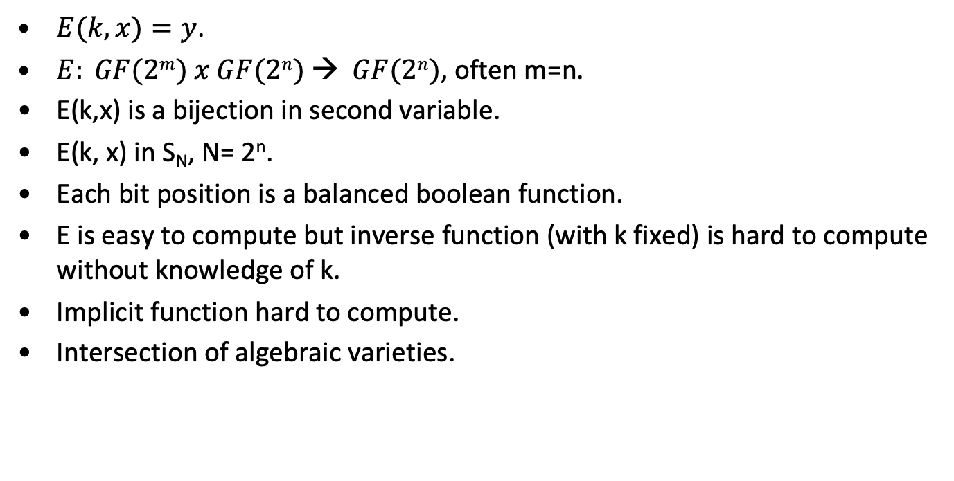
Mathematical view of block ciphers
$E(k, x)=y$.
$E: GF(2m) x GF(2n) → GF(2n)$, often m=n.
E(k,x) is a bijection in second variable.
E(k, x) in S_{N}, N= 2^{n}.
Each bit position is a balanced boolean function.
E is easy to compute but inverse function (with k fixed) is hard to compute without knowledge of k.
Implicit function hard to compute.
Intersection of algebraic varieties.

Slide 4
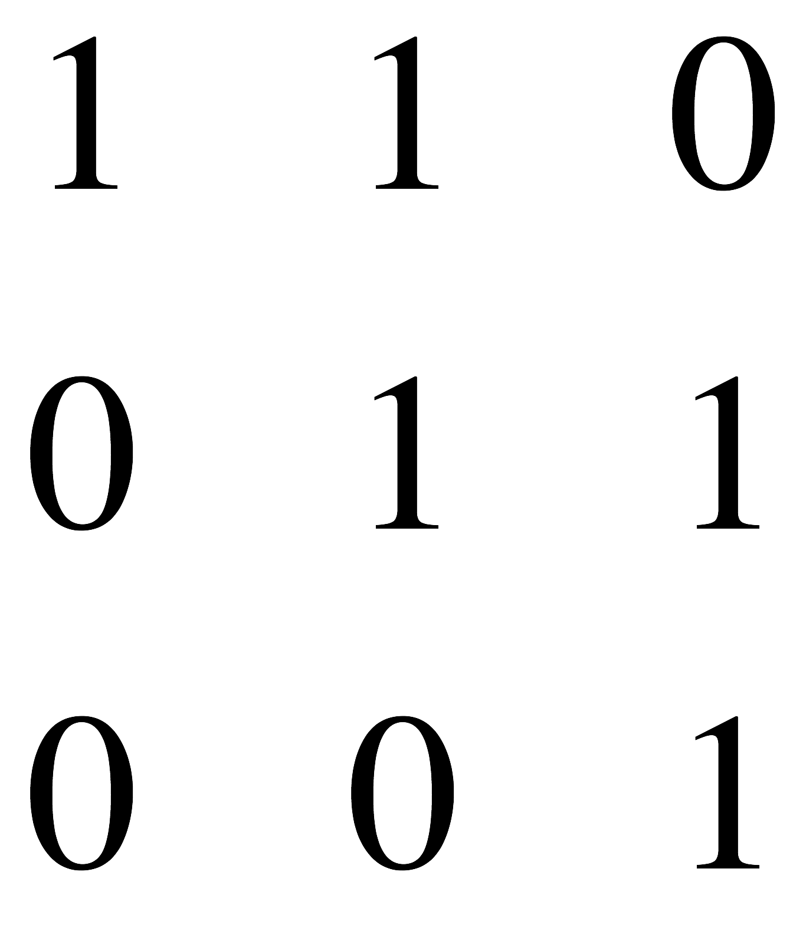
A (very bad) block cipher
Let M be an invertible n x n matrix over GF(2).
Suppose k is an n-bit vector representing the key and p is an n bit vector representing the plaintext block
Put c= M(p+k). C is the plaintext
Example:
M= , k= (1,1,1)^{T}, p= (1,0,1)^{T}, c= (1,1,0)^{T}.
Why is this so bad?
Better (but still bad)
Let R(k) be a rule that selects an invertible matrix from GF(2)^{n} x GF(2)^{n}. Put c=R(k)p.
Lesson: linear is bad

Slide 5
Guiding Theorems
Implicit Function Theorem: If f(x,y)= c, is a continuously differentiable function from F^{n} x F^{m} into F^{m} and the mxm Jacobian in the y variables is non- zero in a region, there is a function g from R^{n} to R^{m} such that F(x, g(x))=c. When F is linear, this function is very easy to compute. Think of g as mapping the plaintext to the key (for fixed ciphertext).
Functions in over finite fields are polynomials: If f is a function from k^{n} to k, where k is a finite field, f can be written as a polynomial in the n variables.
Reduction in dimension: Generally (pathological exceptions aside), if f is a function from k^{n} to k, where k is a finite field, and f(x)=c, one variable can be written as a function of the other n-1 variables. In other words, if g is a function from k^{n} to k subject to the constraint f(x)=c, then g can be rewritten as a function of n-1 variables.

Slide 6
Data Encryption Standard
Federal History
1972 study.
RFP: 5/73, 8/74.
NSA: S-Box influence, key size reduction.
Published in Federal Register: 3/75.
FIPS 46: January, 1976.
DES
Descendant of Feistel’s Lucifer.
Designers: Horst Feistel, Walter Tuchman, Don Coppersmith, Alan Konheim, Edna Grossman, Bill Notz, Lynn Smith, and Bryant Tuckerman.
Brute Force Cracking
Key size controversy: USG wanted 48 bit keys, IBM wanted 64 bit keys. Result: 56-bit keys.
EFS DES Cracker: $250K, 1998. 1,536 custom chips. Can brute force a DES key in days.
Deep Crack and distributed net break a DES key in 22.25 hours (dated)

Slide 7
Horst Feistel: Lucifer
First serious needs for civilian encryption (in electronic banking), 1970’s
IBM’s response: Lucifer, an iterated SP cipher
Lucifer (v0):
Two fixed, 4x4 s-boxes, S₀ & S₁
A fixed permutation P
Key bits determine which s-box is to be used at each position
8 x 64/4 = 128 key bits (for 64-bit block, 8 rounds)
x
S₁
S₁
. . . .
S₀
S₀
S₀
S₁
P
S₁
S₁
. . . .
S₀
S₀
S₀
S₁
...
S₁
S₁
. . . .
S₀
S₀
S₀
S₁
P
Graphic by cschen@cc.nctu.edu.tw
E_{K}(x)

Slide 8
From Lucifer to DES
x
8 fixed, 6x4 s-boxes (non-invertible)
Expansion, E, (simple duplication of 16 bits)
Round keys are used only for xor with the input
56-bit key size
16 x 48 round key bits are selected from the 56-bit master key by the “key schedule”.
32 bits
E
48
k_{i}
⊕
S₁
S₂
. . . .
S₈
32
P
f(x, k_{i})

Slide 9
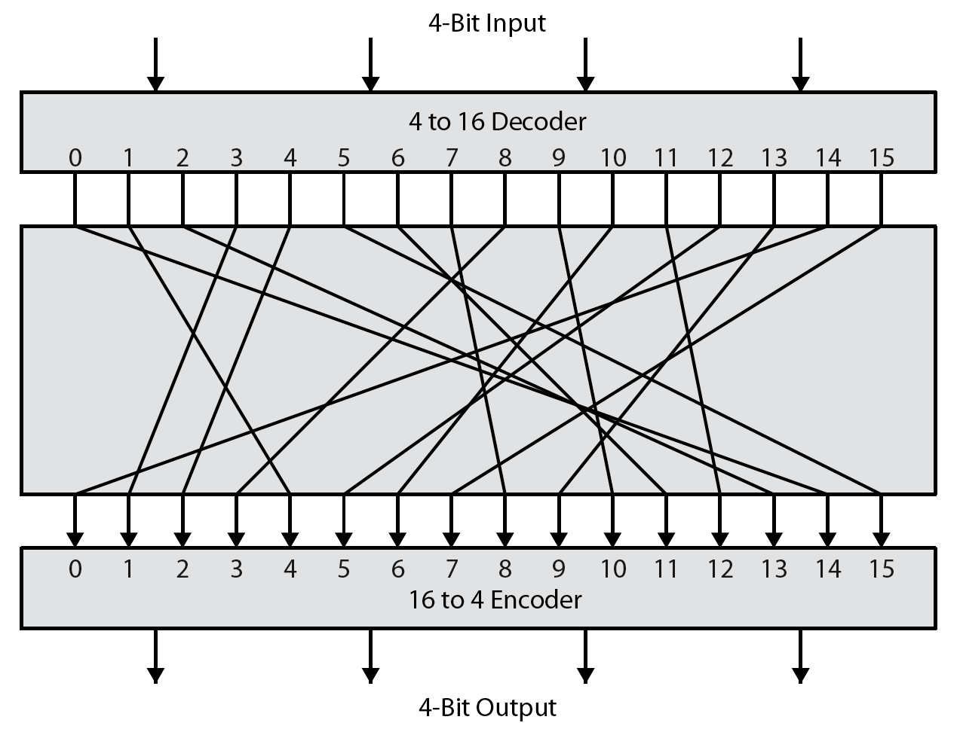
What is a “safe” block cipher
Notes:
Feistel refers to an n-bit general substitution as an ideal block cipher, because it allows for the maximum number of possible encryption mappings from the plaintext to ciphertext block. A 4-bit input produces one of 16 possible input states, which is mapped by the substitution cipher into a unique one of 16 possible output states, each of which is represented by 4 ciphertext bits. The encryption and decryption mappings can be defined by a tabulation, as shown in Stallings Figure 3.1. It illustrates a tiny 4-bit substitution to show that each possible input can be arbitrarily mapped to any output - which is why its complexity grows so rapidly.

Slide 10
Feistel Ciphers
A straightforward SP cipher needs twice the hardware: one for encryption (S, P), one for decryption (S⁻¹, P⁻¹).
Feistel’s solution:
Lucifer v1: Feistel SP cipher; 64-bit block, 128-bit key, 16 rounds.
x
L
R
where the
f function
is SP:
⊕
x
f
f
⊕
S
S
. . . .
S
k_{i}
⊕
f
...
...
P
f
⊕
(why?)
f(x, k_{i})
E_{K}(x)

Slide 11
Iterated Feistel Cipher
Key
Key Schedule
Plaintext
k₁
k₂
r Feistel
Rounds
k_{r}
Ciphertext

Slide 12
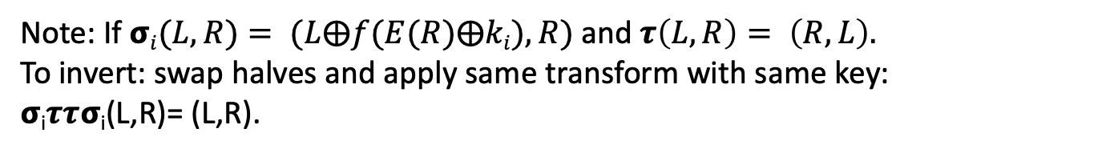
Feistel Round
k_{i}
Graphic courtesy of Josh Benaloh
f
F(K,X)= non-linear function
Note: If $σi(L,R)= (L⨁f(E(R)⨁ki), R)$and $τ\left(L, R\right)= \left(R, L\right).$
To invert: swap halves and apply same transform with same key:
𝞂_{i}𝝉𝝉𝞂_{i}(L,R)= (L,R).

Slide 13
DES Round Function
32 bits
Sub-key
48 bits
6/4-bit substitutions
32-bit permutation
_{Slide courtesy of Josh Benaloh}

Slide 14
Chaining Feistel Rounds
f
k_{i}
f
k_{i+1}

Slide 15
DES
64-bit Plaintext
k₂
k₁ (48 bits)
56-bit Key
16 Feistel
Rounds
k₁₆
64-bit Ciphertext

Slide 16
DES Round
L (32 bits)
R (32 bits)
f
k_{i} (48 bits)
L’ (32 bits)
R’ (32 bits)
F(K,X)= non-linear function

Slide 17
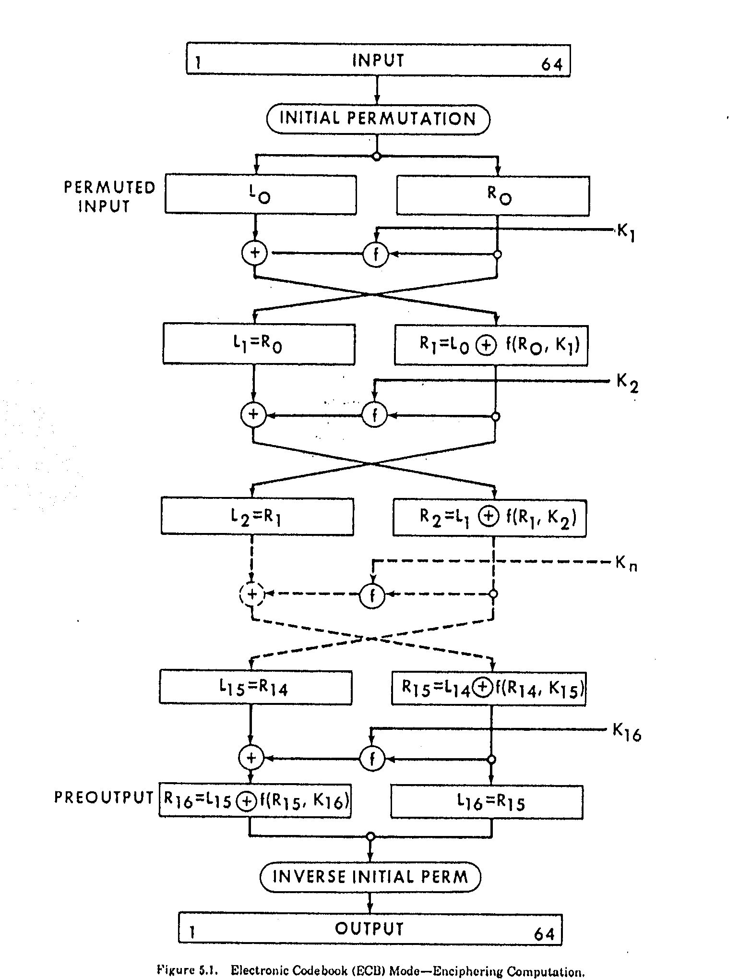

Slide 18
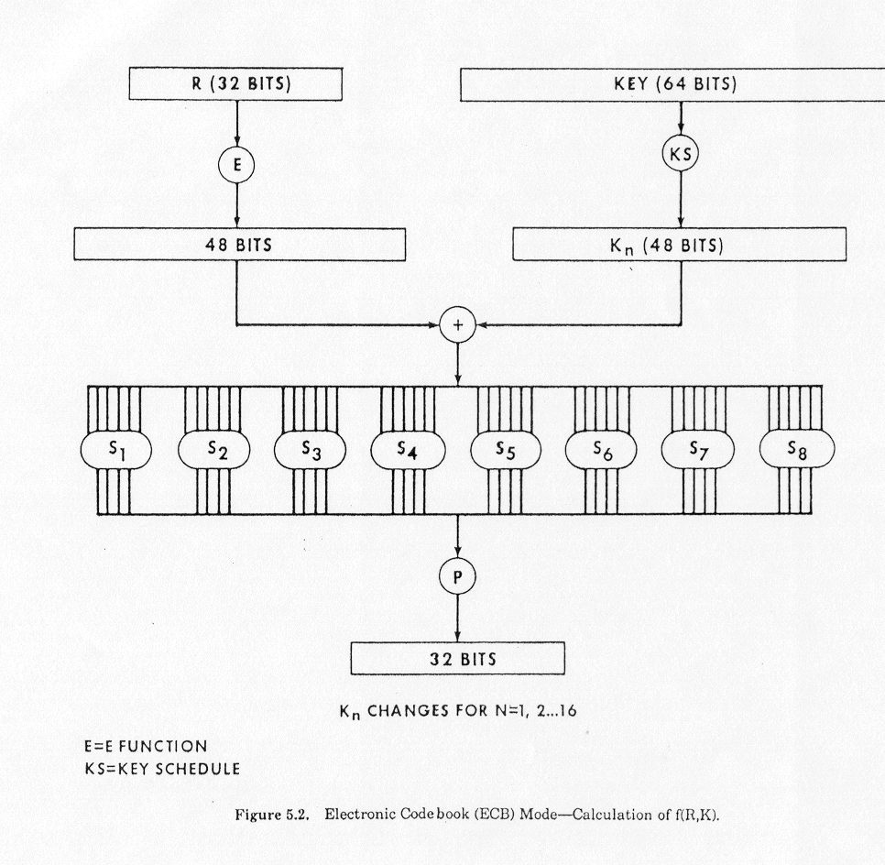

Slide 19
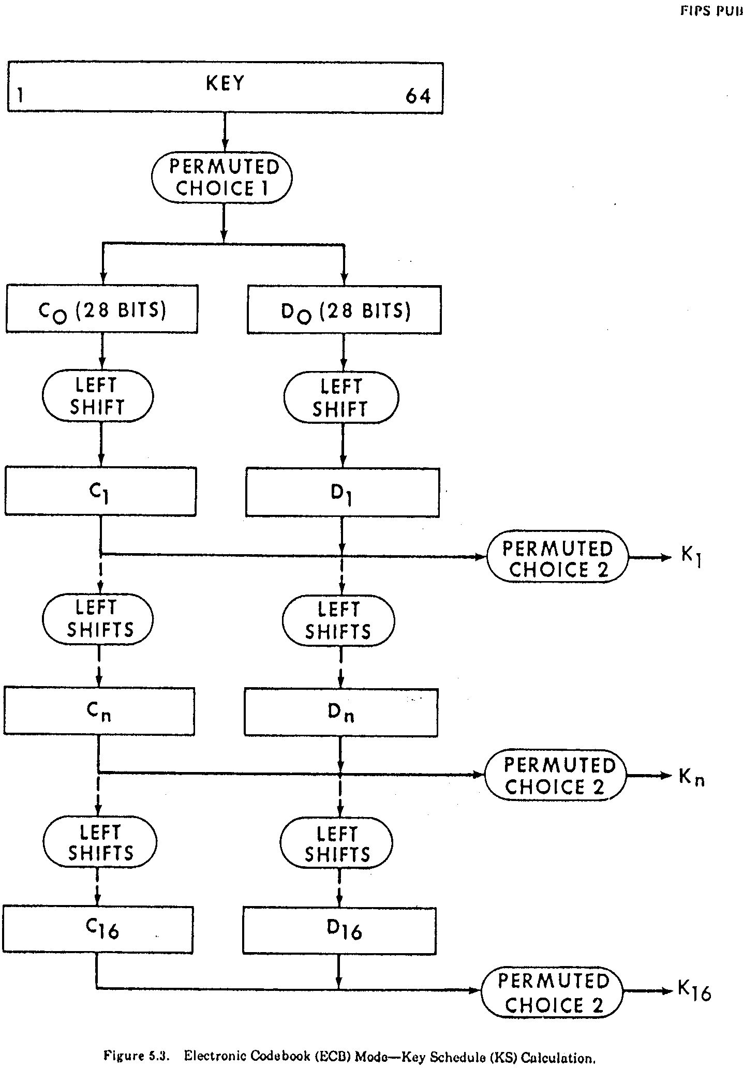

Slide 20
DES Described Algebraically
𝞂_{i}(L,R)= (L⨁f(E(R)⨁k_{i}), R)
k_{i} is 48 bit sub-key for round i.
f(x)= P(S₁S₂S₃ … S₈(x)). Each S –box operates on 6-bit quantities and outputs 4 bit quantities.
P permutes the resulting 32 output bits.
𝜏(L, R)= (R, L).
Each round (except last) is 𝜏𝞂_{i.}
Note that 𝜏𝜏= 𝜏²= 1= 𝞂_{i}𝞂_{i} = 𝞂_{i}².
Full DES is: DES_{K}(x)= IP⁻¹ 𝞂₁₆ 𝜏 ... 𝞂₃ 𝜏 𝞂₂ 𝜏 𝞂₁ IP(x).
So, its inverse is: DES_{K}⁻¹(x)= IP⁻¹ 𝞂₁ 𝜏 ... 𝞂₁₄ 𝜏 𝞂₁₅ 𝜏 𝞂₁₆ IP(x).

Slide 21
DES Key Schedule
C₀D₀= PC₁(K)
C_{i+1} = LeftShift(Shift_{i}, C_{i}), D_{i+1} = LeftShift(Shift_{i}, D_{i})
K_{i}= PC₂(C_{i} ||D_{i})
Shift_{i}= <1,2,2,2,2,2,2,1,2,2,2,2,2,2,1,1>
Note: Irregular Key schedule protects against related key attacks. [Biham, New Types of Cryptanalytic Attacks using Related Keys, TR-753, Technion]

Slide 22
DES Key Schedule
pc1[64]
57 49 41 33 25 17 09 01 58 50 42 34 26 18 10 02
59 51 43 35 27 19 11 03 60 52 44 36 63 55 47 39
31 23 15 07 62 54 46 38 30 22 14 06 61 53 45 37
29 21 13 05 28 20 12 04 00 00 00 00 00 00 00 00
pc2[48]
14 17 11 24 01 05 03 28 15 06 21 10 23 19 12 04
26 08 16 07 27 20 13 02 41 52 31 37 47 55 30 40
51 45 33 48 44 49 39 56 34 53 46 42 50 36 29 32

Slide 23
DES Key Schedule
Key schedule round 1
10 51 34 60 49 17 33 57 2 9 19 42
3 35 26 25 44 58 59 1 36 27 18 41
22 28 39 54 37 4 47 30 5 53 23 29
61 21 38 63 15 20 45 14 13 62 55 31
Key schedule round 2
2 43 26 52 41 9 25 49 59 1 11 34
60 27 18 17 36 50 51 58 57 19 10 33
14 20 31 46 29 63 39 22 28 45 15 21
53 13 30 55 7 12 37 6 5 54 47 23

Slide 24
DES Data
S1 (hex)
e 4 d 1 2 f b 8 3 a 6 c 5 9 0 7
0 f 7 4 e 2 d 1 a 6 c b 9 5 3 8
4 1 e 8 d 6 2 b f c 9 7 3 a 5 0
f c 8 2 4 9 1 7 5 b 3 e a 0 6 d
S2 (hex)
f 1 8 e 6 b 3 4 9 7 2 d c 0 5 a
3 d 4 7 f 2 8 e c 0 1 a 6 9 b 5
0 e 7 b a 4 d 1 5 8 c 6 9 3 2 f
d 8 a 1 3 f 4 2 b 6 7 c 0 5 e 9
S3 (hex)
a 0 9 e 6 3 f 5 1 d c 7 b 4 2 8
d 7 0 9 3 4 6 a 2 8 5 e c b f 1
d 6 4 9 8 f 3 0 b 1 2 c 5 a e 7
1 a d 0 6 9 8 7 4 f e 3 b 5 2 c

Slide 25
DES Data
S4 (hex)
7 d e 3 0 6 9 a 1 2 8 5 b c 4 f
d 8 b 5 6 f 0 3 4 7 2 c 1 a e 9
a 6 9 0 c b 7 d f 1 3 e 5 2 8 4
3 f 0 6 a 1 d 8 9 4 5 b c 7 2 e
S5 (hex)
2 c 4 1 7 a b 6 8 5 3 f d 0 e 9
e b 2 c 4 7 d 1 5 0 f a 3 9 8 6
4 2 1 b a d 7 8 f 9 c 5 6 3 0 e
b 8 c 7 1 e 2 d 6 f 0 9 a 4 5 3
S6 (hex)
c 1 a f 9 2 6 8 0 d 3 4 e 7 5 b
a f 4 2 7 c 9 5 6 1 d e 0 b 3 8
9 e f 5 2 8 c 3 7 0 4 a 1 d b 6
4 3 2 c 9 5 f a b e 1 7 6 0 8 d

Slide 26
DES Data
S7 (hex)
4 b 2 e f 0 8 d 3 c 9 7 5 a 6 1
d 0 b 7 4 9 1 a e 3 5 c 2 f 8 6
1 4 b d c 3 7 e a f 6 8 0 5 9 2
6 b d 8 1 4 a 7 9 5 0 f e 2 3 c
S8 (hex)
d 2 8 4 6 f b 1 a 9 3 e 5 0 c 7
1 f d 8 a 3 7 4 c 5 6 b 0 e 9 2
7 b 4 1 9 c e 2 0 6 a d f 3 5 8
2 1 e 7 4 a 8 d f c 9 0 3 5 6 b
E
32 1 2 3 4 5
4 5 6 7 8 9
8 9 10 11 12 13
12 13 14 15 16 17
16 17 18 19 20 21
20 21 22 23 24 25
24 25 26 27 28 29
28 29 30 31 32 1
Note: DES can be made more secure against linear attacks by changing the order of the S-Boxes: Matsui, On Correlation between the order of S-Boxes and the Strength of DES. Eurocrypt, 94.

Slide 27
DES Data
P
1 2 3 4 5 6 7 8 9 10 11 12 13 14 15 16
16 7 20 21 29 12 28 17 1 15 23 26 5 18 31 10
17 18 19 20 21 22 23 24 25 26 27 28 29 30 31 32
2 8 24 14 32 27 3 9 19 13 30 6 22 11 4 25
Note on applying permutations: For permutations of bit positions, like P above, the table entries consisting of two rows, the top row of which is “in order” means the following. If t is above b, the bit at b is moved into position t in the permuted bit string. For example, after applying P, above, the first bit of the output string was at position 16 of the input string.

Slide 28
Another cipher for the era: TEA
tea(unsigned K[4], unsigned& L, unsigned& R){
unsigned d = 0x9e3779b9;
unsigned s = 0;
for(int i = 0; i < 32; i++) {
s += d;
L += ((R<<4)+K[0])^(R+s)^((R>>5)+K[1]);
R += ((L<<4)+K[2])^(L+s)^((L>>5)+K[3]);
}
}

Slide 29
S Boxes as Polynomials over GF(2)
1,1: 56+4+35+2+26+25+246+245+236+2356+16+15+156+14+146+145+13+135+134+1346+1345+13456+125+1256+1245+123+12356+1234+12346
1,2: C+6+5+4+45+456+36+35+34+346+26+25+24+246+2456+23+236+235+234+2346+1+15+156+134+13456+12+126+1256+124+1246+1245+12456+123+1236+1235+12356+1234+12346
1,3: C+6+56+46+45+3+35+356+346+3456+2+26+24+246+245+236+16+15+145+13+1356+134+13456+12+126+125+12456+123+1236+1235+12356+1234+12346
1,4: C+6+5+456+3+34+346+345+2+23+234+1+15+14+146+135+134+1346+1345+1256+124+1246+1245+123+12356+1234+12346
Legend: C+6+56+46 means 1⨁x₆⨁x₅x₆⨁x₄x₆

Slide 30
Decomposable Systems
E_{k1||k2}(x)= E’_{k1}(x)||E’’_{k2}(x)
Good mixing and avalanche condition
m | t | 2^{mt} | m2^{t}
2 | 32 | 2⁶⁴ | 2³³
4 | 16 | 2⁶⁴ | 2¹⁸

Slide 31
Feistel Ciphers defeat simple attacks
After 4 rounds get flat statistics.
Parallel system attack
Even a weak round function can yield a strong Feistel cipher if iterated sufficiently.
Provided it’s non-linear

Slide 32
DES Attacks: Exhaustive Search
Symmetry DES(k⨁1, x⨁1)=DES(k, x)⨁1
Suppose we know plain/cipher text pair (p,c)
for(k=0;k<2⁵⁶;k++) {
if(DES(k,p)==c) {
printf(“Key is %x\n”, k);
break;
}
}
Expected number of trials (if k was chosen at random) before success: 2⁵⁵

Slide 33
DES Attacks: Poor key hygiene
Poor random number generator: 20 bits of entropy
2²⁰ vs 2⁵⁶
Second biggest real problem
First biggest: bad key management
Symmetric ciphers are said to be secure in practice if no known attack works more efficiently than exhaustive search.
Note that the barrier is computational not information theoretic.

Slide 34
Suppose you decide the keyspace is too small?
Can you increase security by encrypting twice or more?
E’(k₁||k₂, x)= E(k₁, E(k₂,x))
Answer: Maybe.
Three times is the charm (triple DES).
If you do it twice, TMTO attack reduces it to little more than one key search time (if you have a lot of memory).

Slide 35
What’s the complexity of breaking a Block Cipher
Suppose there are K keys (K=2⁵⁶ for DES)
Pick a plaintext p and sort the pairs (E(p,x), x) for x= 0,1,…, K-1)
Ask for E(p,k)=c.
Lookup (c,x) in the table.
x is the key.
O(1) after precomputation!

Slide 36
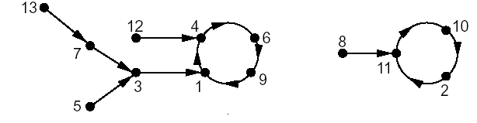
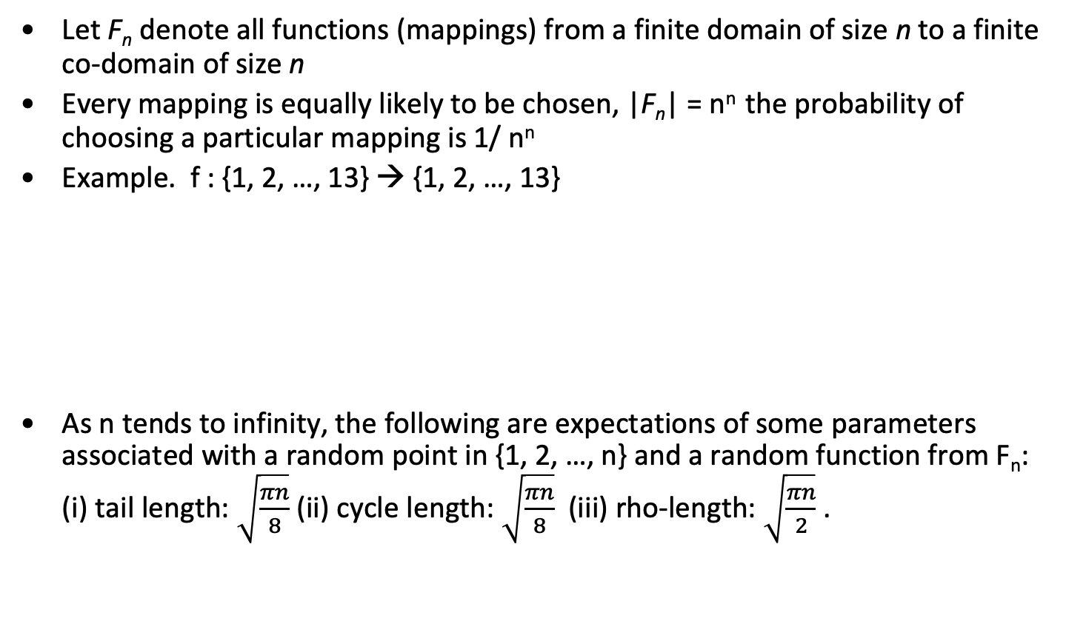
Random mappings
Let F_{n} denote all functions (mappings) from a finite domain of size n to a finite co-domain of size n
Every mapping is equally likely to be chosen, |F_{n}| = n^{n} the probability of choosing a particular mapping is 1/ n^{n}
Example. f : {1, 2, …, 13} → {1, 2, …, 13}
As n tends to infinity, the following are expectations of some parameters associated with a random point in {1, 2, …, n} and a random function from F_{n}: (i) tail length: $\sqrt{\frac{πn}{8}}$ (ii) cycle length: $\sqrt{\frac{πn}{8}}$ (iii) rho-length: $\sqrt{\frac{πn}{2}}$.
Graphic by Maithili Narasimha

Slide 37
Time memory trade off (“TMTO”)
If we can pre-compute a table of (k, E_{k}(x)) for a fixed x, then given corresponding (x,c) we can find the key in O(1) time.
Trying random keys takes O(N) time (where N, usually, 2^{k}, is the number of possible keys)
Can we balance “memory” and “time” resources?
It is not a 50-50 proposition. Hellman showed we could cut the search time to O(N^{(1/2)}) by pre-computing and storing O(N^{(1/2)}) values.

Slide 38
Chain of Encryptions
Assume block length n and key length k are equal: n = k
Construct chain of encryptions:
SP = K₀
K₁ = E(P, SP)
K₂ = E(P, K₁)
:
:
EP = K_{t} = E(P, K_{t−1})
Pre-compute m encryption chains, each of length t +1
Save only the start and end points
SP₀
EP₁
SP₁
SP_{m-1}
Slide adapted from Mark Stamp

Slide 39
TMTO Attack
To attack a particular unknown key K
For the same chosen P used to find chains, we know C where C = E(P, K) and K is unknown key
Compute the chain (maximum of t steps)
X₀ = C, X₁ = E(P, X₀), X₂ = E(P, X₁),…
Suppose for some i we find X_{i} = EP_{j}
Since C = E(P, K) key K should lie before ciphertext C in chain!
EP_{j}
SP_{j}
C
K
Slide adapted from Mark Stamp

Slide 40
DES TMTO
Suppose block cipher has k = 56
Suppose we find m= 2²⁸ chains each of length t= 2²⁸ and no chains overlap (unrealistic)
Memory: 2²⁸ pairs (SP_{j}, EP_{i})
Time: about 2²⁸ (per attack)
Start at C, find some EP_{j} in about 2²⁷ steps
Find K with about 2²⁷ more steps
Attack never fails!
Slide adapted from Mark Stamp

Slide 41
But things are a little more complicated
K
C
EP
Chains can cycle and merge
False alarms, etc.
What if block size not equal key length?
This is easy to deal with
To reduce merging
Compute chain as F(E(P, K_{i−1})) where F permutes the bits
Chains computed using different functions can intersect, but they will not merge
SP
SP₀
F₀ chain
EP₁
SP₁
F₁ chain
EP₀
Slide adapted from Mark Stamp

Slide 42
TMTO in Practice
Let
m= random starting points for each F(# chains/table)
t = Length of each chain
r= number of “tables”, i.e., random functions
Then mtr = total pre-computed chain elements
Pre-computation is about mtr work
Each TMTO attack requires
About mr “memory” and about tr “time”
Choose m= t= r= 2^{k/3}, mtr= 2^{k}.
Slide adapted from Mark Stamp

Slide 43
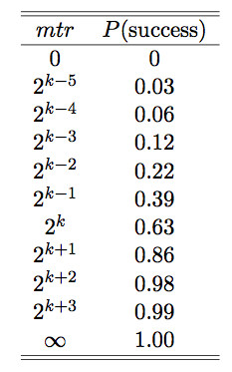
Success Probability
Throw n balls into m urns
What is expected number of urns that have at least one ball?
See Feller, Intro. to Probability Theory
Why is this relevant to TMTO attack?
“Urns” correspond to keys
“Balls” correspond to constructing chains
Assuming k-bit key and m, t, r defined as previously discussed
Then, approximately,
P(success) = 1 − e^{−mtr/k}
Slide adapted from Mark Stamp

Slide 44
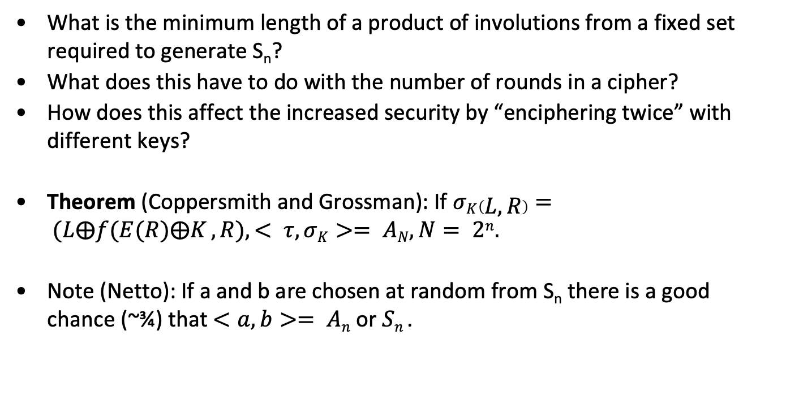
Group theory and DES
What is the minimum length of a product of involutions from a fixed set required to generate S_{n}?
What does this have to do with the number of rounds in a cipher?
How does this affect the increased security by “enciphering twice” with different keys?
Theorem (Coppersmith and Grossman): If $σK\left(L,R\right)= (L⨁f(E(R)⨁K , R), < τ, σK>= AN, N= 2n.$
Note (Netto): If a and b are chosen at random from S_{n} there is a good chance (~¾) that $<a,b>= An$or $Sn$.

Slide 45
DES is not a group
Set E₁(x)= DES_{0xffffffffffffff}(x), E₀(x)= DES_{0x00000000000000}(x).
F(x)= E₁(E₀(x)).
There is an x: F^{m}(x)= x, m~2³², a cycle length.
If |F|=n, m|n.
Suppose DES is closed under composition so F=E_{k}=DES_{k}.
E_{k}^{i}= E_{k}^{j}, E_{k}^{(j-i)}= I. 0≦i<j≦2⁵⁶.
Coppersmith found lengths of cycles for 33 plaintexts and the LCM of these cycle lengths >2²⁷⁷.

Slide 46
If DES were a group…
Suppose E_{K1}(E_{K2}(x))= E_{K3}(x), that there are N possible keys, plaintexts and ciphertexts and that for a given plaintext-ciphertext pair there is only one possible key then there is a birthday attack that finds the key in
O(N^{(1/2)}).
Construct D_{K1}(x) for O(N^{(1/2)}) random keys, K₁ and E_{K2}(x) for O(N^{(1/2)}) random keys, K₂. If there is a match, c=E_{K1}(E_{K2}(x)). This has the same effect as finding K₃.

Slide 47
DES Key Schedule
C₀D₀= PC₁(K)
C_{i+1}= LeftShift(Shift_{i}, C_{i}), D_{i+1}= LeftShift(Shift_{i}, D_{i}).
K_{i}= PC₂(C_{i} ||D_{i})
Shift_{i}= <1,2,2,2,2,2,2,1,2,2,2,2,2,2,1,1>
Note: Irregular Key schedule protects against related key attacks. [Biham, New Types of Cryptanalytic Attacks using Related Keys, TR-753, Technion]

Slide 48
Weak Keys
DES has:
Four weak keys k for which E_{k}(E_{k}(m))= m.
Twelve semi-weak keys which come in pairs k₁ and k₂ and are such that E_{k1}(E_{k2}(m))= m.
Weak keys are due to “key schedule” algorithm

Slide 49
How Weak Keys Arise
A 28 bit quantity has potential symmetries of period 1, 2, 4, 7, and 14.
Suppose each of C₀ and D₀ has a symmetry of period 1; for example, C₀ =0x0000000, D₀= 0x1111111. We can easily figure out a master key (K) that produces such a C₀ and D₀.
Then DES_{K}(DES_{K}(x))=x.

Slide 50
Interlude: Useful Math for Boolean Functions
Algebraic Representations
Linear Functions
Affine approximations
Bent Functions: functions furthest from linear
Hadamard transforms
MDS, linear codes, RS codes
Random Functions
Correlation and Correlation Immunity
Some Notation:
Let L₁(P)⨁L₂(C) = L₃(K)⨁c with probability p_{i}
e_{i}= |1- p_{i}| called the “bias”

Slide 51
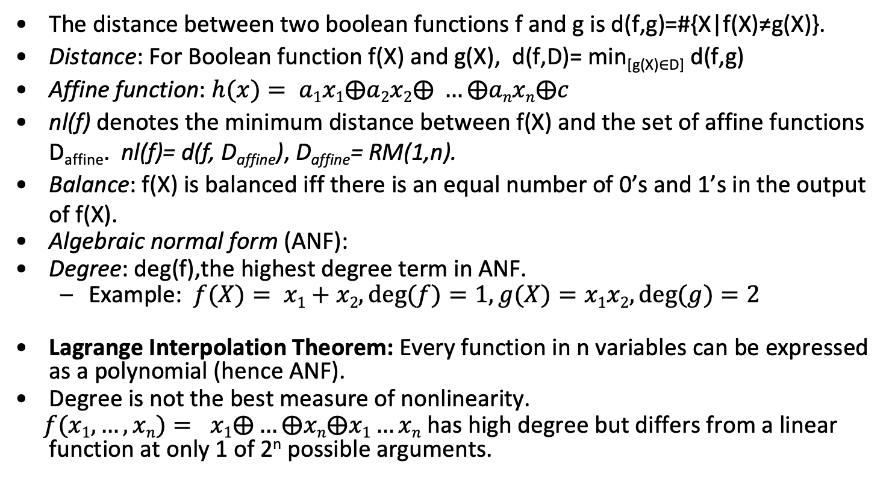
Boolean Functions
The distance between two boolean functions f and g is d(f,g)=#{X|f(X)≠g(X)}.
Distance: For Boolean function f(X) and g(X), d(f,D)= min_{[g(X)∈D]} d(f,g)
Affine function: $h(x)= a1x1⨁a2x2⨁ …⨁anxn⨁c$
nl(f) denotes the minimum distance between f(X) and the set of affine functions D_{affine}. nl(f)= d(f, D_{affine}), D_{affine}= RM(1,n).
Balance: f(X) is balanced iff there is an equal number of 0’s and 1’s in the output of f(X).
Algebraic normal form (ANF):
Degree: deg(f),the highest degree term in ANF.
Example: $f(X)= x1+x2, deg⁡(f)=1,g(X)=x1x2, deg⁡(g)=2$
Lagrange Interpolation Theorem: Every function in n variables can be expressed as a polynomial (hence ANF).
Degree is not the best measure of nonlinearity.
$f(x1,…,xn)= x1⨁…⨁xn⨁x1…xn$has high degree but differs from a linear function at only 1 of 2^{n} possible arguments.

Slide 52
Example: polynomial representation
If f is boolean function on n variables x₁, x₂, …, x_{n} and a=(a₁, a₂, …, a_{n}) then f(x₁, x₂, …, x_{n})=∑_{a}g(a) x₁^{a1} x₂^{a2} …, x_{n}^{an} where g(a) = ∑ _{b<a} f(b₁, b₂, …, b_{n}). Here b<a means the binary representation of b does not have a 1 unless there is a corresponding 1 in the representation of a.
x₁ | x₂ | x₃ | f(x₁, x₂, x₃)
0 | 0 | 0 | 1
1 | 0 | 0 | 0
0 | 1 | 0 | 1
1 | 1 | 0 | 0
0 | 0 | 1 | 1
1 | 0 | 1 | 0
0 | 1 | 1 | 0
1 | 1 | 1 | 1
g(0,0,0)= f(0,0,0)=1
g(0,1,0)=f(0,0,0)+f(0,1,0)=0
g(1,0,0)=f(0,0,0)+f(1,0,0)=1
g(1,1,0)=f(0,0,0)+f(1,0,0) )+f(0,1,0))+f(1,1,0)=0
g(0,0,1)=f(0,0,0)+f(0,0,1)=0
g(0,1,1)=f(0,0,0)+f(0,0,1) +f(0,1,0)+f(0,1,1)=1
g(0,0,1)= g(1,0,1)= g(0,1,1)= g(1,1,1)= 0
f(x₁, x₂, x₃)= 1+x₁+x₂ x₃

Slide 53
Best affine approximation of f₁
f₁
0000 0001 0010 0011 0100 0101 0110 0111
1 0 0 1 0 1 1 0
1000 1001 1010 1011 1100 1101 1110 1111
0 1 1 0 0 1 1 0
W(f)(w)=F(w) = 2^{-n} ∑_{x} (-1)^{f(x)⊕(w,x)}
As polynomial: 1+x₄+x₃+x₂+x₁+x₂x₁
Spectrum:
0000 0001 0010 0011 0100 0101 0110 0111
0.00 0.00 0.00 0.50 0.00 0.00 0.00 -0.50
1000 1001 1010 1011 1100 1101 1110 1111
0.00 0.00 0.00 -0.50 0.00 0.00 0.00 -0.50
L(x)= x₃+x₄ is best linear approximation. dist(f₁, L(x))= 8 (.5+1)=12, so they disagree on 16-12=4 values

Slide 54
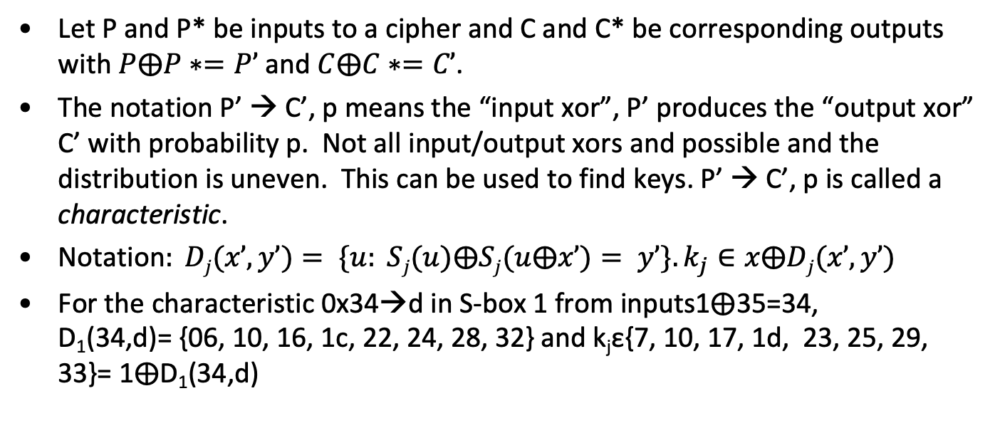
Differential Characteristics
Let P and P* be inputs to a cipher and C and C* be corresponding outputs with $P⨁P∗=P’$and $C⨁C∗=C’$.
The notation P’ → C’, p means the “input xor”, P’ produces the “output xor” C’ with probability p. Not all input/output xors and possible and the distribution is uneven. This can be used to find keys. P’ → C’, p is called a characteristic.
Notation$: Dj(x’,y’)= \{u: Sj(u)⨁Sj(u⨁x’)= y’\}. k_{j}∈x⨁Dj(x’,y’)$
For the characteristic 0x34→d in S-box 1 from inputs1⨁35=34, D₁(34,d)= {06, 10, 16, 1c, 22, 24, 28, 32} and k_{j}ε{7, 10, 17, 1d, 23, 25, 29, 33}= 1⨁D₁(34,d)

Slide 55
Differential Cryptanalysis – 3 rounds
L₁⨁L₃= f(k₂,R₁). ………. (1)
L₄⨁L₃=f (k₄,R₃). ………. (2)
R₄=R₃, L₂=R₁, L₃=R₂.
1&2→ L₄⨁L₁= f(k₂,R₁)⨁f(k₄,R₃).
L₄⨁L₁= f(k₂,R₁)⨁f(k₄,R₃). ……..(3)
L₄*⨁L₁*= f(k₂,R₁*)⨁f(k₄,R₃*). .... (4)
3&4→ L₄’⨁L₁’= f(k₂,R₁*)⨁f(k₄,R₃*)⨁f(k₂,R₁*)⨁f(k₄,R₃*).
R₁=R₁* →L₄’⨁L₁’= f(k₄,R₃)⨁f(k₄,R₃*).
L₁ R₁
L₁
R₁
⨁
F
k₂
L₂
R₂
⨁
F
k₃
⨁
L₃
R₃
F
k₄
L₄ R₄

Slide 56
Simplified DES
L₀R₀
L_{i+1}= R_{i}, each 6 bits.
R_{i+1}= L_{i}⨁f(R_{i},K_{i})
K is 9 bits.
E(x)= (x₁ x₂ x₄ x₃ x₄ x₃ x₅ x₆)
S₁
101 010 001 110 011 100 111 000
001 100 110 010 000 111 101 011
S₂
100 000 110 101 111 001 011 010
101 011 000 111 110 010 001 100
K_{i} is 8 bits of K starting at i^{th} bit.
L₀
R₀
⨁
F
L₁
R₁
⨁
F
L₂
R₂
⨁
F
⨁
L₃
R₃
F
L₄
R₄
L₄ R₄

Slide 57
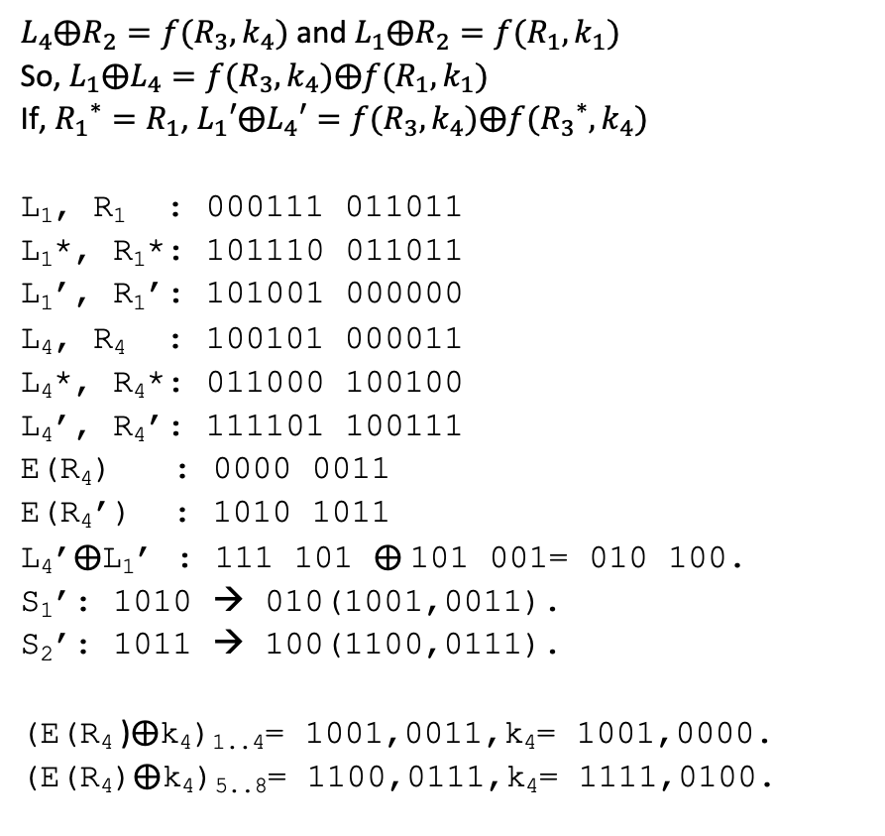
Differential Cryptanalysis – 3 rounds
$L_{4}⨁R_{2}=f(R_{3},k_{4})$ and $L_{1}⨁R_{2}=f(R_{1},k_{1})$
So, $L_{1}⨁L_{4}=f(R_{3},k_{4})⨁f(R_{1},k_{1})$
If, ${R_{1}}^{∗}=R_{1}$, $L_{1}′⨁L_{4}′=f(R_{3},k_{4})⨁f({R_{3}}^{∗},k_{4})$
L₁, R₁ : 000111 011011
L₁*, R₁*: 101110 011011
L₁’, R₁’: 101001 000000
L₄, R₄ : 100101 000011
L₄*, R₄*: 011000 100100
L₄’, R₄’: 111101 100111
E(R₄) : 0000 0011
E(R₄’) : 1010 1011
L₄’⨁L₁’ : 111 101 ⨁ 101 001= 010 100.
S₁’: 1010 → 010(1001,0011).
S₂’: 1011 → 100(1100,0111).
(E(R₄ )⨁k₄)_{1..4}= 1001,0011,k₄= 1001,0000.
(E(R₄)⨁k₄)_{5..8}= 1100,0111,k₄= 1111,0100.
L₁ R₁
L₁
R₁
⨁
F
k₁
L₂
R₂
⨁
F
L₃
⨁
R₃
F
k₄
L₄ R₄

Slide 58
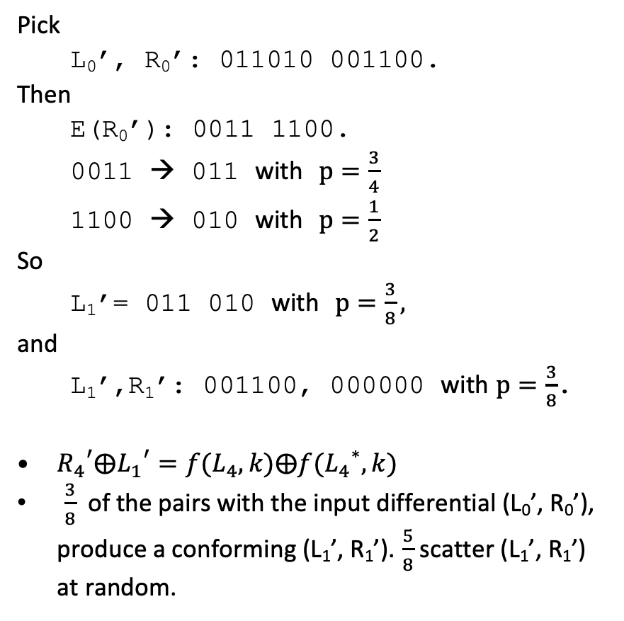
Differential Cryptanalysis, 4 rounds
Pick
L₀’, R₀’: 011010 001100.
Then
E(R₀’): 0011 1100.
0011 → 011 with $p=\frac{3}{4}$
1100 → 010 with $p=\frac{1}{2}$
So
L₁’= 011 010 with $p=\frac{3}{8},$
and
L₁’,R₁’: 001100, 000000 with $p=\frac{3}{8}$.
${R_{4}}^{′}⨁{L_{1}}^{′}=f(L_{4},k)⨁f({L_{4}}^{∗},k)$
$\frac{3}{8}$ of the pairs with the input differential (L₀’, R₀’), produce a conforming (L₁’, R₁’). $\frac{5}{8}$ scatter (L₁’, R₁’) at random.
L₀R₀
L₀
R₀
⨁
F
L₁
R₁
⨁
F
L₂
⨁
R₂
F
L₃
⨁
F
R₃
k
L₄ R₄

Slide 59
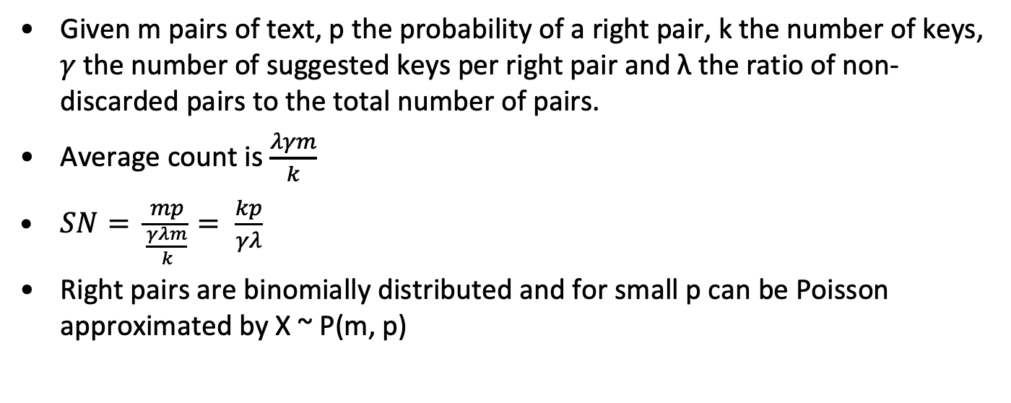
Estimating cost of Differential Attack
Given m pairs of text, p the probability of a right pair, k the number of keys, 𝛾 the number of suggested keys per right pair and λ the ratio of non-discarded pairs to the total number of pairs.
Average count is $\frac{λγm}{k}$
$SN= \frac{mp}{\frac{γλm}{k}}= \frac{kp}{γλ}$
Right pairs are binomially distributed and for small p can be Poisson approximated by X ~ P(m, p)

Slide 60
Comments on Differential Cryptanalysis of DES
# Rounds | Needed pairs | Analyzed Pairs | Bits Found | # Char rounds | Char prob | S/N | Chosen Plain
4 | 2³ | 2³ | 42 | 1 | 1 | 16 | 2⁴
6 | 2⁷ | 2⁷ | 30 | 3 | 1/16 | 2¹⁶ | 2⁸
8 | 2¹⁵ | 2¹³ | 30 | 5 | 1/10486 | 15.6 | 2¹⁶
16 | 2⁵⁷ | 2⁵ | 18 | 15 | 2^{-55.1} | 16 | 2⁵⁸

Slide 61
DES S-Box Design Criteria
No S-box is linear or affine function of its input.
Changing one bit in the input of an S-Box changes at least two output bits.
S-boxes were chosen to minimize the difference between the number of 1’s and 0’s when any input bit is held constant.
S(X) and S(X⨁001100) differ in at least 2 bits
S(X) ⨁ S(X⨁11xy00)

Slide 62
Comments on effect of components on Differential Cryptanalysis
E
Without expansion, there is a 4 round iterative characteristic with p= 1/256
P
Major influence. If P=I, there is a 10-round characteristic with p= 2^{-14.5} (but other attacks would be worse).
S Box order
If S1, S7 and S4 were in order, there would be a 2 round iterative characteristic with p= 1/73. However, Matsui found an order (24673158) that is better and also better against Linear crypto. Optimum order for LC resistance: 27643158.
S properties
S boxes are nearly optimum against differential crypto

Slide 63
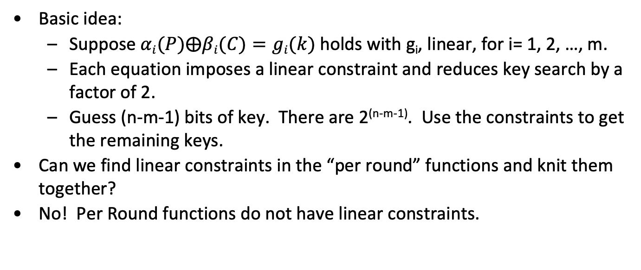
Linear Cryptanalysis
Basic idea:
Suppose $αi(P)⨁βi(C)=gi(k)$holds with g_{i}, linear, for i= 1, 2, …, m.
Each equation imposes a linear constraint and reduces key search by a factor of 2.
Guess (n-m-1) bits of key. There are 2^{(n-m-1)}. Use the constraints to get the remaining keys.
Can we find linear constraints in the “per round” functions and knit them together?
No! Per Round functions do not have linear constraints.

Slide 64
Linear Cryptanalysis
Next idea
Can we find 𝛼(P)⨁β(C)= L(k) which holds with L, linear, with probability p?
Suppose 𝛼(P)⨁β(C)= L(k), with probability p>.5.
Collect a lot of plain/cipher pairs.
Each will “vote” for L(k)=0 or L(k)=1.
Pick the winner.
p= 1/2+𝝴 requires c 𝝴⁻² texts (we’ll see why later).
𝝴 is called “bias”.

Slide 65
Linear Cryptanalysis Notation
P_{L} P_{R}
Matsui numbers bits from right to left, rightmost bit is bit 0. FIPS (and everyone else) goes from left to right starting at 1. I will use the FIPS conventions. To map Matsui positions to everyone else’s:
M(i)= 64-EE(i). For 32 bits make the obvious change.
Matsui also refers to the two portions of the plaintext and cipher-text as (P_{H}, P_{L}), (C_{H}, C_{L}), we’ll stick with (P_{L}, P_{R}), (C_{L}, C_{R}).
⨁
Y₁
X₁
F
k₁
Y₂
X₂
⨁
F
k₂
⨁
Y₃
X₃
F
k₃
C_{L} C_{R}

Slide 66
Linear and near linear dependence
Here is a linear relationship over GF(2) in S5 that holds with probability 52/64 (from NS₅(010000,1111)= 12:
X[2]⨁Y[1]⨁Y[2]⨁Y[3]⨁Y[4]=K[2]⨁1.
Sometimes written: X[2]⨁Y[1,2,3,4]=K[2]⨁1.
You can find relations like this using the “Boolean Function” techniques we describe a little later
After applying P, this becomes
X[17]⨁F(X,K)[3,8,14,25]= K[26]⨁1
X_{[1..6]}
Y_{[1..4]}
S5
K_{[1..6]}

Slide 67
Linear Cryptanalysis of 3 round DES
X[17] ⨁Y[3,8,14,25]= K[26] ⨁1, p= 52/64
Round 1
X₁[17]⨁Y₁[3,8,14,25]= K₁[26]⨁1
P_{R}[17]⨁P_{L}[3,8,14,25]⨁R₁[3,8,14,25]=
K₁[26] ⨁1
Round 3
X₃[17]⨁Y₃[3,8,14,25]= K₃[26]⨁1
R₁[3,8,14,25]⨁C_{L}[3,8,14,25]⨁C_{R}[17]=
K₃[26] ⨁1
Adding the two get:
P_{R}[17]⨁P_{L}[3,8,14,25]⨁C_{L}[3,8,14,25]⨁C_{R}[17]=
K₁[26]⨁K₃[26]
Holds with p= (52/64)²+(12/64)²=.66
P_{L} P_{R}
L₀
R₀
⨁
Y₁,
3,8,14,25
X₁, 17
F
k₁
L₁
R₁
⨁
Y₂
X₂
F
k₂
L₂
R₂
⨁
Y₃
X₃
F
k₃
C_{L} C_{R}

Slide 68
Piling up Lemma
Let X_{i} (1≦i≦n) be independent random variables whose values are 0 with probability p_{i}. Then the probability that X₁⨁X₂⨁ ... ⨁X_{n}= 0 is
½+2^{n-1} ∏_{[1,n]} (p_{i}-1/2)
Proof:
By induction on n. It’s tautological for n=1.
Suppose Pr[X₁⨁X₂⨁ ... ⨁X_{n-1}= 0]= q= ½+2^{n-2} ∏_{[1,n-1]} (p_{i}-1/2).
Then Pr[X₁⨁X₂⨁ ... ⨁X_{n}= 0]= qp_{n} +(1-q)(1-p_{n})= ½+2^{n-1} ∏_{[1,n]} (p_{i}-1/2) as claimed.

Slide 69
Mathematics of biased voting
Central Limit Theorem. Let X, X₁ , … , X_{n} be independent, identically distributed random variables and let S_{n} = X₁+X₂+ … +X_{n}. Let m= E(X) and σ²=E((X-μ)²). Finally set T_{n}= (S_{n}-nμ)/(σ√n), n(x)= 1/(√2π) exp(-x²/2) and
N(a,b)= ∫_{[a,b]} n(x) dx.
Then
Pr(a≦T_{n}≦ b)= N(a,b).
N is the Normal Distribution; it is symmetric around x=0.
N(-∞,0)= ½.
N(-.5, .5)=.38, N(-.75,.75)= .55, N(-1,1)= .68,
N(-2,2)=.9546, N(-3,3)= .9972

Slide 70
Application of CLT to LC
p= ½+𝜖, 1-p= ½-𝜖. Let L(k,P,E_{k}(P))=0 be an equation over GF(2) that holds with probability p. Let X_{i} be the outcome (1 if true, 0 if false) of an experiment picking P and testing whether L holds for the real k.
E(X_{i})= p, E((X_{i}-p)²)= p(1-p)² + (1-p)(0-p)²= p(1-p). Let T_{n} be as provided in the CLT.
Fixing n, what is the probability that more than half the X_{i} are 1 (i.e.- What is the probability that n random equations vote for the right key)?
This is just Pr(T_{n}𝞂 –𝜖√n/√(1/4–𝜖²)). If n=d² 𝜖 ⁻², this is just
Pr(T_{n} 𝞂 –d/ √(1/4–𝜖²)) or, if 𝜖 is small Pr(T_{n} 𝞂-2d).
Some numerical values: d= .25, N(-.5, ∞) = .69, d= .5, N(-1, ∞) = .84,
d= 1, N(-2, ∞) = .98, d= 1.5, N(-3, ∞) = .999.

Slide 71
End
Thank you, IBM, and collaborators, for a great cipher.

Slide 72
L₁
R₁
⨁
f
k₁
L₂
R₂
⨁
f
k₂
L₃
R₃
⨁
f
k₃
L₄
R₄
⨁
f
k₄
L₅
R₅
⨁
f
k₅
L₆
R₆
…

