Slide 1
Cryptanalysis
Block Ciphers 2
John Manferdelli
JohnManferdelli@hotmail.com
© 2004-2012, John L. Manferdelli.
This material is provided without warranty of any kind including, without limitation, warranty of non-infringement or suitability for any purpose. This material is not guaranteed to be error free and is intended for instructional use only

Slide 2
Differential Cryptanalysis of DES

Slide 3
How input differentials affect output
Expansion Matrix
Out | 1 | 2 | 3 | 4
1 | 4,4 | 2,3 | 5,4 | 6,1
2 | 8,1 | 3,4 | 7,4 | 5,1
3 | 1,1 | 4,3 | 6,3 | 7,2
4 | 2,1 | 5,2 | 8,3 | 3,2
5 | 1,2 | 2,4 | 6,4 | 4,2
6 | 8,4 | 7,3 | 1,3 | 3,1
7 | 5,3 | 4,1 | 8,2 | 2,2
8 | 6,2 | 3,3 | 1,4 | 7,1
P | 1 | 2 | 3 | 4
1 | 16 | 7 | 20 | 21
2 | 29 | 12 | 28 | 17
3 | 1 | 15 | 23 | 26
4 | 5 | 18 | 31 | 10
5 | 2 | 8 | 24 | 14
6 | 32 | 27 | 3 | 9
7 | 19 | 13 | 30 | 6
8 | 22 | 11 | 4 | 25
32 | 1 | 2 | 3 | 4 | 5
4 | 5 | 6 | 7 | 8 | 9
8 | 9 | 10 | 11 | 12 | 13
12 | 13 | 14 | 15 | 16 | 17
16 | 17 | 18 | 19 | 20 | 21
20 | 21 | 22 | 23 | 24 | 25
24 | 25 | 26 | 27 | 28 | 29
28 | 29 | 30 | 31 | 32 | 1
After P
On average 1 bit difference affects 3 S boxes in next round after expansion.

Slide 4
How input differentials affect output
P | 1 | 2 | 3 | 4
1 | 16 | 7 | 20 | 21
2 | 29 | 12 | 28 | 17
3 | 1 | 15 | 23 | 26
4 | 5 | 18 | 31 | 10
5 | 2 | 8 | 24 | 14
6 | 32 | 27 | 3 | 9
7 | 19 | 13 | 30 | 6
8 | 22 | 11 | 4 | 25
Expansion Matrix
Out | 1 | 2 | 3 | 4
1 | 4 | 2 | 5 | 6
2 | 8 | 3 | 7 | 5
3 | 1 | 4 | 6 | 7
4 | 2 | 5 | 8 | 3
5 | 1 | 2 | 6 | 4
6 | 8 | 7 | 1 | 3
7 | 5 | 4 | 8 | 2
8 | 6 | 3 | 1 | 7
32 | 1 | 2 | 3 | 4 | 5
4 | 5 | 6 | 7 | 8 | 9
8 | 9 | 10 | 11 | 12 | 13
12 | 13 | 14 | 15 | 16 | 17
16 | 17 | 18 | 19 | 20 | 21
20 | 21 | 22 | 23 | 24 | 25
24 | 25 | 26 | 27 | 28 | 29
28 | 29 | 30 | 31 | 32 | 1
P⁻¹ | 1 | 2 | 3 | 4
1 | 9 | 17 | 23 | 31
2 | 13 | 28 | 2 | 18
3 | 24 | 16 | 30 | 6
4 | 26 | 20 | 10 | 1
5 | 8 | 14 | 25 | 3
6 | 4 | 29 | 11 | 19
7 | 32 | 12 | 22 | 7
8 | 5 | 27 | 15 | 21
After P
Affected by box

Slide 5
DC of DES, 4 rounds - 1
P_{L}’ P_{R}’
0x20000000 00000000
Input differential: 0x20000000 00000000
A’= 0, a’=0; b’= 0x20000000, B’ is affected (at most) as mask=0x00808202=P(f0000000) since only the first S box is non-zero
d’= C_{R}’ is known
D’= C_{L}’⨁B’ is known in 28 bits (all but the mask positions: 0x00808202)
S/N= pk/(λ𝛾), is the ratio of discarded pairs to all pairs, is the number of keys suggested by a pair. Remember only about .8 of xor output patterns are possible.
Bits that leave all S-boxes but S₁ are valid.
Weighted probabilities (next slide)
For each S box, try all 2⁶ keys and bump counts for each key which matches the differential, d’→D’.
L₀
R₀
⨁
A=0
a=0
F
L₁
R₁
B=0x00?0??0?
b= 0x20000000
⨁
F
L₂
R₂
⨁
C
c
F
L₃
R₃
⨁
D
d
F
L₄
R₄
C_{L} C_{R}

Slide 6
DC of DES, 4 rounds - 2
P_{L}’ P_{R}’
0x20000000 00000000
For Sbox 1:
0x04→0x3, p= 6/64 (0x00000202)
0x04→0x5, p= 10/64 (0x00800002)
0x04→0x6, p= 10/64 (0x00800200)
0x04→0x7, p= 6/64 (0x00800202)
0x04→0x9, p= 4/64 (0x00008002)
0x04→0xa, p= 6/64 (0x00008200)
0x04→0xb, p= 4/64 (0x00008202)
0x04→0xc, p= 2/64 (0x00808000)
0x04→0xd, p= 8/64 (0x00808002)
0x04→0xe, p= 6/64 (0x00808200)
0x04→0xf, p= 2/64 (0x00808202)
L₀
R₀
⨁
A=0
a=0
F
L₁
R₁
B=0x00?0??0?
b= 0x20000000
⨁
F
L₂
R₂
⨁
C
c
F
L₃
R₃
⨁
D
d
F
L₄
R₄
C_{L} C_{R}

Slide 7
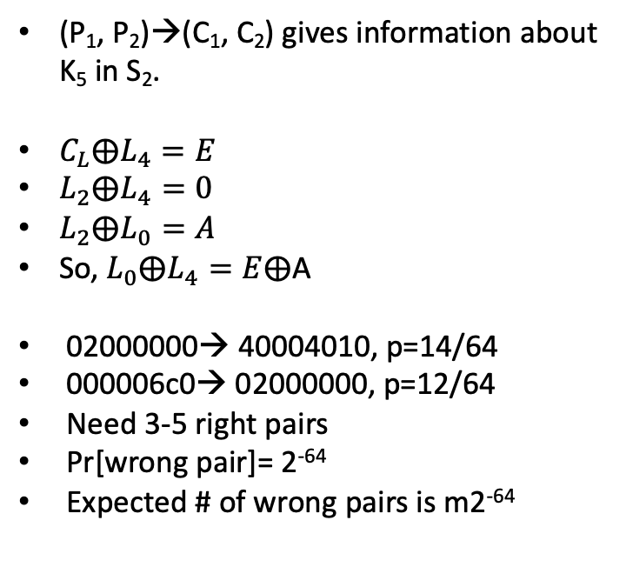
DC of DES, 5 rounds
P_{L}
P_{R}
40 00 46 d0 02 00 00 00
L₀
R₀
⨁
(P₁, P₂)→(C₁, C₂) gives information about K₅ in S₂.
$C_{L}⨁L_{4}=E$
$L_{2}⨁L_{4}=0$
$L_{2}⨁L_{0}=A$
So, $L_{0}⨁L_{4}=E⨁$A
02000000→ 40004010, p=14/64
000006c0→ 02000000, p=12/64
Need 3-5 right pairs
Pr[wrong pair]= 2⁻⁶⁴
Expected # of wrong pairs is m2⁻⁶⁴
F
p=14/64
A= 40004010
a= 02000000
L₁
R₁
⨁
F
B= 02000000
b= 000006c0
p=12/64
L₂
R₂
⨁
F
p=1
C= 00000000
c= 00000000
L₃
R₃
⨁
F
p=12/64
D= 02000000
d= 000006c0
L₄
R₄
⨁
F
p=14/64
E= 40004010
e= 02000000
C_{L}
40 00 46 d0 02 00 00 00
C_{R}

Slide 8
DC of DES, 8 rounds - 1
L₄R₄
P_{L} P_{R}
0x405c 0000 0400 0000
L₄
R₄
⨁
F
L₀
R₀
E’=4008 0000
e’=4008 0000
⨁
F
p=1/4
A’=4008 0000
a’=0400 0000
R₅
L₅
⨁
F
L₁
R₁
F’=4008 0000
f’=405c 0000
⨁
F
B’=0400 0000
b’=0054 0000
p=10/64
L₆
R₆
⨁
F
L₂
R₂
G’=4008 0000
g’=4008 0000
⨁
F
p=1
C’=0000
c’= 0000
L₇
R₇
⨁
F
L₃
R₃
H’=4008 0000
h’=4008 0000
⨁
L₈
R₈
F
D’=4008 0000
d’=4008 0000
L₄
R₄
C_{L} C_{R}

Slide 9
DC of DES, 8 rounds - 2
Requires 25,000 cipher texts. Finds 30 bits in K₈.
Uses 5 round differential 405c 0000 0400 0000 → 405c 0000 0400 0000 for five rounds, p= 1/10485.76.
f’= d’⨁E’= b’⨁A’=L’, H’= l’⨁g’= l’⨁e’⨁F’
S/N= 2³⁰/(4⁵·10485.76)= 100
4008 0000= P(0a00 0000), 0400 0000=P(0010 0000)
S/N=2³⁰/(4⁵·10485.76)=100 for 30 bits --- too many counters.
Reduce to 24 bit search with enhanced probability.
e’ → E’=P(0W 00 00 00)= X0 0Y Z0 00=f’ = X0 5V Z0 00.
W ε{1,2,3,8,9,a,b}, Xε{0,4}, Yε{0,8}, Zε{0,4}. V=Y⨁4.
Z=0, 0400 0000→4008 0000, p=1/4, all others Z=4, p=20/64
p_{e’→E’}=1/4+.8(20/64)=1/2
Pr(24 bit, differential)= [(16·10·16)/64³ ]·[(16·10·32)/64³]= 1/5243

Slide 10
DC of DES, 8 rounds - 3
For enhanced probability, 24 bits, find keys in S₂, S₆, S₇, S₈.
e’=0400 0000 → E’=P(0w 00 00 00)= x0 0y z0 00= f’ = x0 5v z0 00.
S/N= 2²⁴/(4⁴·.8·5243)= 15.6
Alternatively use 18 bit count (S₆, S₇, S₈), requiring 150,000 pairs with S/N= 1.2 followed by 12 bits.
These keys allow us to calculate 20 bits of H, H*.
Can use this to complete K₈ (48 bits).
Final 8 bits from exhaustive search.

Slide 11
DC of DES, 8 rounds - 4
18 bits of key, 150,000 pairs from S₂, S₆, S₇, S₈
Set up 2¹⁸ counter
Preprocess S_{I}, S_{I}’→S_{O}’.
For each cipher text pair
Calculate S_{EH}’=S_{Ih}’, S_{Oh’}’ for S₂, S₅, S₆, S₇, S₈
For each of S₂, S₅, S₆, S₇, S₈, check is S_{ih}’→S_{Oh}’ is not satisfied for any S-box. If so, discard.
For S₆, S₇, S₈, get all S_{Ih} which are possible for S_{ih}→S_{Ih}. Calculate S_{Kh}= S_{Ih}⨁S_{Eh}
Get entry of maximal count

Slide 12
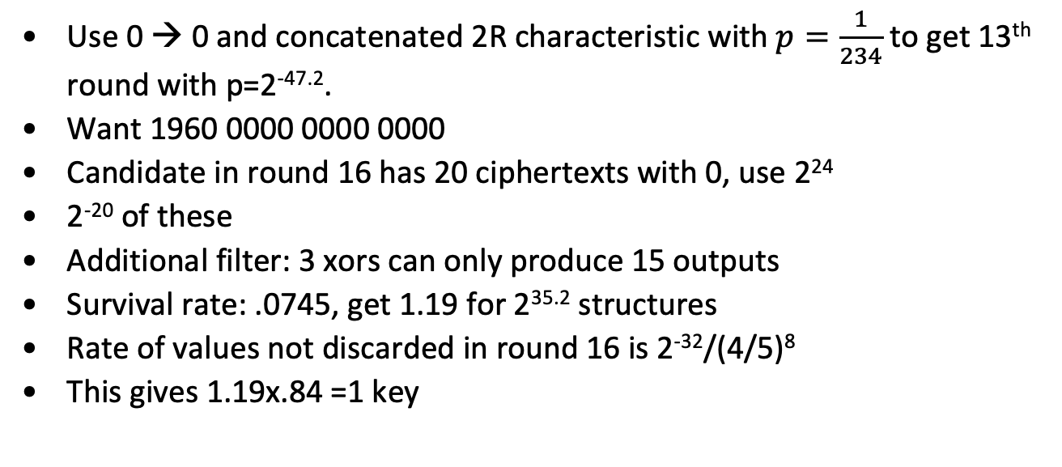
Full Differential Attack on DES
Use 0 → 0 and concatenated 2R characteristic with $p=\frac{1}{234}$ to get 13th round with p=2^{-47.2}.
Want 1960 0000 0000 0000
Candidate in round 16 has 20 ciphertexts with 0, use 2²⁴
2⁻²⁰ of these
Additional filter: 3 xors can only produce 15 outputs
Survival rate: .0745, get 1.19 for 2^{35.2} structures
Rate of values not discarded in round 16 is 2⁻³²/(4/5)⁸
This gives 1.19x.84 =1 key

Slide 13
Summary of DES DC Attacks
# Rounds | # Pairs needed | # Pairs used | # bits found | # chrtstcs | p | S/N | l | g
4 | 2³ | 2³ | 24 | 1 | 1 | 16
6 | 2⁷ | 2⁷ | 30 | 3 | 1/16 | 2¹⁶
8 | 2¹⁵ | 2¹³ | 30 | 5 | 1/104656 | 15.6
8 | 2¹⁷ | 2¹³ | 30 | 5 | 1/104656 | 1.2
8 | 2²⁰ | 2¹⁹ | 30 | 5 | 1/55000 | 1.5
9 | 2²⁵ | 2²⁴ | 30 | 6 | 10⁻⁶ | 1.0
9 | 2²⁶ | 2⁸ | 48 | 7 | 10⁻²⁴ | 2²³
For simple attacks

Slide 14
Linear Cryptanalysis of DES

Slide 15
One round linear constraint
S₅(x₁⨁k₁,x₂⨁k₂,x₃⨁k₃,x₄⨁k₄,x₅⨁k₅,x₆⨁k₆)[1,2,3,4]⨁x₂=k₂⨁1, p=52/64
Output of F from S₅ is permuted (by P) into positions 8,14,25,3 of round output, O.
Input to S₅ for F comes from bits 16,17,18,19,20,21 of round input, I (after expansion).
Key bits for S₅ are from bits 25,26,27,28,29,30 of the round key, K.
After renaming input, output and key bits in this way, the constraint becomes O[3,8,14,25]⨁I[17] = K[26]⨁1.
K[1,2,3,4,5,6]
K[1,…,48]
Y[1,2,3,4]
S₅
O[1,…,32]
F
X[1,2,3,4,5,6]
I[1,…,32]
P⁻¹ | 1 | 2 | 3 | 4
1 | 9 | 17 | 23 | 31
2 | 13 | 28 | 2 | 18
3 | 24 | 16 | 30 | 6
4 | 26 | 20 | 10 | 1
P⁻¹ | 1 | 2 | 3 | 4
5 | 8 | 14 | 25 | 3
6 | 4 | 29 | 11 | 19
7 | 32 | 12 | 22 | 7
8 | 5 | 27 | 15 | 21

Slide 16
Matsui’s Per Round Constraints
 | SBox | Sbox Equation | w | ht(w) | Prob | Round Equation
A | 5 | X[2]⨁Y[1,2,3,4]= K[2]⨁1 | 40₈ | 40 | 12/64 | X[17]⨁Y[3,8,14,25]=K[26]
B | 1 | X[2,3,5,6]⨁Y[2]=K[2,3,5,6]⨁1 | 27₈ | 20 | 22/64 | X[1,2,4,5]⨁Y[17]=K[2,3,5,6]
C | 1 | X[4]⨁Y[2]= K[4]⨁1 | 4₈ | 4 | 30/64 | X[3]⨁Y[17]=K[4]
D | 5 | X[2]⨁Y[1,2,3]= K[2] | 10₈ | 20 | 42/64 | X[17]⨁Y[8,14,25]=K[26]
E | 5 | X[1, 5]⨁Y[1,2,3]= K[1,5]⨁1 | 22₈ | 32 | 16/64 | X[16,20]⨁Y[8,14,25]=K[25,29]
Ht(w) is (unnormalized) Hadamard weight. Note that a-d=ht(w) and a+d=2^{n} so
a= (2^{n}+ht(w))/2 where a= # places linear appx agrees and d= # places linear appx disagrees.
Matsui: Linear Cryptanalysis Method for DES Cipher. Eurocrypt, 98. By the way, Matsui’s bit numbering scheme differs from ours.

Slide 17
S-Box constraints
S-1, Y[4 ]:
w : 000 001 002 003 004 005 006 007 008 009 010 011 012 013 014 015
ht: 000 000 004 004 -04 004 000 008 -08 000 004 -04 004 -12 000 000
w : 016 017 018 019 020 021 022 023 024 025 026 027 028 029 030 031
ht: -04 -04 -08 -08 -08 000 -12 -04 -04 004 000 -08 008 -08 -04 -04
w : 032 033 034 035 036 037 038 039 040 041 042 043 044 045 046 047
ht: 000 000 -04 -04 -04 004 -08 000 -08 000 -04 020 -12 004 008 008
w : 048 049 050 051 052 053 054 055 056 057 058 059 060 061 062 063
ht: 004 004 008 008 -16 -08 -12 -04 020 -04 000 -08 000 -16 -04 028
S5, Y[1 2 3 4 ]:
w : 000 001 002 003 004 005 006 007 008 009 010 011 012 013 014 015
ht: 000 000 008 008 000 -08 000 008 -08 008 000 000 008 000 008 000
w : 016 017 018 019 020 021 022 023 024 025 026 027 028 029 030 031
ht: 040 -08 000 000 000 -08 000 -08 008 008 000 000 000 -08 000 008
w : 032 033 034 035 036 037 038 039 040 041 042 043 044 045 046 047
ht: 000 000 024 008 000 008 000 008 000 000 -08 -08 000 -08 000 008
w : 048 049 050 051 052 053 054 055 056 057 058 059 060 061 062 063
ht: -08 -08 000 000 000 -08 000 008 000 000 008 -08 -08 000 -08 000

Slide 18
S-Box constraints to round constraints
S-Box output bit use
S[1]: 9 17 23 31
S[2]: 13 28 2 18
S[3]: 24 16 30 6
S[4]: 26 20 10 1
S[5]: 8 14 25 3
S[6]: 4 29 11 19
S[7]: 32 12 22 7
S[8]: 5 27 15 21

Slide 19
LC of DES, 3 rounds - 1
Input at round 1 to activate S₅ constraint is
P_{R}[17].
Output at round 1 for constraint is
O[3,8,14,25] = P_{L}[3,8,14,25]⨁R₂[3,8,14,25] which holds with probability 52/64.
Key bits are K₁[26] and K₃[26].
First round thus yields
P_{L}[3,8,14,25]⨁R₂[3,8,14,25]⨁P_{R}[17]= K₁[26]⨁1
Similarly using the same S₅ relation, round 3 is
C_{L}[3,8,14,25]⨁R₂[3,8,14,25]⨁C_{R}[17]= K₃[26]⨁1, which holds with probability 52/64.
Adding we get
P_{L}[3,8,14,25]⨁C_{L}[3,8,14,25]⨁P_{R}[17]⨁C_{R}[17]= K₁[26]⨁K₃[26].
This holds with probability
p= (52/64)²+(12/64)² = .6953
P_{L}[3,8,14,25] P_{R}[17]
L₁
[3,8,14,25]
R₁
⨁
F
[17]
[26]
L₂
R₂
⨁
F
L₃
[26]
R₃
⨁
[3,8,14,25]
[17]
F
C_{L}[3,8,14,25] C_{R}[17]

Slide 20
Evaluating experimental outcome
Suppose an affine constraint P[j₁, …, j_{m}]⨁C[l₁, …, l_{m’}]= K[k₁, …, k_{m’’}] holds with probability p. Put x=(x₁, …, x_{n}) where x_{i}= P_{i}[j₁, …, j_{m}]⨁C_{i}[l₁, …, l_{m’}] for the observed sequence (P_{i}, C_{i}) of corresponding plain and cipher text. x is sampled from one of two populations: one with K[k₁, …, k_{m’’}] =0 and one with K[k₁, …, k_{m’’}] =1. We assume that the choice of population 1 or population 2 is made at random prior to observation of (P_{i}, C_{i}).
If x is sampled from the first population (q=0), Pr(x_{i}|q=0)= p while if x is sampled from the second population (q=1), Pr(x_{i}|q=1)= q= 1-p.
Denoting p₀= Pr(q=0|x) and p₁= Pr(q=1|x), from Bayes Theorem, we obtain p₀= Pr(q=0|x) = Pr(x|q=0)·Pr(q=0)/Pr(x) while p₁= Pr(q=1|x) = Pr(x|q=1)·Pr(q=1)/Pr(x).
Pr(q=0)=Pr(q=1)= 1/2. Suppose we observe a 0’s in x and b 1’s (a+b=n), then Pr(x|q=0)= _{n}C_{a} pªq^{b} and similarly, Pr(x|q=1)= _{n}C_{a} qªp^{b}, while Pr(x)= _{n}C_{a} (1/2)ª (1/2)^{b}= 2^{-n}_{n}C_{a} .
So p₀= 2^{n-1}pªq^{b} and p₁= 2^{n-1}qªp^{b}.
Thus, p₀/p₁= (p/q)ª(q/p)^{b}.

Slide 21
LC of DES, 3 rounds - 2
P_{L} P_{R}
P_{R}[17]⨁P_{L}[3,8,14,25]⨁C_{L}[3,8,14,25]⨁
C_{R}[17] = K₁[26]⨁K₃[26]
Recall p= .6953 so q= .3047.
If we observe a 0’s in x and b 1’s, the previous result gives:
Pr(q=0|x)/Pr(q=1|x) = (p/q)ª(q/p)^{b}.
Equivalently, if a>b,
Pr(q=0|x)/Pr(q=1|x) = (p/q)^{a-b}≅(7/3)^{a-b}.
So, if, for example, a-b=5, p₀ ≅.99.
L₀
R₀
[3,8,14,25]
[ 17]
⨁
F
k₁
L₁
R₁
⨁
Y₂
X₂
F
k₂
L₂
R₂
⨁
Y₃
X₃
F
k₃
C_{L} C_{R}

Slide 22
LC of DES, 5 rounds - 1
P_{L}[17], P_{R}[1,2,3,4,5,8,14,25]
L₀
[17]
[2,3,5,6]
[1,2,4,5]
R₀
⨁
F
[]
L₁
[26]
R₁
⨁
[3,8,14,25]
[17]
F
L₂
R₂
⨁
F
L₃
[26]
R₃
⨁
[3,8,14,25]
[17]
F
L₄
[2,3,5,6]
R₄
⨁
[17]
[1,2,4,5]
F
C_{L}[17],C_{R}[1,2,3,4,5,8,14,25]

Slide 23
LC of DES, 5 rounds - 2
P_{L}[17]⨁R₁[17]= K₁[2,3,5,6]⨁P_{R}[1,2,4,5]⨁1 …..(Eq B)
P_{R}[3,8,14,25]⨁R₂[3,8,14,25]= K₂[26]⨁R₁[17]⨁1 …..(Eq A)
R₂[3,8,14,25]⨁C_{R}[3,8,14,25]= K₄[26]⨁C_{R}[17]⨁1 …..(Eq A)
C_{L}[17]⨁R₃[17]= K₅[2,3,5,6]⨁C_{R}[1,2,4,5]⨁1 …..(Eq B)
Adding yields:
P_{L}[17]⨁P_{R}[1,2,3,4,5,8,14,25]⨁C_{L}[17]⨁C_{R}[1,2,3,4,5,8,14,25] =
K₁[2,3,5,6]⨁K₂[26]⨁K₄[26]⨁K₅[2,3,5,6]
This holds with probability:
p= p_{B}²p_{A}²+p_{B}²q_{A}²+p_{A}²q_{B}²+4(q_{A}p_{B}q_{B}p_{A})+q_{B}²q_{A}²≅.519=.5+1.22x2⁻⁶,
where q_{i}=1-p_{i}. p/q=1.07927..
Suppose we decide, based on an excess (e), of LHS values. Odds of right answer is r=(p/q)^{e}. For example, if e= 64, r ≅131.92.

Slide 24
LC of DES, 8 rounds - 1
L₄R₄
P_{L}[8,14,25], P_{R}[16,20]
L₄
[26]
R₄
⨁
[3,8,14,25]
[17]
F
k₅
L₀
[25,29]
R₀
⨁
[8,14,25]
[16,20]
F
k₁
L₅
R₅
⨁
F
R₁
k₆
L₁
⨁
F
k₂
[26]
L₆
R₆
⨁
[3,8,14,25]
[17]
F
k₇
L₂
[26]
R₂
⨁
[8,14,25]
[17]
F
k₃
[2,3,5,6]
L₇
R₇
⨁
[17]
[1,2,4,5]
F
k₈
L₃
[4]
R₃
⨁
[17]
[3]
F
k₄
L₄
R₄
C_{L}[17], C_{R}[1,2,3,4,5,8,14,25]

Slide 25
LC of DES, 8 rounds - 2
P_{L}[8,14,25]⨁R₁[8,14,25]= K₁[25, 29]⨁P_{R}[16,20]⨁1 ……(Eq E)
R₁[8,14,25]⨁R₃[8,14,25]= K₃[26]⨁R₂[17] ……(Eq D)
R₃[3,8,14,25]⨁R₅[3,8,14,25]= K₅[26]⨁R₄[17] ……(Eq A)
R₂[17]⨁R₄[17]= K₄[4]⨁R₃[3]⨁1 ……(Eq C)
R₅[3,8,14,25]⨁R₇[3,8,14,25]= K₇[26]⨁R₆[17] ……(Eq A)
C_{L}[17]⨁R₆[17]= K₈[2,3,5,6]⨁C_{R}[1,2,4,5]⨁1 ..….(Eq B)
P_{L}[8,14,25]⨁P_{R}[16,20]⨁C_{R}[1,2,3,4,5,8,14,25]⨁C_{L}[17] =
K₁[25,29]⨁K₃[26]⨁K₄[4]⨁K₅[26]⨁K₇[26]⨁K₈[2,4,5,6]⨁1.
This holds with probability: p≅ 0.500596 =.50+1.22x2⁻¹¹.

Slide 26
15 Round Linear Approximation
Pattern: E-DCA-ACD-DCA-A. Note L_{i}=R_{i-1}, L_{i} ⨁ R_{i+1}=L_{i} ⨁ L_{i+2}.
1 P_{L}[8,14,25] ⨁ R₂[8,14,25] ⨁ P_{R}[16,20] = K₁[23,25]
3 L₃[8,14,25] ⨁ R₄[8,14,25] ⨁ R₃[17] = K₃[26]
4 L₄[17] ⨁ R₅[17] ⨁ R₄[3] = K₄[4]
5 L₅[3,8,14,25] ⨁ R₆[3,8,14,25] ⨁ R₅[17] = K₅[26]
7 L₇[3,8,14,25] ⨁ R₈[3,8,14,25] ⨁ R₇[17] = K₇[26]
8 L₈[17] ⨁ R₉[17] ⨁ R₈[3] = K₈[4]
9 L₉[8,14,25] ⨁ R₁₀[8,14,25] ⨁ R₉[17] = K₉[26]
11 L₁₁[8,14,25] ⨁ R₁₂[8,14,25] ⨁ R₁₁[17] = K₁₁[26]
12 L₁₂[17] ⨁ R₁₃[17] ⨁ R₁₂[3] = K₁₂[4]
13 L₁₃[3,8,14,25] ⨁R₁₄[3,8,14,25] ⨁R₁₃[17] = K₁₃[26]
15 L₁₅[3,8,14,25] ⨁C_{L}[3,8,14,25] ⨁ C_{R}[17] = K₁₅[26]

Slide 27
15 Round Linear Approximation
Adding and canceling:
P_{L}[8,14,25]⨁P_{R}[16,20]⨁C_{L}[3,8,14,25]⨁C_{R}[17]=
K₁[23,25]⨁K₃[26]⨁K₄[4]⨁K₅[26]⨁K₇[26]⨁K₈[4]
⨁K₉[26]⨁K₁₁[26]⨁K₁₂[4]⨁K₁₃[26]⨁K₁₅[26]
which holds (Piling-up Lemma) with the indicated probability.

Slide 28
Full Linear Attack on DES
Linear cryptanalysis can be accomplished with ~2⁴³ known plaintexts, using a more sophisticated estimation 14 round approximation
For each 48 bit last round sub-key, decrypt cipher-text backwards across last round for all sample cipher-texts
Increment count for all sub-keys whose linear expression holds true to the penultimate round
This is done for the first and last round yielding 13 key bits each (total: 26)
Here they are:
P_{R}[8,14,25]⨁C_{L}[3,8,14,25]⨁C_{R}[17]= K₁[26]⨁K₃[4]⨁K₄[26]⨁K₆[26]⨁K₇[4]⨁
K₈[26] ⨁K₁₀[26]⨁K₁₁[4]⨁K₁₂[26]⨁K₁₄[26]
with probability ½ -1.19x2⁻²¹
C_{R}[8,14,25]⨁P_{L}[3,8,14,25]⨁P_{R}[17]= K₁₃[26]⨁K₁₂[24]⨁K₁₁[26]⨁K₉[26]⨁
K₈[24] ⨁K₇[26]⨁K₅[26]⨁K₄[4] ⨁K₃[26]⨁K₁ [26]
with probability ½ -1.19x2⁻²¹

Slide 29
FEAL (A fortunate mistake)

Slide 30
FEAL-4
Four round Feistel cipher with a 64-bit block and 64-bit key
Plaintext: P, Cipher-text: C
Round function: F
Several equivalent descriptions
32-bit sub-keys: K₀, K₁, …, K₅
Most important failed cipher: showed the power of differential cryptanalysis and linear cryptanalysis
All blocks have bits starting at 0 on the left, so low order bit in first byte is bit 7

Slide 31
FEAL-4 – First description
P_{L}
P_{R}
k₄
⨁
⨁
k₅
⨁
L₀
k₀
R₀
⨁
F
L₁
k₁
R₁
⨁
F
L₂
k₂
R₂
⨁
F
L₃
k₃
R₃
⨁
F
⨁
C_{L}
C_{R}

Slide 32
FEAL-4 – Second description
P_{L}
P_{R}
⨁
L₀
k₀
R₀
⨁
F
L₁
k₁
R₁
⨁
F
L₂
k₂
R₂
⨁
F
L₃
k₃
R₃
⨁
F
⨁
k₄
⨁
⨁
k₅
C_{L}
C_{R}

Slide 33
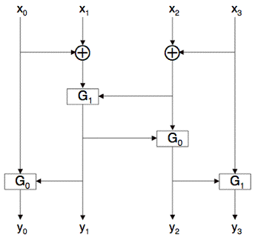
FEAL-4 Round Function
G₀(a,b) = (a+b (mod 256))<<< 2
G₁(a,b) = (a+b+1 (mod 256))<<< 2
where “<<<” is left cyclic shift
(rotation)
F(x₀,x₁,x₂,x₃) = (y₀,y₁,y₂,y₃) where
y₁ = G₁(x₀⨁x₁, x₂⨁x₃)
y₀ = G₀(x₀, y₁)
y₂ = G₀(y₁, x₂⨁x₃)
y₃ = G₁(y₂, x₃)
Diagram from Mark Stamp

Slide 34
FEAL-4 Key Schedule
F_{K}(a₀||a₁||a₂||a₃, b₀||b₁||b₂||b₃)= c₀||c₁||c₂||c₃ by
d₁= a₀⨁a₁
d₂= a₂⨁a₃
c₁= G₁(d₁, a₂⨁b₀)
c₂= G₀(d₂, c₁⨁b₁)
c₀= G₀(a₀, c₁⨁b₂)
c₃= G₁(a₃, c₂⨁b₃)
k₋₂= 0
k₋₁= k_{L}
k₀= k_{R}
k_{i}= f_{K}(k_{i-2},k_{i-1}⨁k_{i-3})

Slide 35
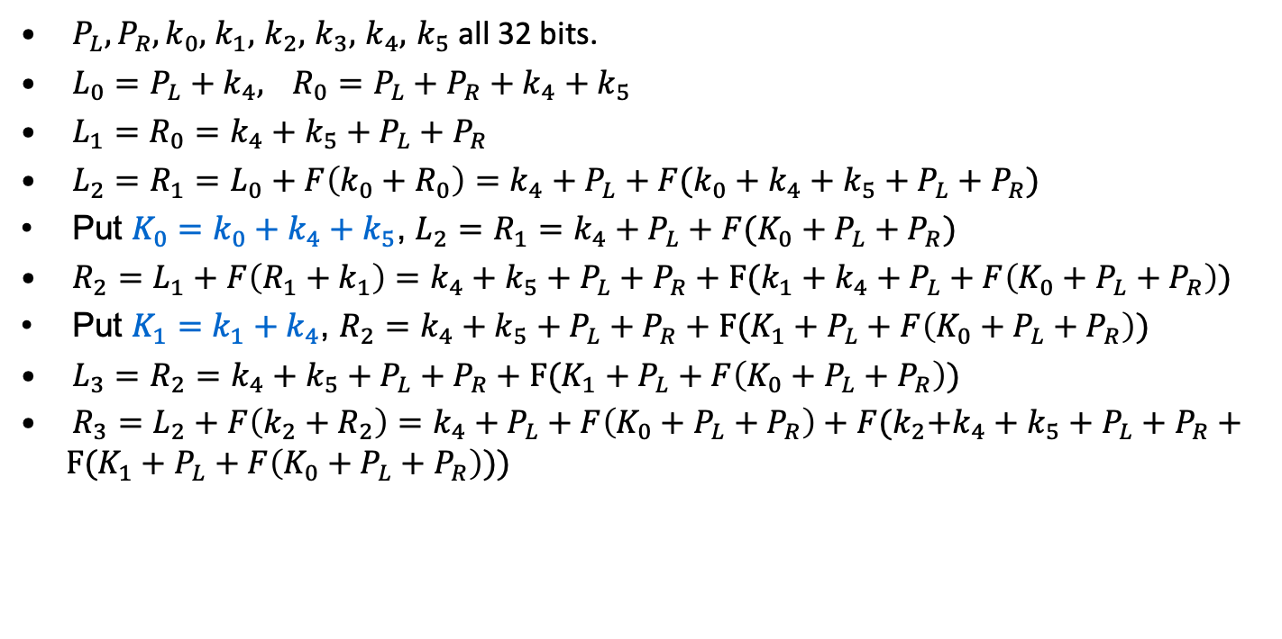
FEAL-4 Encryption Equations (First Description)
$P_{L}, P_{R},k_{0},$ $k_{1},$ $k_{2},$ $k_{3},$ $k_{4},$ $k_{5}$ all 32 bits.
$L_{0}=P_{L}+k_{4},$ $R_{0}=P_{L}+P_{R}+k_{4}+k_{5}$
$L_{1}=R_{0}=k_{4}+k_{5}+P_{L}+P_{R}$
$L_{2}=R_{1}=L_{0}+F\left(k_{0}+R_{0}\right)=k_{4}+P_{L}+F(k_{0}+k_{4}+k_{5}+P_{L}+P_{R})$
Put $K_{0}=k_{0}+k_{4}+k_{5}$, $L_{2}=R_{1}=k_{4}+P_{L}+F(K_{0}+P_{L}+P_{R})$
$R_{2}=L_{1}+F\left(R_{1}+k_{1}\right)=k_{4}+k_{5}+P_{L}+P_{R}+F(k_{1}+k_{4}+P_{L}+F\left(K_{0}+P_{L}+P_{R}\right))$
Put $K_{1}=k_{1}+k_{4}$, $R_{2}=k_{4}+k_{5}+P_{L}+P_{R}+F(K_{1}+P_{L}+F\left(K_{0}+P_{L}+P_{R}\right))$
$L_{3}=R_{2}=k_{4}+k_{5}+P_{L}+P_{R}+F(K_{1}+P_{L}+F\left(K_{0}+P_{L}+P_{R}\right))$
$R_{3}=L_{2}+F\left(k_{2}+R_{2}\right)=k_{4}+P_{L}+F\left(K_{0}+P_{L}+P_{R}\right)+F{(k}_{2}+k_{4}+k_{5}+P_{L}+P_{R}+F(K_{1}+P_{L}+F\left(K_{0}+P_{L}+P_{R}\right)))$

Slide 36
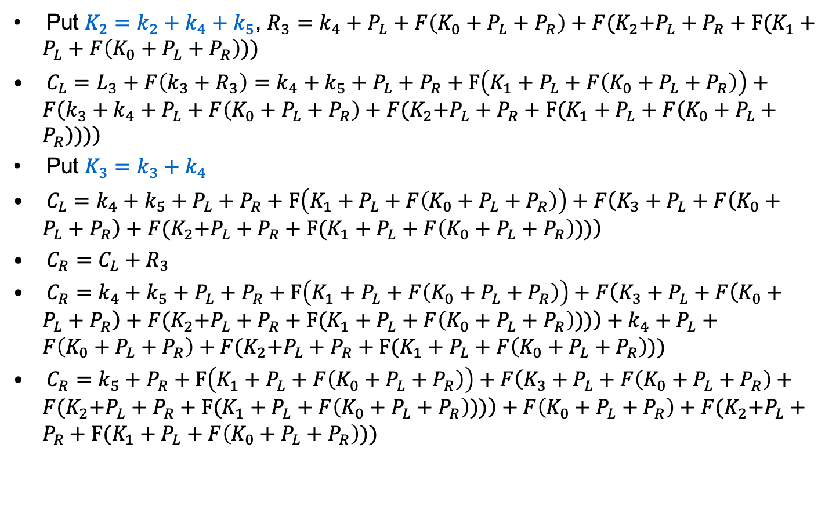
FEAL-4 Encryption Equations (First Description)
Put $K_{2}=k_{2}+k_{4}+k_{5}$, $R_{3}=k_{4}+P_{L}+F\left(K_{0}+P_{L}+P_{R}\right)+F{(K}_{2}+P_{L}+P_{R}+F(K_{1}+P_{L}+F\left(K_{0}+P_{L}+P_{R}\right)))$
$C_{L}=L_{3}+F\left(k_{3}+R_{3}\right)=k_{4}+k_{5}+P_{L}+P_{R}+F\left(K_{1}+P_{L}+F\left(K_{0}+P_{L}+P_{R}\right)\right)+F\left(k_{3}+k_{4}+P_{L}+F\left(K_{0}+P_{L}+P_{R}\right)+F{(K}_{2}+P_{L}+P_{R}+F(K_{1}+P_{L}+F\left(K_{0}+P_{L}+P_{R}\right)))\right)$
Put $K_{3}=k_{3}+k_{4}$
$C_{L}=k_{4}+k_{5}+P_{L}+P_{R}+F\left(K_{1}+P_{L}+F\left(K_{0}+P_{L}+P_{R}\right)\right)+F\left(K_{3}+P_{L}+F\left(K_{0}+P_{L}+P_{R}\right)+F{(K}_{2}+P_{L}+P_{R}+F(K_{1}+P_{L}+F\left(K_{0}+P_{L}+P_{R}\right)))\right)$
$C_{R}=C_{L}+R_{3}$
$C_{R}=k_{4}+k_{5}+P_{L}+P_{R}+F\left(K_{1}+P_{L}+F\left(K_{0}+P_{L}+P_{R}\right)\right)+F\left(K_{3}+P_{L}+F\left(K_{0}+P_{L}+P_{R}\right)+F{(K}_{2}+P_{L}+P_{R}+F(K_{1}+P_{L}+F\left(K_{0}+P_{L}+P_{R}\right)))\right)+k_{4}+P_{L}+F\left(K_{0}+P_{L}+P_{R}\right)+F{(K}_{2}+P_{L}+P_{R}+F(K_{1}+P_{L}+F\left(K_{0}+P_{L}+P_{R}\right)))$
$C_{R}=k_{5}+P_{R}+F\left(K_{1}+P_{L}+F\left(K_{0}+P_{L}+P_{R}\right)\right)+F\left(K_{3}+P_{L}+F\left(K_{0}+P_{L}+P_{R}\right)+F{(K}_{2}+P_{L}+P_{R}+F(K_{1}+P_{L}+F\left(K_{0}+P_{L}+P_{R}\right)))\right)+F\left(K_{0}+P_{L}+P_{R}\right)+F{(K}_{2}+P_{L}+P_{R}+F(K_{1}+P_{L}+F\left(K_{0}+P_{L}+P_{R}\right)))$

Slide 37
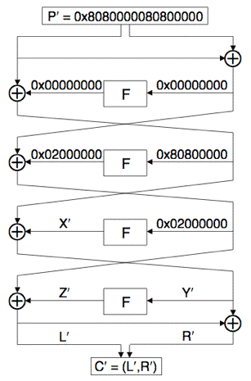
FEAL-4 Basic Differential Attack
For the differential attack, any description is fine.
If A₀⨁A₁ = 0 then F(A₀) = F(A₁), p=1.
If A₀⨁A₁= 0x80800000 then F(A₀)⨁F(A₁)= 0x02000000, p=1
Choose (P₀, P₁):
P₀⨁P₁=0x8080000080800000
P’= P₀⨁P₁, C’=C₀⨁C₁
L’=0x02000000⨁Z’, Y’=0x80800000 ⨁ X’
For C= (L,R) we have Y = L⨁R
Solve for sub-key K₃: Z’= 0x02000000⨁L’
Compute Y₀= L₀⨁R₀, Y₁= L₁⨁R₁
Guess K₃ and compute guessed Z₀, Z₁
Note: Z_{i}= F(Y_{i}⨁K₃)
Compare true Z’ to guessed Z’
R’
S’
T’
Diagram from Mark Stamp

Slide 38
FEAL-4 Improved Differential Attack
Using 4 chosen plaintext pairs
Work is of order 2³²
Expect one K₃ to survive
Can reduce work to about 2¹⁷
For 32-bit word A=(a₀,a₁,a₂,a₃), define
M(A) = (z, a₀⨁a₁, a₂⨁a₃, z), where z is all-zero byte
For all possible A=(z, a₀, a₁, z), compute
Q₀= F(M(Y₀)⨁A) and Q₁= F(M(Y₁)⨁A)
Can be used to find 16 bits of K₃
When A = M(K₃), we have ⟨Q₀⨁Q₁⟩_{8…23}= ⟨Z′⟩_{8…23} where ⟨X⟩_{i…j} is bits i thru j of X. Can recover K₃ with about 2¹⁷ work
Once K₃ is known, can successively recover K₂,K₁,K₀ and finally K₄,K₅
Second characteristic: 0xa200 8000 0x2280 8000

Slide 39
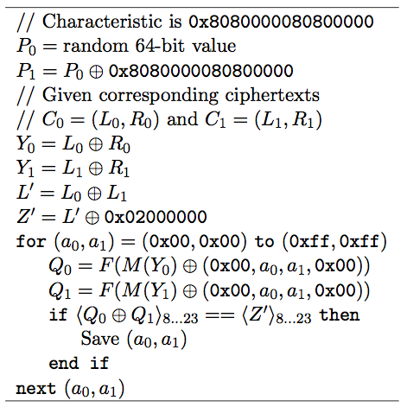
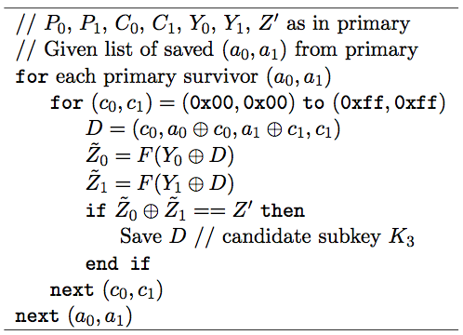
FEAL-4 Differential Attack
Primary for K₃
Secondary for K₃
Assuming only one chosen plaintext pair
Slide adapted from Mark Stamp

Slide 40
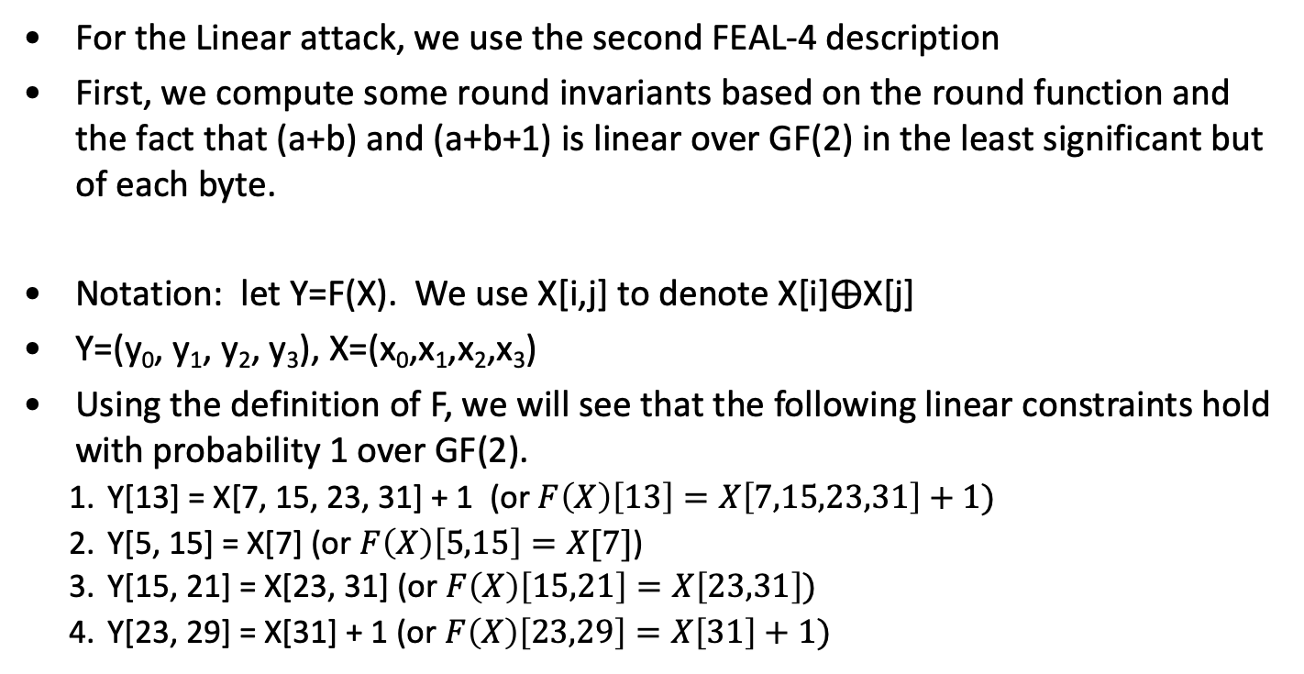
FEAL-4 Round equations for F
For the Linear attack, we use the second FEAL-4 description
First, we compute some round invariants based on the round function and the fact that (a+b) and (a+b+1) is linear over GF(2) in the least significant but of each byte.
Notation: let Y=F(X). We use X[i,j] to denote X[i]⨁X[j]
Y=(y₀, y₁, y₂, y₃), X=(x₀,x₁,x₂,x₃)
Using the definition of F, we will see that the following linear constraints hold with probability 1 over GF(2).
Y[13] = X[7, 15, 23, 31] + 1 (or $F\left(X\right)\left[13\right]=X\left[7,15,23,31\right]+1)$
Y[5, 15] = X[7] (or $F\left(X\right)\left[5,15\right]=X[7]$)
Y[15, 21] = X[23, 31] (or $F\left(X\right)\left[15,21\right]=X\left[23,31\right])$
Y[23, 29] = X[31] + 1 (or $F\left(X\right)\left[23,29\right]=X\left[31\right]+1)$

Slide 41
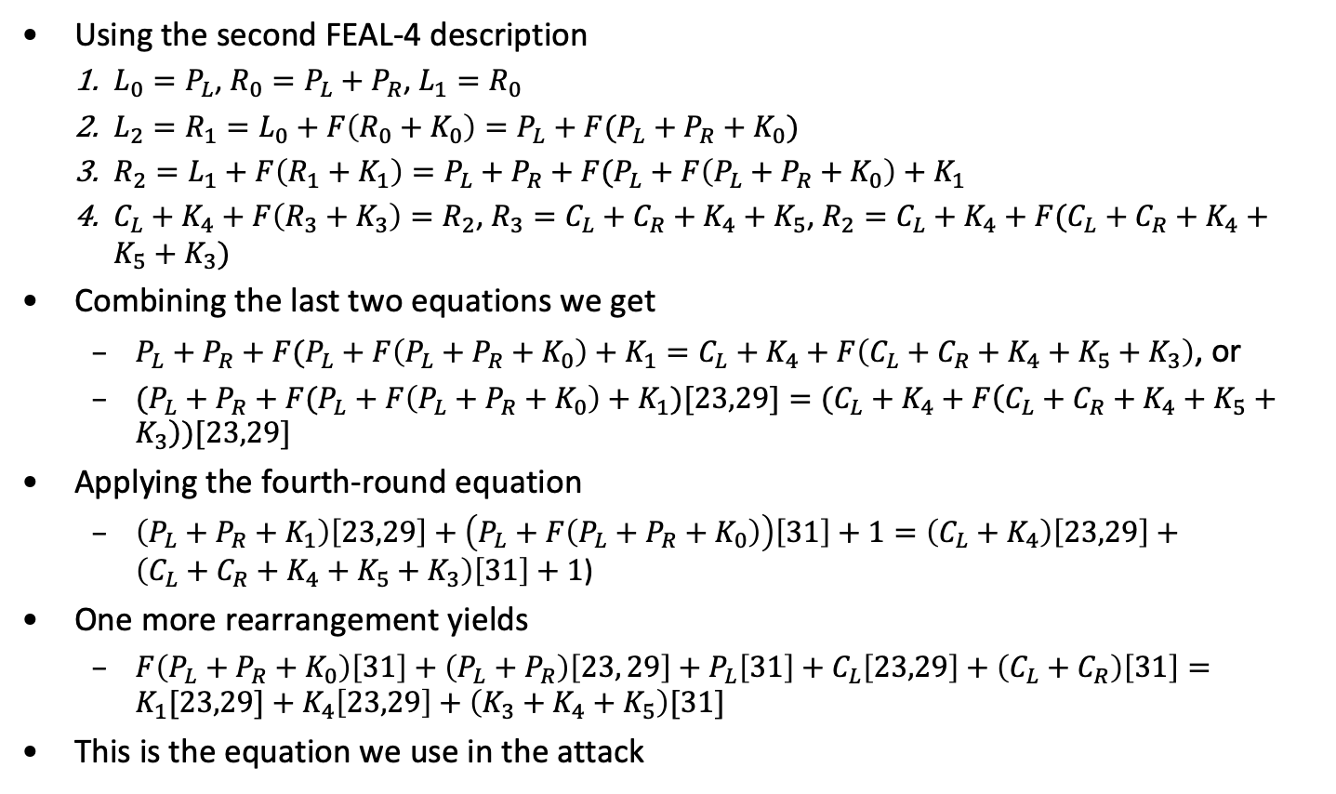
FEAL-4 Linear Equations
Using the second FEAL-4 description
$L_{0}=P_{L}$, $R_{0}=P_{L}+P_{R}$, $L_{1}=R_{0}$
$L_{2}=R_{1}=L_{0}+F\left(R_{0}+K_{0}\right)=P_{L}+F(P_{L}+P_{R}+K_{0})$
$R_{2}=L_{1}+F\left(R_{1}+K_{1}\right)=P_{L}+P_{R}+F(P_{L}+F\left(P_{L}+P_{R}+K_{0}\right)+K_{1}$
$C_{L}+K_{4}+F\left(R_{3}+K_{3}\right)=R_{2}$, $R_{3}=C_{L}+C_{R}+K_{4}+K_{5}$, $R_{2}=C_{L}+K_{4}+F(C_{L}+C_{R}+K_{4}+K_{5}+K_{3})$
Combining the last two equations we get
$P_{L}+P_{R}+F(P_{L}+F\left(P_{L}+P_{R}+K_{0}\right)+K_{1}=C_{L}+K_{4}+F\left(C_{L}+C_{R}+K_{4}+K_{5}+K_{3}\right)$, or
$(P_{L}+P_{R}+F(P_{L}+F\left(P_{L}+P_{R}+K_{0}\right)+K_{1})[23,29]=(C_{L}+K_{4}+F\left(C_{L}+C_{R}+K_{4}+K_{5}+K_{3}\right))[23,29]$
Applying the fourth-round equation
$\left(P_{L}+P_{R}+K_{1}\right)\left[23,29\right]+\left(P_{L}+F\left(P_{L}+P_{R}+K_{0}\right)\right)\left[31\right]+1=\left(C_{L}+K_{4}\right)\left[23,29\right]+\left(C_{L}+C_{R}+K_{4}+K_{5}+K_{3}\right)\left[31\right]+1$)
One more rearrangement yields
$F\left(P_{L}+P_{R}+K_{0}\right)\left[31\right]+\left(P_{L}+P_{R}\right)\left[23, 29\right]+P_{L}\left[31\right]+C_{L}\left[23,29\right]+\left(C_{L}+C_{R}\right)\left[31\right]=K_{1}[23,29]+K_{4}\left[23,29\right]+\left(K_{3}+K_{4}+K_{5}\right)[31]$
This is the equation we use in the attack

Slide 42
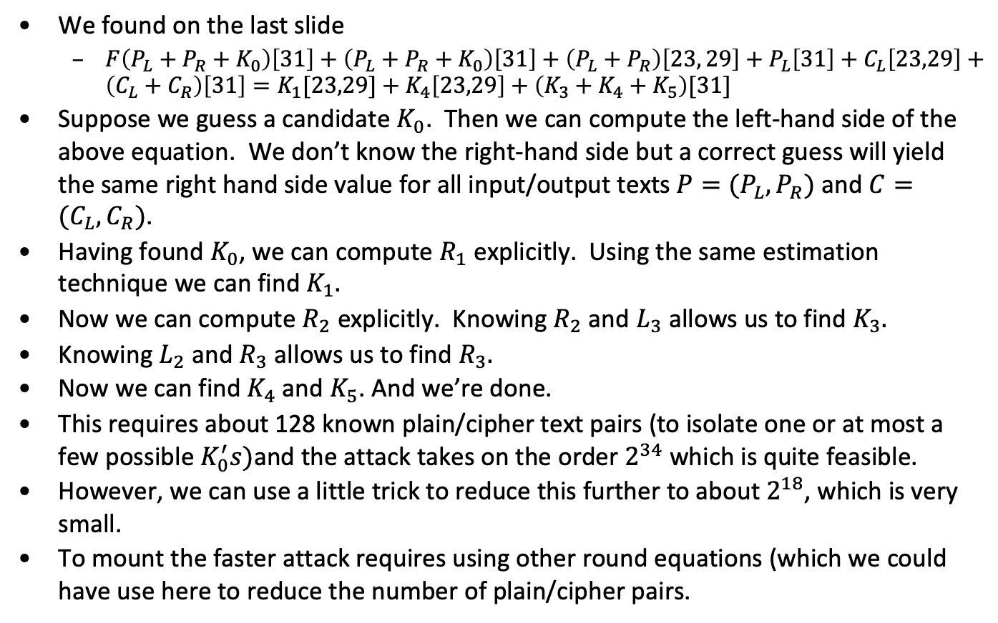
FEAL-4 Simple Linear Attack
We found on the last slide
$F\left(P_{L}+P_{R}+K_{0}\right)\left[31\right]+\left(P_{L}+P_{R}+K_{0}\right)\left[31\right]+\left(P_{L}+P_{R}\right)\left[23, 29\right]+P_{L}\left[31\right]+C_{L}\left[23,29\right]+\left(C_{L}+C_{R}\right)\left[31\right]=K_{1}[23,29]+K_{4}\left[23,29\right]+\left(K_{3}+K_{4}+K_{5}\right)[31]$
Suppose we guess a candidate $K_{0}$. Then we can compute the left-hand side of the above equation. We don’t know the right-hand side but a correct guess will yield the same right hand side value for all input/output texts $P=(P_{L},P_{R})$ and $C=(C_{L},C_{R})$.
Having found $K_{0}$, we can compute $R_{1}$ explicitly. Using the same estimation technique we can find $K_{1}.$
Now we can compute $R_{2}$ explicitly. Knowing $R_{2}$ and $L_{3}$ allows us to find $K_{3}.$
Knowing $L_{2}$ and $R_{3}$ allows us to find $R_{3}.$
Now we can find $K_{4}$and $K_{5}$. And we’re done.
This requires about 128 known plain/cipher text pairs (to isolate one or at most a few possible $K_{0}^{′}s)$and the attack takes on the order $2^{34}$ which is quite feasible.
However, we can use a little trick to reduce this further to about $2^{18}$, which is very small.
To mount the faster attack requires using other round equations (which we could have use here to reduce the number of plain/cipher pairs.

Slide 43
Computing the constraint Equations - A
The final equation we used above can be written as:
h_{A}(P,C)= (C_{L}+P_{L}+P_{R})[23,29]+P_{L}[31]+(C_{L}+C_{R})[31]+F(P_{L}+P_{R}+K₀)[31]
It was derived from
(L₄+R₀)[23,29] = Y₁[23,29] + Y₃[23, 29].
Y₁[23, 29] = F(R₁+k₁)[31]+1, and R₁[31] = L₀[31]+F(R₀+K₀)[31], giving
Y₁[23, 29] = (L₀[31] + F(R₀+K₀)+k₁)[31] +1
Y₃[23,29] = (R₄+K₃)[31]+1
Combining, we get
h_{A}(P,C) = f(K_{i}) = (L₄+R₀)[23,29] + (R₄+L₀+F(R₀+K₀))[31]
Should be constant

Slide 44
Computing the Constraint Equations - B
Analogously,
(L₄+R₀)[13] = Y₁[13] + Y₃[13]
Y₁[13] = F(R₁+K₂)[13]+1 = (R₁+K₂)[7, 15, 23, 31]+1
R₁[7, 15, 23, 31] = (L₀[7, 15, 23, 31] + F(R₀+K₀))[7, 15, 23, 31], so
Y₁[13] = (L₀[7, 15, 23, 31] + F(R₀+K₀))[7, 15, 23, 31] + K₂[7, 15, 23, 31]+1
Y₃[13] = F(R₄+K₃)[13]+1 = (R₄+K₃) [7, 15, 23, 31]+1
(L₄+R₀)[13] = (L₀[7, 15, 23, 31] + F(R₀+K₀))[7, 15, 23, 31]+
K₂[7, 15, 23, 31]+(R₄+K₃) [7, 15, 23, 31]
This yields
h_{B}(P,C)= (C_{L}+P_{L}+P_{R})[13]+(P_{L}+(C_{L}+C_{R})+F(P_{L}+P_{R}+K₀))[7, 15, 23, 31]

Slide 45
Computing the Constraint Equations - C
Similarly
(L₄+R₀)[5, 15] = Y₁[5, 15] + Y₃[5, 15]
Y₁[5, 15] = F(R₁+K₂)[5, 15] +1 = (R₁+K₂)[7]
R₁[7] = (L₀[7] + F(R₀+K₀))[7], so
Y₁[5, 15] = (L₀[7]+F(R₀+K₀))[7] + K₂[7]
Y₃[5, 15] = F(R₄+K₃)[5, 15] = (R₄+K₃) [7]
(L₄+R₀)[5, 15] = (L₀[7]+F(R₀+K₀))[7]+K₂[7]+(R₄+K₃) [7]
This gives
h_{C}(P,C)= (C_{L}+P_{L}+P_{R})[5, 15]+(P_{L}+(C_{L}+C_{R})+F(P_{L}+P_{R}+K₀))[7]

Slide 46
Computing the Constraint Equations - D
From Y[15, 21] = X[23, 31]
(L₄+R₀)[15, 21] = Y₁[15, 21] + Y₃[15, 21]
Y₁[15, 21] = F(R₁+K₂)[15, 21]+1 = (R₁+K₂)[23, 31]
R₁[23, 31] = (L₀+ F(R₀+K₀))[23, 31], so
Y₁[15, 21] = (L₀ + F(R₀+K₀))[23, 31] + K₂[23, 31]
Y₃[15, 21] = F(R₄+K₃)[15, 21] = (R₄+K₃) [23, 31]
This gives
(L₄+R₀)[15, 21] = (L₀+ F(R₀+K₀))[23, 31] + K₂[23, 31] +(R₄+K₃) [23, 31]
This gives
h_{D}(P,C)= (C_{L}+P_{L}+P_{R})[15, 21]+(P_{L}+(C_{L}+C_{R})+F(P_{L}+P_{R}+K₀))[23, 31]

Slide 47
Computing the Constraint Equations - E
We will use one more constraint. Adding all four round constraints, we get
(L₄+R₀)[5,13,21] = Y₁[5,13,21]+Y₃[5,13,21] = F(R₁+K₁) [5,13,21] + F(R₄+K₃) [5,13,21]
F(R₄+K₃) [5,13,21] = (R₄+K₃) [15]+1 and since R₁ = L₀+F(L₀+Y₀+K₀),
F(R₁+K₁) [5,13,21] = F(L₀+F(L₀+Y₀+K₀)+K₁)= (L₀+F(L₀+Y₀+K₀)+K₁)[15]+1
This gives
h_{E}(P,C)= (C_{L}+P_{L}+P_{R})[5,13,21]+P_{L}[15]+(C_{L}+C_{R})[15]+F(P_{L}+P_{R}+K₀)[15]
Putting P_{L}+P_{R}+K₀ = (x₀, x₁, x₂, x₃), we note that F(P_{L}+P_{R}+K₀)[15] is only dependent on (x₀⨁x₁, x₂⨁x₃)
Similar relations hold looking at FEAL-4 as a decryption algorithm. These constraints are summarized in the next two slides.

Slide 48
FEAL-4 Summary of invariants
Name | First Round Equation | Key bits affecting outcome
A | h_{A}(P,C)=(C_{L}+P_{L}+P_{R})[23,29]+P_{L}[31]+(C_{L}+C_{R})[31]+F(P_{L}+P_{R}+K₀)[31]
B | h_{B}(P,C)= (C_{L}+P_{L}+P_{R})[13]+ (P_{L}+(C_{L}+C_{R})+F(P_{L}+P_{R}+K₀))[7, 15, 23, 31]
C | h_{C}(P,C)= (C_{L}+P_{L}+P_{R})[5, 15]+ (P_{L}+(C_{L}+C_{R})+F(P_{L}+P_{R}+K₀))[7]
D | h_{D}(P,C)= (C_{L}+P_{L}+P_{R})[15, 21]+ (P_{L}+(C_{L}+C_{R})+F(P_{L}+P_{R}+K₀))[23, 31]
E | h_{E}(P,C)=(C_{L}+P_{L}+P_{R})[5,13,21]+P_{L}[15]+ (C_{L}+C_{R})[15]+F(P_{L}+P_{R}+K₀)[15] | 9,…,15; 17,...,23

Slide 49
FEAL-4 Summary of invariants
Name | Fourth Round Equation | Key bits affecting outcome
A | h_{A}’(P,C)=(P_{L}+C_{L}+C_{R})[23,29]+(C_{L}+P_{L}+P_{R}))[31]+F(C_{L}+C_{R}+K₃)[31]
B | h_{B}’ (P,C)= (P_{L}+C_{L}+C_{R})[13]+(C_{L}+(P_{L}+P_{R})) [7, 15, 23, 31]+F(C_{L}+C_{R}+K₃))[7, 15, 23, 31]
C | h_{C}’ (P,C)= (P_{L}+C_{L}+C_{R})[5, 15]+ (C_{L}+(P_{L}+P_{R}) [7]+F(C_{L}+C_{R}+K₃))[7]
D | h_{D}’ (P,C)= (P_{L}+C_{L}+C_{R})[15, 21]+(C_{L}+(P_{L}+P_{R})) +F(C_{L}+C_{R}+K₃))[23, 31]
E | h_{E}’ (P,C)=(P_{L}+C_{L}+C_{R})[5,13,21]+ (C_{L}+(P_{L}+P_{R})) [15]+F(C_{L}+C_{R}+K₃)[15] | 9,…,15; 17,...,23

Slide 50
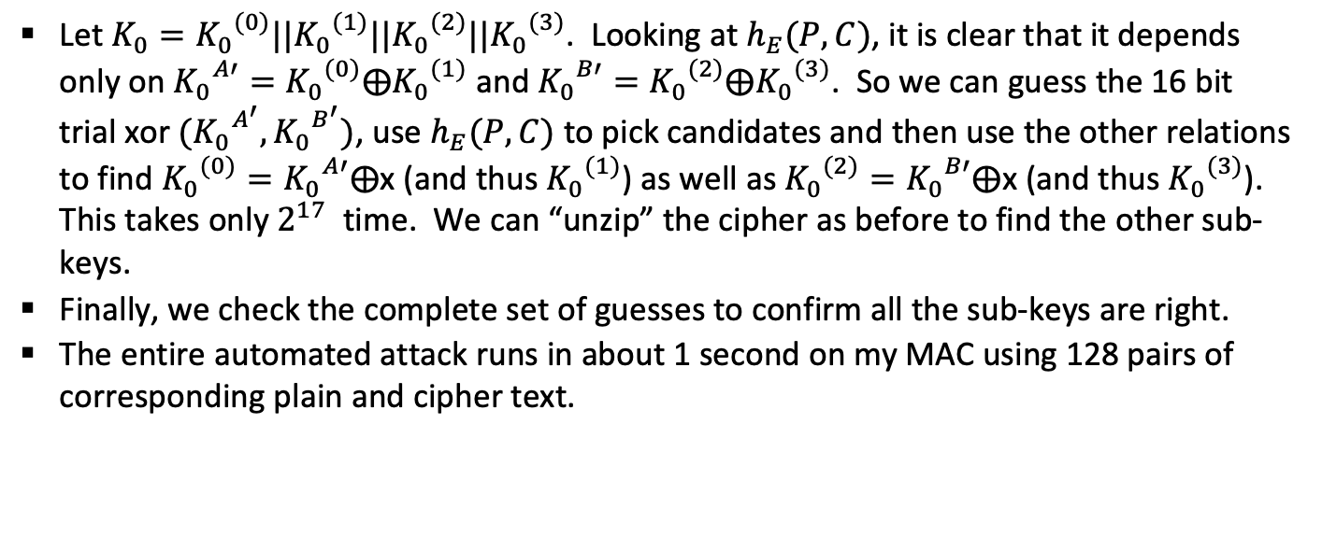
Faster FEAL-4 Linear Attack
Let $K_{0}={K_{0}}^{(0)}||{K_{0}}^{(1)}||{K_{0}}^{(2)}||{K_{0}}^{(3)}$. Looking at $h_{E}(P,C)$, it is clear that it depends only on ${K_{0}}^{A′}={K_{0}}^{(0)}⨁{K_{0}}^{(1)}$ and ${K_{0}}^{B′}={K_{0}}^{(2)}⨁{K_{0}}^{(3)}$. So we can guess the 16 bit trial xor $({K_{0}}^{A^{′}},{K_{0}}^{B^{′}})$, use $h_{E}(P,C)$ to pick candidates and then use the other relations to find ${K_{0}}^{(0)}={K_{0}}^{A′}⨁$x (and thus ${K_{0}}^{(1)}$) as well as ${K_{0}}^{(2)}={K_{0}}^{B′}⨁$x (and thus ${K_{0}}^{(3)}$). This takes only $2^{17}$ time. We can “unzip” the cipher as before to find the other sub-keys.
Finally, we check the complete set of guesses to confirm all the sub-keys are right.
The entire automated attack runs in about 1 second on my MAC using 128 pairs of corresponding plain and cipher text.

Slide 51
Rationalizing all the FEAL-4 Descriptions
We gave two descriptions of FEAL-4. The original description was different and there is a third description used by Matsui and Yamaguchi that we used in the original notes. We’d like to show that they are all equivalent.

Slide 52
FEAL-4 – Third description
P_{L}
P_{R}
⨁
L₀
K₀
R₀
⨁
F
L₁
K₁
R₁
⨁
F
K₄
⨁
⨁
K₅
L₂
K₂
R₂
⨁
F
L₃
K₃
R₃
⨁
F
⨁
C_{L}
C_{R}

Slide 53
Automated attack
./new_feal4.exe -preparecorrespondingtext 1234567890abcdef 23234545ababcdcd 2048 feal.in1 feal.in2
Key schedule
k0 : 90abcdef
k1 : 32b729f8
k2 : ada42552
k3 : d26ad875
k4 : ed3f65e8
k5 : 5f452e24
k6 : 14ee3941
k7 : dbcb9075
k0+k4+k5 : 22d18623
k1+k4 : df884c10
k2+k6 : b94a1c13
k3+k6+k7 : 1d4f7141
k4+k5+k6 : a694728d
k4+k6+k7 : 221accdc

Slide 54
Automated attack
./new_feal4.exe -linearattack feal.in1 feal.in2
256 pairs examined
Plain: a1b24026 54a3e397, Cipher: c259fa58 99a44084
Plain: 44392b89 3e28d016, Cipher: b01696d4 59d70a09
…
…
Final check
Round 1 trial key: 22d18623
Round 2 trial key: df884c10
Round 3 trial key: b94a1c13
Round 4 trial key: 1d4f7141
k4k5k6 trial key: a694728d
k4k6k7 trial key: 221accdc
succeeded

Slide 55
Boomerang Attack
P₂
P₄
E₀: α→ β with probability, p.
E₁: 𝛿 →𝛾 with probability, q.
For each pair (P₁, P₂) with E₀: α→β, obtain (C₁, C₂) and compute C₃= C₁⨁ 𝛾 and C₄= C₂⨁𝛾. Request the decryption of (C₃, C₄) as (P₃, P₄).
Probability that P₃⨁P₄=α, is p²q².
For random permutation, the probability that P₃⨁P₄=α, is 2^{-n}.
Can also be mounted for all possible β’s and 𝛾’s as long as β¹𝛾, with p²= [∑_{β,α→β} Pr²(α→β)]^{1/2}, q²= [∑_{𝛾,𝛾→𝛿} Pr²(𝛾→𝛿)]^{1/2}
P₁
α
P₃
α
E₀
I₂
𝛿
I₄
β
𝛿
β
I₁
I₃
E₁
𝛾
C₂
C₄
C₁
𝛾
C₃

Slide 56
End

Slide 57
DES Data

Slide 58
S Boxes as Polynomials over GF(2)
1,1: 56+4+35+2+26+25+246+245+236+2356+16+15+156+14+146+145+13+135+134+1346+1345+13456+125+1256+1245+123+12356+1234+12346
1,2: C+6+5+4+45+456+36+35+34+346+26+25+24+246+2456+23+236+235+234+2346+1+15+156+134+13456+12+126+1256+124+1246+1245+12456+123+1236+1235+12356+1234+12346
1,3: C+6+56+46+45+3+35+356+346+3456+2+26+24+246+245+236+16+15+145+13+1356+134+13456+12+126+125+12456+123+1236+1235+12356+1234+12346
1,4: C+6+5+456+3+34+346+345+2+23+234+1+15+14+146+135+134+1346+1345+1256+124+1246+1245+123+12356+1234+12346
2,1: C+4+456+3+36+35+26+245+2456+235+2356+1+16+156+1456+13+136+135+1356+12+
125+1256+1246+1236+12356
2,2: C+5+4+35+34+346+345+2+256+246+2456+236+1+156+145+13+135+134+
1346+1345+12+126+125+124+1246+12456+123+1235+12356+1234
2,3: C+6+5+4+456+36+3456+2+24+246+23+1+1245+12456+1235+12356
2,4: C+6+5+45+3+26+24+245+23+236+1+156+145+1456+1356+126+1256+1245+12456+
123+1236
Legend: C+6+56+46 means 1⨁x₆⨁x₅x₆⨁x₄x₆

Slide 59
S boxes as polynomials
3,1: 6+4+45+35+2+1+16+15+146+145+13+135+12+126+125+1256+123+1236+1235+12346
3,2: C+6+5+4+46+456+36+35+356+34+346+345+3456+2+25+256+24+245+23+236+
234+2346+1+16+14+146+145+1456+135+1356+1346+13456+126+125+
1256+124+1246+12456+1234+12346
3,3: 6+46+45+456+3+35+26+25+256+24+246+23+236+235+2356+234+1+1456+
13456+12+126+125+1256+124+123+1236+1235+12356+1234
3,4: C+5+46+45+456+3+35+34+3456+2+24+245+2456+235+2356+234+16+14+146+
145+1456+13+1356+134+13456+12+124+1245+12456+123+1234
4,1: C+56+4+46+45+3+3456+26+25+256+245+2456+23+236+2346+1+16+156+
146+1456+13+136+135+13456+12+125+124+1245+123+1236+12356+1234
4,2: C+6+5+56+46+45+3+345+3456+2+26+256+2456+236+234+2346+16+15+
156+14+146+145+1456+136+135+1345+13456+12+125+124+1245+1236+1235+
12356+1234
4,3: C+56+46+45+456+3+36+35+2+26+256+2456+23+2356+234+2346+1+15+156+
146+135+1356+1346+13456+1256+124+1245+12356+1234
4,4: 6+5+56+4+46+456+36+35+26+25+256+245+2456+23+235+2356+2346+1+
156+14+146+1356+134+1346+1345+13456+125+1256+124+1245+1235+12356+1234

Slide 60
S boxes as polynomials
5,1: 56+45+3+36+35+356+346+345+3456+26+25+256+24+246+2456+235+16+14+
145+13+136+1346+1345+13456+12+126+125+1256+124+1245+123+1236+1235+
12356+1234
5,2: C+5+56+4+46+45+36+35+34+346+345+3456+2+25+256+246+245+235+2356+234+
2346+1+16+156+14+145+13+136+135+134+1346+1345+13456+126+125+124+
12456+123+12356+1234+12346
5,3: 6+5+4+3+36+356+346+3456+24+236+2346+1+156+145+1456+1345+126+1246+
123+1236+1234+12346
5,4: 6+5+56+46+45+36+34+346+345+3456+2+24+246+245+236+2356+15+156+146+
13+136+1356+1345+1256+124+1246+1245+12456+1236+1234
6,1: 5+456+3+34+346+345+3456+24+2456+23+234+2346+1+16+145+1456+135+134+
1346+1345+13456+126+1246+12456+1236
6,2: 6+4+456+35+256+245+23+235+16+15+1456+13+136+135+1356+12+1245+
12456+123+12356
6,3: C+6+5+4+3+35+345+2+24+2456+1+145+1456+13+136+1356+1345+1245+123+
1236+1235+12356+12346
6,4: C+5+56+46+45+456+36+356+34+346+345+3456+2+23+2346+16+15+156+146+1456+
13+136+135+1356+1246+12456+1236+12356+12346

Slide 61
S boxes as polynomials
7,1: 6+5+45+3+34+345+2+246+2456+23+1+146+1456+1346+13456+1256+1246+1236
7,2: 5+56+4+45+456+3+36+346+3456+2+245+2456+2346+16+15+156+13+135+1356+
1346+13456+124+1245+123+1236+1235+12356+12346
7,3: C+5+4+3456+2+26+24+2456+23+1+16+14+13+1345+12+1246+12456+1236+1234
7,4: 6+5+3+345+3456+24+23+236+234+2346+16+15+156+14+1456+136+135+1345+
13456+12+124+1245+123+1236+1235+1234+12346
8,1: C+5+56+4+46+45+3+356+346+3456+2+256+245+236+16+15+1456+13+135+1356+
1346+1256+124+1246+1245+123+1235+12356+12346
8,2: 5+45+3+35+2+26+256+246+2456+236+2346+1+15+156+14+146+145+1456+135+
125+12456+1235+12356
8,3: C+6+5+4+35+2+25+24+245+23+156+14+146+13+135+1356+134+1346+125+124+
1245+123+1234+12346
8,4: C+6+5+46+456+3+34+346+26+25+256+24+246+245+234+2346+1+16+156+145+
1456+136+135+134+1346+1246+12456+1236+12356+1234+12346

Slide 62
Amplified Boomerang Attack
Given plaintext pair (P₁, P₂)(P₃,P₄))
For random permutations, the probability that P₁⨁P₂= P₃⨁P₄= a,
E₀: a → b with probability, p.
When both pairs satisfy E₀(P₁)⨁E₀(P₂) = E₀(P₃)⨁E₀(P₄) = b, E₀(P₁)⨁E₀(P₃) = (E₀(P₁)⨁b)⨁(E₀(P₃)⨁b)=E₀(P₂) ⨁E₀(P₄).
If E₀(P₁)⨁E₀(P₃) = E₀(P₂)⨁E₀(P₄) = g, each has a probability, q, to be a right pair wrt g→d. C₁⨁C₃=C₂⨁C₄=d
Pr(quartet becomes right quartet with difference a)= (Np)²/2 quartets
Expected number of right quartets is _{Np}C₂2^{-n}q²
P₂
P₄
P₁
a
P₃
a
E₀
I₂
d
I₄
b
d
b
I₁
I₃
E₁
g
C₂
C₄
g
C₁
C₃

Slide 63
Truncated Differentials
A truncated differential predicts that the differences are restricted to some set. For example, in the description of the 2R-attack on 7-round DES for a right pair with respect to the 5-round characteristic, there are some cipher text bits with a zero difference for sure. This can be described as a 7-round truncated differential of DES with probability p=1/9511 that predicts the difference of 12 output bits.
Truncated differentials can be used in the differential 1R- and 2R-attacks, to discard wrong pairs. Another application of truncated differentials is to define a distinguisher for the cipher (resulting in a key recovery attack at the end). For example, there is a 12-round truncated differential (in rounds 5–16) of Skipjack with probability 1 that predicts 16 bits of difference.

Slide 64
Rectangle Attack
Given N pairs with difference a, pN pairs satisfy a→b.
pN pairs satisfy a→b.
~(Np)²/2 quartets that satisfy differentials.
Given Np pairs (P₁,P₂),(P₃,P₄), expected number of right quartets is _{Np}C₂ 2^{-n} q²=N² 2^{-n+1} (pq)²
E’= E_{f} ·E₁·E₀· E_{b},Z_{i}=E₀(P_{i}))
Instead of just looking for g→d, look for any g’→d.

Slide 65
Rectangle Distinguisher
P₁⨁P₂=P₃⨁P₄=a, C₁⨁C₃=C₂⨁C₄=b
Pr[(P₁,P₂),(P₃,P₄) is a right quartet]= 2^{-n} ∑_{a,b} ([Pr(a→a) Pr(b→b)) ∑_{g} ([Pr(g→d) Pr(g⨁a⨁b→d))
E’= E_{f}·E₁·E₀·E_{b}, Z_{i}=E₀(P_{i}))
Steps
Data collection
Initialize
Insert
Generate Quartet
Find and analyze quartets
Count sub-keys

Slide 66
Bilinear Attack
Let L_{r}[0, 1, 2, . . . , n−1], R_{r}[0, 1, 2, . . . , n−1] are the input to round r and L_{r}[0, 1, 2, . . . , n − 1], O_{r}[0, 1, 2, . . . , n−1] are the input (without key) and output to the round functions.
If α ⊆ {0, 1, 2, . . . , n−1}, define L_{r}[α] =⊕_{s∈α} L_{r}[s].
Consider the bilinear L_{r+1}[β]·R_{r+1}[α]⊕R_{r}[β]·L_{r}[α] = L_{r}[β]·O_{r}[α].

Slide 67
Slide Attack
Let F be a per-round function.
If C = E_{K}(P) = F^{m}_{K}(P), P,CεGF(2)^{n} and P′ = F(P)
C′ = E(P′) = F(C). To find slide pairs, let a_{F}(P,C) = K which is easy to calculate. Store 2^{n}/2 (and possibly less as in DES) pairs (P,C) if a_{F}(P,C) = a_{F}(P′,C′), P′ = F_{K}(P) and C′ = F(C). By birthday collision, this will happen.
Effective against rounds which implement weak permutations.

Slide 68
Original FEAL-4
P_{L}
P_{R}
k₄
⨁
⨁
k₅
⨁
L₀
k₀
R₀
⨁
F
L₁
k₁
R₁
⨁
F
L₂
R₂
⨁
F
k₂
L₃
k₃
R₃
⨁
F
L₄
R₄
⨁
⨁
k₇
k₆
⨁
C_{L}
C_{R}

Slide 69
Refactored FEAL-4
P_{L}
P_{R}
⨁
L₂
R₂
L₀
R₀
K₂
⨁
F
K₀
⨁
F
L₃
R₃
L₁
R₁
K₃
⨁
F
⨁
F
K₁
L₄
R₄
k₄,k₆,k₇
⨁
⨁
k₄,k₅,k₆
⨁
C_{L}
C_{R}
K₀ = k₀+k₅+k₆
K₃ = k₃+k₆+k₇
K₁ = k₁+k₄
K₂ = k₂+k₆

Slide 70
FEAL-4 Linear Attack using refactored FEAL-4
Now we can explain why we refactored FEAL-4.
If we knew L₀, R₀, L₄, R₄, we could mount a standard linear attack on FEAL-4. Because of the “whitening” keys, k₄, k₅, k₆, k₇, L₀, R₀, L₄, R₄ are unknown.
However, if we use the round key K₀ = k₀+k₄+k_{5,} for the first-round key and K₃ = k₃+k₆+k₇ for the last round key, we can express the inputs to F in the first and last rounds in terms of P_{L}, P_{R}, C_{L}, C_{R}, K₀, and K₃. This allows us to find K₀, and K₃.
We can then use K₀ and K₃ to find K₁ and K₂
Knowing K₀, K₃, K₁, and K₂ allows us to compute the intermediate keys K₄, K₅ for refactored FEAL4 and then we can compute the original k₀, k₁, k₂, k₃, k₄, k₅, k₆, k₇.

Slide 71
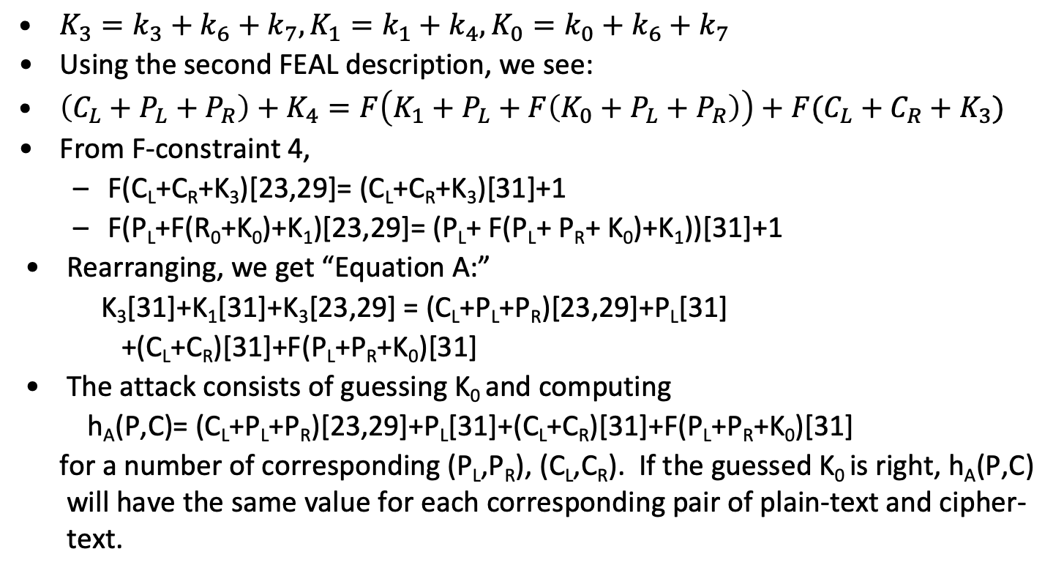
FEAL-4 Linear Attack
$K_{3}=k_{3}+k_{6}+k_{7}, K_{1}=k_{1}+k_{4}, K_{0}=k_{0}+k_{6}+k_{7}$
Using the second FEAL description, we see:
$\left(C_{L}+P_{L}+P_{R}\right)+K_{4}=F\left(K_{1}+P_{L}+F\left(K_{0}+P_{L}+P_{R}\right)\right)+F(C_{L}+C_{R}+K_{3})$
From F-constraint 4,
F(C_{L}+C_{R}+K₃)[23,29]= (C_{L}+C_{R}+K₃)[31]+1
F(P_{L}+F(R₀+K₀)+K₁)[23,29]= (P_{L}+ F(P_{L}+ P_{R}+ K₀)+K₁))[31]+1
Rearranging, we get “Equation A:”
K₃[31]+K₁[31]+K₃[23,29] = (C_{L}+P_{L}+P_{R})[23,29]+P_{L}[31]
+(C_{L}+C_{R})[31]+F(P_{L}+P_{R}+K₀)[31]
The attack consists of guessing K₀ and computing
h_{A}(P,C)= (C_{L}+P_{L}+P_{R})[23,29]+P_{L}[31]+(C_{L}+C_{R})[31]+F(P_{L}+P_{R}+K₀)[31]
for a number of corresponding (P_{L},P_{R}), (C_{L},C_{R}). If the guessed K₀ is right, h_{A}(P,C) will have the same value for each corresponding pair of plain-text and cipher-text.
Slide adapted from Mark Stamp

Slide 72
Strategy for FEAL-4 Linear Attack
We use h_{E}(P,C) to estimate the xor of the first two and last two bytes of K₀ and R₀ to estimate the xor of the two halves of K₀ (see slide 47) then we use h_{A,} …, h_{D} to find K₀.
Next, we use h_{E}’(P,C) to estimate the xor of the first two and last two bytes of K₃ and R₄ then we use h_{A}’, …, h_{D}’ to find K₃.
Next compute candidate K₁’s; for successful candidates, compute
k₄+k₅+k₆ = F(P_{L}+F(P_{L}+P_{R}+K₀)+K₁) + F(C_{L}+C_{R}+K₃) + (P_{L}+P_{R}+C_{L})
Analogously, for round 3, compute candidate K₂’s; for successful, candidates compute
k₄+k₆+k₇ = F(C_{L}+F(C_{L}+C_{R}+K₃)+K₂) + F(P_{L}+P_{R}+K₀) +(C_{L}+C_{R}+P_{L})
The “vanilla” attack of guessing K₀, also works but our modified attack is much faster --- on the order of 2¹⁶, which is peanuts.

Slide 73
FEAL-4 Linear Attack in gory detail
Remember k₄+k₅+k₆ = F(P_{L}+F(P_{L}+P_{R}+K₀)+K₁)+F(C_{L}+C_{R}+K₃)+(P_{L}+P_{R}+C_{L})
If X= P_{L}+F(P_{L}+P_{R}+K₀), Y= F(C_{L}+C_{R}+K₃) and Z= P_{L}+P_{R}+C_{L}. Note that X, Y and Z are known once we know K₀ and K₃.
k₄+k₅+k₆= Z+Y+F(X+K₁).
Guess K₁[0,1], K₁[2,3] and compute X[0,1], X[2,3], we can test the guess by checking that (Z+Y+F(X+K₁))[8,9,…15] remains constant over a set of plain/cipher pairs. This requires 2¹⁶ time.
Next, guess K₁[0], K₁[3] and again confirm the guess by checking that (Z+Y+F(X+K₁)) is constant.
Now that we know K₁, can compute k₄+k₅+k₆= Z+Y+F(X+K₁).
By looking at the corresponding FEAL-4 decryption, we get K₂ in exactly the same way as well as the other invariants r intermediate key, k₄+k₆+k₇.
Finally, we check the complete set of guesses to confirm all the sub-keys are right.
The entire automated attack runs in about 1 second on my MAC using 128 pairs of corresponding plain and cipher text.

