Slide 1
Electronics of Radio
Notes on David Rutledge’s book
John Manferdelli

Slide 2
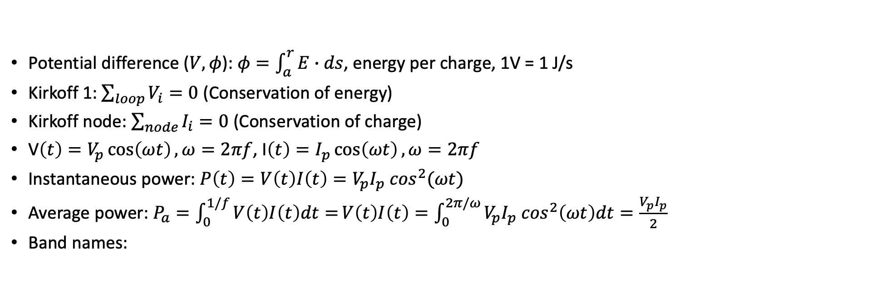
Basic concepts
Potential difference ($V, φ$): $φ=\int_{a}^{r}{E∙ds}$, energy per charge, 1V = 1 J/s
Kirkoff 1: $\sum_{loop}{V_{i}=0}$ (Conservation of energy)
Kirkoff node: $\sum_{node}{I_{i}=0}$ (Conservation of charge)
V$\left(t\right)=V_{p}\cos\left(ωt\right), ω=2πf$, I$\left(t\right)=I_{p}\cos\left(ωt\right), ω=2πf$
Instantaneous power: $P\left(t\right)=V\left(t\right)I\left(t\right)=V_{p}I_{p} \cos^{2}(ωt)$
Average power: $P_{a}=\int_{0}^{1/f}{V\left(t\right)I\left(t\right)dt=}V\left(t\right)I\left(t\right)=\int_{0}^{2π/ω}{V_{p}I_{p} \cos^{2}\left(ωt\right)dt}=\frac{V_{p}I_{p}}{2}$
Band names:
Name | Frequency
VLF | 3-30kHz
LW | 20-300kHz
MW | 300kHz-3MHz
HF | 3MHz-30MHz
VHF | 30-300MHz
Name | Frequency
UHF | 300MHz-1GHz
uW | 1-30GHz
milliW | 30-300GHz
submilliF | >300GHz

Slide 3
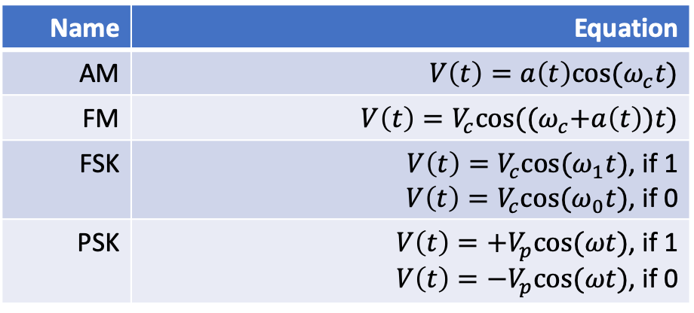
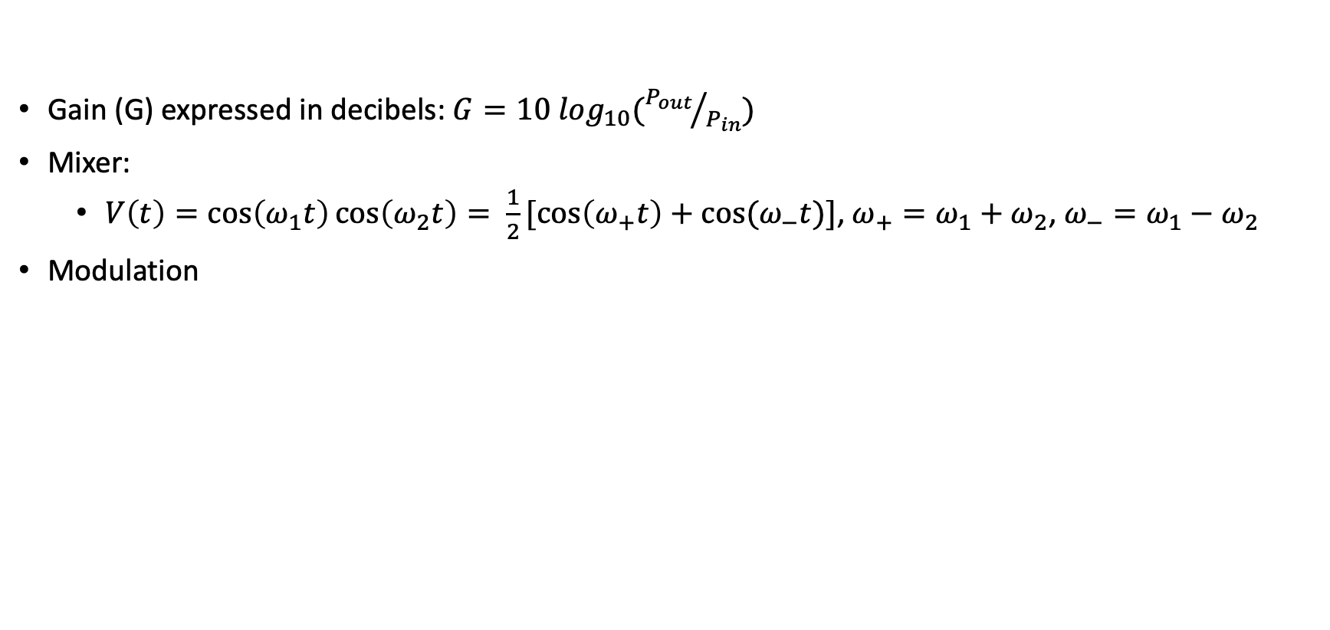
Signals
Gain (G) expressed in decibels: $G=10 \log_{10}({P_{out}}/{P_{in}})$
Mixer:
$V\left(t\right)=\cos\left(ω_{1}t\right)\cos\left(ω_{2}t\right)= \frac{1}{2}[\cos\left(ω_{+}t\right)+cos⁡(ω_{−}t)]$, $ω_{+}=ω_{1}+ω_{2}$, $ω_{−}=ω_{1}−ω_{2}$
Modulation
Name | Equation
AM | $$V\left(t\right)=a\left(t\right)cos⁡(ω_{c}t)$$
FM | $$V\left(t\right)=V_{c}cos⁡({(ω}_{c}+a\left(t\right))t)$$
FSK | $V\left(t\right)=V_{c}cos⁡(ω_{1}t)$, if 1 $V\left(t\right)=V_{c}cos⁡(ω_{0}t)$, if 0
PSK | $V\left(t\right)={+V}_{p}cos⁡(ωt)$, if 1 $V\left(t\right)=−V_{p}cos⁡(ωt)$, if 0

Slide 4

Resistors, capacitors, inductors, diodes
Resistor: $IR=v$
Capacitor: $CV=q, C\frac{dV}{dt}=i$
Inductor: $V=L\frac{di}{dt}$
Diodes
Energy stored

Slide 5
Impedance and phasors
Impedance and phasors

Slide 6
Phasor Power
Impedance and phasors

Slide 7
Circuit analysis with Kirchoff and impedance
RC circuits
Parallel and series

Slide 8
Filters
x

Slide 9
Thevenin and Norton
Lookback

Slide 10
Resonance and Q
Resonance

Slide 11
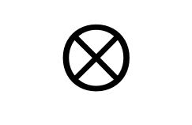
Norcal 40A
7 MHz
2W
<10 MHz
Harmonic
Filter
RF
Filter
Power
Amp
$$⊗$$
RF Mixer
20 mW
4.9 MHz
9.1 MHz
Driver
IF Filter
300 uW
VFO
2.1 MHz
Product
Detector
Buffer
$$⊗$$
BFO
4.9 MHz
10 uW
9.8 MHz
Audio
Transmit
Filter
AGC
7 MHz
2.8 MHz
Transmit
Mixer
$$⊗$$
AGC
Detector
Audio
Amp
Key
Transmit oscillator
4.9 MHz

Slide 12
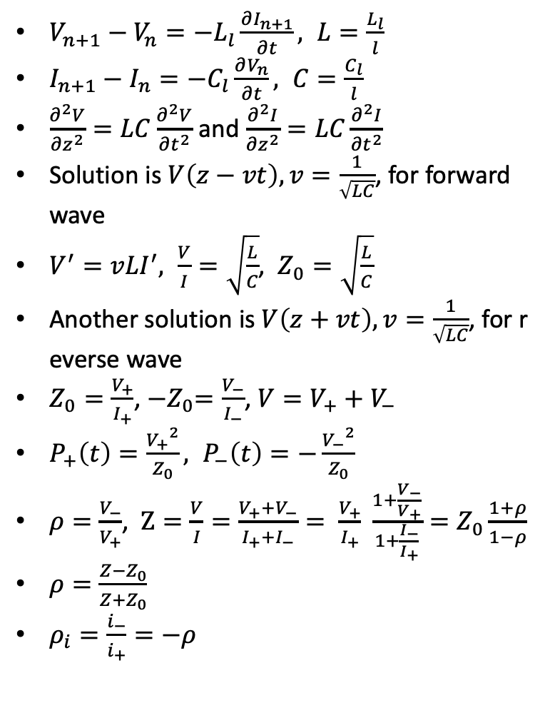
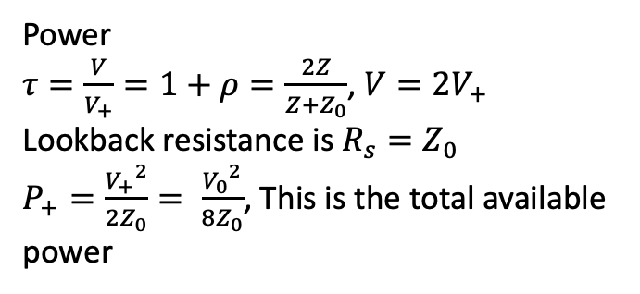
Transmission Lines
$V_{n+1}−V_{n}=−L_{l}\frac{∂I_{n+1}}{∂t}, L=\frac{L_{l}}{l}$
$I_{n+1}−I_{n}=−C_{l}\frac{∂V_{n}}{∂t}, C=\frac{C_{l}}{l}$
$\frac{∂^{2}V}{{∂z}^{2}}=LC\frac{∂^{2}V}{{∂t}^{2}}$ and $\frac{∂^{2}I}{{∂z}^{2}}=LC\frac{∂^{2}I}{{∂t}^{2}}$
Solution is $V\left(z−vt\right), v=\frac{1}{\sqrt{LC}}$, for forward wave
$V^{′}=vLI^{′}, \frac{V}{I}=\sqrt{\frac{L}{C}}$, $Z_{0}=\sqrt{\frac{L}{C}}$
Another solution is $V\left(z+vt\right), v=\frac{1}{\sqrt{LC}}$, for reverse wave
$Z_{0}=\frac{V_{+}}{I_{+}}$, ${−Z}_{0}=\frac{V_{−}}{I_{−}}$, $V=V_{+}+V_{−}$
$P_{+}\left(t\right)=\frac{{V_{+}}^{2}}{Z_{0}}, P_{−}\left(t\right)=−\frac{{V_{−}}^{2}}{Z_{0}}$
$ρ=\frac{V_{−}}{V_{+}}$, $Z=\frac{V}{I}=\frac{V_{+}+V_{−}}{I_{+}+I_{−}}= \frac{V_{+}}{I_{+}} \frac{1+\frac{V_{−}}{V_{+}}}{1+\frac{I_{−}}{I_{+}}}=Z_{0}\frac{1+ρ}{1−ρ}$
$ρ=\frac{Z−Z_{0}}{Z+Z_{0}}$
$ρ_{i}=\frac{i_{−}}{i_{+}}=−ρ$
I_{n}
V_{n}
L_{l}
…
C_{l}
Power
$τ=\frac{V}{V_{+}}=1+ρ=\frac{2Z}{Z+Z_{0}}$, $V=2V_{+}$
Lookback resistance is $R_{s}=Z_{0}$
$P_{+}=\frac{{V_{+}}^{2}}{2Z_{0}}= \frac{{V_{0}}^{2}}{8Z_{0}}$, This is the total available power

Slide 13
Transmission Lines - continued
x

Slide 14
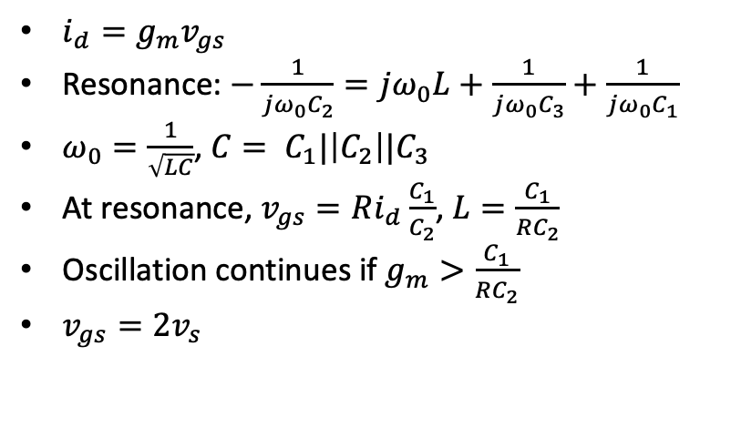
Norcal Clapp oscillator
$i_{d}=g_{m}v_{gs}$
Resonance: $−\frac{1}{jω_{0}C_{2}}=jω_{0}L+\frac{1}{jω_{0}C_{3}}+\frac{1}{jω_{0}C_{1}}$
$ω_{0}=\frac{1}{\sqrt{LC}}$, $C= C_{1}|\left|C_{2}\right||C_{3}$
At resonance, $v_{gs}=Ri_{d}\frac{C_{1}}{C_{2}}$, $L=\frac{C_{1}}{RC_{2}}$
Oscillation continues if $g_{m}>\frac{C_{1}}{RC_{2}}$
$v_{gs}=2v_{s}$
9v
C₃
C₁ (1200pF)
L (19uH)
C₂ (1200 pF)
out
R

Slide 15
Filters
Low pass
L₂
L₄
C₁
C₂
C₃
High pass
C₁
C₂
C₃
L₂
L₄
7 MHz bandpass
C₁ (34.5 pF)
L₂ (15 uH)
C₂ (6nF)
L₄ (8nH)

Slide 16
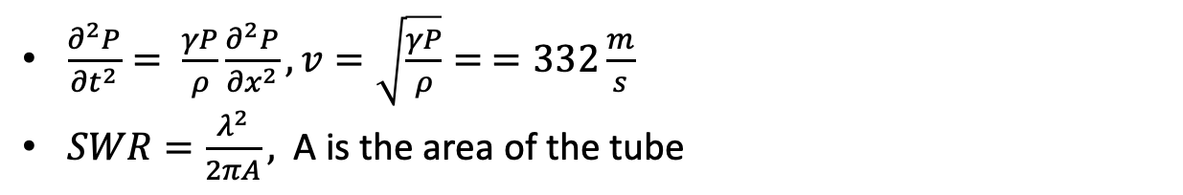
Acoustics
$\frac{∂^{2}P}{{∂t}^{2}}= \frac{γP}{ρ}\frac{∂^{2}P}{{∂x}^{2}}, v=\sqrt{\frac{γP}{ρ}}= =332\frac{m}{s}$
$SWR=\frac{λ^{2}}{2πA},$ A is the area of the tube

Slide 17
Transistors
When key is down, transistor conducts

Slide 18
Transmitter switch
2N3906
8V
8V TX
R₂₄ (150K)
When key is down, transistor conducts
R₉ (47K)
Key jack
C₄₇ (47nF)
relay

Slide 19
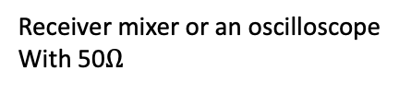
Receiver switch
C₁
50pF
L₁ (15uH)
8V TX
Receiver mixer or an oscilloscope
With 50$Ω$
2N4124
Harmonic filter
R₁
1.8K
C₂
47nF
If using function generator
use a 1.8K resistor
When transistor conducts the receiver filter shorts

Slide 20
Norcal Harmonic Filter
L₇
L₈
Power amp, or,
function generator
Antenna
Jack out
C₄₅
330pF
C₄₆
820pF
C₄₇
330pF
L₇, L₈ use T37-2 core, 18 turns, 1.3uH
Compare loss at 7MHz and 14MHz

Slide 21
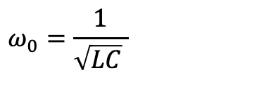
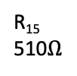
Norcal VCO
RIT 1
R₁₇
10K
R₂₀
4.7K
8V
C₅₄
47nF
R₁₉
47K
C₄₉
47pF
C₅₁
390pF
J309
R₁₅
510$Ω$
$$ω_{0}=\frac{1}{\sqrt{LC} }$$
LM393 pin 7
C₅₂
1200pF
R₂₃
1.8K
C₅₀
25pF
D₉
R₂₁
47K
D₈
MVAM108
L₉
TX VFO
C₇
10pnF
C₅₃
1200pF
RFC
1mH
RX VFO
C₃₂
150 pF
L9: T68-7 62 turns
Check MVAM108 capacitor when R₁₇ is high and low
Start resistor (R₂₁) pulls gat to ground at start
When gain limiting diode (D9) conducts, it pulls gate negative
Oscillator keeps growing as long as g_{m}>1/R

Slide 22
Norcal Receiver Incremental Tuning (RIT)
RIT 1
R₁₆
1K
R₁₅
510
LM393
8
1
7
8V
2
3
C₄
5pF
6
4
5
on
1.4V
From VFO
off
8V TX
LM393 is a comparator
For function generator connect through 1.5K

Slide 23
Norcal RF Filter
C₁
50 pF
L₁
15uH
RX Ant
8V TX
2N4124
To RF
Mixer
R₁
1.8K
R₂
1K
C₃
47nF
To receiver
switch

Slide 24
Norcal RF Mixer
8V
C₄
5pF
SA602
RF
Filter
8
C₂
50pF
1
T₂
C₁₈
47nF
7
50mVpp if
using function
generator
2
C₅
10nF
6
RX VFO
3
From VCO
4
5
C₆
47pF
T₃
IF Filter

Slide 25

Norcal IF Cohn Filter
X₁ through X₄ are 4.91 MHz
C₁₀, C₁₁, C₁₂ are 270 pF
Set function generator to 50mV_{pp} from function generator
Calculate R and X for filter
C₉
X₁
X₂
X₃
X₄
C₁₃
C₁₀
C₁₁
C₁₂
L₉ (18 uH)
200$Ω$
C₁₄
47pF
To SA602 wants 1.5K
Matching network
Equivalent circuit for
crystal and generator

Slide 26
Norcal Product Detector
8V
1.4V
SA602
C₁₈
270 pF
8
1
IF in
7
2
C_{15. +}
2.2uF
C₁₇
50 pF
3
6
4
5
4.91 MHz
AF1
AF2
620 Hz output through AF1 and AF2

Slide 27
Norcal AGC
8V TX
8V
Connect to
function generator
through 300K, here
R₂₀
4.7K
R₃
150K
C₄₁
100uF
C₅₅
100nF
AF2
J309
R_{5c}
2.2M
C₅₅
10nF
R_{5a}
2.2M
C₂₇
100uF
R₇
47K
To audio
in
D₁
D₂
From product
detector
C₂₈
100nF
Key tune
D₄
D₆
R₆
10K
Threshold
R_{5b}
2.2M
R_{5d}
2.2M
D₅
AGC pt at
audio amp
AF1
C₂₁
100nF

Slide 28
Norcal Audio Amp
8V
C₂₃
2.2uF
+
C₅₅ (10 nF)
1
2
8
R₂₂
1.8K
+
Audio in
5
3
386
4
-
6
+
+
C₂₇ (100 uF)
AGC pt
C₃₀ (2.2 uF)
R₆
500
Speaker
+
C₂₆ (10 uF)

Slide 29
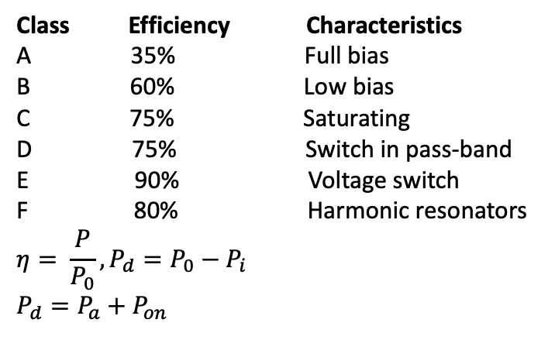
Amplifier classes
I
I
V
Class Efficiency Characteristics
A 35% Full bias
B 60% Low bias
C 75% Saturating
D 75% Switch in pass-band
E 90% Voltage switch
F 80% Harmonic resonators
$$η= \frac{P}{P_{0}}, P_{d}=P_{0}−P_{i}$$
$$P_{d}=P_{a}+P_{on}$$
t
t
t
Class A
Class B
Class C
V
V
V
t
t
t
Class D
Class E
Class F

Slide 30
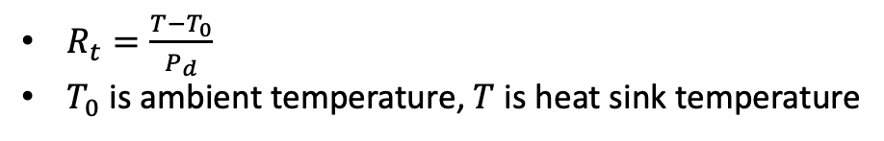


Norcal Power Amp
Norcal-40 Power amp is class C
8V
Supply power
3,200 mW
R₁₄
1$Ω$
RFC
18uH
Active loss
P_{a}, 260 mW
2N3553
Harmonic
Filter
Power transistor
Driver
C₄₄
47nF
R₁₄
100$Ω$
IN4753A
Active loss
P_{on}, 430 mW
Antenna
2500 mW
$R_{t}=\frac{T−T_{0}}{P_{d}}$
$T_{0}$ is ambient temperature, $T$ is heat sink temperature

Slide 31









Norcal matching transformers
T₁ is driver matcher uses FT 37-43
Measurement circuit below
T₁, 14:4
50$Ω$
200$Ω$
100$Ω$
50$Ω$
1K$Ω$
T₂ is RF matcher uses FT 37-61
Measurement circuit below
C₄
5pF
T₂, 1:20
50$Ω$
C₂
50pF
1.5K$Ω$
T₃, 23:6
T₃ is IF matcher uses FT 37-61
Measurement circuit below
L₄, 18uH
750$Ω$
C₁₄
47pF
C₆
47pF
1.5K$Ω$

Slide 32


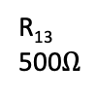


Norcal Driver
8V
out
T₁
R₁₄
100$Ω$
2N2222A
$Use 50Ω$ scope probe
R₁₁
510$Ω$
R₁₂
20$Ω$
R₁₃
500$Ω$
+
Key jack
C₅₆
10uF
C₄₈
10nF

Slide 33
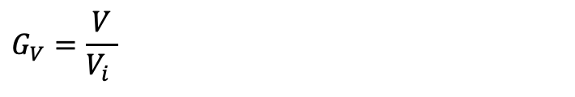


Norcal Buffer
8V TX
C₃₆
47nF
Function
Generator
C₃₉
50pF
Pin 4 transmit
mixer
C₃₇
5pF
R₁₀
510$Ω$
1.5K
Driver
C₃₈
100pF
C₅₀
25pF
L₆
3.1uF
J309
R₁₁
510$Ω$
$$G_{V}=\frac{V}{V_{i} }$$

Slide 34
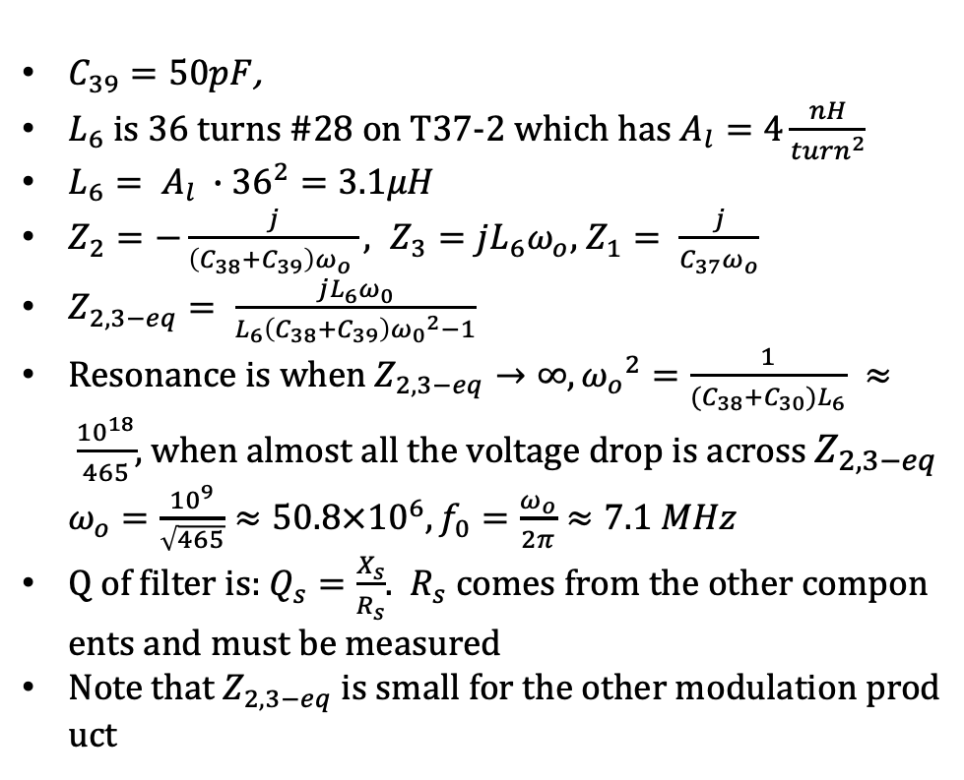
Norcal transmit bandpass filter
$C_{39}=50pF$,
$L_{6}$ is 36 turns #28 on T37-2 which has $A_{l}=4\frac{nH}{{turn}^{2}}$
$L_{6}= A_{l} ∙{36}^{2}=3.1μH$
$Z_{2}=−\frac{j}{\left(C_{38}+C_{39}\right)ω_{o} }, Z_{3}=jL_{6}ω_{o}$, $Z_{1}= \frac{j}{C_{37}ω_{o}}$
$Z_{2,3−eq}= \frac{jL_{6}ω_{0}}{L_{6}\left(C_{38}+C_{39}\right){ω_{0}}^{2}−1}$
Resonance is when $Z_{2,3−eq}→∞, {ω_{o}}^{2}=\frac{1}{(C_{38}+C_{30})L_{6}} ≈ \frac{{10}^{18}}{465}$, when almost all the voltage drop is across $Z_{2,3−eq}$ $ω_{o}=\frac{{10}^{9}}{\sqrt{465}}≈50.8×{10}^{6}, f_{0}=\frac{ω_{o}}{2π}≈7.1 MHz$
Q of filter is: $Q_{s}=\frac{X_{s}}{R_{s}}$. $R_{s}$ comes from the other components and must be measured
Note that $Z_{2,3−eq}$ is small for the other modulation product
C37 (5pF)
C₃₉
C₃₈ (100pF)
L₆

Slide 35
Norcal transmit mixer and oscillator
8V
TX VFO
C₃₁
5 pF
SA602
C₃₆
270 pF
8
1
7
2
C₃₃
47nF
C₃₄
50 pF
L₅
18 uH
3
6
5
4
4.91 MHz
Buffer
Amp

Slide 36
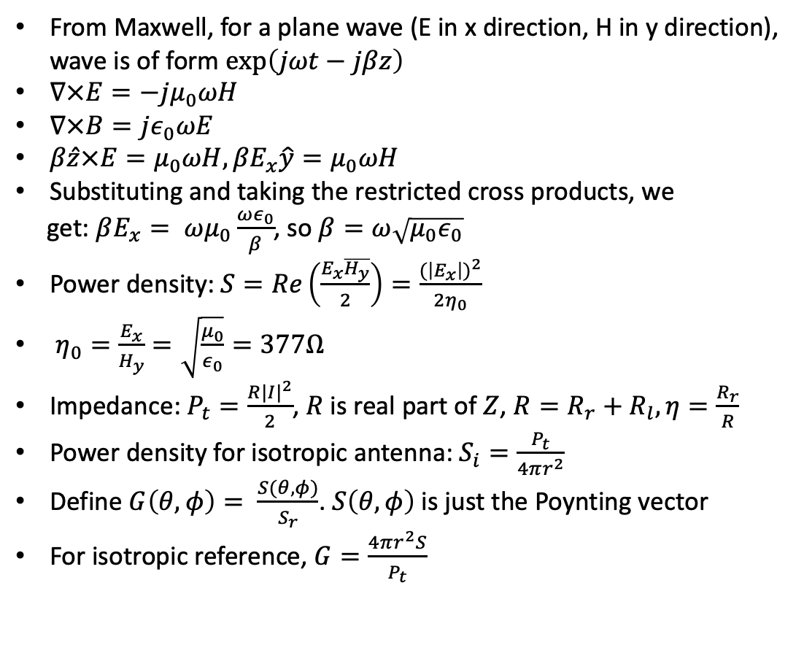
Antennas and propagation
From Maxwell, for a plane wave (E in x direction, H in y direction), wave is of form $\exp\left(jωt−jβz\right)$
$∇×E=−jμ_{0}ωH$
$∇×B=jε_{0}ωE$
$β\hat{z}×E=μ_{0}ωH, βE_{x}\hat{y}=μ_{0}ωH$
Substituting and taking the restricted cross products, we
get: $βE_{x}= ωμ_{0}\frac{ωε_{0}}{β}$, so $β=ω\sqrt{μ_{0}ε_{0}}$
Power density: $S=Re\left(\frac{E_{x}\overline{H_{y}}}{2}\right)=\frac{{(\left|E_{x}\right|)}^{2}}{2η_{0}}$
$η_{0}=\frac{E_{x}}{H_{y}}=\sqrt{\frac{μ_{0}}{ε_{0}}}=377Ω$
Impedance: $P_{t}=\frac{R{|I|}^{2}}{2}$, $R$ is real part of $Z$, $R=R_{r}+R_{l}, η=\frac{R_{r}}{R}$
Power density for isotropic antenna: $S_{i}=\frac{P_{t}}{4πr^{2}}$
Define $G\left(θ,φ\right)= \frac{S(θ,φ)}{S_{r}}$. $S\left(θ,φ\right)$ is just the Poynting vector
For isotropic reference, $G=\frac{4πr^{2}S}{P_{t}}$
Receiving antenna Thevenin
C
R

Slide 37
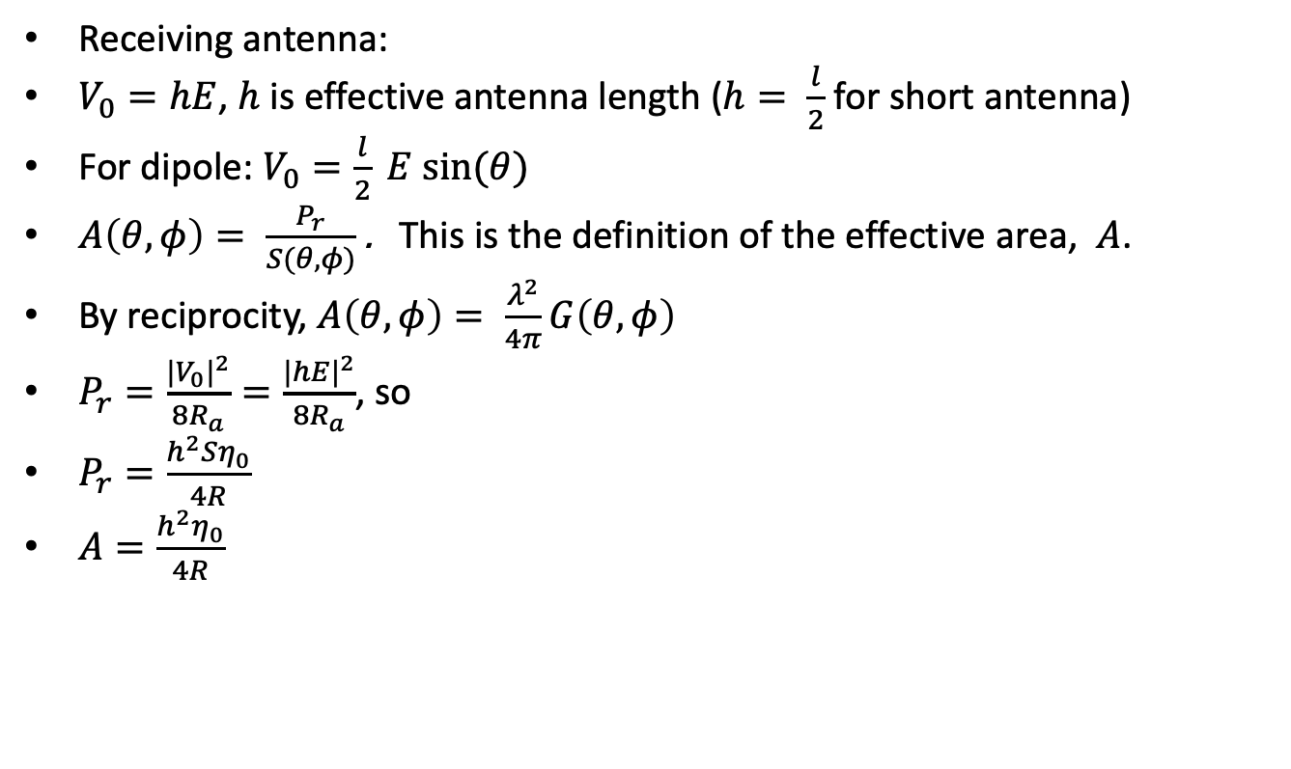
Antennas and propagation
Receiving antenna:
$V_{0}=hE$, $h$ is effective antenna length ($h= \frac{l}{2}$ for short antenna)
For dipole: $V_{0}=\frac{l}{2} E sin⁡(θ)$
$A\left(θ, φ\right)= \frac{P_{r}}{S(θ,φ)}$ . This is the definition of the effective area, $A$.
By reciprocity, $A\left(θ, φ\right)= \frac{λ^{2}}{4π}G\left(θ, φ\right)$
$P_{r}=\frac{{{|V}_{0}|}^{2}}{8R_{a}}=\frac{{|hE|}^{2}}{8R_{a}}$, so
$P_{r}=\frac{h^{2}Sη_{0}}{4R}$
$A=\frac{h^{2}η_{0}}{4R}$

Slide 38
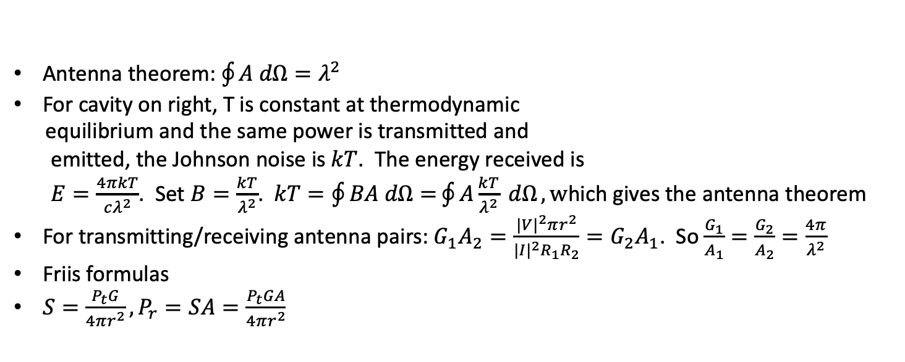
Antennas and propagation
Insulated cavity
T
A
Antenna theorem: $\oint{A dΩ=λ^{2}}$
For cavity on right, T is constant at thermodynamic
equilibrium and the same power is transmitted and
emitted, the Johnson noise is $kT$. The energy received is
$E=\frac{4πkT}{cλ^{2}}$. Set $B=\frac{kT}{λ^{2}}$. $kT=\oint{BA dΩ=}\oint{A\frac{kT}{λ^{2}} dΩ}, w$hich gives the antenna theorem
For transmitting/receiving antenna pairs: $G_{1}A_{2}=\frac{{|V|}^{2}πr^{2}}{{|I|}^{2}R_{1}R_{2}}=G_{2}A_{1}$. So $\frac{G_{1}}{A_{1}}=\frac{G_{2}}{A_{2}}=\frac{4π}{λ^{2}}$
Friis formulas
${S=\frac{P_{t}G}{4πr^{2}}, P}_{r}=SA=\frac{P_{t}GA}{4πr^{2}}$

Slide 39
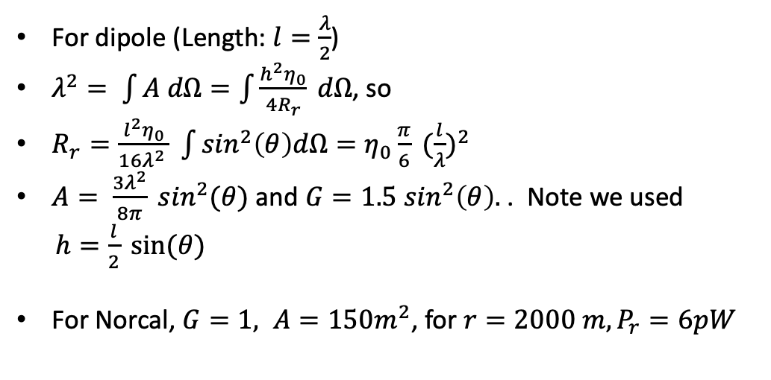
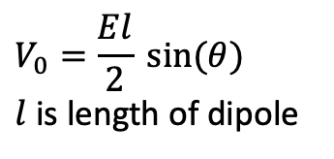
Reciprocity and dipole
Dipole Thevenin equivalent circuit
For dipole (Length: $l=\frac{λ}{2}$)
$λ^{2}= \int{A dΩ=\int{\frac{h^{2}η_{0}}{4R_{r}} dΩ}}$, so
$R_{r}=\frac{l^{2}η_{0}}{16λ^{2} } \int{\sin^{2}\left(θ\right)dΩ=η_{0}\frac{π}{6}} {(\frac{l}{λ})}^{2}$
$A= \frac{3λ^{2}}{8π} \sin^{2}(θ)$ and $G=1.5\sin^{2}\left(θ\right).$ . Note we used
$h=\frac{l}{2} sin⁡(θ)$
For Norcal, $G=1, A=150m^{2}$, for $r=2000 m, P_{r}=6pW$
C
R
$$V_{0}=\frac{El}{2} sin⁡(θ)$$
$l$ is length of dipole

Slide 40
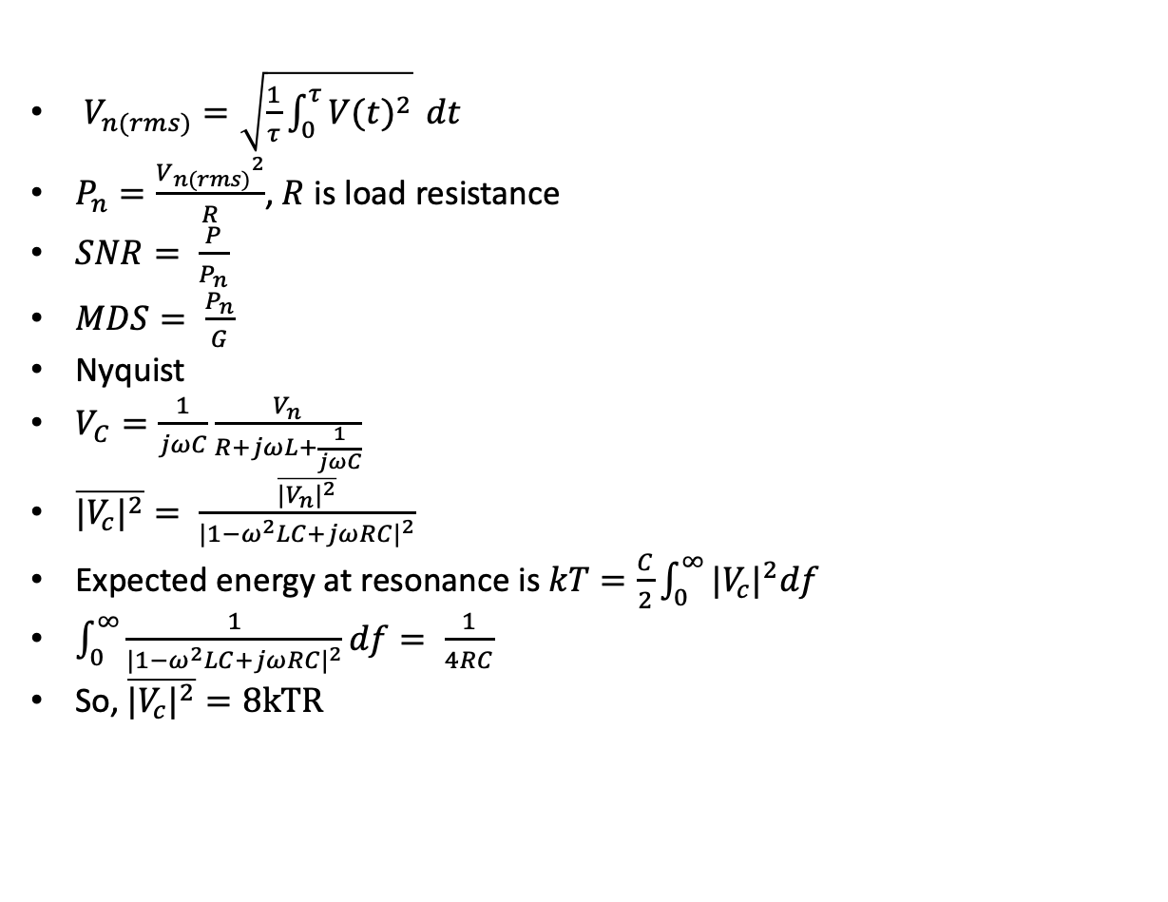
Noise
$V_{n(rms)}=\sqrt{\frac{1}{τ}\int_{0}^{τ}{{V(t)}^{2}}} dt$
$P_{n}=\frac{{V_{n(rms)}}^{2}}{R}$, $R$ is load resistance
$SNR= \frac{P}{P_{n}}$
$MDS= \frac{P_{n}}{G}$
Nyquist
$V_{C}=\frac{1}{jωC}\frac{V_{n}}{R+jωL+\frac{1}{jωC}}$
$\overline{{|V_{c}|}^{2}}= \frac{\overline{{|V_{n}|}^{2}}}{{|1−ω^{2}LC+jωRC|}^{2}}$
Expected energy at resonance is $kT=\frac{C}{2}\int_{0}^{∞}{{|V_{c}|}^{2}df}$
$\int_{0}^{∞}{\frac{1}{{|1−ω^{2}LC+jωRC|}^{2}}df}= \frac{1}{4RC}$
So, $\overline{{|V_{c}|}^{2}}=8kTR$

Slide 41
Norcal circuit diagram, 1

Slide 42
Norcal circuit diagram, 2

Slide 43
Norcal circuit diagram, 3

Slide 44
Norcal circuit diagram, 4

Slide 45
Norcal circuit diagram, 5

Slide 46
Block Diagram

Slide 47
Block Diagram

