Slide 1
Cryptanalysis
Discrete Log Based Systems
John Manferdelli
JohnManferdelli@hotmail.com
© 2004-2020, John L. Manferdelli.
This material is provided without warranty of any kind including, without limitation, warranty of non-infringement or suitability for any purpose. This material is not guaranteed to be error free and is intended for instructional use only.

Slide 2
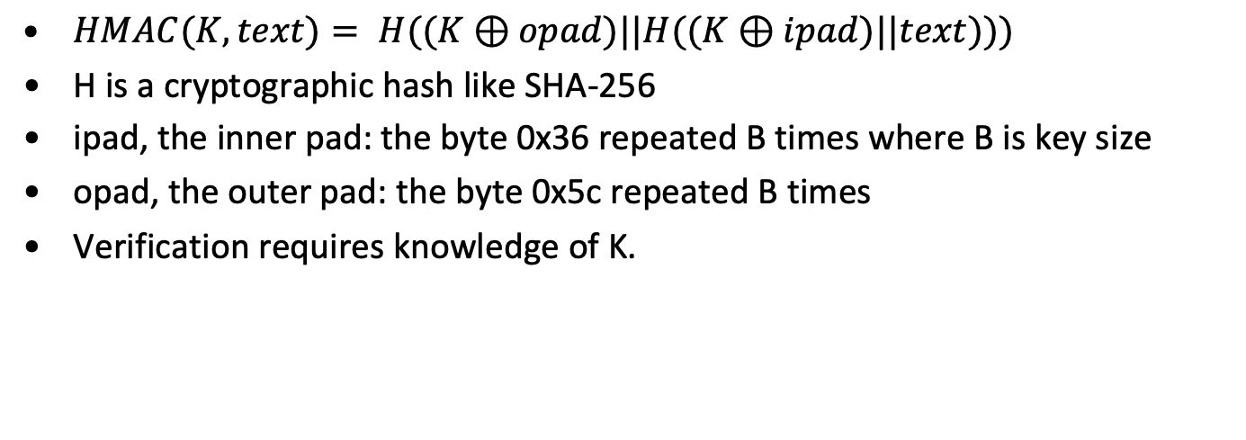
HMAC’s concluded
$HMAC(K, text)= H((K⊕opad)||H((K⊕ipad)||text)))$
H is a cryptographic hash like SHA-256
ipad, the inner pad: the byte 0x36 repeated B times where B is key size
opad, the outer pad: the byte 0x5c repeated B times
Verification requires knowledge of K.

Slide 3
Discrete log based public key systems

Slide 4
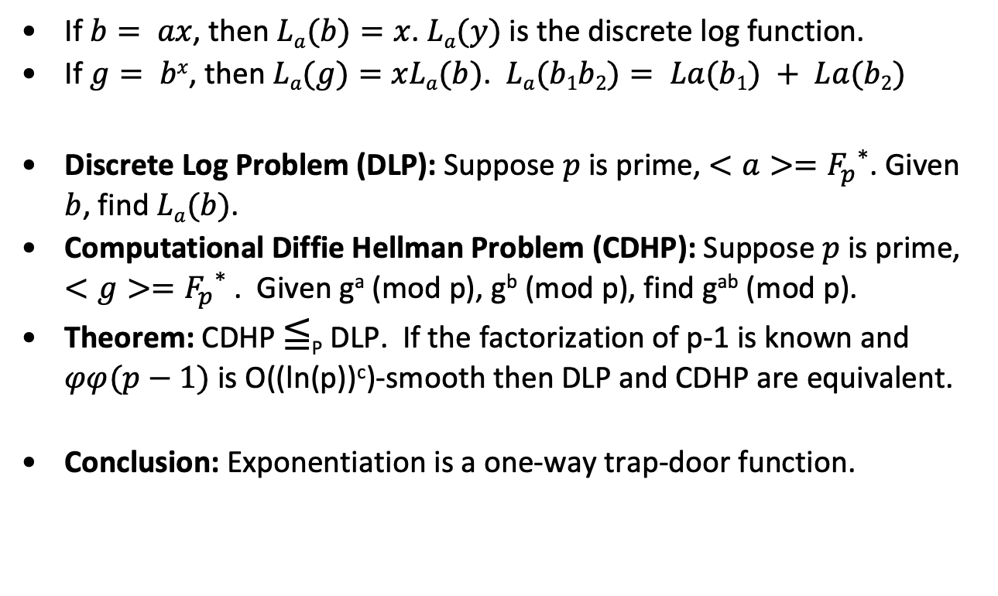
Discrete Log
If $b= ax$, then $La(b)=x$. $La(y)$ is the discrete log function.
If $g= bx$, then $La(g)=xLa(b)$. $La(b1b2)= La(b1) + La(b2)$
Discrete Log Problem (DLP): Suppose $p$ is prime, $<a>={F_{p}}^{∗}$. Given $b$, find $La(b)$.
Computational Diffie Hellman Problem (CDHP): Suppose $p$ is prime, $<g>={F_{p}}^{∗}$. Given gª (mod p), g^{b} (mod p), find g^{ab} (mod p).
Theorem: CDHP ≦_{P} DLP. If the factorization of p-1 is known and $φφ(p−1)$is O((ln(p))^{c})-smooth then DLP and CDHP are equivalent.
Conclusion: Exponentiation is a one-way trap-door function.

Slide 5
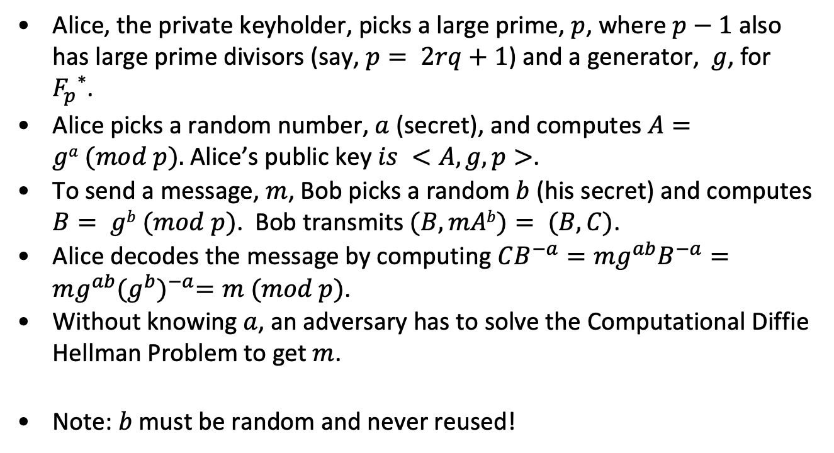
El Gamal cryptosystem
Alice, the private keyholder, picks a large prime, $p$, where $p−1$ also has large prime divisors (say, $p= 2rq+1$) and a generator, $g$, for ${F_{p}}^{∗}$.
Alice picks a random number, $a$ (secret), and computes $A=ga (mod p).$Alice’s public key $is <A, g, p>$.
To send a message, $m$, Bob picks a random $b$ (his secret) and computes $B= gb (mod p)$. Bob transmits $(B, mAb)= (B, C)$.
Alice decodes the message by computing $CB^{−a}=mg^{ab}B^{−a}=mg^{ab}{(g^{b})}^{−a}=m (mod p)$.
Without knowing $a$, an adversary has to solve the Computational Diffie Hellman Problem to get $m$.
Note: $b$must be random and never reused!

Slide 6
El Gamal Example
Alice chooses
p=919. g=7.
a=111, A= 7¹¹¹= 461 (mod 919).
Alice’s Public key is <919, 7, 461>
Bob wants to send m=45, picks b= 29.
B=7²⁹ =788(mod 919), 461²⁹= 902 (mod 919),
C= (45)(902)= 154(mod 919).
Bob transmits (788, 154).
Alice computes (788)⁻¹¹¹= 902⁻¹(mod 919).
(54)(902)+(-53)(919)=1. 54= 902⁻¹ (mod 919)
Calculates m= (154) (54)=45 (mod 919).

Slide 7
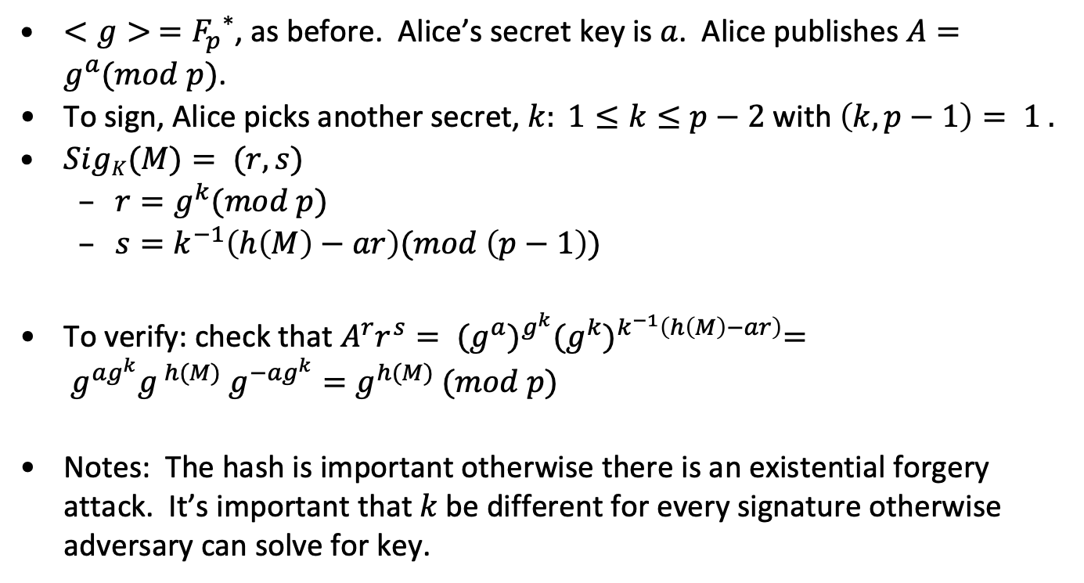
El Gamal Signature
$<g> ={F_{p}}^{∗}$, as before. Alice’s secret key is $a$. Alice publishes $A=g^{a}(mod p)$.
To sign, Alice picks another secret, $k: 1≤k≤p−2$ with $\left(k, p−1\right)= 1 .$
$SigK(M)= (r,s)$
$r=g^{k}(mod p)$
$s=k^{−1}\left(h\left(M\right)−ar\right)(mod \left(p−1\right))$
To verify: check that $A^{r}r^{s}= {(g^{a})}^{g^{k}}{(g^{k})}^{k^{−1}\left(h\left(M\right)−ar\right)}= g^{ag^{k}}g^{ h(M)} g^{−ag^{k}}=g^{h(M)} (mod p)$
Notes: The hash is important otherwise there is an existential forgery attack. It’s important that $k$be different for every signature otherwise adversary can solve for key.

Slide 8
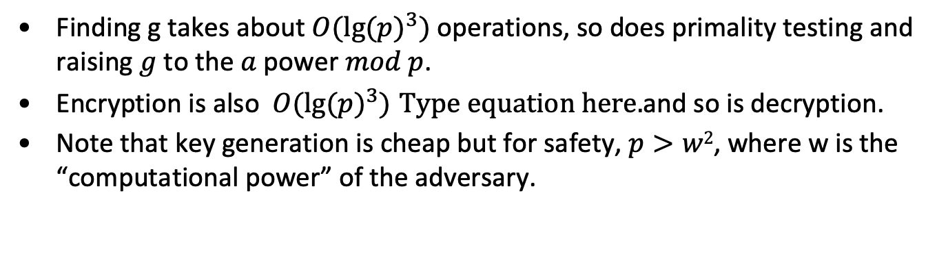
Timing
Finding g takes about $O({lg⁡(p)}^{3})$operations, so does primality testing and raising$g$to the $a$ power $mod p$.
Encryption is also$O({lg⁡(p)}^{3})$ and so is decryption.
Note that key generation is cheap but for safety, $p>w2$, where w is the “computational power” of the adversary.

Slide 9
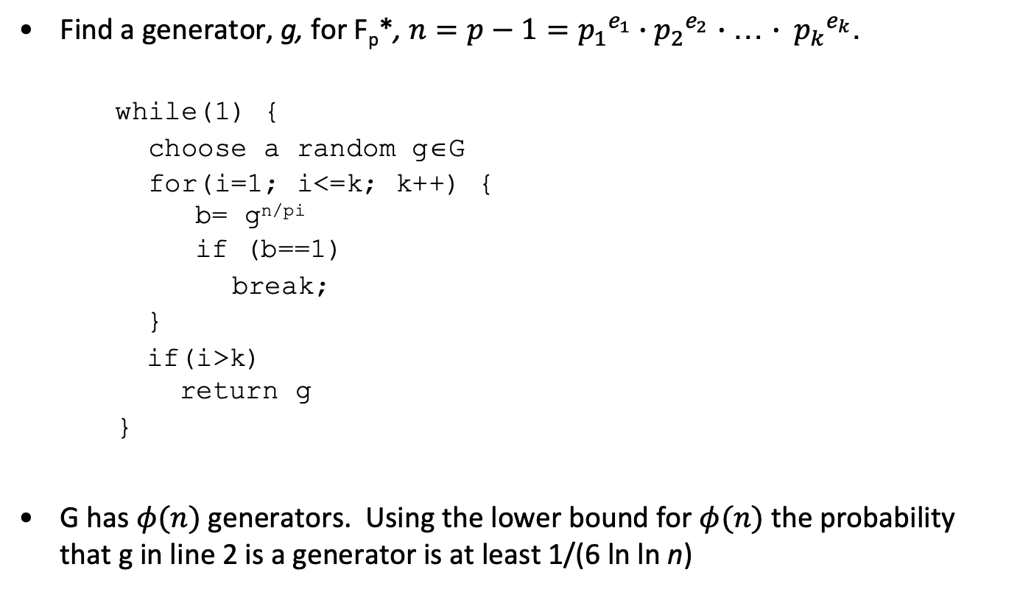
Finding generators (Gauss)
Find a generator, g, for F_{p}*, $n=p−1={p_{1}}^{e_{1}}{{∙p}_{2}}^{e_{2}}$ $∙$… $∙ {p_{k}}^{e_{k}}$.
while(1) {
choose a random g∈G
for(i=1; i<=k; k++) { b= g^{n/pi} if (b==1)
break;
}
if(i>k) return g
}
G has $φ(n)$ generators. Using the lower bound for $φ(n)$the probability that g in line 2 is a generator is at least 1/(6 ln ln n)

Slide 10
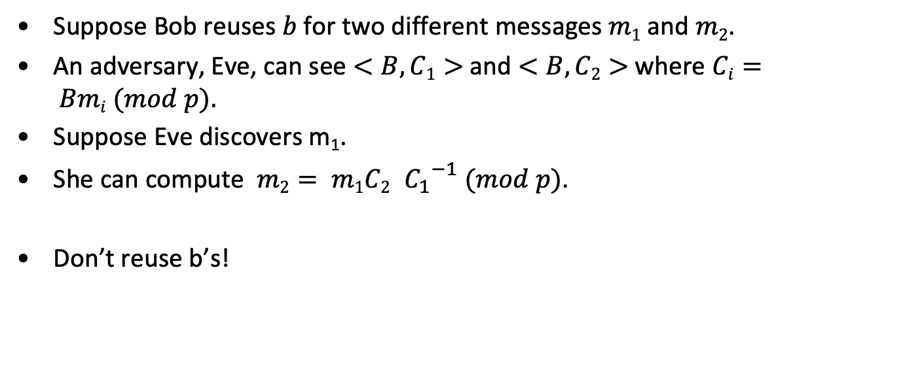
Attack on reused nonce
Suppose Bob reuses $b$ for two different messages $m1$ and $m2$.
An adversary, Eve, can see $<B, C1>$and $<B, C2>$where $Ci= Bmi (mod p).$
Suppose Eve discovers m₁.
She can compute $m2= m1C2 {C_{1}}^{−1} (mod p)$.
Don’t reuse b’s!

Slide 11
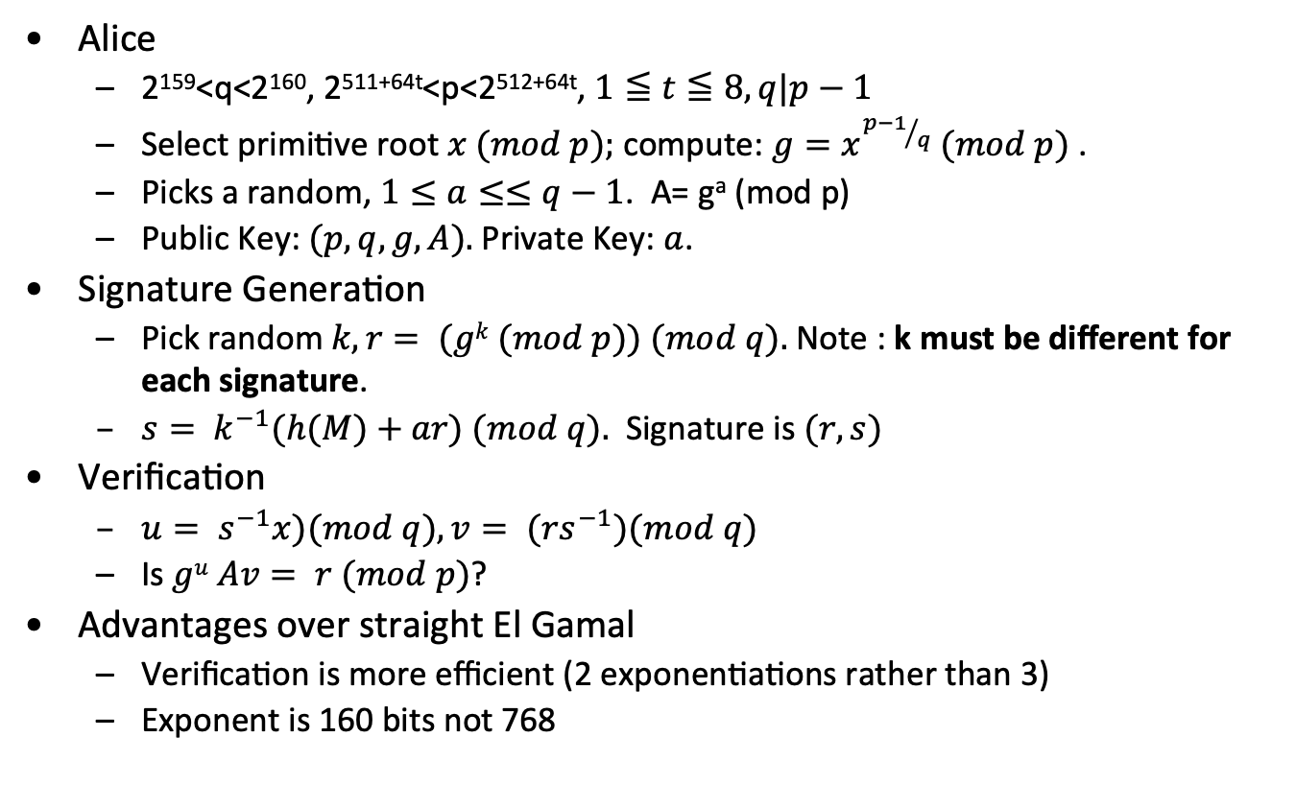
DSA
Alice
2¹⁵⁹<q<2¹⁶⁰, 2^{511+64t}<p<2^{512+64t}, $1≦t≦8, q|p−1$
Select primitive root$x (mod p);$compute: $g=x^{{p−1}/q} (mod p)$ .
Picks a random, $1≤a≤≤q−1$. A= gª (mod p)
Public Key: $(p, q, g, A).$Private Key: $a$.
Signature Generation
Pick random$k, r= (gk (mod p)) (mod q).$Note : k must be different for each signature.
$s= k^{−1}(h(M)+ar) (mod q).$ Signature is $(r,s)$
Verification
$u= s^{−1}x)(mod q), v= (rs^{−1})(mod q)$
Is $gu Av= r (mod p)$?
Advantages over straight El Gamal
Verification is more efficient (2 exponentiations rather than 3)
Exponent is 160 bits not 768

Slide 12
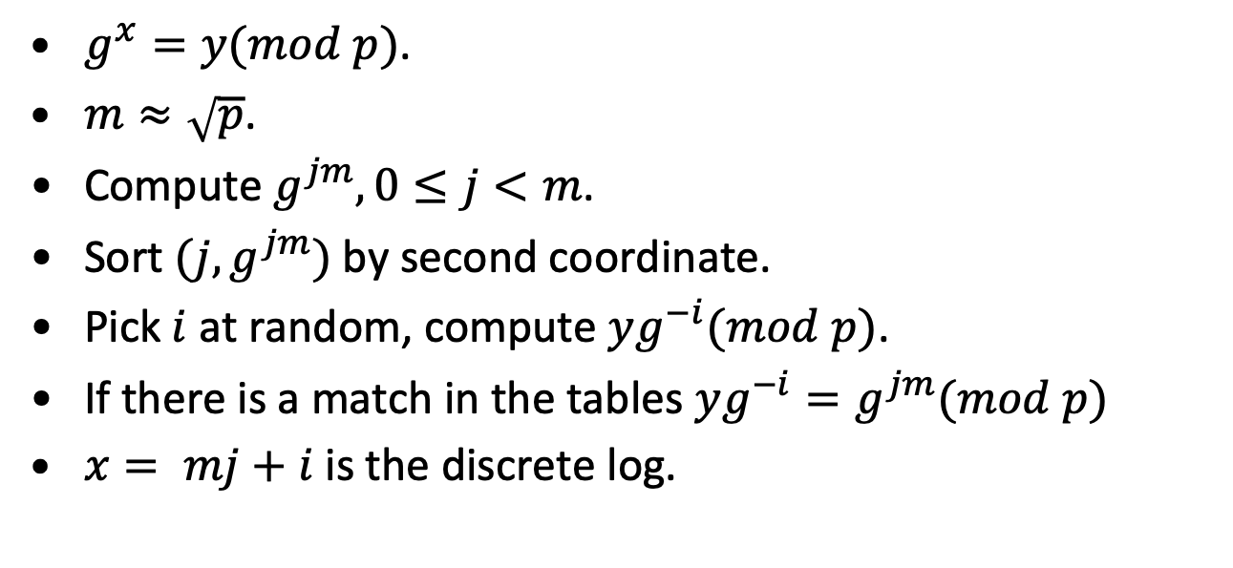
Baby Step Giant Step --- Shanks
$g^{x}=y(mod p)$.
$m≈\sqrt{p}$.
Compute $g^{jm}, 0≤j<m$.
Sort $(j,g^{jm})$by second coordinate.
Pick$i$at random, compute $yg^{−i}(mod p)$.
If there is a match in the tables $yg^{−i}=g^{jm}(mod p)$
$x= mj+i$is the discrete log.

Slide 13
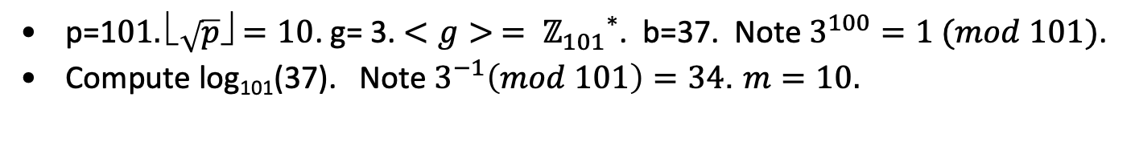
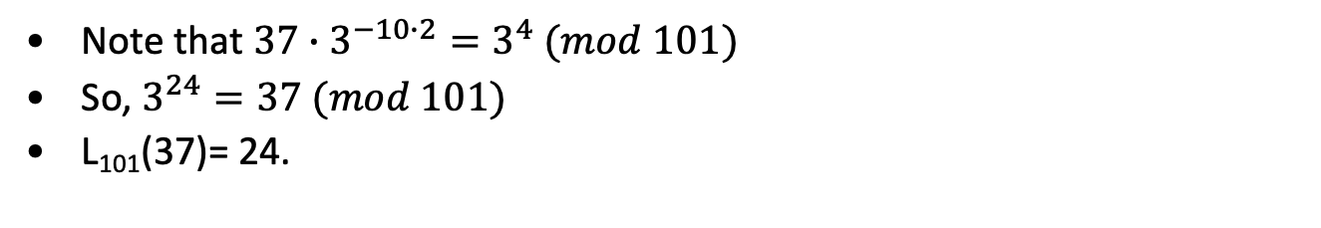
Baby Step Giant Step Example
p=1$01. \sqrt{p}✗=10$. g= 3. $<g> = {ℤ_{101}}^{∗}$. b=37. Note $3^{100}=1 (mod 101)$.
Compute log₁₀₁(37). Note $3^{−1}\left(mod 101\right)=34$. $m=10.$
j | 1 | 2 | 3 | 4 | 5 | 6 | 7 | 8 | 9 | 10
3^{j} | 3 | 9 | 27 | 81 | 41 | 22 | 66 | 97 | 89 | 65
37(34)^{mj} | 13 | 81 | 23 | 19 | 64 | 88 | 20 | 78 | 82 | 37
Note that $37∙3^{−10∙2}=3^{4} (mod 101)$
So, $3^{24}=37 (mod 101)$
L₁₀₁(37)= 24.

Slide 14
Discrete log Pollard
x_{i+1}= f(x_{i})
f(x_{i})= bx_{i}, if x_{i} 𝝴 S₁.
f(x_{i})= x_{i}², if x_{i} 𝝴 S₂.
f(x_{i})= ax_{i}, if x_{i} 𝝴 S₃.
x_{i}= a^{a[i]}b^{b[i]}.
a[i]= a[i], if x_{i} 𝝴 S₁.
a[i]= 2a[i], if x_{i} 𝝴 S₂.
a[i]= a[i]+1, if x_{i} 𝝴 S₃.
b[i]= b[i]+1, if x_{i} 𝝴 S₁.
b[i]= 2b[i], if x_{i} 𝝴 S₂.
b[i]= b[i], if x_{i} 𝝴 S₃.
x_{2i}=x_{i} → a_{2i}-a_{i}= L_{a}(b)(b_{2i}-b_{i})

Slide 15

Pollard $ρ$example
p=229, n=191, b=228, a=2. L₂(228)=110
i | x_{i} | a_{i} | b_{i}
1 | 228 | 0 | 1
2 | 279 | 0 | 2
3 | 92 | 0 | 4
4 | 184 | 1 | 4
5 | 205 | 1 | 5
6 | 14 | 1 | 6
7 | 28 | 2 | 6
8 | 256 | 2 | 7
9 | 152 | 2 | 8
10 | 304 | 3 | 8
11 | 372 | 3 | 9
12 | 121 | 6 | 18
13 | 12 | 6 | 19
14 | 144 | 12 | 38
i | x_{2i} | a_{2i} | b_{2i}
1 | 279 | 0 | 2
2 | 184 | 1 | 4
3 | 14 | 1 | 6
4 | 256 | 2 | 7
5 | 304 | 3 | 8
6 | 121 | 6 | 38
7 | 144 | 12 | 152
8 | 235 | 48 | 154
9 | 72 | 48 | 118
10 | 14 | 96 | 119
11 | 256 | 97 | 120
12 | 304 | 98 | 51
13 | 121 | 5 | 104
14 | 144 | 10 | 163
x₁₄= x₂₈, (b₁₄-b₂₈)= 125 (mod 191), L₂(228)=125⁻¹ (a₂₈-a₁₄)= 110.

Slide 16
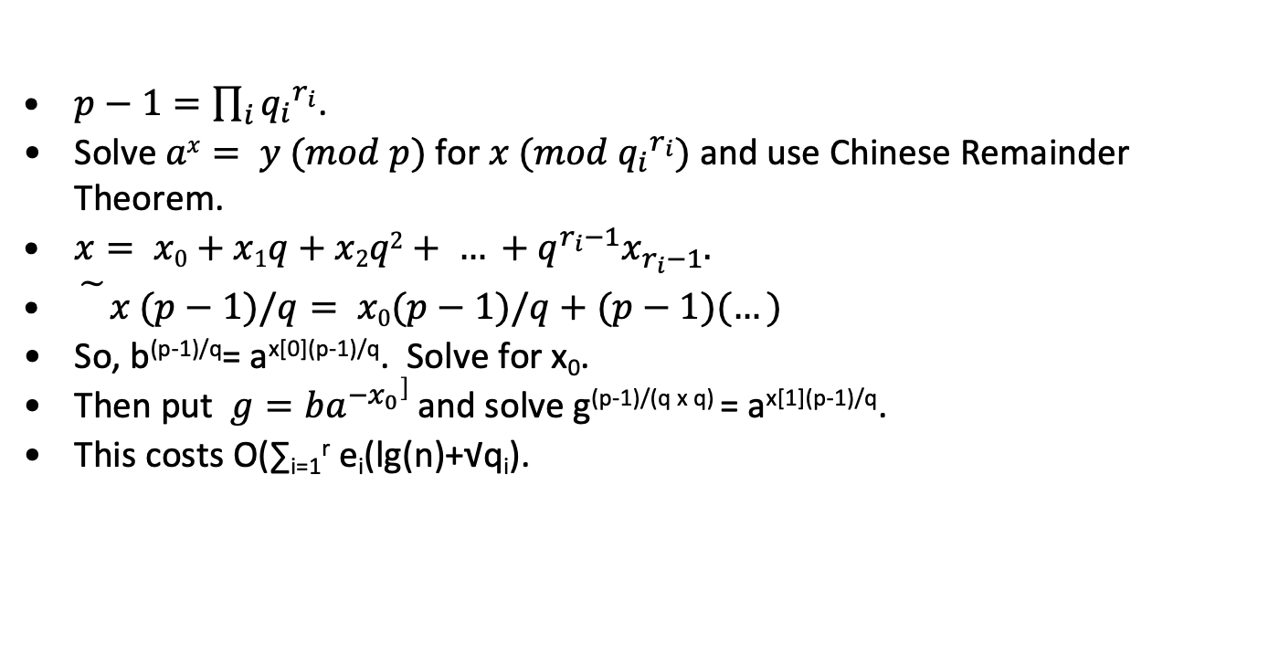
Pohlig-Hellman
$p−1=\prod_{i}{{q_{i}}^{r_{i}}}$.
Solve $ax= y (mod p)$for $x (mod {q_{i}}^{r_{i}})$ and use Chinese Remainder Theorem.
$x= x0+x1q+x2q2+ … +q^{r_{i}−1}x_{r_{i}−1}.$
$\tilde{}x (p−1)/q= x0(p−1)/q+(p−1)(…)$
So, b^{(p-1)/q}= a^{x[0](p-1)/q}. Solve for x₀.
Then put $g=ba^{−x_{0}}]$ and solve g^{(p-1)/(q x q)} = a^{x[1](p-1)/q}.
This costs O(∑_{i=1}^{r} e_{i}(lg(n)+√q_{i}).

Slide 17
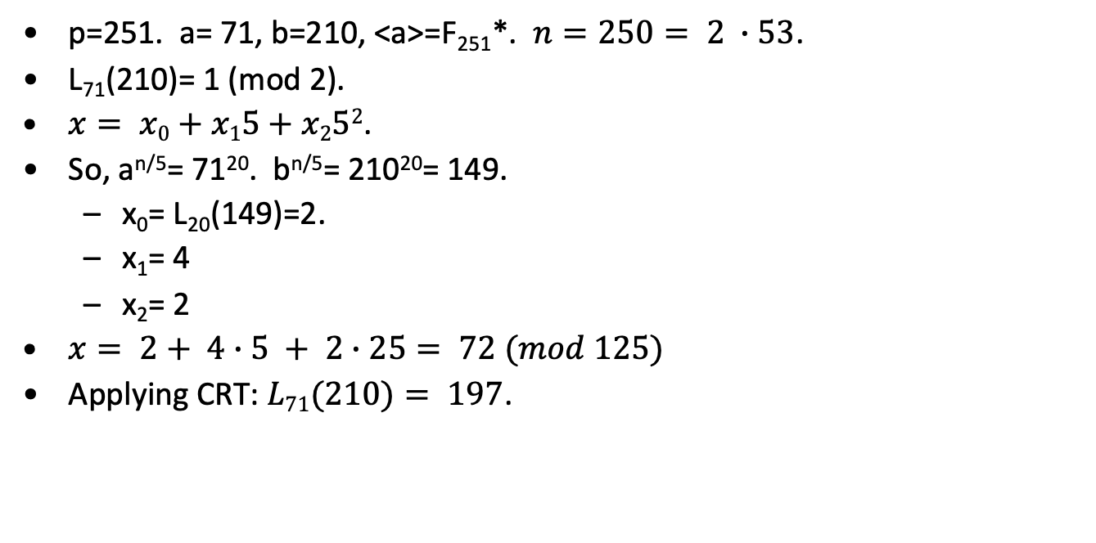
Pohlig-Hellman example
p=251. a= 71, b=210, <a>=F₂₅₁*. $n=250= 2 ∙53$.
L₇₁(210)= 1 (mod 2).
$x= x0+x15+x252$.
So, a^{n/5}= 71²⁰. b^{n/5}= 210²⁰= 149.
x₀= L₂₀(149)=2.
x₁= 4
x₂= 2
$x= 2+ 4∙5 + 2∙25= 72 (mod 125)$
Applying CRT: $L71(210)= 197$.

Slide 18
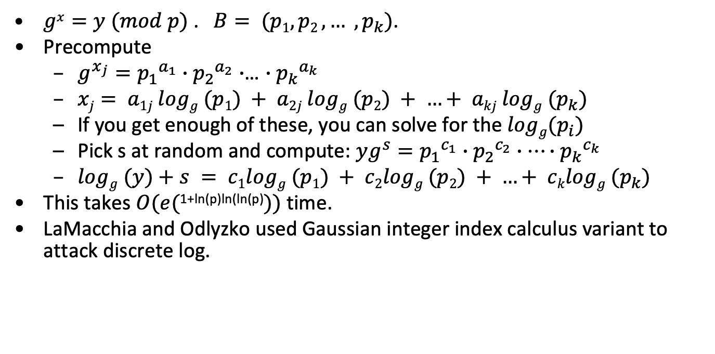
Index Calculus
$gx=y (mod p)$. $B= (p1, p2 , … , p_{k})$.
Precompute
$g^{x_{j}}={p_{1}}^{a_{1}}∙{p_{2}}^{a_{2}}∙$… $∙{p_{k}}^{a_{k}}$
$xj= a1j logg (p1) + a2j logg (p2) + …+ akj logg (p_{k})$
If you get enough of these, you can solve for the $logg(p_{i})$
Pick s at random and compute: $yg^{s}={p_{1}}^{c_{1}}∙{p_{2}}^{c_{2}}∙…∙{p_{k}}^{c_{k}}$
$logg (y)+s = c1logg (p1) + c2logg (p2) + …+ cklogg (p_{k})$
This takes $O(e(\text{1+}\text{ln}\text{(}\text{p}\text{)}\text{ln}\text{(}\text{ln}\text{(}\text{p}\text{)}))$ time.
LaMacchia and Odlyzko used Gaussian integer index calculus variant to attack discrete log.

Slide 19
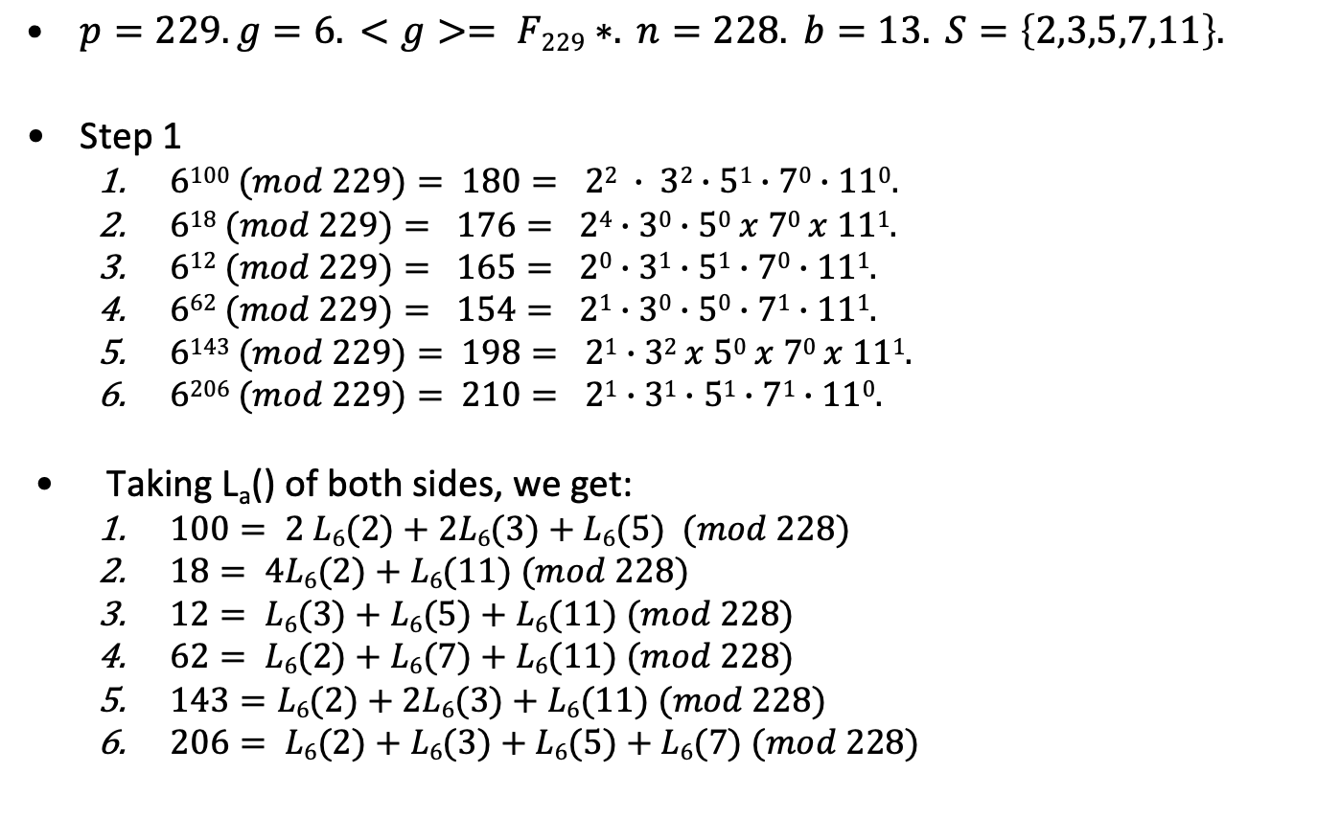
Index Calculus Example
$p=229. g=6. <g>= F229∗. n=228. b=13. S=\left\{2,3,5,7,11\right\}.$
Step 1
$6100 (mod 229)= 180= 22 ∙ 32∙51∙70∙110.$
$618 (mod 229)= 176= 24∙30∙50 x 70 x 111.$
$612 (mod 229)= 165= 20∙31∙51∙70∙111.$
$662 (mod 229)= 154= 21∙30∙50∙71∙111.$
$6143 (mod 229)= 198= 21∙32 x 50 x 70 x 111.$
$6206 (mod 229)= 210= 21∙31∙51∙71∙110.$
Taking L_{a}() of both sides, we get:
$100= 2 L6(2)+2L6(3)+L6(5) (mod 228)$
$18= 4L6(2)+L6(11) (mod 228)$
$12= L6(3)+L6(5)+L6(11) (mod 228)$
$62= L6(2)+L6(7)+L6(11) (mod 228)$
$143=L6(2)+2L6(3)+L6(11) (mod 228)$
$206= L6(2)+L6(3)+L6(5)+L6(7) (mod 228)$

Slide 20
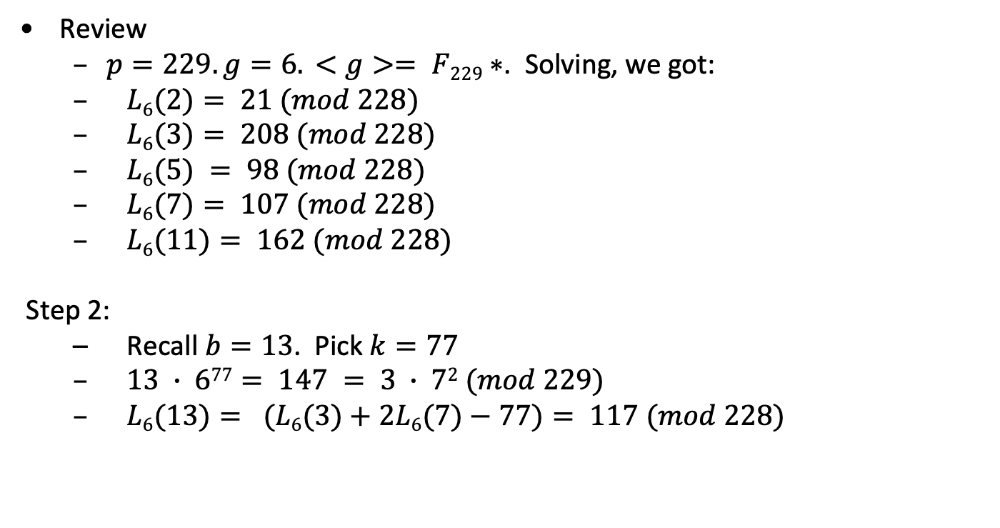
Index Calculus example - continued
Review
$p=229. g=6. <g>= F229∗$. Solving, we got:
$L6(2)= 21 (mod 228)$
$L6(3)= 208 (mod 228)$
$L6(5) = 98 (mod 228)$
$L6(7)= 107 (mod 228)$
$L6(11)= 162 (mod 228)$
Step 2:
Recall $b=13$. Pick$k=77$
$13 ∙ 677= 147 = 3 ∙ 72 (mod 229)$
$L6(13)= (L6(3)+2L6(7)−77)= 117 (mod 228)$

Slide 21
Diffie Hellman key exchange
Alice
Bob
A1: s= min(p size),
N_{a} in {0, … 2²⁵⁶-1}
s,N_{a}
(p,q,g), X=g^{x}, Auth_{B}
B1: Choose (p,q,g),
x in {0, … 2²⁵⁶-1}
A2: Check (p,q,g) X, Auth_{B}, pick y in {0,…q-1}
Y= g^{y}, Auth_{A}
B2: Check Y, Auth_{A}
K= X^{y}
K= Y^{x}

Slide 22
DH key exchange example
p=3547, g=2.
Alice: a= 7.
Bob: b=17.
A→B₁: A=128 (=2⁷), Sign_{A}(SHA-2(128||r₁))
B→A₁: B=3380(=2¹⁷), Sign_{B}(SHA-2(3380||r₂))
K= 128¹⁷=3380⁷= 362.

Slide 23
Access Control: authentication and authorization
Authenticate
Authorize
Principal
Request
Guard
Object
Channel
Execution environment
Policy
Audit log
Isolation boundary
Authentication is process of identifying a security principal. Here are some ways:
Login/password or smart card/pin (user)
Cryptographic Hash (program)
Ability to decrypt (channel)

Slide 24
Authentication
When logging on to a computer you enter
user name and
password
The first step is called identification. You announce who you are.
The second step is called authentication. You prove that you are who you claim to be.
To distinguish this type of ‘authentication’ from other interpretations, we may refer specifically to entity authentication: The process of verifying a claimed identity.
Slide from Dieter Gollmann

Slide 25
Authentication
Login: jlm
Password: ********
Welcome John Manferdelli
>
25

Slide 26
Problems with Passwords
Authentication by password is widely accepted and not too difficult to implement.
Managing password security can be quite expensive; obtaining a valid password is a common way of gaining unauthorised access to a computer system.
Typical issues
how to get the password to the user,
forgotten passwords,
password guessing,
password spoofing,
compromise of the password file.
Slide from Dieter Gollmann

Slide 27
Guessing Passwords
Exhaustive search (brute force): Try all possible combinations of valid symbols up to a certain length.
Intelligent search: search through a restricted name space, e.g. passwords that are somehow associated with a user like name, names of friends and relatives, car brand, car registration number, phone number,…, or try passwords that are generally popular.
Typical example for the second approach: dictionary attack trying all passwords from an on-line dictionary.
You cannot prevent an attacker from accidentally guessing a valid password, but you can try to reduce the probability of a password compromise.
Slide from Dieter Gollmann

Slide 28
Password Salting
To slow down dictionary attacks, a salt can be appended to the password before encryption and stored with the encrypted password.
If two users have the same password, they will now have different entries in the file of encrypted passwords.
Example: Unix uses a 12 bit salt.
Slide from Dieter Gollmann

Slide 29
Access Control Matrix
Capabilities:
access rights are stored with the subject
rows of the access control matrix
Access Control Lists (ACLs)
access rights are stored with the object.
columns of the access control matrix.
bill.doc
edit.exe
fun.com
Alice
-
{exec}
{exec,read}
Bob
{read,write}
{exec}
{exec,read,write}

Slide 30
Digital signatures
A
B
accept
reject
document
+
signature
sign
verify
document
Slide from Dieter Gollmann

Slide 31
Digital Signatures
A has a public verification key and a private signature key (→ public key cryptography).
A uses her private key to compute her signature on document m.
B uses a public verification key to check the signature on a document m he receives.
This provides non-repudiation.
Signature algorithm= hash+padding+private key operation
Slide from Dieter Gollmann

Slide 32
Bleichenbacher Attack on PKCS1
Chosen-ciphertext attack.
RSA PKCS #1 v1.5 : c = (00 || 02 || r || 0 || m)^{e} mod n
Attacker can test if 16 MSBs of plaintext = ’02’.
Attack: to decrypt a given ciphertext C do:
Pick r ∈ Z_{n}.
Compute C’ = r^{e}⋅C = (r ⋅ PKCS1(M))^{e}.
Send C’ to oracle and use response.
Slide from Dan Boneh

Slide 33
Side-Channel Attacks
Some attack vectors …
Fault Attacks
Timing Attacks
Cache Attacks
Power Analysis
Electromagnetic Emissions
Acoustic Emissions
Slide from Dieter Gollmann

Slide 34
End

Slide 35
Berlekamp factorization
f(x)= ∏_{i=1}^{t} f_{i}(x) over F_{p}, deg(f(x))=n. f_{i}(x) irreducible.
F={f(x)};
for(i=1; i<n;i++)
x^{iq}= ∑_{j=0}^{n-1}q_{ij}x^{j} (mod f(x)), q_{ij} eF_{p}.
Find basis <v₁, …, v_{t}> of null space of (Q-I_{n});
// w= w₀, …, w_{n-1}. w(x) = w₀+w₁ x+ … +w_{n-1} x^{n-1}
for(i=1; i⍃t;i++) {
for (h(x)𝝴F, deg (h)>1;) {
Compute (h(x), v_{i}(x)-a), a 𝝴 F_{p};
Replace h(x) in F with these;
}
return (F);
O(n³+tpn²), t= # irreducible factors. Can be reduced to O(n³+t lg(p)n²).

Slide 36
Berlekamp factorization example
1 | 0 | 0 | 0 | 0 | 0 | 0
0 | 0 | 1 | 0 | 0 | 0 | 0
0 | 0 | 0 | 0 | 1 | 0 | 0
0 | 0 | 0 | 0 | 0 | 0 | 1
0 | 1 | 0 | 0 | 0 | 0 | 0
0 | 0 | 0 | 1 | 0 | 0 | 0
0 | 0 | 0 | 0 | 0 | 1 | 0
1
x
x²
x³
x⁴
x⁵
x⁶
1
x²
x⁴
x⁶
x¹
x³
x⁵
Factor x⁷-1 over GF(2).
=
Adding and solving get:
1
x⁴+x²+x = x(x³+x+1)
x⁶+x⁵+x³= x³(x³+x²+1)
Dividing into x⁷-1, we get: (x+1)

