Slide 1
Cryptanalysis
Introduction to Public Key Systems: RSA
John Manferdelli
JohnManferdelli@hotmail.com
© 2004-2020, John L. Manferdelli.
This material is provided without warranty of any kind including, without limitation, warranty of non-infringement or suitability for any purpose. This material is not guaranteed to be error free and is intended for instructional use only.

Slide 2
Public Key (Asymmetric) Cryptosystems
An asymmetric cipher is a pair of key dependant maps, (E(PK,-), D(pK,-)), based on related keys (PK, pK).
D(pK, E(PK,x))=x, for all x.
PK is called the public key. pK is called the private key.
Given PK it is infeasible to compute pK and infeasible to compute x given y= E(PK, x).
Diffie, Hellman, Ellis, Cocks, Williamson. Diffie and Hellman, "New Directions
in Cryptography“, IEEE Trans on IT 11/1976. CESG work in 1/70-74.

Slide 3
Uses of Public-Key Ciphers
Symmetric Key Distribution
Key Exchange and other protocols
Digital Signatures
Sealing Symmetric Keys (SMIME)
Authentication
Proving Knowledge without disclosing secrets (used in anonymous authentication)
Symmetric Key systems cannot do any of these. However, symmetric key systems are much faster than Public Key systems.

Slide 4
Symmetric Key Distribution
Imagine you are the head of security for Microsoft and insist that all Microsoft financial communications transmitted over the Internet be encrypted for your finance machines. You buy “black boxes” for every Internet egress point, each with a known Public Key (the private key is generated on the black box and is known only to that hardware).
Every day, just before 0^{h} Zulu, you generate a new symmetric key K_{d}, encrypt it and transmit E(PK_{i}, K_{d}) to each black box, i, (Hopefully, using a mechanism that insures that it comes from you or what happens?)
What’s good about this? Keys are never touched by humans.
What would you do if you were worried that some black boxes could be compromised (i.e.- private keys determined)?

Slide 5
Diffie Hellman Key Exchange (simplified)
Alice
Bob
A1: s= min(p size),
N_{a} in {0, … 2²⁵⁶-1}
s,N_{a}
(p,q,g), X=g^{x}, Auth_{B}
B1: Choose (p,q,g),
x in {0, … 2²⁵⁶-1}
A2: Check (p,q,g) X, Auth_{B}, pick y in {0,…q-1}
Y= g^{y}, Auth_{A}
B2: Check Y, Auth_{A}
K= X^{y}
K= Y^{x}

Slide 6
Digital Signatures
I want to send you messages you can rely from time to time, like:
M=“I, John Manferdelli, promise on March 1, 2013, that (1) I will give everyone in CS 294-90 an A, (2) I will eat my vegetables.”
How can I prove (electronically) they come from me?
I generate a public/private key pair PK_{JLM}, pK_{JLM}.
One day in class I personally give you PK_{JLM} on a piece of paper.
When I send a message like M I also transmit: D(pK_{JLM}, SHA-256(M)).
When you get M, you calculate SHA-256(M) and compare it to E(PK_{JLM}, SHA-256(M)), if it matches, you can tell it’s from me.

Slide 7
Sealing Symmetric Keys (Key encapsulation)
I want to send you a confidential document, M (like an email). I know your public key PK_{you} (maybe you told it to me, maybe it’s in a directory, maybe someone I trust gave it to me and vouched for it).
I generate a new symmetric key, K, at random.
I encrypt M with CBC-AES using K and transmit to you:
IV
CBC-AES_{K}(IV,M)
E(PK_{you}, K)
I may also sign the message so you can be sure it came from me
This is essentially how S/MIME mail works.

Slide 8
Authentication
I am on a physically secure line (no one can eavesdrop or modify messages between me and the other end point) so I’m not worried about confidentiality.
I want to make sure you, my lawyer, is on the other end and I know your public key PK_{you}.
Before I say anything I’d regret reading in the New York Times, I generate a (big) random number, N and append the date and time, calling this entire message, M. I transmit M and ask you to apply D(pK_{you}, M). If E(PK_{you}, M)=M, I can be sure it’s my attorney; otherwise, I take the fifth.

Slide 9
Trapdoor functions
Public Key systems are based on “computationally hard” “trap door problems”.
Find a function y=f(x) which is easy to compute but hard to invert without “secret” information, t forming the trapdoor. With t, it is easy to compute g(t, f(x))=x
Some trapdoors
Factoring: f(x) =x^{e} (mod n). n=pq, p, q are “large” primes –thousands of bits long. Knowledge of p and q is the trapdoor.
Discrete Log: h= gª (mod p). f(x)= (xh^{b},g^{b}), b selected at random by encryptor. a is the trapdoor.
Elliptic curve discrete log: Given Elliptic curve E(a,b): y²=x³+ax+b, over a finite field Z_{p}, and a base point B= nP. Message is encoded as point on E(a, b), M. f(M)= (M+rB, rP). r is picked randomly by encryptor. Trapdoor is n.

Slide 10
Existing Public-Key Ciphers
Rivest Shamir Andelman (1978)
Based on factoring
El Gamal (1984)
Based on discrete log
Elliptic Curve (1985, Miller-Koblitz)
Based on elliptic curve discrete log (over finite fields).
New NIST PK systems
Based on shortest vector in lattice

Slide 11
Math for RSA

Slide 12
Some Number Theory
Fundamental Theorem of Arithmetic
Euclidean algorithm for GCD
Solving congruences
Chinese remainder theorem
Integer arithmetic mod n
Fermat’s Theorem
Quadratic Reciprocity: Legendre and Jacobi symbols.
Primality testing

Slide 13
Fundamental Theorem of Arithmetic
Let n be any positive integer, n can be written as a product of primes in an essentially unique way (except for units and the order of the primes).
It may be hard to actually carry out this factorization.
Easy to get rid of small factors.
Suppose n=ab and a as well as b are “large.”
Example: Factor 9,313,729.
= 2713 x 3433
Have to try factors until about n^{1/2}.
Factoring is hard

Slide 14
Greatest common divisor
gcd(a,b):= max{teZ, t>0: t|a and t|b. Sometimes simply denoted (a,b).
(4,6)=2, (12, 36)=12, (2,5)=1
Euclid’s algorithm: If a,b 𝝴 Z⁺, a>b, ∃q, r 𝝴 Z⁺: a=bq+r, 0≤r<b.
If r=0, b|a.
Plucker: ∃x,y𝝴Z: (a,b)= ax+by
Proof (and efficient computation) uses Euclidean algorithm. Suppose
a>b. a=bq+r and t|a, t|b → t|r. Put s=(a,b) and a=r₀ and b=r₁.
We have r₀=q₁r₁+r₂, and s|r₂. We compute successively r_{i-1}=q_{i}r_{i}+r_{i+1},
noting that s|r_{i}. Eventually, we come to a k: r_{k-1}=q_{k}r_{k}+r_{k+1}, and r_{k}=q_{k+1}r_{k+1}.
We claim (a,b)= r_{k+1}. Observe that using these recursions, we can write
r_{k}= ax+by; for example, the first two recursions give r₂=a-bq₁ and
b=r₂q₂+r₃, yielding r₃=b-r₂q₂=b-q₂(a-bq₁)= aq₂+b(1-q₁q₂). It is also clear
by induction that r_{k+1}|s and r_{k+1}|r_{i}, i<k+1. Thus r_{k+1}|a and r_{k+1}|b so s|r_{k+1}.
Since r_{k+1}|s and s|r_{k+1}, |s|=|r_{k+1}|.

Slide 15
Chinese Remainder Theorem
If x= a₁ (mod m₁) and x= a₂ (mod m₂) and (m₁, m₂)= 1, then the simultaneous equations have a unique solution mod m₁m₂.
Proof: k₁m₁+k₂m₂= 1. Set a= a₂k₁m₁+a₁k₂m₂ . This is a solution. Also a practical computational method.

Slide 16
CRT Example
N= 1517= 37 x 41, solve 5 x² = 2 (mod 1517).
First solve 5 x² = 2 (mod 37) and 5 x² = 2 (mod 41).
(15)5 + (-2)37 = 1 and (-8)5 + (1)41 =1 so:
x² = 2 x 15 = 30 (mod 37) and x² = 2 x (-8) = 25 (mod 41).
20² = 30 (mod 37) and 5² = 25 (mod 41).
Use CRT
(10)37+(-9)41= 1
(5)(10)(37)+(20)(-9)(41)= 538= y (mod 1517)
5 (538)²= 2 (mod 1517).

Slide 17
Solving Congruences (mod p)
Solve ax=b (mod p)
Procedure: If (a,p) does not divide b, there is no solution if b≠0(mod p) and everything is a solution if b=0(mod p). After dividing both sides by (a,b), this leaves us with (a, p)=1. We find u,v such that au+pv=1. (ub) is the solution.
This is very fast even if a, b and p are enormous integers.
We can also solve recurrences of the form ax=b (mod p^{e})

Slide 18
Solving Congruence Example
Solve 5x=2 (mod 37)
(15)5 + (-2)37 = 1 so the solution is (2x15)= 30 (mod 37)
5x30= 150= 4x37+2
If only all problems were this easy

Slide 19
A little group theory
A group, G, is a with an operation * (usually written as multiplication) such that:
a*(b*c)=(a*b)*c
a*1=1*a=a
∀a∃a⁻¹:a*a⁻¹=1
S is a subgroup of G If S⊆G and S is a group.
Lagrange’s Theorem: if S is a subgroup of a finite group G, then
|S| | |G|.
Proof: Let a𝝴G then Sa= {sa: s𝝴S}. Sa=Sb or Sa∩Sb=∅. [If s₁a=s₂b, then
ss₁⁻¹s₁a=sa𝝴Sb for any s𝝴S, similarly ss₂⁻¹s₂b=sa𝝴Sa so Sa=Sb.] Thus G is a
disjoint union of Sa_{i} for selected a_{i}𝝴G.
Example (cyclic groups):
C_{n}= {g¹, g², …g^{n}=1}. g^{i} g^{j}= g^{(i+j)(mod n)}, g⁰=1.
C₆= {1,g,g²,g³,g⁴,g⁵}. S₀= {1}, S₁={1,g² g⁴} and S₂={1, g³} are all subgroups of C₆. Note that 1|6, 3|6 and 2|6.

Slide 20
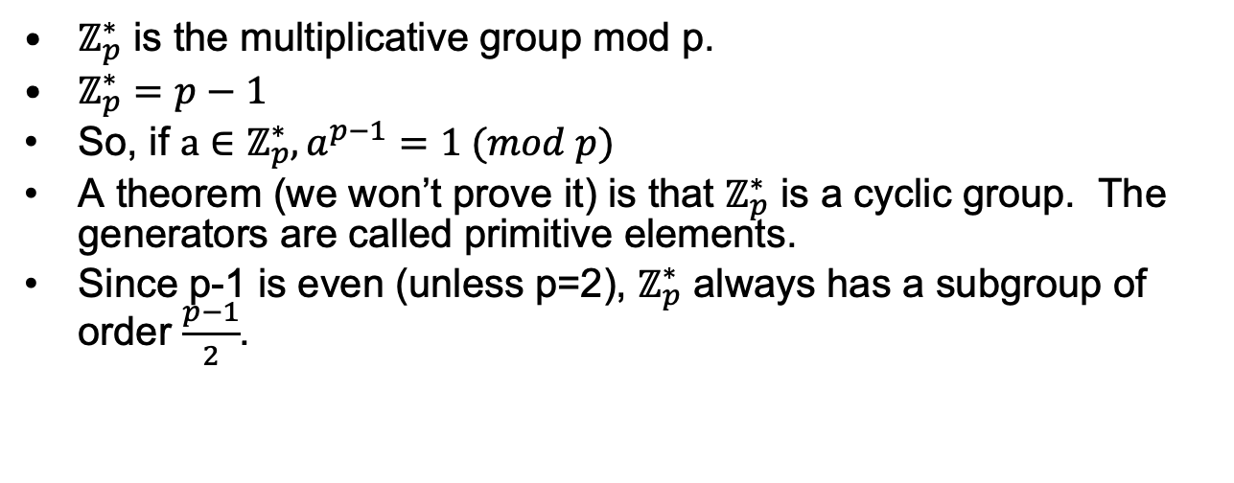
Multiplicative group mod p
$ℤ_{p}^{∗}$ is the multiplicative group mod p.
$ℤ_{p}^{∗}=p−1$
So, if $a∈ℤ_{p}^{∗}, a^{p−1}=1 (mod p)$
A theorem (we won’t prove it) is that $ℤ_{p}^{∗}$ is a cyclic group. The generators are called primitive elements.
Since p-1 is even (unless p=2), $ℤ_{p}^{∗}$ always has a subgroup of order $\frac{p−1}{2}$.

Slide 21
Primitive roots mod p
Wilson’s theorem: a^{p-1} =1 (mod p)
Proof: The size of the multiplicative group, Z_{p}*, is p-1. <a^{i}, i=1,….>=S is a subgroup of the multiplicative group. |S|= smallest t≧1: a^{t}=1. By Lagrange,
t=|S| | |Z_{p}*|=p-1 so a^{p-1} =1 (mod p).
Generators mod p are also called primitive roots primitive roots are “irreducible” solutions to x^{p-1}=0 =0
Example: p=11, 2 is a primitive root
i | 2^{i} (mod 11)
1 | 2
2 | 4
3 | 8
4 | 5 (=16)
5 | 10
i | 2^{i} (mod 11)
6 | 9 (=20)
7 | 7
8 | 3
8 | 6
10 | 1

Slide 22
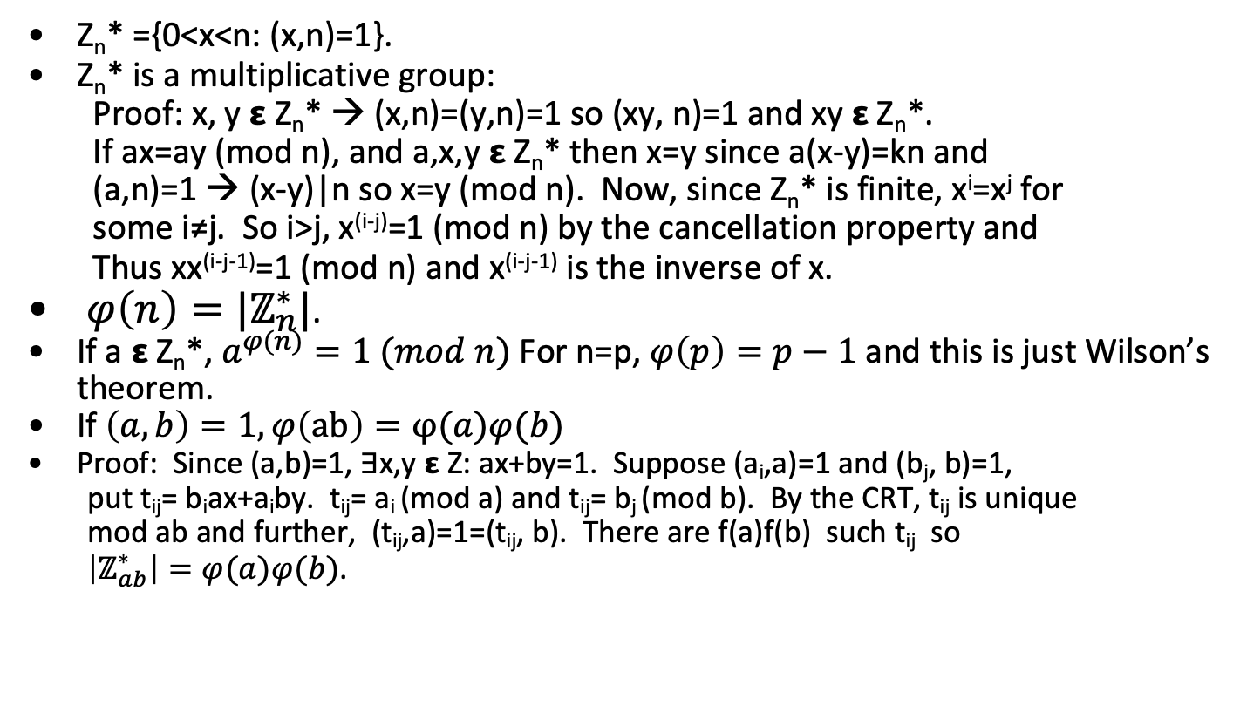

Composite moduli and $φ(n)$
Z_{n}* ={0<x<n: (x,n)=1}.
Z_{n}* is a multiplicative group:
Proof: x, y 𝝴 Z_{n}* → (x,n)=(y,n)=1 so (xy, n)=1 and xy 𝝴 Z_{n}*.
If ax=ay (mod n), and a,x,y 𝝴 Z_{n}* then x=y since a(x-y)=kn and
(a,n)=1 → (x-y)|n so x=y (mod n). Now, since Z_{n}* is finite, x^{i}=x^{j} for
some i≠j. So i>j, x^{(i-j)}=1 (mod n) by the cancellation property and
Thus xx^{(i-j-1)}=1 (mod n) and x^{(i-j-1)} is the inverse of x.
$φ\left(n\right)=|ℤ_{n}^{∗}|$.
If a 𝝴 Z_{n}*, $a^{φ(n)}=1 (mod n)$ For n=p, $φ\left(p\right)=p−1$ and this is just Wilson’s theorem.
If $\left(a,b\right)=1, φ\left(ab\right)=φ(a)φ(b)$
Proof: Since (a,b)=1, ∃x,y 𝝴 Z: ax+by=1. Suppose (a_{i},a)=1 and (b_{j}, b)=1,
put t_{ij}= b_{i}ax+a_{i}by. t_{ij}= a_{i} (mod a) and t_{ij}= b_{j} (mod b). By the CRT, t_{ij} is unique
mod ab and further, (t_{ij},a)=1=(t_{ij}, b). There are f(a)f(b) such t_{ij} so
$\left|ℤ_{ab}^{∗}\right|=φ(a)φ(b)$.

Slide 23
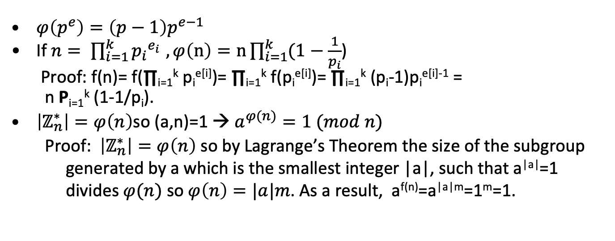
The Multiplicative Group (mod n)
$φ\left(p^{e}\right)=\left(p−1\right)p^{e−1}$
If $n= \prod_{i=1}^{k}{{p_{i}}^{e_{i }}}, φ\left(n\right)=n\prod_{i=1}^{k}{(1−\frac{1}{p_{i}}}$)
Proof: f(n)= f(∏_{i=1}^{k} p_{i}^{e[i]})= ∏_{i=1}^{k} f(p_{i}^{e[i]})= ∏_{i=1}^{k} (p_{i}-1)p_{i}^{e[i]-1} =
n P_{i=1}^{k} (1-1/p_{i}).
$\left|ℤ_{n}^{∗}\right|=φ\left(n\right)$so (a,n)=1 → $a^{φ(n)}=1 (mod n)$
Proof: $\left|ℤ_{n}^{∗}\right|=φ\left(n\right)$ so by Lagrange’s Theorem the size of the subgroup generated by a which is the smallest integer |a|, such that a^{|a|}=1 divides $φ(n)$ so $φ\left(n\right)=|a|m$. As a result, a^{f(n)}=a^{|a|m}=1^{m}=1.

Slide 24
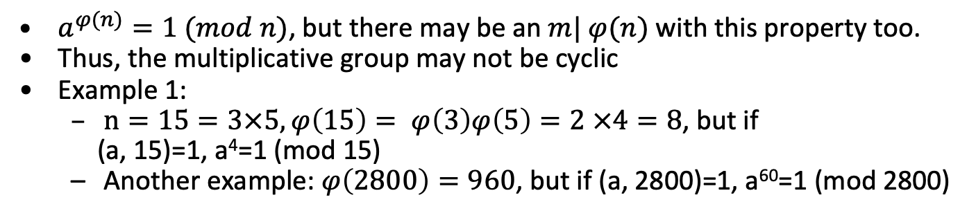
For n composite, multiplicative group need not be cyclic
$a^{φ(n)}=1 (mod n)$, but there may be an $m| φ(n)$ with this property too.
Thus, the multiplicative group may not be cyclic
Example 1:
$n=15=3×5,φ\left(15\right)= φ\left(3\right)φ\left(5\right)=2 ×4=8$, but if
(a, 15)=1, a⁴=1 (mod 15)
Another example: $φ\left(2800\right)=960$, but if (a, 2800)=1, a⁶⁰=1 (mod 2800)
a | a⁴ (mod 15)
2 | 1
4 | 1
7 | 1
8 | 1
a | a⁴ (mod 15)
11 | 1
13 | 1
14 | 1
1 | 1

Slide 25
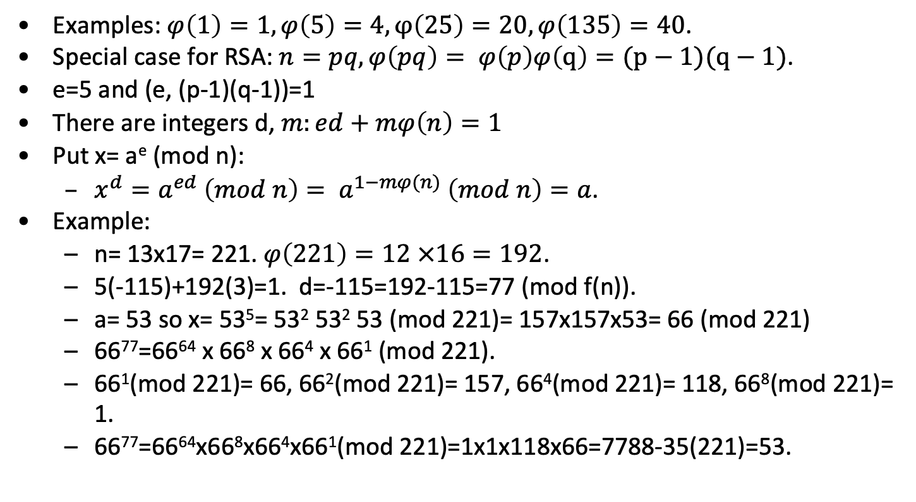

$$φ(n)$$
Examples: $φ\left(1\right)=1, φ\left(5\right)=4, φ\left(25\right)=20, φ\left(135\right)=40$.
Special case for RSA: $n=pq, φ\left(pq\right)= φ\left(p\right)φ\left(q\right)=(p−1)(q−1)$.
e=5 and (e, (p-1)(q-1))=1
There are integers d, $m:ed+mφ\left(n\right)=1$
Put x= a^{e} (mod n):
$x^{d}=a^{ed} \left(mod n\right)= a^{1−mφ(n)} \left(mod n\right)=a$.
Example:
n= 13x17= 221. $φ\left(221\right)=12 ×16=192$.
5(-115)+192(3)=1. d=-115=192-115=77 (mod f(n)).
a= 53 so x= 53⁵= 53² 53² 53 (mod 221)= 157x157x53= 66 (mod 221)
66⁷⁷=66⁶⁴ x 66⁸ x 66⁴ x 66¹ (mod 221).
66¹(mod 221)= 66, 66²(mod 221)= 157, 66⁴(mod 221)= 118, 66⁸(mod 221)= 1.
66⁷⁷=66⁶⁴x66⁸x66⁴x66¹(mod 221)=1x1x118x66=7788-35(221)=53.

Slide 26

Solving Congruences (mod n)
Solve ax=b (mod n)
Same as for n=p, except some equations will not have solutions.
Procedure: If (a,n) does not divide b, there is no solution if b>0 (mod n) and everything is a solution if b=0 (mod n). After dividing both sides by (a,n), This leaves us with $\left(a, \frac{n}{(a,n)}\right)=1$. We find u,v such that au+pn=1. (ub) is the solution.

Slide 27
Solving Congruence Example mod n
Solve 3x=2 (mod 55)
3(-18)+55(1)=1
3(-18)=3(55-18)=3(37)=1 (mod 55)
3(37x2)= 2 (mod 55)
So 74= 19 (mod 55) is a solution: 3x19=57=2 (mod 55)

Slide 28
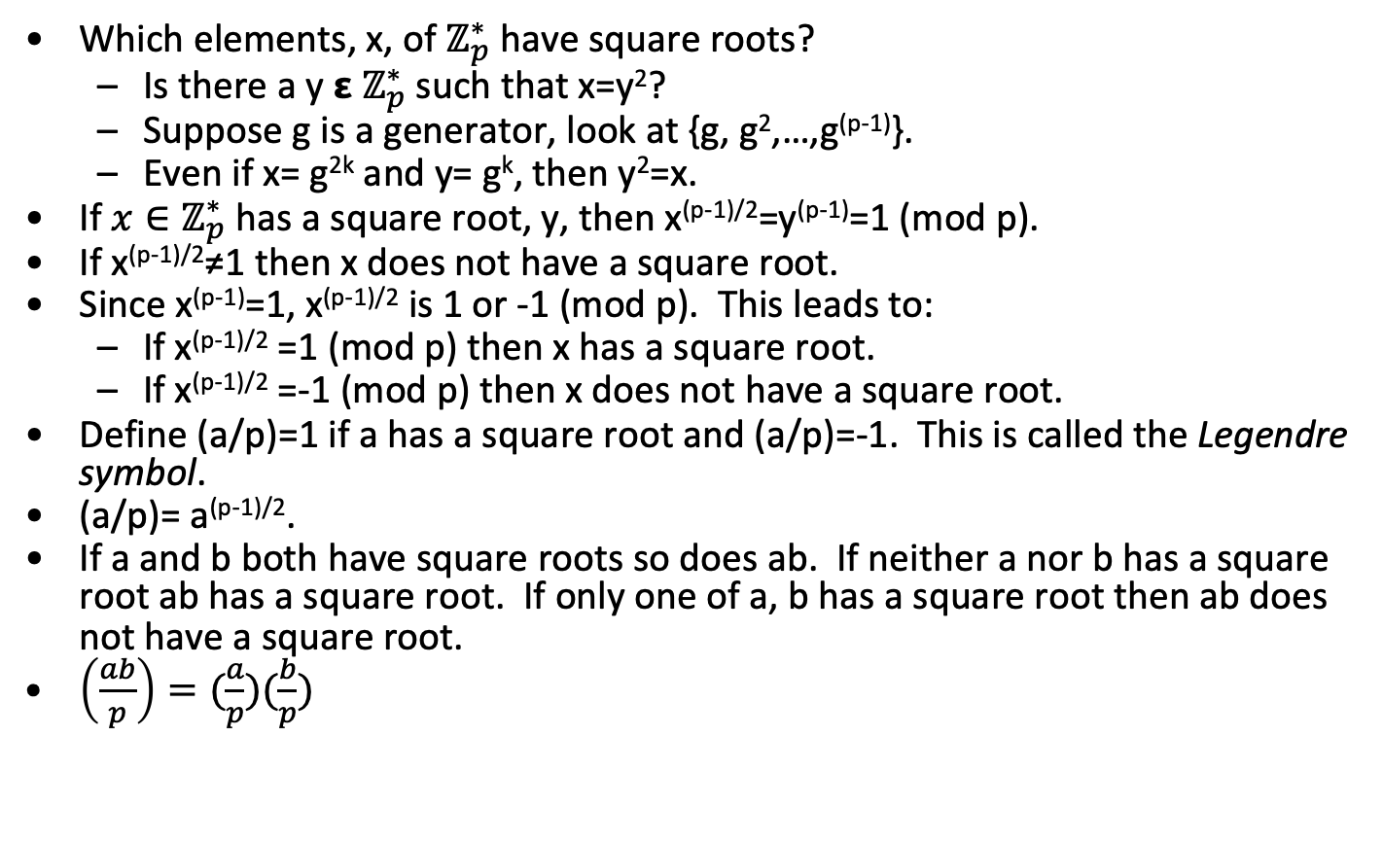
Quadratic Residues
Which elements, x, of $ℤ_{p}^{∗}$ have square roots?
Is there a y 𝝴 $ℤ_{p}^{∗}$ such that x=y²?
Suppose g is a generator, look at {g, g²,…,g^{(p-1)}}.
Even if x= g^{2k} and y= g^{k}, then y²=x.
If $x∈ℤ_{p}^{∗}$ has a square root, y, then x^{(p-1)/2}=y^{(p-1)}=1 (mod p).
If x^{(p-1)/2}≠1 then x does not have a square root.
Since x^{(p-1)}=1, x^{(p-1)/2} is 1 or -1 (mod p). This leads to:
If x^{(p-1)/2} =1 (mod p) then x has a square root.
If x^{(p-1)/2} =-1 (mod p) then x does not have a square root.
Define (a/p)=1 if a has a square root and (a/p)=-1. This is called the Legendre symbol.
(a/p)= a^{(p-1)/2}.
If a and b both have square roots so does ab. If neither a nor b has a square root ab has a square root. If only one of a, b has a square root then ab does not have a square root.
$\left(\frac{ab}{p}\right)=(\frac{a}{p})(\frac{b}{p})$

Slide 29
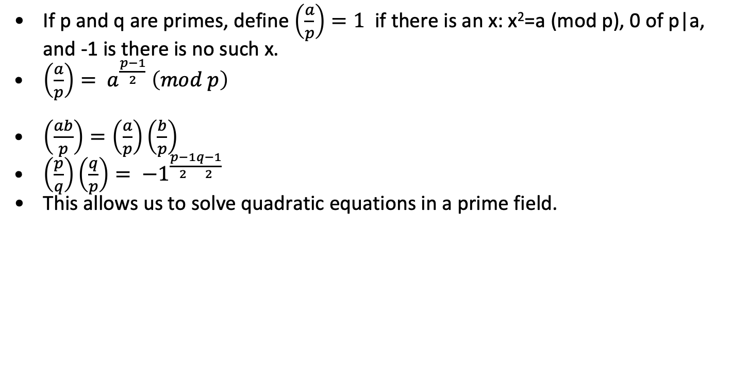
Law of Quadratic Reciprocity
If p and q are primes, define $\left(\frac{a}{p}\right)=1$ if there is an x: x²=a (mod p), 0 of p|a, and -1 is there is no such x.
$\left(\frac{a}{p}\right)= a^{\frac{p−1}{2}} \left(mod p\right)$
$\left(\frac{ab}{p}\right)=\left(\frac{a}{p}\right)\left(\frac{b}{p}\right)$
$\left(\frac{p}{q}\right)\left(\frac{q}{p}\right)= {−1}^{\frac{p−1}{2}\frac{q−1}{2}}$
This allows us to solve quadratic equations in a prime field.

Slide 30
Quadratic Reciprocity Example
 | 7 | 11 | 13 | 17 | 29 | 31
7 |  | -1 | -1 | -1 | 1 | 1
11 | 1 |  | -1 | -1 | -1 | -1
13 | -1 | -1 |  | 1 | 1 | -1
17 | -1 | -1 | 1 |  | -1 | -1
29 | 1 | -1 | 1 | -1 |  | -1
31 | -1 | 1 | -1 | -1 | -1
(7/11)(11/7)=(-1)^{5x3}=-1
(7/13)(13/7)=(-1)^{6x3}=1
(7/17)(17/7)=(-1)^{8x3}=1
(11/31)(31/11)=(-1)^{15x5}=-1
Entry in row i, column j is p[i]^{([j]-1)/2}

Slide 31
Large Integer Computation
Almost all public key algorithms are based on “hard” number theory problems over enormous (e.g.- 2048 bit) integers.
We need to know how to do arithmetic on computers with huge numbers
Addition/subtraction
Multiplication
Modulus
Modular inverses
Exponentiation
Testing Primality
Factoring

Slide 32
Algorithm Timings
Adding two m-bit numbers takes O(m) time.
Multiplying two m-bit numbers takes <O(m²).
Multiplying a 2m-bit number and reducing modulo and m-bit number takes O(m²).
Computing (a, b) for a, b< n takes O(ln²(n)) time (i.e.- fast). This is Euclid’s Algorithm and it started Knuth, Euclid and everyone else off on computational complexity. If n has m bits this is O(m²).
Testing a number n for primality takes O(n^{clg(lg(n))})=O(2^{cmlg(m)}).
Best known factoring: O(n^{c(lg(n)^(1/3)(lg(lg(n))^(2/3))})=O(2^{cm(m^(1/3)(lg(m)^(2/3))}). [a lot longer].

Slide 33
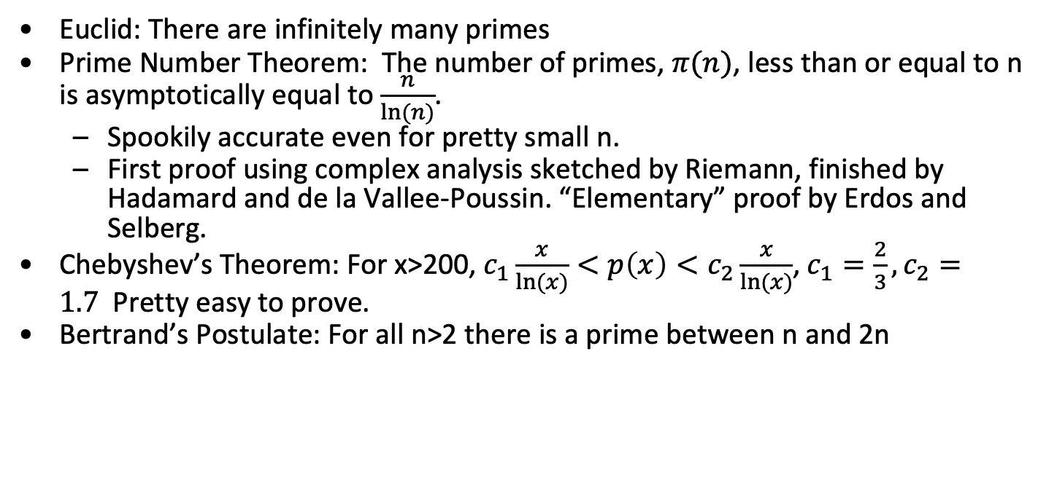
Primes are plentiful
Euclid: There are infinitely many primes
Prime Number Theorem: The number of primes, $π(n)$, less than or equal to n is asymptotically equal to $\frac{n}{ln⁡(n)}$.
Spookily accurate even for pretty small n.
First proof using complex analysis sketched by Riemann, finished by Hadamard and de la Vallee-Poussin. “Elementary” proof by Erdos and Selberg.
Chebyshev’s Theorem: For x>200, $c_{1}\frac{x}{ln⁡(x)}<p\left(x\right)<c_{2}\frac{x}{ln⁡(x)}$, $c_{1}=\frac{2}{3}, c_{2}=1.7$Pretty easy to prove.
Bertrand’s Postulate: For all n>2 there is a prime between n and 2n

Slide 34
Prime Distribution Example
n | p(n) | n/ln(n) | p(n)/(n/ln(n))
10 | 4 | 4.34 | .9217
50 | 14 | 12.78 | 1.10
100 | 25 | 21.71 | 1.15
500 | 95 | 80.46 | 1.17
1000 | 168 | 144.76 | 1.16
10⁶ | 78498 | 72382 | 1.08
10⁹ | 50847478 | 48254949 | 1.05

Slide 35
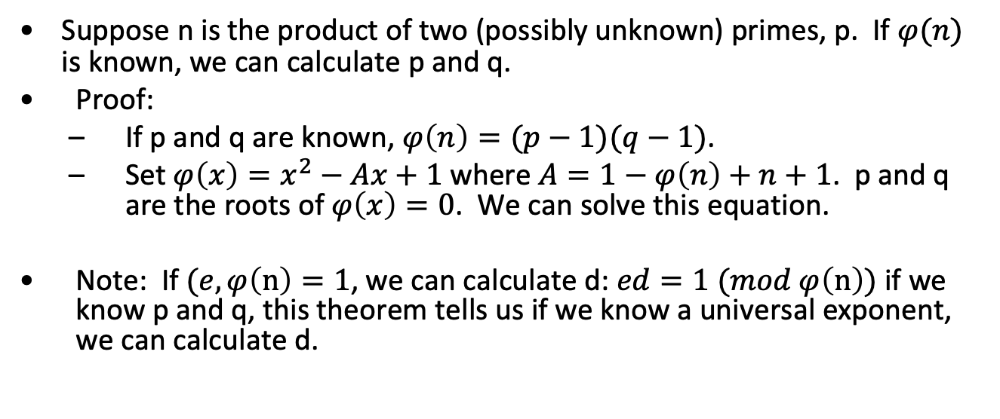
Factoring and exponents
Suppose n is the product of two (possibly unknown) primes, p. If $φ(n)$ is known, we can calculate p and q.
Proof:
If p and q are known, $φ\left(n\right)=(p−1)(q−1)$.
Set $φ\left(x\right)=x^{2}−Ax+1$where $A=1−φ\left(n\right)+n+1$. p and q are the roots of$φ\left(x\right)=0$. We can solve this equation.
Note: If $(e, φ\left(n\right)=1$, we can calculate d: $ed=1 (mod φ\left(n\right))$ if we know p and q, this theorem tells us if we know a universal exponent, we can calculate d.

Slide 36
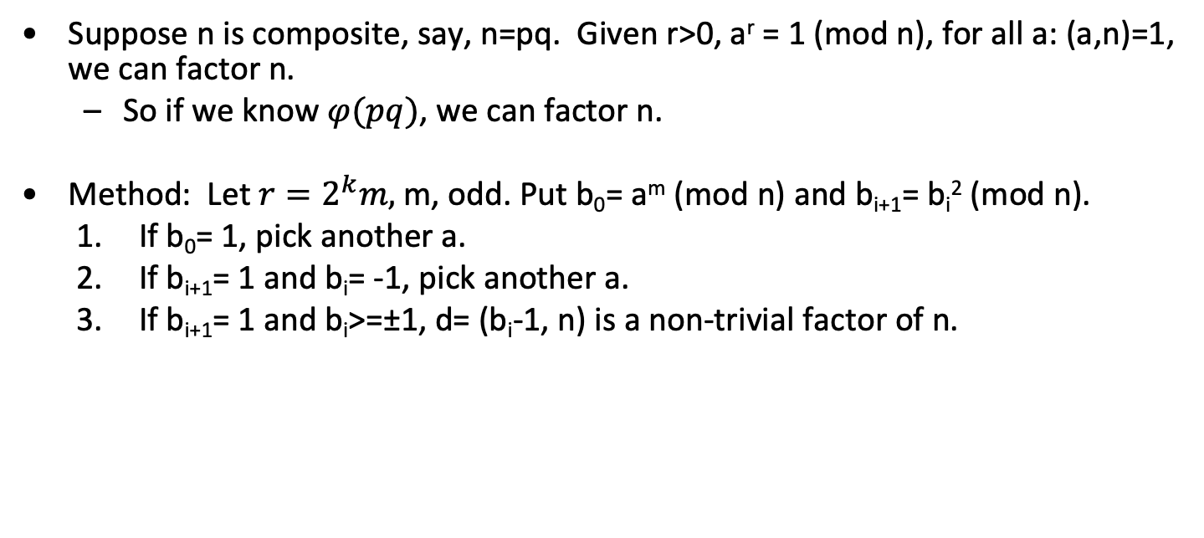
Universal Exponent Theorem
Suppose n is composite, say, n=pq. Given r>0, a^{r} = 1 (mod n), for all a: (a,n)=1, we can factor n.
So if we know $φ(pq)$, we can factor n.
Method: Let $r=2^{k}m,$ m, odd. Put b₀= a^{m} (mod n) and b_{i+1}= b_{i}² (mod n).
If b₀= 1, pick another a.
If b_{i+1}= 1 and b_{i}= -1, pick another a.
If b_{i+1}= 1 and b_{i}>=±1, d= (b_{i}-1, n) is a non-trivial factor of n.

Slide 37
Universal Exponent Example
Let n= 1517. Note that a¹⁴⁴⁰=1 (mod n).
1440= 2⁵(45), m= 45.
b₀= 2⁴⁵=401 (mod 1517)
b₁= 401² =1(mod 1517). Try again.
b₀= 3⁴⁵=776 (mod 1517)
b₁= 776²=1444 (mod 1517)
b₂= 1444² =778(mod 1517).
b₃= 778² =1(mod 1517).
(778-1, 1517)= (777, 1517)=37.

Slide 38
Representing Large Integers
Numbers are represented in base 2^{ws} where ws is the number of bits in the “standard” unsigned integer (e.g. – 32 on IA32, 64 on x64)
Each number has three components:
Sign
Size in 2^{ws} words
2^{ws} words where n= i[ws-1]2^{ws(size-1)} + …+ i[1]2^{ws} + i[0]
Assembly is often used in inner loops to take advantage of special arithmetic instructions like “add with carry”

Slide 39
Classical Algorithms Speed
For two numbers of size s₁ and s₂ (in bits)
Addition/Subtraction: O(s₁)+O(s₂) time and max(s₁, s₂)+1 space
Multiplication/Squaring: O(s₁) x O(s₂) time and space (you can save roughly half the multiplies on squaring)
Division: O(s₁) x O(s₂) time and space
Uses heuristic for estimating iterative single digit divisor: less than 1 high after normalization
Extended GCD: O(s₁) x O(s₂)
Modular versions use same time (plus time for one division by modulus) but smaller space
Modular Exponentiation (a^{e} (mod n)): O((size e)(size n)²) using repeated squaring
Solve simultaneous linear congruence's (using CRT): O(m²) x time to solve 1 where m= number of prime power factors of n

Slide 40
Karasuba Multiplication
(a2^{k}+b) (c2^{k}+d)= ac2^{2k}+(ad+bc)2^{k}+bd
4 multiplies
Asymptotically n²
To save 1 multiply compute
t= (a+b)(c+d)= ac+ad+bc+bd
ac
bd
t-ac-bd= ad+bc
3 multiplies, 2 adds
Asymptotically n^{lg(3)}, lg(3) is about 1.58

Slide 41
Integer Squaring
Reduced number of multiplies because of symmetry
a= 2^{n}a₁+a₀, b= 2^{n}b₁+b₀
ab= 2^{2n}a₁ b₁ + 2^{n}(a₁ b₀+b₁ a₀)+b₀a₀
4 multiplies
a²= 2^{2n}a₁²+2^{n+1}a₁a₀+a₀²
3 multiplies
Cost: If a is t words long, a² takes (t+1)t/2 single precision multiplies

Slide 42
Integer Division Algorithm
x= (x_{n} x_{n-1} … x₀)_{b}, y= (y_{n} y_{n-1} … y₀)_{b}
x/y=q= (q_{n-t} q_{n-1} … q₀)_{b}, x mod y= r = (r_{n} r_{n-1} … r₀)_{b}
Key Step: Estimate Quotient
If y_{t} s [b/2], the estimate
q_{i-t-1}= (x_{i}b+x_{i-1})/y_{t} is at most 2 greater than the correct value
If q_{i-t-1}= (x_{i}b²+x_{i-1}b+x_{i-2})/(y_{t}b+y_{t-1}) is at most 1 greater than the correct value

Slide 43
Integer Division
Normalize: while(x>=yb^{n-t}) q_{n-t}++; x-= yb^{n-t};
For(i=n, downto t+1)
2.1 if(x_{i}=y_{t}) q_{i-t-1}= b-1
else q_{i-t-1}= [x_{i}b+x_{i-1}/y_{t}]
2.2 while(q_{i-t-1}(y_{t}b+y_{t-1})>(x_{i}b²+x_{i-1}b+x_{i-2})) q_{i-t-1}--
2.3 x-= q_{i-t-1} yb^{i-t-1}
2.4 if (x>0) x+= yb^{i-t-1}; q_{i-t-1}++;
r= x
return(q,r)
Cost: (n-t)(t+3) multiplies, (n-t) divisions.

Slide 44
Extended Binary GCD
Input: x= (x_{n} x_{n-1} … x₀)_{b}, y= (y_{n} y_{n-1} … y₀)_{b}. Output: a, b, v: ax+by=v= gcd(x,y).
g=1
while(x&1==y&1==0) x/= 2, y/= 2, g*=2
u=x, v=y, A=1, B=0, C=0, D=1
while (u&1==0)
u/= 2
if(A=B=0 (mod 2)) A/=2, B/=2
else A= (A+y)/2, B= (B-x)/2
5. while (v&1==0)
v/= 2
if(C=D=0 (mod 2)) C/=2, D/=2
else C= (C+y)/2, D= (D-x)/2
if(u>=v) u-=v, A-=C, B-=D
else v-= u, C-=A, D-=B
7. if (u==0) a= C, b= D, return(a,b,gv)
else goto 4
Cost: 2 ([lg(x)]+[lg(y)]+2) iterations

Slide 45
Montgomery Multiplication
Motivation: Modular reduction is expensive (a divide operation). Can we replace the divide with some cheap operation (like shifting?)
Let A, B, and M be n-block integers represented in base x with 0≤M<x ^{n}.
Let R= x ^{n}. gcd(R,M)= 1.
The Montgomery Product of A and B modulo M is the integer ABR^{–1} mod M.
Let M′= –M^{–1} mod R and S= ABM′ mod R.
Fact: (AB+SM)/R≡ ABR^{–1} (mod M).

Slide 46
Montgomery Multiplication and Timing
(r, n)= 1, r= ab (mod n), a#=ar (mod n), rr’-nn’=1, all t words long.
MontPro(a#, b#)
t= a# b# ,m= rn’ (mod n), u= (mn+t)/r
if(n>u) u-= n;
return(u)
MontMult(a,b,n)
Compute n’, a#, b#
x#= MontPro(a#, b#)
return(MontPro(x#,1))
Cost: Reduction takes 2t(t+1) multiplies, no divisions.
Multiply takes 4t(t+1) vs 2t(t+1) for classical.

Slide 47
Exponentiation and Timing
Right to left squaring and multiplication
Left to right squaring and multiplication
Left to right k-ary
Square and multiply exponentiation (SME) timing, if bitlen(e)=t+1 and wt(e) is the Hamming weight, SME takes t squarings and wt(e) multiplies.

Slide 48
Montgomery Exponentiation and Timing
x= (x_{l} x_{l-1} … x₀)_{b}, e= (e_{t} e_{t-1} … e₀)_{b}, m = (m_{l-1} m_{l-2} … m₀)_{b},
R= b^{l}, m’= -m⁻¹ (mod b)
MontExp(x,e,m)
x#= MontMult(x, R², m), A= R (mod m)
for(i= t downto 0)
2.1 A= MontMult(A,A)
2.2 if (e_{i}==1) A= MontMult(A, x#)
return(MontMult(A,1))
Cost: Total: 3l(l+1)(t+1). [For Classical: 2l(l+1) plus l divisions.]
Step | 1 | 2 | 3
# MontMult | 1 | 3/2 t | 1
# SP Mult | 2l(l+1) | 3tl(l+1) | l(l+1)

Slide 49
Montgomery Example
Suppose N = 79, a = 61 and b = 5
R = 10² = 100. RR’-NN’=1, R’=64, N’=81.
a′ = 61⋅100 = 17 (mod 79)
b′ = 5⋅100 = 26 (mod 79)
abR (mod 79)= 61x5x100 (mod 79)= 6
X= a’b’=442= abR² (mod N)
m= (X(mod R))(N’ (mod R))= 42x81 =2 (mod R)
x= (X+mN)/R= (442+2x79)/100 = 6

Slide 50
Primality testing may be easy
Fermat test: If a^{(n-1)} ≠1 (mod n) for any a<n, n is not prime.
Testprime(n, k)
// check to see that no small primes p≤B divide n.
for(i=1; i≤k; i++) {
pick a<n randomly
compute a^{n-1} (mod n).
If a^{(n-1)}(mod n)≠1 then return “n is not prime”
}
return “n is prime”
Intuition: If Testprime(n, 20) returns “n is not prime”, it isn’t, otherwise n is prime with an error of 1 in 10⁶.
Unfortunately, some composite numbers, n, have the property that
all a: 0<a<n will pass Fermat test. These are called Carmichael numbers. n=561= 3x11x17 is a Carmichael number.
There are better tests, however!

Slide 51
Witnesses and liars
b^{n-1}=1 (mod n), we say b is a “witness” to n’s primality.
If b^{n-1}¹1 (mod n) b is said to be a “witness” to n’s compositeness.
b is a liar iff b^{(n-1)}=1 (mod n) and n is not prime.
2 is a liar for 341, 561, 645.
Theorem: There are infinitely many numbers for which 2 is a liar
Proof: d|n → 2^{d}-1|2^{n}-1. Suppose n is a 2-pseudo-prime, so is
m=2^{n}-1: m is obviously composite. Since n is a 2 pseudo-prime
n|k=2^{n}-2 so 2^{n}-1|2^{k}-1.
n is a Carmichael number if n is composite and every 1<b<n is a liar. 561 is a Carmichael number.
Alford, Granville, Pomerance: There are infinitely many Carmichael numbers. Bummer.

Slide 52
Some facts about Carmichael numbers
Theorem: n is an odd composite Carmichael number iff it is square-free and for every prime p|n, (p-1)|(n-1).
Proof: If n is a Carmichael number, a^{p-1}= 1 (mod n) so p-1|n-1. If p²|n then
p(p-1)|f(n) and there is an a: (a,n)=1 whose order is p. Hence p|n-1 which is
impossible.
Theorem: If n is an odd composite Carmichael number, n is divisible by at least 3 distinct primes.
Proof: Suppose the theorem is false. If n is prime, it is not a Carmichael
number so n=pq, p≠q. (p-1)|(pq-1) and (q-1)|(pq-1), thus
(p-1)≧(pq-1)/2 and (q-1)≧(pq-1)/2 so p≧(pq+1)/2 and q≧(pq+1)/2. Hence
4pq≧(pq+1)²= (pq)²+2pq+1 and 0≧(pq)²-2pq+1=(p-1)(q-1), which is
Impossible.

Slide 53
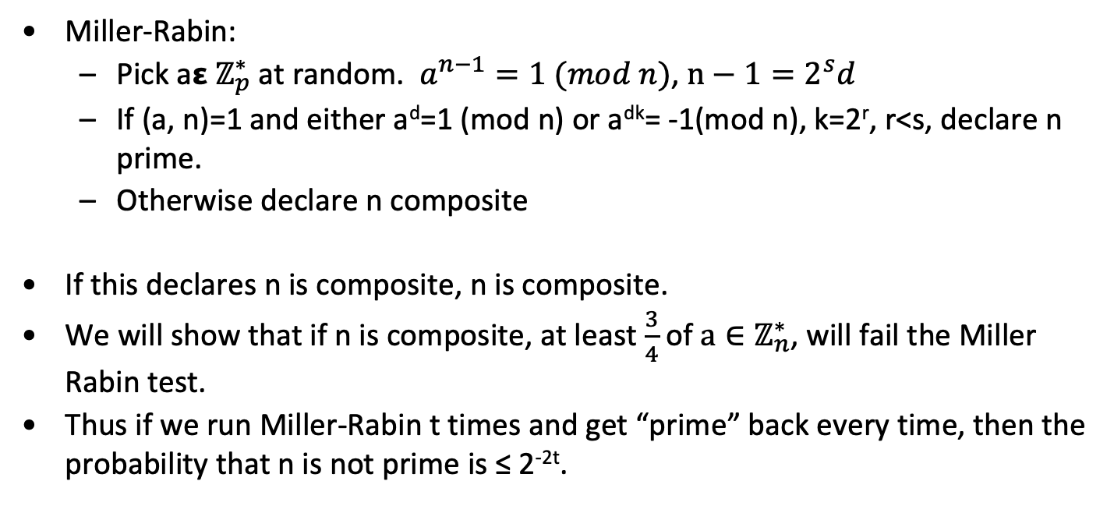
Miller Rabin Test
Miller-Rabin:
Pick a𝝴 $ℤ_{p}^{∗}$at random. $a^{n−1}=1 (mod n)$, $n−1=2^{s}d$
If (a, n)=1 and either a^{d}=1 (mod n) or a^{dk}= -1(mod n), k=2^{r}, r<s, declare n prime.
Otherwise declare n composite
If this declares n is composite, n is composite.
We will show that if n is composite, at least $\frac{3}{4}$of $a∈ℤ_{n}^{∗}$, will fail the Miller Rabin test.
Thus if we run Miller-Rabin t times and get “prime” back every time, then the probability that n is not prime is ≤ 2^{-2t}.

Slide 54
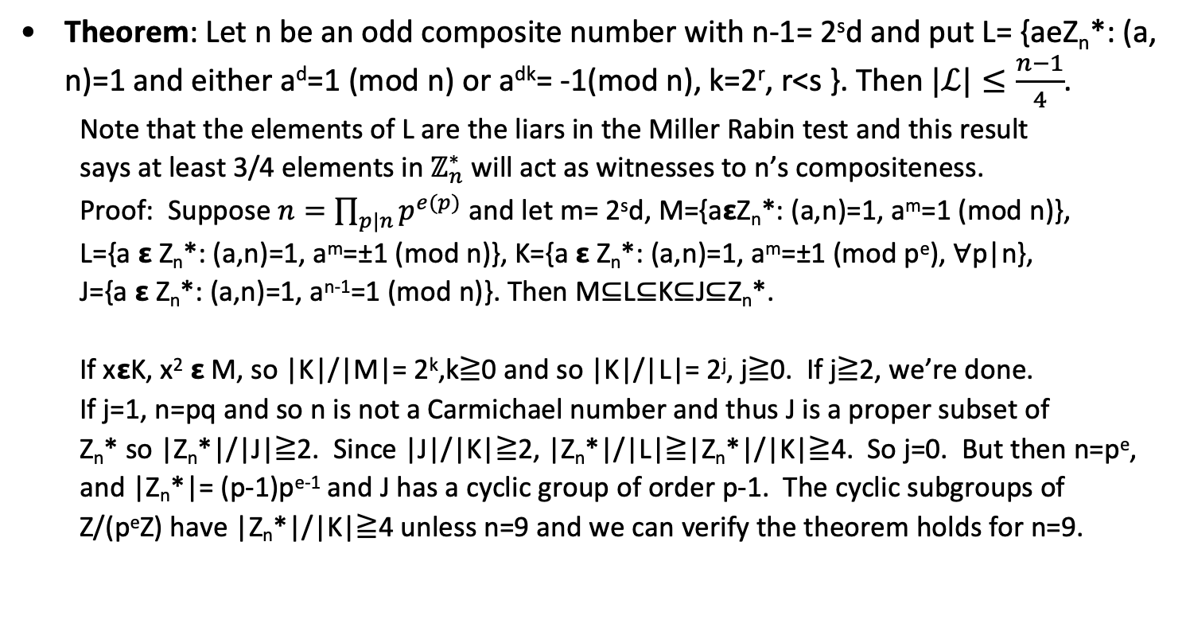
Miller Rabin Test is sufficient
Theorem: Let n be an odd composite number with n-1= 2^{s}d and put L= {aeZ_{n}*: (a, n)=1 and either a^{d}=1 (mod n) or a^{dk}= -1(mod n), k=2^{r}, r<s }. Then $|ℒ|≤\frac{n−1}{4}$.
Note that the elements of L are the liars in the Miller Rabin test and this result
says at least 3/4 elements in $ℤ_{n}^{∗}$ will act as witnesses to n’s compositeness.
Proof: Suppose $n=\prod_{p|n}{p^{e(p)}}$ and let m= 2^{s}d, M={a𝝴Z_{n}*: (a,n)=1, a^{m}=1 (mod n)},
L={a 𝝴 Z_{n}*: (a,n)=1, a^{m}=±1 (mod n)}, K={a 𝝴 Z_{n}*: (a,n)=1, a^{m}=±1 (mod p^{e}), ∀p|n},
J={a 𝝴 Z_{n}*: (a,n)=1, a^{n-1}=1 (mod n)}. Then M⊆L⊆K⊆J⊆Z_{n}*.
If x𝝴K, x² 𝝴 M, so |K|/|M|= 2^{k},k≧0 and so |K|/|L|= 2^{j}, j≧0. If j≧2, we’re done.
If j=1, n=pq and so n is not a Carmichael number and thus J is a proper subset of
Z_{n}* so |Z_{n}*|/|J|≧2. Since |J|/|K|≧2, |Z_{n}*|/|L|≧|Z_{n}*|/|K|≧4. So j=0. But then n=p^{e},
and |Z_{n}*|= (p-1)p^{e-1} and J has a cyclic group of order p-1. The cyclic subgroups of
Z/(p^{e}Z) have |Z_{n}*|/|K|≧4 unless n=9 and we can verify the theorem holds for n=9.

Slide 55
Summary for prime testing
Deterministic test
n is prime if m does not divide n for all m<√n.
Deterministic tests too slow
Randomized tests
Fermat test doesn’t work for Carmichael composite
Solovay-Strassen
Miller-Rabin works fine
If the extended Riemann Hypothesis is true, the Miller-Rabin test is dispositive as to the primality of n if we try all bases up to 2(ln(n))².

Slide 56
Testing Primality - Miller Rabin
MR(n, .25, t), n>3, n, odd. Set n-1= 2^{s}r, r, odd. (t>3, in practice)
Takes ~ O(lg(n)³).
for(i=1; i<=t) {
Choose a, 1<a<n-1. 2 is a good choice first time.
Compute y=a^{r} (mod n)
If y>=1 and y>=n-1) {
j=1
while(j <= (s-1), y>=n-1)
y= y² (mod n)
if (y=1)
return(“no”)
j= j+1
}
if(y>=n-1)
return(“no”)
return(“yes”)
}

Slide 57
Primality Testing Example
From Trappe and Washington. n=561.
n-1=560=2⁴x5x7. Pick a=2.
b₀= 2³⁵= 263 (mod n)
b₁= b₀²= 166 (mod n)
b₂= b₁²= 67 (mod n)
b₃= b₂²= 1 (mod n)
561 is composite. In fact, (b₂-1, 561)=33.

Slide 58
RSA Public-Key Cryptosystem
Alice (Private Keyholder)
Select two large random primes p and q.
Publish the product n=pq.
Use knowledge of p and q to compute Y.
Anyone (Public Key Holder)
To send message Y to Alice, compute Z=Y^{X} mod n.
Send Z and X to Alice.
Rivest, Shamir and Adleman, “On Digital Signatures and Public Key Cryptosystems.” CACM, 2/78.

Slide 59
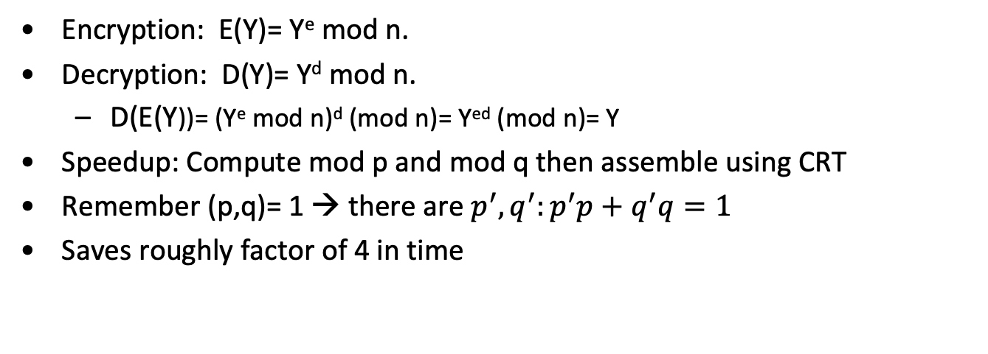
RSA Details
Encryption: E(Y)= Y^{e} mod n.
Decryption: D(Y)= Y^{d} mod n.
D(E(Y))= (Y^{e} mod n)^{d} (mod n)= Y^{ed} (mod n)= Y
Speedup: Compute mod p and mod q then assemble using CRT
Remember (p,q)= 1 → there are $p^{′}, q^{′}:p^{′}p+q^{′}q=1$
Saves roughly factor of 4 in time

Slide 60
RSA Example
p=691, q=797, n=pq=550727. f(n)= 690 x 796= 2³x3x5x23x199.
Need (e, f(n))=1, pick e=7.
1= 7 x 78463 + (-1)f(n), so d= 78463.
78463= 2¹⁶+ 2¹³+ 2¹²+ 2⁹+ 2⁶+ 2⁵+ 2⁴+ 2³+ 2²+ 2¹+ 2⁰ = 65536+8192+4096+512+64+32+16+8+4+2+1. Use this in the successive squaring calculation.
Public Key: <n=550727, e=7>
Private Key: <p=691, q=797, d=78463>.
Encrypt 10. 10⁷ (mod n)= 86914.
Decrypt: (86914)⁷⁸⁴⁶³ (mod n)=10.
Successive squares: 86914, 271864, 268188, 407871, 97024, 79965, 460755, 375388,444736, 362735, 289747, 500129, 378508,532103, 446093, 371923, 66612.

Slide 61
RSA Signatures
An additional property
D(E(Y))= Y^{ed} mod n= Y
E(D(Y))= Y^{de} mod n= Y
Only Alice (knowing the factorization of n) knows D. Hence only Alice can compute D(Y)= Y^{d} mod n.
This D(Y) serves as Alice’s signature on Y.

Slide 62
Old days: p and q should be “strong primes”
p is a “strong prime” if
p-1 has a large prime factor, r.
p+1 has a large prime factor, s.
r-1 has a large prime factor, t.
Other criteria (X9.31)
If e is odd (e,p-1) =1=(e, q-1)
(p-1, q-1) should be “small”
p/q should not be near the ratio of two small integers
p-q has a large prime factor
Add Frobenius test
Add a Lucas test
Doesn’t matter: ECM does just as well on strong primes.

Slide 63
Gordan’s Algorithm
Gordan’s algorithm
Generate 2 primes, s,t of roughly same length.
Pick i₀. Find first prime in sequence, (2it+1), i=i₀, i₀+1,…; denote this prime as r= (2it+1).
Compute, p₀= 2(s^{(r-2)} (mod r))s-1.
Select j₀. Find first prime in sequence, (p₀+2jrs), j=j₀,j₀+1,…; denote this prime as p= (p₀+2jrs).
return(p)

Slide 64
Attacks
Elementary
Common Modulus: K₁= (e₁, d₁, pq), K₂= (e₂,d₂,pq)
Low Public Exponent
Wiener: Let N=pq, q<p<2q, d<1/3n^{1/4}, given <N,e> and ed=1 (mod f(n)), we can find d efficiently.
Uses continued fractions
Coppersmith’s Theorem: Let N be an integer and f a monic polynomial over Z, X=N^{1/d-e} for some e≠0. Given <N, f>, we can efficiently find all integers |x₀|<X satisfying f(x₀)= 0 (mod N). Running time is dominated by LLL on lattice with dimension O(min(1/𝜖, lg(N)).

Slide 65
Attacks, continued
Related Messages and low exponents
Coppersmith’s theorem can be used to strengthen Franklin-Reiter Related Message attack if e=3 and pad is <1/9 message length.
Timing/Glitching
Bleichenbacher’s Attack on PKCS 1
Factoring
Pollard rho
p-1
Quadratic Sieve
Number Field Sieve
Reference: Boneh, Twenty years of attacks on RSA. Notices AMS.

Slide 66
Common Modulus Attack
(e₁, e₂)=1.
c₁= m^{e1} (mod n)
c₂= m^{e2} (mod n)
d₁e₁+d₂e₂ = 1
(c₁)^{d1} (c₂)^{d2} = m, oops!

Slide 67
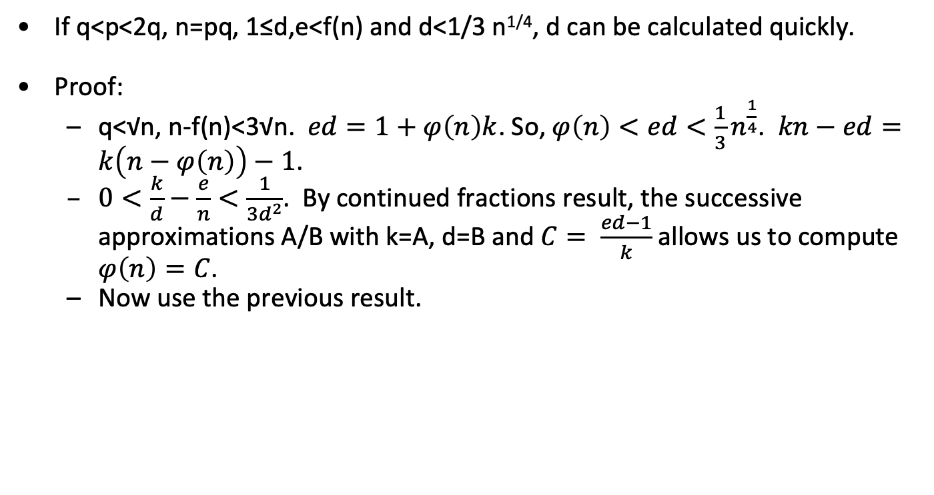
Small exponent attack on RSA
If q<p<2q, n=pq, 1≤d,e<f(n) and d<1/3 n^{1/4}, d can be calculated quickly.
Proof:
q<√n, n-f(n)<3√n. $ed=1+φ\left(n\right)k$. So, $φ\left(n\right)<ed<\frac{1}{3}n^{\frac{1}{4}}$. $kn−ed=k\left(n−φ\left(n\right)\right)−1$.
$0<\frac{k}{d}−\frac{e}{n}<\frac{1}{3d^{2}}$. By continued fractions result, the successive approximations A/B with k=A, d=B and $C= \frac{ed−1}{k}$allows us to compute $φ\left(n\right)=C$.
Now use the previous result.

Slide 68
Short plaintext
c= m^{e} (mod n), m, unknown (but small).
Make two lists: cx^{-e} (mod n) and y^{e} with x,y “small.”
When they match:
cx^{-e} = y^{e} (mod n) and c= (xy)^{e} (mod n).

Slide 69
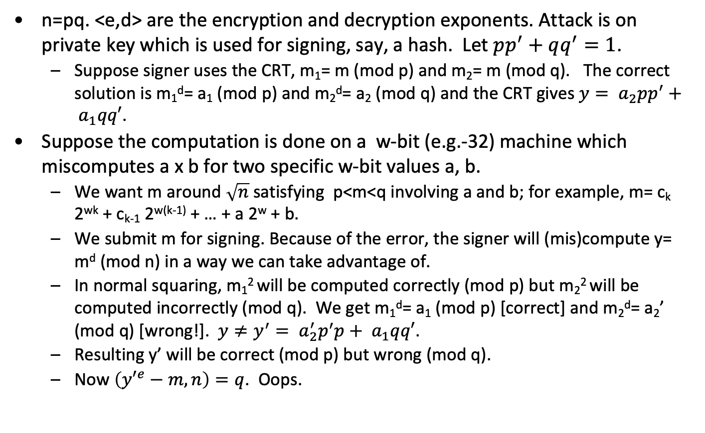
Glitching Attack
n=pq. <e,d> are the encryption and decryption exponents. Attack is on private key which is used for signing, say, a hash. Let $pp^{′}+qq^{′}=1$.
Suppose signer uses the CRT, m₁= m (mod p) and m₂= m (mod q). The correct solution is m₁^{d}= a₁ (mod p) and m₂^{d}= a₂ (mod q) and the CRT gives $y= a_{2}pp^{′}+ a_{1}qq′$.
Suppose the computation is done on a w-bit (e.g.-32) machine which miscomputes a x b for two specific w-bit values a, b.
We want m around $\sqrt{n}$satisfying p<m<q involving a and b; for example, m= c_{k} 2^{wk} + c_{k-1} 2^{w(k-1)} + … + a 2^{w} + b.
We submit m for signing. Because of the error, the signer will (mis)compute y= m^{d} (mod n) in a way we can take advantage of.
In normal squaring, m₁² will be computed correctly (mod p) but m₂² will be computed incorrectly (mod q). We get m₁^{d}= a₁ (mod p) [correct] and m₂^{d}= a₂’ (mod q) [wrong!]. $y≠y^{′}= a_{2}^{′}p^{′}p+ a_{1}qq′$.
Resulting y’ will be correct (mod p) but wrong (mod q).
Now $\left({y′}^{e}−m, n\right)=q$. Oops.

Slide 70
Glitching Attack Example
p=37, q=41. n=pq=1517. f(n) = 36 x 40 = 2⁵ x 3² x 5 = 1440.
Note as before that 10(37)+(-1)41=1.c= Ö1517 ~ 38. We pick m= 39.
Now imagine an RSA scheme with e=7 and the foregoing parameters.
3 (1440) +(-617) 7=1, so d= -617=823 (mod 1440).
m₁= m (mod 37)=2, m₂= m (mod 41)= 39.
d₁= d (mod 36)= 31, d₂= d (mod 40)= 23.
2³¹=22 (mod 37), 39²³= 33 (mod 41).
By the CRT, y=m^{d} (mod n)= (10)(37)(33)+(-9)(41)22= 1058. We confirm 1058⁷= 39 (mod n).
Now suppose w=3, 39= 4 x 8 + 7 and suppose the error in the computer is that it thinks 4 x 7 = 26.
Computing m₂² (mod 41) we get 13 instead of the correct answer, 4.
Using the usual exponentiation procedure, we would compute 39²³ (mod 41) =12 (wrong!) and y’= (10)(37)(12)+(-9)(41)22 =873. 873⁷ (mod n)=1334.
(1334-39,1517)= (1295, 1517)=37. Bingo!

Slide 71
Repeated Squaring
// Compute y = x^{d} (mod N)
// where, in binary, d = (d₀,d₁,d₂,…,d_{n}) with d₀ = 1
s = x
for i = 1 to n
s = s² (mod N)
if d_{i} == 1 then
s = s⋅x (mod N)
end if
next i
return s

Slide 72
Timing Attack (Kocher)
Attack on repeated squaring
Does not work if CRT or Montgomery used
In most applications, CRT and Montgomery multiplication are used
This attack originally designed for smartcards
Can be generalized (differential power analysis)
Recover private key bits one (or a few) at a time
Private key: d = d₀, d₁,…, d_{n} with d₀ = 1
Recover bits in order, d₁, d₂, d₃,…

Slide 73
Kocher’s Attack
Suppose bits d₀, d₁,…, d_{k−1}, are known
We want to determine bit d_{k}
Randomly select C_{j} for j=0,1,…,m-1, obtain timings T(C_{j}) for C_{j}^{d} (mod N)
For each C_{j} emulate steps i=1,2,…,k-1 of repeated squaring
At step k, emulate d_{k}= 0 and d_{k}= 1
Variance of timing difference will be smaller for correct choice of d_{k}
Example from Mark Stamp

Slide 74
Preventing Timing Attack
RSA Blinding
To decrypt C, generate random r
Y = r^{e}C (mod N)
Decrypt Y then multiply by r⁻¹ (mod N):
r⁻¹Yd = r⁻¹(r^{e}C)^{d} = r⁻¹rC^{d} = C^{d} (mod N)
Since r is random, timing information is hidden

Slide 75
Factoring
Security of RSA algorithm depends on (presumed) difficulty of factoring
Given n = pq, find p or q and RSA is broken
Factoring like “exhaustive search” for RSA
What are best factoring methods?
How does RSA “key size” compare to symmetric cipher key size?

Slide 76

Trial Division
Given n, trial divide n by 2, 3, 4, 5, 6, 7,…, ⎣√(n)⎦
Expected work is about $\frac{\sqrt{π}}{2}$
Trying only prime numbers reduces search
π(n) ≈ n/ln(n) is number of primes up to n.

Slide 77
Fast generic factoring algorithms
Pollard p-1
Elliptic curve factoring
Pollard r
Quadratic sieve
Number field sieve
Last three exploit basic idea of finding x, y with
x²=y² (mod n) using methods that make it likely
that (x-y) and (x+y) “split” the factors of n.

Slide 78
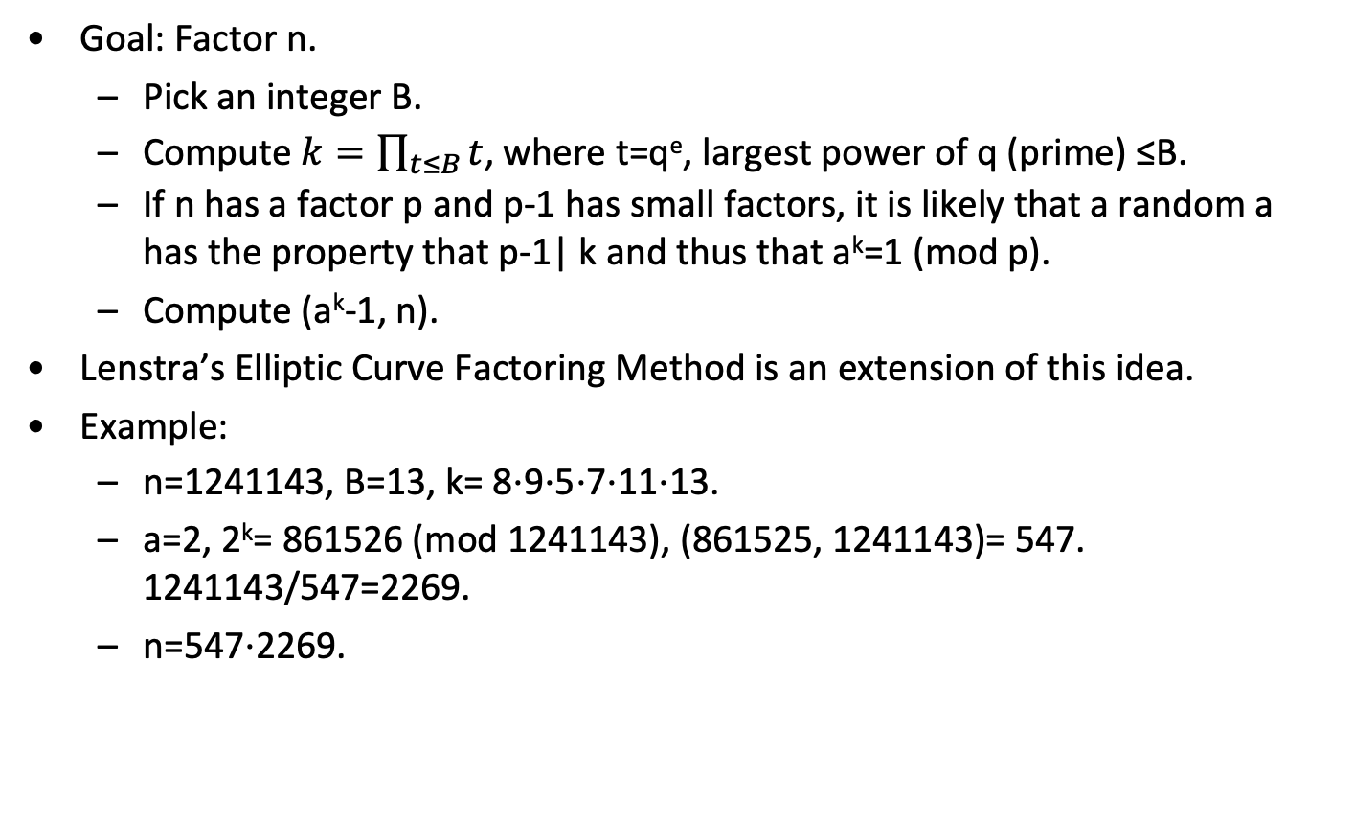
Pollard p-1
Goal: Factor n.
Pick an integer B.
Compute $k=\prod_{t≤B}{t}$, where t=q^{e}, largest power of q (prime) ≤B.
If n has a factor p and p-1 has small factors, it is likely that a random a has the property that p-1| k and thus that a^{k}=1 (mod p).
Compute (a^{k}-1, n).
Lenstra’s Elliptic Curve Factoring Method is an extension of this idea.
Example:
n=1241143, B=13, k= 8⋅9⋅5⋅7⋅11⋅13.
a=2, 2^{k}= 861526 (mod 1241143), (861525, 1241143)= 547. 1241143/547=2269.
n=547⋅2269.

Slide 79
Kraitchik’s observation
We want to factor n= pq.
Suppose we find x, y such that n|x²−y² using unrelated “random” processes for generating x and y.
x²=y² (mod n), (x-y)(x+y)= 0 (mod n).
If (x-y)(x+y) | pq, it is much more likely that p and q will appear in different factors than that pq will divide one of the factors.
The odds are n^{1/2}:1 for nearly equal p and q.
To factor, compute ((x-y), n) and in the “likely” case well get
(x-y, n)= p or (x-y, n)= q.

Slide 80
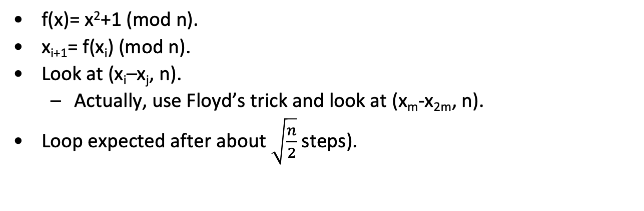
Factoring – Pollard ρ
f(x)= x²+1 (mod n).
x_{i+1}= f(x_{i}) (mod n).
Look at (x_{i}–x_{j}, n).
Actually, use Floyd’s trick and look at (x_{m}-x_{2m}, n).
Loop expected after about $\sqrt{\frac{n}{2}}$ steps).

Slide 81
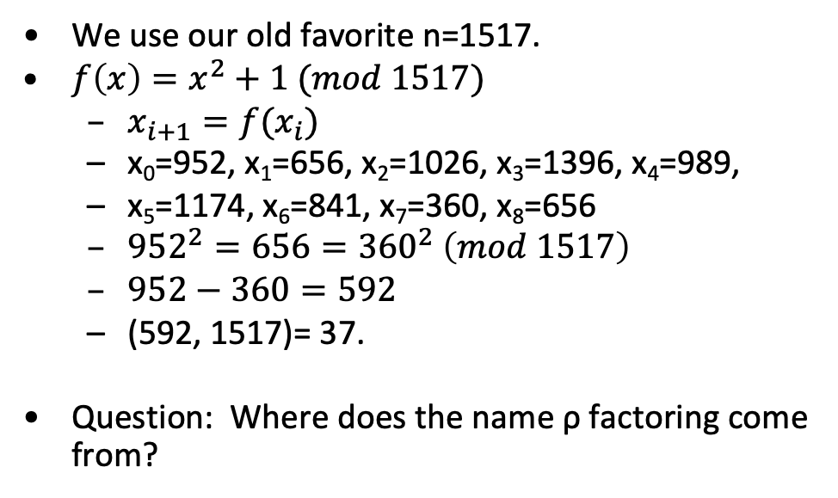
Pollard ρ factoring Example
1174
841
We use our old favorite n=1517.
$f\left(x\right)=x^{2}+1 (mod 1517)$
$x_{i+1}=f(x_{i})$
x₀=952, x₁=656, x₂=1026, x₃=1396, x₄=989,
x₅=1174, x₆=841, x₇=360, x₈=656
${952}^{2}=656={360}^{2} \left(mod 1517\right)$
$952−360=592$
(592, 1517)= 37.
Question: Where does the name ρ factoring come from?
989
1396
360
1026
656
952

Slide 82
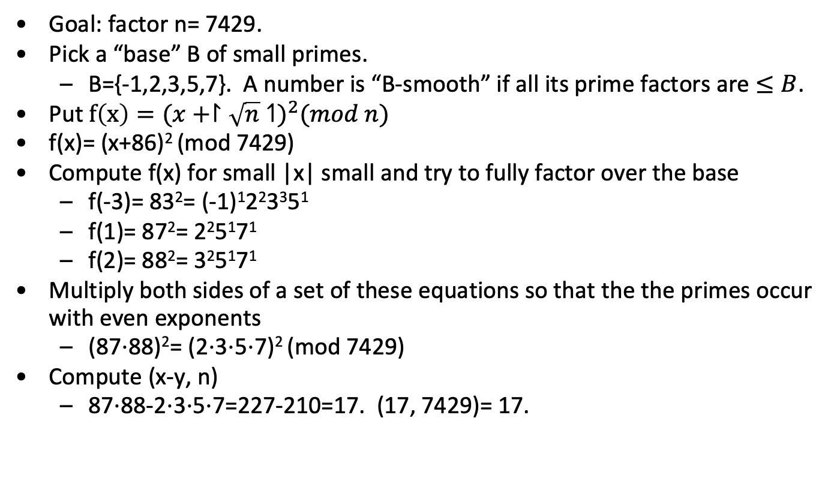
Quadratic sieve: motivating example
Goal: factor n= 7429.
Pick a “base” B of small primes.
B={-1,2,3,5,7}. A number is “B-smooth” if all its prime factors are $≤B$.
Put $f\left(x\right)=({x+↾\sqrt{n}↿)}^{2}(mod n)$
f(x)= (x+86)² (mod 7429)
Compute f(x) for small |x| small and try to fully factor over the base
f(-3)= 83²= (-1)¹2²3³5¹
f(1)= 87²= 2²5¹7¹
f(2)= 88²= 3²5¹7¹
Multiply both sides of a set of these equations so that the the primes occur with even exponents
(87⋅88)²= (2⋅3⋅5⋅7)² (mod 7429)
Compute (x-y, n)
87⋅88-2⋅3⋅5⋅7=227-210=17. (17, 7429)= 17.

Slide 83
Linear algebra step
Let B={p: p<B} and |B|= k.
If we have r>k “smooth” numbers
x_{i}²= ∏_{j<k} p_{j}^{e[i,j]}
Solve ∑_{i<k} t_{i}e[i,j]=0 (mod 2), j= 1,2,…,k using Gaussian elimination.
Need “non-trivial” solution. It t_{i}= 1, include equation i
For large sets, we use a more efficient solver: block Weidemann
Previous example
f(1)= 87²= 2²3⁰5¹7¹, f(2)= 88²= 2⁰3²5¹7¹
From f(1): t₁(2), t₁ (0), t₁(1), t₁(1) → 0, 0, t₁, t₁
From f(2): t₂(0), t₂ (2), t₂(1), t₂(1) → 0, 0, t₂, t₂
Solve: t₁+t₂= 0, t₁+t₂= 0. Solutions are (t₁, t₂)= (0,0), (1,1).
First solution is “trivial,” second leads to the factorization on previous page

Slide 84
Quadratic Sieve: basic parameters
Pick the mechanism for generating fully factored squares.
Pick the size of the required number of fully factored squared for reduction.
In our case, this is determined by the (pre-specified) interval [-C,C].
Pick the factor base (B) of primes.
Tradeoff between size of B and effort to fully factor trial square
Tradeoff between the size of B and C to ensure sufficient relations for the linear algebra phase.
Pick the mechanism to accelerate factoring
Sieving in our case
Some more recent mechanisms involve ECM
Use Linear algebra to solve equations

Slide 85
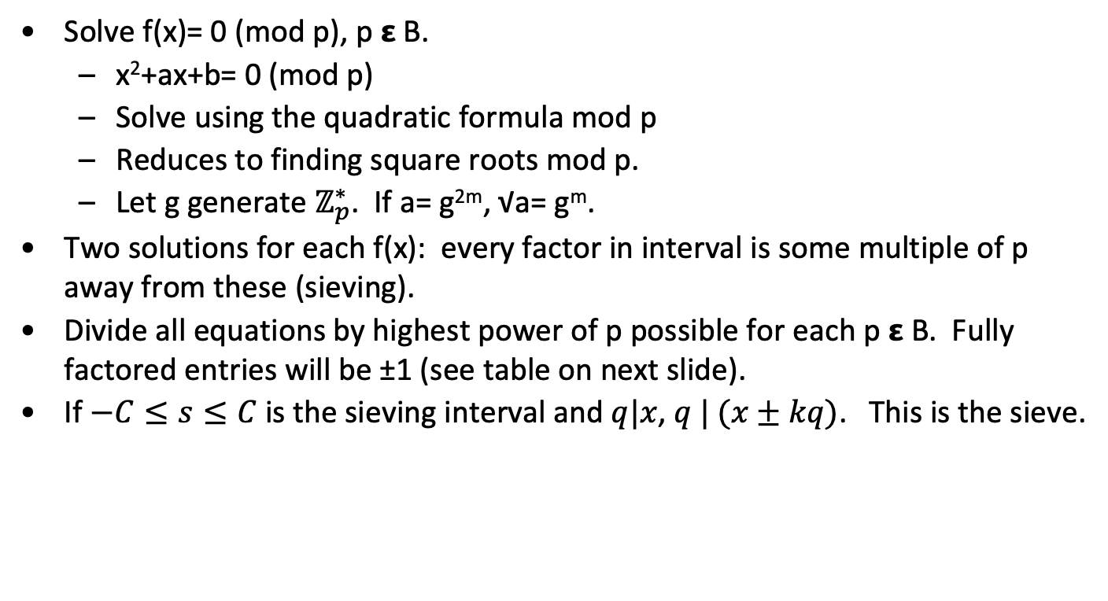
Generating fully factored squares over factor base: sieving
Solve f(x)= 0 (mod p), p 𝝴 B.
x²+ax+b= 0 (mod p)
Solve using the quadratic formula mod p
Reduces to finding square roots mod p.
Let g generate $ℤ_{p}^{∗}$. If a= g^{2m}, √a= g^{m}.
Two solutions for each f(x): every factor in interval is some multiple of p away from these (sieving).
Divide all equations by highest power of p possible for each p 𝝴 B. Fully factored entries will be ±1 (see table on next slide).
If $−C≤s≤C$ is the sieving interval and $q|x$, $q | (x±kq)$. This is the sieve.

Slide 86
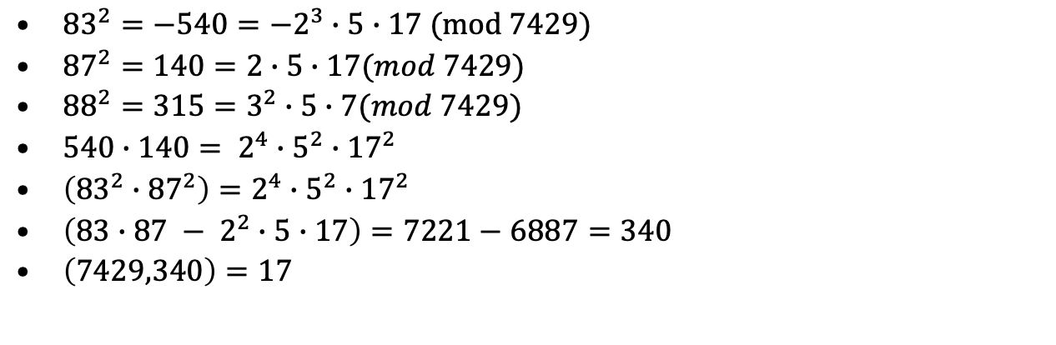
Sieve Example
n= 7429, m=86. B={-1,2,3,5,7}
s | -3 | -2 | -1 | 0 | 1 | 2 | 3
F(s)= (s+m)²-n | -540 | -373 | -204 | -33 | 140 | 315 | 492
p=2 | -135 |  | -51 |  | 35 |  | 123
p=3 | -5 |  | -17 | -11 |  | 35 | 41
p=5 | -1 |  |  |  | 7 | 7
p=7 |  |  |  |  | 1 | 1
${83}^{2}=−540={−2}^{3}∙5∙17 (mod 7429)$
${87}^{2}=140=2∙5∙17(mod 7429)$
${88}^{2}=315=3^{2}∙5∙7(mod 7429)$
$540∙140= 2^{4}∙5^{2}∙{17}^{2}$
$\left({83}^{2}∙{87}^{2}\right)=2^{4}∙5^{2}∙{17}^{2}$
$\left(83∙87 − 2^{2}∙5∙17\right)=7221−6887=340$
$\left(7429,340\right)=17$

Slide 87
Quadratic sieve experimental results
To analyze QS, we need to finds a good interval and estimate sieving and solving times
# of decimal digits | 50 | 60 | 70 | 80 | 90 | 100 | 110 | 120
# factor base x 1000 | 3 | 4 | 7 | 15 | 30 | 51 | 120 | 245
# sieving interval x 10⁶ | .2 | 2 | 5 | 6 | 8 | 14 | 16 | 26

Slide 88
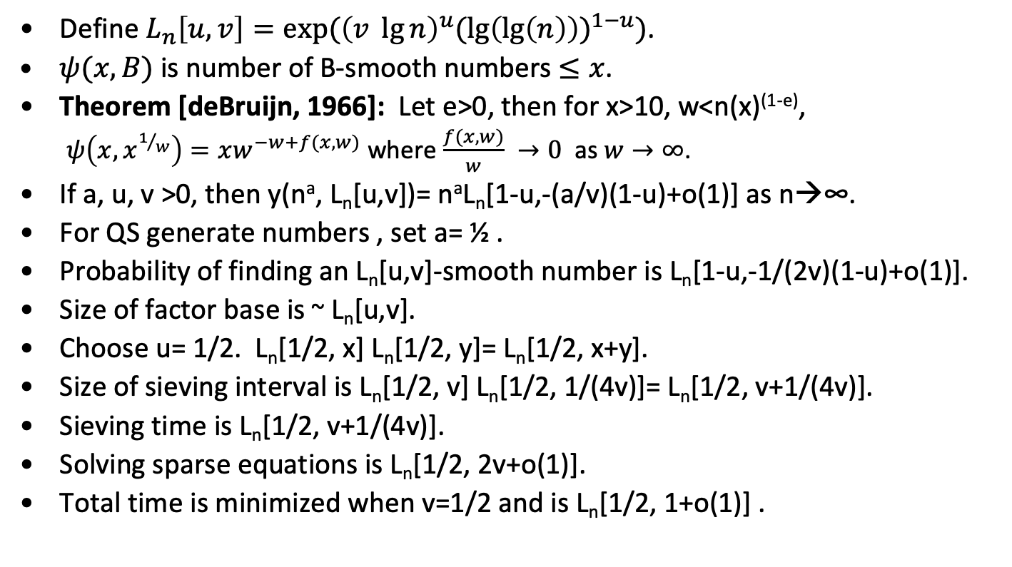
Quadratic Sieve Analysis
Define $L_{n}\left[u,v\right]=exp⁡({\left(v \lg{n}\right)}^{u}{(\lg\left(\lg\left(n\right)\right))}^{1−u})$.
$ψ(x,B)$ is number of B-smooth numbers $≤x$.
Theorem [deBruijn, 1966]: Let e>0, then for x>10, w<n(x)^{(1-e)},
$ψ\left(x,x^{1/w}\right)=xw^{−w+f(x,w)}$ where $\frac{f(x,w)}{w} →0$ as $w→∞$.
If a, u, v >0, then y(nª, L_{n}[u,v])= nªL_{n}[1-u,-(a/v)(1-u)+o(1)] as n→∞.
For QS generate numbers , set a= ½ .
Probability of finding an L_{n}[u,v]-smooth number is L_{n}[1-u,-1/(2v)(1-u)+o(1)].
Size of factor base is ~ L_{n}[u,v].
Choose u= 1/2. L_{n}[1/2, x] L_{n}[1/2, y]= L_{n}[1/2, x+y].
Size of sieving interval is L_{n}[1/2, v] L_{n}[1/2, 1/(4v)]= L_{n}[1/2, v+1/(4v)].
Sieving time is L_{n}[1/2, v+1/(4v)].
Solving sparse equations is L_{n}[1/2, 2v+o(1)].
Total time is minimized when v=1/2 and is L_{n}[1/2, 1+o(1)] .

Slide 89
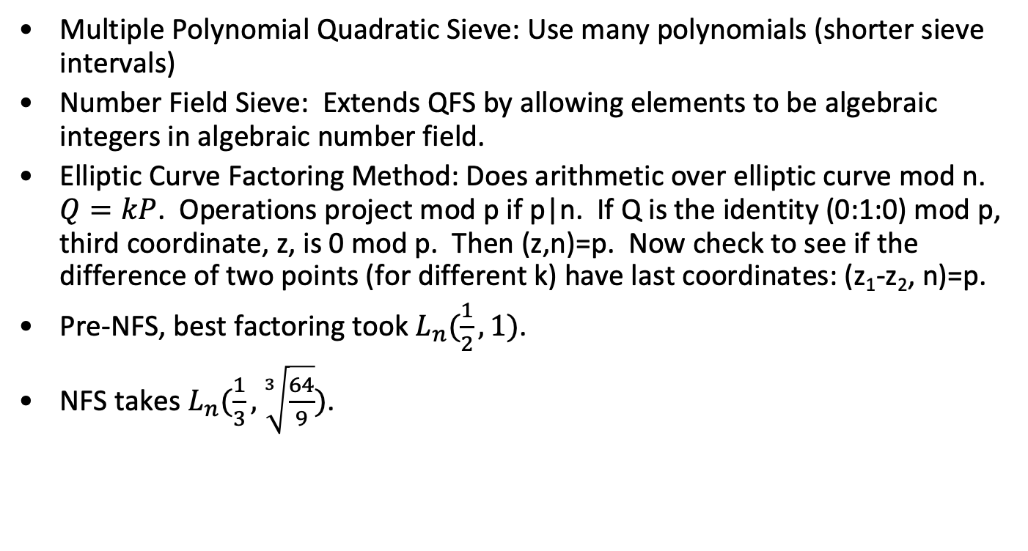
Three more algorithms
Multiple Polynomial Quadratic Sieve: Use many polynomials (shorter sieve intervals)
Number Field Sieve: Extends QFS by allowing elements to be algebraic integers in algebraic number field.
Elliptic Curve Factoring Method: Does arithmetic over elliptic curve mod n. $Q=kP$. Operations project mod p if p|n. If Q is the identity (0:1:0) mod p, third coordinate, z, is 0 mod p. Then (z,n)=p. Now check to see if the difference of two points (for different k) have last coordinates: (z₁-z₂, n)=p.
Pre-NFS, best factoring took $L_{n}(\frac{1}{2},1)$.
NFS takes $L_{n}(\frac{1}{3},\sqrt[3]{\frac{64}{9}})$.

Slide 90
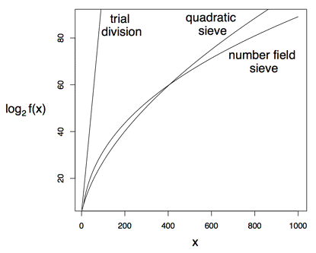
Factoring Algorithms
Example from Mark Stamp

Slide 91
Work Factors
Method | f(x)
Trial Division | n/lg(n)
Quadratic Sieve | (n lg(n))^{1/2}
Number Field Sieve | 1.9223 n^{1/3} lg(n)^{2/3}
Quadratic Sieve: L_{n}[1/2, 1+o(1)]
ECM: L_{p}[1/2, -√(1/2)] where p is smallest prime dividing n.
NFS (Pollard again): L_{n}[1/3, (64/9)^{(1/3)}].
QS best for N up to 390 bit 117 digits), then NFS.

Slide 92
RSA Caution: Homomorphism
Commutivity
Given plain/cipher pairs (p_{i}, c_{i}), i= 1, 2,…, n, one can produce product pairs like (p₁p₅p₂, c₁c₅c₂) of corresponding plain/cipher pairs.
Solution: padding

Slide 93
Factoring projects
On August 22, 1999, the 155-digit (512 bit) RSA Challenge Number was factored with the General Number Field Sieve.
Sieving took 35.7 CPU-years in total on...
160 175-400 MHz SGI and Sun workstations
8 250 MHz SGI Origin 2000 processors
120 300-450 MHz Pentium II PCs
4 500 MHz Digital/Compaq boxes
Total CPU-effort : 8000 MIPS years over 3.7 months.
768-bit problem took 2,000 core years

Slide 94
RSA Summary
RSA is a great algorithm.
Just don’t do anything stupid.
Reasonable exponents
Good padding
Good prime generation

Slide 95
End

Slide 96
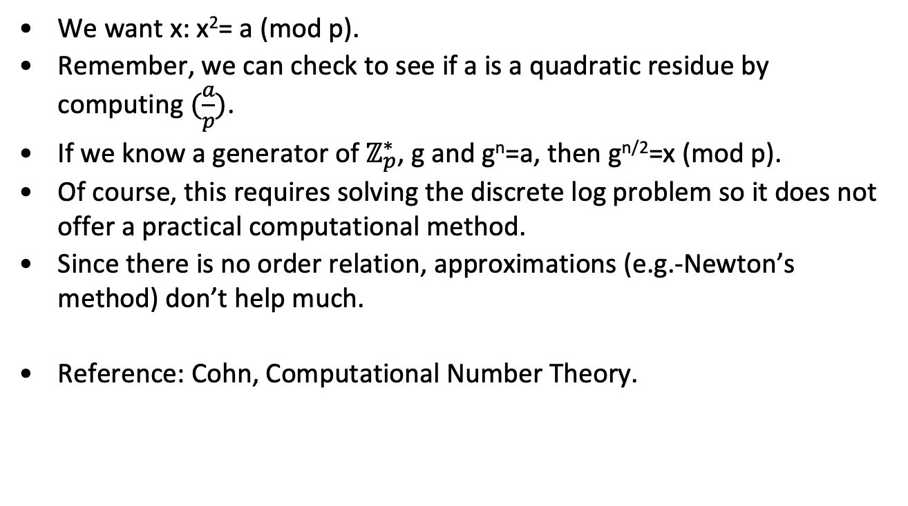
Square roots mod p -- general comments
We want x: x²= a (mod p).
Remember, we can check to see if a is a quadratic residue by computing $(\frac{a}{p})$.
If we know a generator of $ℤ_{p}^{∗}$, g and g^{n}=a, then g^{n/2}=x (mod p).
Of course, this requires solving the discrete log problem so it does not offer a practical computational method.
Since there is no order relation, approximations (e.g.-Newton’s method) don’t help much.
Reference: Cohn, Computational Number Theory.

Slide 97
Square roots mod p --- simple cases
We want x: x²= a (mod p). First check (a/p)=1.
p= 3 (mod 4):
x= a^{(p+1)/4} (mod p)
Example: x² = 7 (mod 31), x= 7⁸ (mod 31)= 10. 100=7 (mod 31).
p= 5 (mod 8)
b=a^{(p-1)/4} = ±1(mod p).
If b=1, x= a^{(p+3)/8} (mod p).
If b= -1, x= (2a) (4a)^{(p-5)/8} (mod p).
Example 1: p=13. a= 9. b= 9³= 1 (mod p). x= 9² = 3 (surprise!).
Example 2: p=29. a= 6. 6⁷= -1 (mod p). x= (12)(24)³= 8 (mod 29). 8² = 6 (mod 29).
This leaves the hard case, p=1 (mod 8).

Slide 98
General case - Tonelli-Shanks
We want x: x²= a (mod p)
p-1=2e x q, q, odd.
Square-Root(a)
Choose n: (n/p)= -1; z= n^{q} (mod p); Q=(q-1)/2.
y=z; r=e; x=a^{Q} (mod p); b=ax² (mod p); x= ax (mod p);
// Now if R=2^{r-1}, ab=x², y^{R}=-1, b^{R}=1;
if(b==1)
return(x);
M=2^{m}; for smallest m>0: b^{M}= 1 (mod p)
if(m=r)
return “non-residue”
TT= 2^{r-m-1}; t= y^{TT} (mod p); y= t² (mod p); r=m; x=xt; b=by; goto 3;

Slide 99
Tonelli-Shanks example
We want x: x²=a(mod p). p=41, a=5, g=7.
p-1=2³ x 5. Note 6²⁰= -1(41) so 6 is a non-residue.
a= 5; n=6; z= 6⁵ = 27(mod 41).
Step | m | t | y | r | x | b
0 | 3 |  | 27 | 3 | 2 | 9
1 | 2 | 2 | 32 | 2 | 13 | 1
x=13. 13² (mod 41)= 5.

